Slide 1
Background for Molecular Biology of Lactase Persistence
Eukaryotes perform combinatorial control of gene expression
Multiple regulatory transcription factors “vote” to express a gene
The result is spatial (which cell types) and temporal (which stage of development) control of gene expression
Regulatory transcription factors bind to DNA sequences that are
Near the promoter (promoter proximal)
Far away from the promoter (enhancer or silencer)
Regulatory transcription factors are activators or repressors
Regulatory transcription factors usually have a DNA binding domain and an activation domain
There are several families of DNA binding domains
Most use an alpha helix to contact the bases in the major groove of DNA
DNA binding domains bind to specific DNA sequences, known as binding sites or motifs
Motifs are short, usually 8-12 base pairs long
Motifs can be degenerate (variations possible)
Transcription factors themselves are encoded by genes and subject to gene regulation by other transcription factors (in a gene regulatory network)
Variation in binding site sequences can affect transcription factor binding and, thus, expression of the regulated gene

Slide 2
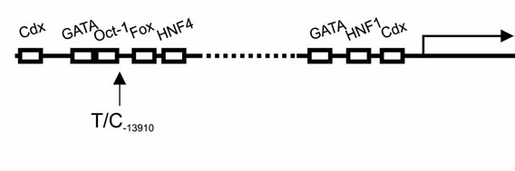
LCT enhancer (left) and proximal promoter region (right)
The enhancer is located within intron 13 of the upstream MCM6 gene, over 13,000 base pairs away from the transcription start site.
3 TF binding sites in proximal promoter
5 TF binding sites in enhancer
Total of 6 different TFs bind these 8 binding sites
Lewinsky et al. (2005) Figure 3A
5’-...GCAATACAGATAAGATAATGTAGCCCCTG...-3’
-------
Underline is Oct-1 binding site
Dashed line is overlapping GATA binding site

Slide 3
LCT enhancer (left) and proximal promoter region (right)
The enhancer is located within intron 13 of the upstream MCM6 gene, over 13,000 base pairs away from the transcription start site.
Lewinsky et al. (2005) Figure 3A
The European SNP associated with lactase persistence is at the end of the Oct-1 binding site.
5’-...GCAATACAGATAAGATAATGTAGTCCCTG...-3’
-------
Underline is Oct-1 binding site
Dashed line is overlapping GATA binding site

Slide 4
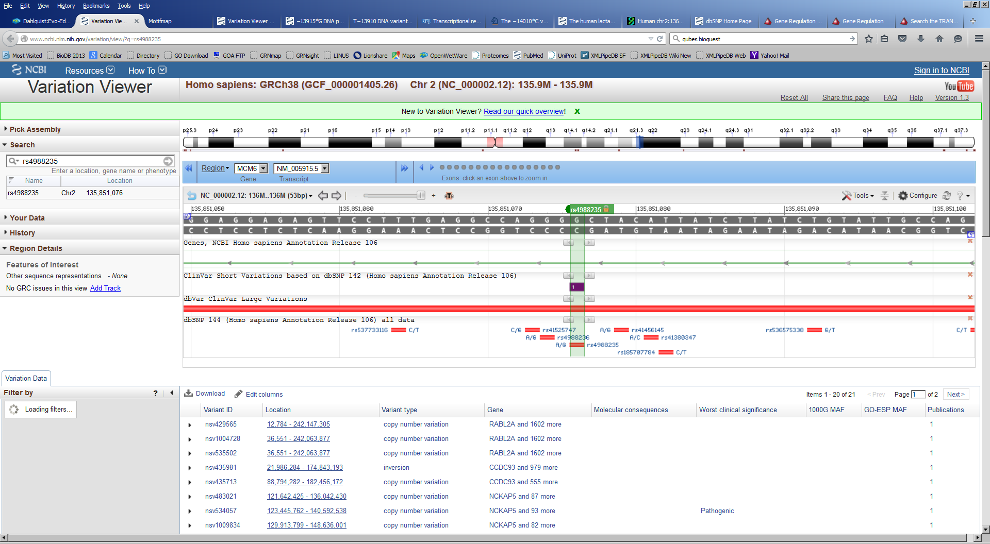
6 SNPs are located in or near the Oct-1 binding site in the LCT enhancer region
3’
5’
http://www.ncbi.nlm.nih.gov/variation/view/?q=rs4988235, Accessed 19 June 2015

Slide 5
“wild type” and 6 SNP sequences, top strand only shown
3’
5’
“Wild type”: 5’-...CAGGGGCTACATTATCTT...-3’
rs185707784: 5’-...CAGGGGCTACACTATCTT...-3’
rs41380347: 5’-...CAGGGGCTACCTTATCTT...-3’
rs41456145: 5’-...CAGGGGCTGCATTATCTT...-3’
rs4988235: 5’-...CAGGGACTACATTATCTT...-3’
rs4988236: 5’-...CAGAGGCTACATTATCTT...-3’
rs41525747: 5’-...CACGGGCTACATTATCTT...-3’
http://www.ncbi.nlm.nih.gov/variation/view/?q=rs4988235, Accessed 19 June 2015

Slide 6
“wild type” and 6 SNPs: both strands of DNA shown for each, top strand in black, bottom strand in grey, oriented as shown in NCBI Variation Viewer window
wt top strand: 5’-...CAGGGGCTACATTATCTT...-3’
bottom: 3’-...GTCCCCGATGTAATAGAA...-5’
rs185707784: 5’-...CAGGGGCTACACTATCTT...-3’
bottom: 3’-...GTCCCCGATGTGATAGAA...-5’
rs41380347: 5’-...CAGGGGCTACCTTATCTT...-3’
bottom: 3’-...GTCCCCGATGGAATAGAA...-5’
rs41456145: 5’-...CAGGGGCTGCATTATCTT...-3’
bottom: 3’-...GTCCCCGACGTAATAGAA...-5’
rs4988235: 5’-...CAGGGACTACATTATCTT...-3’
bottom: 3’-...GTCCCTGATGTAATAGAA...-5’
rs4988236: 5’-...CAGAGGCTACATTATCTT...-3’
bottom: 3’-...GTCTCCGATGTAATAGAA...-5’
rs41525747: 5’-...CACGGGCTACATTATCTT...-3’
3’-...GTGCCCGATGTAATAGAA...-5’

Slide 7
“wild type” and 6 SNPs: bottom strand only shown for each, oriented as shown in NCBI Variation Viewer window
wt bottom: 3’-...GTCCCCGATGTAATAGAA...-5’
rs185707784: 3’-...GTCCCCGATGTGATAGAA...-5’
rs41380347 : 3’-...GTCCCCGATGGAATAGAA...-5’
rs41456145 : 3’-...GTCCCCGACGTAATAGAA...-5’
rs4988235 : 3’-...GTCCCTGATGTAATAGAA...-5’
rs4988236 : 3’-...GTCTCCGATGTAATAGAA...-5’
rs41525747: 3’-...GTGCCCGATGTAATAGAA...-5’
“wild type” and 6 SNPs: bottom strand only shown for each, oriented as shown in LCT enhancer region/TF binding sites (reversed so 5’ is on left)
wt bottom: 5’-...AAGATAATGTAGCCCCTG...-3’
rs185707784: 3’-...AAGATAGTGTAGCCCCTG...-5’
rs41380347 : 3’-...AAGATAAGGTAGCCCCTG...-5’
rs41456145 : 3’-...AAGATAATGCAGCCCCTG...-5’
rs4988235 : 3’-...AAGATAATGTAGTCCCTG...-5’
rs4988236 : 3’-...AAGATAATGTAGCCTCTG...-5’
rs41525747: 3’-...AAGATAATGTAGCCCGTG...-5’

Slide 8
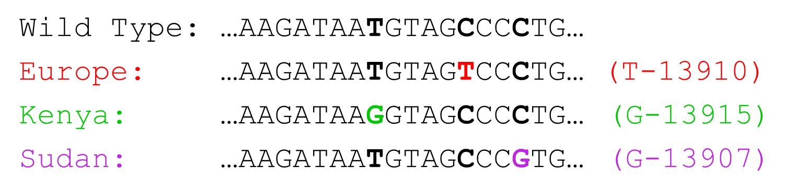
“wild type” and 6 SNPs: bottom strand only shown for each, oriented as shown in LCT enhancer region/TF binding sites (reversed so 5’ is on left)
wt bottom: 5’-...AAGATAATGTAGCCCCTG...-3’
rs185707784: 5’-...AAGATAGTGTAGCCCCTG...-3’
rs41380347: 5’-...AAGATAAGGTAGCCCCTG...-3’ G-13915, Kenya
rs41456145: 5’-...AAGATAATGCAGCCCCTG...-3’
rs4988235: 5’-...AAGATAATGTAGTCCCTG...-3’ T-13910, Europe
rs4988236: 5’-...AAGATAATGTAGCCTCTG...-3’
rs41525747: 5’-...AAGATAATGTAGCCCGTG...-3’ G-13907, Sudan
Graphic from original Evo-Ed PowerPoint

Slide 9
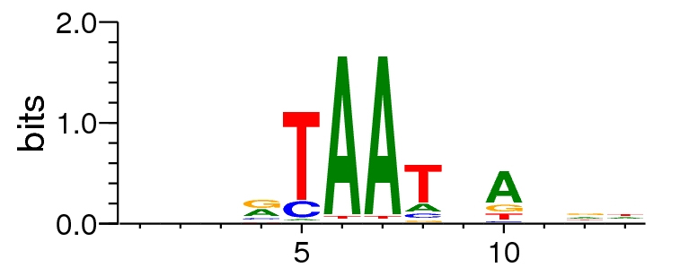
“wild type” and 6 SNPs compared to Oct-1 binding site shown in Lewinsky et al. (2005), Fig. 2A
wt bottom: 5’-...AAGATAATGTAGCCCCTG...-3’
rs185707784: 5’-...AAGATAGTGTAGCCCCTG...-3’
rs41380347: 5’-...AAGATAAGGTAGCCCCTG...-3’ G-13915, Kenya
rs41456145: 5’-...AAGATAATGCAGCCCCTG...-3’
rs4988235: 5’-...AAGATAATGTAGTCCCTG...-3’ T-13910, Europe
rs4988236: 5’-...AAGATAATGTAGCCTCTG...-3’
rs41525747: 5’-...AAGATAATGTAGCCCGTG...-3’ G-13907, Sudan
Transfac M000137: NNNRTAATNANNN Oct-1 consensus sequence
5’-GGCAATACAGATAAGATAATGTAGTC-3’
-------
Underline is Oct-1 binding site
Dashed line is overlapping GATA binding site
DNA logo of Oct-1 binding motif (M000137)
http://motifmap.ics.uci.edu/

Slide 10
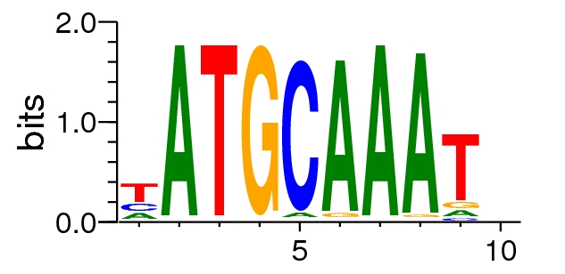
MotifMap Database reports 9 different consensus binding sites for Oct-1
“Canonical”
M00342
“Non-canonical”
M00137
NNNVTAAWNRNNN consensus from Motifmap
NNNRTAATNANNN consensus from Transfac

Slide 11
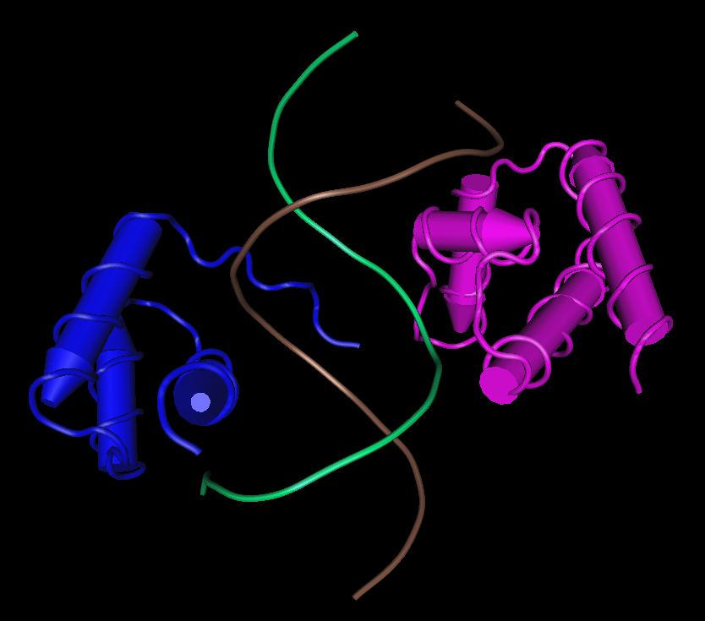
8 structures for Oct-1 (POU2F1) in the Protein Data Bank
The POU2F1 protein is 743 amino acids long.
It has a homeobox DNA binding domain and a POU-specific DNA binding domain separated by a flexible linker.
The POU-specific domain contacts the 5' half of the canonical binding site (ATGCAAAT).
The POU homeodomain contacts the 3' half of the canonical binding site (ATGCAAAT).
The linker region is not visible in the crystal structure.
Since the POU2F1 binding site in the LCT enhancer is noncanonical, we cannot use the crystal structure to understand structurally how the SNPs affect the binding of POU2F1.
1OCT viewed with
NCBI Cn3D

Slide 12
rs4988235 in red
>hg19_dna range=chr2:136608590-136608902 5'pad=0 3'pad=200 strand=+ repeatMasking=none
AAAATCAAACATTATACAAATGCAACCTAAGGAGGAGAGTTCCTTTGAGG
CCAGGGGCTACATTATCTTATCTGTATTGCCAGCGCAGAGGCCTACTAGT
ACATTGTAGGGTCTAAGTACATTTTTCCTGAATGAAAGGTATTAAATGGT
AACTTACGTCTTTATGCACTCTATAAACTATGACGTGATCGTCTCCGTCT
AACAACTACACTCAAATGCTTACCAAGCTCTTTAAAGGGAAGAATTCCAT
GGTCGTATGAGCATTCAACAGTTACATAAAAATGTATTTGCAGTGAATTC
TAGTATGTCCCAT

Slide 13
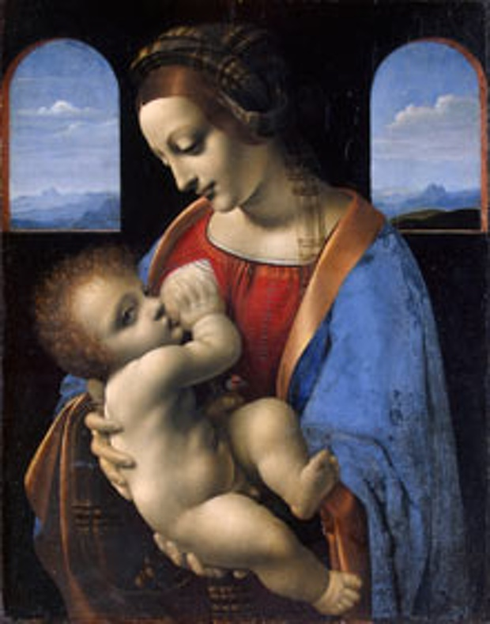
Leonardo da Vinci's Madonna and Child (Madonna Litta).
Photograph: State Hermitage Museum, St Petersburg
http://www.theguardian.com/commentisfree/2011/dec/30/leonardo-da-vinci-madonna-litta-breastfeeding

