Slide 1
Cold Adaptation in Budding Yeast
Schade, B., Jansen, G., Whiteway, M., Entian, K. D., & Thomas, D. Y. (2004). Cold adaptation in budding yeast. Molecular biology of the cell, 15(12), 5492-5502.
Avery Vernon Moore, Courtney Merriam, Jordan Detamore, Zachary Goldstein
Department of Biology
Loyola Marymount University
BIOL 368
December 13, 2016

Slide 2
Outline
Unicellular organisms respond to stress, little is known about cell response to cold shock.
Cold shock affects transcriptional responses in Saccharomyces cerevisiae.
Two distinct expression patterns are defined as an early (ECR) and late (LCR) cold response.
Study suggests environmental stress response (ESR) is activated during the late cold response (LCR).
Significant glycogen and trehalose accumulation and induction of transcriptional activators Msn2p and Msn4p occur during the LCR.
ECR did not show markers of the ESR.

Slide 3
Outline
Unicellular organisms respond to stress, little is known about cell response to cold shock.
Cold shock affects transcriptional responses in Saccharomyces cerevisiae.
Two distinct expression patterns are defined as an early (ECR) and late (LCR) cold response.
Study suggests environmental stress response (ESR) is activated during the late cold response (LCR).
Significance of glycogen and trehalose accumulation and the induction of transcriptional activators Msn2p and Msn4p occurring during the LCR.
ECR did not show markers of the ESR.

Slide 4
Yeast cells respond to environmental changes on the transcriptional level
Genes are induced or repressed due to changes in the environment.
Regulation of ESR depends on the function of transcription factors Msn2p and Msn4p that bind to stress response elements (STREs).
Little is known about yeast growth and survival at low temperatures.
Cold temperatures induce physical and biochemical changes, such as decreased membrane fluidity and membrane transport.

Slide 5
Outline
Unicellular organisms respond to stress, little is known about cell response to cold shock.
Cold shock affects transcriptional responses in Saccharomyces cerevisiae.
Two distinct expression patterns are defined as an early (ECR) and late (LCR) cold response.
Study suggests environmental stress response (ESR) is activated during the late cold response (LCR).
Significance of glycogen and trehalose accumulation and the induction of transcriptional activators Msn2p and Msn4p occurring during the LCR.
ECR did not show markers of the ESR.

Slide 6
Cold shock in S. cerevisiae wild type and Δmsn2, Δmsn4 strains
Diploid strains were used to perform cold shock and DNA microarrays.
Samples collected at 0m, 10m, 30m, 120m, 12 hours, and 60 hours.
Glucose and trehalose concentrations in the yeast cells were determined for each sample.
Study compared experimental data to Gasch et al. (2000) and Sahara et al. (2002) data.
Student’s t-test (p value < 0.03) was used for experimental analysis.

Slide 7
Outline
Unicellular organisms respond to stress, little is known about cell response to cold shock.
Cold shock affects transcriptional responses in Saccharomyces cerevisiae.
Two distinct expression patterns are defined as an early (ECR) and late (LCR) cold response.
Study suggests environmental stress response (ESR) is activated during the late cold response (LCR).
Significance of glycogen and trehalose accumulation and the induction of transcriptional activators Msn2p and Msn4p occurring during the LCR.
ECR did not show markers of the ESR.

Slide 8
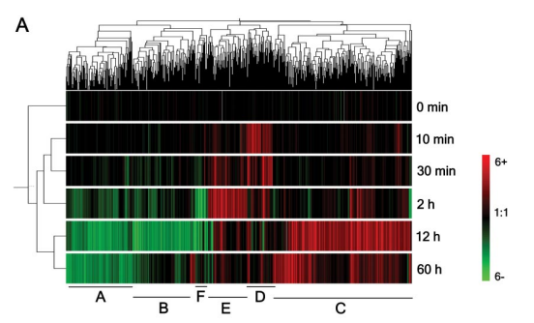
S. cerevisiae respond to temperature change from 30 to 10°C
634 genes examined.
3 induced gene clusters
2 repressed genes clusters
Clusters D, E are ECR during 0-2 hours.
Clusters A, B, C are LCR after 12 and 60 hours.
= down regulated genes
= up regulated genes

Slide 9
Outline
Unicellular organisms respond to stress, little is known about cell response to cold shock.
Cold shock affects transcriptional responses in Saccharomyces cerevisiae.
Two distinct expression patterns are defined as an early (ECR) and late (LCR) cold response.
Study suggests environmental stress response (ESR) is activated during the late cold response (LCR).
Significance of glycogen and trehalose accumulation and the induction of transcriptional activators Msn2p and Msn4p occurring during the LCR.
ECR did not show markers of the ESR.

Slide 10
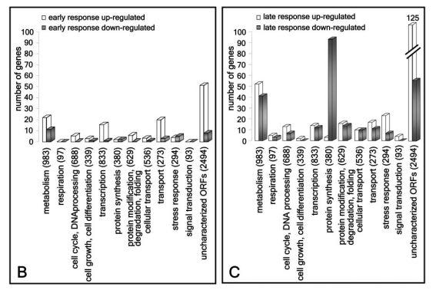
Vertical dendrogram shows similarities between different times of exposure to cold
Regulation responses in ECR and LCR
Gene expression patterns on horizontal dendrogram

Slide 11
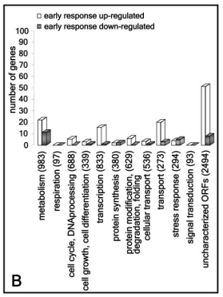
Genes in ECR associated with transport, lipid and amino acid metabolism, transcription, and other unknown ORFs
Transcription genes included the RNA helicase genes, the RNA processing genes, and the RNA polymerase subunit gene.
Genes involved in lipid metabolism involved in membrane fluidity were also affected (ex: OLE1).
Expression of 32 genes were reduced by at least twofold in the first 2 hours.

Slide 12
Outline
Unicellular organisms respond to stress, little is known about cell response to cold shock
Cold shock affects transcriptional responses in Saccharomyces cerevisiae.
Two distinct expression patterns are defined as an early (ECR) and late (LCR) cold response.
Study suggests environmental stress response (ESR) is activated during the late cold response (LCR)
Significance of glycogen and trehalose accumulation and the induction of transcriptional activators Msn2p and Msn4p occurring during the LCR.
ECR did not show markers of the ESR.

Slide 13
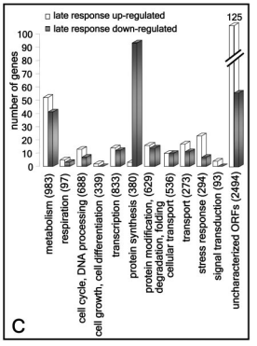
Genes in LCR associated with carbohydrate metabolism
280 LCR genes were induced at 12 and/or 60 hours.
Genes identified are involved in glycolysis, glycogen metabolism, and trehalose metabolism.
Another set of induced LCR genes encode for heat shock proteins.
256 LCR genes were repressed.
Genes identified are involved in protein synthesis, nucleotide biosynthesis, protein modification and vesicle transport.

Slide 14
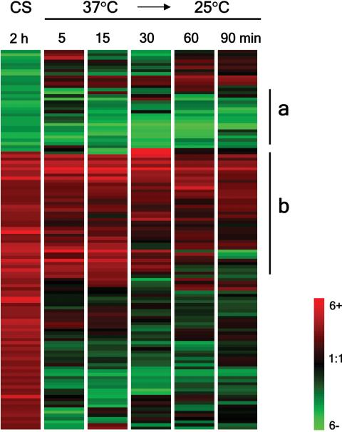
Temperature downshift yields similar response to early cold shock response.
47% of induced early cold shock genes were induced by the temperature downshift (a).
A large amount of down regulated genes in early cold shock were also repressed in the temperature downshift (b).

Slide 15
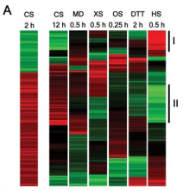
ECR genes showed reciprocal transcriptional behavior in comparison to other stress stimuli
Comparison of ECR genes (CS 2 hours) to LCR genes (CS 12 hours) and to the responses to other stimuli.
Half of repressed ECR genes were induced in heat shock.
40% of induced ECR genes were repressed after 0.5 hours of heat shock.
18% of induced ECR genes showed no heat shock response.
CS=cold shock, MD=menadione, XS=oxidative stress, OS=osmotic stress, DTT=reducing agent, HS=heat shock

Slide 16
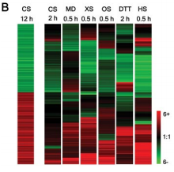
LCR genes showed consistent transcriptional responses
CS=cold shock, MD=menadione, XS=oxidative stress, OS=osmotic stress, DTT=reducing agent, HS=heat shock

Slide 17
Outline
Unicellular organisms respond to stress, little is known about cell response to cold shock
Cold shock affects transcriptional responses in Saccharomyces cerevisiae.
Two distinct expression patterns are defined as an early (ECR) and late (LCR) cold response.
Study suggests environmental stress response (ESR) is activated during the late cold response (LCR)
Significance of glycogen and trehalose accumulation and the induction of transcriptional activators Msn2p and Msn4p occurring during the LCR.
ECR did not show markers of the ESR.

Slide 18
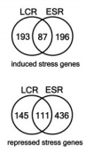

LCR Involves the ESR and ECR indicates a cold-specific transcriptional response
Induced and repressed LCR and ECR genes compared to identified environmental stress response (ESR) genes (Gasch et al., 2000).
Induced and repressed LCR genes had a significant overlap of 87 and 111 genes with induced ESR genes.
ECR and ESR genes did not have a significant overlap.

Slide 19
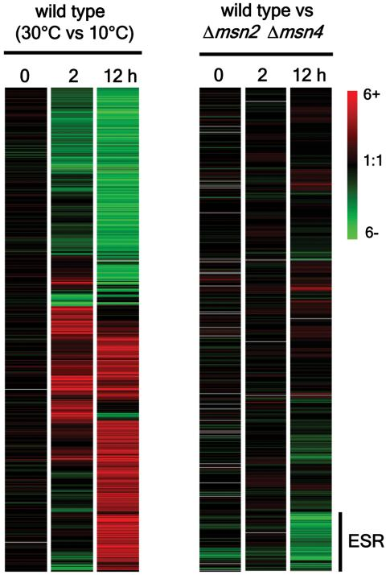
Msn2p and msn4p play a major role in late cold shock response and environmental response
Msn2p and msn4p are transcription factors that are required for 99 long cold shock response genes.
There are other factors that control late cold shock response.
Msn2p and msn4p have little effect in early cold shock response

Slide 20
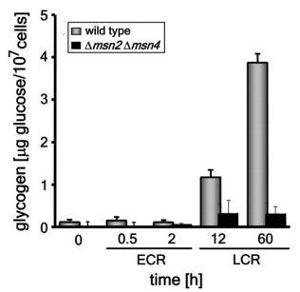
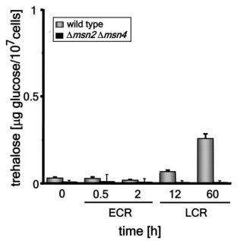
Genes involved in carbohydrate metabolism are induced at 12 hours
Increase in glycogen and trehalose content observed after 12 hours (LCR).
Induction of genes in carbohydrate metabolism depend on STREs in the promoters.
Mutant strains lacking Msn2p and Msn4p lose induction of these genes during cold treatment.

Slide 21
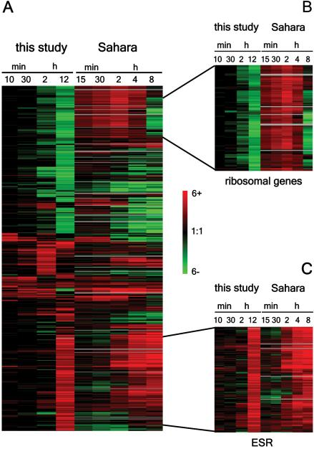
Comparison of Shade and Sahara et al. (2000)
Comparison of 634 cold-responsive genes.
Contradiction between Schade and Sahara et al. (2002). Induction versus repression of ribosomal genes.
Consistency between the Schade and Sahara et al. (2002). Environmental stress response genes unregulated at times greater than 2 hours.
Notes:
*Comparison of Shade and Sahara et al. (2000) yield conflicting and supporting results
*Comparison of 634 cold-responsive genes
*Contradiction between the Schade and Sahara et al. (2002) data. Difference found in induction or repression of ribosomal genes.
*Consistency between the Schade and Sahara et al. (2002) data. Environmental stress response genes being unregulated at times of exposure longer than 2 hours.

Slide 22
Outline
Unicellular organisms respond to stress, little is known about cell response to cold shock.
Cold shock affects transcriptional responses in Saccharomyces cerevisiae.
Two distinct expression patterns are defined as an early (ECR) and late (LCR) cold response.
Study suggests environmental stress response (ESR) is activated during the late cold response (LCR).
Significant glycogen and trehalose accumulation and induction of transcriptional activators Msn2p and Msn4p occur during the LCR.
ECR did not show markers of the ESR.

Slide 23
Acknowledgements
Dr. Dahlquist
Department of Biology, Loyola Marymount University
Bioinformatic Lab, Fall 2016

Slide 24
References
Schade, B., Jansen, G., Whiteway, M., Entian, K. D., & Thomas, D. Y. (2004). Cold adaptation in budding yeast. Molecular biology of the cell, 15(12), 5492-5502.

