Slide 1





DNA aSsEmBlY tEcHnIqUes
Design and construct novel biological organisms programmed by genetic circuits using standardized biological parts called BioBricks
Every BioBrick is a physical DNA sequence on a circular plasmid
Standardized sequences on BioBricks enable Standard Assembly of two BioBricks
Several BioBrick assembly standards have been proposed to improve upon the original BioBrick standard
Traditional techniques involve assembly by restriction enzyme digestion and ligation. iGEM utilizes this in an idempotent fashion
There are also several existing and more recently developed PCR-based methods currently being used for DNA assembly that have the potential for standardization. These convert overlapping, blunt-end PCR products into fragments with sticky overhangs that can anneal to form circular plasmids.

Slide 2






Towards a BioBrick Standard
Standard Sequence
DNA part
Standard Sequence
Prefix Sequence
DNA part
Suffix Sequence
Prefix Sequence
DNA part
Suffix Sequence
RS1
RS2
RS3
RS4
Notes:
2

Slide 3
DNA Biobrick assembly techniques
Tom Knight's original BioBrick assembly standard (Bba)
Biofusion Standard (Silver lab)
Freiburg Fusion Standard (Freiburg IGEM 2007)‏
The Berkeley (BBb) Format (now called BglBricks)
Tom Knight's BB-2 proposal
3A
assembly is by restriction enzyme digestion and ligation
MODULAR PLUG AND PLAY PARTS: IDEMPOTENCE

Slide 4
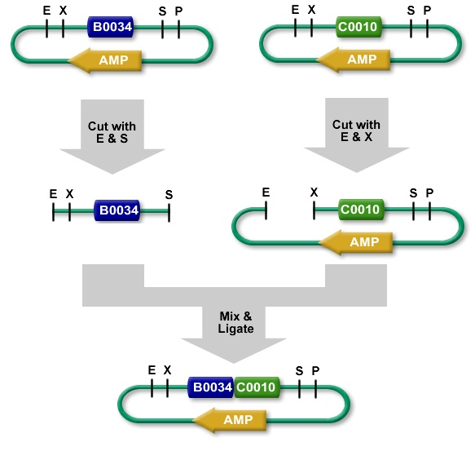
BB 1 (BBa) standard assembly

Slide 5





Restriction enzyme techniques have limitations
GAATTC
CTTAAG
EcoRI
GCGGCCGC
CGCCGGCG
NotI
TCTAGA
ACATCT
XbaI
A
T
G
C
ACTAGT
TGATCA
SpeI
GCGGCCGC
CGCCGGCG
NotI
T
A
A
T
*G
ACGTC
PstI
DNA part 1
TACTAGAG
ATGATCTC
SCAR SITE
DNA part 2
CTGCAG
G ACGTC
Part 1 = RBS
Part 2 = ORF
Fixed distance set by SCAR site
May affect translation efficiency
Part 1 = ORF
Part 2 = ORF
Fusion protein
Part 1
Part 2
ACC
TAC TAG AG
ATG
Ile
Tyr
STOP
Met
Frame shift – prevents read-through
Fusion protein requires continuous read of codons

Slide 6


Biofusion Standard (Silver lab)‏
Changes – Insertions and Deletions
↓
↓
A
T
↓
G
C
T
A
↓
↓
↓
GAATTC
CTTAAG
EcoRI
GCGGCCGC
CGCCGGCG
NotI
T TCTAGA
A AGATCT
XbaI
ACTAGT
TGATCA
SpeI
A
T
DNA part
GCGGCCGC
CGCCGGCG
NotI
CTGCAG
GACGTC
PstI
↑
↑
↑
↑
↑
↑
New Biofusion Standard
↓
↓
A
T
↓
↓
A
T
↓
↓
GAATTC
CTTAAG
EcoRI
GCGGCCGC
CGCCGGCG
NotI
TTCTAGA
AACATCT
XbaI
DNA part
ACTAGT
TGATCA
SpeI
GCGGCCGC
CGCCGGCG
NotI
CTGCAG
GACGTC
PstI
↑
↑
↑
↑
↑
↑
DNA part
ACTAGA
TGATCT
SCAR
DNA part
ACT AGA
Thr Arg
Biobrick Foundation
Notes:
6

Slide 7

Freiburg Fusion Standard (Freiburg IGEM 2007)‏
Prefix
5' GAATTC GCGGCCGC T TCTAGA TG GCCGGC
EcoRI NotI XbaI NgoMIV
Met
DNA part 2
OR
5' GAATTC GCGGCCGC T TCTAGA
EcoRI NotI XbaI
ATG.DNA part
Use native ATG
contained in part
Suffix
DNA part 1
ACCGGT TAAT ACTAGT A GCGGCCG CTGCAG 3‘
AgeI SpeI NotI PstI
Fusion (AgeI & NgoMIV – compatible overhangs CCGG)
DNA part 1
DNA part 2
ACC GGC
Thr Gly

Slide 8
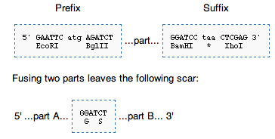
Berkeley BBb Format: assembly with BamHI and BglII restriction enzymes

Slide 9
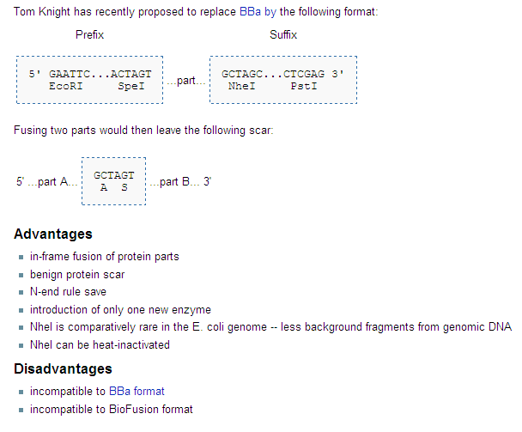
Tom Knight’s BB-2 proposal

Slide 10
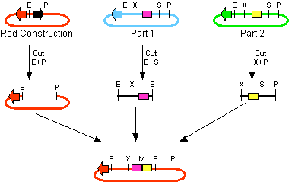
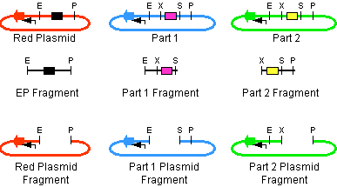
3A http://openwetware.org/wiki/Synthetic_Biology:BioBricks/3A_assembly
relies on three way ligation (between the two parts and the backbone vector)
uses both positive and negative selection to reduce/eliminate the number of incorrect assemblies that give rise to colonies after transformation
designed so that gel purification of the digested parts is unnecessary
The vectors necessary for doing 3A assembly are only available at high copy. If your assembly generates a construct that places a large burden on the cell at high copy, it may be difficult to assemble using this technique until new vectors are available.

Slide 11
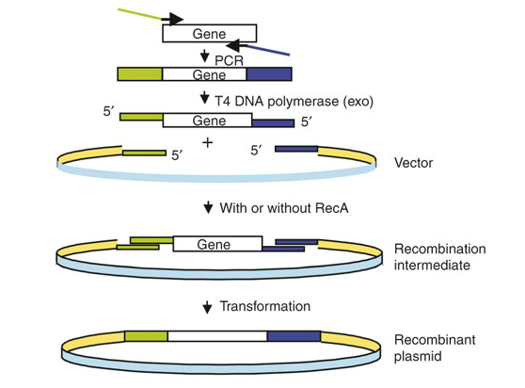
SLIC Sequence and Ligation Independent Cloning

Slide 12
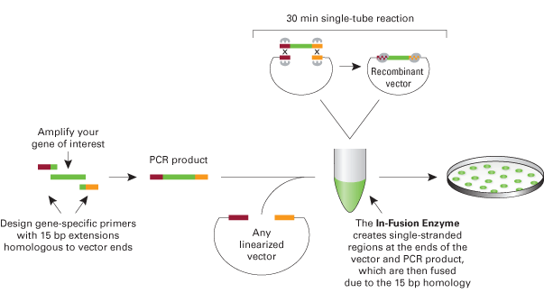
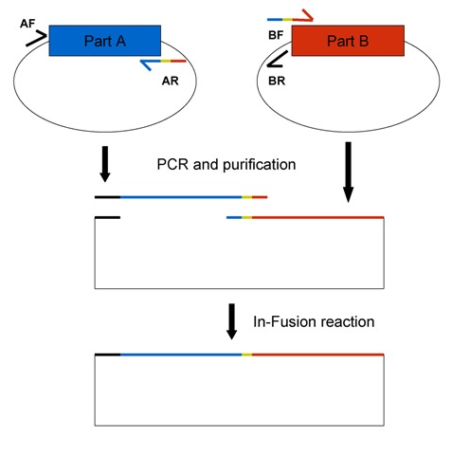
InFusion alternative assembly method that allows for BioBricks to be assembled via fusion of PCR products
faster, does not require restriction digestions or ligations or DNA extraction from a gel, and is more flexible
supplies are more expensive, custom primers are required, and occasionally there are mutations in assembled plasmids

