Slide 1
Transcriptional Regulatory Networks in Saccharomyces cerevisiae
Lee, T. I., Rinaldi, N. J., Robert, F., Odom, D. T., Bar-Joseph, Z., Gerber, G. K., Hannett, N. M., Harbison, C. T., Thompson, C. M., Simon, I., Zeitlinger, J., Jennings, E. G., Murray, H.L ., Gordon, D. B., Ren, B., Wyrick, J. J., Tagne, J. B., Volkert, T. L., Fraenkel, E., Gifford, D. K. & Young, R. A. (2002). Transcriptional regulatory networks in Saccharomyces cerevisiae. Science, 298(5594), 799-804. DOI: 10.1126/science.1075090
Kristen Horstmann, Tessa Morris, and Lucia Ramirez
Loyola Marymount University
March 24, 2015
BIOL398-04: Biomathematical Modeling

Slide 2
Develop a mathematical model to map and understand how cells control global gene expression networks
Experimental Design:
Epitope tagging, Chromatin IP, Microarray, Statistical Analysis
Regulator Density:
Relationship between promoter and regulator
Network Motifs
6 Networks: Autoregulation, Multicomponent loop, feed-forward loop, single-input, multi-input, regulator chain
Network Structures
Algorithm applied to cell cycle
Computational model created
Regulatory binding network
Conclusion and Significance:
Interactions between genes and transcription factors can be mapped using the model created
Can then be used to improve our understanding of human health

Slide 3
Develop a mathematical model to map and understand how cells control global gene expression networks
Experimental Design:
Epitope tagging, Chromatin IP, Microarray, Statistical Analysis
Regulator Density:
Relationship between promoter and regulator
Network Motifs
6 Networks: Autoregulation, Multicomponent loop, feed-forward loop, single-input, multi-input, regulator chain
Network Structures
Algorithm applied to cell cycle
Computational model created
Regulatory binding network
Conclusion and Significance:
Interactions between genes and transcription factors can be mapped using the model created
Can then be used to improve our understanding of human health

Slide 4
Logic
Know sites bound by transcriptional regulators
Identify network motifs
Create model for transcriptional regulatory networks

Slide 5
Introduction
Known how most transcriptional regulators encoded in S. cerevisae associate with genes
Describe the pathways yeast use to regulate global gene expression
Use the genome sequence and genome-wide binding analysis to find the transcription regulatory structure

Slide 6
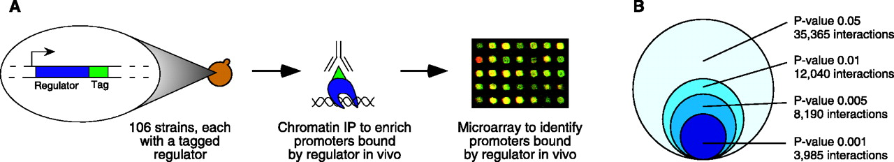
Experimental Design
Use genome-wide location analysis to investigate how yeast transcriptional regulators bind to promoter sequences across the genome
Figure 1-A
Notes:
Yeast transcriptional regulators were tagged by introducing the coding sequence for a c-myc epitope tag into the normal genomic locus for each regulator
106 of the yeast strains contained a single epitope-tagged regulator whose expression could be detected in rich growth conditions.
Chromatin immunoprecipitation (ChIP) was performed on each of these 106 strains
Promoter regions were identified by hybridization to microarrays containing a genome-wide set of yeast promoter regions

Slide 7
Yeast and Tagging
Studied all 141 transcription factors listed in the Yeast Proteome Database that were reported to have DNA binding and transcriptional activity
Myc epitope tagging (at COOH terminus of each regulator) was used to identify transcription factors in each yeast strain, might have affected the function of some transcriptional regulators
Notes:
Third bullet: which was done to increase the likelihood that tagged factors were expressed at physiologic levels and correct placement was confirmed by PCR and immunoblot analysis
Fourth bullet: For 17 of the 141 factors they weren’t able to obtain viable tagged cells, despite three attempts to tag each regulator

Slide 8
Analysis
Immunoblot analysis showed 106 of the 124 tagged regulator proteins could be detected when yeast cells were grown in rich medium (yeast extract, peptone, and dextrose)
Performed genome-wide location analysis experiment for the 106 yeast strains that expressed epitope-tagged regulators
Genome-wide location data were subjected to quality control filters and normalized, then the ratio of immunoprecipitated to control DNA was determined for each array spot
Notes:
First bullet: even though not all the transcriptional regulators were expected to be expressed at detectable levels under these conditions

Slide 9
Statistical Analysis
Confidence value (p-value) for each spot from each array was calculated using an error model
Data for each of the three samples in an experiment were combined by a weighted average method
Each ratio was weighted by p-value then averaged
Final p-values for these combined ratios were then calculated
Notes:
First bullet: Error models were used to obtain a probabilistic assessment of regulator location data because of the properties of the biological system of study (cell populations, DNA binding factors capable of binding to both specific and nonspecific sequences) and the expectation of noise in microarray-based data

Slide 10
Statistical Results
The total number of protein-DNA interactions in the location analysis data set, using a range of p-value thresholds
Notes:
Effect of p-value threshold
The sum of all regulator-promoter region interactions is displayed as a function of varying p-value thresholds applied to the entire location data set for the 106 regulators.
More stringent p-values reduce the number of interactions reported but decrease the likelihood of false-positive results.

Slide 11
Develop a mathematical model to map and understand how cells control global gene expression networks
Experimental Design:
Epitope tagging, Chromatin IP, Microarray, Statistical Analysis
Regulator Density:
Relationship between promoter and regulator
Network Motifs
6 Networks: Autoregulation, Multicomponent loop, feed-forward loop, single-input, multi-input, regulator chain
Network Structures
Algorithm applied to cell cycle
Computational model created
Regulatory binding network
Conclusion and Significance:
Interactions between genes and transcription factors can be mapped using the model created
Can then be used to improve our understanding of human health

Slide 12
Regulatory Density
~4000 interactions were observed between regulators and promoter regions (p-value = 0.001)
The promoter regions of 2342 of 6270 yeast genes (37%) were bound by one or more of the 106 transcriptional regulators
Many yeast promoters were bound by multiple transcriptional regulators
  Previously associated with gene regulation in higher eukaryotes
  Suggests that yeast genes are also frequently regulated through combinations of regulators

Slide 13
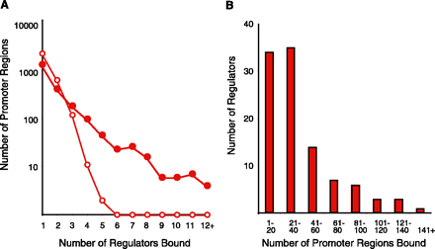
Regulators Bound per Promoter Region
Red circles: actual location data
White circle: distribution expected from the same set of p-values randomly assigned among regulators and intergenic regions
Notes:
At a p-value threshold of 0.001, significantly more intergenic regions bind four or more regulators than expected by chance.
Randomly assigned p-values; slim chance of getting a promoter region with more than 6 regulators bound
1-3 can happen randomly; 6-12 do not happen randomly
shows this isn’t just a chance event; what actually happened is different from a random distribution

Slide 14
Different Promoter Regions Bound by Each Regulator
More than one third of the promoter regions that are bound by regulators were bound by two or more regulators
Relative to the expected distribution from randomized data, there was a high number of promoter regions that were bounded by four or more regulators
Because of the stringency of the p-value (0.001) threshold, this is an underestimate of regulator density
Notes:
Ranged from 0 to 181 (P value threshold = 0.001)
Average of 38 promoter regions per regulator

Slide 15
Develop a mathematical model to map and understand how cells control global gene expression networks
Experimental Design:
Epitope tagging, Chromatin IP, Microarray, Statistical Analysis
Regulator Density:
Relationship between promoter and regulator
Network Motifs
6 Networks: Autoregulation, Multicomponent loop, feed-forward loop, single-input, multi-input, regulator chain
Network Structures
Algorithm applied to cell cycle
Computational model created
Regulatory binding network
Conclusion and Significance:
Interactions between genes and transcription factors can be mapped using the model created
Can then be used to improve our understanding of human health

Slide 16
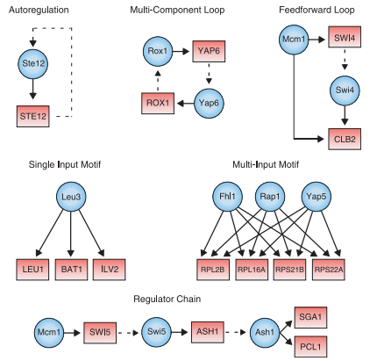
Network Motifs in Yeast Regulatory Network
= Regulator
= Gene Promoter
= Regulator binded to a promoter
= Genes encoding regulators linked to their respective regulators
Notes:
Def: simplest units of commonly used transcriptional regulatory network architecture that provides specific regulatory capacities such as positive and negative feedback loops.
- Motifs suggest models for regulatory mechanisms that can be tested
Autoregulation: regulator that binds to the promoter region of its own gene (10% of yeast gene)
Advantages:
reduced response time to environmental stimuli
Decreased biosynthetic cost of regulation (takes less energy)
Increased stability of gene expression
i. EX: When Ste12 is exposed to pheromone, the concentrations of the pheromone-responsive Ste12 transcriptional regulator rapidly increase, leading to the binding of other genes required for the mating process.
Multicomponent loops: a regulatory circuit whose closure involves two or more factors (only observed in 3 of the 106 regulators)
Advantages:
closed-loop structure provides the capacity for feedback control (stable bc not affected by external eniv)
offers the potential to produce bistable systems that can switch between two alternative states
Feedforward loops: contain a regulator that controls a second regulator so both regulators bind a common target gene (39 regulators are involved in 49 feedforward loops potentially controlling 240 genes in the yeast network)
Advantages: may act as a switch (expression of the target gene may depend on the rest of levels of the master and secondary regulators), which provide a form of multistep ultrasensitivity
Single-input: contain a single regulator that binds a set of genes under a specific condition
Advantage: coordinating a discrete unit of biological function, such as a set of genes that code for the subunits of a biosynthetic apparatus or enzymes of a metabolic pathway.
EX: several genes of the leucine biosynthetic pathway are controlled by the Leu3 transcriptional regulator.
Multi-input: consist of a set of regulators that bind together to a set of genes.
a. We found 295 combinations of two or more regulators that could bind to a common set of promoter regions.
b. offers the potential for coordinating gene expression across a wide variety of growth conditions.
c. EX: each of the regulators bound to a set of genes can be responsible for regulating those genes in response to a unique input. In this manner, two different regulators responding to two different inputs would allow coordinate expression of the set of genes under these two different conditions
Regulator chain: consist of chains of 3 or more regulators in which one regulator binds the promoter for a second regulator, the second binds the promoter for a third regulator, and so forth
observed frequently in the location data for yeast regulators; we found 188 regulator chain motifs, which varied in size from 3 to 10 regulators.
the chain represents the simplest circuit logic for ordering transcriptional events in a temporal sequence. The most straightforward form of this appears in the regulatory circuit of the cell cycle, where regulators functioning at one stage of the cell cycle regulate the expression of factors required for entry into the next stage of the cell cycle

Slide 17
Develop a mathematical model to map and understand how cells control global gene expression networks
Experimental Design:
Epitope tagging, Chromatin IP, Microarray, Statistical Analysis
Regulator Density:
Relationship between promoter and regulator
Network Motifs
6 Networks: Autoregulation, Multicomponent loop, feed-forward loop, single-input, multi-input, regulator chain
Network Structures
Algorithm applied to cell cycle
Computational model created
Regulatory binding network
Conclusion and Significance:
Interactions between genes and transcription factors can be mapped using the model created
Can then be used to improve our understanding of human health

Slide 18
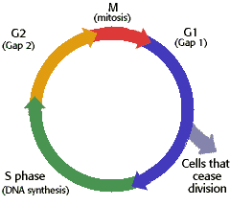
Assembling Motifs into Network Structures
Algorithm was created that examines over 500 expression experiments
Genome is scanned for genes common to phase G. Matches are examined for regulators common to S
P value is then relaxed to “recapture” data that wasn’t used
Ultimate goal: using the main motifs to create replica of cell cycle based only on the location/data of the regulators with no prior cell cycle knowledge

Slide 19
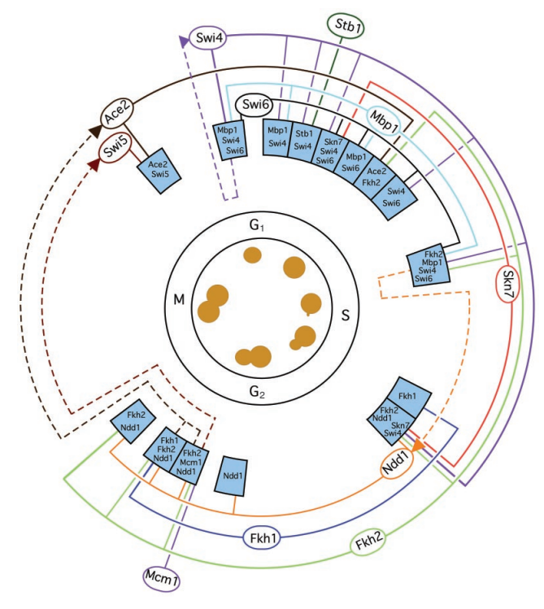
Yeast Cell Cycle Model
Transcriptional regulatory network created from binding and expression data
Boxes correspond to when peak expression occurred
Blue Box: set of genes w/ common regulators
Ovals: regulators connected to their genes w/ solid line
Arc: defines time of activity
Dashed line: gene in the box encodes outer ring regulator
Notes:
Cell cycle regulators bound to other cell cycle regulators
This phenomenon was also apparent among transcriptional regulators that fall into the metabolism and environmental response categories
Found that multiple transcriptional regulators within each category were able to bind to genes encoding regulators that are responsible for control of other cellular processes

Slide 20
Creating a Computational Model
Created model based on peak expression of common expression multi-input motifs
Three notable results:
  Model correctly assigned all the regulators to previously proven stages of the cell cycle
  Two relatively unknown regulators could be assigned based strictly on binding data
  Required no prior knowledge and was completely automatic
Hopefully can use as a general outline for creating more complex network models

Slide 21
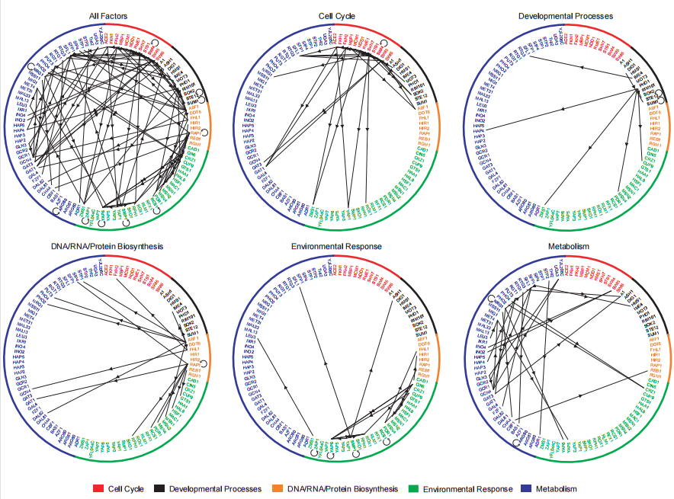
Regulatory Binding Network
All 106 regulators displayed in a circle
Sorted into functional categories (color coded)
Lines follow regulators binding to each other/itself

Slide 22
Develop a mathematical model to map and understand how cells control global gene expression networks
Experimental Design:
Epitope tagging, Chromatin IP, Microarray, Statistical Analysis
Regulator Density:
Relationship between promoter and regulator
Network Motifs
6 Networks: Autoregulation, Multicomponent loop, feed-forward loop, single-input, multi-input, regulator chain
Network Structures
Algorithm applied to cell cycle
Computational model created
Regulatory binding network
Conclusion and Significance:
Interactions between genes and transcription factors can be mapped using the model created
Can then be used to improve our understanding of human health

Slide 23
Significance of Regulatory Network Information
Identified network motifs that provide specific regulatory capacities for yeast
These motifs can be used as building blocks to construct large network structures through an automated approach that combines genome-wide location and expression data (without prior knowledge)
Future research will require knowledge of regulator binding sites under various growth conditions and experimental testing of models that emerge from computational analysis of regulator binding, gene expression, and other information. (alter conditions)
This approach can be applied to higher eukaryotes

Slide 24
Conclusion
Cell is the product of specific gene expression programs involving regulated transcription
Known how most transcriptional regulators encoded in S. cerevisiae interact with genes across the genome
Describes potential pathways yeast cells can use to regulate global gene expression programs
Identify network motifs and show that an automated process can use motifs to assemble a transcription regulatory network structure

Slide 25
Take home message
The interactions between genes and transcription factors can be mapped using the model described, which can then be used to improve our understanding of human health and design new strategies to combat disease.

