Slide 1
Considering Carbon and Fermentation vs. Respiration
Elizabeth Polidan
Department of Mathematics
Loyola Marymount University
BIOL 398-03/MATH 388
February 28, 2013

Slide 2
Outline
Point 1
Point 2
  2a
  2b
  2c
Point 3
Point 4

Slide 3
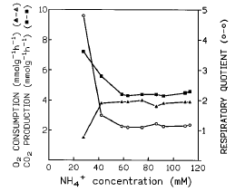
By the time NH₄⁺ concentration goes from limiting to excess at 61 mM no more fermentation
Respiratory quotient shows
at 29 mM NH₄⁺ in the feed, the culture is performing fermentation.
At 44 mM NH₄⁺, yeast begin to switch over to respiration.
After nitrogen is no longer limiting (61 mM NH₄⁺) complete
respiration.
Figure from ter Schure, et al. 1995b

Slide 4
Respiration vs. Fermentation
Respiration (aerobic)
  C₆H₁₂O₆ + 6O₂ → 6CO₂ + 6H₂O + 36ATP
  More energy, less glucose needed, but slower
  Faster growth rate - ~3 times faster (Novak, et. al., 2007)
Fermentation (anaerobic)
  2ATP + C₆H₁₂O₆ → 2CH₃CH₂OH + 2CO₂ + 4ATP
  Less energy, more glucose needed, but faster
Use the different growth rates and inefficiencies in the model

Slide 5
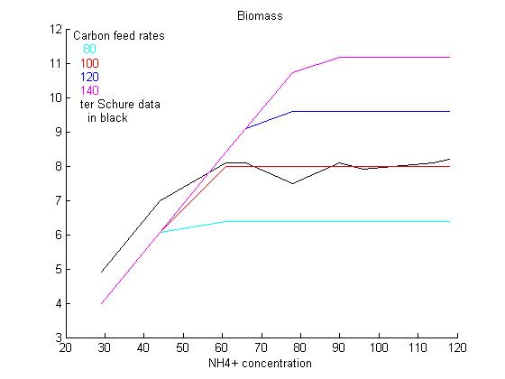
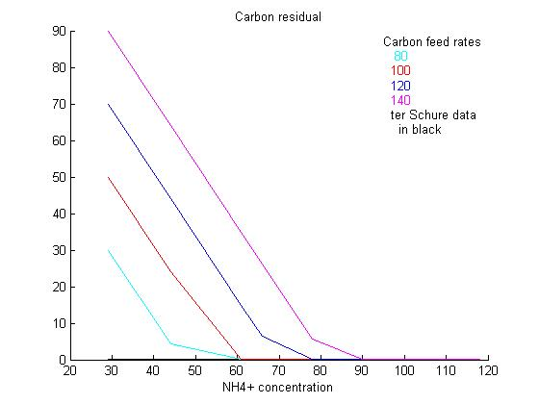
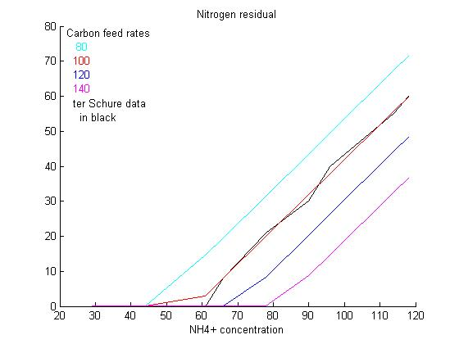
What happens at different levels of carbon?
Biomass
Carbon Residual
Nitrogen Residual

Slide 6
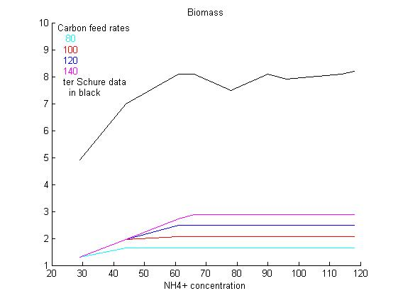
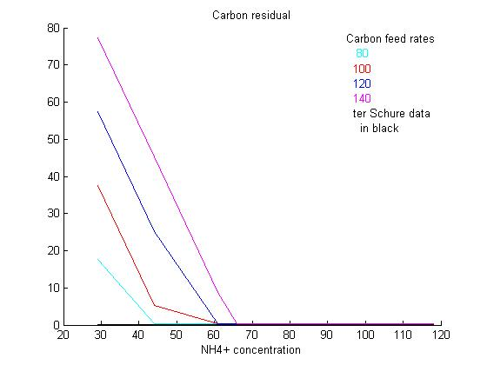
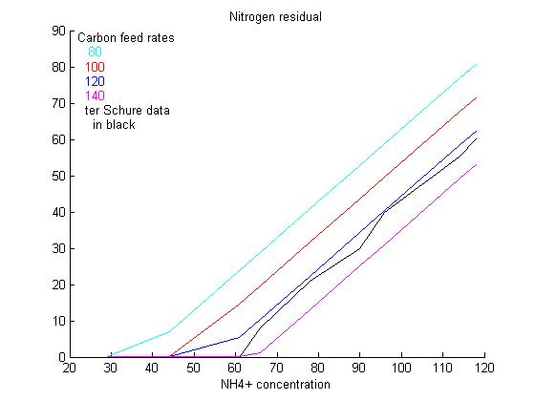
And if it is fermentation?
Biomass
Residual Carbon
Residual Nitrogen

Slide 7
Summary
Yeast may prefer anaerobic metabolism, but aerobic is much more efficient
  Summ 1a
  Summ 1b
  Summ 1c
Summ 2
Summ 3
Summ 4
  Summ 4a

Slide 8
References
Alberts, B., Bray, D., Hopkin, K., Johnson, A., Lewis, J., Raff, M., Roberts, K., & Walter, P. (2004) Essential Cell Biology, 2nd edition, New York, NY: Taylor & Francis Group, pp. 431-433.
Novak, J., Basarova, G., Teixeira, J.A., & Vicente, A.A. (2007) Monitoring of Brewing yeast propagation under aerobic and anaerobic conditions employing flow cytometry, Journal of the Institute of Brewing, 111:249-255.
Ter Schure, E.G., Sillije, H.H.W., Raeven, L.J.R.M, Boonstra, J., Verkleij, A.J., and Verrips, C.T. (1995a) Nitrogen-regulated transcription and enzyme activities in continuous cultures of Saccharomyces cerevisiae, Microbiology, 141:1101-1108.
Ter Schure, E.G., Sillije, H.H.W., Verkleij, A.J., Boonstra, J., and Verrips, C.T. (1995b) The concentration of ammonia regulates nitrogen metabolism in Saccharomyces cerevisiae, J. Bacteriol., 177:6672-6675.

