Slide 1
Inside-Out Integrin Activation

Slide 2
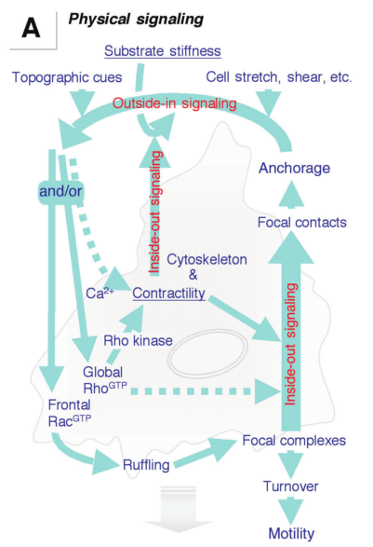
Inside-Outside-Inside… What’s the focus?
Cells utilize integrins to interact physically with the extracellular environment in a number of different ways
There has been a lot of focus on how outside-in mechanisms affect cell behavior
  Stiffness, shear stresses, bead twisting, etc.
However, we must consider that not only do cells just respond to their environment, but that there are feedback loops present in this system
    outside-inside-outside as well as inside-out signaling
The focus of this discussion will be on how inside-out activation of integrins
Discher, DE. Janmey, P. Wang, YL. Tissue Cells Feel and Respond to the Stiffness of Their Substrate. 2005. Science.

Slide 3
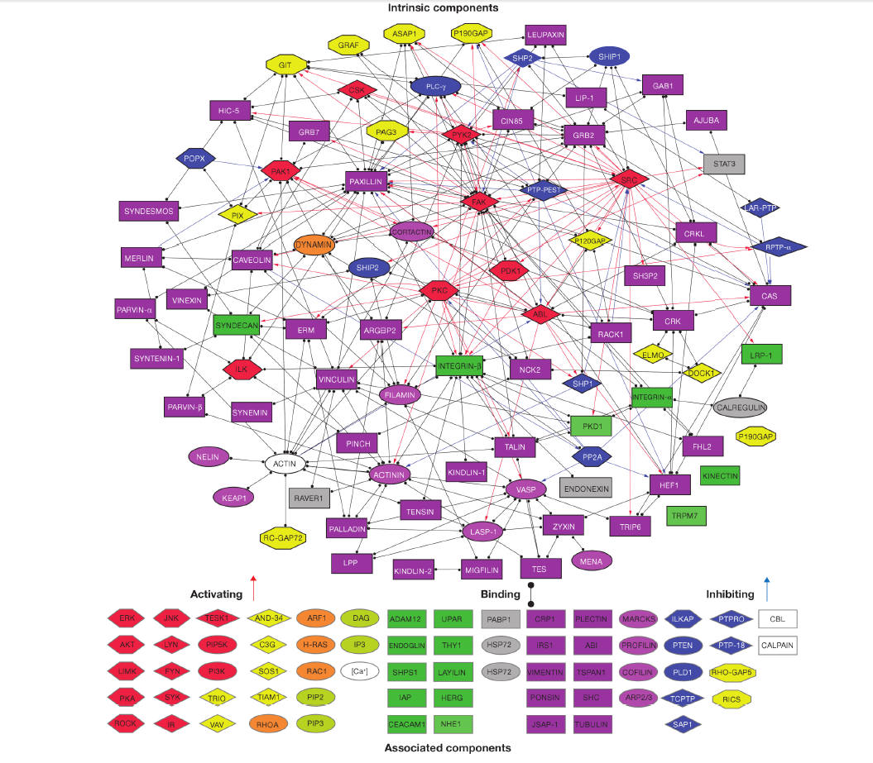
The Adhesome
Zaidel-Bar, R. Functional Atlas of the Integrin Adhesome. 2007

Slide 4
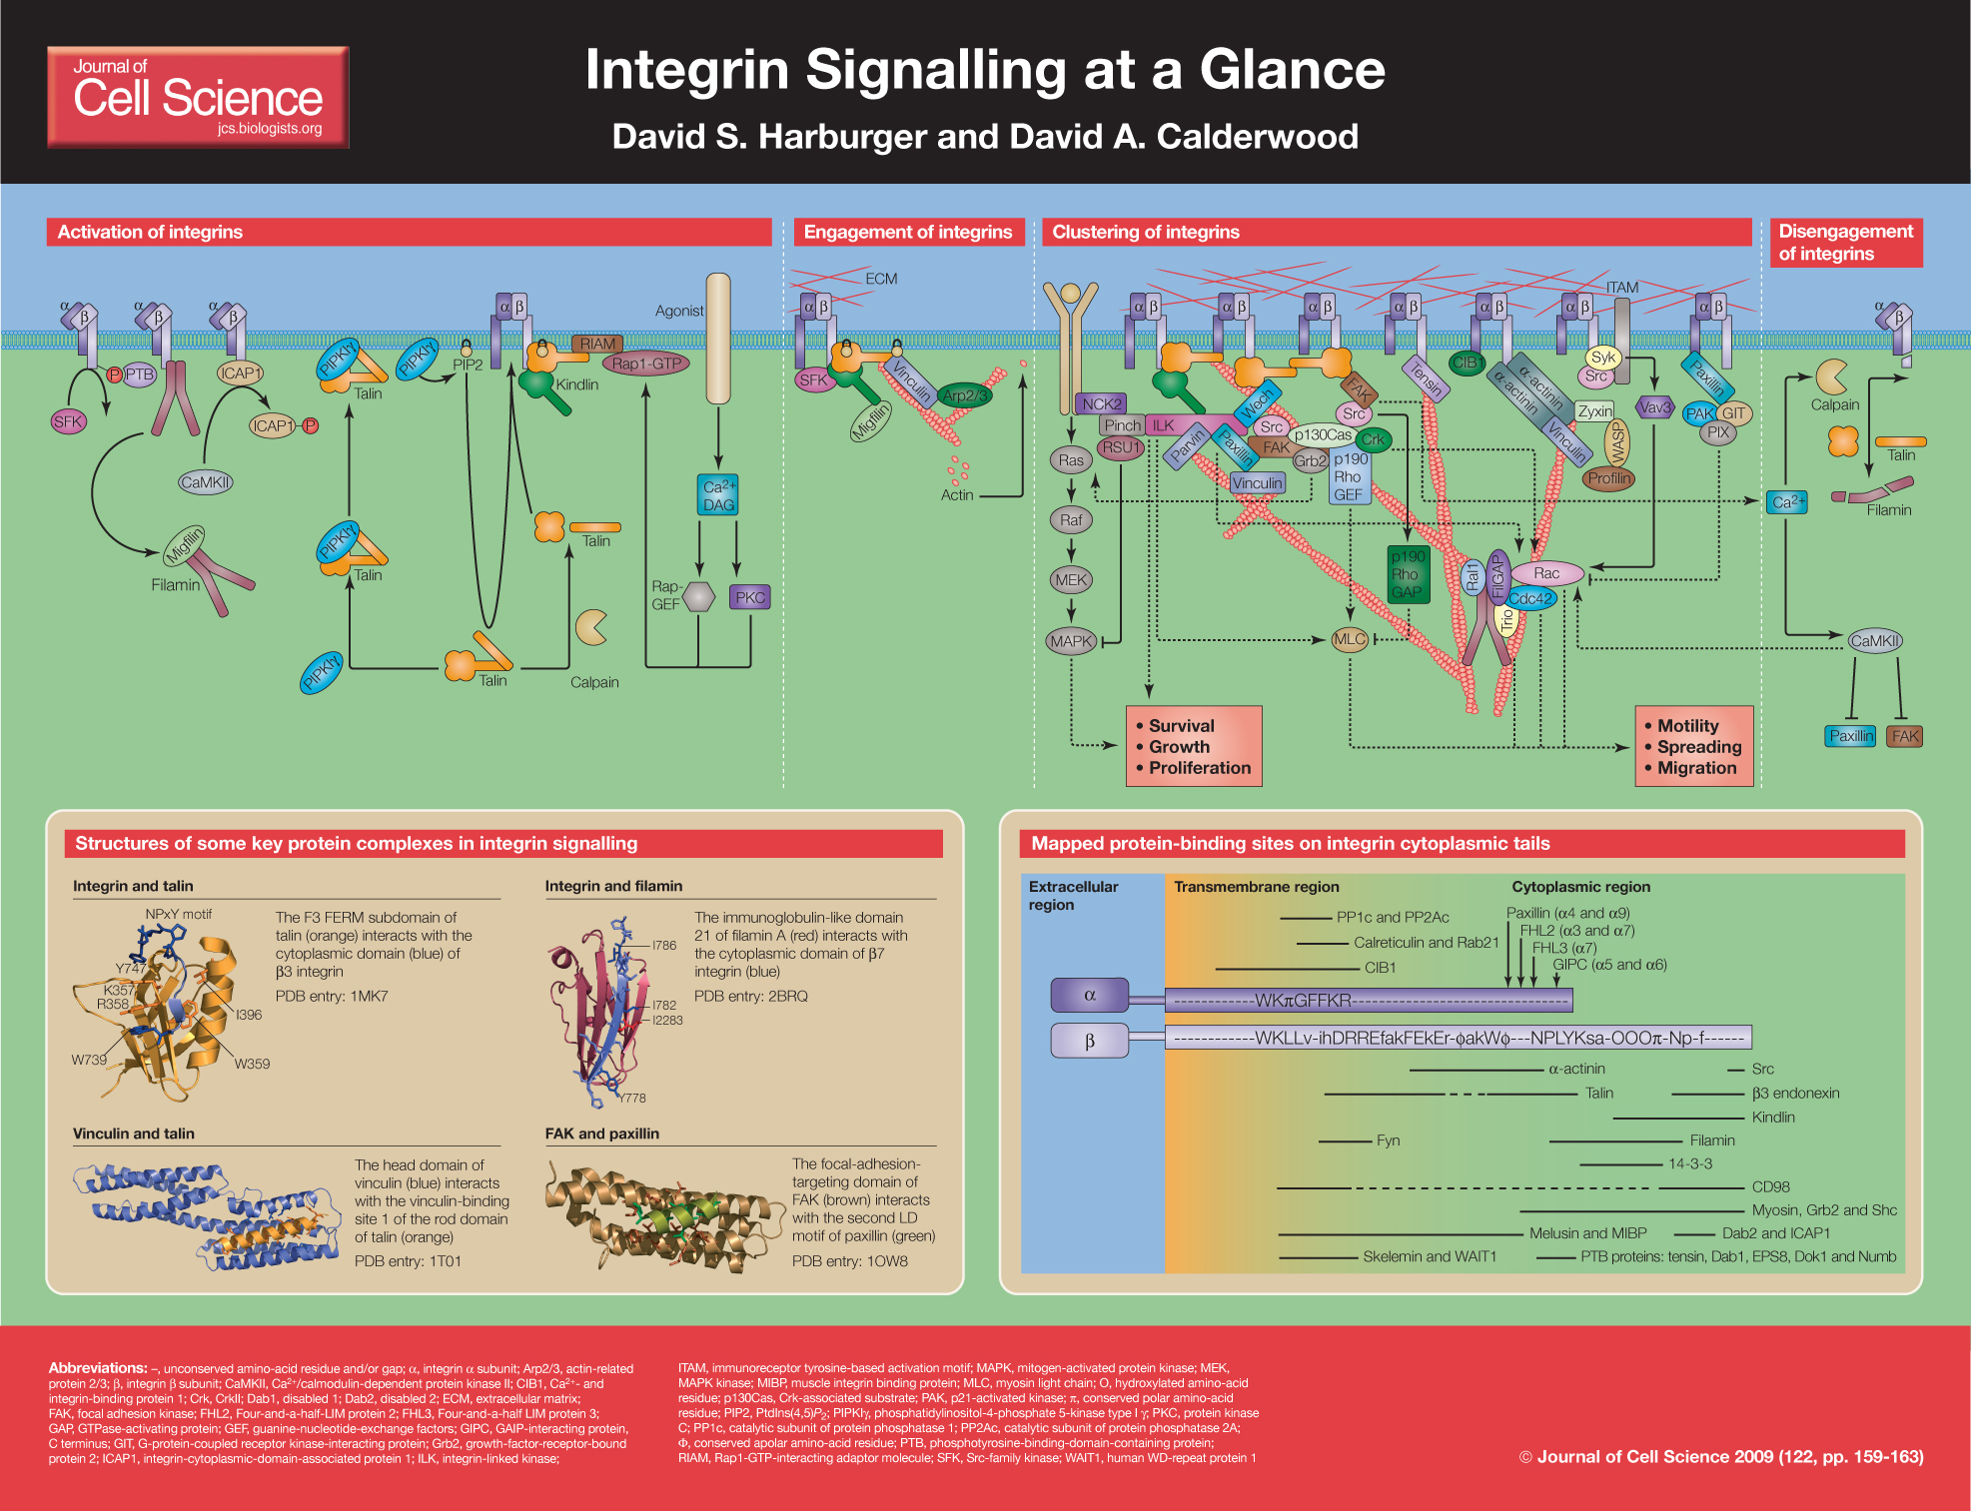
How can Integrins be Activated?
Inactive
Active
Harburger and Callwood. 2009. Integrin Signaling at a Glance.

Slide 5
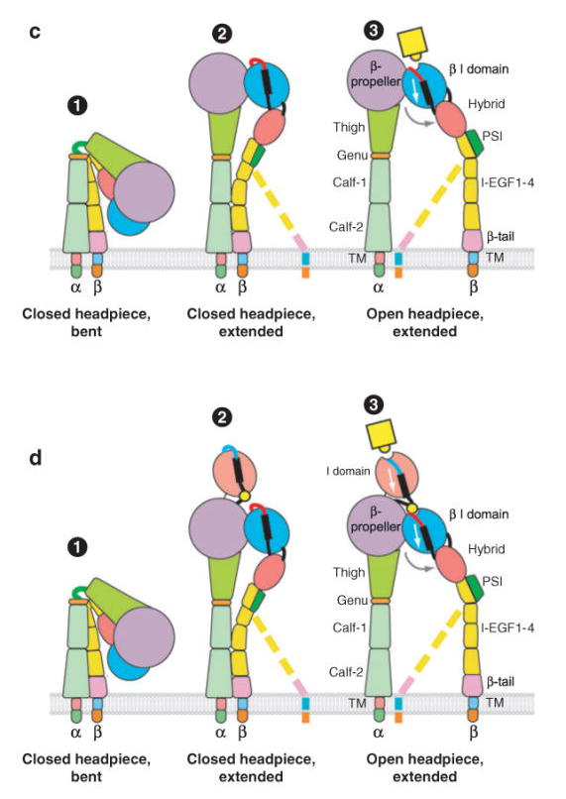
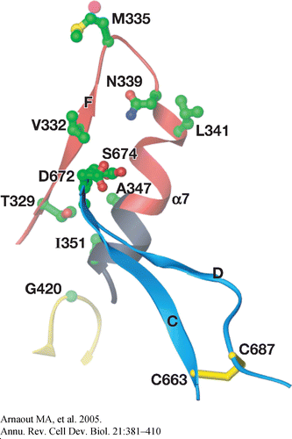
Models of Integrin Activation
There are two differing models on how integrins are activated:
Switchblade Model (Luo et al. 2007)
Deadbolt Model (Arnaout et al. 2005)

Slide 6
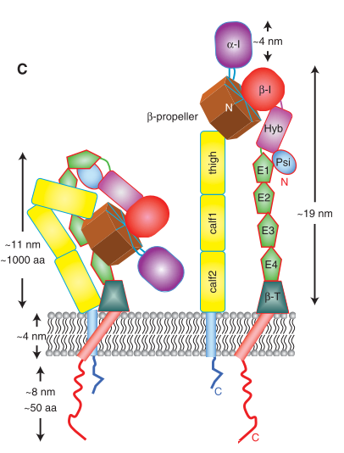
What do integrins look like “normally”
As we learned last week, integrins are large, heterodimeric, transmembrane proteins made up of two subunits – α and β.
  There are 18 α and 8 β subunits form 24 different integrin heterodimers
The subunits pass through the membrane with a single helix and a short, unstructured cytoplasmic tail
It has been observed using x-ray crystallography that integrins all have a very similar, “bent” look to them – “inactive”
We can get x-ray crystallography results demonstrating the “active” form of integrins by truncating the cytoplasmic domains
Campbell, ID. Humphries, MJ. Integrin Structure, Activation, and Interactions. 2015. Cold Springs Harbor.
Xiong et al. Crystal structure of the extracellular segment of the integrin alpha V beta 3. 2001. Science.
Notes:
aVb3, with and without ligand (Xiong et al. 2001, 2002), aIIbb3 (Zhu et al. 2008), and axb2 (Xie
Basically, we know this is true for a few integrins, but not necessarily all integrins
Using cryo-EM we can see active forms on the surface of the cell

Slide 7
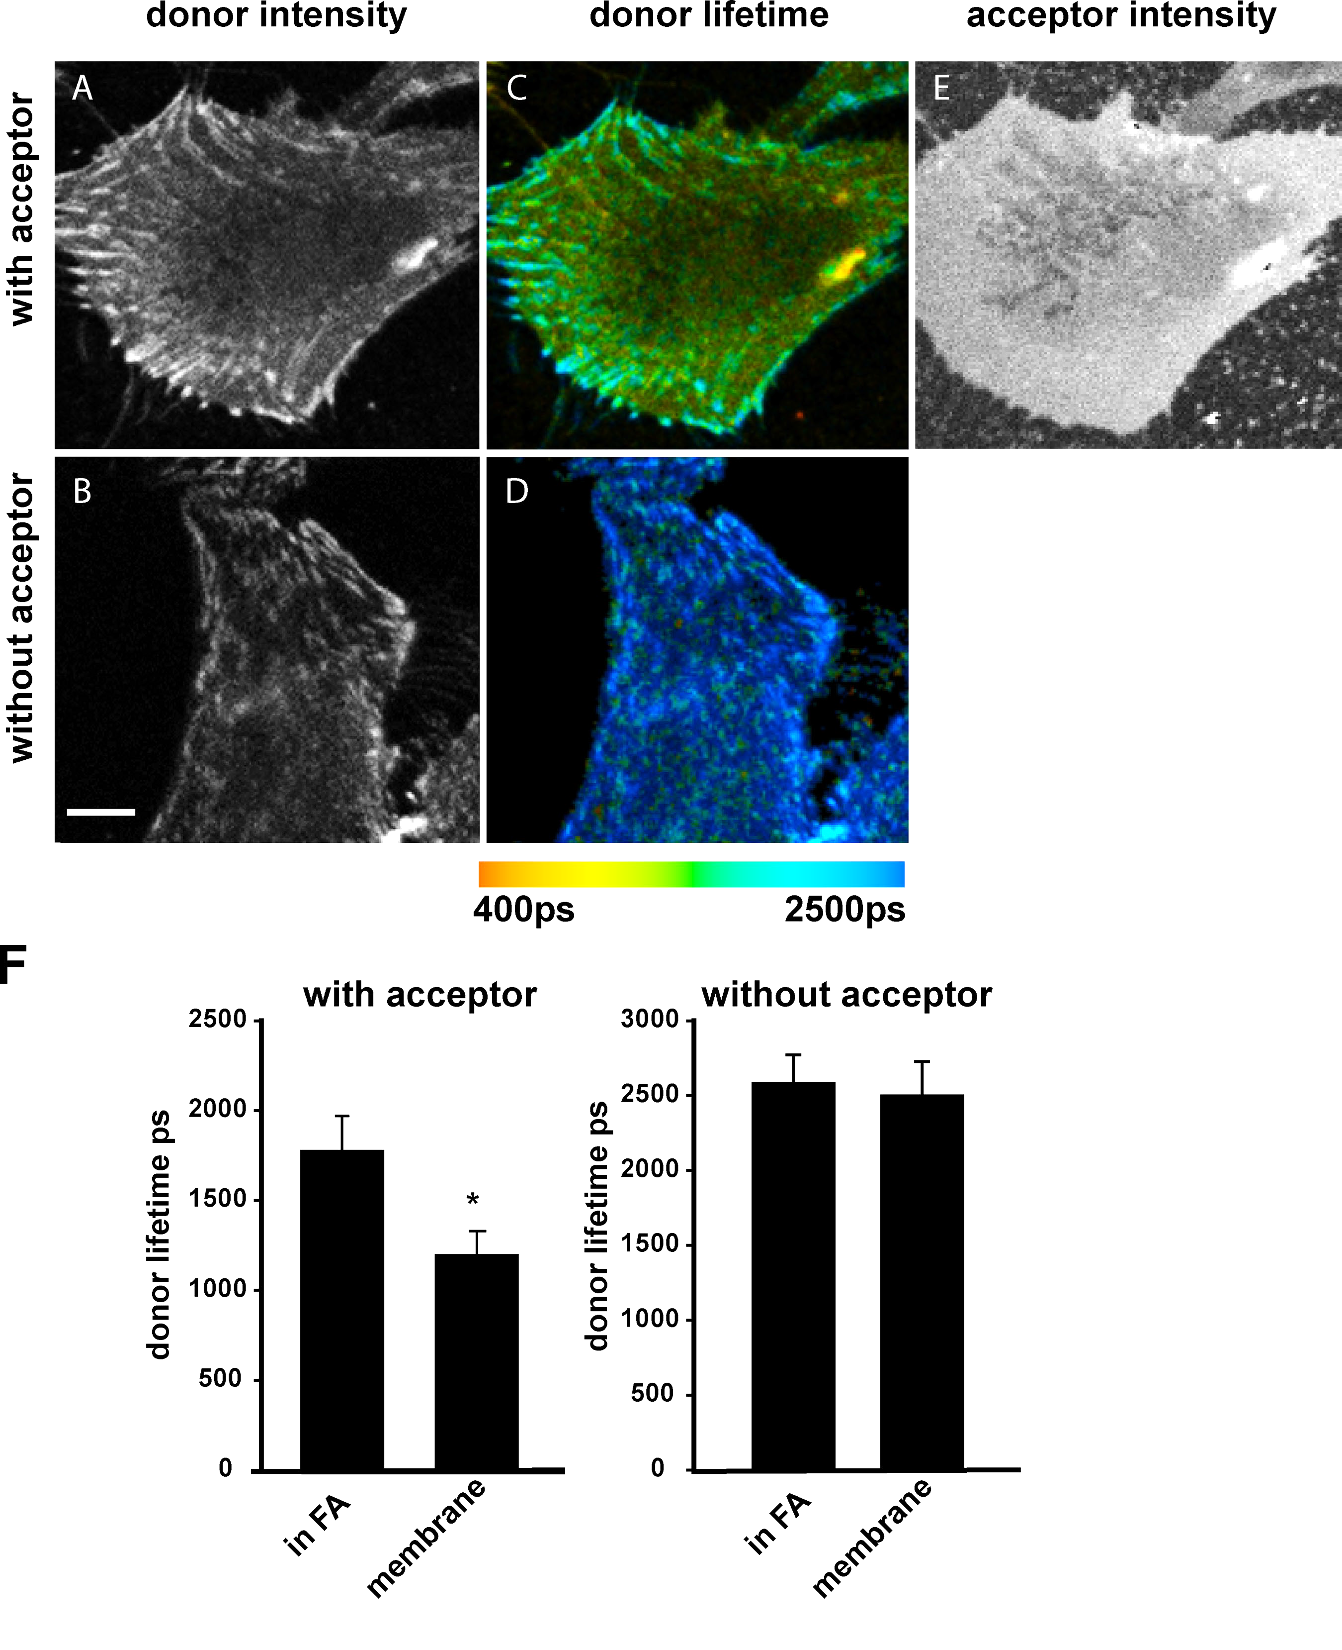
Active Integrins
FLIM FRET to demonstrate the differences in conformation of an active vs. inactive integrin
Since FRET only occurs over 10nm, what’s going on?
Introducing a disulfide bond results in locking the “legs” together of integrins
By fluorescently labeling the head of the integrin and membrane, it was found that there was increased donor lifetime in the FA
Since FRET is based on the distance of the two fluorophores, the further away the two, the longer the lifetime
Akarki et al. 2010. Focal adhesions are sites of integrin extension.
Notes:
TCSPC-FLIM-FRET directly measures the time between the absorption and emission of individual photons in the FRET donor fluorophores and has the advantage of providing quantitative results largely free from artifacts such as photobleaching and radiative transfer

Slide 8
The Deadbolt Model
There is a “deadbolt” model, which is in contrast to the “switchblade” model
This model proposes that the integrins don’t have to be fully extended to interact with ligands and is somewhat controversial
This proposal is based on some EM reports that observed “bent” alphaVbeta3 binding to integrin in solution
Basically, the interaction at this site “locks” the integrin in a low affinity state
Studies have been conducted by deleting the CD loop in the β integrin and found no effect on ligand binding.

Slide 9
What is important to the activation of integrins?
NMR studies of the cytoplasmic tails have been published, but there is little agreement about what the structure of the tail looks like.
The structure and “tilt” of the transmembrane domain is critically important to regulating the activity of integrin heterodimers
The interaction between these two domains has been shown through the use of co-immunoprecipitation, cysteine crosslinking, FRET labeled cytoplasmic tails, activating mutants, and NMR
Talin provides the link between the integrin and the cytoskeleton, causing the shift in active states

Slide 10
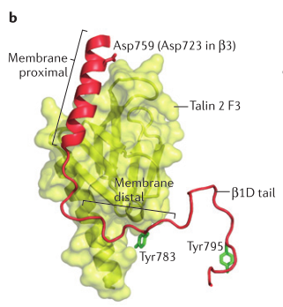
Talin is responsible for inside-out activation of the integrin
The F3 Domain of talin interacts with the β integrin’s cytoplasmic domain
Important to note that images like this aren’t “real”, but composites of various NMR and x-ray structures.

Slide 11
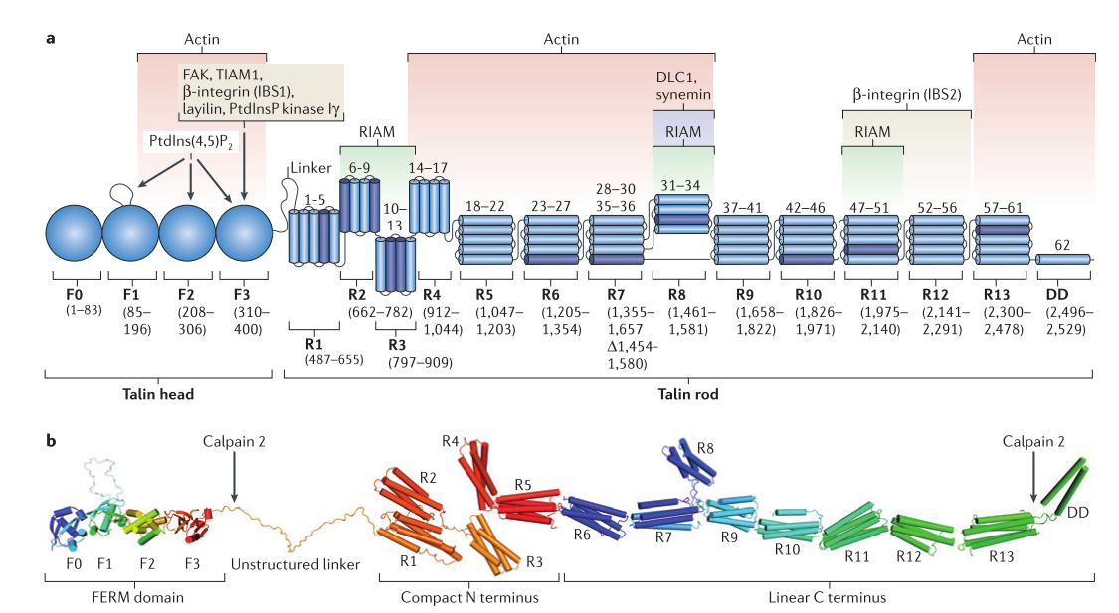
Structure of Talin

Slide 12
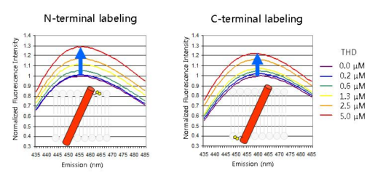
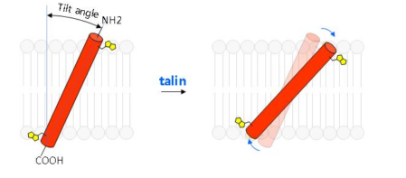
Talin and Its Role in Activating Integrins
The binding of talin to the integrin causes a change in the stability and structure of the α-β transmembrane domain interaction through binding to integrin β3
An increase in fluourescence emission resulted as increasing amounts of talin (only the head domain) was added to the solution
This indicates that talin causes a change in conformation, that results in the activation of integrins
Ginsberg, M. Integrin Activation. 2014. BMB Reports.
Notes:
Such talin-induced motion was demon- strated by increased fluorescence of solvatochromic dyes at- tached to the N- or C-terminii of the β3 TMD in the presence of THD (41)

Slide 13
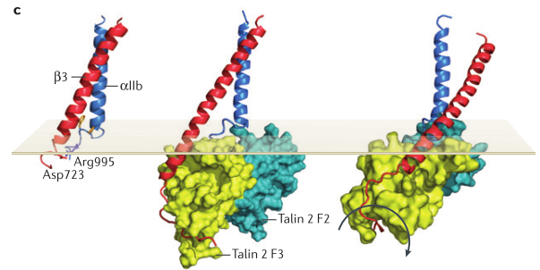
What does this look like?

Slide 14
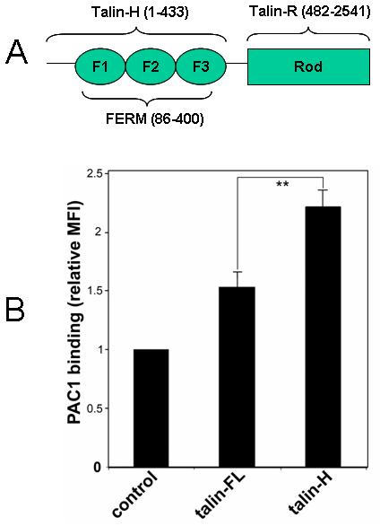
Talin Activation and Autoinhibition
Using NMR, it was also found that Talin-R binds to Talin-F2F3, resulting in autoinhibition of talin and a closed conformation
Modifying a region on Talin to inhibit the binding of the R region to the PTB domain (F3) causes talin to become constitutively active
This autoinhibition can be disrupted also by Phosphatidylinositol 4,5-bisphosphate (PIP2)
Most of this was demonstrated through NMR and shifts due to binding
EGFP-talin (Talin FL), EGFP-talin-H or EGFP vector alone
Goksoy et al. 2008. Structural basis for the autoinhibition of talin in regulating integrin activation.

Slide 15
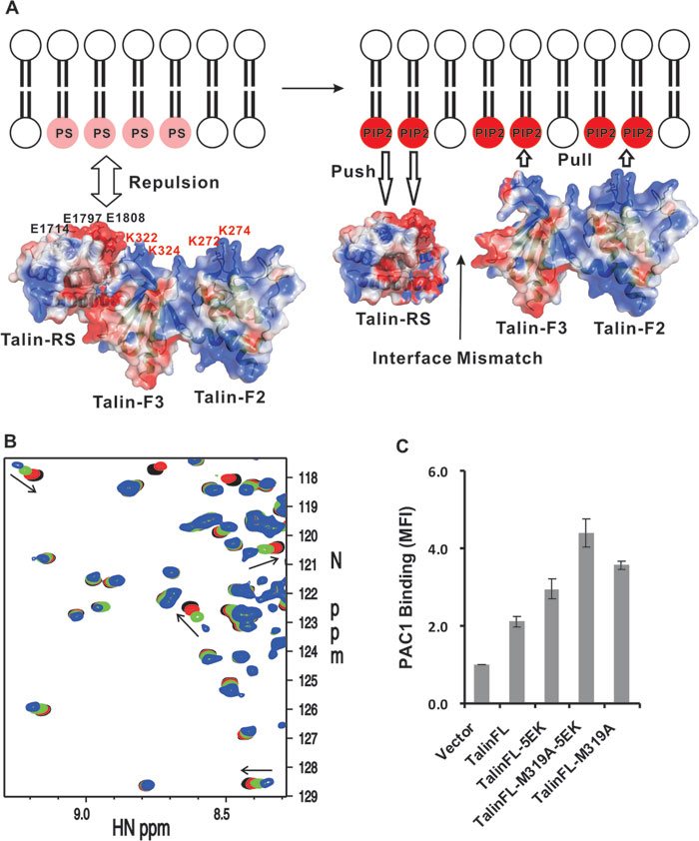
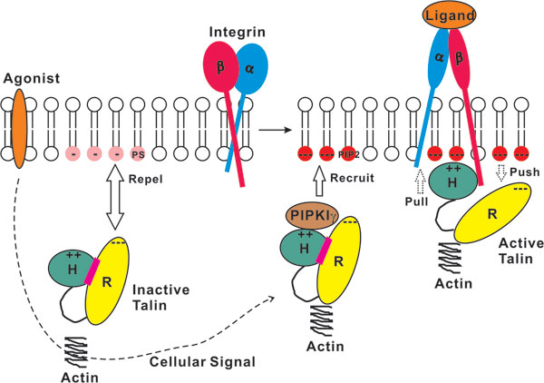
PIP2 Can Help Unmask Talin
The membrane lipid phosphotidylinositol-4,5-bisphosphate (PIP2) within the membrane strongly attracts talin, while it repels the RS domain
In vivo, PIPKIγ kinase locally enriches PIP2 once recruited by talin
It is possible PIP2 is converted to PIP3 by recruitment of PI3K, which is known to aid in integrin activation
Song et al. 2012. A novel membrane-dependent on/off switch mechanism of talin FERM domain at sites of cell adhesion

Slide 16
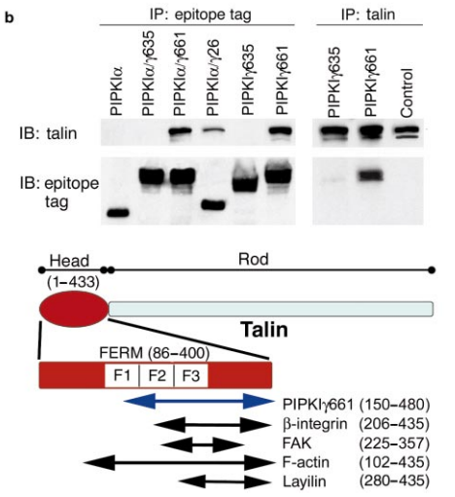
PIPKIγ and PIP2 / Talin
PIPK1γ binds to Talin, resulting in the production of phosphatidylinositol 4,5 bisphosphate (PIP2)
Only PIPK1γ661, not PIPK1γ635 has been found to pull down
Vinculin, FAK, and tensin don’t pull down with PIPK1γ661
Ling et al. 2002. Type Ig phosphatidylinositol phosphate kinase targets and regulates focal adhesions
Wu et al. 2011. PIPKIγ Regulates Focal Adhesion Dynamics and Colon Cancer Cell Invasion.

Slide 17
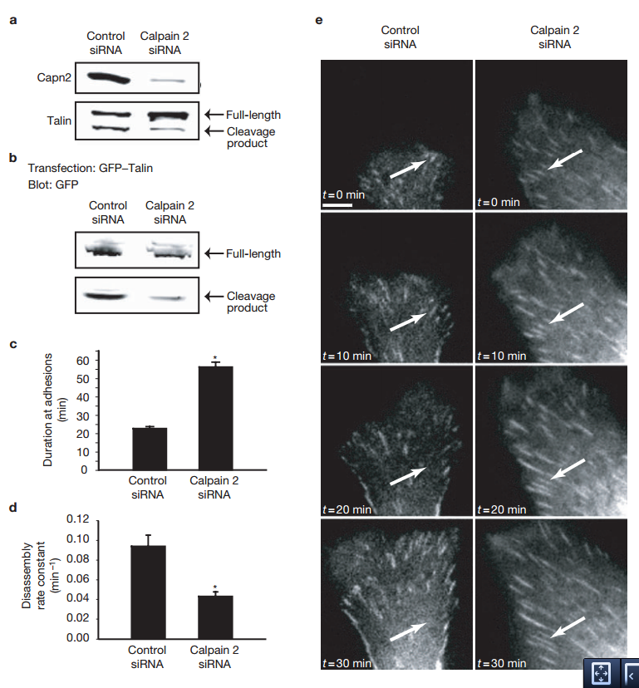
How else is talin regulated?
Talin can be regulated through a number of mechanisms from within the cell, including being degraded by calpain-2
Mouse NIH3T3s were demonstrated on FN where we see that Calpain 2 siRNA results in talin being left intact
Also, using fluorescence, we see that the talin persists at adhesion sites longer without calpain-2 in both metrics
Basically measured how the adhesions grew over time as compared to how they disassembled to get the rate constant
Franco et al. 2004. Calpain-mediated proteolysis of talin regulates adhesion dynamics

Slide 18
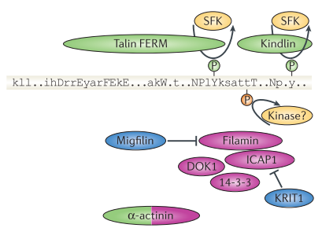
Talin can be inhibited by SRC Family Kinase
Talin binding can also be inhibited by SFK
Phosphorylation of the integrin tail inhibits binding of the talin-F3 domain and thus activation of the integrin
Dok1 competes for binding and negatively regulates integrin activation
This gets real complex though and we start going into outside-in signaling if we continue on with SFKs
Oxley et al. 2007. An Integrin Phosphorylation Switch. THE EFFECT OF INTEGRIN TAIL PHOSPHORYLATION ON DOK1 AND TALIN BINDING
Notes:
In this situation the chemical shifts change continuously as the binding partner is added. Essentially, the interaction is so weak, that the complex only exists for part of the time it takes to record the NMR experiment. The observed chemical shift is therefore a weighted average of the chemical shifts for the free protein and the complex until the binding partner has been added to excess.

Slide 19
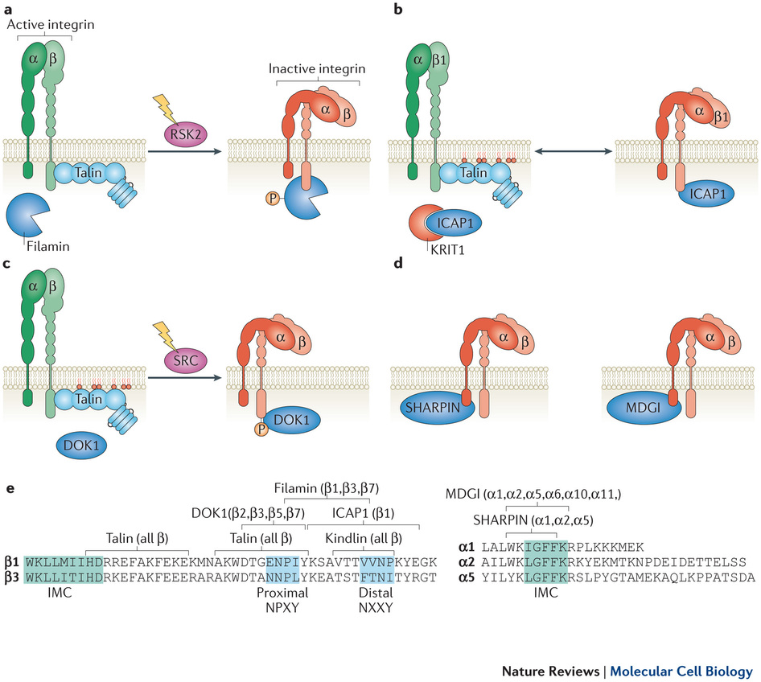
Other modes of integrin inactivation
Bouvard et al. 2013. Integrin inactivators: balancing cellular functions in vitro and in vivo

Slide 20
Filamin, the tumor suppressor?
Filamin actively inactivates integrins through its complex
Using NMR, it was found that Filamin A can and does bind to both alpha IIb and beta 3 in vitro
Given that multiple filamin repeats bind and inhibit integrin, it is also possible that filamin clusters inactivate integrins
Filamin-stabilized inactive integrin would prevent spontaneous integrin activation in resting cells and activation such as thrombosis and tumor metastasis
Liu et al. 2015. Structural mechanism of integrin inactivation by filamin
Notes:
Sharpin, CIB and MDG
Differences in the activation of α_{IIb}β₃integrin measured with PAC-1 were normalized to differences in surface expression of α_{IIb}β₃integrin measured with 2G12 antibody
KREE interrupts filamin binding to integrin
Data are normalized for differences in surface expression of α_{IIb}β₃ integrin as measured by 2G12 antibody. In all experiments, EGFP or EGFP-tagged proteins are transiently expressed with α_{IIb}β₃. Relative fluorescence intensity (RFI) values are mean ± s.e.m. of fold change in PAC-1 binding over transiently expressed α_{IIb}β₃ and EGFP (scaled to 1), from multiple independent experiments as described. (a) Integrin activation assay showing the different effects of talin head (talin H), ​FLNa-Ig21 and the ​FLNa-Ig21 mutants (E2276A, F21EA; A2268K, F21AK) on the activation state of the transiently expressed α_{IIb}β₃. (n = 3 independent transfections; experiments were repeated four times with independent cell cultures.) The difference between vector (EGFP) and ​FLNa-Ig21 is significant (P < 0.001 by two tailed t test). The difference between vector (EGFP) and E2276A (F21EA) or A2268K (F21AK) is not significant (P >0.05). (b) Integrin activation assay showing that transiently expressed ​α_{IIb}(K994E R997E)​β₃ mutant, ​α_{IIb}(KREE)​β₃, exhibits substantially enhanced PAC-1 binding as compared to the WT integrin (P <0.05, two tailed t test). (n = 3 independent transfections; experiments were repeated two times with independent cell cultures.) (c) Integrin activation assay showing that ​FLNa-Ig9 (P <0.05), Ig12 (P <0.001), Ig17 (P <0.001) and Ig19 (P <0.001) exert an inhibitory effect on the PAC-1 binding of the transiently expressed α_{IIb}β₃. ​FLNa-Ig4 did not have a significant inhibitory effect (P >0.05). (n = 3 independent transfections; experiments were repeated two times with independent cell cultures.) All Pvalues were calculated by two-tailed t test.1

Slide 21
RAP1-RIAM Pathway
Rap1–GTP regulates activation of integrins: α4β1, α5β1, αLβ2, Mβ2, and αIIbβ3
There is not much known about how RAP1-RIAM interacts with integrins as a whole
Ras GTPases are small, monomeric proteins that cycle between bound (GTP) and unbound (GDP) forms as facilitated by GEFs while GAPs enhance hydrolysis
Han et al. discovered that Rap1 induced the formation of an “integrin activation complex” containing talin and RIAM

Slide 22
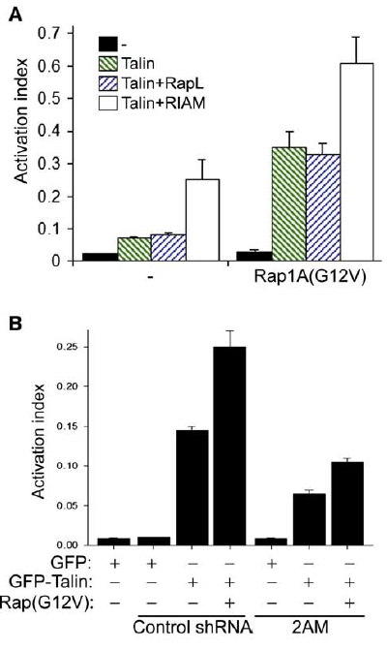
RIAM and Talin Interactions
They found that the activation of integrins as determined by PAC1 adhesion using flow cytometry
RIAM, but not RapL enhances activation of integrins
2AM knocks down RIAM
It has been suggested as well that knocking down this pathway can reduce tumor metastasis
Han et al. 2006. Reconstructing and Deconstructing Agonist-Induced Activation of Integrin AlphaIIbBeta3
Notes:
(AI), defined
as 100 3 (Fo 2 Fr)/(FoLIBS6 2 Fr), where Fo is the median fluorescence
intensity (MFI) of PAC1 binding, Fr is the MFI of PAC1 binding
in the presence of competitive inhibitor (Ro43-5054, 1 mM), and
FoLIBS6 is the MFI of PAC1 binding in the presence of 2 mM
anti-LIBS6.

Slide 23
RAP1-RIAM Complex and Tumor Metastasis
Cell adhesion decreases with the introduction of mutant RAP1 or RIAM
HA-tagged full-length talin and GFP-tagged RIAM constructs were transfected into CHO cells
HA-talin was immunoprecipitated with anti-HA antibody, and associated GFP-RIAM fragments were detected by Western blotting
Need both the binding region of RIAM and talin for integrins to function
Lee. 2008. RIAM Activates Integrins by Linking Talin to Ras GTPase Membrane-targeting Sequences

Slide 24
Controversy?
Although RAP1A-/- mice seem healthy and viable, the loss of RAP1 in vitro causes a decreased adherence to fibronectin, though RAP1B could be “picking up the slack”
Recently it has been found that RIAM is possibly unnecessary as RIAM null mice were found to be healthy overall
Stritt et al. 2015. Rap1-GTP–interacting adaptor molecule (RIAM) is dispensable for platelet integrin activation and function in mice

Slide 25
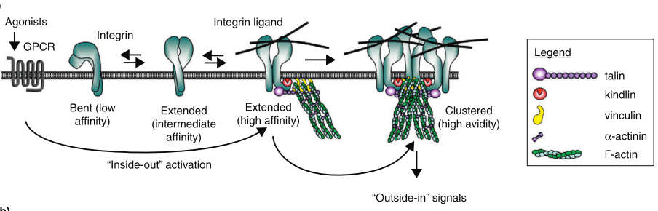
Kindlin and its role in inside-out signaling

Slide 26
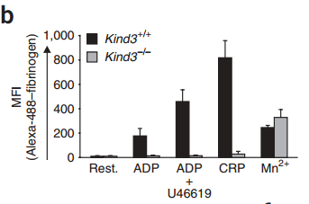
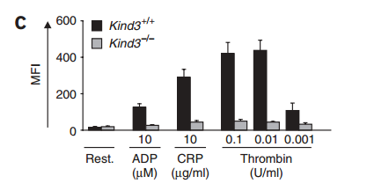
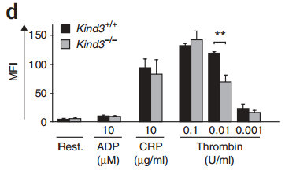
Kindlin also plays a role in activation
There are 3 types of Kindlins (1,2,3)
All 3 have similar sequences, but each is differentially expressed in different tissues & has different roles; not all integrins are the same?
Kindlin-3 has been identified as having an important adhesion role with β1 and β3 integrins in platelets and leukocytes
  Kindlin-3 knockout mice die from hemorrhaging shortly after birth and also show significant osteoporosis
Moser et al. 2008. Kindlin-3 is essential for integrin activation and platelet aggregation. N Med
Notes:
ADP (Adenosine Diphosphate), the TxA2 analog U46619, thrombin, collagen and the GPVI-activating collagen-related peptide (CRP), whereas none of the agonists induced aggregation of Kind3/ pla telets
Kind3/ platelets (gray bars) show a complete block in activation of integrin-aIIbb3 after stimulation with ADP (10 mM), CRP (10 mg/ml) and different concentrations (0.001–0.1 U/ml) of thrombin (c), whereas platelet degranulation measured by the surface expression of P-selectin is largely intact after the same treatments (d)
Resting platelets store P-selectin in a-granules, which fuse with the plasma membrane during agonist-induced platelet activation1. Both CRP and thrombin induced P-selectin translocation on wild-type and Kind3/ platelets, although a significant reduction was consistently observed at intermediate concentrations of thrombin (P o 0.001; Fig. 2d). As expected, the weak agonist ADP did not induce P-selectin surface expression in wild-type and Kind3/ platelets. Thus, although loss of Kindlin-3 specifically disables integrin activation, it still permits agonist-induced P-selectin translocation

Slide 27
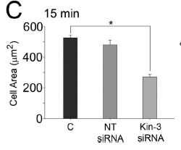
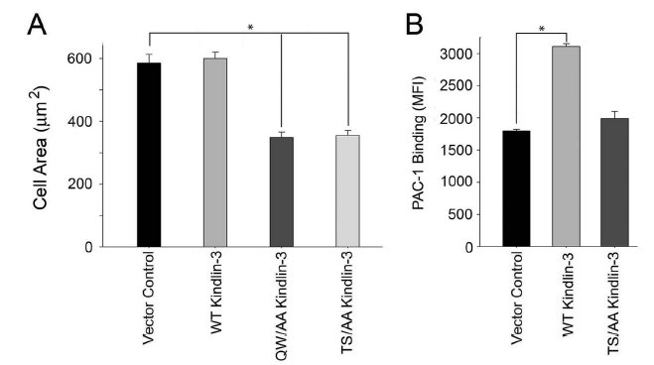
Phosphorylation of Kindilin-3 Regulates Its Activity
Stimulating cells with fibrinogen or thrombin results in increased phosphorylation of kindilin-3 as determined by mass spectrometry
  Occurs at Thr₄₈₂ or Ser₄₈₄
Kindlin-3 colocalizes with integrins in focal adhesions during the cell spreading on fibrinogen, kindlin-3 knockdown inhibits adhesion and spreading, and both kindlin-3 and talin contribute to agonist-induced integrin function in HEL cells
Also determined that phosphomutants were able to limit cell spreading
Bialkowska et al. 2014. Site-specific Phosphorylation of Kindlin-3 Protein Regulates
Its Capacity to Control Cellular Responses Mediated by Integrin alphaIIb beta 3.
Notes:
FIGURE 4. Kindlin-binding site residues in integrin 3 cytoplasmic tail
influence HEL cell spreading. HEL cells were stimulated with 800 nMPMAfor
5 min, and cells were plated on fibrinogen for 30 min. Cells were fixed, and
actin was visualized with Alexa 488 phalloidin. Compared with control HEL
cells and cells expressing PSGL-1 alone, expression of the wild-type 3CT
chimera inhibited 3-mediated cell spreading by 50%. Y747A mutation,
which interferes with talin binding, resulted in a loss of inhibitory activity,
whereas Y747F mutation, which still allows talin binding, had an inhibitory
effect on spreading. S752P and Y759A, which block kindlin-2 binding, also led
to loss of competitive activity. This loss was not observed in S752A substitution,
which would retain kindlin binding to 3 CT. The 3 CT kindlin-2 core
(Ala750 to Gly761) was also sufficient to significantly suppress cell spreading.
The 3CT 748, which only expresses the talin but not the kindlin-binding
site, also significantly inhibited HEL cell spreading. The areas of cells were
measured using ImageJ software, and 300 cells were quantified in each
experiment (*, p 0.001). The error bars represent means S.E. of three
independent experiment

Slide 28
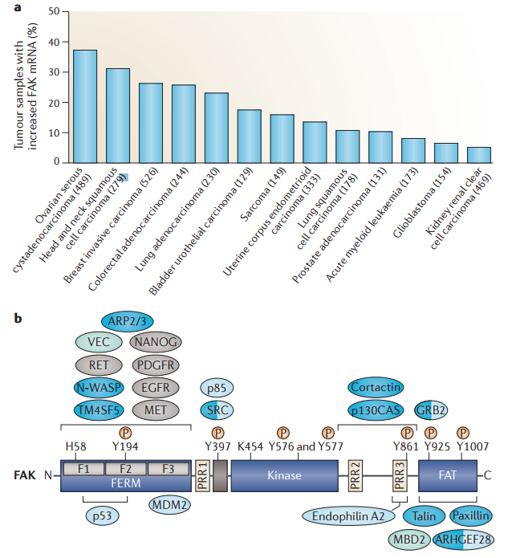
How Integrin Activation Relates to Cancer
Integrin activation is complex as we saw, and there are many pathways involved with the activation and engagement of integrins
FAK plays a role in numerous pathways and knocking out FAK results in increased apoptosis of cells
FAK overexpression is noted in a number of solid cancers
Sulzmaier et al. 2014. FAK in cancer: mechanistic findings and clinical applications
Mitra. 2006. Integrin-regulated FAK–Src signaling in normal and cancer cells

Slide 29
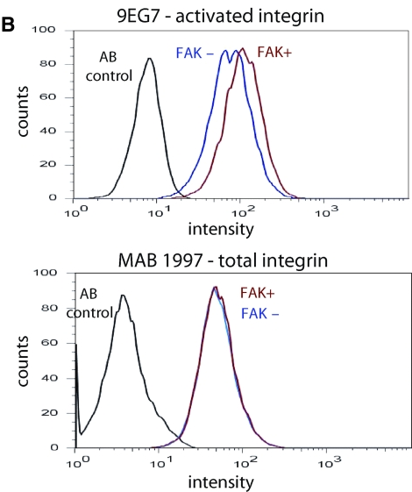
FAK Could Play a Role in Activation Though…
Using flow cytometry for integrin expression (1997) and activation (9EG7)
9EG7 is a conformation specific antibody
The issue with these studies is that they involved the cells binding to fibronectin, which could lead to confounding effects
Michael et al. 2009. Focal Adhesion Kinase Modulates Cell Adhesion Strengthening via Integrin Activation
Notes:
(B) Flow cytometry analyses for integrin expression (MAB1997) and activation (9EG7) at 15 min adhesion to fibronectin. Integrin α₅β₁ surface expression (MAB1997, AB1950) was equal for both FAK-expressing and FAK-null cells. In contrast, FAK-expressing cells had elevated expression of the 9EG7-dependent activated integrin epitope. Results were confirmed in six independent experiments.

Slide 30
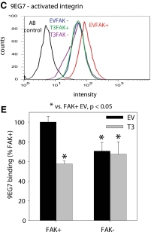
FAK Integrin Activation
FAK may play a role as evidenced by flow cytometry
EV = Empty vector
T3 = Talin shRNA
Demonstrates that talin is only effected by shRNA (A) and only talin, not vinculin (B), nor does it affect total integrin expression
The activation of integrins requires both FAK and Talin
Michael et al. 2009. Focal Adhesion Kinase Modulates Cell Adhesion Strengthening via Integrin Activation

Slide 31
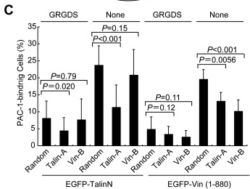
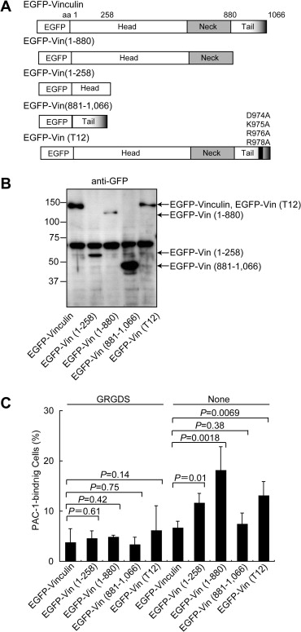
Other players?
It’s possible that vinculin plays a role in the activation of integrins as well
PAC-1 binding by the vinculin head domain was significantly abolished by the silencing of talin-1
This goes to demonstrate that there may be more parts involved
Ohimara et al 2010. Vinculin activates inside-out signaling of integrin alphaIIb beta3 in Chinese hamster ovary cells
Notes:
a constitutively active form of vinculin bearing
mutations that inhibit the head–tail association (EGFP-Vin (T
12)) (Fig. 3A) [3]. PAC-1 binding to CHO cells expressing native
aIIbb3 was significantly increased by the expression of EGFP-Vin
(1–880) but also EGFP-Vin (1–258) and EGFP-Vin (T 12), but was
not affected by the expression of EGFP-Vin (881–1066) (Fig. 3C).
The increase in PAC-1 binding elicited by EGFP-Vin (1–880) was
much higher than those elicited by EGFP-Vin (1–258) or EGFPVin
(T 12) (Fig. 3C). These data suggest that the activated form of
vinculin can increase the ligand-binding capacity of aIIbb3.

Slide 32
Conclusions

Slide 33
Open Questions
It’s quite difficult to determine the structure of many of these activation complexes, especially for “physiologically relevant” integrins in a more “natural” setting. How can this be done?
Do the x-ray and NMR studies sufficiently prove the structures?
There are limited studies that have been carried out on a handful of integrins and cell types, so expanding these are of interest.
Working out how cancer and drugs could work on this set of pathways is of interest.

