Slide 1
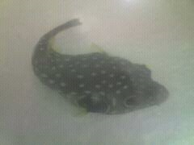
Tetrodotoxin Production in E. coli Using Pufferfish FLP Genes
Brett Fuller
Chase Meusel
Holly Tjaden

Slide 2
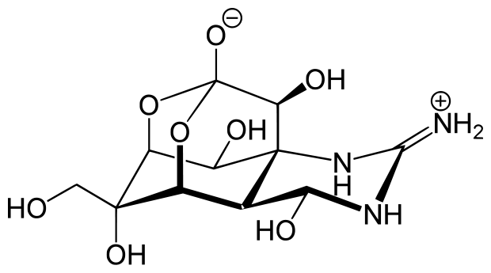
Tetrodotoxin
-A neurotoxin produced by many organisms in nature
-Causes paralysis in the victim
-100 times more poisonous than cyanide
-25 mg of toxin can kill an average adult male
-Most prevalent in the liver and other internal organs
-Seafood eaters find pufferfish a delicacy due to the dangers
Tetrodotoxin
Notes:
Such as:
newts, pufferfish, angelfish, toads, sea stars, etc.
Why?
blocks sodium gated ion channels between nerves, blocking action potentials

Slide 3
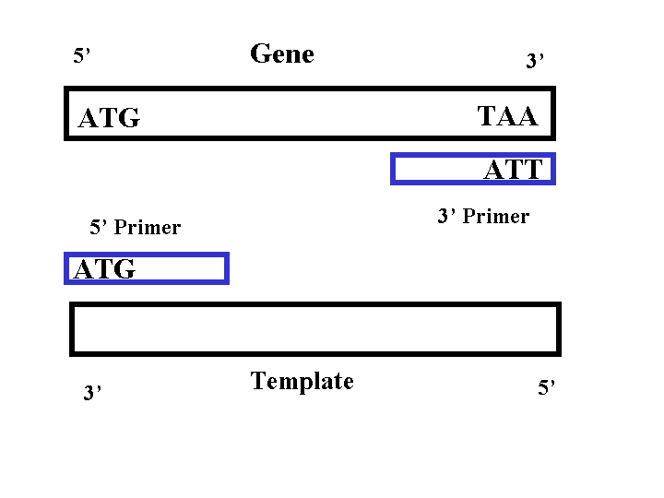
Project Goals
Primary
-To clone the FLP genes from a pufferfish into a plasmid with an indicator and insert it into E. coli.
Secondary
-Clone as many of the FLP genes as possible into plasmids and try each of them to see which ones (if any) coded for tetrodotoxin.

Slide 4
Methods
Isolate genomic DNA from pufferfish tail clipping
Amplify all possible DNA sequence from set of five primers using PCR
Modify PCR parameters to confirm identity
DNA ligation of PCR product into a T-Vector for sequencing
Transformation of T-Vector ligation in E. coli to increase plasmid count
Isolation of possible inducible promoters
Re-amplify sequence and insert into plasmid behind promoter
Isolate an indicator protein and insert into plasmid behind promoter
Test for presence of modified plasmid using UV radiation

Slide 5
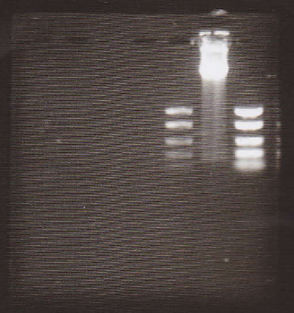
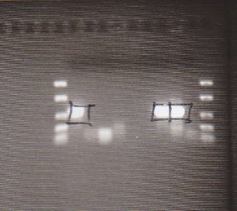
Results (what DID work)
Obtained genomic DNA from pufferfish
Obtained a sequence from FLP 2,3 F and FLP 3 R in the range expected
PICTURE
NNNNNNNNNNNNNGGGCGANTGGGCCCGACGTCGCATGCTCCCGGCCGCCATGGCGGCCGCGGGAATTCGATTGGG
AGTCTTTAGTGTTTATTAAAAAGGAGTCCATCAGTTAAAACAAAATACAATCAAAGCTCTTTCTTAGTCCATCTTTGTGCAGGA
GCACGGCGAGTCCCTACCACGGGTTACTCATTCTGCTCCCCCAAACATTTGATCTCTCGGGACACTGTCGTGGTGGCCAA
AGGAGATCCTCACCCTCTTGCTCCTTCCCACCGACCTCACCCGGAGAGCCAGGCCGCTGCTGCTTTGACCTTTTCTCGTG
TAGCTCCAGCTCCTTCGTCCGAATGGGCACAGAGGCGATTCTTCTTTGCAGCGGTGTCCTAGGGCCTGCCGCCTGCAGCT
GTGATTGCGTGAACCATTGCTGCGGCCATCCGGATCACCGCCACGGGGGGGATCTGCATGTGCCTTCTTACCAGCAAGTT
TCTGGAGGTCCATGTGGCGTCTTTGATGGCGGCAAGGGTGAGCCACTGCTTAGCAAAGTCACTCGCTCCATCTTCCAATC
ACTAGTGAATTCGCGGCCGCCTGCAGGTCGACCATATGGGAGAGCTCCCAACGCGTTGGATGCATAGCTTGAGTATTCTA
TAGTGTCACCTAAATAGCTTGGCGTAATCATGGTCATAGCTGTTTCCTGTGTGAAATTGTTATCCGCTCACAATTCCACA
CAACATACGAGCCGGAAGCATAAAGTGTAAAGCCTGGGGTGCCTAATGAGTGAGCTAACTCACATTAATTGCGTTGCGCT
CACTGCCCGCTTTCCAGTCGGGAAACCTGTCGTGCCAGCTGCATTAATGAATCGGCCAACGCGCGGGGAGAGGCGGTTTG
CGTATTGGGCGCTCTTCCGCTTCCTCGCTCACTGACTCGCTGCGCTCGGTCGTTCGGCTGCGGCGAGCGGTATCAGCTCA
CTCNAGGNGGTAATACGGTTATCCACAGAANCNGGGNATAACGCNGNAAAGAACATGTGAGCAAAAGGNCAGCAAAAGGC
CAGGANNGTAAAAAGGCCGCNTNGCTGGNGTTTTTCCNTNGGCTCCGCCCCCCTGACGANCATCACAAAATCGANGCTCA
ANNNNNNANGNNNNANNNCNNNNGNNTANNANNAANNCCNNNNTTNCCCNNNNNNNCNTCNNNNNNNTNNCNN
NNNCGNNCNNNNNNNNNCNNNNNCNNNCNNNNNNNCCNNNNNNNNNNCNNNNNN
Gel Pic
Notes:
Band was ~ 80ng/ul (Huge)
Standard is ~ 4 ng/ul
Bands at ~550 bp
cut the bands out of the gel and used them

Slide 6

Results (what DID NOT work)
Only obtained good samples of one primer pair amplification out of six
Never obtained BioBrick parts for indicator (mCherry)
Never got a chance to ligate the PCR product with the promoter
The AraC promoter never transformed from BioBrick isolation

Slide 7
Changing Goals
After we found out that only one sequence actually amplified, we had to focus on just that one sequence
Initial BioBrick indicator did not work, so we put that off until later
Could not use BioBrick extensions to our primers, so we could not use the BioBrick system to add our pieces in
Added in an inducible promoter after examining properties of the sequence
Final goal changed from producing tetrodotoxin in E. coli to just getting everything together due to time constraints

Slide 8
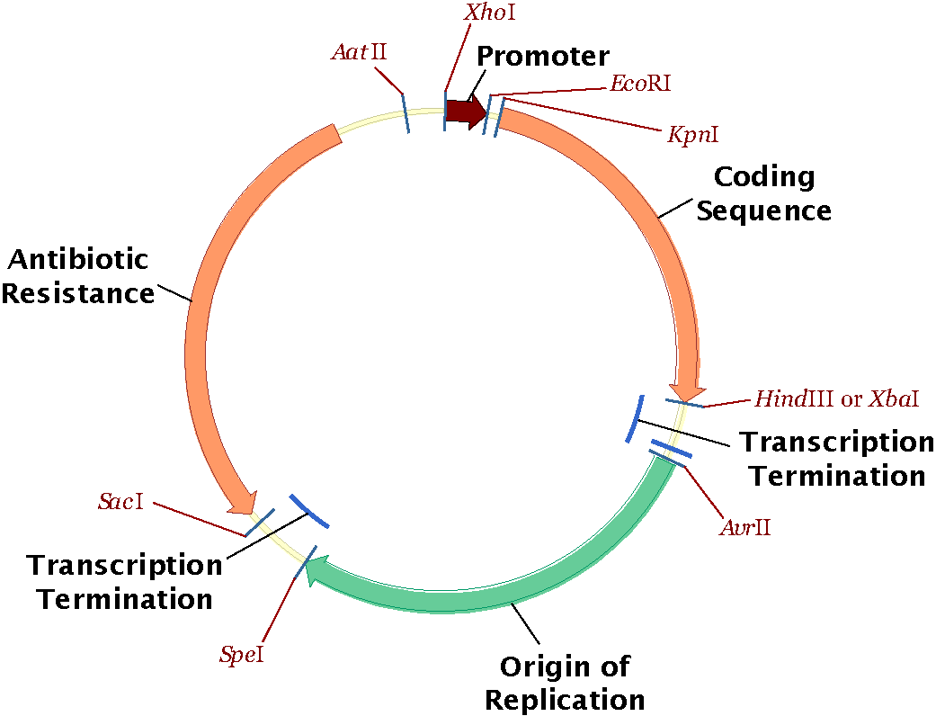
Conclusion
-Due to time constraints, we did not have a chance to really finish our project
-All of the materials needed to create the final product were ready
-Tests for the final product would have included an inducible promoter which would have been induced after the colonies grew up
-this would allow the bacteria to produce toxin before dying
-color indicator would show us that if the sequence was right, it would be producing toxin

Slide 9
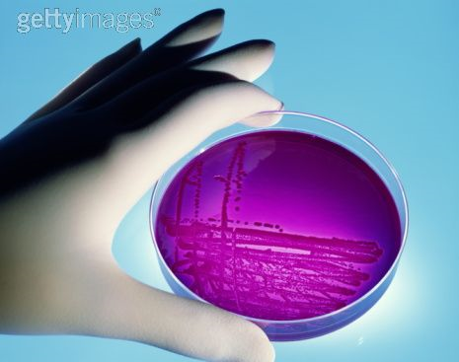
Future Research
-In order for future research to be done, a purer sequence would have to be isolated
-Successful ligations of the promoter plasmid (w/promoter) and the toxin sequence behind and a color indicator behind that would have to be accomplished
-Testing for whether it worked or not would involve introducing lactose into grown-up colonies and observing the results

Slide 10
Practical Applications
-An insect paralyzer
-Biological Warfare
-Culinary Science
-Medicinal Uses
Questions?

Slide 11
