Slide 1
Week 14 Assignment
Kara Dismuke

Slide 2
MATLAB Counter (fixed b)

Slide 3
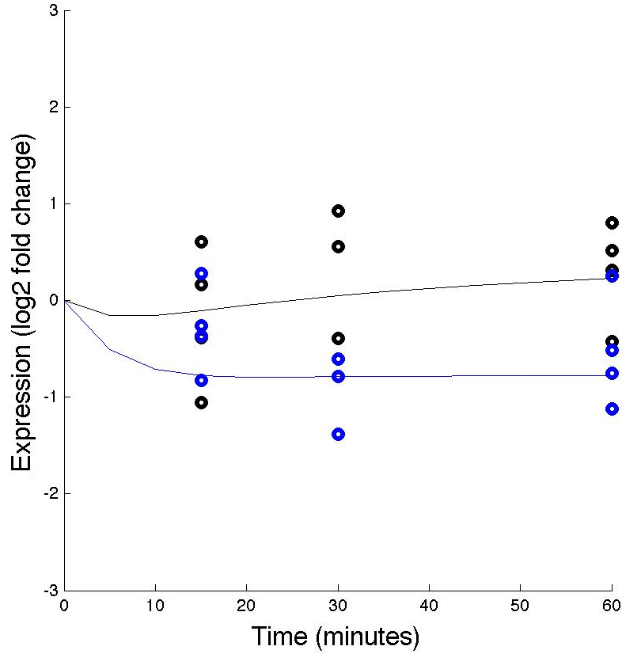
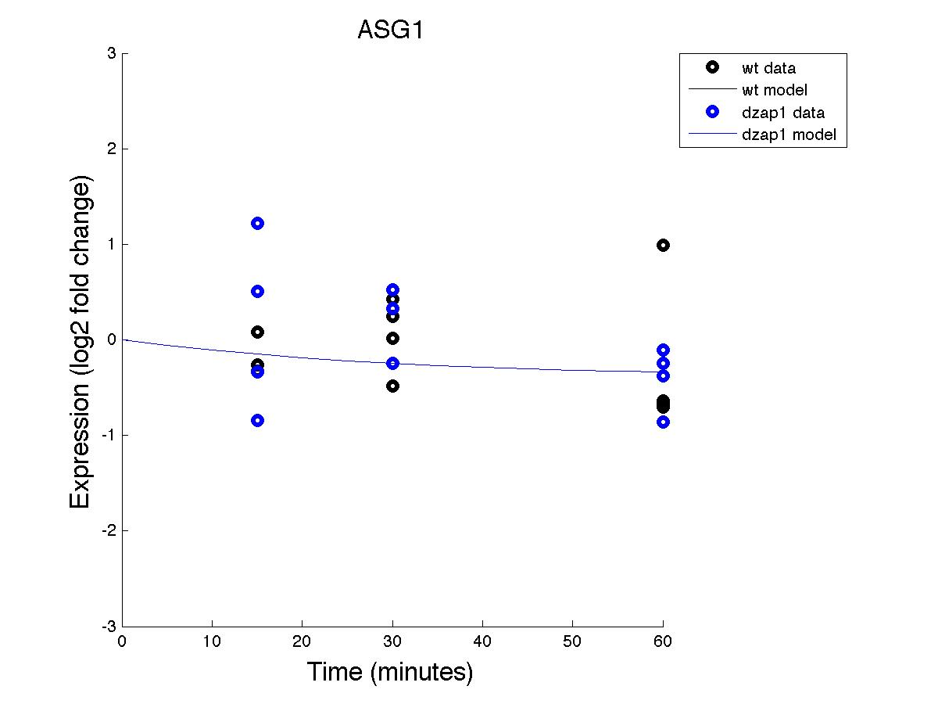
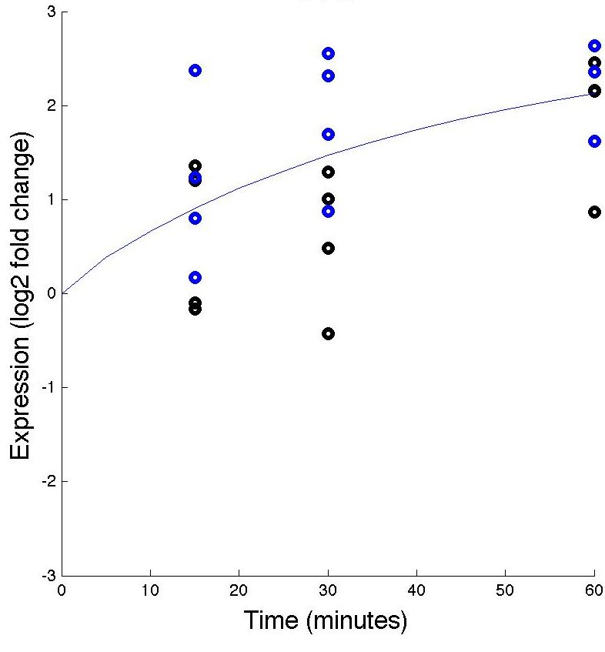
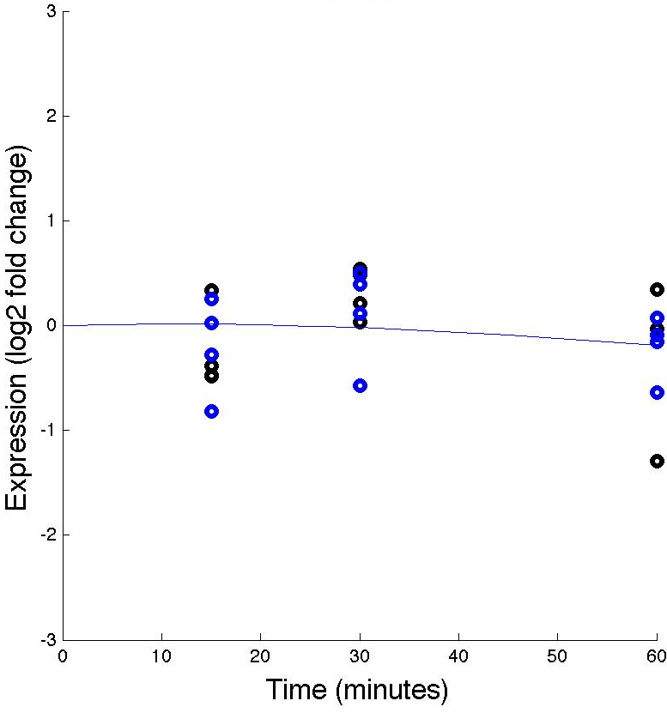
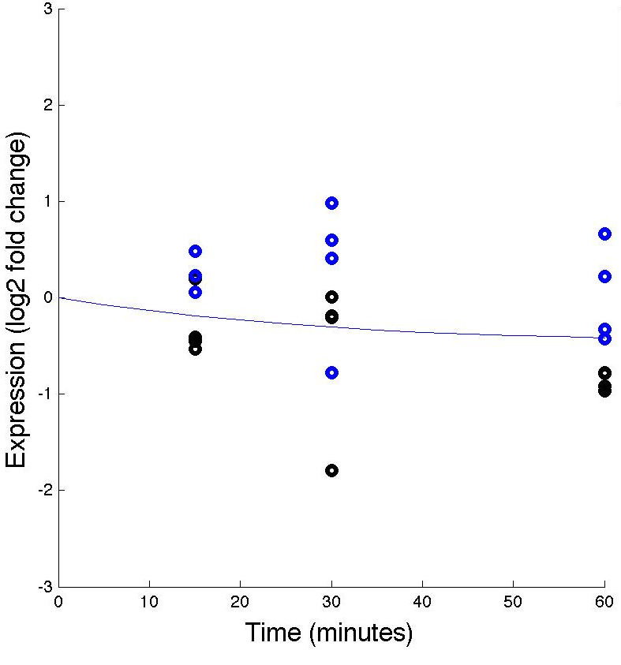
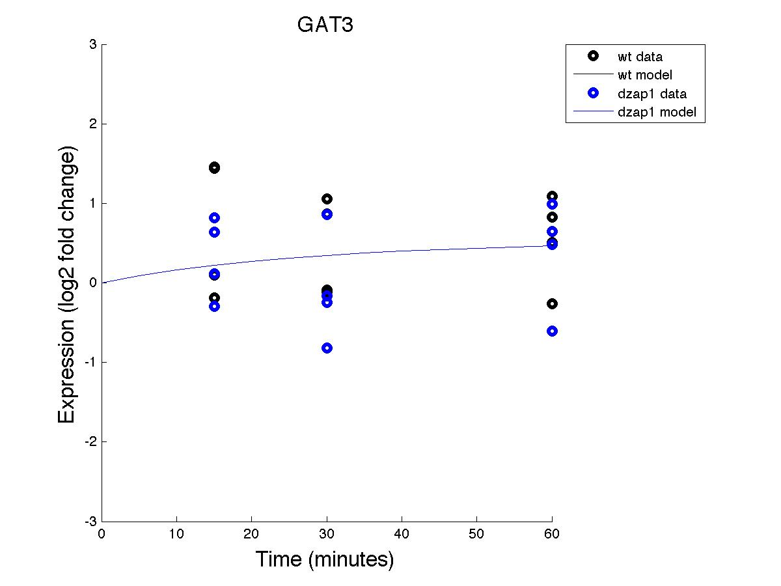
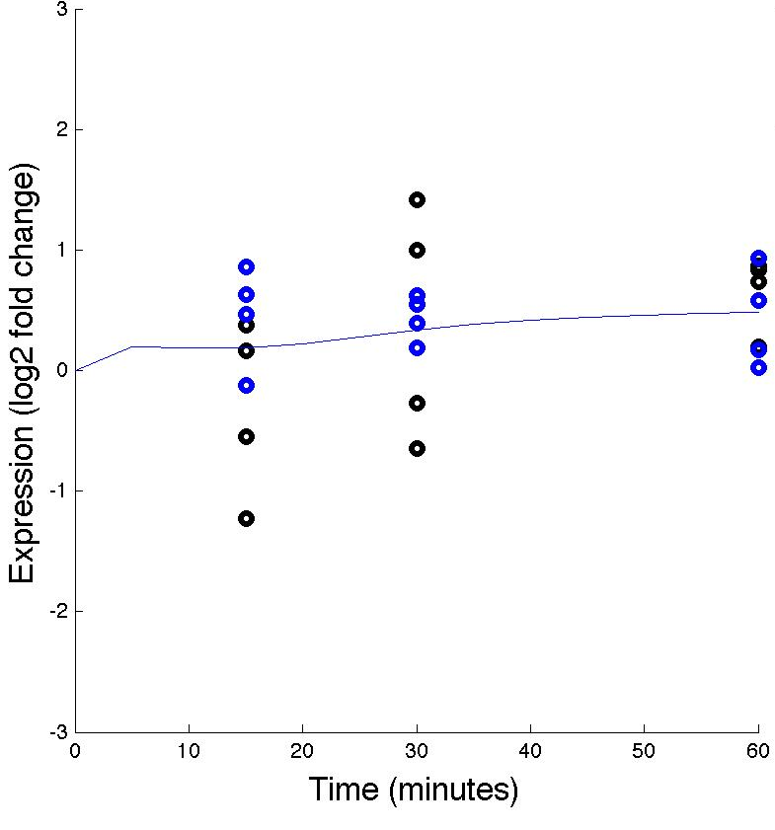
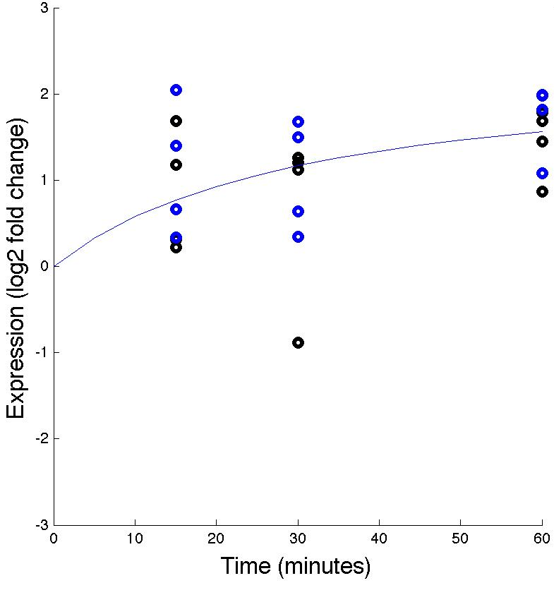
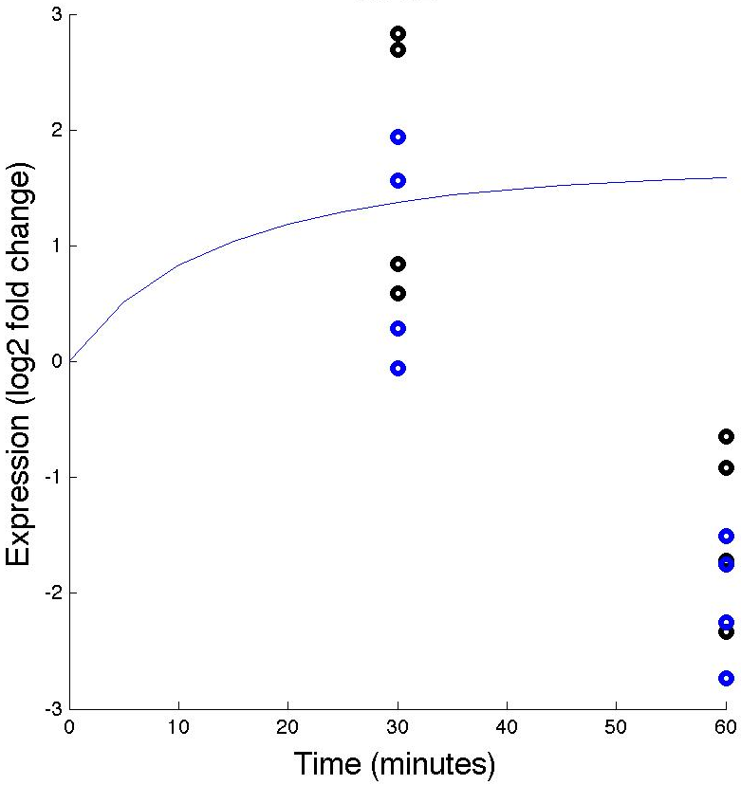
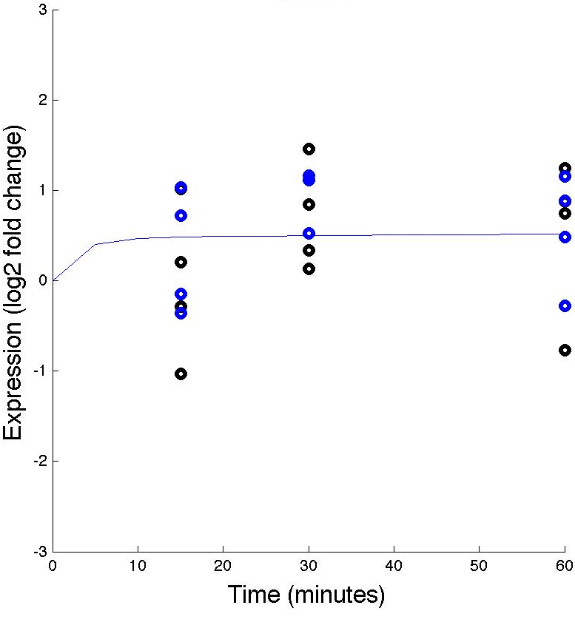
Effects of WT &dZAP1 on expressions of various genes (with fixed b)
ACE2
ASG1
CIN5
CYC8
FKH2
GAT3
GLN3
HMO1
MIG2
MSN2

Slide 4
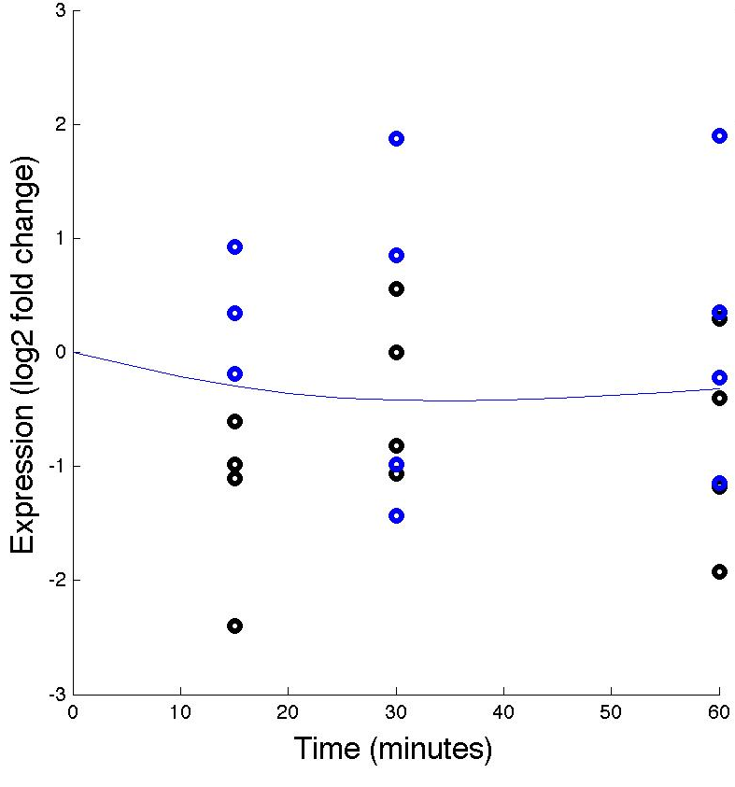
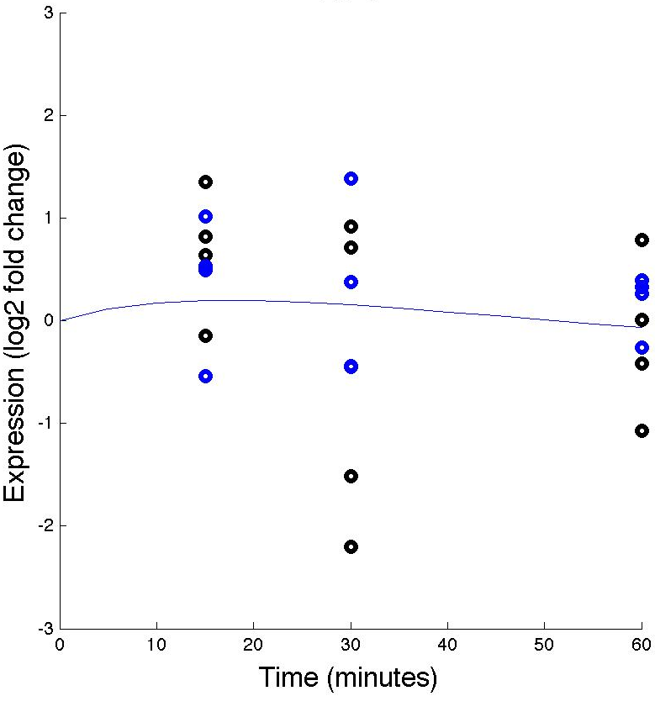
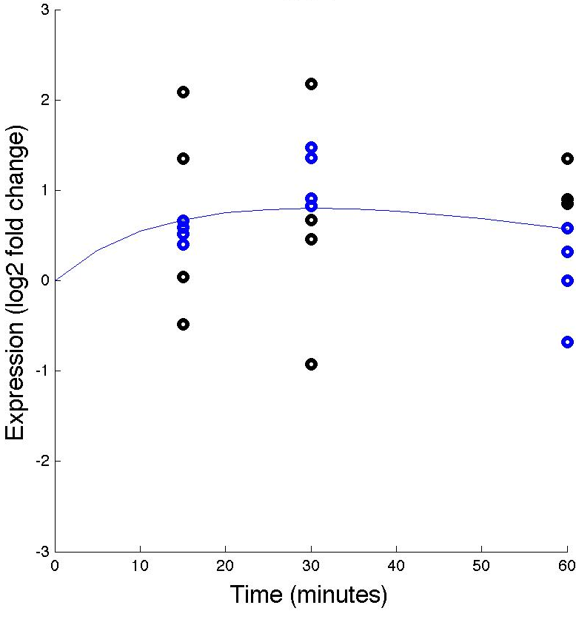
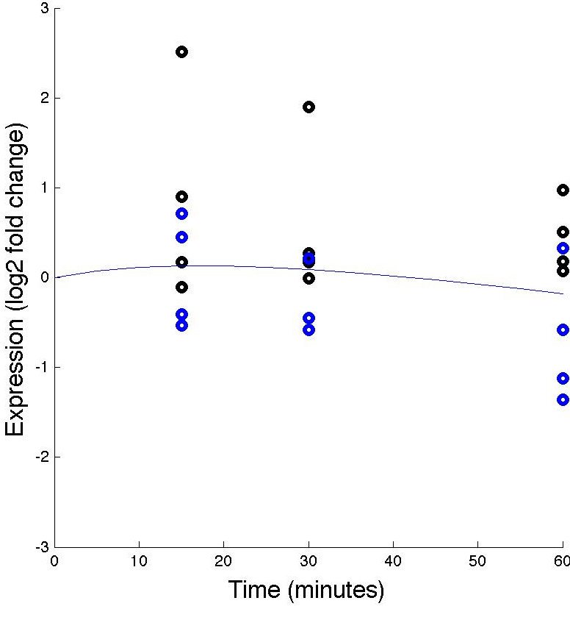
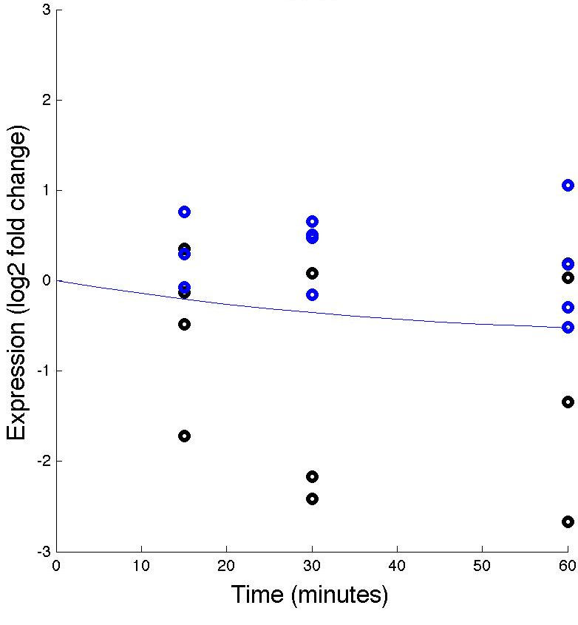
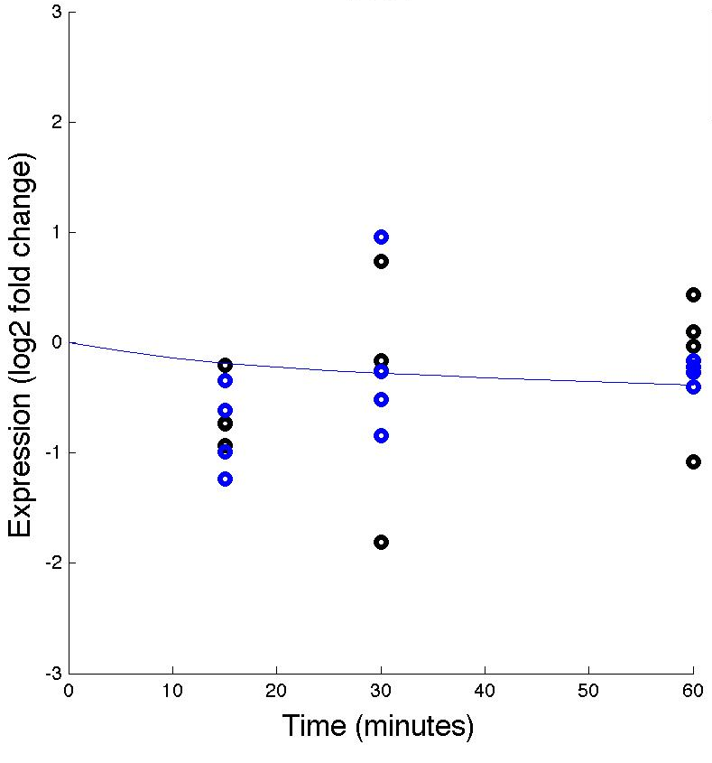
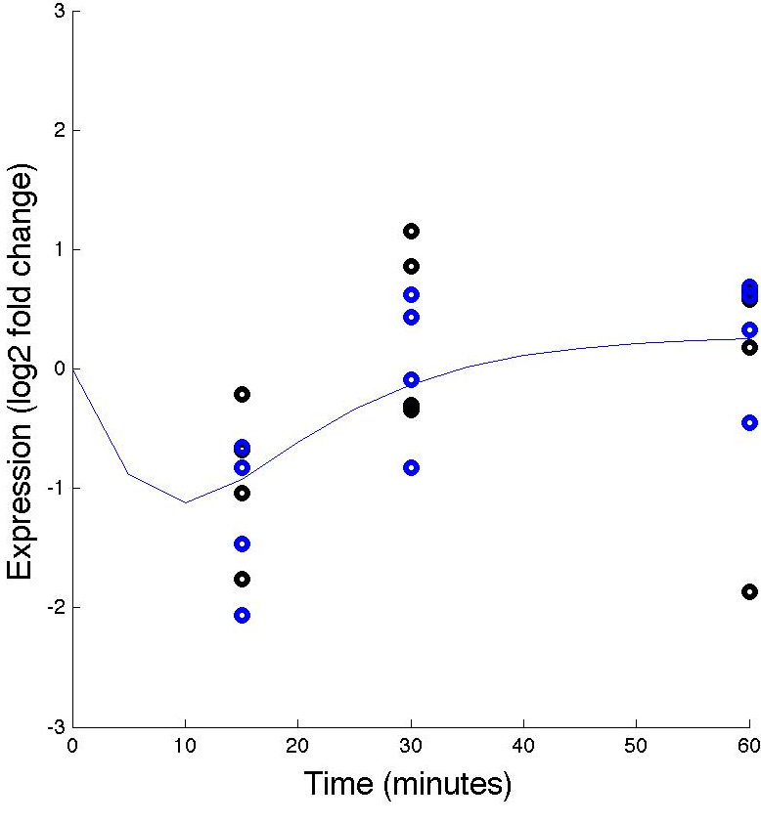
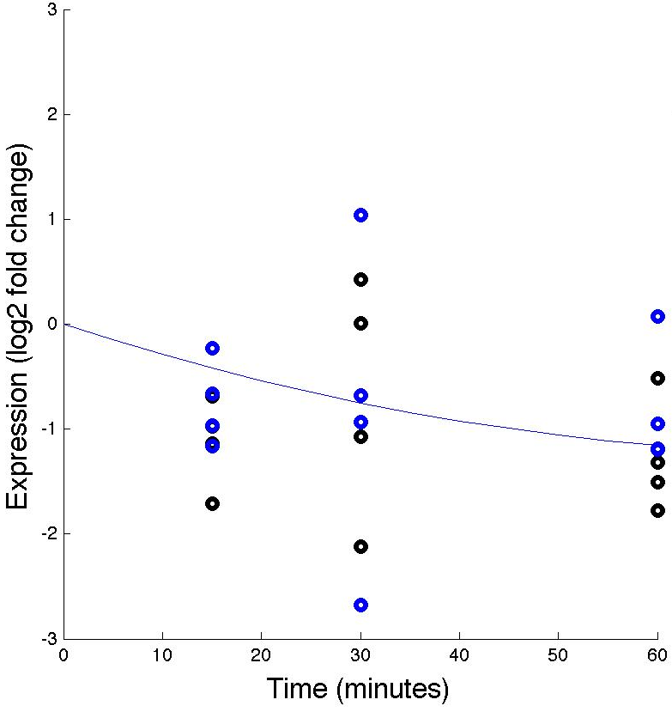
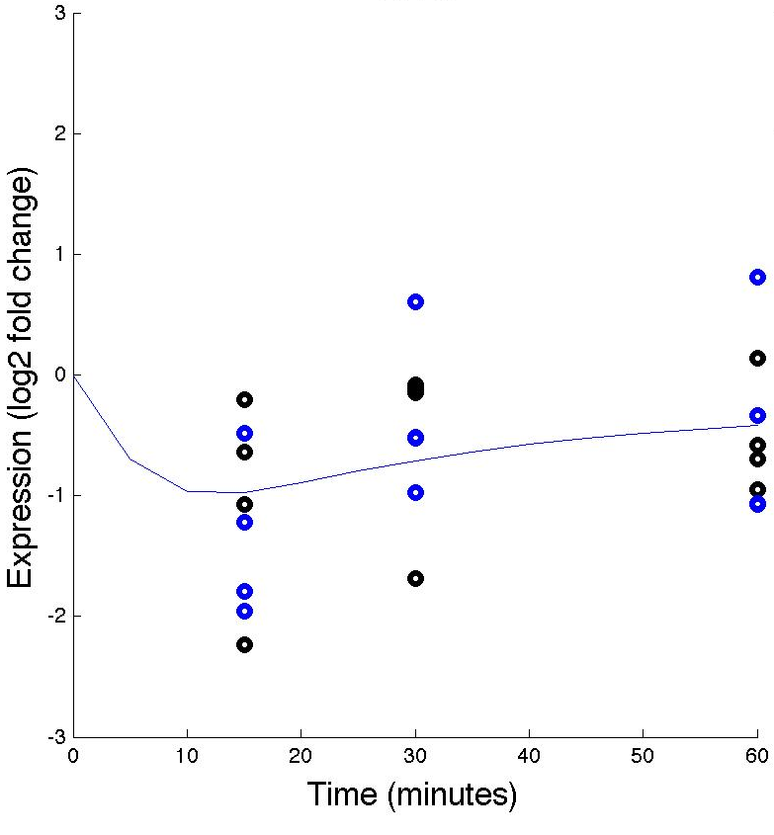
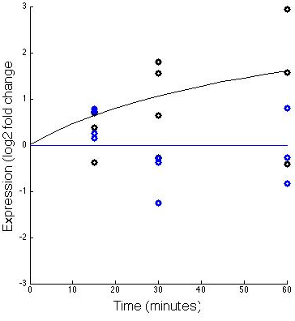
Effects of WT &dZAP1 on expressions of various genes (with fixed b)
PDR1
RIF1
SFP1
SNF6
STB5
SWI5
YHP1
YLR278C
YOX1
ZAP1

Slide 5
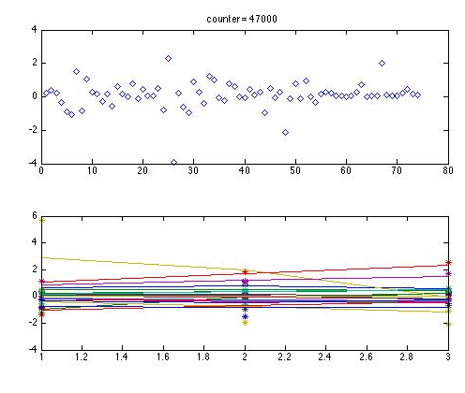
MATLAB Counter (estimated b)

Slide 6



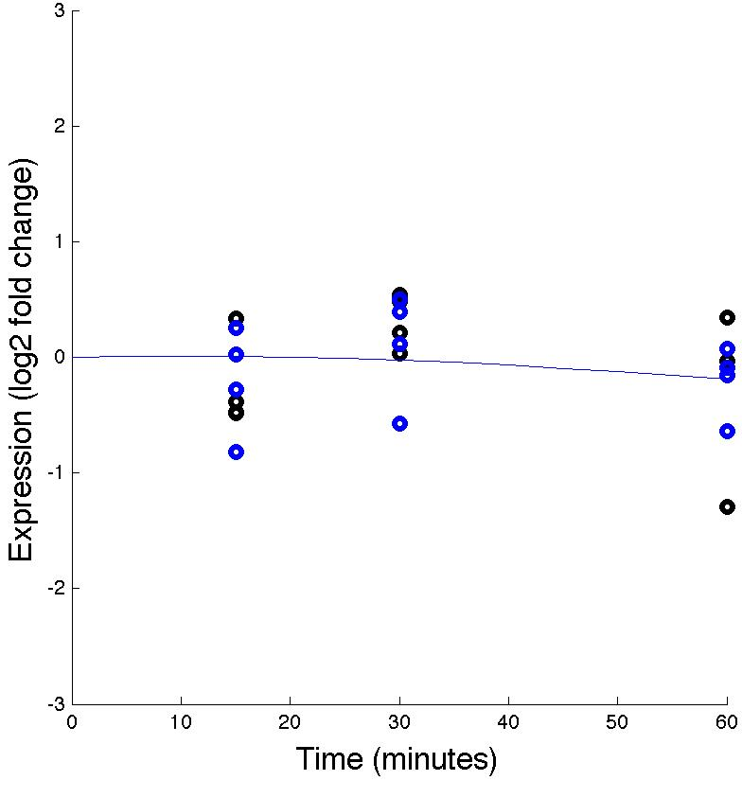


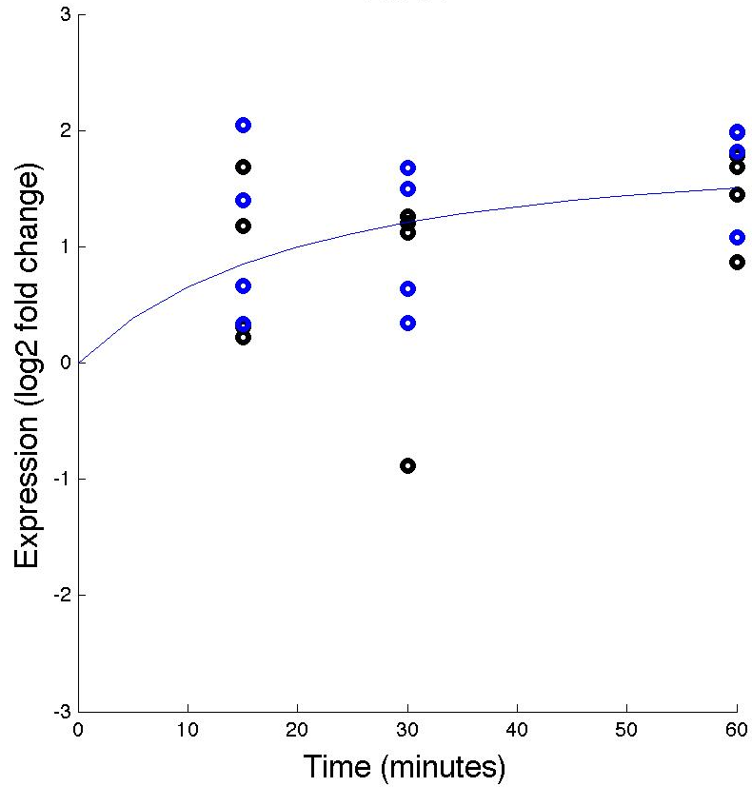
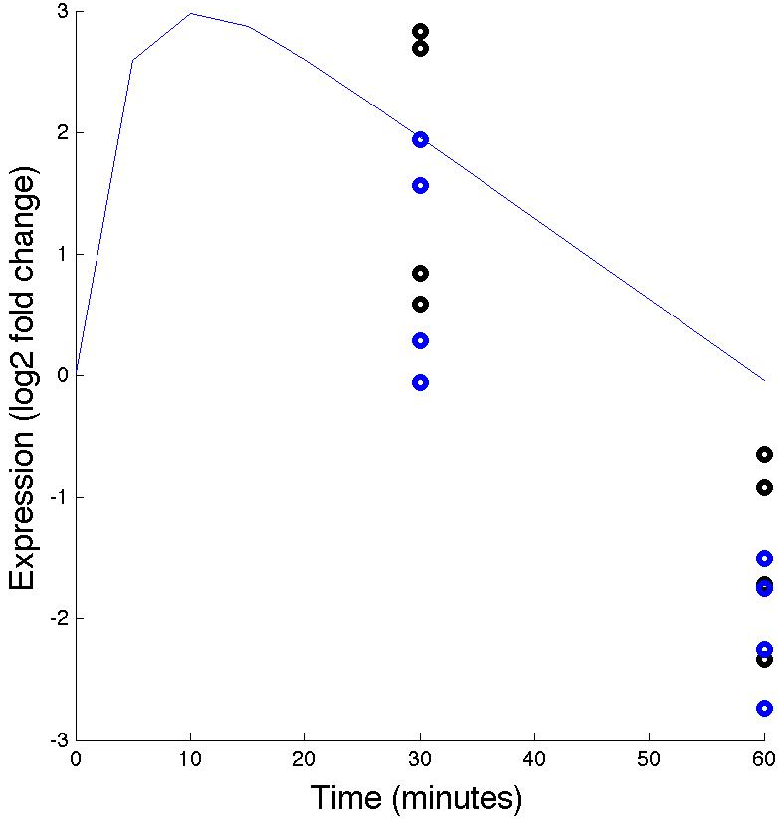
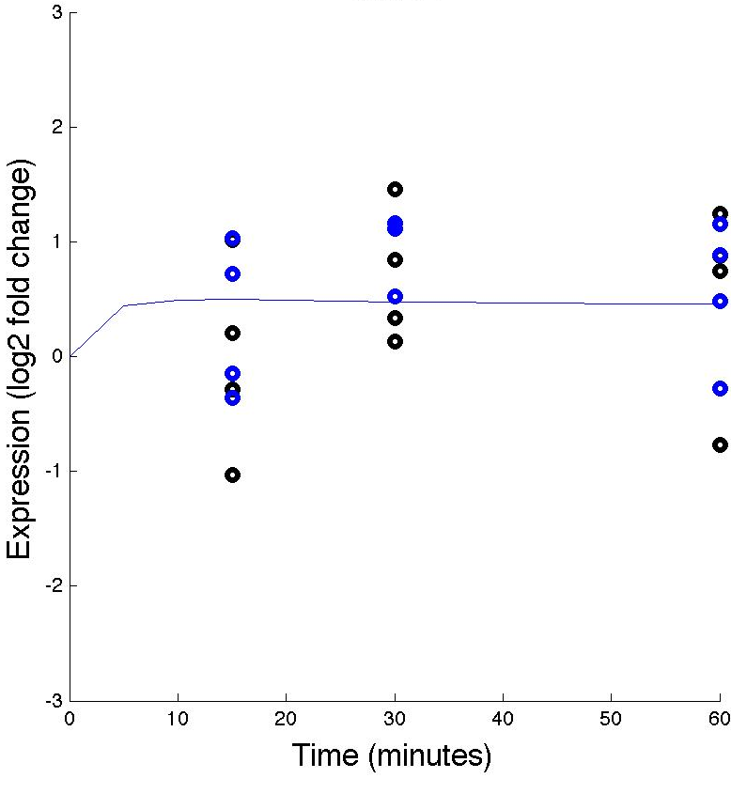
Effects of WT &dZAP1 on expressions of various genes (with estimated b)
ACE2
ASG1
CYC8
CIN5
FKH2
GAT3
GLN3
HMO1
MSN2
MIG2
Notes:
CHANGE

Slide 7
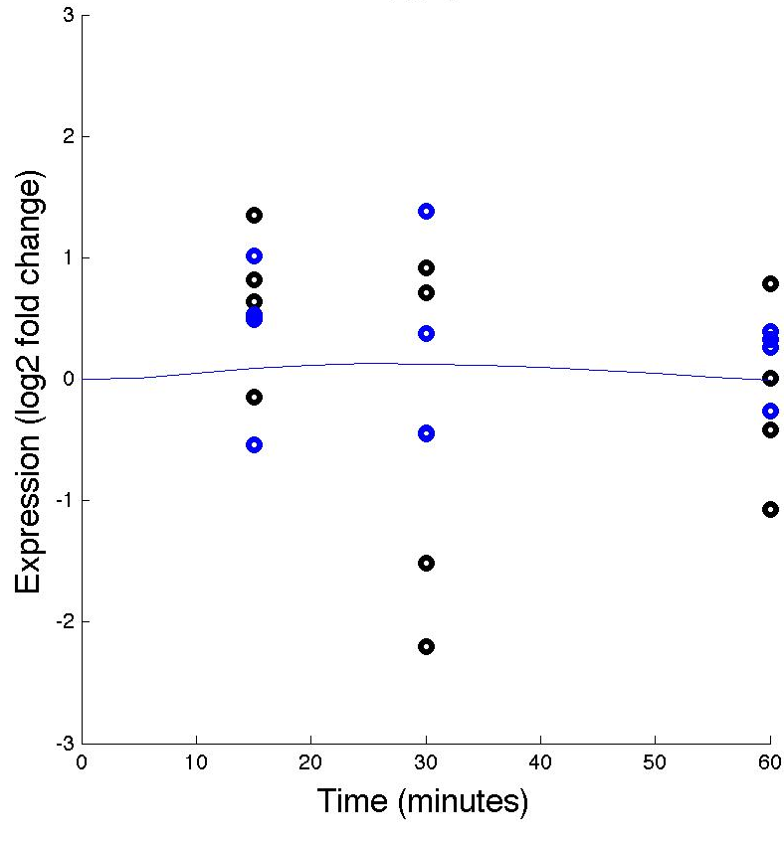
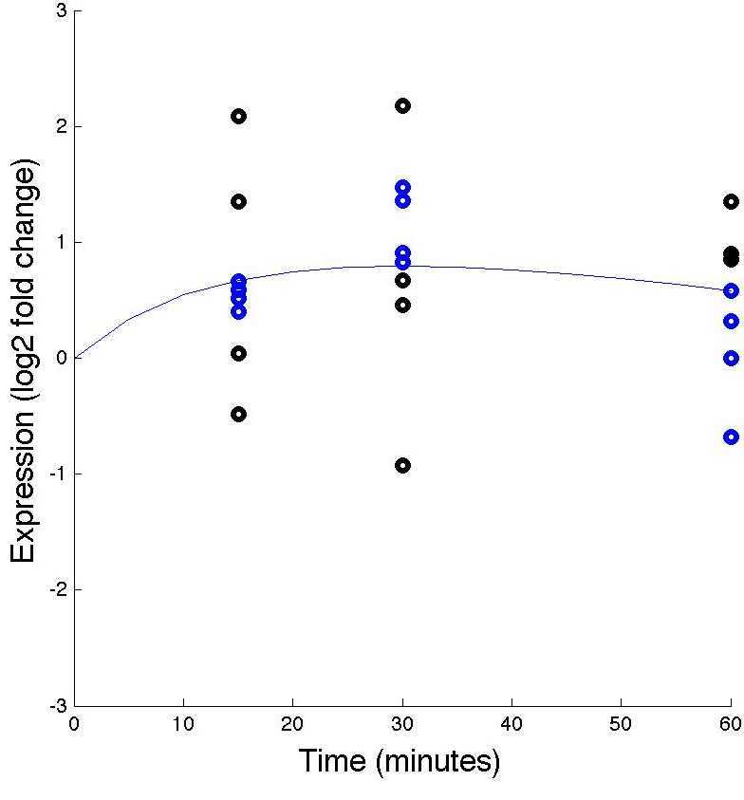


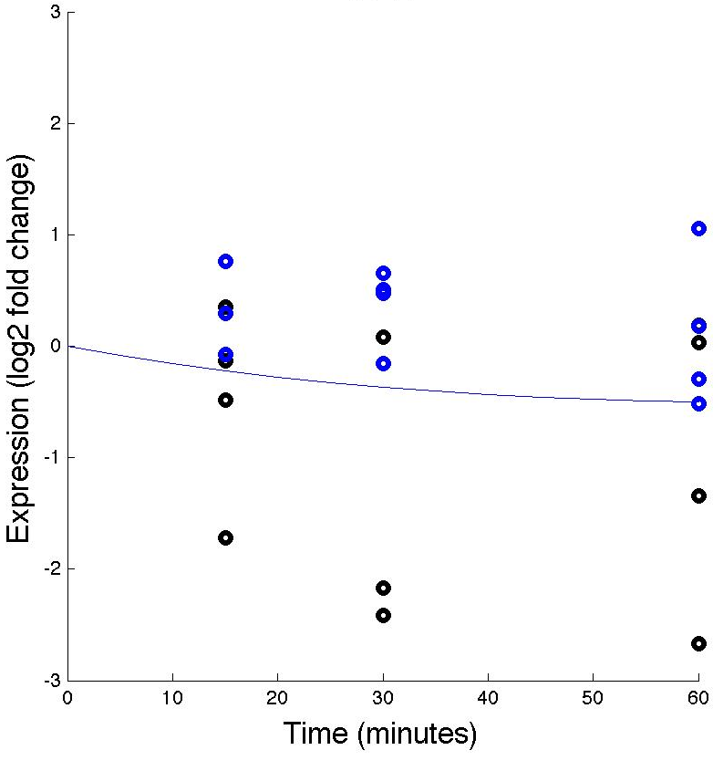
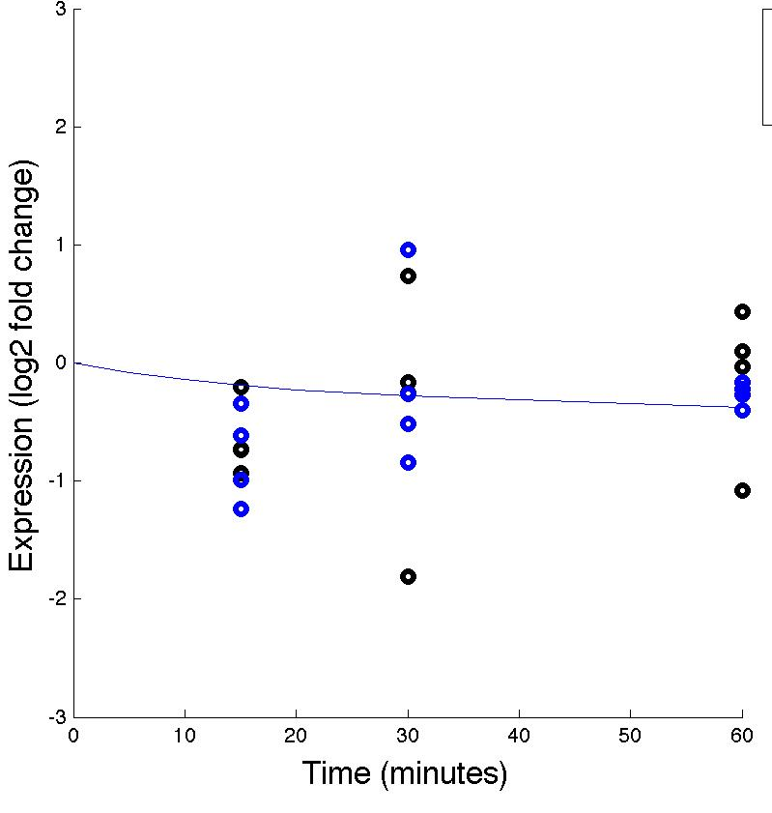




Effects of WT &dZAP1 on expressions of various genes (with estimated b)
PDR1
RIF1
SNF6
SFP1
STB5
SWI5
YHP1
YLR278C
YOX1
ZAP1
Notes:
CHANGE

Slide 10
GRNsight Generated Network (fixed b)
More descriptive title?

Slide 11
GRNsight Generated Network (estimated b)
More descriptive title?

