Slide 1
The Baccelerator
Overview of presentation:
Fast Response Module - > change of plans
Diagram of the Current System
Stimulant – Schistosoma
Display of Peptide
Signalling pathway
Output amplifying module

Slide 2
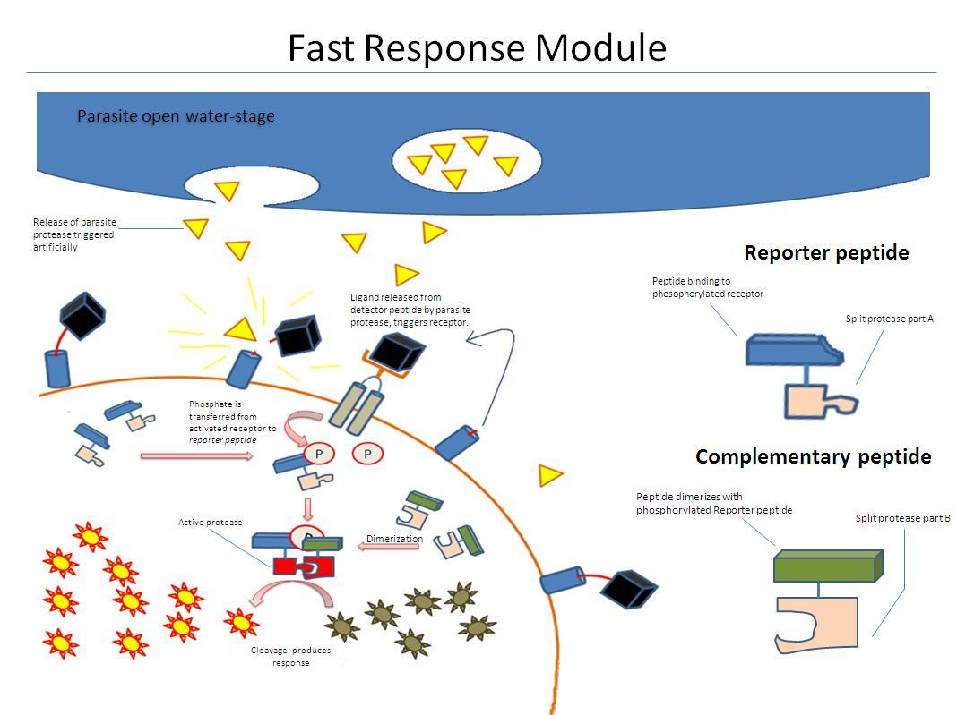

Slide 3
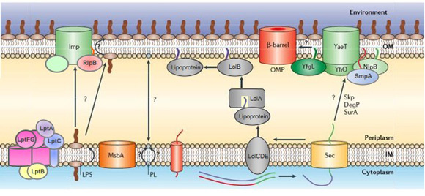
Chassis related problems
 | E. coli | B. subtilis
Protein presentation | + outer membrane + pilli | +/- → Ben
Protein detection | No membrane permeabillity +/- EnvZ modularity | + ComE → Harriet - Not well characterised

Slide 4
Fast Response Module (FRM) – original plan

Slide 5
FRM – phosphorylation
Multiple unknowns:
Phosphorylation equilibrium
Transient interaction
Location of dimerisation

Slide 6
FRM – split protein problems
Steric factors – flexible linkers and coiled coils
Strength of affinity for the halves of TEV
Loss of protease speed

Slide 7
The Baccelerator
Overview of presentation:
Fast Response Module - > change of plans
Diagram of the Current System
Stimulant – Schistosoma
Display of Peptide
Signalling pathway
Output amplifying module
Parts from registry

Slide 8
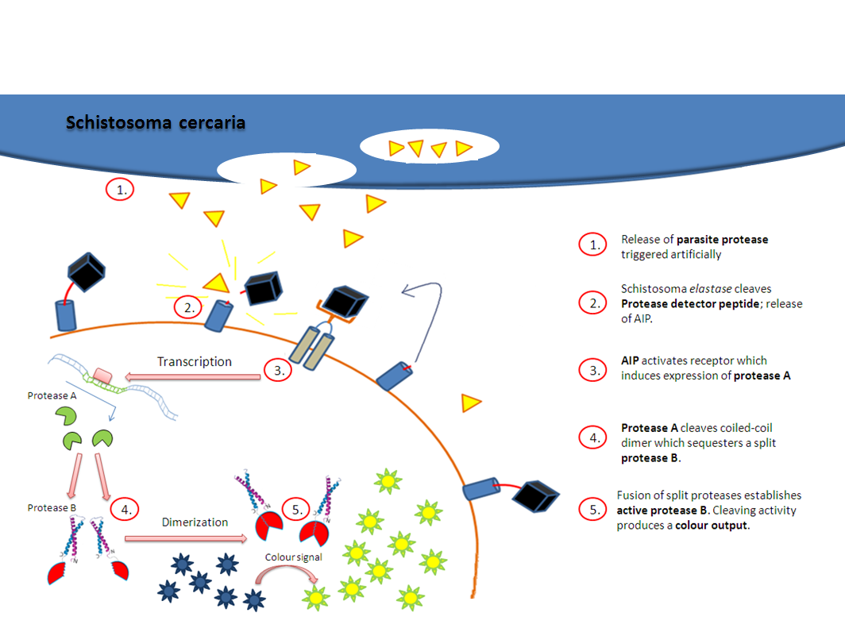
The Baccellarator

Slide 9
The Baccelerator
Overview of presentation:
Fast Response Module - > change of plans
Current Diagram of the System
Stimulant – Schistosoma
Display of Peptide
Signalling pathway
Output amplifying module
Parts from registry

Slide 10
Parasite detection
Infective stages often water-bourne
Use of proteases for skin penetration
Detection via:
  specific proteolytic cleavage of signaling molecules from surface of our organism and
  consequent signal activation
Major health care problem in many rural areas

Slide 11
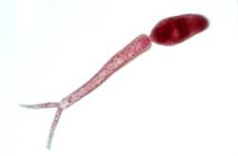
Schistosoma
Infective stage: water-bourne cecaria
Releases proteases in the presence of unsaturated C18 fatty acids:
  Oleic acid
  Linoleic acid
  Linolenic acid
Chemotaxis and activation of invasive behaviour tested in lab and field

Slide 12
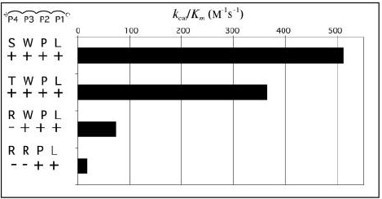
Proteases
Mostly Elastase
Well characterized and highly specific
Expressed by three schistosoma speices only:
  S. mansoni,
  S. haematobium
  S. douthitti
SWPL sequence is
cleaved most
efficiently

Slide 13
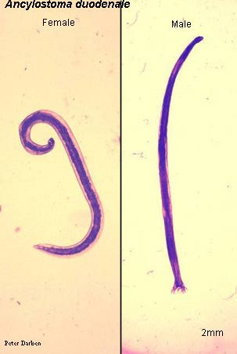
Hookworm
Nearly one billion people infected worldwide
Larval stage exist in sandy or loamy soil
Infection acquired when larval stage penetrates through skin
skin penetration is associated with the secretion of an array of bioactive molecules including proteases, immunomodulators and proteins

Slide 14
The Baccelerator
Overview of presentation:
Fast Response Module - > change of plans
Current Diagram of the System
Stimulant – Schistosoma
Display of Peptide
Signalling pathway
Output amplifying module
Parts from registry

Slide 15
Autoinducing Peptide
Secretion and Surface Display

Slide 16
Exported Protein Structure
Cleavage Site
N
C
AIP
Wall Binding

Slide 17
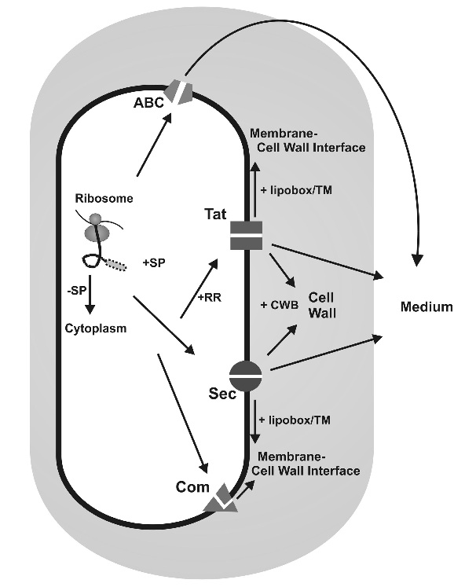
Secretion Mechanisms
4 varieties
N-terminus Signal Peptide
Removed during post-translocational modification
Sec and Tat are the main mechanisms
Must be in cell wall

Slide 18
Quality Control System
Enzymes present in Periplasm
Embedded in both the membrane and wall
Screen all proteins that are abnormal, or have folded or bound incorrectly
Hindrance to heterologous protein production
Tat pathway may bypass some of this
Further research needed

Slide 19
Cell Wall Binding Repeats
Based at C terminus
Repeated sequence
Affinity for components of the cell wall
Ionic attachment

Slide 20
Cell Wall Sorting Signal
Based at C terminus
LPxTG sequence + specialised tail
Sortase SrtA binds protein to cell wall
Covalent attachment
Present in S. Aureus
Similar mechanism possible in B. Subtilis

Slide 21
Potential Solutions
Secrete into the extracellular space
  Doesn't carry as much risk
  Far less efficient/sensitive
Develop synthetic surface protein
  Cell wall binding repeats + AIP
  Cell wall sorting signal
Attach to existing surface protein
  7 candidates at present
  All exported via Tat pathway

Slide 22
The Baccelerator
Overview of presentation:
Fast Response Module - > change of plans
Current Diagram of the System
Stimulant – Schistosoma
Display of Peptide
Signalling pathway
Output amplifying module
Parts from registry

Slide 26
The Baccelerator
Overview of presentation:
Fast Response Module - > change of plans
Current Diagram of the System
Stimulant – Schistosoma
Display of Peptide
Signalling pathway
Output amplifying module
Parts from registry

Slide 27
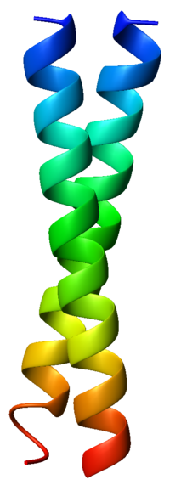



Split GFP
Split GFP
GFP
GFP
TEV recognition site
TEV

Slide 28


Speed

Slide 29
Kinetics of amplification?
Factors influencing the extent of amplification
TEV transcription rate
TEV rate of cleaving
Dimerised TEV just 40% efficient!
GFP and coiled coils being cleaved by both:
TEV_{100%}
TEV_{40%}

