Slide 1
Modeling the Gene Expression of Saccharomyces cerevisiae Δcin5 Under Cold Shock Conditions
Kevin McKay
Laura Terada
Department of Biology
Loyola Marymount University
May 9th, 2013

Slide 2
Outline
How does Saccharomyces cerevisiae Δcin5 change its gene expression under cold shock conditions?
Analyzing DNA microarray data.
Three models proposed to understand cold shock response in Δcin5:
  Sigmoidal with fixed b at 0
  Sigmoidal with fixed b at 1
  Michaelis-Menten with fixed b at 1
Do Profiles 2 and 45 from STEM clustering of the Δcin5 data match the three models?
  Profile 2 added transcription factors STE12, SOK2, RAP1, YAP5, and TEC1 to the given list.
  Profile 45 added transcription factors STE12, SOK2, RAP1, INO4, and ABF1.
CIN5 has a relationship with itself, HOT1, SMP1, PHD1, MSS11, and YAP6.
All five genes were compared between the model data and actual data.
Weights of gene expression showed discrepancies between models.
Suggesting future directions of the S. cerevisiae early cold shock response.

Slide 3
S. cerevisiae Responds to Cold Shock by Regulating Gene Expression
Optimum range for growth is 25-35°C.
This study uses a cold shock temperature of 13°C.
Low temperatures can reduce enzyme kinetics and membrane fluidity, while also affecting other cellular processes such as ribosome biogenesis proteins (Tai et al., 2007).
Early cold shock is from 15 to 120 minutes.
Discrepancies between prior studies show the need for further research on the S. cerevisiae early cold shock response.
CIN5 regulates PHD1, MSS11, SMP1, YAP6, and HOT1.
Deleting CIN5 from S. cerevisiae during cold shock is expected to change the activity of its target genes.

Slide 4
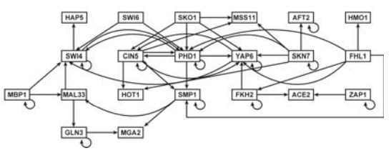
CIN5 Involved in the Cold Shock Response
Each node is a gene encoding a transcription factor.
Edges represent a regulation relationship between the two genes involved (either activation or repression).
CIN5 has a relationship with itself, HOT1, SMP1, PHD1, MSS11, and YAP6.

Slide 5
Analyzing DNA Microarray Data From the Dahlquist Lab
Δcin5 yeast cells were grown and harvested at 15m, 30m, 60m, 90m, and 120m (n=4 for each).
Cold shock was up to t60 at 13°C.
Recovery was at 30°C from t60 to t120.
DNA microarrays were performed on each sample.
Spots were identified and assigned, and red/green ratios were calculated.
Ratios were log₂ transformed and normalized using Excel.
T-tests and p values were determined through Excel to test for significant changes in gene expression.
Hierarchical clustering performed through STEM software.
Profiles 2 and 45 were selected for further analysis.
Gene regulatory networks of transcription factors were made for each profile using YEASTRACT.
  Profile 2 added transcription factors STE12, SOK2, RAP1, YAP5, and TEC1 to the given list.
  Profile 45 added transcription factors STE12, SOK2, RAP1, INO4, and ABF1.
Nonlinear differential equations were used to analyze the strength of connections between transcription factor-encoding genes in Δcin5 under cold shock from Vu and Vorhadsky, 2007.
The Michaelis-Menten equation was also used.

Slide 6
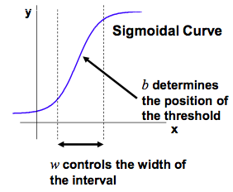

Sigmoidal Functions From Vu and Vorhadsky, 2007, for Two Proposed Models
The equation models the influence on expression of a gene by its transcription factors, or rate of expression of gene HMO1 (in this case).
The rate of expression of the target gene is a combination of activating or regulating transcription factors (P over the exponential function) and degradation of mRNA (D)*HMO1
Setting fixed b = 0 allows the model to estimate “b”
Setting fixed b = 1 forces “b” to be an initial value (0)
In this example equation, the only transcription factor regulating HMO1 is FHL1, but the equation can account for multiple transcription factors with a summation in place of FHL1.
Variable | Meaning
b | the threshold at which expression of the gene goes from off to on
w | the weight of the gene controlling the target gene

Slide 7
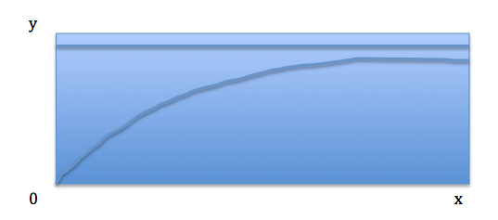
Using the Michaelis-Mentin Equation for the Third Proposed Model
dx_{i}/dt = P_{i}∑(|w_{ij}|x_{j}/(1+w_{ij}x_{j}))(w_{ij}/∑|w_{ij}|)I_{i} -λ_{i}x_{i}
Gives change in expression of gene “i” over time.
Accounts for multiple transcription factors acting upon gene “i” as well as degradation rate (λ).
No “b” because the graph intercepts the y axis at “0”
“I_{i}” is included so we can distinguish between repression and degradation
If regulation by transcription factor “j” is activating, then I = 1, if regulation by transcription factor j is repressing, then I = 0, which gets rid of the regulatory part of the equation and only allows for modeling of degradation (and activation)

Slide 8
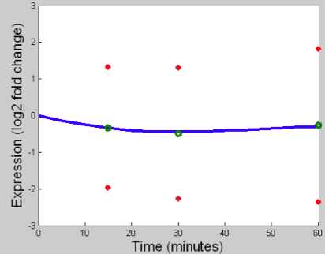
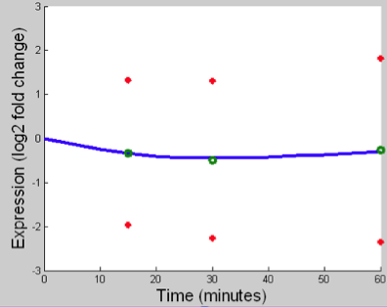
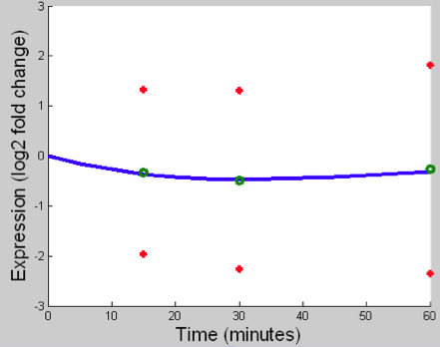
Comparing Model Data to Actual Data For PHD1
PHD1
PHD1
PHD1
Top (Laura) and bottom (Kevin) left to right: Sigmoidal Fixed b=1, Sigmoidal Fixed b=0, Michaelis-Menten
PHD1 is down regulated over time during cold shock
All of the models fit the data well
Laura’s network looked to fit a little bit more precisely, especially for the Michaelis-Menten plot

Slide 9
PHD1 is Slightly Down Regulated
Laura’s Sigmoidal weight data shows that PHD1 is down regulated by SKO1 and SWI4
Laura’s Michaelis-Menten weight data is not consistent with the gene expression plots
Kevin’s Sigmoidal weight data shows that PHD1 is down regulated by FHL1 and PHD1
Kevin’s Michaelis-Menten weight data could be consistent as activators and repressors seem to balance out, which is consistent with the plot

Slide 10
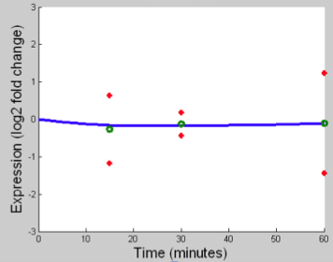
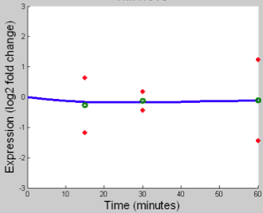
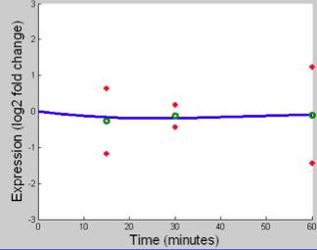
Comparing Model Data to Actual Data For MSS11
MSS11
MSS11
MSS11
Top (Laura) and bottom (Kevin) left to right: Sigmoidal Fixed b=1, Sigmoidal Fixed b=0, Michaelis-Menten
MSS11 showed constant 0 expression change
The model fit pretty well with the data deviating partially at time 15 minutes

Slide 11
MSS11 Repressed by SKO1, TEC1, and STE12
The Sigmoidal weight data shows down regulation of MSS11 by SKO1, TEC1, and STE12
Expression plots show little or no change in regulation

Slide 12
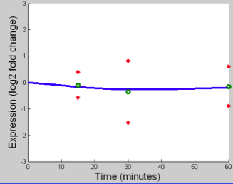
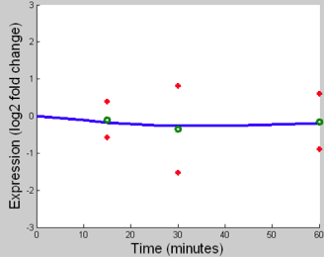
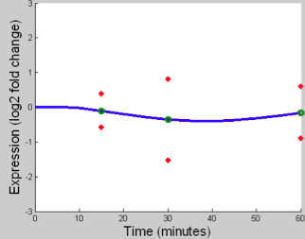
Comparing Model Data to Actual Data For YAP6
YAP6
YAP6
YAP6
Top (Laura) and bottom (Kevin) left to right: Sigmoidal Fixed b=1, Sigmoidal Fixed b=0, Michaelis-Menten
YAP6 showed an overall slight decrease in expression
The Michaelis-Menten plots fit the data most precisely

Slide 13
YAP6 is Primarily Down Regulated by FKH2, SKO1, STE12, and PHD1
Sigmoidal weight data corresponds to the expression plots for both Kevin and Laura’s models
Michaelis-Menten model weights do not fit expression plots

Slide 14
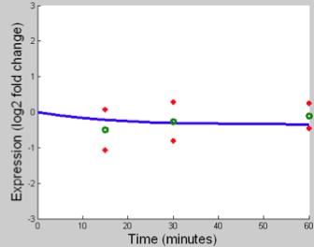
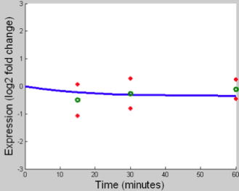
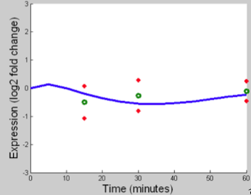
Comparing Model Data to Actual Data For SMP1
SMP1
SMP1
SMP1
Top (Laura) and bottom (Kevin) left to right: Sigmoidal Fixed b=1, Sigmoidal Fixed b=0, Michaelis-Menten
SMP1 model data showed overall down regulation
The actual data however, suggests a slight up regulation so our models did not fit perfectly

Slide 15
SMP1 Models Show Weight Differences
Laura’s Sigmoidal weight data shows that FHL1 down regulates SMP1
Kevin’s Sigmoidal weight data shows that FHL1 up regulates SMP1
Differences in gene regulatory network might account for weight changes for SMP1

Slide 16
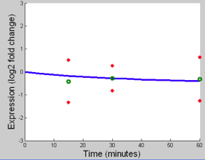
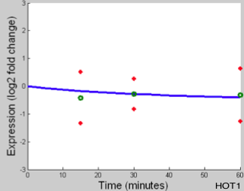
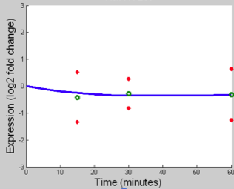
Comparing Model Data to Actual Data For HOT1
HOT1
HOT1
HOT1
Top (Laura) and bottom (Kevin) left to right: Sigmoidal Fixed b=1, Sigmoidal Fixed b=0, Michaelis-Menten
HOT1 showed down regulation in our models
The data suggested initial down regulation and then steady expression values at 0

Slide 17
HOT1 Down Regulated by SKN7
SKN7 possibly down regulates HOT1 at 15m
Laura’s Michaelis-Menten Model shows SKN7 as an activator of HOT1

Slide 18
Summary
Sigmoidal weight data better explained the gene expression plots for HOT1, MSS11, PHD1, SMP1, and YAP6.
YAP6 gene expression had the closest fit between the model data and actual data because the transcription factors chosen for our networks could be correct with respect to YAP6 regulation.
Michaelis-Menten weight data seemed less consistent with the gene expression plots.
Differences in gene regulatory networks resulted in different model weight data and gene expression plots.
These models give us a way by which to interpret the DNA microarray data.
Our gene regulatory networks give us a starting point to understand the entire regulatory network of all transcription factors.
For the five genes we analyzed in depth, actual data for SMP1 showed up regulation during cold shock, although our models did not match.
Therefore, SMP1 might regulate the cold shock response.

Slide 19
Future Research
Adding more transcription factors to our networks
Using a linear differential equation model
Deleting different genes other than CIN5
Looking at closer time points (i.e. performing microarrays at shorter time intervals)

Slide 20
Acknowledgements
Dr. Dahlquist
Department of Biology
Loyola Marymount University
Dr. Fitzpatrick
Department of Mathematics
Loyola Marymount University

Slide 21
References
Tai et al. (2007) Molecular Biology of the Cell 18: 5100-5112.
Dahlquist (2013) Biology 388 PowerPoint Presentation.

