Slide 1

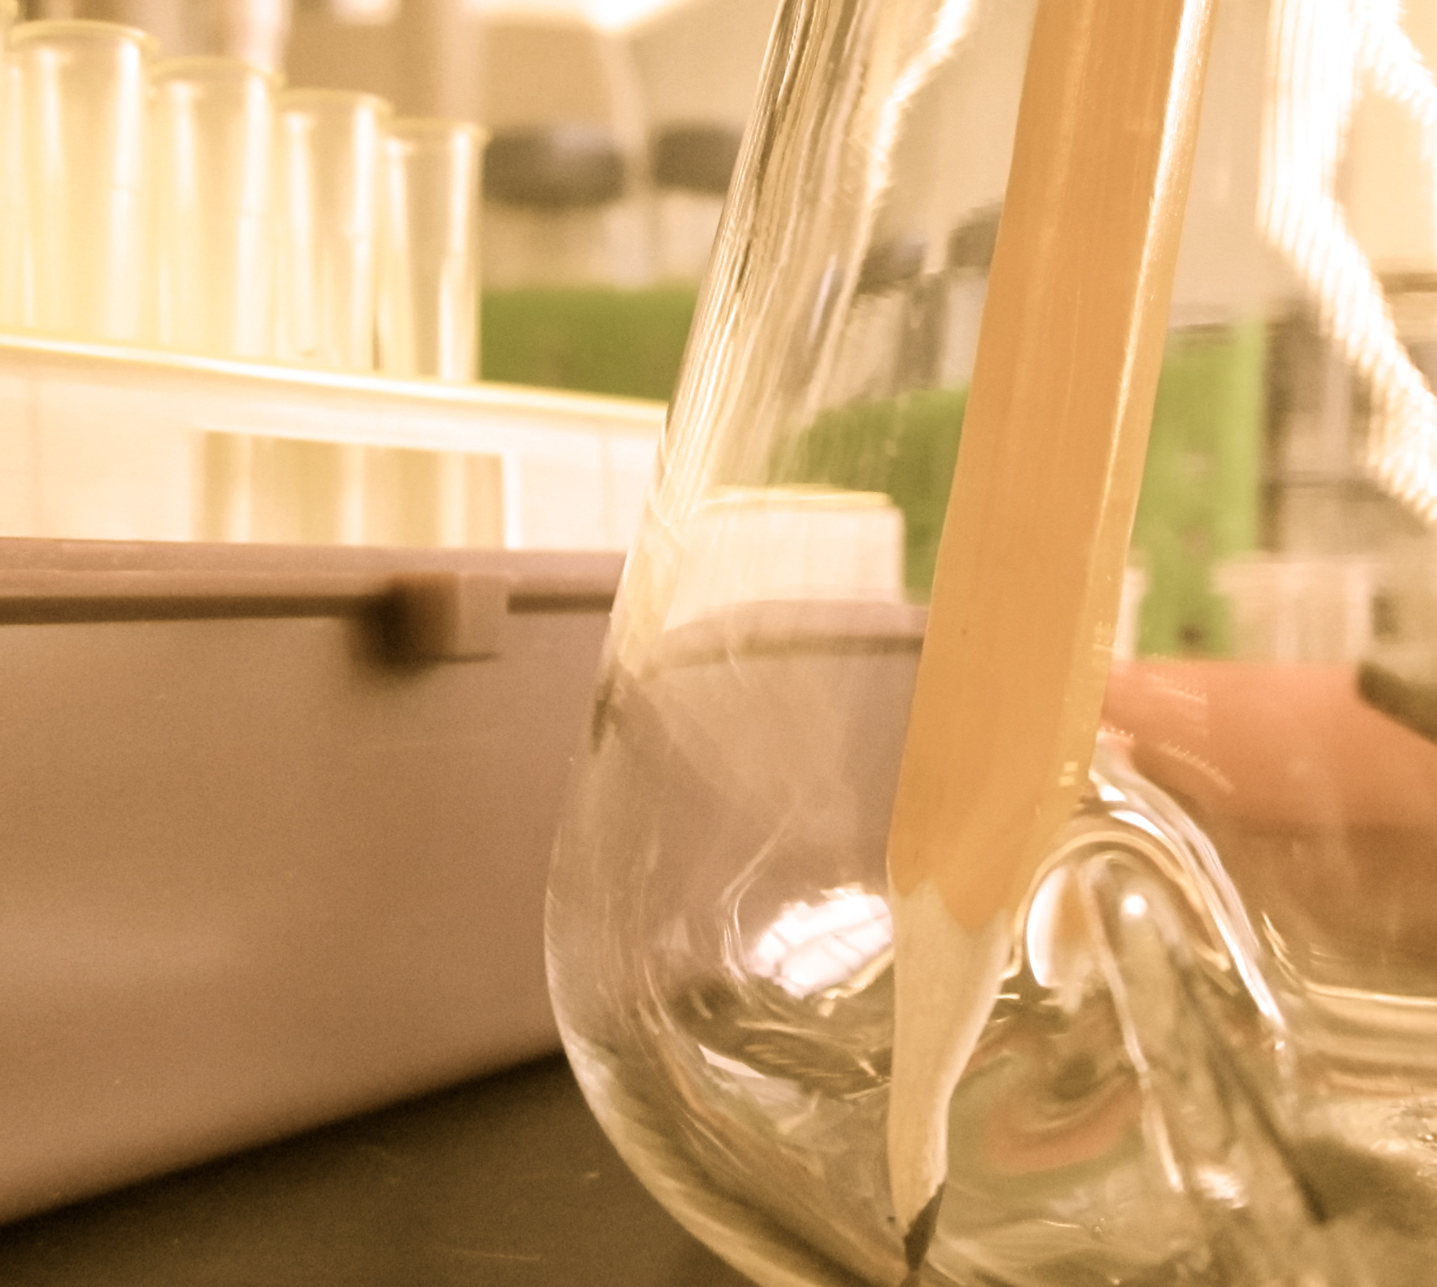
TA TRAINING: FALL 2015
Diana Chien, BE Communication Lab Coordinator/Instructor
Helping you communicate effectively.
be.mit.edu/communicationlab

Slide 2
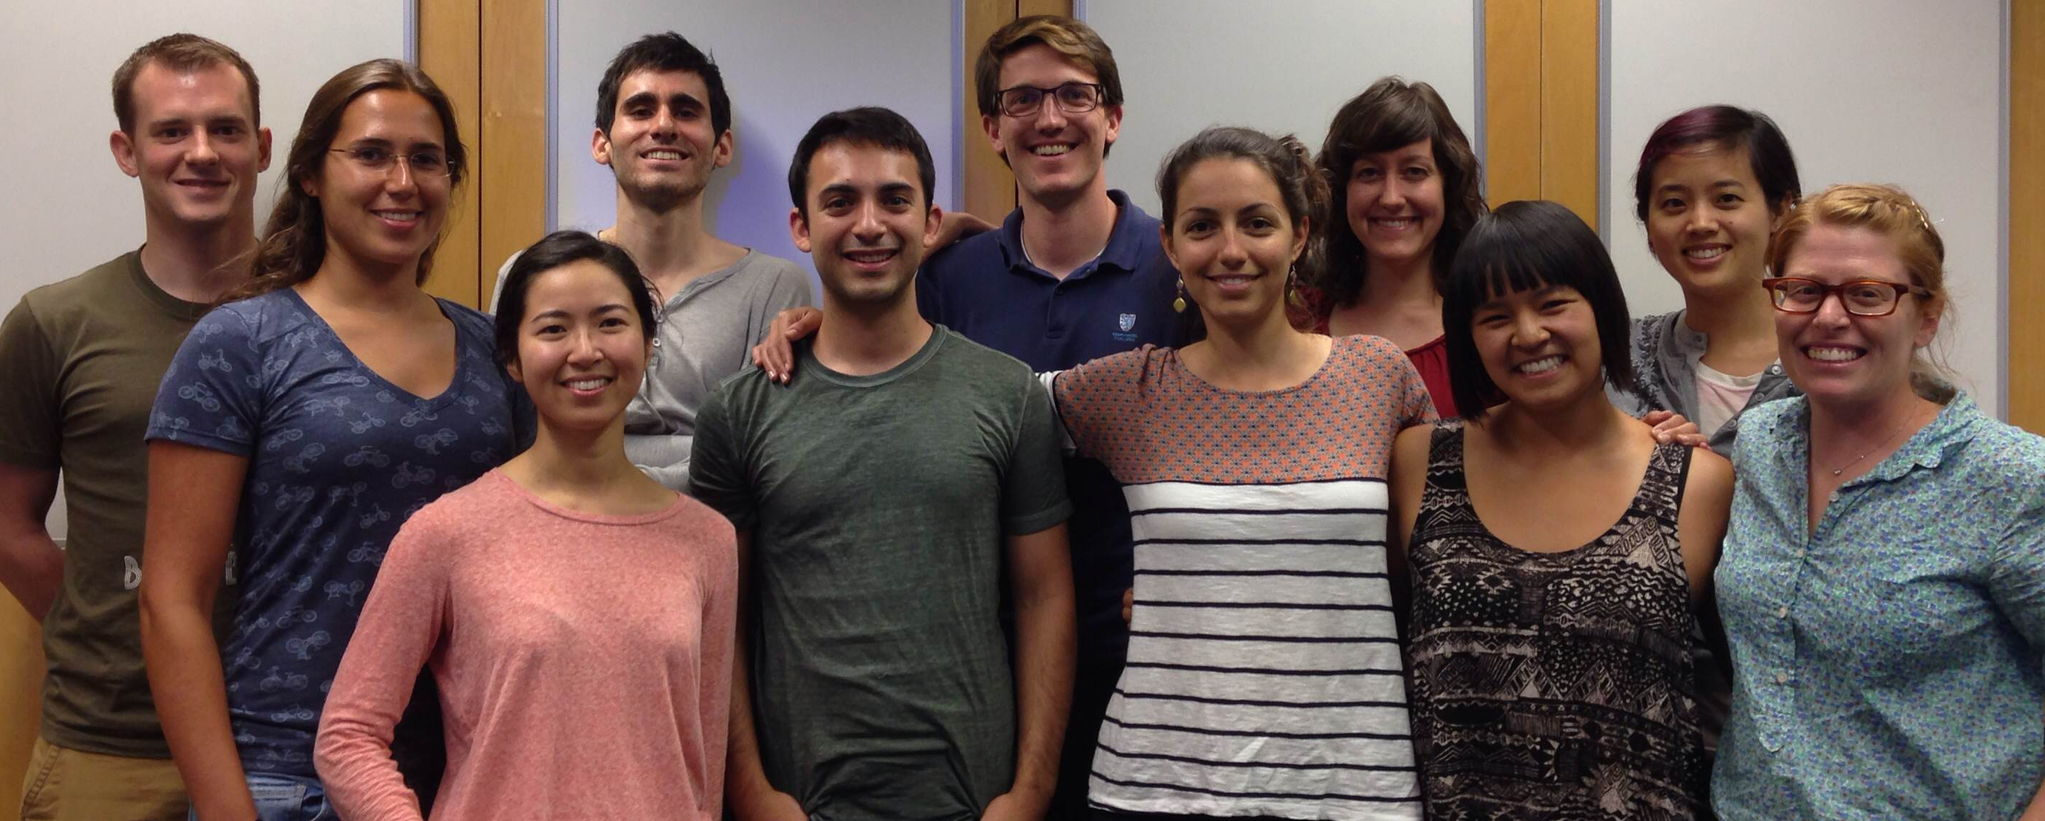
The BE Communication Lab is a team of 12 peer coaches: 11 PhD students and 1 postdoc.
Our lab is for scientists, by scientists.
Notes:
Understand content, think about how to organize & deliver it
Many of us already familiar with content & assignments for Course 20 classes

Slide 3
We can support the students in your class,
or support your communication & pedagogy skills as a TA.

Slide 4
The BE Communication Lab can help you as a TA:
Recitation support & group facilitation
Structural support for syllabus design
Rubric design
Oral presentation skills

Slide 5
Example rubric created for 20.111
Notes:
Rubrics save time and create consistency

Slide 6
The BE Communication Lab can help your students:
Individual & group coaching
Figure, slide, & poster design
Oral presentation skills
Papers, abstracts, proposals…
Notes:
If your students feel that they’re struggling with communication, send them to us!

Slide 7
What we do...
...and don’t
Meet each client where they’re at: from brainstorming to final edits
Analyze content, message, and organization
Model field-specific best practices
Proofread, grammar police, work on ESL
Provide answers
Notes:
What would this document need to look like for a professional journal, poster session?
We avoid creating inconsistency with class expectations – any really specific questions about content/structure are referred back to TA’s/instructors

Slide 8
Courses that already partner with the Communication Lab:
FALL
SPRING
20.S900
20.109
20.201
20.309
20.416
20.109
20.111
20.309
20.310
Notes:
Incentive structure for visiting the lab, to avoid students doing last-minute work.
Grading expectations shared with Fellows to create consistency.

Slide 9
How to get help
Make an appointment with Diana: dchien@mit.edu
Talk to your faculty about connecting with us.
Visit the Communication Lab website: http://be.mit.edu/communicationlab

