Slide 1
Biomaterials and Cell-Biomaterial Interactions
Module 3, Lecture 2
20.109 Spring 2014

Slide 2
Lecture 1 review
What is tissue engineering?
Why is tissue engineering?
Why care about cartilage?
What are we asking in Module 3?

Slide 3
Topics for Lecture 2
Introduction to biomaterials in TE
properties
examples
Cartilage composition
collagen
proteoglycans
structure → function

Slide 4
Today in Lab: M3D2
Condition 1 of 2
0.5 mL beads, 6 mL media
0.5 mL beads, 6 mL media
1 condition per plate (2 plates total)
2 wells per plate (split 1 mL of beads)
if contaminate 1 well on D3, still have 1 on D4

Slide 5
Properties of biomaterials
Physical/mechanical
strength
elasticity
architecture (e.g., pore size)
Chemical
degradability
toxicity
water content
Biological
motifs that cells recognize
release of soluble components
Lifetime
OH
O
OH
O⁻
O

Slide 6
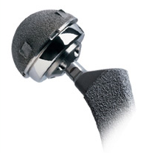
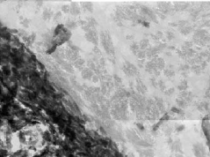
The right material for the job
Metals
Ti, Co, Mg alloys
pros: mechanically robust
applications: orthopedics, dentistry
Ceramics
Al₂O₃, Ca-phosphates, sulfates
pros: strength, bonding to bone
applications: orthopedics, dentistry
Polymers
diverse, tunable properties
applications: soft tissues
Metal hip implant
http://www.weisshospital.com/joint-university/hip/metal.html
Interface
General: B. Ratner, ed. Biomaterials Science, 1996.
Image: Porter et al., Biomaterials 25:3303 (2004).
Si-HA
Bone
Notes:
Silicate-hydroxyapatite mix vs. plain HA in bone → mechanical interlocking (chemical bond not needed, additional) b/w collagen fibrils and the Si-HA.

Slide 7
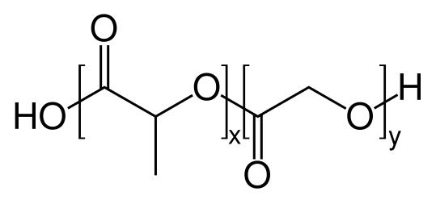
Basics of polymer structure
Linear polymers
repeated chemical unit, or
heterogeneous repeats: co-polymer
Homo- example: PEG
synthesis: epoxide ring-opening
adds one monomer at a time
Co- example: PLGA
successive ester bonds formed
also by ring-opening!
Many types of linear syntheses
As MW increases
entanglements and strength ⬆
processability ⬇
Poly(ethylene glycol)
(
O
)
n
H
OH
Poly(lactic-co-glycolic acid)
[public domain image]

Slide 8
Polymers are diverse and tunable
Chemical groups affect
mechanical properties
stability/degradability
hydrophilicity
reactivity/modification ease
gas permeability
PEG
unique relationship with water
resists protein adsorption
low MW easily excreted
PLGA
ester bonds hydrolyzed
PLA more hydrophobic and degrades more slowly cf PGA
(
O
)
n
H
OH
Poly(ethylene glycol)
Poly(lactic-co-glycolic acid)
[public domain image]
Notes:
PEG: mix of hydrophilic/hydrophobic, special relationship with water (H-bonds with O; coil structure), low MW easily excreted, resists protein adsorption
PLGA: ester links water degradable; very hydrophobic (drug delivery issues); PGA more crystalline, degrades faster than PLA; acidity issues, but overall safe
Low MW point is for drug capsules; note also PEGylation for slower protein drug clearance (lower immunogenicity)

Slide 9
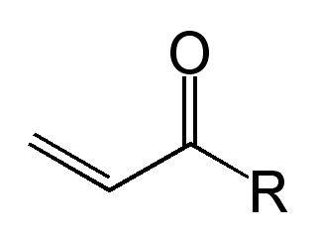
Network polymer synthesis example
Linear polymer with reactive end groups:
=
acryloyl
=
=
UV
=
=
*
radical
=
*
+ initiator
=
=
=
=
*
=
Network structure
covalently cross-linked chains
water-swollen (if hydrophilic)
Network polymer
Notes:
Contrast covalent cross-links with physical entangmlements
CH2CHCOR http://en.wikipedia.org/wiki/Acryloyl_group the CH and the CO both sites for radical formation
MAYBE ORALLY MENTION ANOTHER APPROACH?

Slide 10
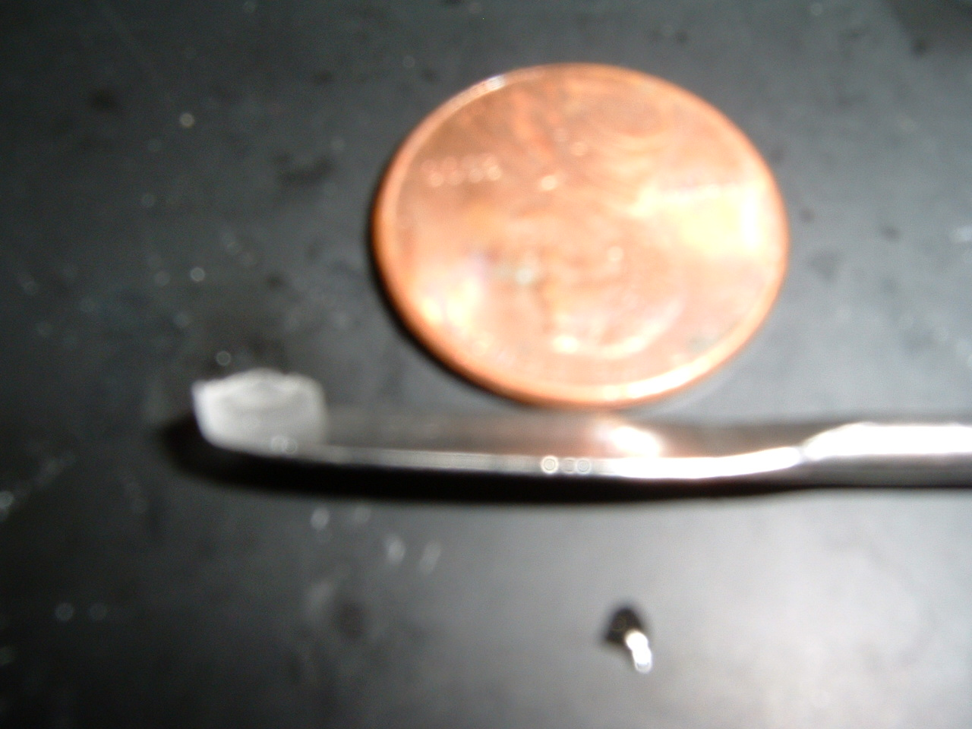
Properties of hydrogels such as PEG
Mimic soft tissues
water content
elasticity
diffusivity
Synthesis at physiological conditions
temperature
pH
UV light: spatio-temporal control; safe; patterning potential
Injectability
Chemical modification
(Stachowiak & Irvine)
Review: Nguyen KT & West JL, Biomaterials 23:4307 (2002)
Notes:
MORE RECENT REVIEW?
ADD A SLIDE HERE WITH A MORE RECENT PATTERNING ETC EXAMPLE? OR ADDED MATERIAL FOR LECTURE 3? WAIT FOR LEC 3

Slide 11
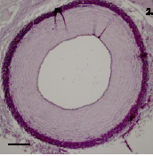
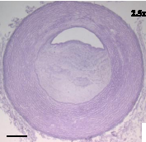
Materials must be biocompatible
Avoid bio-incompatibility
chemical toxicity: cells, genomes
immunogenicity
protein/cell adhesion → clotting
bacterial adhesion
Material properties
material and its degradation products non-toxic and non-immunogenic
resistance to protein adhesion
Sterility
PEG is a great bioinert material
Normal artery
Occluded artery
Data from: Zavan B, et al., FASEB J 22:2853 (2008).
Notes:
Large vessels (4mm) in porcine model; some occlusions.
Vascular TE. Research gap is proper ECM (esp elastin) biosynthesis.
2010: “Nonetheless, a durable small-caliber (diameter: <6 mm) conduit remains elusive, and patency rates for infrainguinal revascularization through the use of a prosthetic graft have changed little over the past 30 years. “ “insufficient or noncrosslinked elastin” “Unlike collagen, the stable crosslinked fiber network of native elastin makes isolation and purification techniques difficult. “
2006: “elastin: the missing link”

Slide 12
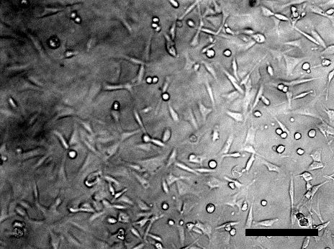
Beyond bioinert: bioactive materials
Fibroblasts on polymer-peptide gels (Stachowiak).
Attach proteins/peptides for
specific cell adhesion
degradability
Release cytokines for
proliferation
differentiation
attraction
e.g., West JL and Hubbell JA Macromolecules 32:241 (1999)

Slide 13
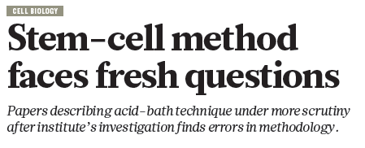


Interlude: scientific misconduct
Sources
Nature News
03/18/14
Boston Globe
04/09/14
Notes:
NOTE: WAS REPRODUCILITY; ALSO RECENT P-VALUE STUFF ON MTMB COULD BE INTERESTING

Slide 14
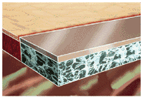
Natural vs. synthetic polymers
Natural pros/cons
built-in bioactivity
lot-to-lot variation, unpredictable
poor mechanical strength
immunogenicity (xenologous sources)
Synthetic pros/cons
predicting biocompatibility is tough
mechanical and chemical properties readily altered
minimal lot-to-lot variation
Synthetic advantages: tunable and reproducible
Notes:
[S13 EXAMPLES SLIDE? OR NEW LEC3 MTL (STATS GONE)]

Slide 15
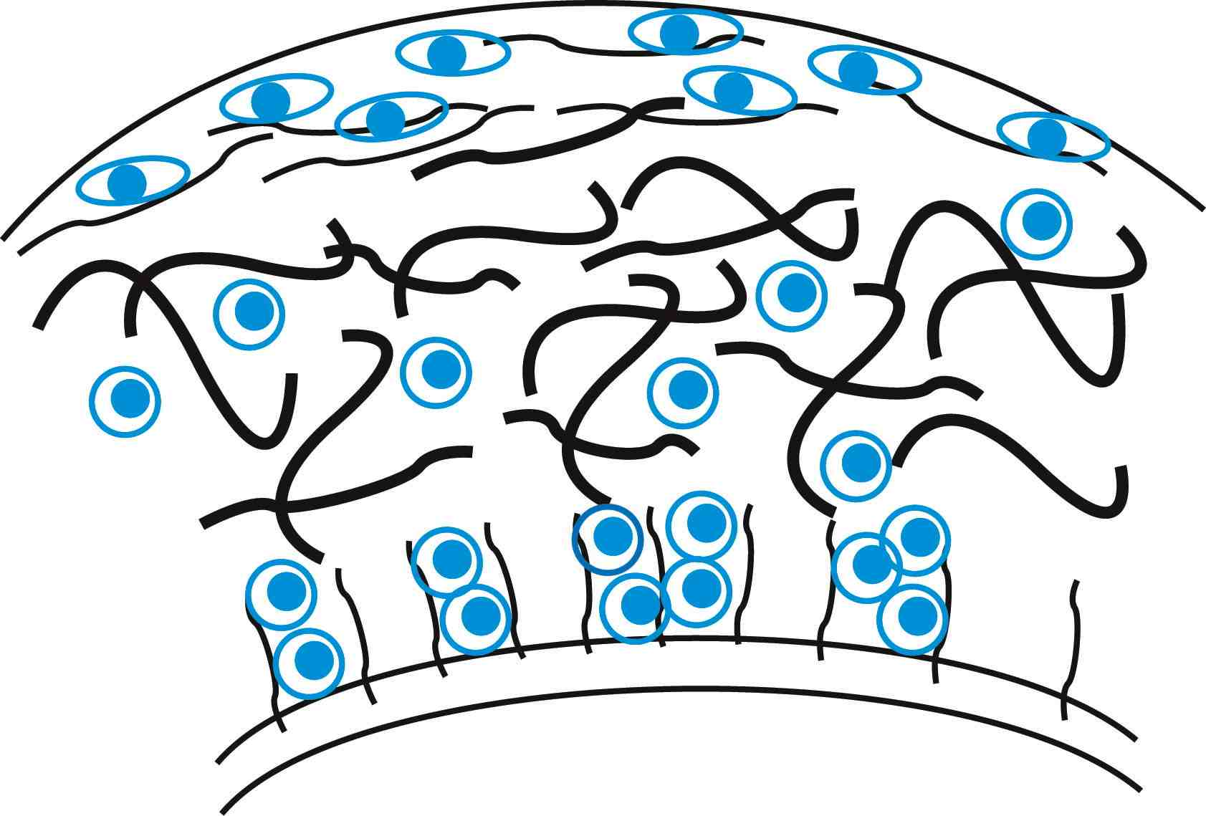
Revisiting cartilage structure
chondrocytes
cartilage surface
proteoglycans
collagen fibers
boundary with bone
Water-swollen, heterogeneous, avascular and cell-poor tissue.

Slide 16
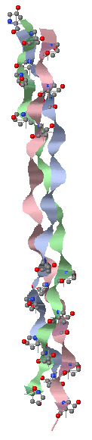
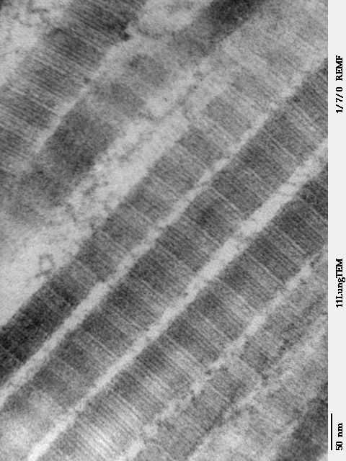
Structure of collagen(s)
1° structure:
Gly-X-Y repeats
proline, hydroxyproline
3° structure: triple helix
Gly: flexibility
Hyp: H-bonding
4° structure: fibrils
many but not all collagens
cross-links via lysine, hydroxylysine
periodic banding observable
HYP residues
Molecular image made using Protein Explorer (PDB ID: 1bkv).
Fibril image from public domain.
E. Vuorio & B. de Crombrugghe Annu Rev Biochem 59:837 (1990)
Notes:
Fibrils can be homo and heterotypic. Banding occurs because of consistent gap between chains (40 nm horizontal gap, 67 nm overlap hence darker, each 300 nm long). Called “quarter-stagger” array.

Slide 17
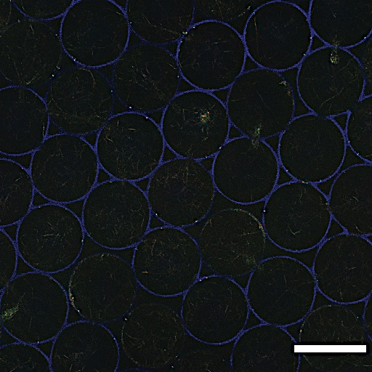
Macro structure of fibrillar collagen
PEG scaffold:
microporous (bead template)
strict order
CN filler:
nanoporous
apparent disorder
A. Stachowiak and D.J. Irvine, confocal reflection microscopy of collagen-filled synthetic scaffold.

Slide 18
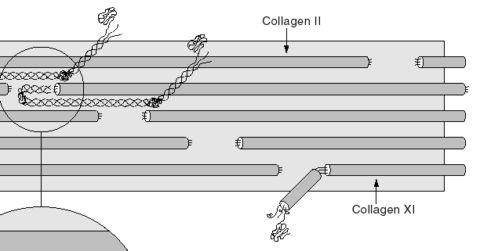
Collagen composition in cartilage
Collagen types vary in
location
glycoslyation
higher-order structure
homo- (II) or hetero- (I) trimers
Cartilage collagens
Type II with IX and XI
exact roles of IX and XI unknown
inter-fibrillar cross-links
modulate fibril diameter
integration with rest of ECM
others(III, VI, X, XII, XIV)
Little collagen turnover in adult cartilage
CN XI
CN II
CN XI
D. Eyre (2002)
D.J. Prockop Annu Rev Biochemritis Res 64:403 (1995)
D. Eyre Arthritis Res 4:30 (2002)
Notes:
Mutations to II, IX, XI cause disease. Specifically, IX may help coordinate insertion of PGs etc. in the ECM and XI big role in determining diameter (even if IX not present).
CN III may play a role in wound healing/matrix remodeling. Support roles for the non-II’s, essentially.
“Our results show that type IX collagen and COMP are involved in matrix assembly by mediating the anchorage and regulating the distribution of other matrix macromolecules such as proteoglycans and matrilins and have counteracting effects on collagen fibril growth. Loss of type IX collagen and COMP leads to matrix aberrations that may make cartilage more susceptible to degeneration.”

Slide 19
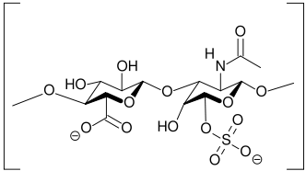
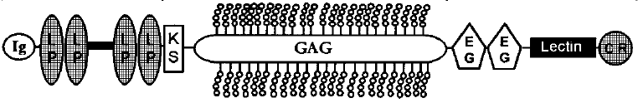
Proteoglycans are bulky and charged
PG: proteins with GAG side chains
GAG is glycosaminoglycan
many charged groups: COO⁻ , SO₃⁻
electrostatic repulsion
Main cartilage PG is aggrecan
GAG is primarily chondroitin sulfate (CS)
aggrecans polymerize via hyaluronin (HA)
Chondroitin sulfate
(public domain image)
Aggrecan monomer
CS chains
HA-binding
R.V. Iozzo Annu Rev Biochem 67:609 (1998)
Notes:
POISED TO GET IT CAUSE M2: Multiple globular domains, can distinguish on Western. Some may be cleaved off by aggrecanases, want to know if have full-length or not. LP = link protein. Lectin domain can bind sugars, may connect different cell/ECM components.

Slide 20
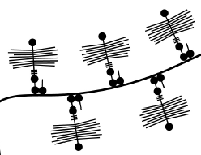
PG form aggregates of varying sizes
Monomer > 1M, aggregates > 100M Da
Average size decreases
with age
with osteoarthritis (OA)
Aggrecenase inhibitors may be an OA target
High negative charge density leads to osmotic swelling
CS chains
Aggrecan aggregate
C.B & W. Knudson Cell & Dev Bio 12:69 (2001)
HA
CS chains
Notes:
Review osmotic swelling: PG high charge density thus need high positive ion influx, and subsequently water wants to come in due to [ion] difference.

Slide 21
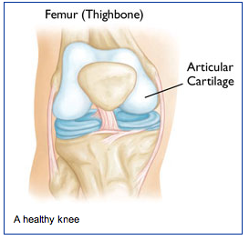
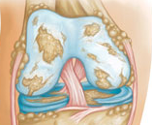
Macro structure of the knee
See also movie:http://orthoinfo.aaos.org/topic.cfm?topic=a00212
Requirements of a joint
load transfer
bone/bone
bone/muscle
flexibility
synovial fluid lubricates
OA
knee
Healthy knee
http://orthoinfo.aaos.org/topic.cfm?topic=a00212
Notes:
Review osmotic

Slide 22
Cartilage structure and function
Cartilage composition
dry weight: CN 50-75% ; PG 15-30%
water: 60-80%
cells: 5-10% (v/v)
Role of PG
high compressive strength (osmotic swelling)
low permeability and high drag coefficient reduce wear on joint → H₂O bears some load
Role of CN
high tensile strength (~GPa)
contain swelling forces of PG
bone
synovial fluid
cartilage
bone
V.C. Mow, A. Ratcliffe, and S.LY. Woo, eds. Biomechanics of Diarthrodial Joints (Vol. I) Springer-Verlag New York Inc. 1990
Notes:
Review osmotic swelling: PG high charge density, but packed close/constrained by CNII. Thus need high positive ion influx, and subsequently water wants to come in due to [ion] difference. CN again constrains the swelling behaviour.
Under compression, water is excluded, but low permeability and high drag coefficient mean it is hard to remove water and thus it bears the load, and permeability further decreases as some water leaves. OA degradation means that more water comes in and increases permeability. Latter increase means less load is shared by the fluid.

Slide 23
Principles of osmotic pressure
Water must have equal chemical potential in both compartments: μ_{H2O,1} = μ_{H2O,2}
Solutes decrease μ, pressure increases μ
Infinite water would equalize [solute], but influx limited
Charges must also be balanced (Donnan equilibrium)
Simplified cartilage model
H₂O + high [Na⁺]/PG⁻
1
Membrane:
PG can’t cross
H₂O + low [Na⁺]
2
Notes:
If water is constrained from entering compartment 1 to equalize solute concentrations, an excess pressure in compartment 1 makes for equal μ → hence compressive strength

Slide 24
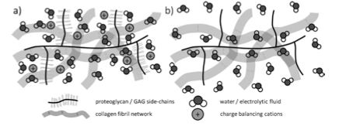
Poor water retention in OA cartilage reduces load sharing, increases wear
Simplified cartilage model
Image: DA Binks et al., Br J Radiol 86:20120163 (2013).
Notes:
REVIEW THIS ONE

Slide 25
Lecture 2: engineered and native biomaterials
Diverse biomaterials are used in TE.
Cell-material interactions can be (+), (-), or neutral.
Hydrogels are useful for soft tissue engineering: similar properties and easily tunable.
The composition of cartilage supports its functions.
Next time… cell viability and imaging; intro to standards in scientific communities.

