Slide 1
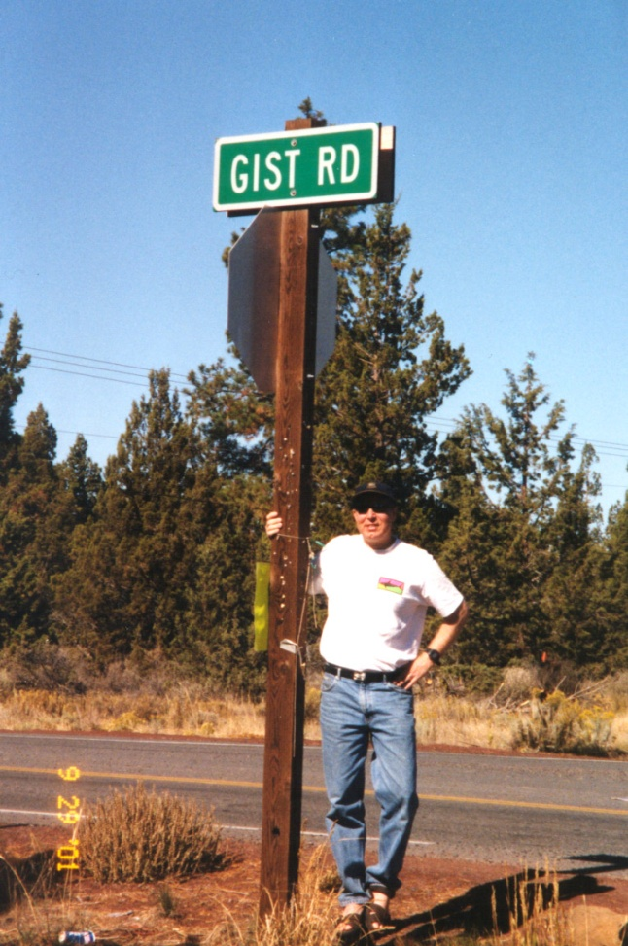
ETV1 is a lineage survival factor that cooperates with KIT in gastrointestinal stromal tumors
Introduction
Tim Butler
March 8th, 2012

Slide 2
Topics for Today
GI Stromal Tumors (GIST)
KIT Signaling
KIT targeted therapy
ETV1

Slide 3
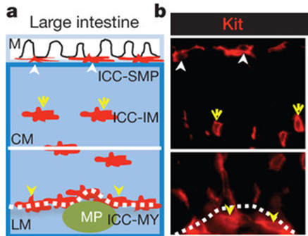
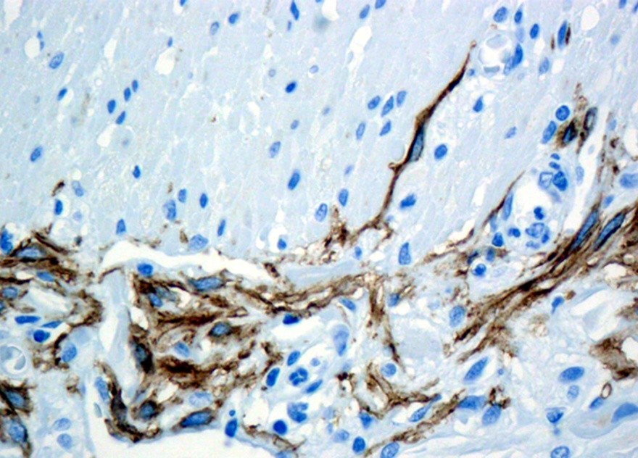

Interstitial Cells of Cajal
Discovered by Ramon Cajal
Identified by IHC using KIT
Pacemaker for smooth muscle contraction in gut
Courtesy of Dr. Heinrich
Notes:
Cajal worked on characterizing the nervous system, won 1906 nobel prize with Golgi
Enteric nervous system, peristalsis
Section of intestine showing ICC cells in brown stained with KIT ab
Schema showing 3 subtypes of ICC cells and their staining with KIT separates them from surroundings
Myenteric, intramuscular, submucosal

Slide 4
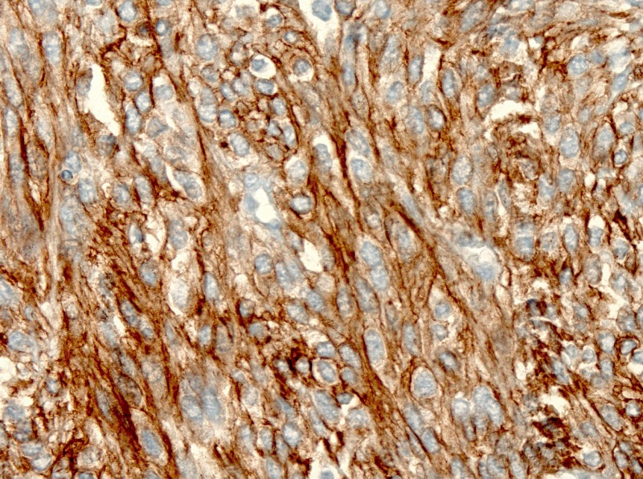
GI Stromal Tumors (GIST)
Median age of presentation: 65
75% contain mutations in KIT
1 case in 100K
Surgery curative in ~50% of patients
Tumors arise from ICCs
Courtesy of Dr. M. Heinrich
Notes:
Another 10% PDGFRA
Remaining KIT WT signaling poorly understood

Slide 5
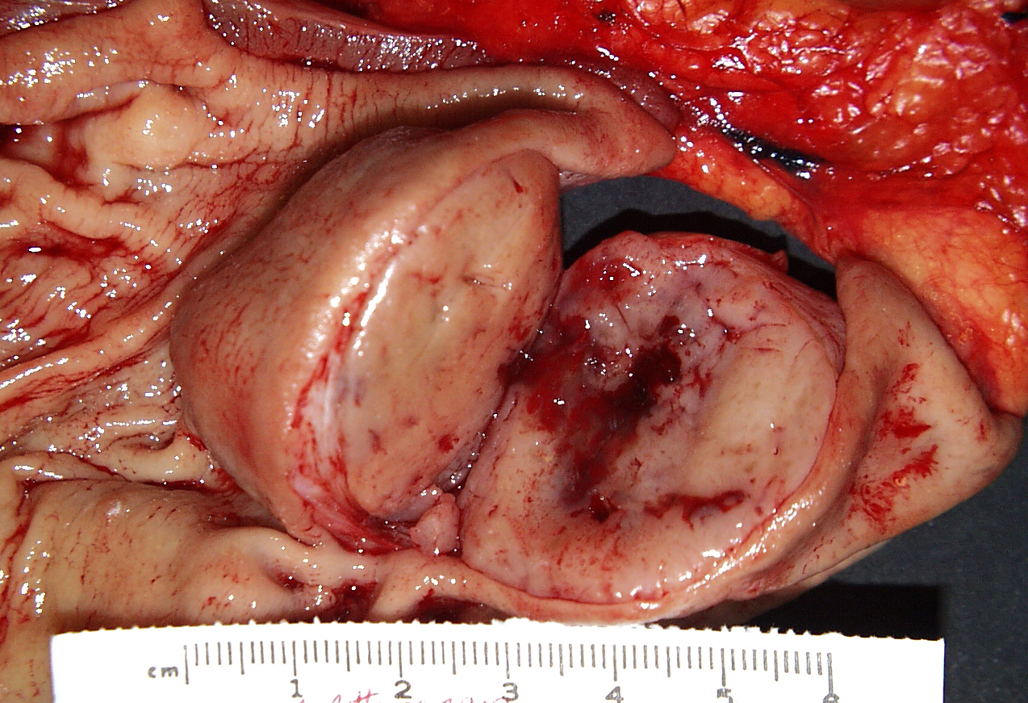
GI Stromal Tumors (GIST)
Median age of presentation: 65
75% contain mutations in KIT
1 case in 100K
Surgery curative in ~50% of patients
Tumor
Gastric mucosa
Courtesy of Dr. C. Corless

Slide 6
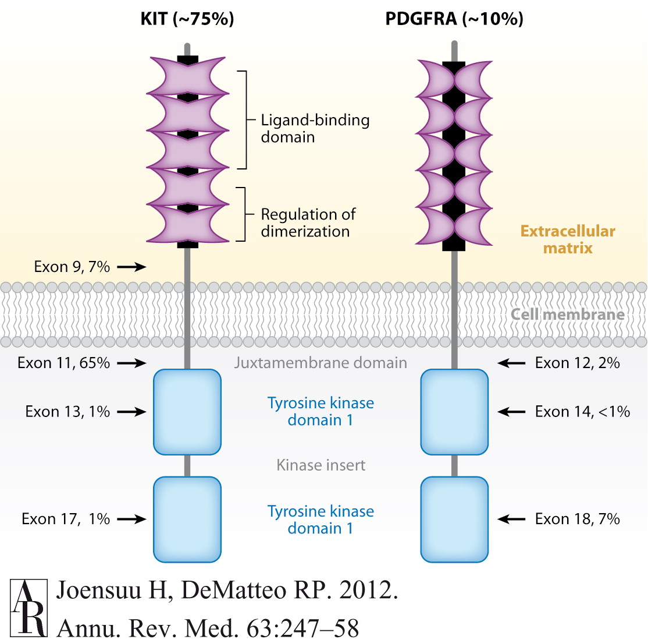
KIT
Notes:
RTK becomes constitutively active

Slide 7
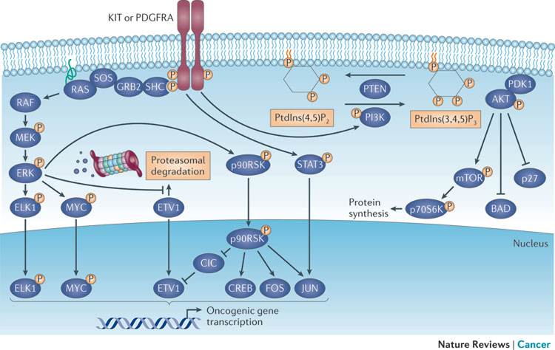
KIT Signalling
Notes:
MAP kinase pathway and PI3K

Slide 8
Targeted KIT Therapy: Imatinib
100
Imatinib mesylate
80
60
Survival (%)
40
20
Chemotherapy
0
0
1
2
3
4
5
Years after registration
With longer term follow up median survival is 5-6 years
39% of patients alive at 7 years
Blanke et al. ASCO 2004 Gastrointestinal Cancers Symposium. Abstract 2.
Notes:
Presentation with metastatic disease, chemo very low survival, imatinib much better, over time becomes less effective

Slide 9
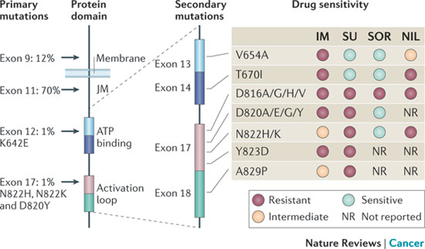
Imatinib Resistance
Most patients initially respond to Imatinib therapy
Over time resistance occurs via secondary mutations
2nd and 3rd line therapies used that are unaffected by mutations
Notes:
Exon 13/14 prevent imatinib binding

Slide 10
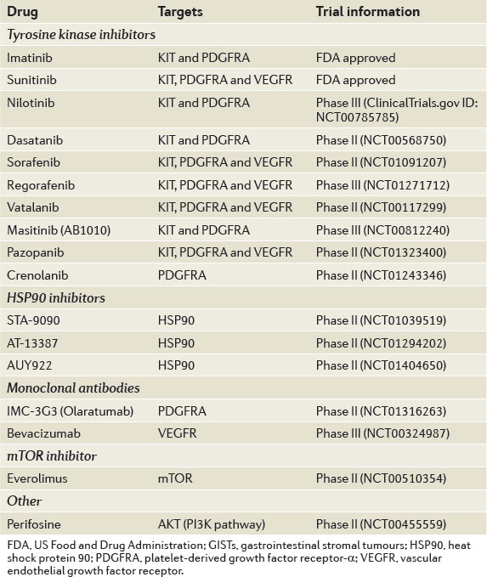
Beyond Imatinib
Notes:
Most drugs in pipeline target KIT, trying to be unaffected by mutations
HSP90 general target for activated chaperone proteins

Slide 11
Targeted Therapy
X
X
X

Slide 12
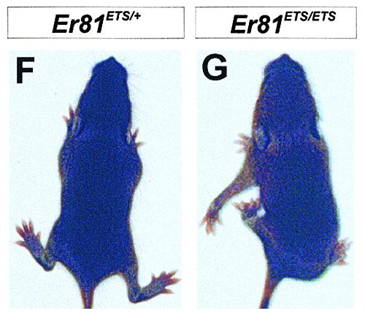
ETS Variant 1 (ETV1)
Member of ETS family of transcription factors
KO mice show defects in motor/sensory neuron development
Arber et al. 2000 Cell 101:5
Notes:
Distorted forlimb positioning, death w/in 3-4 weeks

Slide 13
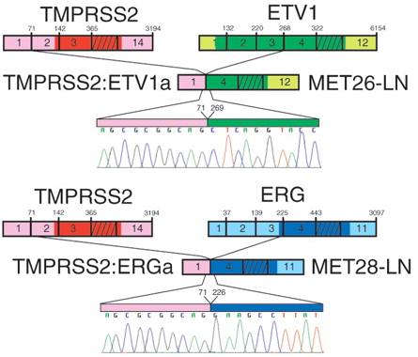
ETV1 and Cancer
ETV1 previously identified as oncogenic
Recurrent gene fusion in prostate cancer
Amplification in Melanoma
Notes:
ERG another ETS TF family member, one of these overexpression in 57% of prostate cancer
TMPRSS2 expressed in normal prostate tissue, strongly induced by andorgens, ETV1/ERG expression becomes androgen inducible

Slide 14
ETV1 Signaling
Notes:
Downstream of KIT/MAPK pathway

