Slide 1
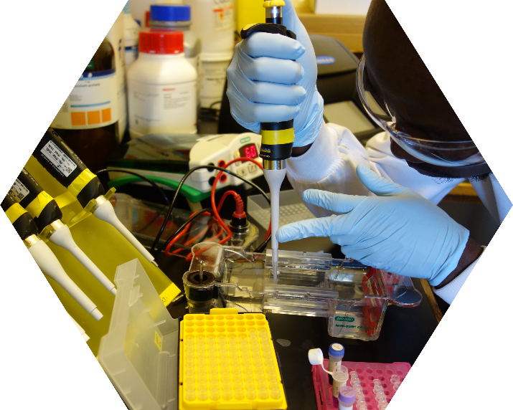
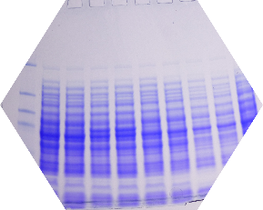
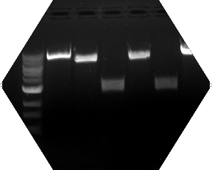
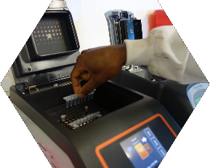




A Practical Workshop on
Molecular Biology
Protein Production
&
Open Wet Labs
Africa Project
Date to be announced soon
Ho | Ghana
School of Basic & Biomedical Sciences
University of Health & Allied Sciences
APPLICATION PROCESS
Eligibility: Postgraduate Students
To Apply: Send your CV and cover letter stating why you want to attend the workshop and how it applies to your research. Emails should have the subject: Molecular Biology Workshop 2015.
Send to: ghanayoungacademy@gmail.com
ORGANISERS
Kwabena Duedu
University of Edinburgh, United Kingdom
Vincent Amarh
University of Edinburgh, United Kingdom
Kwamena Sagoe
University of Ghana, Ghana
APPLICATION DEADLINE
Not open for applications yet. Send informal enquiries to koduedu@gmail.com
Japheth Opintan
University of Ghana, Ghana
Eugene Fletcher
Chalmers University of Technology, Sweden
Activities include
PCR design and optimization
Expression and purification of Taq and pfu DNA polymerases
Cloning & protein engineering
DNA fingerprinting & metagenomics
Gel analysis with ImageJ
Francis Ankrah
Ghana Young Academy
Ghana Academy of Arts & Sciences, Ghana
Sponsored by
Supported by
THE UNIVERSITY of EDINBURGH
Development Trust

