Slide 1
Immunology, Cell and Drug Delivery
4/16/13
Lecture 16, ChE 590B

Slide 2
Introduction to Immunology

Slide 3
Pathogens and Antigens
Pathogens are disease-causing micro-organisms, including viruses, bacteria, fungi, protozoa, and worms.
An antigen is anything that stimulates an immune response.
Nearly all pathogens are antigens, stimulating a strong immune response. Antigens are not always pathogens.
Pollens that cause hay fever are one of many examples of nonpathogenic antigens.

Slide 4
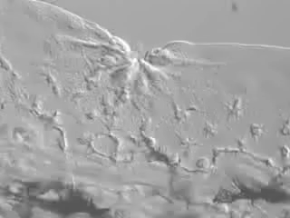
Innate Immune Responses
Immediately following a break in the skin, phagocytes engulf bacteria within the wound.
This is an example of a nonspecific immune response which is innate against a pathogen.
Adaptive immunity mounts a response against a specific antigen, where as innate immunity mounts a general response against any antigen.

Slide 5
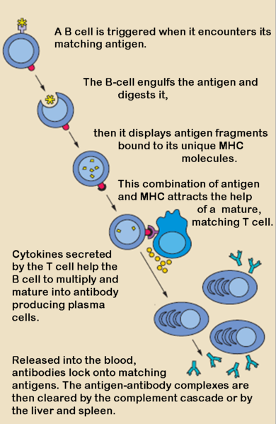
Adaptive Immunity
B cells are responsible for the production of antibody against free pathogens and soluble products from pathogens while cytotoxic T cells destroy pathogen and virally infected cells and abnormal cells.
Antibody produced by B cells complexes free pathogen and soluble products from pathogens to help remove the threat. Cytotoxic T cells remove infected or damaged cells.
B cells can only proliferate and make a strong immune response if helper T cells give activation signals. Without the helper T cells, B cells can response only to a limited number of antigens, usually those with repeating structures such as a bacterial cell wall polysaccharide.

Slide 6
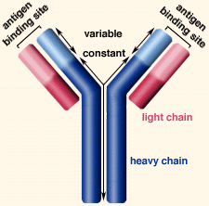
Adaptive Immunity, Continued
The ability to produce billions of different antibodies in humans results from the production of variable regions of light and heavy antibody genes by DNA rearrangement.
The combination of gene fragments prior to binding antigen produces the variable coding sequence for the antibody gene.
An antibody immunoglobulin is a "Y" shaped molecule made up of two identical "light" and "heavy" chains of amino acids. The variable region includes the N-terminal 110-130 amino acids of the light and heavy chains, and is responsible for binding to antigen. The constant region is the C-terminal end and contains similar amino acids for each class of antibody. Light chains may be lambda or kappa. The five major classes of heavy chain are IgM, IgG, IgA, IgD, and IgE. Each of these classes differ in their locations in our body and how they stimulate the innate system to remove antigen.

Slide 7
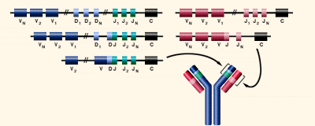
The immune system creates billions of different antibodies with a limited number of genes by rearranging DNA segments during B cell development, prior to antigen exposure. Mutation can also increase genetic variation in antibodies.
When a stem cell changes to become a B cell, DNA segments for both heavy (VDJ) and light (VJ) chains are randomly combined. Each B cell ends up with functional genes for making one light and one heavy chain coding for an antibody as a membrane-bound receptor. Antibody specificity depends on the gene fragments used. Antibodies are produced that can react with almost any chemical structure in nature, including our own proteins.
Over 15,000,000 combinations of variable, diversity and joining gene segments are possible. Imprecise recombination and mutation increase the variability into billions of possible combinations.

Slide 8
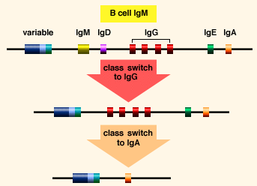
Allergies
An allergy is an immune response to a harmless antigen, such as pollen, animal dander or a specific food. Mast cells bind IgE, and when antigen (or allergen) binds with IgE, mast cells release histamines. This produces the familiar "hay fever" or allergic reactions, including dilation of blood vessels, inflammation and sometimes difficult breathing. The most serious allergic reactions trigger anaphylactic shock where a massive release of histamine causes shock and potential death.
Whether or not we suffer from allergies largely depends on whether we make an IgE response to antigen. Since IgE is present at very low levels in our blood (.05 µg/ml), hay fever sufferers can be desensitized by giving increasing doses of the antigen causing the allergy. Frequent doses of antigen usually lead to a strong IgG response. The IgE does not disappear, but since IgG levels are at around 10 mg/ml, the IgG can remove most of the offending antigen before IgE containing mast cells are activated.
Before binding antigen, B cells contain IgM molecules only. Following antigen binding, when plasma cells are produced, class switching occurs. Class switching refers to a DNA rearrangement changing the heavy chain constant gene in memory cells. Loss of coding regions for the constant part of the heavy chain causes IgG, IgA, and IgE to be produced. Below is an example of class switching to produce IgA.

Slide 9
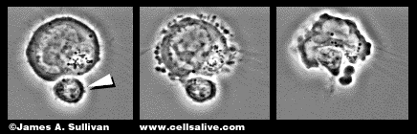
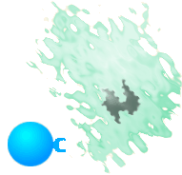
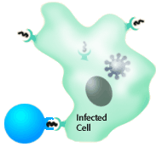

Mono
Epstein Barr virus (EBV) infects endothelial cells and B cells. About half of us are infected by the virus while very young, and do not suffer disease. Around half of individuals who avoid the virus while young are infected in the teenage years and develop a disease called mononucleosis. In this disease, lymph nodes swell painfully as our immune system produces large numbers of lymphocytes to eliminate virus-producing cells. These lymphocytes are probably:
Pathogens that escape antibody detection can enter and infect cells. The cellular system is composed of cytotoxic T cells and helper T cells.
Cytotoxic T cells kill infected cells, preventing these cells from producing more pathogen. Receptors on the surface of cytotoxic T cells detect fragments of the virus on the surfaces of infected cells. A successful immune response against a virus means that we will make large numbers of virus specific cytotoxic T cells. In an EBV infection, cytotoxic T cells can make up the vast majority of our white blood cells.
T cells contain a T cell receptor that is like the antibody of B cells. Each T cell has only one kind of receptor. Analogous to the genetic events of antibody production, T cells rearrange a set of genes coding for the T cell receptor. Each T cell ends up with a unique receptor, but the population of T cells contains billions of different receptors.
Specific cytotoxic T cells can become nearly half of the T cells in an infected person's body. These cells eventually deplete the virus by removing infected cells.
the virus by removing infected cells.

Slide 10
Autoimmune diseases
The lack of an immune response to self is called Tolerance
Tolerance is the “opposite” of autoimmunity. Autoimmunity is an immune response to self, and tolerance is the lack of that response.

Slide 11
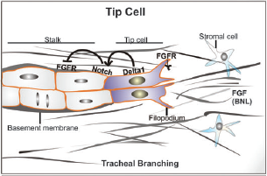
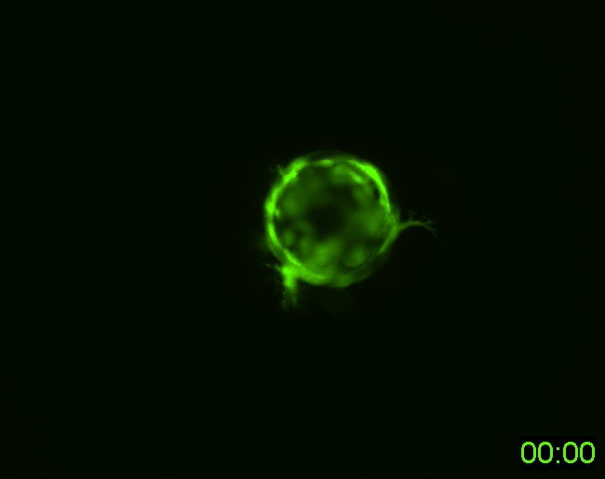
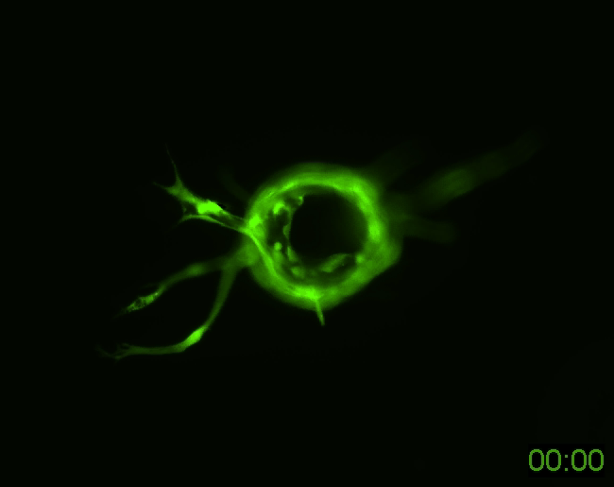
Examples of vascularizing tissues
Is this a mechanism to pre-vascularize tissue engineered implants?
Ghajar et al, Exp Cell Res 2010

Slide 12
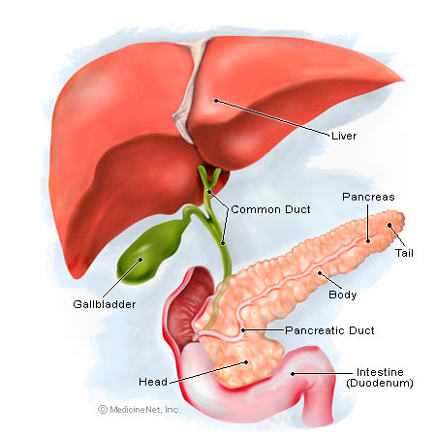
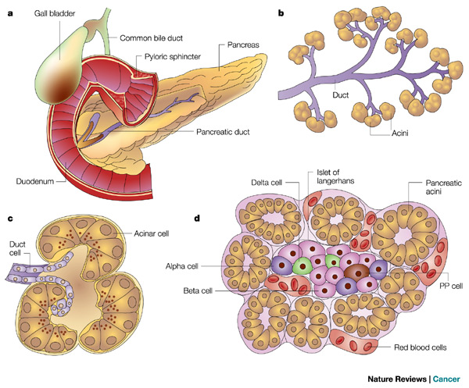
Pancreas Function

Slide 13
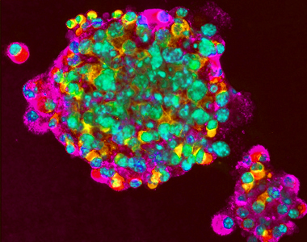
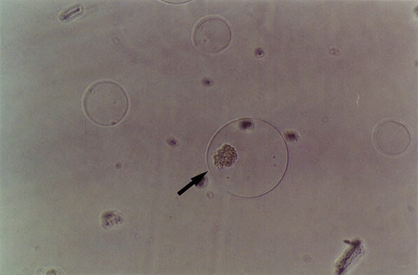
Hydrogel culture of islet cells
Stem cell differentiation to islet cells

