Slide 1
3-D PEG HYDROGELS
Lauren Jansen
April 24, 2013

Slide 2
What is a Hydrogel?
Hydrophilic polymer material that can absorb large amounts without dissolving.
A network composed of physical or chemical crosslinkers that are prepared from monomers, pre-polymers, or already hydrophilic polymers.

Slide 3
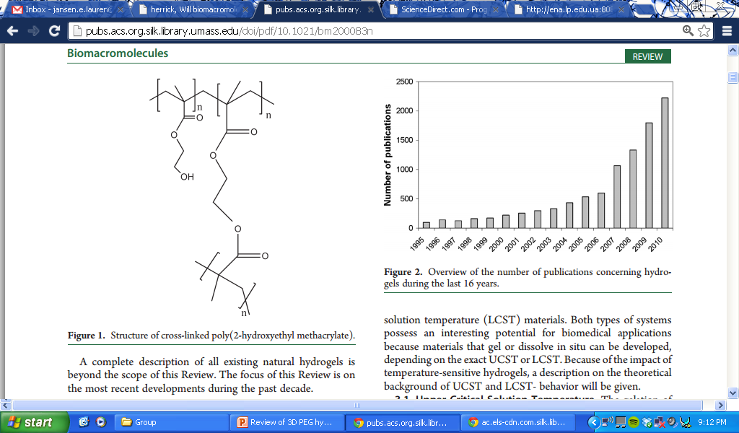
1960: The First Hydrogel
Desire: Polymers that can permanently contact living tissues
Problem: Available materials had many fundamental problems
Poor biological compatibility (toxicity)
Impermeable to metabolites
Mechanical irritation
Demand for a suitable plastic:
Permitted High Water Content
Inert to normal biological systems
Permeable to metabolites
Solution: Hydrogels!
Glycolmonomethacrylates (Contact Lens)

Slide 4
Motivation for Hydrogels
Drug delivery, scaffolds, food preservation, biosensors
Study cell and tissue physiology
Large water content and rubbery consistency makes hydrogels great mimics for living tissue
“A cell can no longer be thought of as a solitary entity deﬁned by its genome, but must be evaluated in the context of the ECM” -Kristy Anseth

Slide 5
Hydrogels Classification
Preparation
Type: Homopolymer, multipolymer, interpenetrating, and copolymer hydrogels
Polymerization Method: chemical, photopolymerization, or irradiative
Overall charge
Neutral, anionic, ampholytic, or cationic
Crosslinking
Physical, chemical
Physical characteristics
Amorphous, semicrystalline, hydrogen-bonded, supramolecular, or hydrocolloidal
Smart Polymers: respond to environmental conditions
Examples: pH sensitive, thermo polymers, cryo-polymers, self assembling
Notes:
An Interpenetrating polymer network (IPN) is a polymer comprising two or more networks which are at least partially interlaced on a polymer scale but not covalently bonded to each other.
Copolymer.
Homopolymer hydrogels are cross-linked networks of one type of hydrophilic monomer unit, whereas copolymer hydrogels are produced by cross-linking of two comonomer units, at least one of which must be hydrophilic to render them swellable. Multipolymer hydrogels are produced from three or more comonomers reacting together.
Ampholytic: can react with an acid or base
In amorphous hydrogels, the macromolecular chains are arranged randomly. Semicrystalline hydrogels are characterized by dense regions of ordered macromolecular chains (crystallites). Finally, hydrogen bonds
and complexation structures may be responsible for the three-dimensional structure formed.
Supramolecular- having a structure that is more complex than unimolecular
A hydrocolloid is defined as a colloid system wherein the colloid particles are hydrophilic polymers dispersed in water
Thermo Polymers:
UCT--The gelation of many biopolymers is reversible temperature sensitive formation of intermolecular hydrogen bonds.
Example: gelatin (i.e., partially hydrolyzed collagen) and certain polysaccharides including agarose, amylose, amylopectin, and carrageenan.
LCT---Upon heating, aggregation of the hydrophobic groups occurs, Gelation thus occurs spontaneously upon heating because the entropy (TΔS) compensates for the unfavorable enthalpy (ΔH).

Slide 6
For Tissue Engineering: Important Biophysical and Biochemical Properties
Physiological water content for cell transport and survival
Tissue-like elasticity for mechanotransduction
Diffusivity of important cell-secreted molecules
Incorporation of ligands for cell adhesion and function
Matrix degradability for cell remodeling

Slide 7
Natural Hydrogel Polymers
Formed from proteins and ECM components
Collagen, Hyaluronic acid, Matrigel
Biological sources
Chitosan, Alginate, Fibroin
Pros
Inherently biocompatible and bioactive
Promote many cellular functions
Embedded proteins, growth factors, and enzymes
Cons
Vary by batch
High affinity to proteins present in serum
Lacks tunability
Notes:
Matrigel- liquid below 4 C, and is heated to encapsulate cells, consists of laminin and collagen, plus growth factors taken from mouse tumor cells
Fibrin-natural protein synthesized by silk worms; glycine, alanine, and serine, homogeneous porosity
Collagen- Collagen is the major protein of the ECM and at least 12 types of collagen exist in various tissues, but types I, II, III are the most abundant.
Hyaluronic acid-nonsulphated glycosaminoglycan, composed of alternating units of d-glucuronic acid and D-N-acetylglucosamine linked by glycosidic bonds. HA is one of the major components of the ECM of skin, cartilage, and vitreous humor (gel that fills the space between lens and retina).
Chitosan- Chitosan is a partial deacetylated derivative of chitin, which is obtained from the shells of crabs and shrimp. Increasing the basicity of forms a gel. Looked into for bone scaffolds.
Alginate-algae derived, must be coupled with cell interactive sites (RGD) or growth factors (VEGF)
Elastin, Gelatin,

Slide 8
Synthetic Hydrogel Polymers
Non-natural materials
Examples: poly(ethylene glycol), poly(vinyl alcohol), and poly(2-hydroxy ethyl methacrylate)
Pros
Minimal tendency to adsorb proteins
Highly reproducible
Readily available
Opportunity to control presentation of mechanical properties and biochemical cues
Cons
Lacks cell adhesion sites
Tight crosslinks render cells immobile
Protein diffusion is limited preventing cells from secrete ECM
Notes:
Controlled presentation of mechanical and biochemical cues.
Problem #1: Tightly crosslinked network renders cells immobile Solution: Include degradation in the network to study migration, and cell-cell interactions
Problem #2: Protein diffusion is hindered Prevents delivery of cytokines and growth factors he ability for cells to secrete and use ECM which is important for tissue engineering

Slide 9
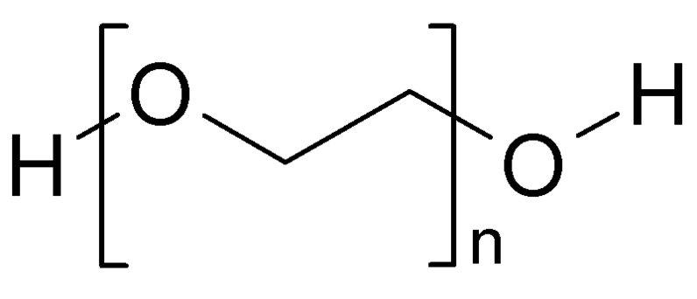
Polyethylene glycol (PEG)
“Gold Standard” for synthetic materials
Multiple preparation methods
Non-fouling
Low inflammatory, safe for in vivo
Easy to incorporate functional groups
Commercially available
Notes:
Cross-links can be formed by chemical reactions that are initiated by heat, pressure, change in pH, or radiation. Cross-linking can also be induced in materials that are normally thermoplastic through exposure to a radiation source, such as electron beam exposure, gamma-radiation, or UV light.

Slide 10
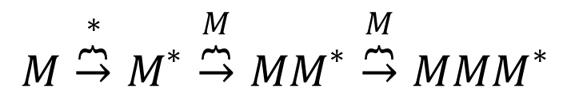

Two common methods of forming PEG-based hydrogels
Chain Growth
Step Growth
$$M\overset{M}{\overbrace{→}}M−M\overset{M}{\overbrace{→}}M−M−M$$
$$M−M\begin{matrix}\overset{12−mer}{\overbrace{→}} & 14−mer \\ \overset{M−M}{\overbrace{→}} & M−M−M−M \\ \overset{M}{\overbrace{→}} & M−M−M\end{matrix}$$
$$M\overset{∗}{\overbrace{→}}M^{∗}\overset{M}{\overbrace{→}}MM^{∗}\overset{M}{\overbrace{→}}M{MM}^{∗}$$
Notes:
Chain growth provides much more control, where step growth has a lot more sporadic interactions.

Slide 11
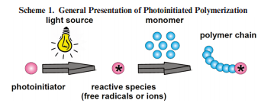
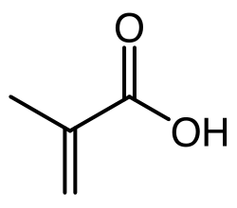
Chain Polymerization
Fundamental Steps
Initiation
Propagation
Termination
Acrylate or methacrylate functional groups
Notes:
Photopolymerization is used to convert a liquid monomer or macromer to a hydrogel by free radical polymerization in a fast and controllable manner under ambient or physiological conditions.

Slide 12
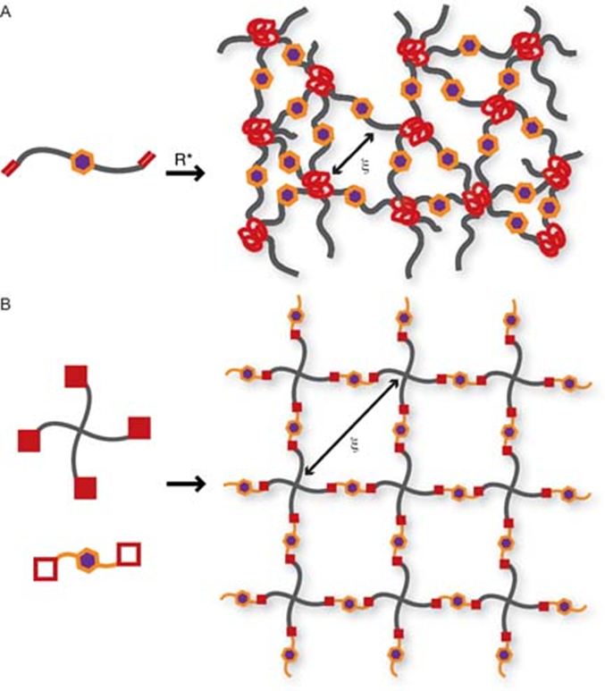
Chain Polymerization
Pros
Formation under physiological conditions
Control of the network
Cons
Hard to characterize
Often uses harmful catalysts
Imperfections and dangling ends are prevalent
Non-uniform degradation
Notes:
The carbon-carbon backbone makes cleavable groups only in the backbone so this gives non-uniform degradation
A major drawback of free-radical cross-linking is that it can significantly reduce encapsulated cell viability and is unwieldy for in vivo delivery of hydrogels cross-linked in situ.
Crosslinking nature rendures classical theories insufﬁcient for hydrogel characterization. Mn is generally unknown for these in-situ-formed gels and only measurable following degradation. Crosslinks are not point junctions, dramatically inﬂuencing the calculation of the average molecular weight between crosslinks ( Mc ). Further, network imperfections, such as cycles and dangling chain ends, are highly prevalent, form to vastly different extents depending on the reaction conditions, and make calculation of related network properties difﬁcult and often inconsistent with experimental observations

Slide 13
Step Growth Polymerization
Two solutions with complementary reactive groups
More homogeneous network
Reaction Types:
Michael-type addition
Radical-mediated thiol-ene photopolmerizations
Copper-free huisgen cycloaddition

Slide 14
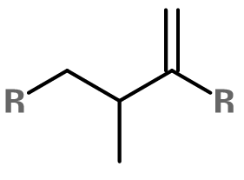
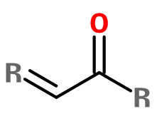
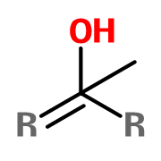
Michael Addition Reaction
Nucleophilic addition of a carbanion or other nucleophile to an α,β-unsaturated carboxylic acid
NUC
NUC
H₃O⁺
NUC
Base removes proton from the α-carbon of the carbon acid
The nucleophile adds to the β-carbon of an α,β-unsaturated carbonyl compound
The α-carbon obtains a proton from the solvent
Notes:
Enols (also known as alkenols) are alkenes with a hydroxyl group affixed to one of the carbon atoms composing the double bond.

Slide 15
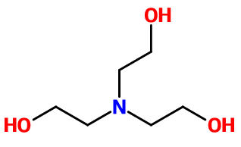
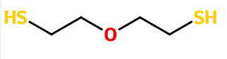
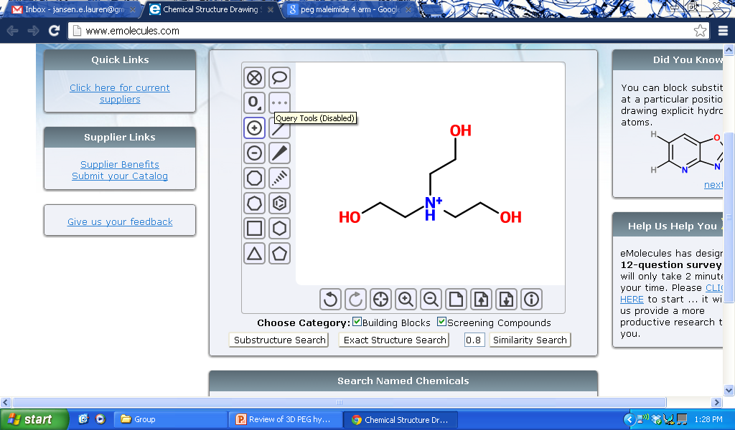
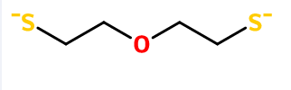
Hydrogel Reaction
n
PEG di-thiol
TEOA
n
Notes:
TEOA turns into a base that deprotonates the thiol quickly
Thiol is more acidic than alcohol so it can be deprotonated

Slide 16
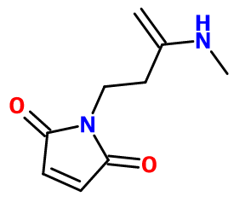
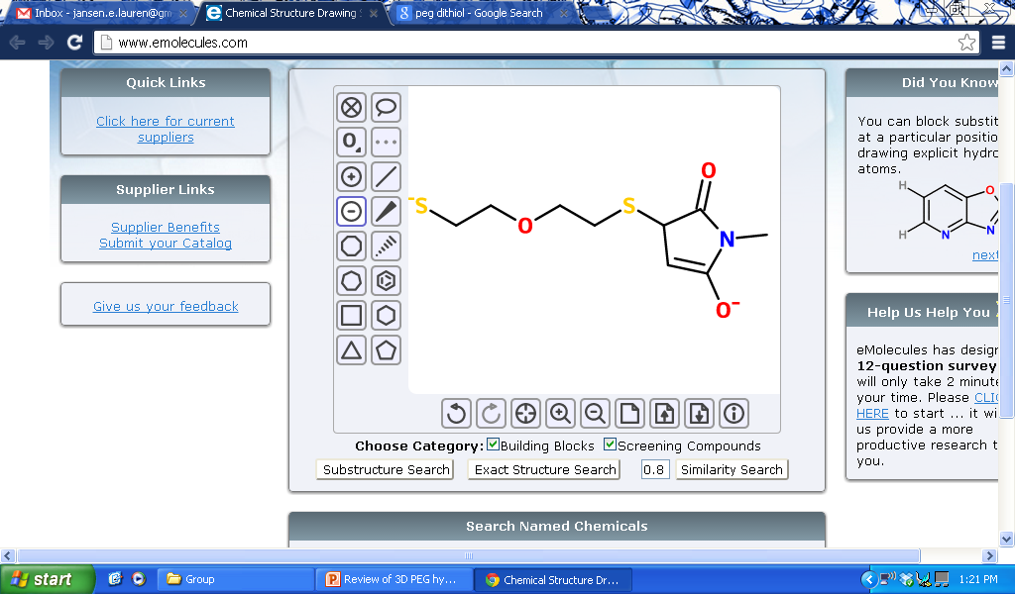
Hydrogel Reaction
O
n
4-arm PEG Maleimide
n
Notes:
The negative charge attacks the most electron deficient site on the maleimide
Charge rearrangement

Slide 17
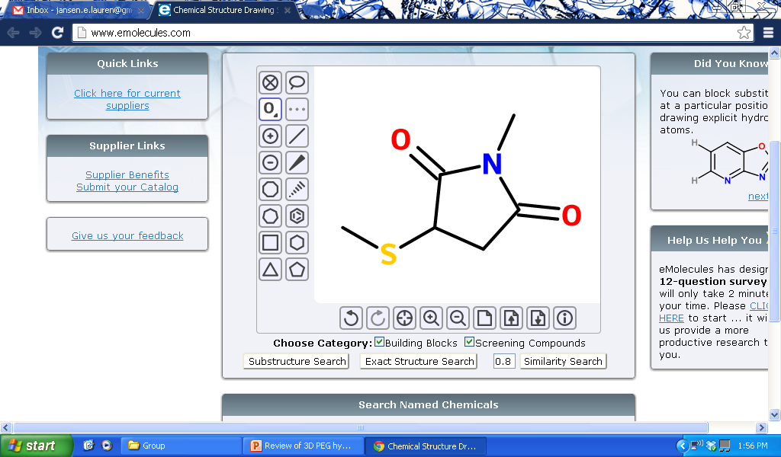
Hydrogel Reaction
n
Notes:
Charge rearrangement
The negative charge removes the proton from TEOA

Slide 18
Hydrogel Reaction
n
O
n
Notes:
Charge rearrangement
The negative charge removes the proton from TEOA

Slide 19
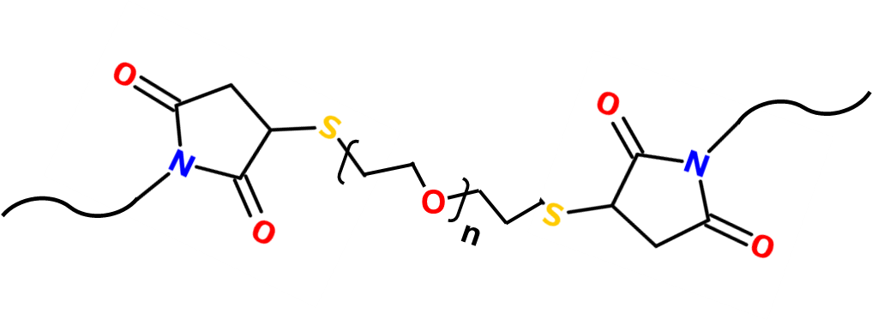

Final Product
Crosslink
Notes:
Michael-type addition cross-linking avoids the use of cytotoxic free-radicals and UV light, but instead require a nucleophilic buffering reagent, such as triethanolamine (TEA) or HEPES, to facilitate the addition reaction. However, hydrogels formed in the presence of high concentrations of TEA have cytotoxic effects
However, the alkaline conditions required for Michael-type reactions promote disulﬁde formation that has been implicated in the off-stoichiometric reaction of monomers during hydrogel formation. Moreover, as the Michael addition is spontaneous, all spatial and temporal control intrinsic in photopolymerization is forfeited.

Slide 20
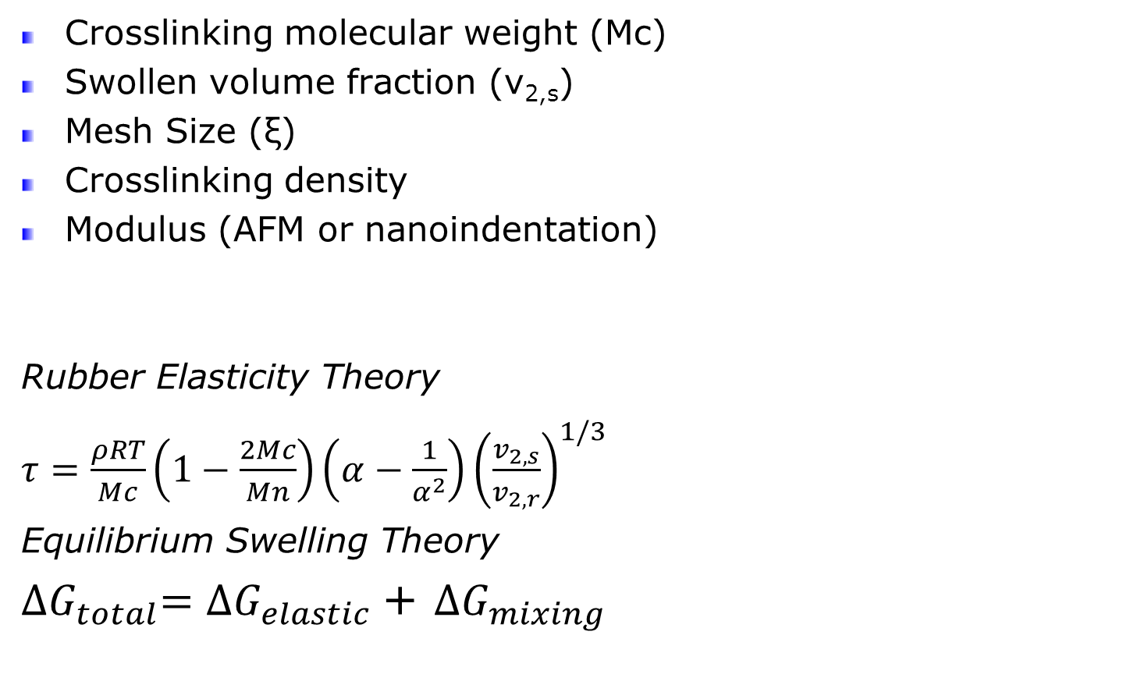
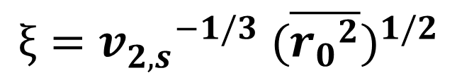
Bulk Characterization Properties
Crosslinking molecular weight (Mc)
Swollen volume fraction (v_{2,s})
Mesh Size (ξ)
Crosslinking density
Modulus (AFM or nanoindentation)
Rubber Elasticity Theory
$τ=\frac{ρRT}{Mc}\left(1−\frac{2Mc}{Mn}\right)\left(α−\frac{1}{α^{2}}\right){\left(\frac{v_{2,s}}{v_{2,r}}\right)}^{1/3}$
Equilibrium Swelling Theory
${∆G}_{total}={∆G}_{elastic }$+ ${∆G}_{mixing}$
ξ
$$ξ={v_{2,s}^{}}^{−1/3} (\overline{{r_{0}}_{}^{2}})^{1/2}$$
Notes:
Mesh Size —root mean squared end to end distance of network shains between two adjacent crosslinks in the unpertured state
DeltaG elastic —the contribution due to the elastic forces developed inside the gel
DeltaG mix- the result of spontaneous mixing of fluid molecules in the polymer chains and how compatible the polymer is with the surrounding fluid
Amongst the more successful theories is rubber elasticity theory, roughly stating that the rubbery modulus scales with the crosslinking density and the temperature (E ∼ ρT).The basic assumptions underlying rubber elasticity theory are that crosslinked polymer strands are connected at points and are represented by a Gaussian distribution.

Slide 21
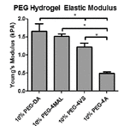
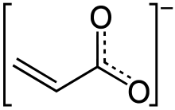
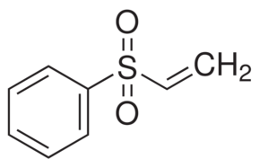
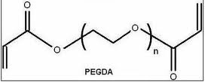
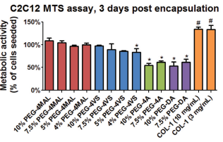
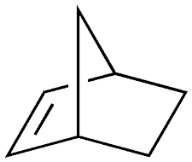
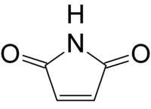
PEG Functional Groups
Name | Group | Reaction
Acrylate |  | Micheal addition
Vinylsulfone |  | Micheal Addition
Diacrylate |  | Photo-polymerized
Norbornene |  | Thiol-ene polymerization
Maleimide |  | Micheal addition
Notes:
General mechanism for radical, step-growth thiol-ene polymerization. An initiator abstracts a hydrogen atom from a thiol. The resulting thiyl radical propagates across the norbornene carbon–carbon double bond. The resulting norbornane radical abstracts a hydrogen atom from a thiol, completing the thioether bond ormation, and regenerating a thiyl radical.
The thiol-ene photopolymerization is cytocompatible, controllable both spatially and temporally, and provides a facile means to tune biochemical and mechanical properties, making this method a versatile tool for the manipulation and study of cellular activity in three dimensions.

Slide 22
Why use Peg Maleimide?
Efficient cross-linking
Bio-ligand incorporation
Appropriate reaction time scales
Gels at physiological temperature and pH
Commercially available
Really easy to make
Good cell spreading

Slide 23
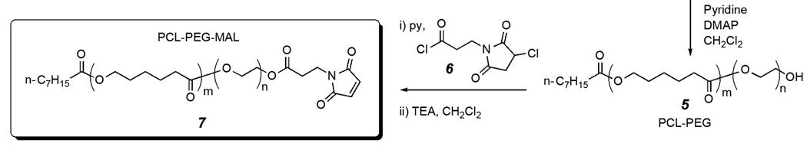
PEG Mal Synthesis: Attempt #1
OH
OH
MAL
MAL
AMIC ACID
3-Chloro-2,5-dioxo-1-pyrrolidinepropanoyl Chloride
OH
OH
MAL
MAL
4-arm PEG Hydroxide
4-arm PEG Maleimide

Slide 24
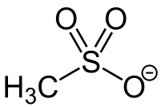
PEG Mal Synthesis: Attempt #2
4-arm PEG Hydroxide
4-arm PEG Amine
OH
NH₂
NH₂
OH
STEP #1
Convert OH to Amine
OH
OH
NH₂
NH₂
Methanesulfonyl Chloride
Triphenylphosphine
Mes
N₃
N₃
Sodium Azide
Mes
Mes
N₃
N₃

Slide 25
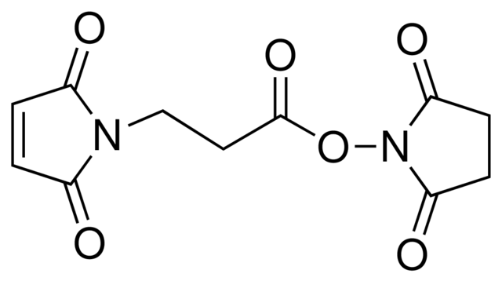
PEG Mal Synthesis: Attempt #2
NH₂
NH₂
NH₂
NH₂
4-arm PEG Amine
3-(Maleimido)propionic acid N-hydroxysuccinimide ester
MAL
MAL
MAL
MAL
4-arm PEG Maleimide

Slide 26
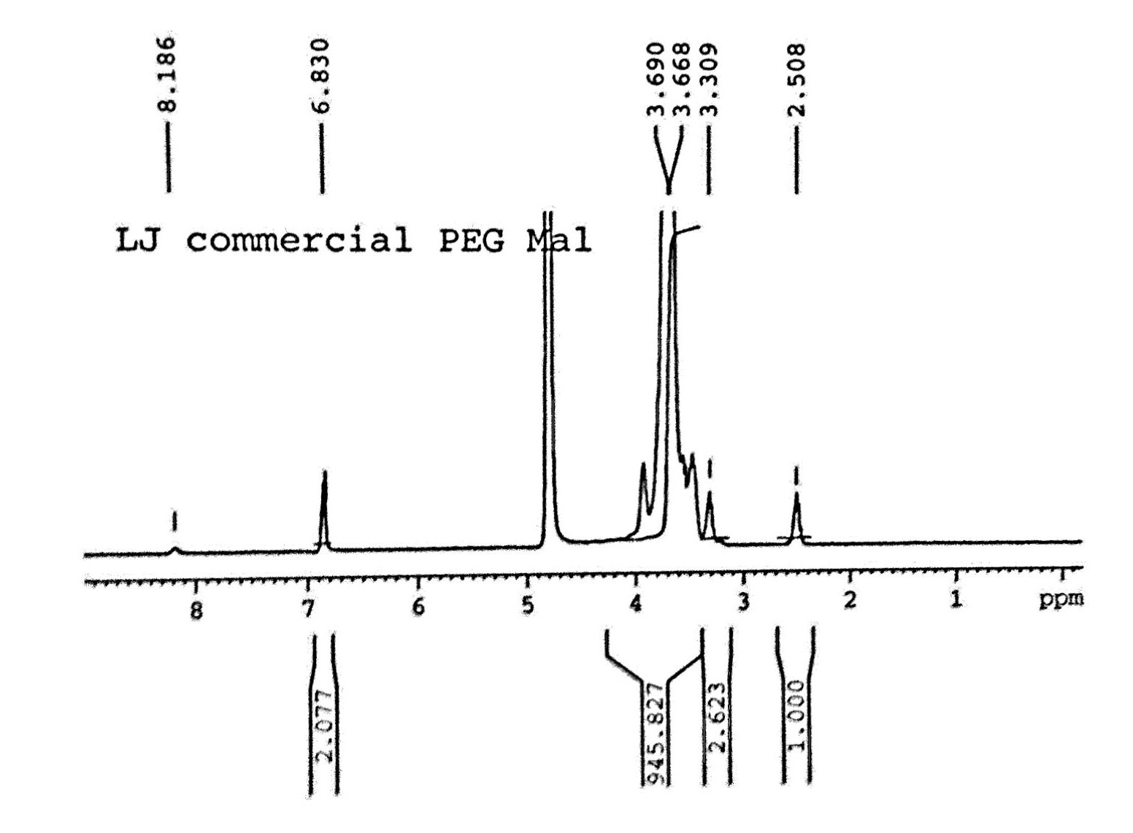
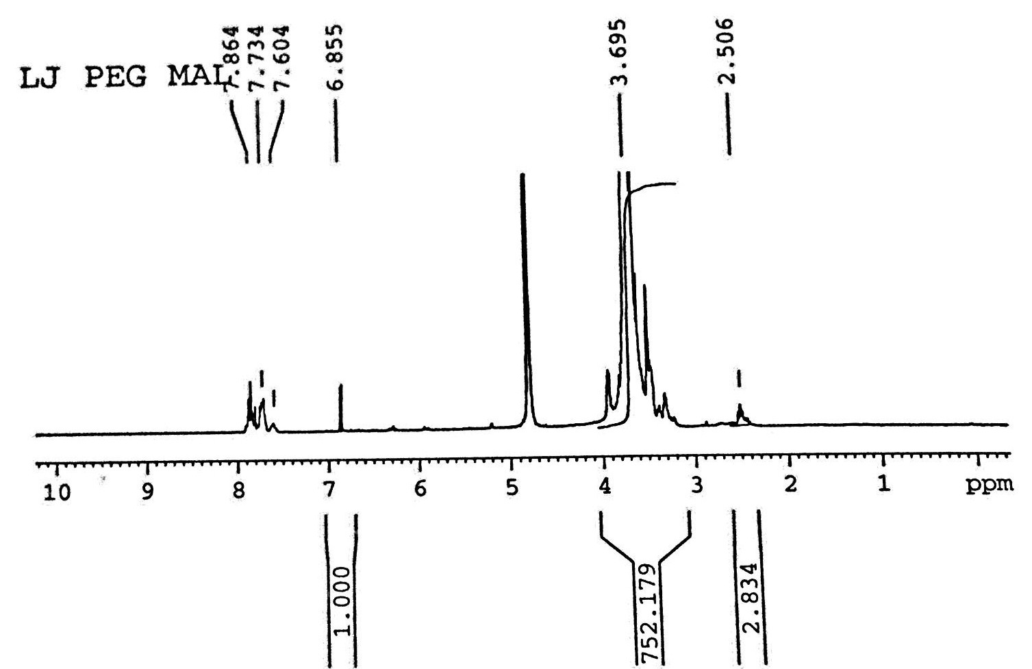
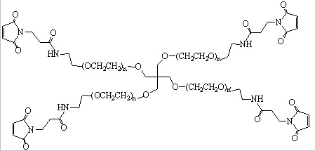
PEG Mal NMR: Attempt #2
NH₂
NH₂
PEG
Solvent
PEG
Solvent
MAL
MAL
Spacer
Spacer
PPH₃
NH₂
NH₂
Amide
4-arm PEG Amine

Slide 27
For Tissue Engineering: Important Biophysical and Biochemical Properties
Physiological water content for cell transport and survival
Tissue-like elasticity for mechanotransduction
Diffusivity of important cell-secreted molecules
Incorporation of ligands for cell adhesion and function
Matrix degradability for cell remodeling
Notes:
Problem #1: Tightly crosslinked network renders cells immobile Solution: Include degradation in the network to study migration, and cell-cell interactions
Problem #2: Protein diffusion is hindered Prevents delivery of cytokines and growth factors he ability for cells to secrete and use ECM which is important for tissue engineering

Slide 28
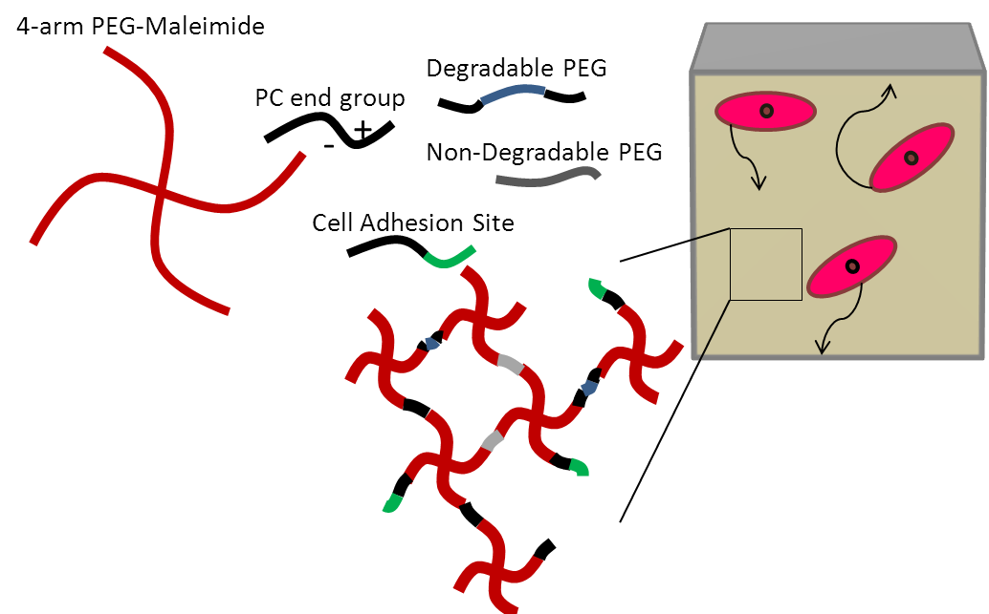
Proposed PEG Network
4 arm PEG-Maleimide
Non-degradable crosslinker
Degradable group: allows for forward movement
Peptide Sequence: Induces cellular traction
Zwitterion: increase hydrophilicity and protein adsorption
Notes:
Phelps et al. Maleimide Cross-linked Bioactive PEG Hydrogel Exhibits Improved Reaction Kinetics and Cross-linking for Cell Encapsulation and In Situ Delivery

Slide 29
Difficulties with 3D networks
Oxygen Diffusion
Non-uniformity in the microenvironment
Proteins can become diffusion limited or stuck
Gradients from medium diffusion
Distribution of soluble growth factors
Standard techniques for imaging and analyzing cell function and protein distribution are more involved
Limited accessibility for immunostaining
Difficult to extract DNA/RNA and secreted proteins
Light scattering, refraction, and attenuation
Notes:
Oxygen Diffusion: In vivo, cells are less than 100 [mm] from a high oxygen source

Slide 30
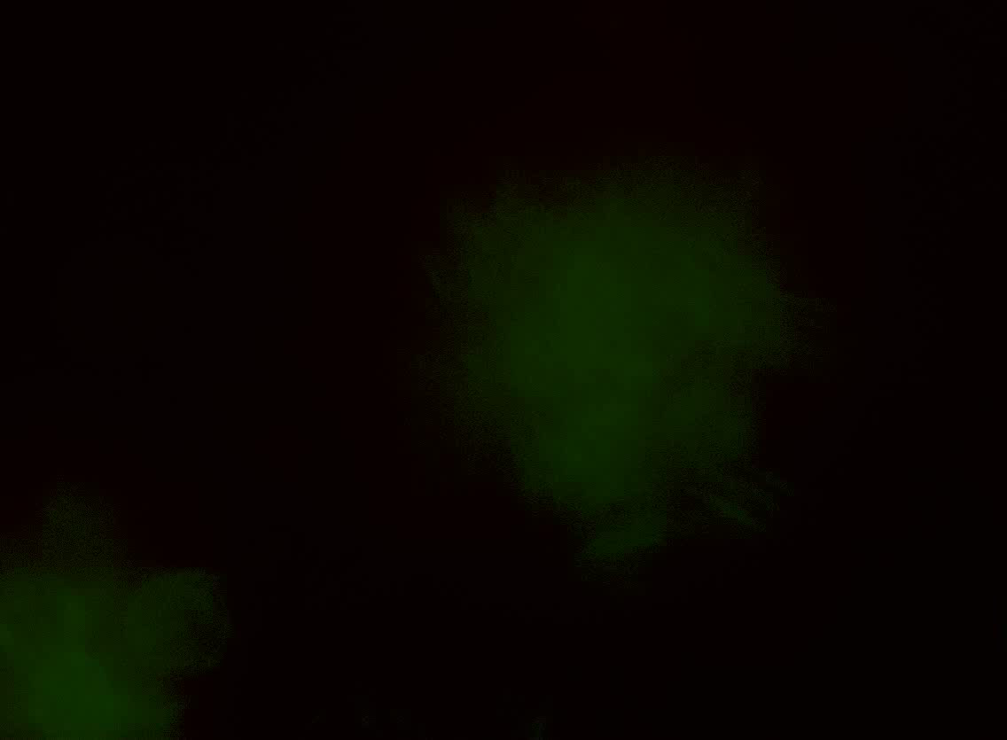
Present
Future
Encapsulated cells
Degradable groups
RGD adhesion site
Groups that allow for matrix stiffening
Adhesion sites specific to tissues of interest
Addition of crosslinking PC groups
Characterize bulk properties
Notes:
To mimic the extracellular matrix to a great extent, various biopolymers including glycosaminoglycans and proteins including collagen and elastin will need to be combined in one ideal matrix. However, to ensure reproducibility and avoid certain risks related to the use of natural materials, material scientists will be obliged to apply selectively recombinant proteins and so on.

Slide 31
Proposed Tissue Mimics
OVERLAID BREAST CANCER CELLS
Proliferation
Niche formation
Cell Invasion
Neural
Stem Cells
Lung
Stem Cells
Marrow-Derived
Stem Cells
Brain Mimic
Lung Mimic
Bone Mimic

Slide 32
References
O. Wichterle, et al. Hydrophilic Gels for Biological Use. Nature 1960. 185(4706): p. 117-118
Vlierberghe, et al. Biopolymer-Based Hydrogels As Scaffolds for Tissue Engineering Applications: A Review. Bio. Mac., 12(5), p. 1387–1408
Kloxin, et al. Mechanical Properties of Cellularly Responsive Hydrogels and Their Experimental Determination. Adv. Mat., 2010. 22(31): p. 3484-94.
Lutolf, et al. Cell-Responsive Synthetic Hydrogels. Adv. Mat., 2003. 15(11): p. 888-92.
Tibbitt, et al. Hydrogels as Extracellular Matrix Mimics for
3D Cell Culture. Biotech. and BioEng., 2009. 103(4): p. 655-63
Hoffman, et al. Biomaterials Science - An Introduction to Materials in Medicine 2nd Edition. 2004. p:35-41
Bruice. Organic Chemistry 3rd edition. 2007. p. 869-70
Fairbanks, et al. A Versatile Synthetic Extracellular Matrix Mimic via Thiol-Norbornene Photopolymerization. Adv. Mat. 2009. 21(48): p. 5005-10
Ji, et al. Maleimide Functionalized Poly(ε-caprolactone)-block-poly(ethylene glycol) (PCL-PEG-MAL): Synthesis, nanoparticle Formation, and Thiol Conjugation. Macromol Chem Phys. 2009. 210(10): p. 823
Datta. Characterization of PEG Hydrogels for Biomedical Applications. Louisana State University. 2007.

Slide 33
Questions??

