Slide 1
Individual Gene Analysis, Categorized on Validity of Inputs

Slide 2
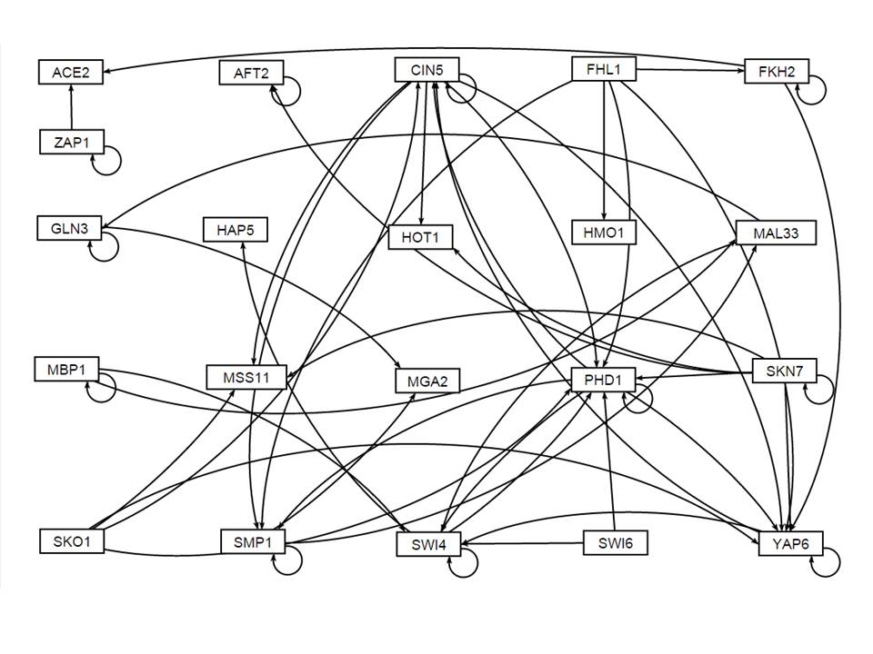

Slide 3
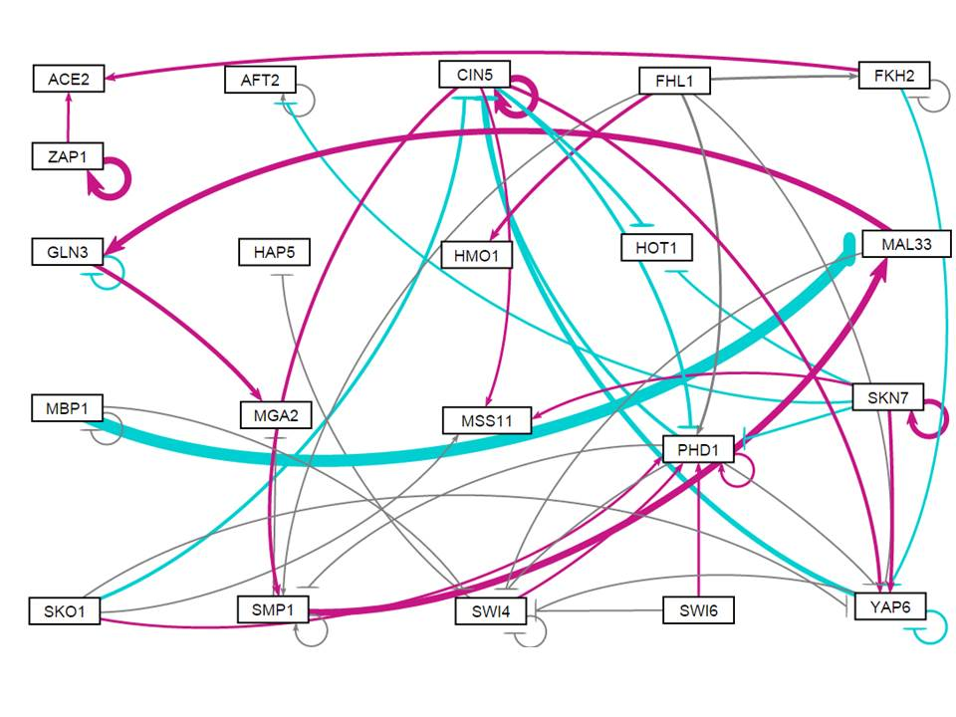
Wt, initial weight 1 run

Slide 4
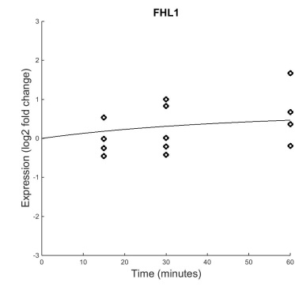
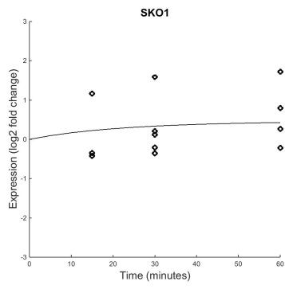
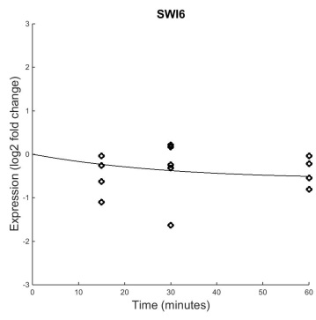
Genes with no Inputs (FHL1, SKO1, SWI6)
dCIN5 B&H p=0.9626
dCIN5 B&H p=0.2005
dCIN5 B&H p=0.6350
dGLN3 B&H p=0.6771
dGLN5 B&H p=0.6552
dGLN5 B&H p=0.4557
wt B&H p=0.4454
B&H p=0.1330
B&H p=0.1178
Good fit
No significant change
Modeled well
Good fit
No significant change, but maybe because of large variance
Modeled well, could have an activator
Fair fit
No significant change, but some
Modeled fairly well, may have a missing repressor
Current downward trend of model is due to a pro rate only slightly larger than degradation rate
It would be helpful to know actual production rate
Notes:
These genes should have no significant dynamics, given nothing is up or down-regulating them

Slide 5
Genes with No inputs are modeled well
Because these genes are not regulated by any other genes, they should have no significant dynamics.
This is reflected in their p-values
No significant dynamics in the wt or dCIN5 and dGLN3 deletion strains
Genes with no inputs are modeled well

Slide 6
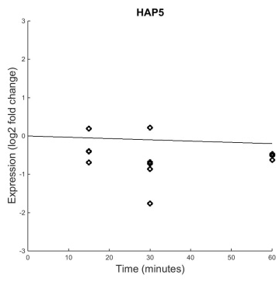
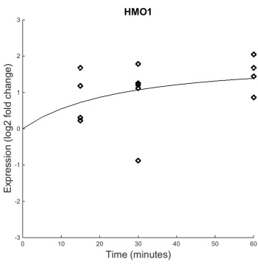
Genes with One Input (HAP5, HMO1)
B&H p=0.1539
B&H p=0.0409
Poor fit
No significant dynamics
Good fit
Significant upward dynamics

Slide 7
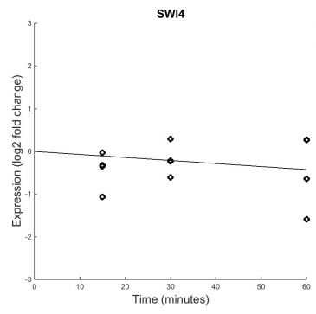
HAP5
Regulator: SWI4
B&H p=0.6367
B&H p=0.1539
Weight: -4.4E-5
Because the dynamics of HAP5’s only regulator are not significant, it is difficult to estimate HAP5’s w and b. SWI4 seems to have essentially no effect on HAP5.
The estimated production rate and weight is extremely small. This could just be noise modeling

Slide 8
HMO1
Regulator: FHL1
B&H p=0.4454
B&H p=0.0409
Weight: 0.24
Although FHL1 has insignificant dynamics, making parameters difficult to estimate, it does produce the correct output in HMO1. HMO1 is probably modeled well
High estimated production rate also contributes to the large upward trend. It would be helpful to know actual production rate
Notes:
NOTE: largest weight (for wt w0 run) was -1.44

Slide 10
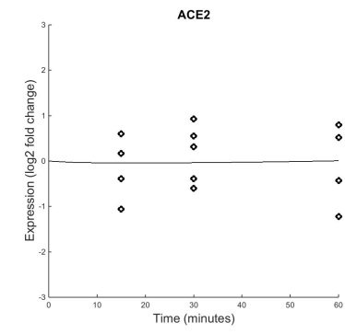
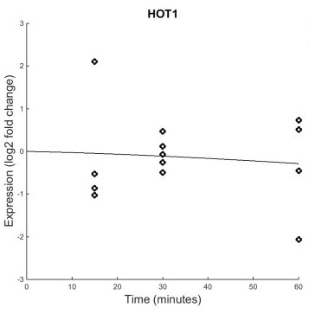
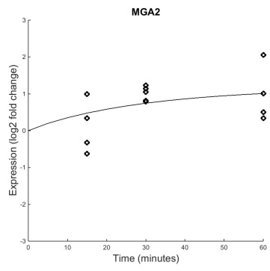
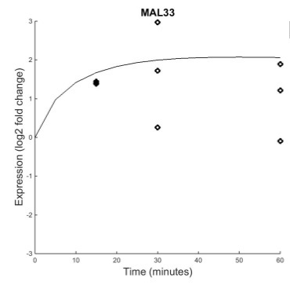
Genes with Two Inputs (ACE2, HOT1, MGA2, MAL33)
B&H p=0.8702
B&H p=0.6387
B&H p=0.1028
B&H p=0.0101
Decent fit
No significant dynamics
Okay fit, given large variance
No significant dynamics
Fairly good fit
No statistically significant dynamics, but visible upward trend
Poor fit, large variance
Significant dynamics

Slide 11
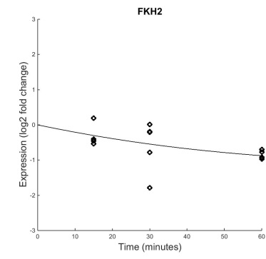
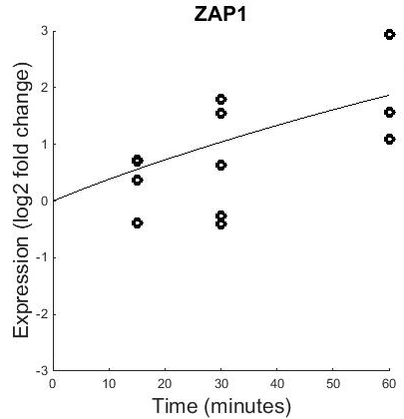
ACE2
Regulators: ZAP1 and FKH2
B&H p=0.1274
Weight: 0.22
B&H p=0.8702
Weight: 0.082
B&H p=0.0086
W and b parameters of ACE2 are easier to estimate because both its regulators have dynamics
Both regulators activate ACE2 in the network. If this was true, ACE2 should show significant upward dynamics
ACE2 is wired incorrectly

Slide 12
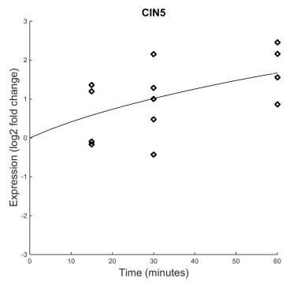
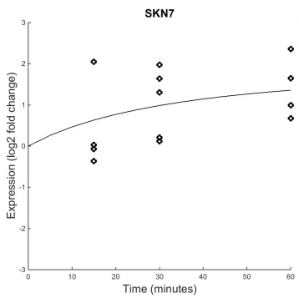
HOT1
Regulators: CIN5 and SKN7
B&H p=0.0642
Weight: -0.19
B&H p=0.6387
B&H p=0.0228
Weight: -0.078
Both regulators show significant dynamics, so it is easier to estimate HOT1’s parameters
Given that both regulators increase their expression, HOT1’s expression should decrease more towards then end of the time series
Unsure… variance of data makes it tricky to determine problem

Slide 13
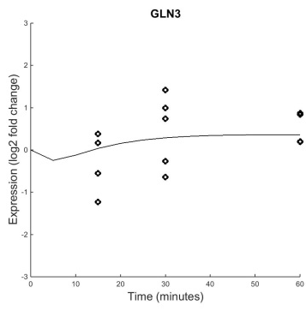
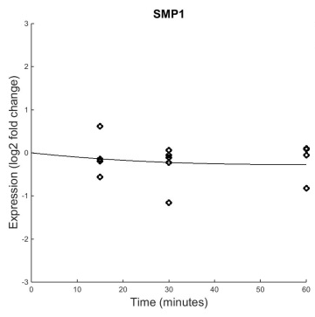
MGA2
Regulators: GLN3 and SMP1
B&H p=0.4125
B&H p=0.1028
Weight: 0.33
B&H p=0.6046
Weight: -0.028
Regulators do not have significant dynamics. MGA2’s parameters are difficult to estimate.
High estimated production rate relative to degradation rate is also causing the upward dynamics. Knowing actual production rate would give a more conclusive case.

Slide 14
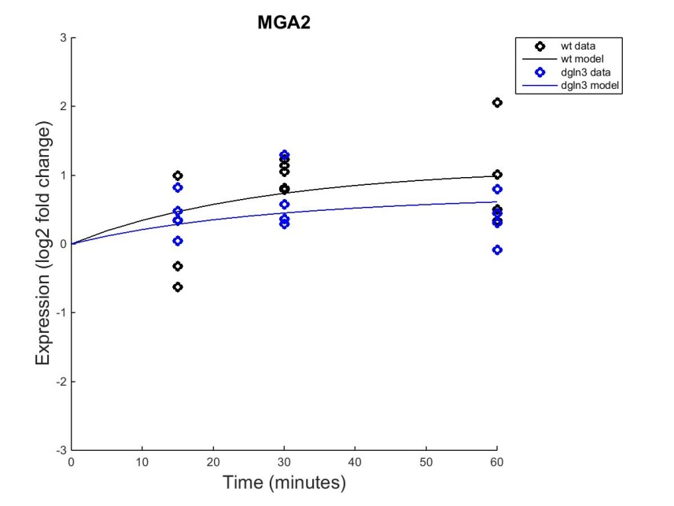
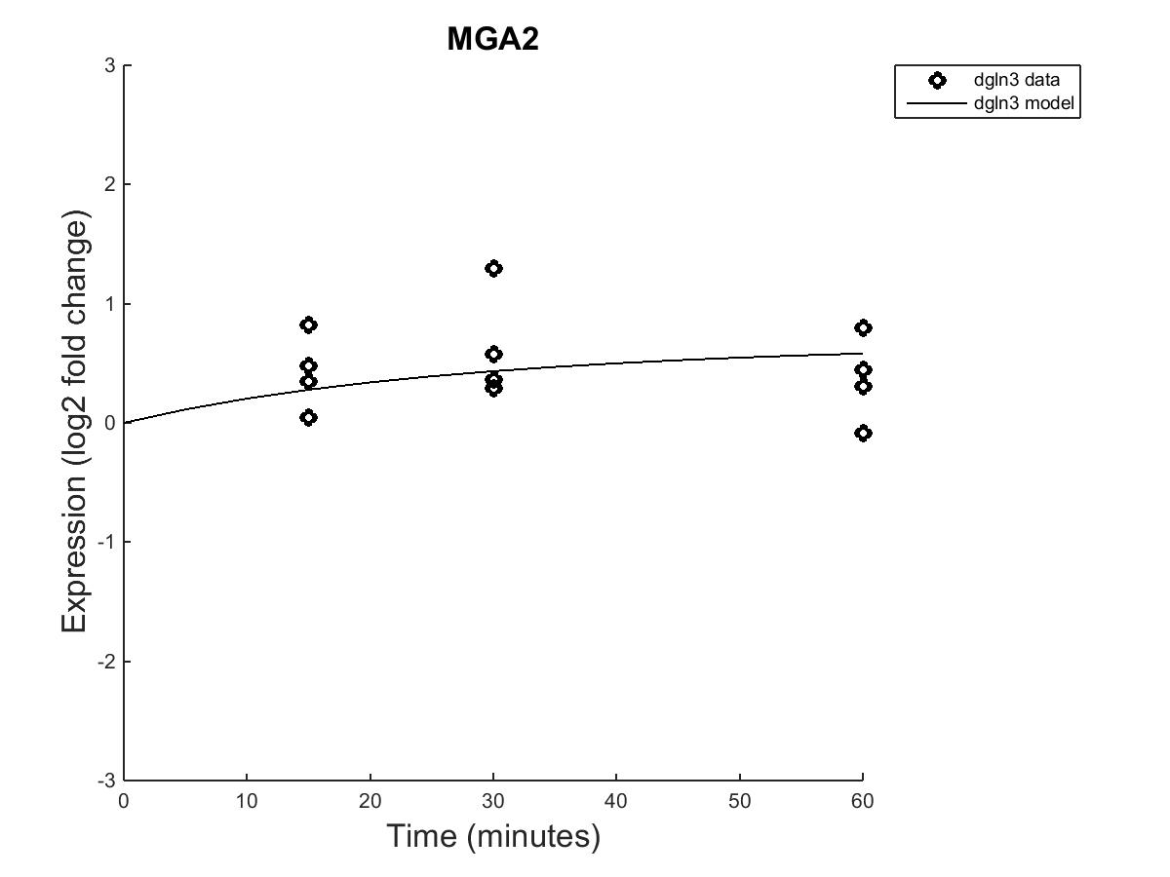
MGA2 with dGLN3
Wt B&H p=0.1028
dGLN3 B&H p=0.4322
Deleting GLN3 decreases the expression of MGA2
MGA2’s wiring to GLN3 is modeled correctly

Slide 15
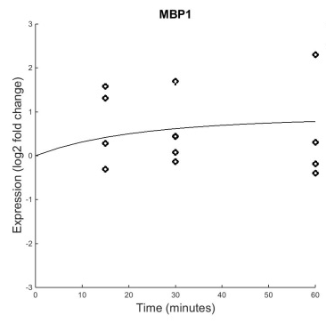
MAL33
Regulators: MBP1 and SMP1
B&H p=0.5240
B&H p=0.0101
Weight: -1.45
B&H p=0.6046
Weight: 0.77
Production rate is huge relative to other genes. The model is attempting to fit the large initial spike
Are these dynamics due to a regulator we’re not seeing?
Why does MBP1 repress MAL33?
Because inputs have no dynamics, it is difficult to estimate w’s and b
Unsure of MAL33 connection

Slide 17
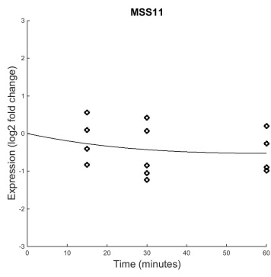
Genes with Three Inputs (MSS11)
Regulators: SKO1, CIN5 and SKN7
B&H p=0.1330
B&H p=0.4275
Weight: 0.024
B&H p=0.0642
Weight: 0.16
Weight: 0.078
Good fit
No significant dynamics
Inputs have some significant dynamics, weights are probably estimated well
Given this, why is there a downward expression?
Estimated production rate is about the same as degradation… this is causing downward model line
Weights are probably good… a good example of why we need to find production and degradation rates from literature
Validity of connection is uncertain
B&H p=0.0228

Slide 19
Genes with Self-Regulation Only (MBP1, SKN7, ZAP1)
B&H p=0.5240
B&H p=0.0228
B&H p=0.0086
Decent fit, large variance though
No significant dynamics
Decent fit, large variance though
Significant upward dynamics
Good fit, large variance though
Significant upward dynamics

Slide 20
MBP1 Self Regulation
B&H p=0.5240
B&H p=0.5240
Weight: -0.03
Upward trend of model described by estimated production rate 4X that of degradation rate
Weight can be almost anything because MBP1 has no significant dynamics… the model made it small so it would fit the up-ish trend of the data
Because of variance of data, it is difficult to tell if MBP1 is missing an activator (it’s probably not wired correctly though… we really need production rates to tell)

Slide 21
SKN7 Self Regulation
B&H p=0.0228
B&H p=0.0228
Weight: 0.50
Because of SKN7’s significant dynamics, we can be fairly confident in the validity of the weight value
Model appears fits the positive feedback connection in the network...
However, the trend looks as if it’s leveling off, which should not be the case with complete positive feedback (see ZAP1) – unless weight is smallish and degradation rate kicks in
SKN7 may have a repressor that levels this off… or a larger degradation rate
Connection validity is uncertain

Slide 22
ZAP1 Self Regulation
B&H p=0.0086
B&H p=0.0086
Weight: 0.77
Because of ZAP1’s significant dynamics, we can be a little more confident in the validity of this weight. ZAP1 seems to be exhibiting a positive feedback cycle trend, which matches the continuous upward trend in expression
The strength of this weight could be masking other activators, but other than this ZAP1 seems to be modeled well

Slide 24
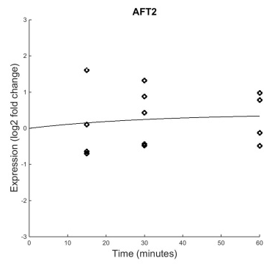
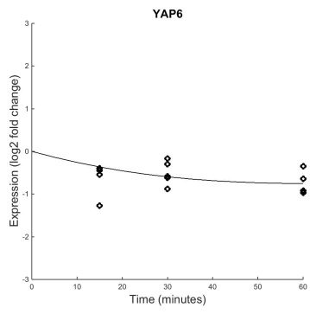
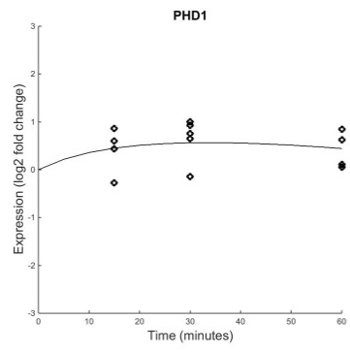
Genes with Self Regulation and Other Inputs (FKH2, AFT2, GLN3, CIN5, SMP1, SWI4, YAP6, PHD1)
B&H p=0.1274
B&H p=0.7161
B&H p=0.4125
B&H p=0.0642
B&H p=0.6046
B&H p=0.6367
B&H p=0.0003
B&H p=0.0017

Slide 25
AFT2 (Two regulators)
Regulators: AFT2 and SKN7
B&H p=0.7161
B&H p=0.7161
Weight: 0.045
B&H p=0.0228
Weight: -0.094
AFT2 has a decent fit, no significant dynamics
Weights are too small to see any effect.
Uncertain of AFT2’s connectivity… because of its dynamics (or absence thereof) it looks like we’re modeling noise

Slide 26
FKH2 (Two regulators)
Regulators: FKH2 and FHL1
B&H p=0.1274
B&H p=0.1274
Weight: -0.014
Weight: 0.062
B&H p=0.4454
FKH2 has a fairly good fit with statistically insignificant dynamics, but a visible downward trend
Because FKH2’s regulators do not have much dynamics, it is difficult to estimate w’s and b
Degradation rate is higher than production rate… model decreased P in attempt to fit data
Unsure of connection validity… no glaring errors, but having a literature production rate would help elucidate weights

Slide 27
GLN3 (Two regulators)
Regulators: GLN3 and MAL33
B&H p=0.4125
B&H p=0.4125
Weight: -0.18
Weight: 0.55
B&H p=0.0101
GLN3 has an okay fit with no significant dynamics
Slight self repression may work to keep levels stable… not enough data points to tell
Regulator MAL33 has a relatively large weight and increased levels of expression…. GLN3 should exhibit more increased expression. Perhaps GLN3 is missing a repressor.
GLN3 is probably missing an input, although variance gives uncertainty.

Slide 28
CIN5 (Four regulators)
Regulators: CIN5, SKO1, PHD1, YAP6
B&H p=0.0642
B&H p=0.0642
Weight: 0.73
B&H p=0.1330
Weight: -0.21
B&H p=0.0017
CIN5 has a fairly good fit with visible expression change, but no statistically significant dynamics because of large variance
Majority of regulators show significant dynamics, making the weights easier to estimate (i.e. they are probably reliable)
CIN5’s production rate is much higher than its degradation rate. This is contributing to large upward dynamics, even with several repressors present.
Again, without knowledge of production and degradation rates, it is difficult to say if CIN5 has the correct inputs.
Weight: -0.29
B&H p=0.0003
Weight: -0.50

Slide 29
SMP1 (Four regulators)
Regulators: SMP1, CIN5, FHL1, PHD1
B&H p=0.6046
Weight: 0.017
B&H p=0.6046
B&H p=0.0642
Weight: 0.19
B&H p=0.4454
SMP1 has a good fit with no significant dynamics
Only two of its four regulators have significant dynamics, making weights difficult to estimate
The largest weight comes from CIN5, which is also up-regulated. SMP1 should also exhibit upward expression.
The slightly downward trend is due to an estimated production rate that is roughly equivalent to the degradation rate
Without knowledge of pro and degradation rates, we cant’s say much about the validity of SMP1’s inputs.
All the weights are so low and SMP1 has no dynamics… we could just be modeling noise
Weight: 0.03
B&H p=0.0017
Weight: -0.04

Slide 30





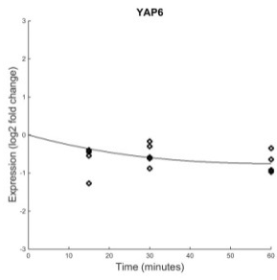
SWI4 (Six regulators)
Regulators: SWI4, MBP1, MAL33, PHD1, SWI6, YAP6
B&H p=0.6367
B&H p=0.6367
Weight: -0.00015
B&H p=0.5240
Weight: -0.0002
B&H p=0.0101
Weight: -0.0004
With SWI4, we are probably modeling noise
SWI4 has a fairly poor fit with no significant dynamics
Several regulators have insignificant dynamics or poor fits themselves
Weights are all very small
Production rate is tiny compared to degradation rate – the model is trying to account for the slightly downward trend
Too many inputs?
B&H p=0.0017
Weight: -0.0002
B&H p=0.1178
Weight: -0.00015
B&H p=0.0003
Weight: -0.00014

Slide 31

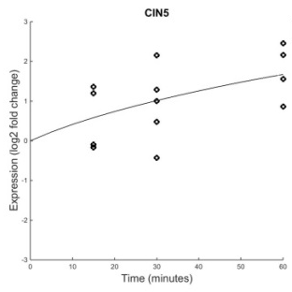
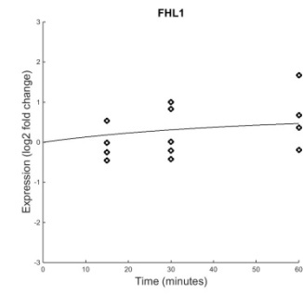
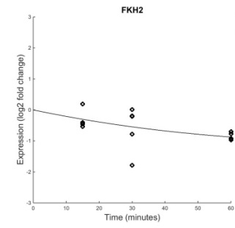
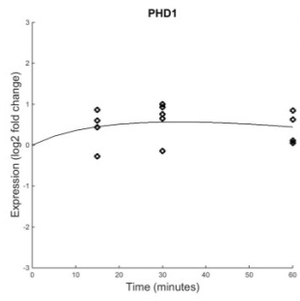


YAP6 (Seven regulators)
B&H p=0.0003
Regulators: YAP6, CIN5, FHL1, FKH2, PHD1, SKN7, SKO1
Weight: -0.17
B&H p=0.0003
B&H p=0.0642
Weight: 0.26
B&H p=0.4454
Weight: -0.022
B&H p=0.1274
Weight: -0.17
YAP6 has significant dynamics and is modeled fairly well
Estimated production rate is less than the degradation rate. This is contributing to the downward trend, even when the strongest weights (coming from genes with significant dynamics) are activating YAP6
Because YAP6’s regulators are mostly dynamic, the weights are probably estimated well. However, the validity of these inputs is uncertain without further knowledge of actual production and degradation rates.
B&H p=0.0017
Weight: -0.01
B&H p=0.0228
Weight: 0.19
B&H p=0.1330
Weight: -0.026

Slide 32







PHD1 (Seven regulators)
B&H p=0.0017
Regulators: PHD1, CIN5, FHL1, SKN7, SKO1, SWI4, SWI6
Weight: 0.16
B&H p=0.0017
B&H p=0.0642
Weight: -0.28
B&H p=0.4454
Weight: 0.062
B&H p=0.0228
Weight: -0.10
PHD1 has a good fit with significant dynamics
Most regulators also have significant dynamics, making the weights easier to estimate
Production rate is 3X degradation rate (a relatively stable value)
Although it is difficult to tell with so many inputs, PHD1’s model follows the trend of its inputs well
Initially activated, then slightly repressed as the two repressors (CIN5 and SKN7) increase their expression
PHD1’s inputs seem justified
B&H p=0.1330
Weight: 0.085
B&H p=0.6367
Weight: 0.16
B&H p=0.1178
Weight: 0.14
Total repression: -0.38
Total activation: 0.61

Slide 34
General Conclusions
We definitely need to get literature production and degradation rates
It is difficult to make any conclusive statements about the connections in the network without knowing the production and degradation rates… too many parameters to take into consideration
In terms of inputs:
6 genes are modeled well
11 genes are uncertain in their inputs (due to the need of P and d) – we could say something definitive about these genes if we didn’t have to estimate P
4 genes are modeled poorly/missing inputs

