Slide 1


Cling-E. coli : Bacteria on target
Harvard iGEM 2007
Ellenor Brown
Stephanie Lo
Alex Pickett
Sammy Sambu
Kevin Shee
Perry Tsai
Shaunak Vankudre
George Xu
Notes:
Hello, we are the Harvard iGEM team of 2007, and our project this summer was Cling-E. coli: Bacteria on Target.

Slide 2

The motivation To develop a system for targeting bacteria to a specific substrate and effecting a cellular response
Introduction
Harvard iGEM 2007
Notes:
So the basic motivation behind this summer’s work was to engineer a system where we could make bacteria bind to a target, and then induce a signal to make it do something.

Slide 3
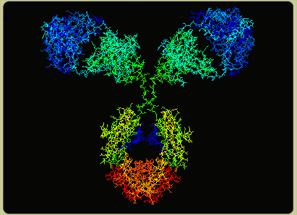
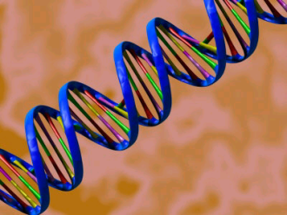
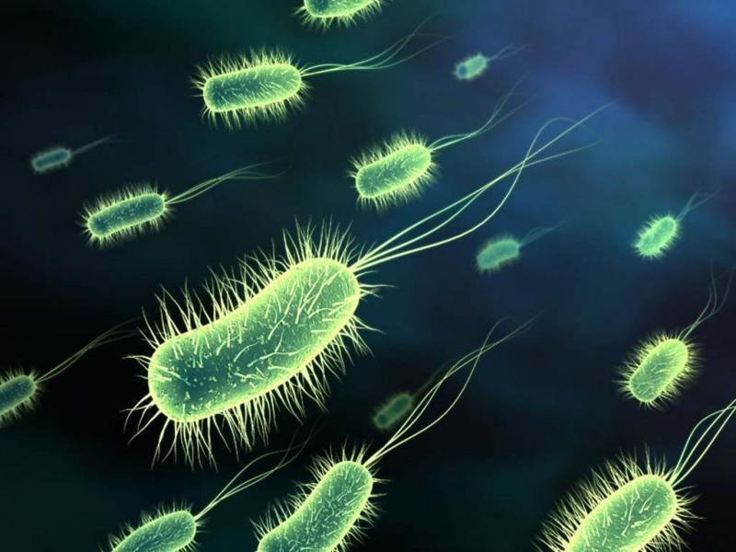
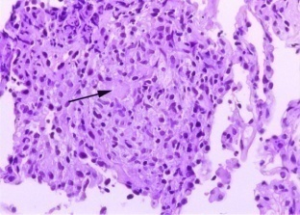
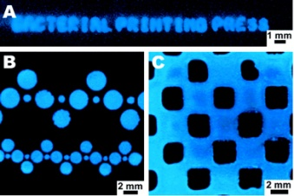
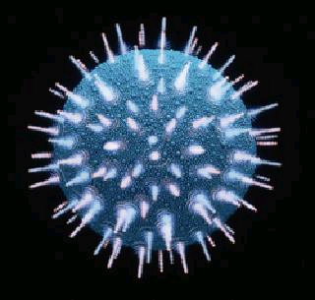
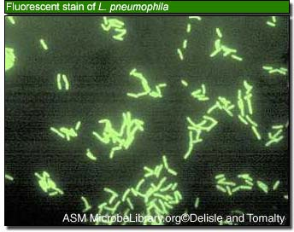

Potential Targets and Applications
Bind Proteins
Bind DNA/RNA
Bind Tissue
Bind Surface
Bind Viruses
Bind Other Cells
Bind Drugs/Toxins
Introduction
Harvard iGEM 2007
Notes:
So there are a lot of targets out there. On the small scale, you could have bacteria binding to proteins, nucleic acids, small molecule drugs or toxins, or larger viruses and cells, or even large metal surfaces and whole tissues. And there are also a lot of applications. On the research side, you could study protein-protein interactions with whole cells, or engineer cell-cell interactions. For biotech, you could make patterned biofilms as a a surface microarray. And medically speaking, bacteria might be utilized to deliver drugs or gene therapies, sequester toxins, fight viruses, or invade cancer tissue. Now these are just some of the current and future goals of synthetic biology, but the next important steps are (1) to get bacteria to bind to something in the surroundings, be it a liquid culture or the human body, and (2) to get them to do something once bound. that’s where targeting and signaling come in.

Slide 4
Bacterial targeting
Quorum-sensing
Quorum-sensing
Fec signal transduction
Fec signal transduction
Introduction
Harvard iGEM 2007
Notes:
This summer we took on three main focuses. The first was bacterial targeting, using peptides on the surface of bacteria to bind to targets. Then we had two different approaches to getting downstream activity. One was quorum-sensing, an indirect way by which bacteria that bind to a target would reach a high enough local concentration to induce a quorum response. The other was Fec signal transduction, a more direct way by which binding a target via FecA would transduce a signal into the cell for a response. And so first up, we’ve got targeting.

Slide 5

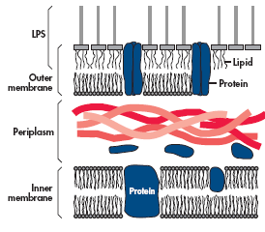
Surface-engineered
bacteria
OmpA – C terminal insertion
Surface Protein
OmpA-Loop1 insertion
Membrane Protein
AIDA-1 – N terminal insertion
Bacterial Targeting
Harvard iGEM 2007
Notes:
In order to successfully target, we were able to engineer the following constructs, each of which contained a fusion protein which displays a peptide on the outer membrane surface of the cell, serving as a membrane anchor for surface binding. Two of the candidate membrane proteins are OmpA1 and AIDA-1. We successfully engineered three different constructs using these two proteins: OmpA with a C terminal insertion, OmpA with an insertion in it’s Loop1 region, and AIDA-1 with an N terminal insertion. We received positive results for all three constructs, but stuck with the AIDA construct because of its superior enrichment.
5

Slide 6
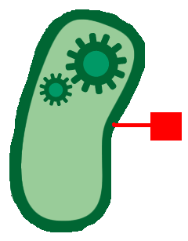
Selecting/enriching for surface-engineered bacteria
Tags
Histidine tag + nickel
Strep2 tag + streptavidin
Assay
Magnetic Activated Cell Sorting (MACS)
Magnetic Bead Assays
Bacterial Targeting
Harvard iGEM 2007
Notes:
In order to test each of our constructs, we added a His tag and a Strep2 tag to our OmpA and AIDA constructs, which bind to nickel beads and streptavidin beads, respectively. Using these tagged constructs, we ran a series of assays in order to find a robust assay that could cell sort through interaction with the outer membrane proteins with the his and strep2 tags. Magnetism Activated Cell Sorting (MACS) proved to be our most robust assay, allowing us to successfully sort for cells expressing our tagged. surface membrane proteins.

Slide 7

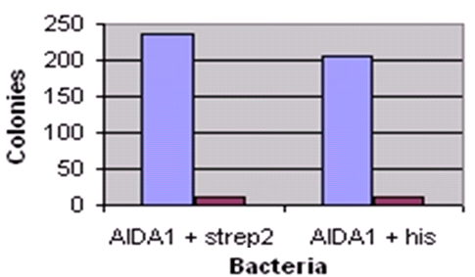

His and Strep2 tagged bacteria bind to beads
Colony counts after MACS selection
of tagged bacteria
235 10 206 11
Bacterial Targeting
Harvard iGEM 2007
Notes:
This is how MACS works: first you grow up two separate colonies. One with the his or strep2 tagged bacteria, and the other which will be used as background cells. In this specific trial we were selecting for AIDA1 + his and AIDA + strep colonies, using RFP labeled bacteria as background. It works in this manner. After you bind the magnetic beads to the tagged bacteria, you put them together in a solution with the RFP-labeled cells, and then run them through a magnetic column. The RFP labeled cells will flow straight through the column while the tagged cells bound to the magnetic bead will stick onto the column. Then, once removed from the magnets you can rinse the column and get all of the desired cells, and plate them. As you can see, the majority of the cells were those tagged with his or strep2 tags, with very low amounts of RFP labeled cells, which are background caused by nonspecific binding of the RFP cells to the magnetically-labeled cells.
7

Slide 8
Results
Surface-expression vehicle – AIDA1
Engineered surface-displayed histidine tag and strep2 tag
Demonstrated bacterial targeting to nickel and streptavidin beads through MACS
Bacterial Targeting
Harvard iGEM 2007
Notes:
8

Slide 9

Bacterial targeting
Quorum-sensing
Fec signal transduction
Quorum Sensing
Harvard iGEM 2007

Slide 10






luxI/luxR Quorum Sensing
R
Receiver
+
Sender
OHHL
Quorum Sensing
Harvard iGEM 2007
Notes:
Sammy just talked about the cell targeting aspect of the project where, in a liquid culture *CLICK*, we have specific binding to a target. Now I’m going to introduce the Intercellular Signaling aspect of our project. The motivation for this portion of the project is to effect a signal *CLICK* only in those cells bound to a target. To do this, we utilized the relatively high local concentration of cells bound to the target and the luxI/luxR Quorum Sensing circuit.
The luxI/luxR quorum sensing circuit involves the two genes luxr *CLICK* and luxI *CLICK* that were taken from the marine bacterium Vibrio fischeri. luxR codes for a protein *CLICK*, which we’ll call R, that is localized within the cell. This acts as the receiver molecule. luxI codes for an enzyme that breaks down the small molecule SAM into the Homoserine Lactone, OHHL *CLICK*. OHHL is freely diffusible through the membrane and will spread out from the cell *CLICK*. In areas of high cell concentration, the concentration of OHHL will also be high. These OHHL will then bind to the R *CLICK* and form a complex *CLICK* that upregulates the luxpR promoter, causing transcription of the reporter gene, which in our case is GFP. *CLICK*

Slide 11


Cell-Cell Signaling Constructs
Receivers (luxR + Reporter)
GFP Receivers
tetR controlled (Bba_T9002)
Quorum controlled (Bba_R0062 + Bba_C0261 + Bba_E0240)
mRFP Receivers
tetR controlled (Bba_F2620 + Bba_I13507)
Quorum controlled (Bba_R0062 + Bba_C0261 + Bba_I13507)
mCherry Receivers (Bba_F2620 + Bba_J06702)
Senders (bicistronic luxI + Reporter)
mRFP Sender
tetR controlled (Bba_S03623 + Bba_I13507)
lacI controlled (Bba_S03608 + Bba_I13507)
Quorum controlled (Bba_R0062 + Bba_A340620 + Bba_I13507)
GFP Sender
tetR controlled (Bba_S03623 + Bba_E0240)
lacI controlled (Bba_S03608 + Bba_E0240)
Quorum controlled (Bba_R0062 + Bba_A340620 + Bba_E0240)
mCherry Sender
tetR controlled (Bba_S03623 + Bba_J06702)
Single Cell
Constitutive (Bba_J23039 + Bba_T9002)
Quorum Controlled (Bba_R0062 + Bba_A340620 + Bba_C0261 + Bba_E0240)
Construction Intermediates
Receiver
Sender
Quorum Sensing
Harvard iGEM 2007
Notes:
As you can see, we built several constructs to test this circuit, including swapping promoters and reporters. In the end, we settled on a two-cell system of Receiver constructs *CLICK*, which contain the genes for the receiver protein and the GFP reporter, and Sender constructs *CLICK*, which contain a bicistronic sender protein and RFP reporter. This RFP helped us quantify how many Sender cells we had in our cultures. In addition to this two-cell system, we also emulated the construct created by Dr. Voigt in his paper, “Environmentally Controlled Invasion of Cancer Cells by Engineered Bacteria,” namely a single-cell construct that contains both the receiver and sender parts in one cell. We believe that this would more closely emulate the wild-type cassette present in Vibrio fischerii, which contains both parts in a single cell. At this time, we are still in the process of characterizing this system. *CLICK*

Slide 12


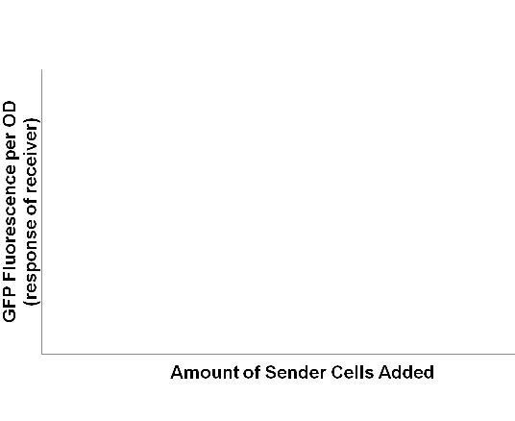
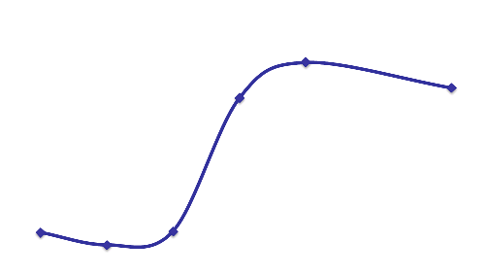
Switch-like Quorum Response
R
Receiver
Sender
Quorum Sensing
Harvard iGEM 2007
Notes:
For the two-cell system, we have been able to show that the reporter response is switch-like and consistent with a quorum circuit. We made several mixed cultures *CLICK* of both sender and receiver cells. *CLICK.* We noticed that at a certain concentration of sender cells, the reporter response increase drastically. This switch-like behavior shows that constructs indeed exhibit quorum response.

Slide 13



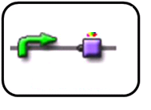
MACS selection of cotransformed luxI-RFP/AIDA-strep2 cells
tetR
luxI-RFP
T7
AIDA-strep2
Red sender
Strep2 tag
Quorum Sensing
Harvard iGEM 2007
Notes:
As a merging of the quorum and targeting projects, the AIDA-N-terminal insertion *CLICK* was cotransformed with the quorum parts. *CLICK*. Shown here, constitutively red sender cells were selected for via a direct magnetic bead assay against untagged green background cells.

Slide 14
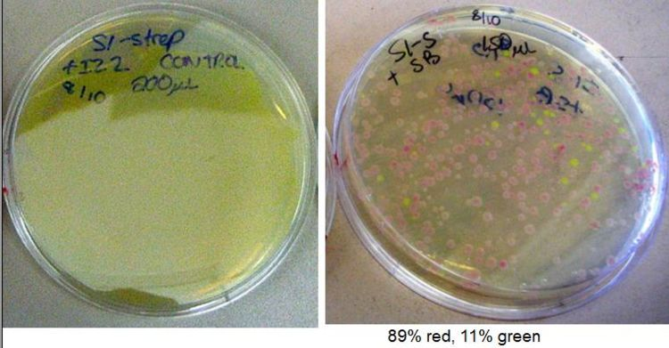
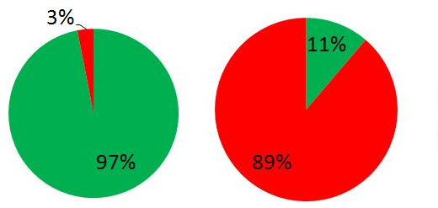
MACS selection of cotransformed luxI-RFP/AIDA-strep2 cells
Before
After
Quorum Sensing
Harvard iGEM 2007
Notes:
The assay was successful, yielding a 60-fold enrichment of the red strep-tagged sender cells. On the left, the plate with the control is shown. It is likely that the green cells had a significant growth advantage because they did not need energy to express the sender construct or the tagged membrane proteins. Through the magnetic bead assay, we were able to select for the red tagged cells (on right).

Slide 15
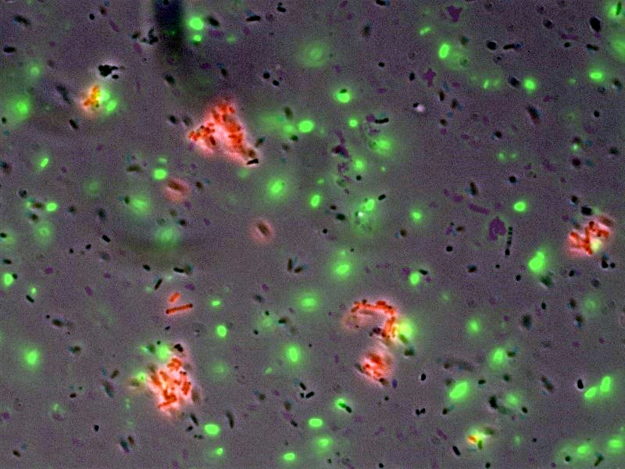
luxI-RFP/AIDA-strep2 cells clump around streptavidin beads
Quorum Sensing
Harvard iGEM 2007

Slide 16
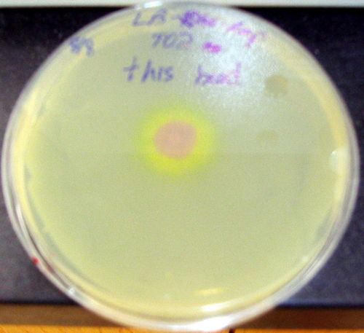


Selected luxI-RFP/AIDA-strep2
cells can send quorum signal
Receiver
R
OHHL
Quorum Sensing
Harvard iGEM 2007
Notes:
In the plate drop experiment, we spread receiver cells on an LB plate. We then took tagged, constitutively red sender cells and selected for them through the direct magnetic bead assay. After selection, we plated them in the middle of the plate containing the receivers. A green halo resulted, indicating that the sender cells had successfully been enriched and were able to act as a quorum system, catalyzing the synthesis of OHHL, which subsequently activated the GFP reporter of the nearby receiver cells. This is in contrast to the negative control, in which non-tagged sender cells were not enriched, so no halo was detectable.

Slide 17

Bacterial targeting
Quorum-sensing
Fec signal transduction
Fec signal transduction
Harvard iGEM 2007

Slide 18
Motivation: Fec System
Goal: Direct cell signaling
Method: Re-engineer an existing signal transduction pathway
Fec system:
well-characterized
only outer membrane signal transducer
Fec signal transduction
Harvard iGEM 2007

Slide 19
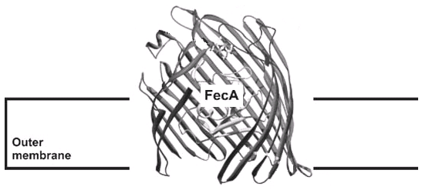
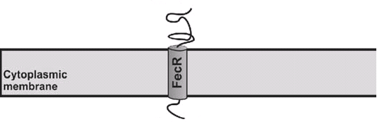

Overview of Fec System
Ferric citrate
Fec signal transduction
Braun et al. “Gene Regulation by Transmembrane Signaling.” Biometals 2006 Apr;19(2):103-13.
Harvard iGEM 2007

Slide 20
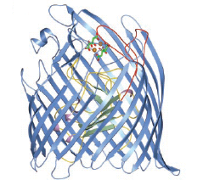
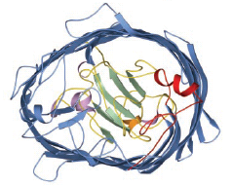
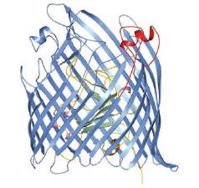
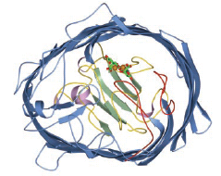
Loops 7 and 8 as
potential insertion sites
Ferric citrate
Loops 7 & 8
Fec signal transduction
Ferguson AD, et al. Structural basis of gating by the outer membrane transporter FecA. Science 2002 Mar 1; 295(5560) 1715-9.
Harvard iGEM 2007

Slide 21
Constructs
From Braun lab (U. Tuebingen, Germany)
Fec knock-out strain, AA93
FecIRA plasmid
P_{Fec}-GFP plasmid
pColA Duet Vector
Allows regulated expression of Fec genes under T7 promoter
Fec signal transduction
Harvard iGEM 2007

Slide 22
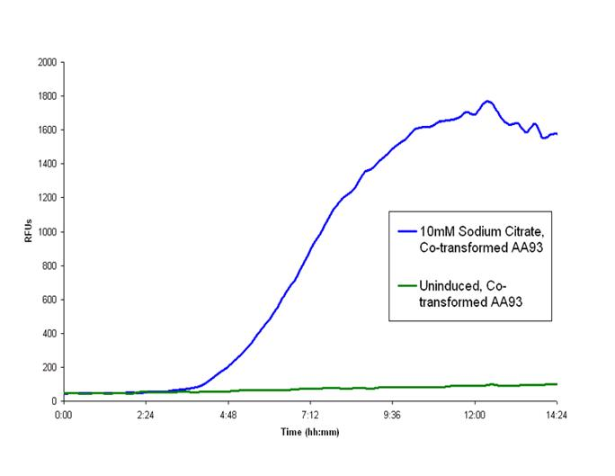
Fec-induced GFP expression
Fec signal transduction
Harvard iGEM 2007

Slide 23
Troubleshooting and Next Steps
Problems:
Growth media: WL vs. LB?
Toxicity: membrane disruption?
Goals:
Nickel and Streptavidin Binding
Finding new targets with signaling
Random library
Computational Approach (Maranas lab)
Fec signal transduction
Harvard iGEM 2007

Slide 24



Conclusions and Future Directions
Surface engineering – AIDA1
Histidine/Strep2 tags
MACS
Bacterial targeting
Bacterial targeting
Random peptide libraries
One-cell/two-cell quorum systems
Characterized
Targeted quorum senders
Characterized wild-type Fec signaling
Fec signal
transduction
Fec signal
transduction
Computational design
Quorum-sensing
Optimize localized quorum response
Quorum-sensing
Conclusion
Harvard iGEM 2007
Harvard iGEM 2007
Notes:
So we’ve made some progress. We successfully engineered the E. coli surface, using the outer membrane protein AIDA, and we displayed histidine and strep2 tags, and demonstrated that they binded to nickel and streptavidin beads in the MACS assay. With quorum-sensing, we constructed one cell and two cell systems, and made some characterization, but more importantly, we were able to put together targeting and quorum-sensing and create a new type of cell that binds to a substrate and sends a quorum signal. And with the Fec system, we were able to implement and characterize native Fec signaling.
We’re excited to have taken these steps in adding extracellular interaction to the toolkit of synthetic biology. In the future, we hope to employ new tags in AIDA and in FecA. Some interesting approaches to developing tags for novel targets include random peptide libraries, by which you grow up a bacterial library of surface peptides and screen for the one that binds to your target, or computational design, using computers to figure out the peptide that binds your target. Finally, with targeted quorum-sensing, we need to optimize the localized quorum response at the time of target-binding

Slide 25
Acknowledgements
Advisors
George Church
Debra Auguste
Jagesh V. Shah
William Shih
Pamela Silver
Alain Viel
Tamara Brenner
Teaching Fellows
Nicholas Guido
Bill Senapedis
Mike Strong
Harris Wang
Funding
HHMI
Harvard Provost
Harvard Life Sciences Division
Harvard School of Engineering and Applied Sciences
Special thanks to…
Volkmar Braun (U of Tuebingen)
Costas Maranas (Penn State U)
Conclusion
Harvard iGEM 2007

