Slide 1
I. Pyrophosphate Assays
Research Update
KL 8/17/2010

Slide 2
Pyrophosphate Concentration Day 0-2
Functional ANK positively regulates osteoblast development (APase, BSP, osteocalcin, osterix, runx2, and type I collagen) (Kirsch, JBMR, 2010)

Slide 3
II. ANK siRNA KD: Time point and Dosage

Slide 4
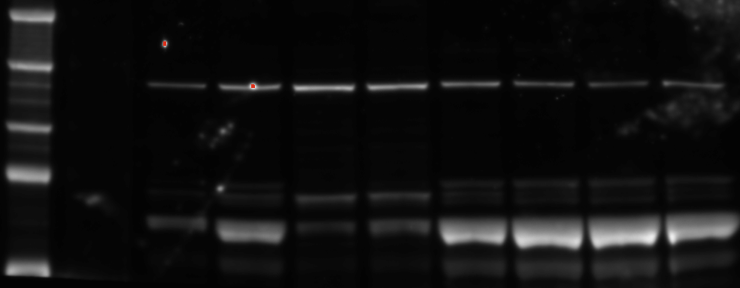
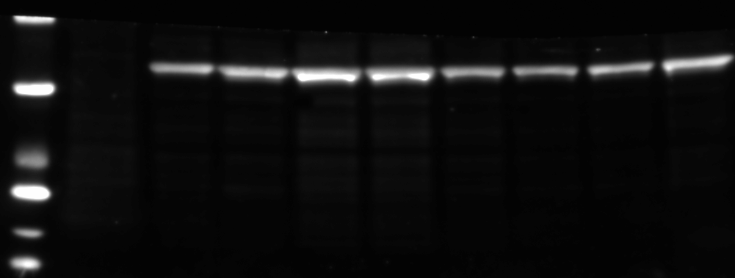
ANK (Santa Cruz) 8/17/2010
ANK
40mM Day 4
ANK
200mM Day 4
ANK
40mM Day 3
ANK
200mM Day 2
ANK
200mM Day 3
Scramble #2 200mM Day 3
ANK
40mM Day 2
MC3T3
Ladder
250 kDa
ANK( 54kDA)
Blocking Solution: 5% NFM, 1hr RT
Primary: 1:200 Rabbit Polyclonal Anti-ANK, 1hr RT
Secondary: 1:4000 Goat Anti-Rabbit, 1hr RT
Chemiluminescence,
150 kDa
100 kDa
75 kDa
50 kDa
37 kDa
Actin( 42kDA)
Blocking Solution: 5% BSA, 1hr RT
Primary: 1:1000 Anti-Actin IgG2A, overnight, 4C
Secondary: 1:10,000 Goat Anti-Mouse Ig-HRP, 1hr RT
Chemiluminescence, sec exposure
25 kDa
20 kDa
15 kDa

Slide 5
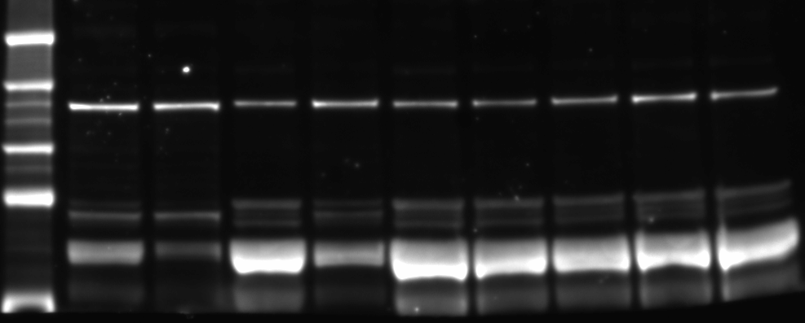
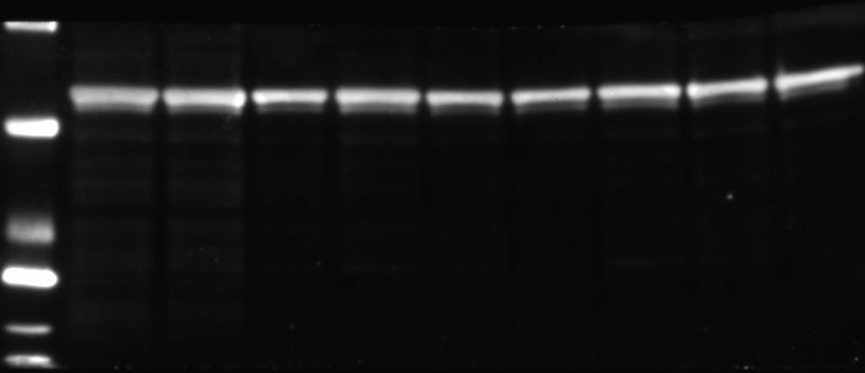
ANK (Santa Cruz) 8/17/2010
Scramble 40nM Day 4
Scramble 200nM Day 3
Scramble #2 40nM Day 2
Scramble #2 40nM Day 3
Scramble 40nM Day 2
Scramble 40nM Day 3
Scramble 200nM Day 2
Scramble 200nM Day 4
Scramble #2 40nM Day 4
Ladder
250 kDa
ANK( 54kDA)
Blocking Solution: 5% NFM, 1hr RT
Primary: 1:200 Rabbit Polyclonal Anti-ANK, 1hr RT
Secondary: 1:4000 Goat Anti-Rabbit, 1hr RT
Chemiluminescence,
150 kDa
100 kDa
75 kDa
50 kDa
37 kDa
Actin( 42kDA)
Blocking Solution: 5% BSA, 1hr RT
Primary: 1:1000 Anti-Actin IgG2A, overnight, 4C
Secondary: 1:10,000 Goat Anti-Mouse Ig-HRP, 1hr RT
Chemiluminescence, sec exposure
25 kDa
20 kDa
15 kDa
10 kDa

Slide 6
III. Western blot: TRPV4 and IFT88 siRNA Knockdowns
(NB110-74960 and H00008100-A01)

Slide 7
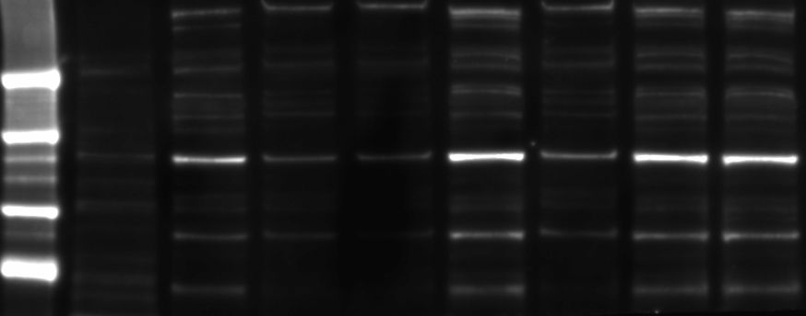
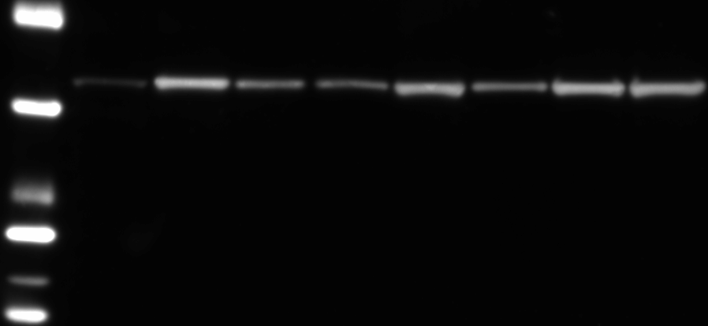
IFT88 (Novus) 8/16/2010
Polaris 2200pmol
Negative Vector Control
Polaris 600pmol
Scrambled 600pmol
Scrambled 2200pmol
Scrambled #2 600pmol
Scrambled #2 2200pmol
MC3T3
Ladder
IFT88( 95kDA)
Blocking Solution: 5% NFM, 1hr RT
Primary: 1:500 Mouse Anti-IFT88, overnight, 4C
Secondary: 1:2000 Goat Anti-Mouse, 1hr RT
Chemiluminescence, 15 sec exposure
250 kDa
150 kDa
100 kDa
75 kDa
50 kDa
37 kDa
Actin( 42kDA)
Blocking Solution: 5% BSA, 1hr RT
Primary: 1:1000 Anti-Actin IgG2A, overnight, 4C
Secondary: 1:10,000 Goat Anti-Mouse Ig-HRP, 1hr RT
Chemiluminescence, 30 sec exposure
25 kDa
20 kDa
15 kDa
10 kDa

Slide 8
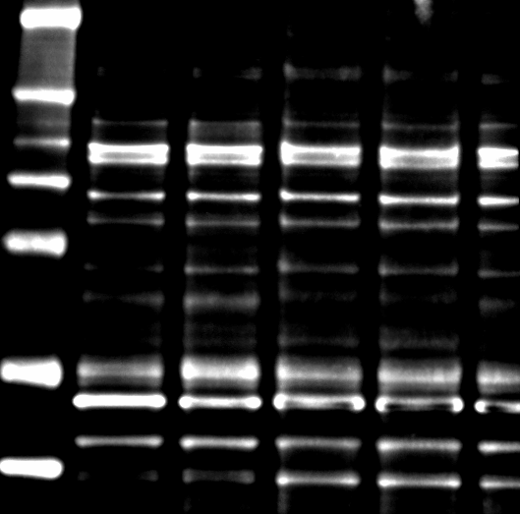
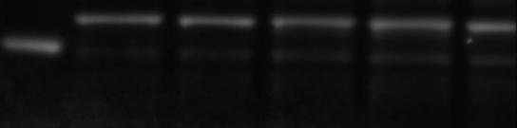
TTC10 (Abcam) 7/14/2010
Scrambled 2200pmol
Polaris 600pmol
Polaris 2200pmol
Scrambled 600pmol
Ladder
WT MC3T3
250 kDa
150 kDa
100 kDa
75 kDa
TTC10( 95kDA)
Blocking Solution: 1% BSA, 1hr RT
Primary: 1:1000 Goat Polyclonal Anti-YTC10, overnight, 4C
Secondary: 1:5000 Rabbit Polyclonal Anti-Goat, 1hr RT
Chemiluminescence, 5 sec exposure
50 kDa
Actin( 42kDA)
Blocking Solution: 5% BSA, 1hr RT
Primary: 1:1000 Anti-Actin IgG2A, overnight, 4C
Secondary: 1:10,000 Goat Anti-Mouse Ig-HRP, 1hr RT
Chemiluminescence, 30 sec exposure
37 kDa

Slide 9
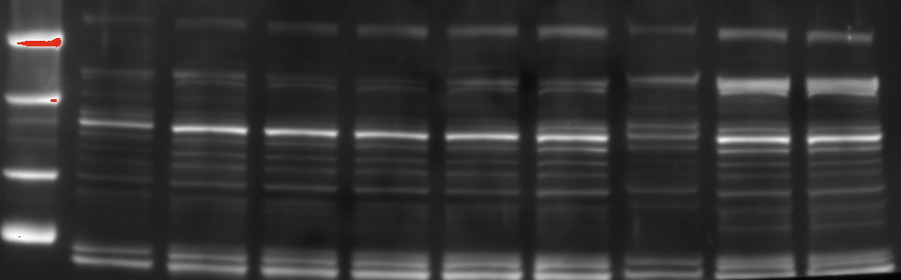
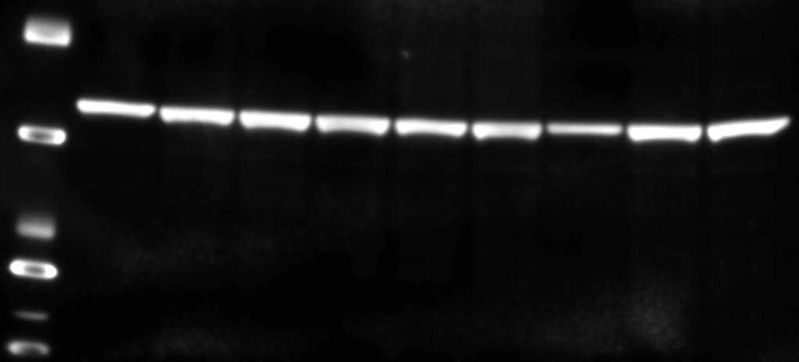
TRPV4 (Novus) 8/16/2010
TRPV4_2 600pmol
TRPV4_1 2200pmol
TRPV4_1 600pmol
Scrambled 600pmol
TRPV4_2 2200pmol
Scrambled 2200pmol
Scrambled #2 2200pmol
Scrambled #2 600pmol
MC3T3
Ladder
TRPV4( 98kDA)
Blocking Solution: 5% NFM, 1hr RT
Primary: 1:1000 Rabbit Polyclonal Anti-TRPV4, O/N, 4C
Secondary: 1:4000 Goat Anti-Rabbit, 1hr RT
Chemiluminescence, 30 sec exposure
250 kDa
150 kDa
100 kDa
75 kDa
50 kDa
37 kDa
Actin( 42kDA)
Blocking Solution: 5% BSA, 1hr RT
Primary: 1:1000 Anti-Actin IgG2A, overnight, 4C
Secondary: 1:10,000 Goat Anti-Mouse Ig-HRP, 1hr RT
Chemiluminescence, 30 sec exposure
25 kDa
20 kDa
15 kDa
10 kDa

Slide 10
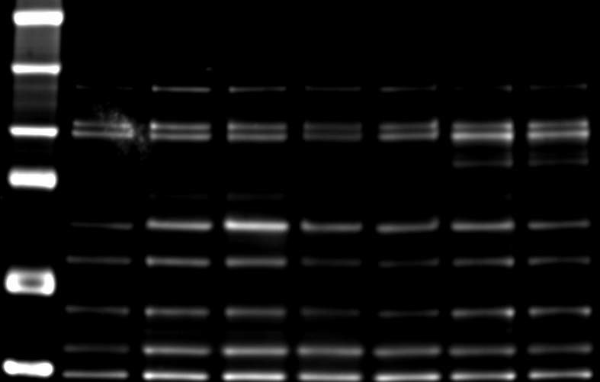
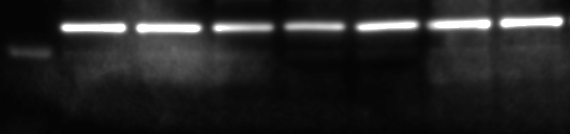
TRPV4 (Alomone) 7/14/2010
TRPV4_1
600pmol
TRPV4_1 2200pmol
Scrambled
600pmol
Scrambled
2200pmol
TRPV4_2
600pmol
TRPV4_2
2200pmol
Ladder
WT MC3T3
250 kDa
TRPV4 (98kDa)
Blocking Solution: 1% BSA TBS-Tween, 1 hr RT
Primary: 1:200 Rabbit PolyclonalAnti-TRPV4 O/N 4C
Secondary: 1:4000 Goat Polyclonal Anti-Rabbit HRP, 1hr RT
150 kDa
100 kDa
75 kDa
Chemiluminescent Detection FUJI Mini 4000: Standard, 30 sec exposure
50 kDa
37 kDa
Actin( 42kDA)
Blocking Solution: 5% BSA, 1hr RT
Primary: 1:1000 Anti-Actin IgG2A, overnight, 4C
Secondary: 1:10,000 Goat Anti-Mouse Ig-HRP, 1hr RT
Chemiluminescence, 30 sec exposure

Slide 11
TRPV4 Literature
TRPV4 localizes to primary cilia and transports Ca2+
  Cholangiocytes (LaRusso)
    Osmosensitive→Ca2+ increases in a TRPV4-, ciliary-, and extracellular Ca-dependent manner
  Porcine Articular Chondrocytes (Guilak)
    Block TRPV4 (GSK205 antagonist)→reduced Ca2+ responsiveness and PGE2 production
    Removal of primary cilia→ eliminated Ca2+ signaling

Slide 12
TRPV4 Literature
Bone (Carmeliet)
  TRPV4 knockout increases bone mass by impairing bone resorption
    Intracellular Ca2+ signaling is required for osteoclast maturation and differentiation (TRAP staining, NFATc1, NFATc1-dependent genes :c-fos, c-jun, calcineurin mRNA)
    Trvp4(-/-) mice had increased bone mass
    Osteoblast #, Osteocalcin, Runx2, alkaline phosphatase were comparable between Trvp4(-/-) and WT, TRPV4 is NOT crucial for osteblast proliferation or differentiation
Notes:
TRAP:staining of tartrate-resistant acid phosphatase in osteoclasts
C-fos: key regulator of osteoclast-macrophage lineage determination and bone remodeling
NFATc1:master regulator of nuclear factor kappaB ligand-induced osteoclast differentiation
C-jun: RANKL-activated transcription factor that regulates osteoclastogenesis
Calcineurin: necessary downstream mediator for osteoclast differentiation

Slide 13
Next:
MC3T3s:
  Knockdown TRPV4 again (Lipo or Neon?)
    Find positive lysate
  Run another Western and PCR
  Run flow
    Measure Ca2+?
    COX2, PGE2

