Slide 1
ANK siRNA knockdown
Optimization, Western assay, Flow Results
Kristen Lee
5/4/2010

Slide 2
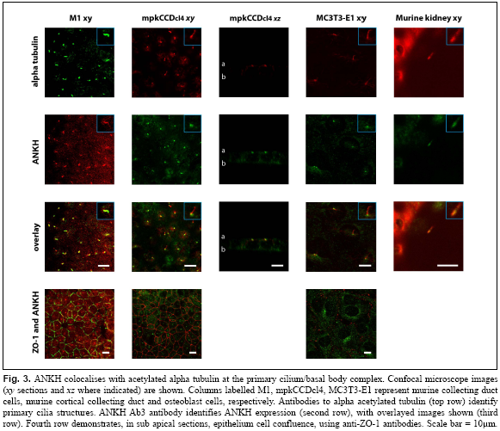
ANK colocalizes to the primary cilia in MC3T3s (acetylated alpha tubulin)

Slide 3
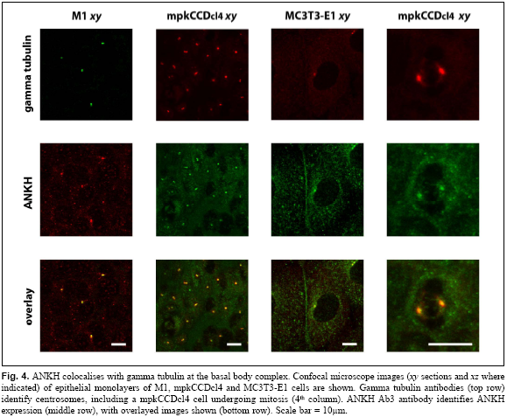
ANK colocalizes to the basal body complex in MC3T3s
(gamma tubulin)

Slide 4
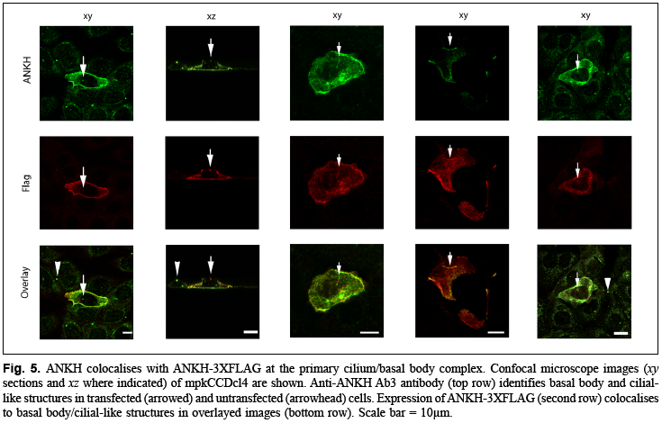
ANK colocalizes to the primary cilia/basal body in MC3T3s
(Transfected ANKH-3XFLAG)

Slide 5
siRNA Optimization
24 well plate→1:1 ratio of Lipo2000:BLOCK-it Fluorescent Oligo was strongest (but I forgot to take BF pictures, no idea if cells were alive/dead)
100mm dish (checked live:dead ratio):
  +a growth control (No Lipo2000, no siRNA)
  +a negative control (No Lipo2000, 600pmol siRNA)
  → 1:1 ratio confirmed
 | 600 pmol siRNA | Fluor Control (no siRNA)
30uL Lipo2000 | (recommended)
15uL Lipo 2000
5uL Lipo 2000

Slide 6
Optimization Procedure
Plated 200,000 cells/slide at Day 0 (I would adjust to 80,000-100,000 cells/slide next time)
Transfect siRNA 6 hours following cell adhesion to fibronectin-coated glass slides (1mL media)
  Lipofectamine 2000 and siRNA complex formation in Reduced Serum OptiMEM (2ul in 100ul OptiMEM for each, then complex)
  MC3T3s in supplemented alphaMEM growth media (but no antibiotics)
Removal of transfection reagent after 24 hours
  MC3T3 supplemented alphaMEM growth media +P-S (10mL)
    (Wash with PBS 3-4 times if bacteria infection is suspected)
Flow/cell lysis with RIPA buffer for Western assay blot at Day 1-Day 4 following transfection

Slide 7
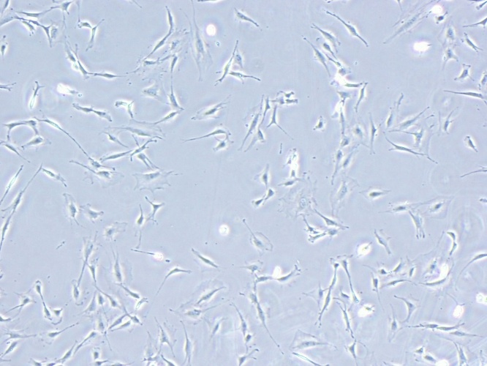
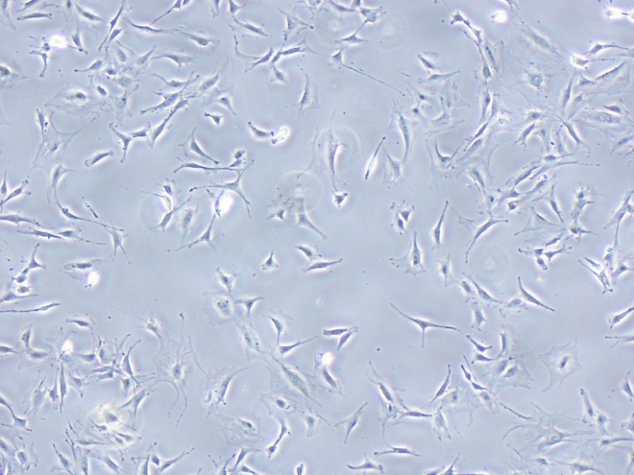
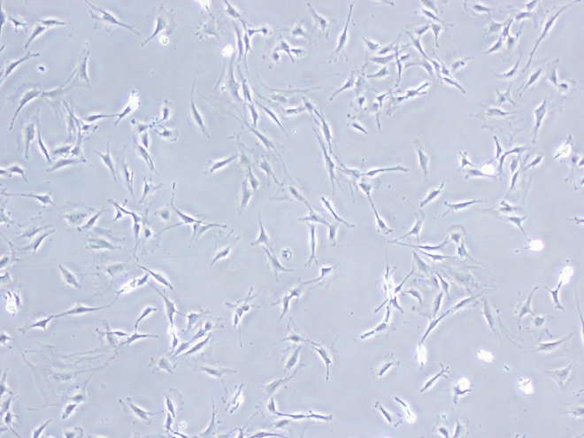
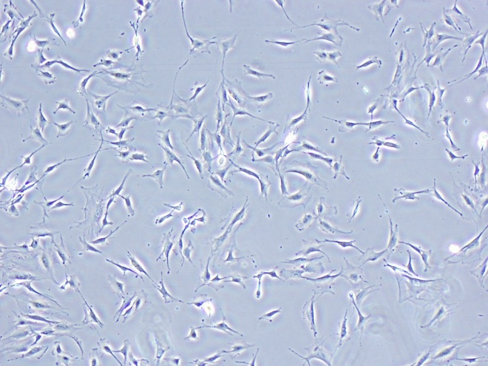
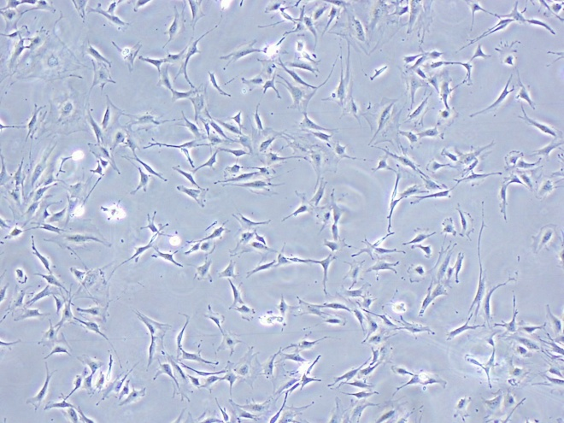
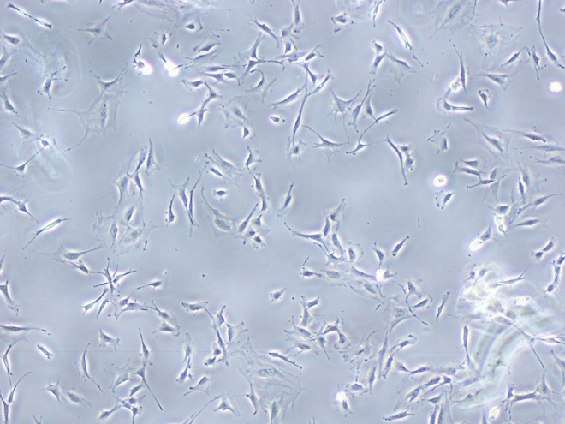
Experimental Slides (4x)
Day 0
600pmol_duplicate
30 uL
Lipo 2000
15 uL
Lipo 2000
5 uL
-200,000 cells/slide
~40% confluency

Slide 8
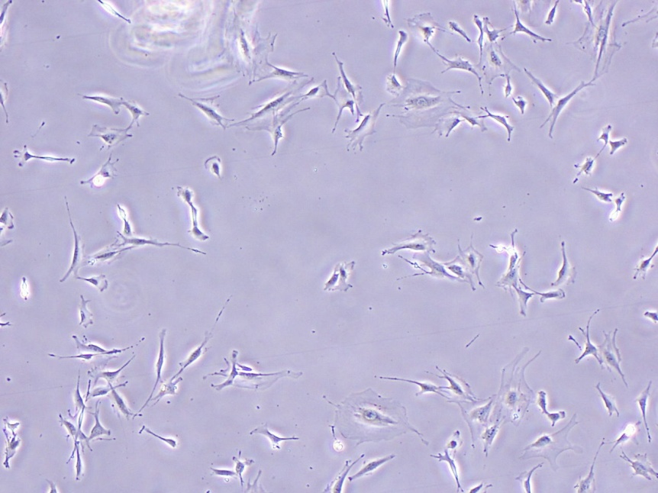
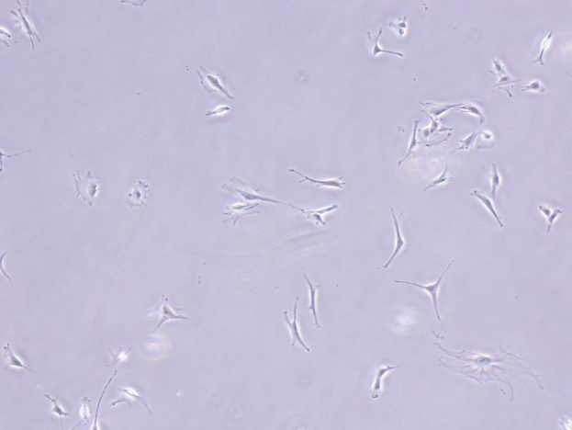
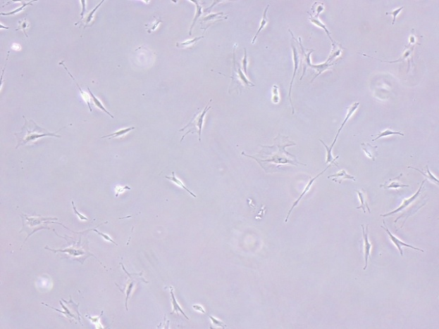
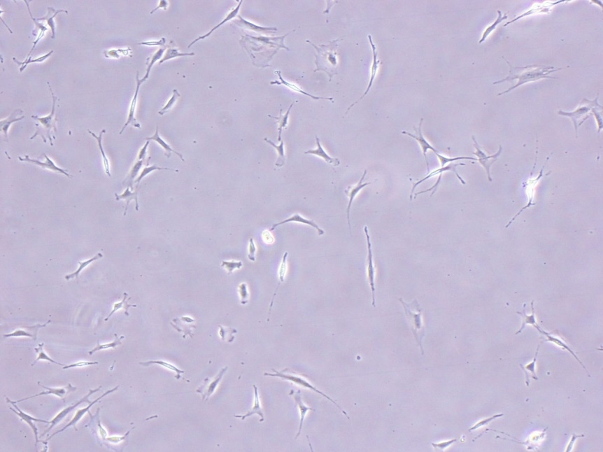
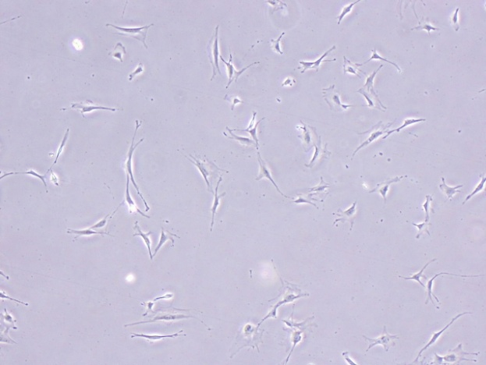
Control Slides (4x) Day 0
No siRNA
No siRNA
30 uL
No Lipo 2000
15 uL
Growth Control
600pmol siRNA
5 uL
No Lipo 2000
Reagent Control

Slide 9
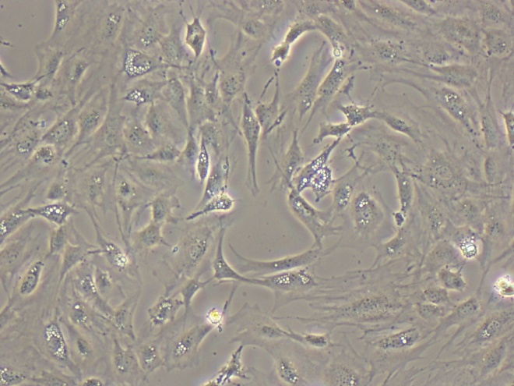
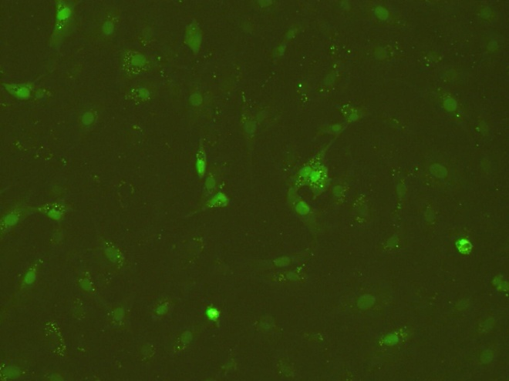
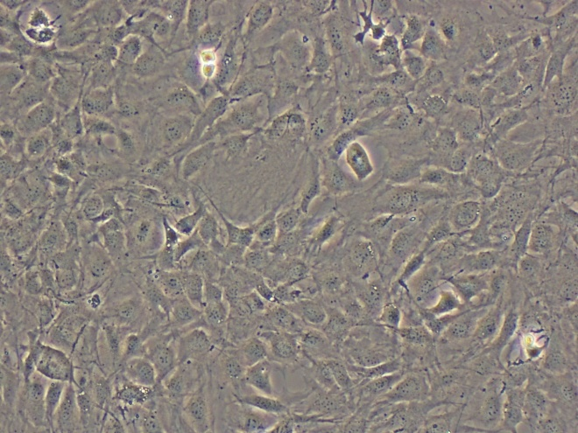

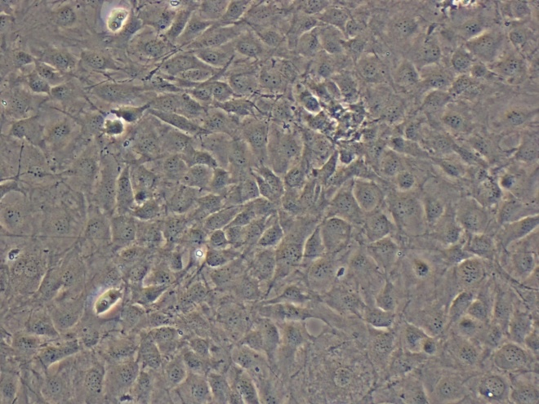

Experimental Slides
48 hours
10x BF: 1/3s exposure
10x Fl: 4s exposure
30 uL Lipo 2000
15 uL Lipo 2000
5 uL Lipo 2000
All negative controls have this same (lack of) fluorescence

Slide 10
BLOCK-it Optimization Result
1:1 Lipofectamine 2000:BLOCK-it Oligo yields strongest uptake
  30 uL Lipo 2000+ 30uL(600pmol) siRNA in 100mL dishes
The addition of 30 uL Lipofectamine 2000 slowed cell replication compared to lower levels and the negative control
  Little difference between 15 uL and 5 uL in affecting cell growth and Oligo uptake
siRNA-mediated transfection was applied on cells and cultured for an additional Day 1-4
  Protein lysates were collected for Western Blots

Slide 11
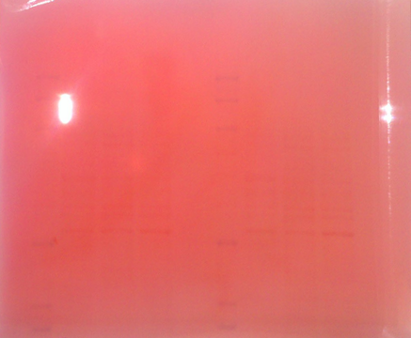
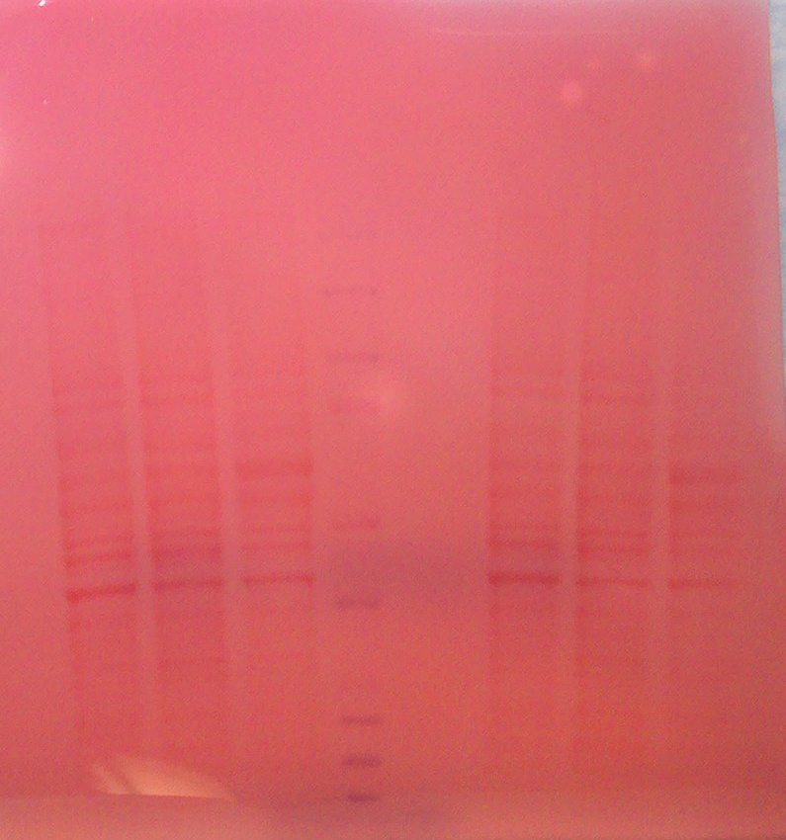
Western Blot optimization: Equal application of protein

Slide 12
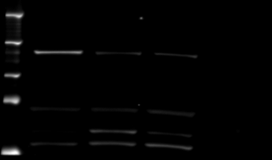
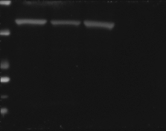
DMP1 protein
Ladder
WT MC3T3
WT C3H
WT IMCD
ANKH (54 kDA):
15 sec exposure
5% non-fat milk
1:500 rabbit anti-ANKH IgG
1:5000 goat anti-rabbit IgG
250 kDa
150 kDa
100 kDa
75 kDa
50 kDa
Actin (42 kDA) :
1 sec exposure
5% BSA
1:1,000 anti-actin Ig2A
1:30,000 goat anti-mouse Ig
37 kDa
25 kDa
20 kDa
15 kDa
10 kDa

Slide 13
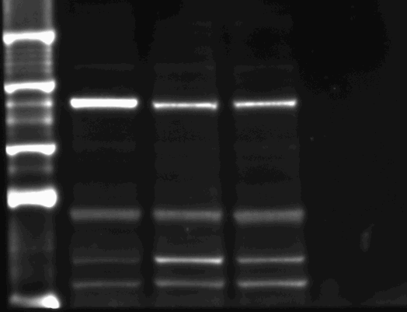
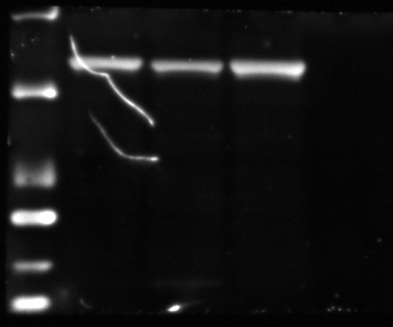
DMP1 protein
Ladder
WT MC3T3
WT C3H
WT IMCD
ANKH (54 kDA):
30 sec exposure
5% non-fat milk
1:1000 rabbit anti-ANKH IgG
1:10.000 goat anti-rabbit IgG
250 kDa
150 kDa
100 kDa
75 kDa
Actin (42 kDA) :
5 sec exposure
5% BSA
1:1,000 anti-actin IgG2A
1:30,000 goat anti-mouse Ig
50 kDa
37 kDa
25 kDa
20 kDa

Slide 14
Western Blot for ANKH
Used Day 1-4 post-transfection incubated cells
For ANKH
  1:500 primary antibody
  1:5,000 secondary

Slide 15
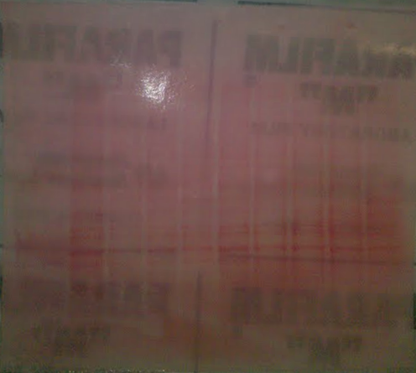
Ponceau S ANK knockdown

Slide 16
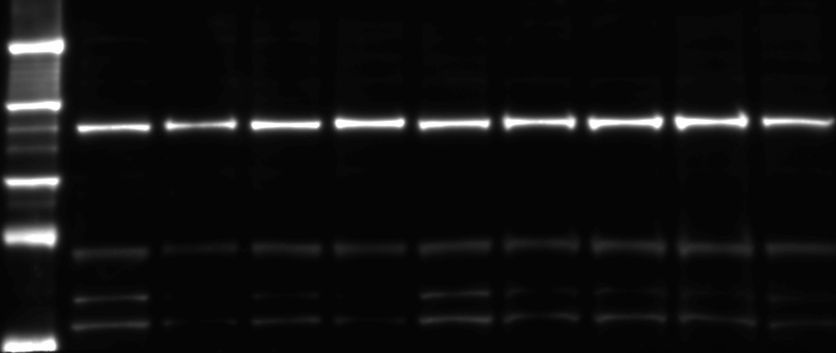
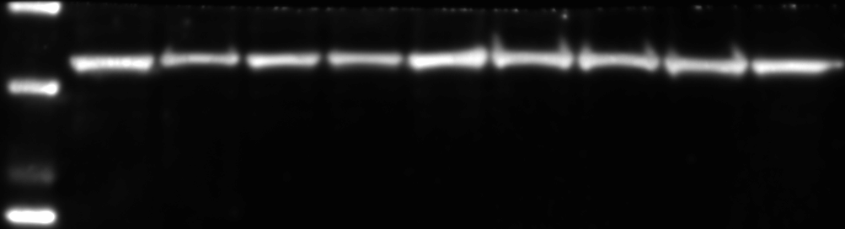
ANK KD Day 1
ANK KD Day 2
ANK KD Day 3
ANK KD Day 4
scramble Day 1
scramble Day 2
Ladder
scramble Day 3
scramble Day 4
WT MC3T3
250 kDa
150 kDa
100 kDa
75 kDa
50 kDa
37 kDa
ANKH (54 kDA):
30 sec exposure
5% non-fat milk
1:500 rabbit anti-ANKH IgG
1:5,000 goat anti-rabbit IgG
Actin (42 kDA):
30 sec exposure
5% BSA
1:1,000 mouse anti-actin IgG2A
1:10,000 goat anti-mouse Ig
25 kDa
20 kDa

Slide 17
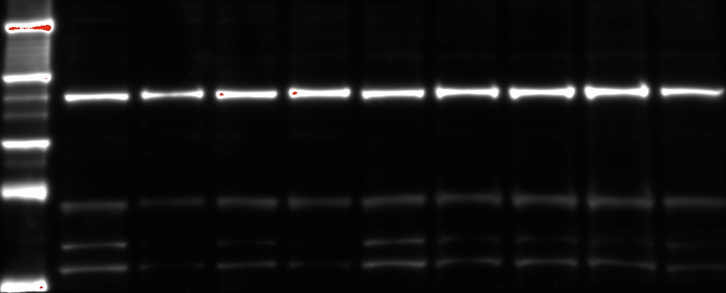
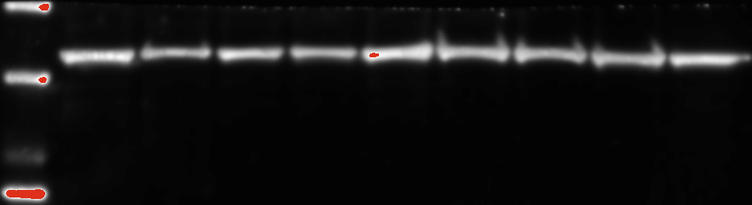
ANK KD Day 1
ANK KD Day 2
ANK KD Day 3
ANK KD Day 4
scramble Day 1
scramble Day 2
Ladder
scramble Day 3
scramble Day 4
WT MC3T3
250 kDa
150 kDa
100 kDa
75 kDa
50 kDa
ANKH (54 kDA):
60 sec exposure
5% non-fat milk
1:500 rabbit anti-ANKH IgG
1:5,000 goat anti-rabbit IgG
Actin (42 kDA):
60 sec exposure
5% BSA
1:1,000 mouse anti-actin IgG2A
1:10,000 goat anti-mouse Ig

Slide 18
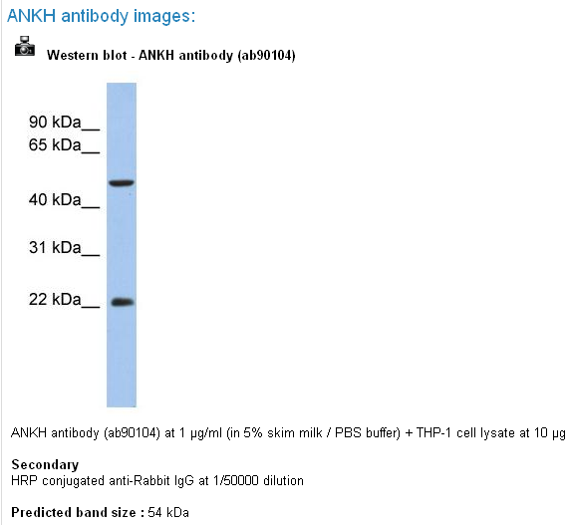
Western blot result:
SC antibody is crap
Try different antibody that has much better data for ANKH detection, although it has a nonspecific band
Santa Cruz biotechnology

