Slide 1
Optimal Feed Rate for Maximum Ethanol Production
Conor Keith
Loyola Marymount University
March 2, 2016

Slide 2
Outline
Chemostats and industrial ethanol manufacturing
Saccharomyces cerevisiae and the fermentation process
The role of glucose feed concentration in the fermentation process
A mathematical model of EtOH production in a chemostat environment
Maximization of EtOH production using free final time optimal control problem
Optimal feed flow rate

Slide 3
How Ethanol is produced on the industrial level
Ethanol fermentation produces ethanol for use in food, beverages, and fuel.
Yeast convert sugars, like glucose, into cellular energy .
Ethanol and carbon dioxide are by products of this process.
Fermentation occurs in large fermentation tanks.
The enzyme alpha-amylase is added to tanks to break down corn starch into shorter carbohydrate chains called dextrins.
During saccharification process the enzyme glucoamylase is added to mixture to break down dextrins into glucose.
Starch is converted to simple sugars, yeast is added to convert glucose into ethanol and carbon dioxide. https://www.osha.gov/dts/osta/otm/otm_iv/descriptions.pdf

Slide 4
Chemostats Can Be Used to Model Industrial Ethanol Production
Chemostat cultures have been used by researchers as a tool to simulate the different stages of industrial ethanol production.
Chemostat cultures allows scientists to gather data regarding metabolic processes of yeast cells.
Enable researchers to test the effects of specific nutrients on ethanol production.

Slide 5
Outline
Chemostats and industrial ethanol manufacturing
Saccharomyces cerevisiae and the fermentation process
The role of glucose feed concentration in the fermentation process
A mathematical model of EtOH production in a chemostat environment
Maximization of EtOH production using free final time optimal control problem
Optimal feed flow rate

Slide 6
Saccharomyces cerevisiae is the Most Relevant Yeast Strain in Ethanol Production
Saccharomyces cerevisiae is commonly used in winemaking, banking and brewing
S. cerevisiae perform the most common type of fermentation
Ethanol becomes toxic to yeast cells at high concentrations
S. cerevisiae is a preffered yeast strain due to its high stress tolerance and its ability to efficiently use carbon and nitrogen resources
Goal of industrial ethanol production is to produce maximum ethanol in shortest period of time
Most ethanol is produced in later stages, i.e. at or near zero growth rates and stationary phase

Slide 7
The Flexibility of Saccharomyces cerevisiae
S. cerevisiae can rapidly switch between respiratory and fermentative sugar metabolism in response to changes in availability of oxygen and fermentable sugars
S. cerevisiae can increase catabolic rates an start accumulating large amounts of ethanol upon this transfer
Glucose starved yeast can adapt when introduced to high glucose concentrations within minutes
Pathways responsible for fermentation process can suddenly catalyze sugar at very high rates, which is why S. cerevisiae is the most preferred yeast in industrial ethanol production (Van den Brink, et. al 2008).

Slide 8
Outline
Chemostats and industrial ethanol manufacturing
Saccharomyces cerevisiae and the fermentation process
The role of glucose feed concentration in the fermentation process
A mathematical model of EtOH production in a chemostat environment
Maximization of EtOH production using free final time optimal control problem
Optimal feed flow rate
Conclusion

Slide 9
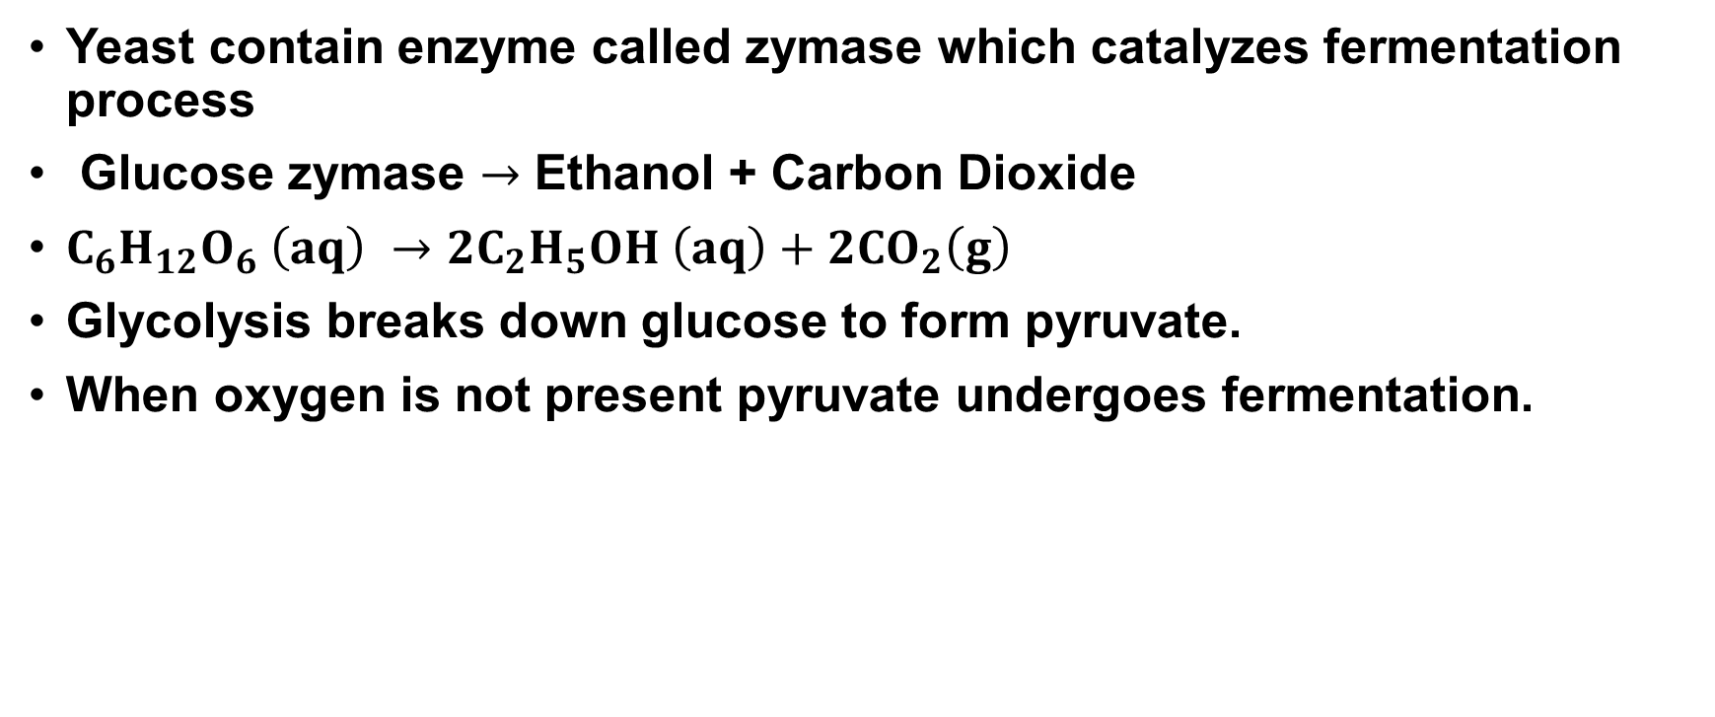
The Role of Glucose in Ethanol Fermentation
Yeast contain enzyme called zymase which catalyzes fermentation process
Glucose zymase $→$ Ethanol + Carbon Dioxide
$C_{6}H_{12}O_{6} \left(aq\right) →2C_{2}H_{5}OH \left(aq\right)+2CO_{2}\left(g\right)$
Glycolysis breaks down glucose to form pyruvate.
When oxygen is not present pyruvate undergoes fermentation.

Slide 10
Outline
Chemostats and industrial ethanol manufacturing
Saccharomyces cerevisiae and the fermentation process
The role of glucose feed concentration in the fermentation process
A mathematical model of EtOH production in a chemostat environment
Maximization of EtOH production using free final time optimal control problem
Optimal feed flow rate

Slide 11

A mathematical model of Ethanol Production in a Continuous Culture
$\frac{dX}{dt} = μX − \frac{F}{V}X$
$\frac{dS}{dt}=−\frac{μ}{Y}X+\frac{F}{V}\left(S_{0}−S\right)$
$\frac{dP}{dt}=πx −\frac{F}{V}P$
$\frac{dV}{dt}=F$

Slide 12
Parameters and Constants in Model
X = Cell mass concentration
S = Glucose concentration
P = Ethanol concentration
μ = Specific growth rate
π = Specific productivity
F = Feed rate
Notation used in Wang, et. al (1999)

Slide 13

Parameters and Constants Continued
$μ=\frac{μ_{0}}{1+\frac{P}{K_{p}}}∗\frac{S}{K_{s}+S}$
$π=\frac{π_{0}}{1+\frac{P}{K_{p}}}∗\frac{S}{K_{s}+S}$
Growth equations from Wang, et. al (2008).

Slide 14
Outline
Chemostats and industrial ethanol manufacturing
Saccharomyces cerevisiae and the fermentation process
The role of glucose feed concentration in the fermentation process
A mathematical model of EtOH production in a chemostat environment
Maximization of EtOH production using free final time optimal control problem
Optimal feed flow rate

Slide 15
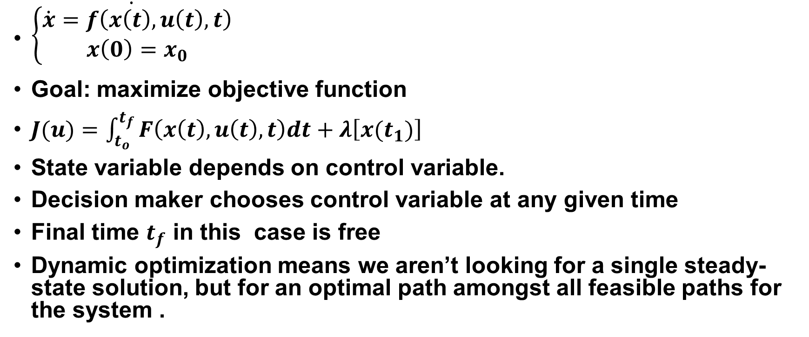
Brief Explanation of Dynamic Optimization
$\dot{\begin{aligned}\left\{\begin{aligned}\dot{x}=f\left(x\left(t\right),u\left(t\right),t\right) \\ x\left(0\right)=x_{0}\end{aligned}\right. \\ \end{aligned}}$
Goal: maximize objective function
$J(u)=\int_{t_{o}}^{t_{f}}{F\left(x\left(t\right),u\left(t\right),t\right)dt+λ\left[x(t_{1})\right] }$
State variable depends on control variable.
Decision maker chooses control variable at any given time
Final time $t_{f}$ in this case is free
Dynamic optimization means we aren’t looking for a single steady-state solution, but for an optimal path amongst all feasible paths for the system .

Slide 16
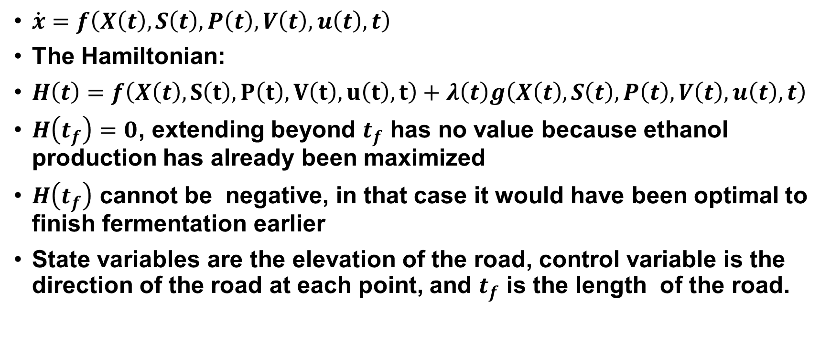
Transversality Condition For Optimal Path
$\dot{x}=f\left(X\left(t\right),S\left(t\right),P\left(t\right),V\left(t\right),u\left(t\right),t\right)$
The Hamiltonian:
$H\left(t\right)=f\left(X\left(t\right),S\left(t\right),P\left(t\right),V\left(t\right),u\left(t\right),t\right)+λ\left(t\right)g\left(X\left(t\right),S\left(t\right),P\left(t\right),V\left(t\right),u\left(t\right),t\right)$
$H\left(t_{f}\right)=0$, extending beyond $t_{f}$ has no value because ethanol production has already been maximized
$H\left(t_{f}\right)$ cannot be negative, in that case it would have been optimal to finish fermentation earlier
State variables are the elevation of the road, control variable is the direction of the road at each point, and $t_{f}$ is the length of the road.

Slide 17
A Mathematical Model of Ethanol Production in a Continuous Culture
$\frac{dX}{dt} = μX − \frac{F}{V}X$
$\frac{dS}{dt}=−\frac{μ}{Y}X+\frac{F}{V}\left(S_{0}−S\right)$
$\frac{dP}{dt}=πx −\frac{F}{V}P$
$\frac{dV}{dt}=F$

Slide 18
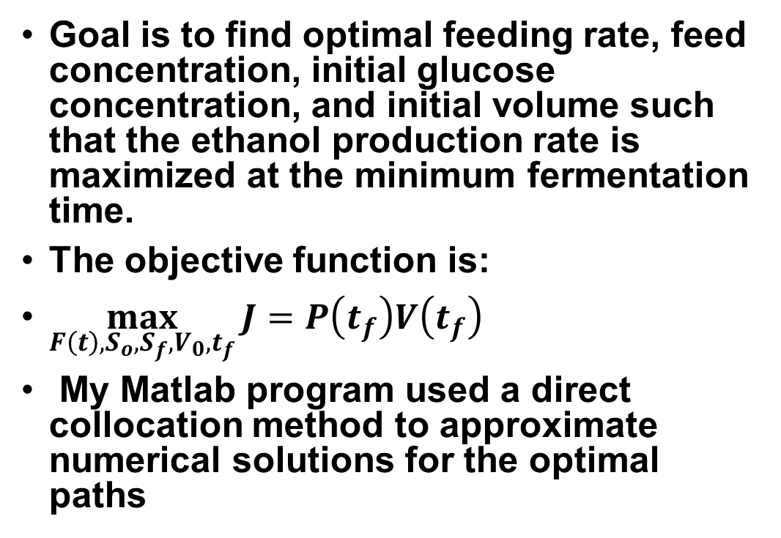
Optimal control of Fermentation Process
Goal is to find optimal feeding rate, feed concentration, initial glucose concentration, and initial volume such that the ethanol production rate is maximized at the minimum fermentation time.
The objective function is:
$\max_{F\left(t\right),S_{o},S_{f},V_{0},t_{f}}{J=P\left(t_{f}\right)V\left(t_{f}\right)}$
My Matlab program used a direct collocation method to approximate numerical solutions for the optimal paths

Slide 19
Optimal Paths For States and Control First Run

Slide 20
Optimal Paths With 70 g/L Reduction In Initial Glucose

Slide 21
Optimal Paths With 10 L Increase in Initial Volume

Slide 22
Results From Previous Research

Slide 23
Values For Optimal Production Rate and Final Time
Optimal final time for my first simulation was about 65 hours and the maximum ethanol production rate was 4.22kg/hr.
Optimal final time for my second simulation was about 61 hours and maximum ethanol production rate was 3.96 kg/hr
Values are similar to values obtained by previous researchers using a similar model but with higher number of collocation points.
The feed rate concentration had an optimal path similar to the paths found in other research.
Once EtOH concentration hits a critical point, biomass decreases sharply towards initial point, but EtOH continues to increase.
This is consistent with (paper), which states that most EtOH is produced in the later stages of fermentation.

Slide 24
Response to Varying Constraints
Under the model I selected, maximum ethanol production is attained by adjusting feed rate concentration of glucose according to optimal path determined by solution to control problem.
EtOH concentration increases despite decreases in biomass concentration of yeast.
Feed rate and EtOH concentration are both constrained by total volume of chemostat/reactor.
Reduction in initial glucose concentration by 70 g/l led to only a minor decrease in ethanol production rate.
An increase in initial volume from 10 L to 20 L causes an increase in final time by > 10 hr

Slide 25
Conclusion
It is possible to maximize EtOH production through optimal altering of feed rate over time.
The optimal path of glucose feed rate is highly sensitive to changes in initial conditions.
The maximum amount of ethanol production and maximum production rate are much less sensitive to changes in initial conditions.
Maximum production is reach quickest when initial volume is low.

Slide 26
Acknowledgments
I would like to thank Dr. Fitzpatrick, Dr. Dahlquist, and my fellow classmates.

Slide 27
References
Brauer, M. J., Saldanha, A. J., Dolinski, K., & Botstein, D. (2005). Homeostatic adjustment and metabolic remodeling in glucose-limited yeast cultures. Molecular biology of the cell, 16(5), 2503-2517.
Van den Brink, J., Canelas, A. B., Van Gulik, W. M., Pronk, J. T., Heijnen, J. J., De Winde, J. H., & Daran-Lapujade, P. (2008). Dynamics of glycolytic regulation during adaptation of Saccharomyces cerevisiae to fermentative metabolism. Applied and environmental microbiology, 74(18), 5710-5723.
Wang, F. S., & Cheng, W. M. (1999). Simultaneous Optimization of Feeding Rate and Operation Parameters for Fed‐Batch Fermentation Processes. Biotechnology Progress, 15(5), 949-952.
Vázquez-Lima, F., Silva, P., Barreiro, A., Martínez-Moreno, R., Morales, P., Quirós, M., ... & Ferrer, P. (2014). Use of chemostat cultures mimicking different phases of wine fermentations as a tool for quantitative physiological analysis. Microbial cell factories, 13(1), 85.
Gabriel, E., & Carrillo, U. (1999). Optimal control of fermentation processes (Doctoral dissertation, PhD Thesis, City University, London).
Banga, J. R., Balsa-Canto, E., Moles, C. G., & Alonso, A. A. (2005). Dynamic optimization of bioprocesses: Efficient and robust numerical strategies. Journal of Biotechnology, 117(4), 407-419.

