Slide 1
GLN3

Slide 2
Shortest Paths
 | CIN5 | CYC8 | GCR2 | GLN3 | HAP4 | HMO1 | MSN2 | MSN4 | SFP1 | SWI4 | SWI5 | TEC1 | YHP1 | YOX1
CIN5 | 0 | 1 | 2 | 2 | 1 | 1 | 1 | 2 | 1 | 2 | 2 | 1 | 1 | 2
CYC8 | 1 | 0 | 2 | 3 | 2 | 1 | 1 | 2 | 2 | 1 | 3 | 2 | 2 | 2
GCR2 | 2 | 2 | 0 | 3 | 2 | 2 | 1 | 2 | 2 | 2 | 3 | 2 | 2 | 2
GLN3 | 2 | 3 | 3 | 0 | 3 | 3 | 2 | 3 | 3 | 2 | 3 | 2 | 1 | 3
HAP4 | 1 | 2 | 2 | 3 | 0 | 1 | 1 | 2 | 2 | 1 | 2 | 1 | 2 | 2
HMO1 | 1 | 1 | 2 | 3 | 1 | 0 | 1 | 1 | 2 | 2 | 2 | 1 | 2 | 1
MSN2 | 1 | 1 | 1 | 2 | 1 | 1 | 0 | 1 | 1 | 1 | 2 | 1 | 1 | 1
MSN4 | 2 | 2 | 2 | 3 | 2 | 1 | 1 | 0 | 2 | 2 | 3 | 2 | 2 | 2
SFP1 | 1 | 2 | 2 | 3 | 2 | 2 | 1 | 2 | 0 | 2 | 1 | 1 | 2 | 2
SWI4 | 2 | 1 | 2 | 2 | 1 | 2 | 1 | 2 | 2 | 0 | 3 | 2 | 1 | 1
SWI5 | 2 | 3 | 3 | 3 | 2 | 2 | 2 | 3 | 1 | 3 | 0 | 1 | 2 | 3
TEC1 | 1 | 2 | 2 | 2 | 1 | 1 | 1 | 2 | 1 | 2 | 1 | 0 | 1 | 2
YHP1 | 1 | 2 | 2 | 1 | 2 | 2 | 1 | 2 | 2 | 1 | 2 | 1 | 0 | 2
YOX1 | 2 | 2 | 2 | 3 | 2 | 1 | 1 | 2 | 2 | 1 | 3 | 2 | 2 | 0

Slide 3
More stats
Graph Average Distance: 1.79121
Graph Diameter: 3
Graph Efficiency: 0.652015
Network Clustering Coefficient: 0.528479

Slide 4
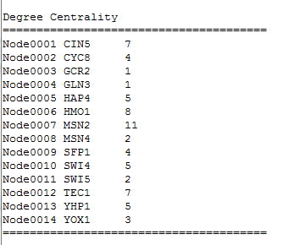
Degree Centrality

Slide 5
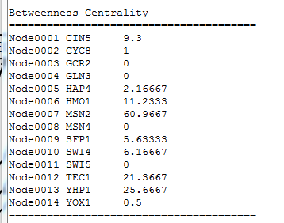
Betweenness Centrality

Slide 6
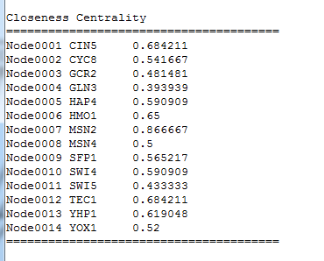
Closeness Centrality

Slide 7
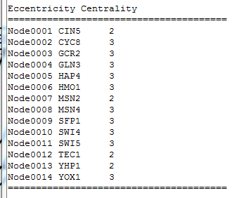
Eccentricity Centrality

Slide 8
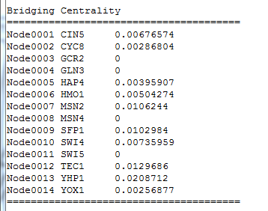
Bridging Centrality

Slide 9
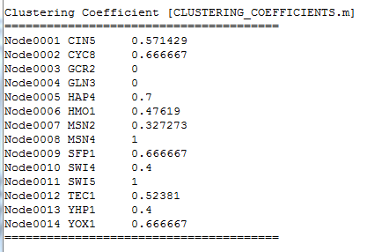
Clustering Coefficient

Slide 10

Clustering Coefficient (Soffer & Vazquez, ‘05)

Slide 11
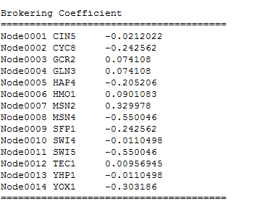
Brokering Coefficient (Cai et al, 2010)

Slide 12
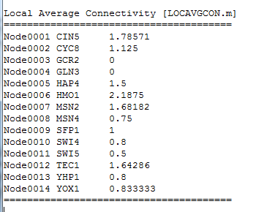
Local Average Connectivity

Slide 13
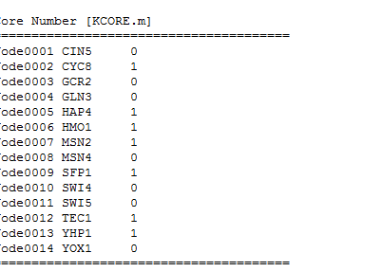
Core Number

Slide 14
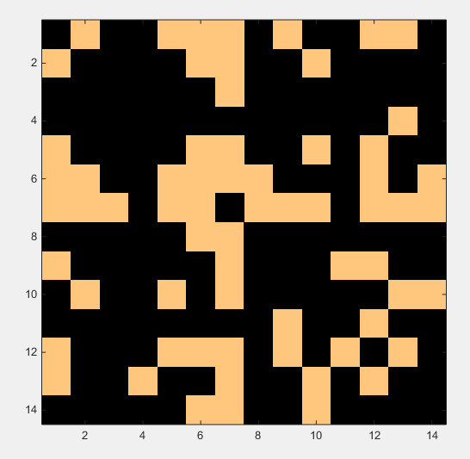
Adjacency Matrix

Slide 15
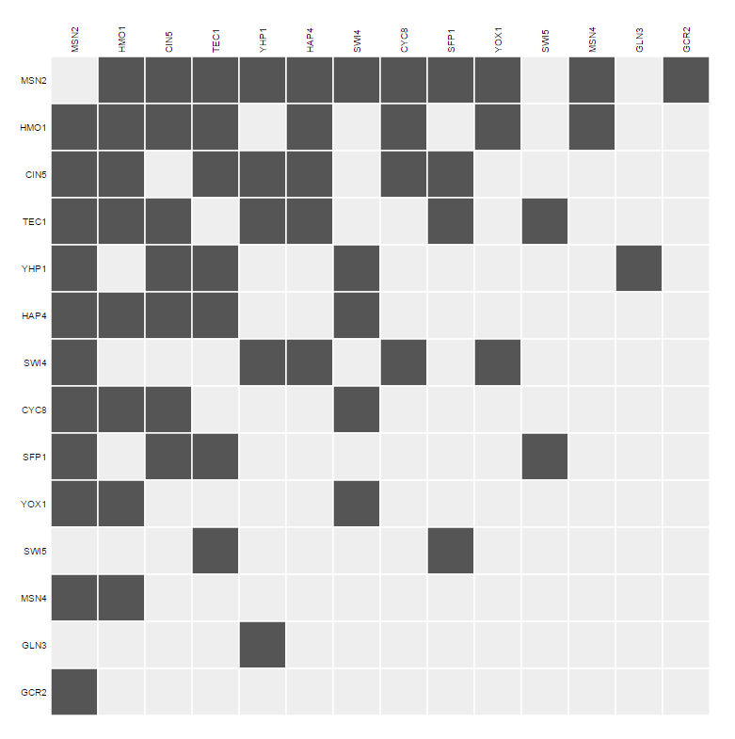

Slide 16
HAP4

Slide 17
 | ACE2 | ASH1 | CIN5 | GCR2 | GLN3 | HAP4 | HMO1 | MSN2 | SFP1 | STB5 | SWI4 | SWI5 | YHP1 | YOX1 | ZAP1
ACE2 | 0 | 1 | 3 | 3 | 3 | 3 | 3 | 2 | 3 | 4 | 3 | 2 | 2 | 3 | 1
ASH1 | 1 | 0 | 2 | 2 | 2 | 2 | 2 | 1 | 2 | 3 | 2 | 1 | 1 | 2 | 2
CIN5 | 3 | 2 | 0 | 2 | 2 | 1 | 1 | 1 | 1 | 1 | 2 | 2 | 1 | 2 | 4
GCR2 | 3 | 2 | 2 | 0 | 3 | 2 | 2 | 1 | 2 | 3 | 2 | 3 | 2 | 2 | 4
GLN3 | 3 | 2 | 2 | 3 | 0 | 3 | 3 | 2 | 3 | 3 | 2 | 3 | 1 | 3 | 4
HAP4 | 3 | 2 | 1 | 2 | 3 | 0 | 1 | 1 | 2 | 1 | 1 | 3 | 2 | 2 | 4
HMO1 | 3 | 2 | 1 | 2 | 3 | 1 | 0 | 1 | 2 | 2 | 2 | 3 | 2 | 1 | 4
MSN2 | 2 | 1 | 1 | 1 | 2 | 1 | 1 | 0 | 1 | 2 | 1 | 2 | 1 | 1 | 3
SFP1 | 3 | 2 | 1 | 2 | 3 | 2 | 2 | 1 | 0 | 1 | 2 | 1 | 2 | 2 | 4
STB5 | 4 | 3 | 1 | 3 | 3 | 1 | 2 | 2 | 1 | 0 | 2 | 2 | 2 | 3 | 5
SWI4 | 3 | 2 | 2 | 2 | 2 | 1 | 2 | 1 | 2 | 2 | 0 | 3 | 1 | 1 | 4
SWI5 | 2 | 1 | 2 | 3 | 3 | 3 | 3 | 2 | 1 | 2 | 3 | 0 | 2 | 3 | 3
YHP1 | 2 | 1 | 1 | 2 | 1 | 2 | 2 | 1 | 2 | 2 | 1 | 2 | 0 | 2 | 3
YOX1 | 3 | 2 | 2 | 2 | 3 | 2 | 1 | 1 | 2 | 3 | 1 | 3 | 2 | 0 | 4
ZAP1 | 1 | 2 | 4 | 4 | 4 | 4 | 4 | 3 | 4 | 4 | 4 | 3 | 3 | 4 | 0

Slide 18
More stats
Graph Average Distance: 2.19048
Graph Diameter: 5
Graph Efficiency: 0.563016
Network Clustering Coefficient: 0.302963

Slide 19
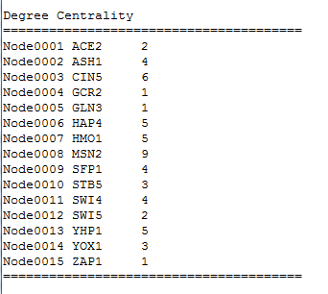
Degree Centrality

Slide 20

Betweenness Centrality

Slide 21
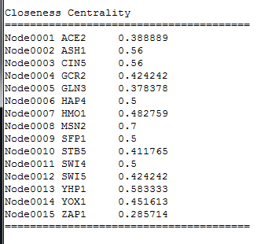
Closeness Centrality

Slide 22
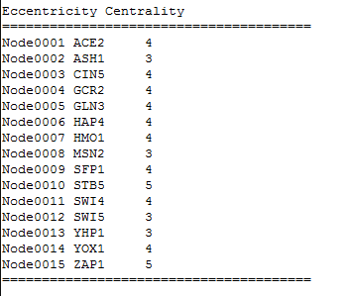
Eccentricity Centrality

Slide 23
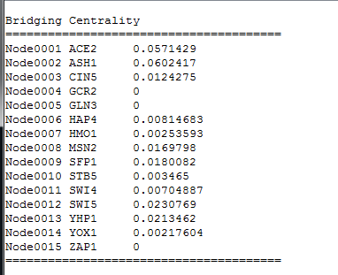
Bridging Centrality

Slide 24

Clustering Coefficient

Slide 25
Clustering Coefficient (Soffer & Vazquez, ‘05)

Slide 26

Brokering Coefficient

Slide 27
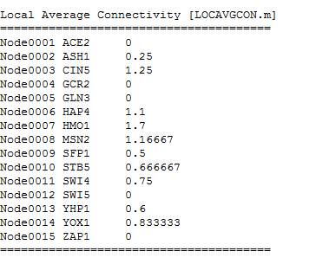
Local Average Connectivity

Slide 28
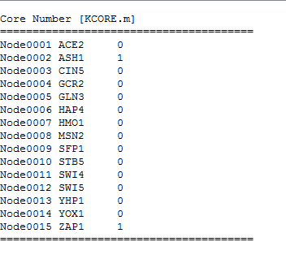
Core Number

Slide 29
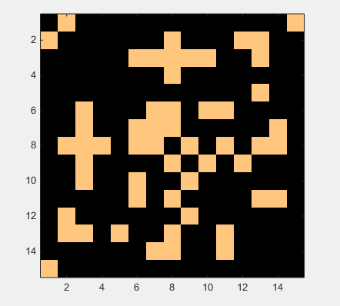

Slide 30
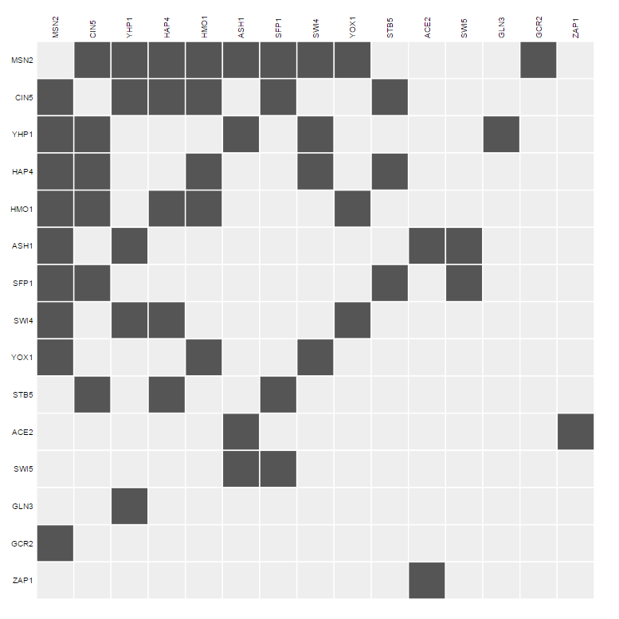

Slide 31
ZAP1 Stats

Slide 32
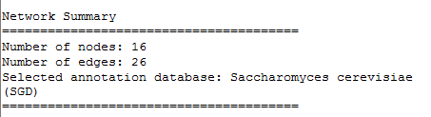
Network Summary

Slide 33
Shortest Path Between Two Nodes
 | ABF1 | ACE2 | CIN5 | CST6 | GCN4 | GCR2 | GLN3 | HAP4 | HMO1 | HSF1 | MCM1 | MGA2 | MSN2 | MSN4 | SWI4 | ZAP1
ABF1 | 0 | 3 | 2 | 1 | 2 | 3 | 2 | 2 | 1 | 2 | 2 | 1 | 2 | 1 | 1 | 4
ACE2 | 3 | 0 | 3 | 4 | 3 | 4 | 4 | 3 | 2 | 3 | 1 | 4 | 3 | 3 | 2 | 1
CIN5 | 2 | 3 | 0 | 3 | 2 | 2 | 3 | 1 | 1 | 2 | 2 | 3 | 1 | 2 | 2 | 4
CST6 | 1 | 4 | 3 | 0 | 3 | 4 | 3 | 3 | 2 | 3 | 3 | 2 | 3 | 2 | 2 | 5
GCN4 | 2 | 3 | 2 | 3 | 0 | 3 | 1 | 1 | 1 | 2 | 2 | 2 | 2 | 2 | 2 | 4
GCR2 | 3 | 4 | 2 | 4 | 3 | 0 | 4 | 2 | 2 | 3 | 3 | 4 | 1 | 2 | 2 | 5
GLN3 | 2 | 4 | 3 | 3 | 1 | 4 | 0 | 2 | 2 | 3 | 3 | 1 | 3 | 3 | 3 | 5
HAP4 | 2 | 3 | 1 | 3 | 1 | 2 | 2 | 0 | 1 | 2 | 2 | 3 | 2 | 2 | 1 | 5
HMO1 | 1 | 2 | 1 | 2 | 1 | 2 | 2 | 1 | 0 | 1 | 1 | 2 | 1 | 1 | 2 | 3
HSF1 | 2 | 3 | 2 | 3 | 2 | 3 | 3 | 2 | 1 | 0 | 2 | 3 | 2 | 2 | 3 | 4
MCM1 | 2 | 1 | 2 | 3 | 2 | 3 | 3 | 2 | 1 | 2 | 0 | 3 | 2 | 2 | 1 | 2
MGA2 | 1 | 4 | 3 | 2 | 2 | 4 | 1 | 3 | 2 | 3 | 3 | 0 | 3 | 2 | 2 | 5
MSN2 | 2 | 3 | 1 | 3 | 2 | 1 | 3 | 2 | 1 | 2 | 2 | 3 | 0 | 1 | 1 | 4
MSN4 | 1 | 3 | 2 | 2 | 2 | 2 | 3 | 2 | 1 | 2 | 2 | 2 | 1 | 0 | 2 | 4
SWI4 | 1 | 2 | 2 | 2 | 2 | 2 | 3 | 1 | 2 | 3 | 1 | 2 | 1 | 2 | 0 | 3
ZAP1 | 4 | 1 | 4 | 5 | 4 | 5 | 5 | 5 | 3 | 4 | 2 | 5 | 4 | 4 | 3 | 0

Slide 34
Other Stats
Graph average distance: 2.39167
Graph diameter: 5
Graph efficiency: 0.520556
Graph clustering coefficient: 0.207143

Slide 35
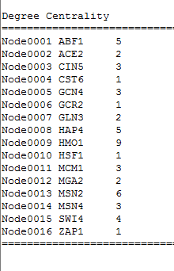
Degree Centrality

Slide 36
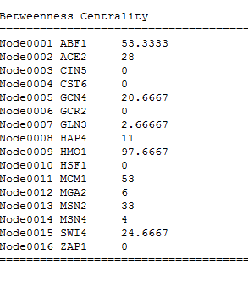
Betweenness Centrality

Slide 37
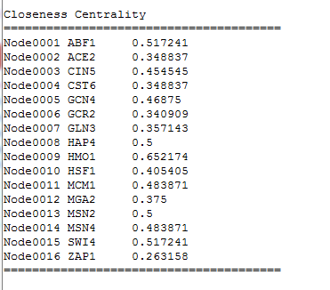
Closeness Centrality

Slide 38
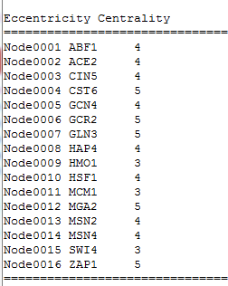
Eccentricity Centrality

Slide 39
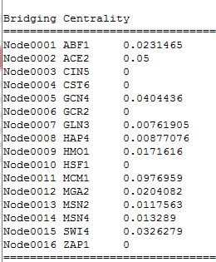
Bridging Centrality

Slide 40
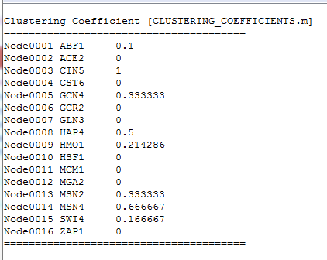
Clustering Coefficient

Slide 41
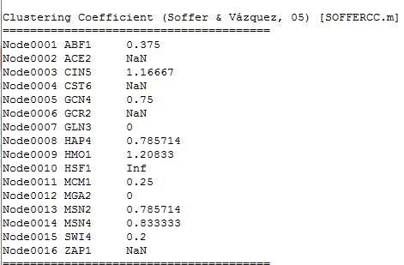
Clustering Coefficient (Soffer and Vazquez, 05)

Slide 42
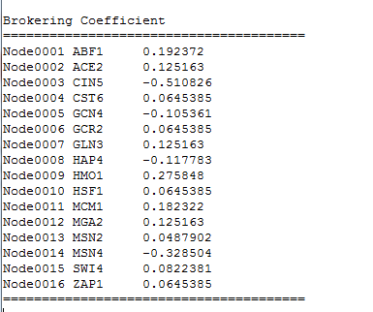
Brokering Coefficient

Slide 43
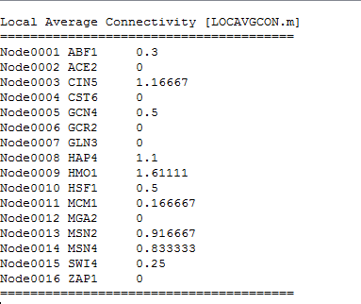
Local Average Connectivity

Slide 44
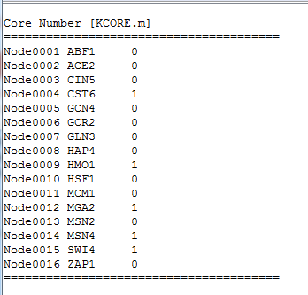
Core Number

Slide 45
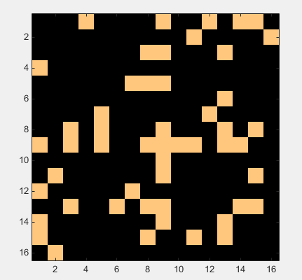
Adjacency Matrix

Slide 46
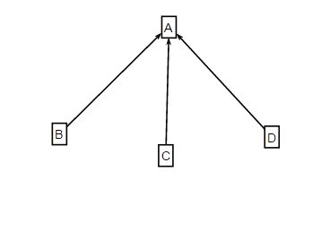
Undirectedness
Found undirected thanks to demo #3 in GRNsight (CUP9/MSN4)
Test Run
Shortest Path Between B & C: 2

