Slide 1
Structure of V3-containing HIV-1 gp120 core
Huang, C. C., Tang, M., Zhang, M. Y., Majeed, S., Montabana, E., Stanfield, R. L., Dimitrov, D. S., Korber, B., Sodroski, J., Wilson, I. A., Wyatt, R., & Kwong, P. D.
(2005) Sci, 310(5750), 1025-1028
Journal Club Presentation
Chloe Jones, Isabel Gonzaga, and Nicole Anguiano
BIOL398: Bioinformatics Laboratory
October 15, 2014

Slide 2
Outline
V3 region of gp120 protein plays a critical role in HIV entry to CD4 T-Cells
V3 sequences are conserved and determine coreceptor used for viral entry
V3 structure facilitates binding to and interaction with coreceptors
Superimposing antibodies on V3 structure with core blocks coreceptor binding
Accessibility of antibodies to V3 aids in immunodominance
Studying the structure of V3 can aid in the understanding of the neutralization and progression of HIV virus

Slide 3
Outline
V3 region of gp120 protein plays a critical role in HIV entry to CD4 T-Cells
V3 sequences are conserved and determine coreceptor used for viral entry
V3 structure facilitates binding to and interaction with coreceptors
Superimposing antibodies on V3 structure with core blocks coreceptor binding
Accessibility of antibodies to V3 aids in immunodominance
Studying the structure of V3 can aid in the understanding of the neutralization and progression of HIV virus

Slide 4
HIV Envelope Structure Allows for Viral Entry to T-Cells
HIV envelope has trimeric spike
Contains 3 gp120 exterior 3 gp41 transmembrane glycoproteins
Host CD4 T-Cells bind to gp120 and causes conformational change
V3 binds to coreceptor (CCR5 or CXCR4)
Virus enters CD4 T Cell

Slide 5
V3 Region Critical to Coreceptor Binding Site
Previous studies do not include V3 analysis in gp120 core structure in coreceptor binding site
V3 plays many roles in coreceptor binding
Determines which coreceptor binds (CXCR4 or CCR5)
Immune responses against HIV targeted towards V3

Slide 6
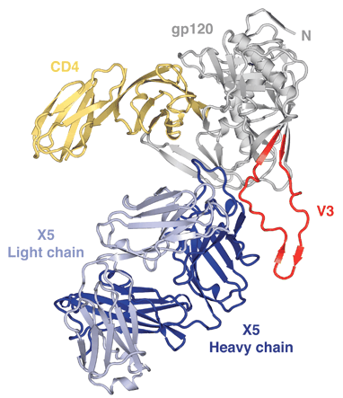
V3 of gp120 Core Binds to CD4 Receptor
3 Clade B isolates of gp120 core were expressed, deglycosylated, purified and complexed with CD4 + fab X5 antibody
Overall, components maintain individual structures
Large difference in X5: 17Å induced fit

Slide 7
Outline
V3 region of gp120 protein plays a critical role in HIV entry to CD4 T-Cells
V3 sequences are conserved and determine coreceptor used for viral entry
V3 structure facilitates binding to and interaction with co-receptors
Superimposing antibodies on V3 structure with core blocks coreceptor binding
Accessibility of antibodies to V3 aids in immunodominance
Studying the structure of V3 can aid in the understanding of the neutralization and progression of HIV virus

Slide 8
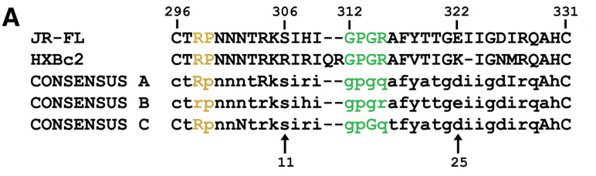
V3 Sequence Conservation Determines Binding Coreceptor
11th or 25th residue:
positive: CXCR4
uncharged/negative: CCR5
CCR5 sequences more conserved
Uppercase: conserved
Lowercase: variable
Yellow: Arg-Pro motif
Green: Gly-Pro-Gly-Arg motif

Slide 9
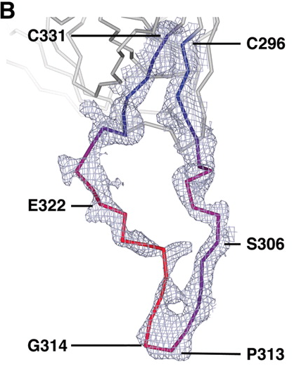
Electron Density and B Values Vary Along V3
Electron Density
Grey areas
B values (Atomic Mobility)
Blue: Low
Red: High

Slide 10
Outline
V3 region of gp120 protein plays a critical role in HIV entry to CD4 T-Cells
V3 sequences are conserved and determine coreceptor used for viral entry
V3 structure facilitates binding to and interaction with coreceptors
Superimposing antibodies on V3 structure with core blocks coreceptor binding
Accessibility of antibodies to V3 aids in immunodominance
Studying the structure of V3 can aid in the understanding of the neutralization and progression of HIV virus

Slide 11
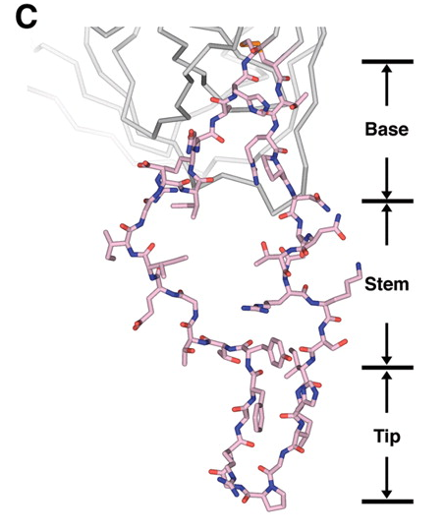
V3 Has a Three-part Structure
Salmon: Carbon
Red: Oxygen
Dark Blue: Nitrogen
Orange: Disulfide
V3 consists of fixed base, accordion-like stem, and β-hairpin tip
Notes:
Fig 2 C

Slide 12
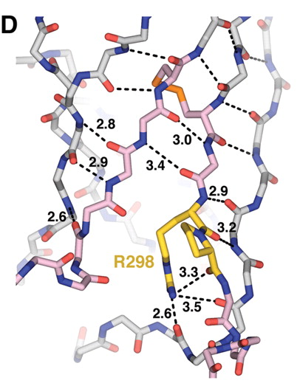
V3 Base Consists of Two Antiparallel Beta Sheets
Yellow: Arg-Pro Motif
Orange: Cys-Cys Disulfide
Conserved Arg-Pro motif interrupts bonding in the sheet
β-sheet interactions on the returning strand resume at residue 297 and continue to the Cys-Cys Disulfide
Notes:
Fig 2 D

Slide 13
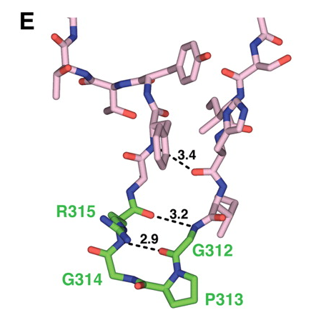
V3 Has a Highly Conserved Tip
Green: Conserved Gly-Pro-Gly-Arg β turn
Tip has antiparallel β-sheet structure with conserved β-turn
Returning strand is less defined

Slide 14
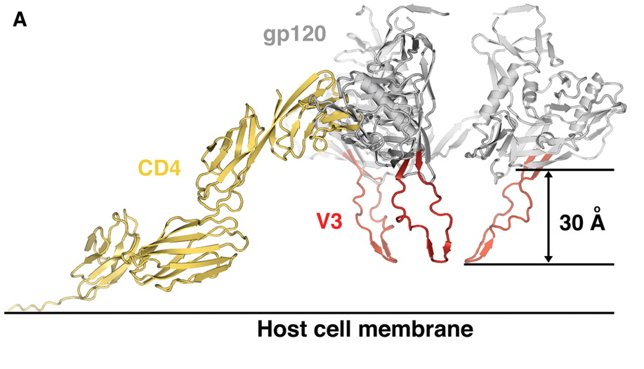
V3 Points Downwards Towards the Target Cell When Bound to CD4
Notes:
Fig 3 A

Slide 15
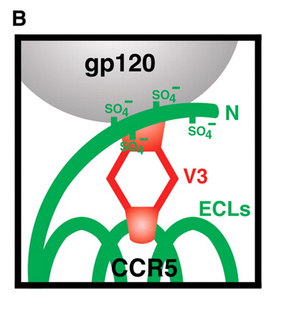
Coreceptor Binds to V3 Base and V3 Tip Binds to Extracellular Loop
Proposed schematic of interaction between V3 and the coreceptor shows coreceptor N-terminus binding to the V3 base and the V3 tip binding to the second extracellular loop

Slide 16
Evidence for Proposed Schematic Comes From Prior Research
The binding of CCR5 N-terminal peptides to gp120 is affected by alterations only to the gp120 core and V3 base (Cormier, Dragic)
Mutant viruses with V3 truncations found to be not affected by small-molecule inhibitors that bound to the second extracellular loop (Lin)

Slide 17
Outline
V3 region of gp120 protein plays a critical role in HIV entry to CD4 T-Cells
V3 sequences are conserved and determine coreceptor used for viral entry
V3 structure facilitates binding to and interaction with co-receptors
Superimposing antibodies on V3 structure with core blocks coreceptor binding
Accessibility of antibodies to V3 aids in immunodominance
Studying the structure of V3 can aid in the understanding of the neutralization and progression of HIV virus

Slide 18
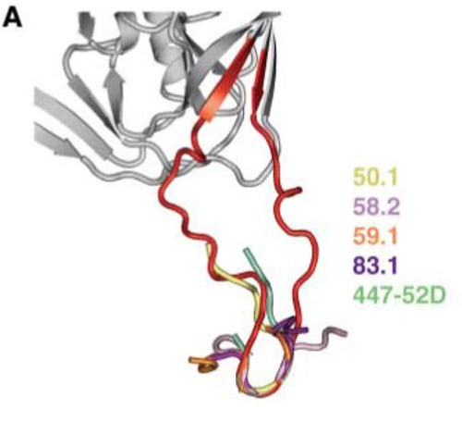
Superimposing Antibodies on V3 Structure with Core Blocks Coreceptor Binding
Monoclonal antibodies 50.1, 58.2, 59.1, 83.1, and 447-52D bind to conserved V3 tip blocking coreceptor binding

Slide 19
Outline
V3 region of gp120 protein plays a critical role in HIV entry to CD4 T-Cells
V3 sequences are conserved and determine coreceptor used for viral entry
V3 structure facilitates binding to and interaction with co-receptors
Superimposing antibodies on V3 structure with core blocks coreceptor binding
Accessibility of antibodies to V3 aids in immunodominance
Studying the structure of V3 can aid in the understanding of the neutralization and progression of HIV virus

Slide 20
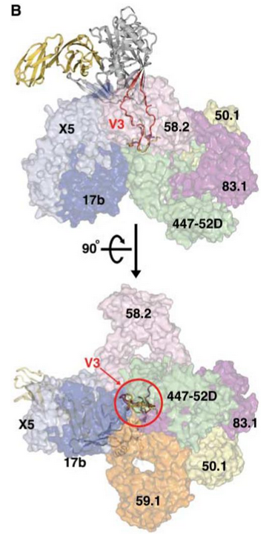
Accessibility of Antibodies to V3 Aids In Immunodominance
Two different views of the accessibility
Antibodies bind to either the core or V3
V3 engulfed in neutralizing antibodies, proposing a role in immunization.
Notes:
extracted from peptide–anti-V3 neutralizing antibody complexes

Slide 21
Outline
V3 region of gp120 protein plays a critical role in HIV entry to CD4 T-Cells
V3 sequences are conserved and determine coreceptor used for viral entry
V3 structure facilitates binding to and interaction with co-receptors
Superimposing antibodies on V3 structure with core blocks coreceptor binding
Accessibility of antibodies to V3 aids in immunodominance
Studying the structure of V3 can aid in the understanding of the neutralization and progression of HIV virus

Slide 22
Structure of V3 Gives Insight About Progression and Neutralization
V3 plays a major role in the establishment of the HIV virus within the body
Coreceptor interaction and altering quaternary interactions of V3 can aid in HIV avoiding immune system and HIV entry into the cells
Conformational Changes important for coreceptor binding (CCR5 or CXCR4)
Spikes on envelope allows for binding of receptors and virus entry, “molecular hook”
From studying the V3 structure, the HIV virus it can be further examined and analyzed towards progression and neutralization
Neutralization targets V3 region

Slide 23
Summary
V3 region of gp120 protein plays a critical role in HIV entry to CD4 T-Cells
V3 sequences are conserved and determine coreceptor used for viral entry
Coreceptor binding to V3 is determined by V3’s three-part structure
Coreceptor binds to V3 base and V3 tip binds to the second extracellular loop of the coreceptor
Superimposing antibodies on V3 structure with core blocks coreceptor binding
Accessibility of antibodies to V3 aids in immunodominance
Studying the structure of V3 can aid in the understanding of the neutralization and progression of HIV virus

Slide 24
Citations
Huang, C. C., Tang, M., Zhang, M. Y., Majeed, S., Montabana, E., Stanfield, R. L., Dimitrov, D. S., Korber, B., Sodroski, J., Wilson, I. A., Wyatt, R., & Kwong, P. D. (2005). Structure of a V3-containing HIV-1 gp120 core. Science, 310(5750), 1025-1028. DOI: 10.1126/science.1118398
E. G. Cormier, T. Dragic. (2002). The Crown and Stem of the V3 Loop Play Distinct Roles in Human Immunodeficiency Virus Type 1 Envelope Glycoprotein Interactions with the CCR5 Coreceptor. J. Virol, 76(17), 8953-8957. DOI: 10.1128/JVI.76.17.8953-8957.2002
G. Lin et al., paper presented at the 12th Conference on Retroviruses and Opportunistic Infections, Boston, 21 to 26 February 2005.

Slide 25
Acknowledgements
Loyola Marymount University
Kam D. Dahlquist, Ph. D

