Slide 1
Nonlinear differential equation model for quantification of transcriptional regulation applied to microarray data of Saccharomyces cerevisiae
Vu, T. T., and Vohradsky, J. (2006) Nucleic Acids Research 35: 279-287.
Jeffrey Crosson¹
Kara M. Dismuke²
Natalie E. Williams³
¹ Department of Engineering, ² Department of Mathematics,
³ Department of Biology
BIOL398-04/MATH388
March 24, 2015

Slide 2
Outline
Introduction
Constructing and Testing the Model
Dynamics of Model
Computational algorithm
Dataset selection
Inference of regulators
Comparison with linear model
Discussion
Summary

Slide 3
Outline
Introduction
Constructing and Testing the Model
Dynamics of Model
Computational algorithm
Dataset selection
Inference of regulators
Comparison with linear model
Discussion
Summary

Slide 4
Introduction
Regulation of gene expression controls cellular processes
Microarray data tracks dynamics of gene expression
Nonlinear differential equation to predict and model gene expression
Many methods in identifying relationships between genes and their regulators
Notes:
Depends on promoter sequences which allow binding of regulatory transcription factors
Gene expression is altered as cell undergoes different environmental conditions and stresses or stages in its life cycle

Slide 5
Outline
Introduction
Constructing and Testing the Model
Dynamics of Model
Computational algorithm
Dataset selection
Inference of regulators
Comparison with linear model
Discussion
Summary

Slide 6

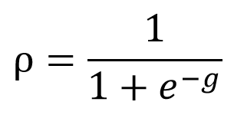
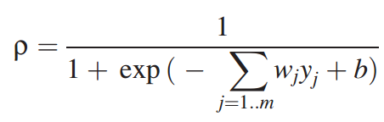
Dynamic Model of Transcriptional Control
A result of previous work on the dynamic simulation of genetic networks
Assumes the recursive action of regulators on the target gene over time
Assumes the regulatory effect on the expression can be expressed as a combinatorial action of its regulators
g = regulatory effect for a certain gene
j = 1, 2, … m
m = number of regulators for a gene
w = regulatory weights
y = expression levels
b = transcription initiation delay
⍴ = sigmoid function of regulatory effect
1
2a
2b

Slide 7
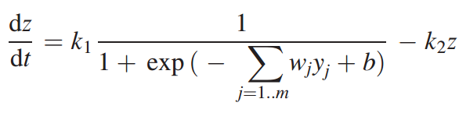
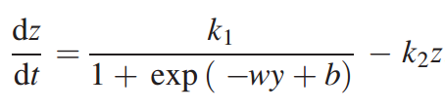

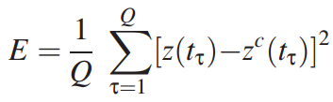
Dynamic Model of Transcriptional Control (Continued)
z = target gene expression level
dz/dt = rate of expression
k1 = maximal rate of expression
k2 = rate constant of degradation
a values = computed from the experimental gene expression profile using least squares minimization procedure
E = error function
The polynomial fit is an approximation of the true expression profile
Gene profiles that minimize the mean square error function are sought for
The result allows the parameters in the differential equation to be estimated
3
4
5
6

Slide 8
Computational Algorithm
The aim is to find a set of potential regulators of a certain target gene by estimating its expression profile
It searches from a group of transcriptional regulators using least squares minimization, the differential equation, and the error function
The differential equation is solved numerically
The parameters w, b, k1, and k2 are optimized with a least squares minimization loop
The missing data points and fluctuation in gene expression profiles is compensated for by approximating the regulator gene profiles by a polynomial of degree n
The degree n is chosen by the number of of data points in the profile and the level of fluctuations

Slide 9
Computational Algorithm (Continued)
Fit regulator gene profiles with a polynomial of degree n
Select a target gene
Select a candidate regulatory gene from the pool of possible regulators
Apply least squares minimization procedure to the target and regulator genes using the differential equation with the error function
Repeat step 3 for all possible regulators
Select regulators that best satisfy the selection criterion
Repeat step 2 for all target genes
5
4
6

Slide 10
Dataset Selection
The eukaryotic cell cycle dataset published by Spellman and others was chosen to evaluate the performance of the model
The dataset records changes in gne expressions using microarrays at 18 points in time over two cell cycle periods
800 genes were identified whose expression was associated with the cell cycle, but the real number of regulators controlling the cell cycle is much smaller
Therefore 184 potential regulator genes were selected for the identification of yeast cell cycle regulators
By combining data from previous published papers and the YEASTRACT database
40 target genes were selected
The same ones in the paper by Chen and others

Slide 11
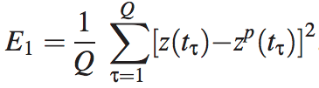
Inference of Regulators
Data in form of log base 2 of ratio between RNA amount and value of standard (same for all time points)
Least squares minimization for each target gene for all potential regulators
Approximation of unknown real profile = least squares best fit of polynomial of degree n to target gene expression profile z^{p}
Estimation of overall error
Deviation from experimental data

Slide 12
Inference of Regulators
Find regulator profile using:
model (Eqn 4)
minimizing E (Eqn 6)
Assumption: fit of model to target regulator profile is at least as good as fit given by Eqn 8
in other words: deviation E (Eqn 6) must be ≤ deviation E₁ (Eqn 9)
Choose regulators where E ≤ E₁
Determine which regulators fit target gene profile better than the others (call “best regulators”)
Correct Identification: regulator identified was also regulator in YEASTRACT
YEASTRACT: current knowledge, but still incomplete
Notes:
Find regulator profile (to then find most probable regulator)

Slide 13
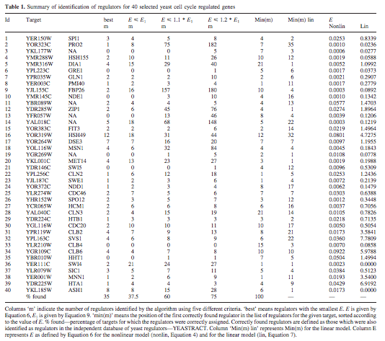
Table 1: Summary of identification of regulators for 40 selected yeast cell cycle regulated genes

Slide 14
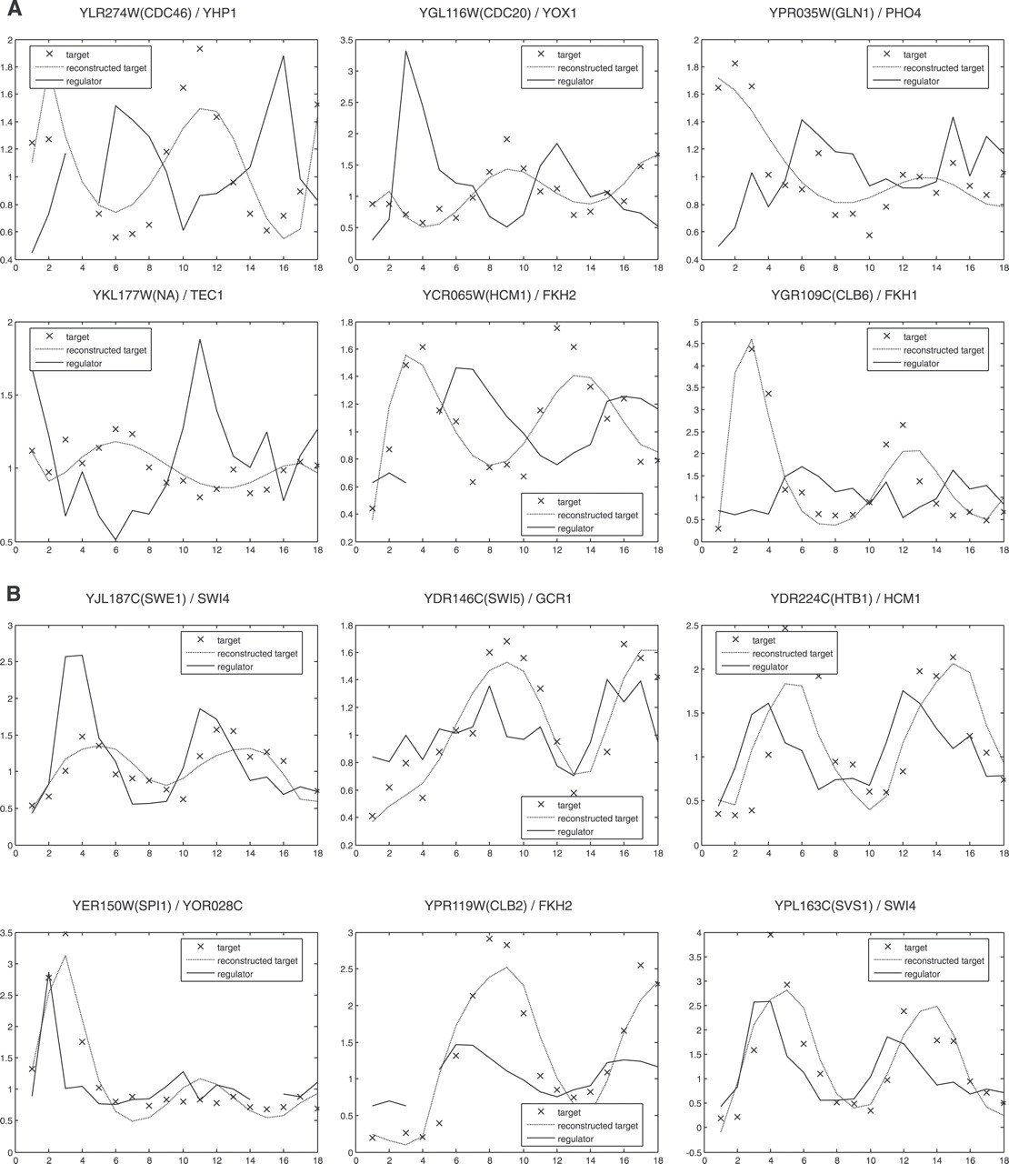
Figure 1: Regulators that are repressors have the “opposite” curve as the target genes and reconstructed target curve
Notes:
x: target (data known about gene beforehand)
dotted: took x data, used paper’s model to generate non-linear curve
solid: considers “best regulators” and chooses THE best one
-based on regulator profile (as determined by model’s best target profile & minimization of E)
-for activator: mirrors
-for repressor: opposite
-Note: we know we are looking for an activator or a repressor to be a particular gene’s best regulator based on the sign of weight (w) (used in the algorithm)
A: These 6 graphs: Regulators are repressors
repressor: turns off target gene expression

Slide 15
Figure 2: Regulators that are activators have a similar curve as the target genes and the reconstructed target curve
Notes:
x: target (data known about gene beforehand)
dotted: took x data, used paper’s model to generate non-linear curve
solid: considers “best regulators” and chooses THE best one
-based on regulator profile (as determined by model’s best target profile & minimization of E)
-for activator: mirrors
-for repressor: opposite
-Note: we know we are looking for an activator or a repressor to be a particular gene’s best regulator based on the sign of weight (w) (used in the algorithm)
B: These 6 Graphs: Regulators are activators
activator: turns on (promotes) target gene expression

Slide 16
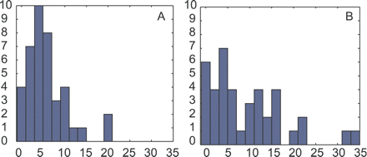
Figure 3: The amount of runs used to correctly identify at least one regulator was lower for the nonlinear model.
A: Nonlinear model
B: Linear model
Distribution of order of correctly identified regulators in the sorted list
Histogram of distribution of the order of correctly identified regulators in the sorted list of potential regulators.
Notes:
for each target gene, we have list of regulators in order of best to worst...min number- least number of tries to get correct regulator
-ranked list: determined by model and E value
draw on blackboard?

Slide 17
Outline
Introduction
Constructing and Testing the Model
Dynamics of Model
Computational algorithm
Dataset selection
Inference of regulators
Comparison with linear model
Discussion
Summary

Slide 18
Discussion: The nonlinear model was able to pair target gene expression with its regulator
Nonlinear algorithm selected the most probable regulator and provided information about how well it controls the target gene
Drawbacks:
The model does not test indirect controls of target genes;
Regulators are selected from a pool independently, usually through sequence analysis;
Does not consider that individual target genes may regulate other target genes; and,
Transcriptional regulation also is controlled by proteins which cannot be recorded by microarrays
Notes:
microarrays look only at mRNA expression

Slide 19
Discussion: The nonlinear algorithm can lead to further explorations in modeling gene regulatory networks.
This model focuses on analyzing the influence of all possible regulators of a given target gene and recover basic transcriptional regulations
Combinatorial control and larger networks can be created by the addition of smaller medium-scale gene regulatory networks
In the future, the speed of the algorithm will improve and the algorithm may have additional extensions that could allow it to consider other factors in constructing these networks
Notes:
other factors: genome-wide location data, DNA sequence information, and targeted biochemical and molecular biological experiments

Slide 20
Outline
Introduction
Constructing and Testing the Model
Dynamics of Model
Computational algorithm
Dataset selection
Inference of regulators
Comparison with linear model
Discussion
Summary

Slide 21
Summary
The dynamics of the model were given by:
The least squares best fit was then compared to the deviations from the experimental data, which resulted in:
Table 1 identified regulators for the target genes
Figures 1 & 2 had the best expression profiles of target/regulator pairs
Figure 3 shows the distribution of the order of correctly identified regulators in the sorted list
The model is capable of correctly identifying regulators, modeling expression profiles, and predicting if regulators repress or activate

