Slide 1
Parallel gene synthesis in a microfluidic device by David Kong et. al
Presented by
Eric Gomez & Dahlia Alkekhia
December 2nd, 2010

Slide 2
Background
Needed in the field: synthesize custom de novo long DNA strands and genes
Issues: accuracy, time, COST
$0.1 per nucleotide for conventionally synthesized oligos
$0.65 – $1.10 per bp for custom gene synthesis services
Example: synthesis of bacterial genomes 106bp in size become prohibitively costly, requiring on the order of $100, 000 in oligos alone
Proposed technology:
Multi-chambered microfluidic device
Notes:
Other important applications for de novo gene synthesis in biomedical research and biotechnology range from the cloning of individual genes to the development of synthetic DNA vaccines (2), vectors for gene therapy (3), and gene libraries for protein engineering and molecular evolution (4).
with the major expenditure components for such long syntheses being attributable to reagent and sample handling, synthesis of long genes of designed sequences for designated functions becomes possible

Slide 3
Why?
minimize reaction volumes 50uL → 500nL
Reduces sample handling and need for robotic handlers
Enables large number of complex reactions to be preformed in parallel
→ reduces costs!
Reduces error
Notes:
→ reduce reagents and required starting oligonucleotide concentrations

Slide 4
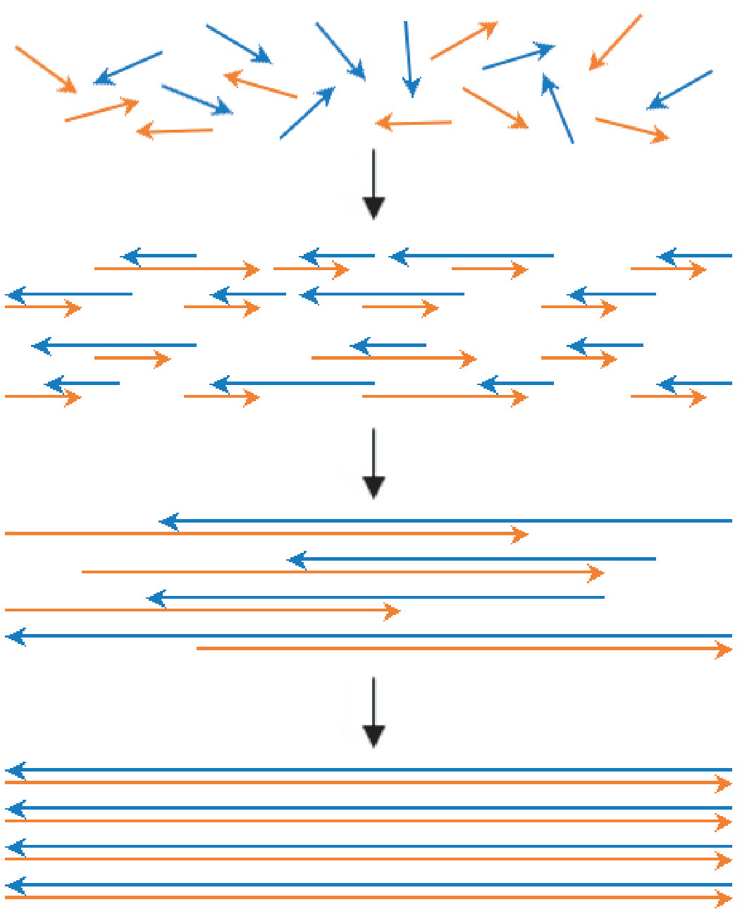
The Tiny Reaction : PCA
- Starting pool of
construction oligos
- Thermocycling leads to
annealing and extension
by DNA polymerase
- Multiple thermocycling
leads to increasingly
extended gene sequences
- Complete gene is achieved,
amplification can be
performed

Slide 5
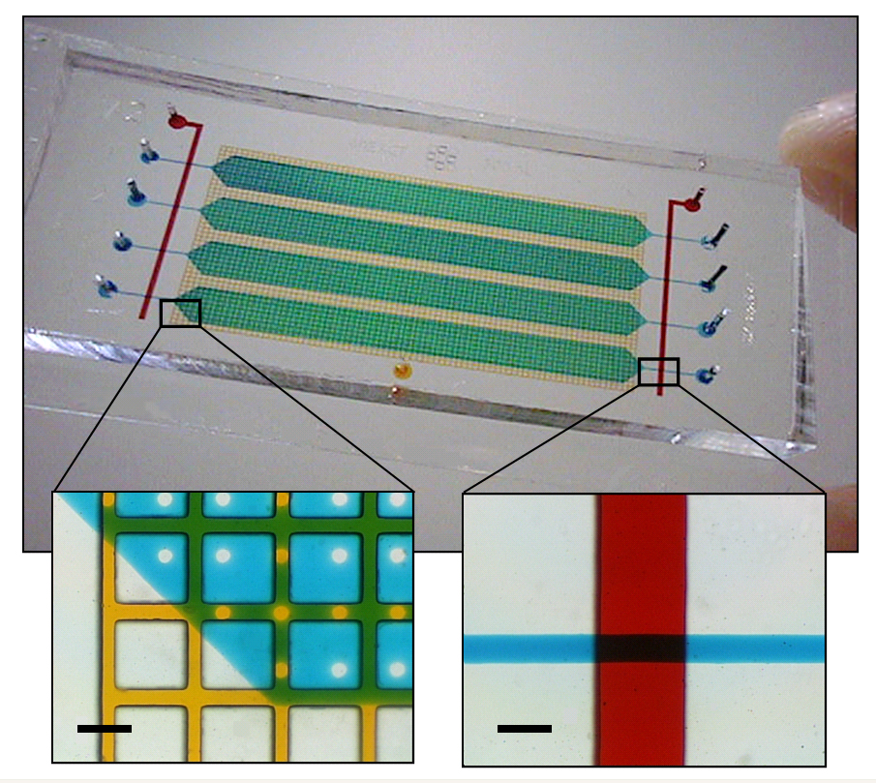
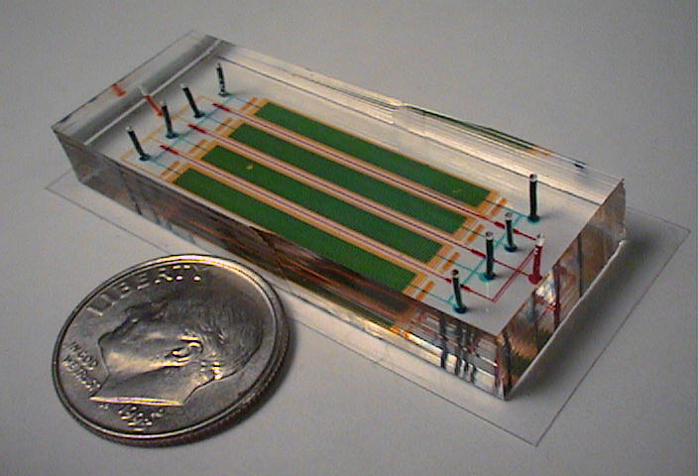
The Tiny Device
Fabrication
PDMS1
PDMS2
PDMS3
Blue & Green: Gene Synthesis Chamber
Yellow: Water Jacket
Blue: Fluid Inlet Channel
Red: Valve Channel

Slide 6
Experimental Procedure
Every microfluidic reaction was also ran in vitro in normal PCR tubes to compare performance
All reaction products analyzed through PAGE
Mixes demonstrating successful synthesis amplified through PCR
Amplified products visualized again through PAGE to verify correct amplification
Products sequenced using amplifying primers to confirm correct gene
Errors quantified by vector cloning and transformation
Genes selected:
bacterial “alba” gene
bacteriophage “hjc” gene
GFP construct
Red fluorescent protein (dsRed)

Slide 7
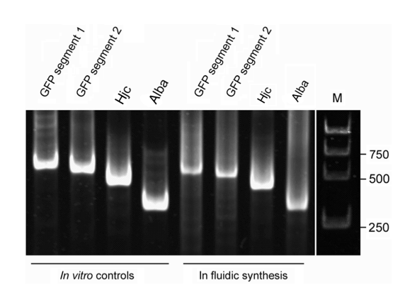
Results
IT WORKED!
With 50% higher yield relative to reactions in PCR tubes
(In PCR tubes)
Notes:
The lower molecular weight species below the product bands indicate normal levels of assembly intermediates for a single reaction PCA
-how can you tell 50% high yield? Why was 750 circled?

Slide 8
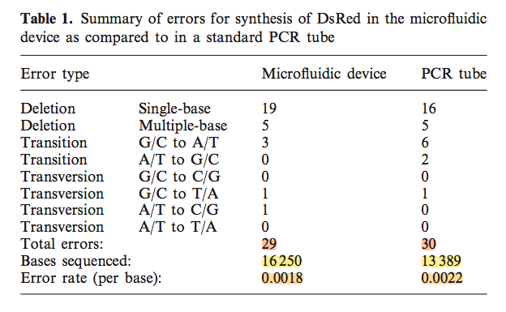
Error
Forty eight clones for both ‘in fluidic’ and in vitro DsRed synthesis yielded:
12.5% of full-length clones were error-free

Slide 9
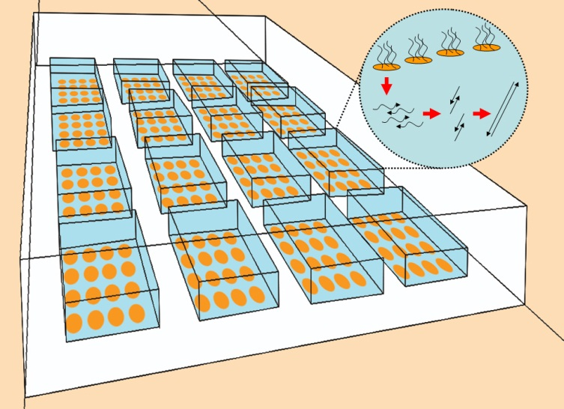
microarray
High density microarray-based method for synthesis of construction oligos
Incorporated into microfluidic device
Cleave and collect
femtomoles or lower concentrations per sequence
Insufficient
Enough for gene synthesis in same device
time
reagents
handling complex pools of oligos
money
introducing more error
amplification
Gene synthesis/ desired application
microfluidic device architecture to enclose sets of oligo spots for gene synthesis

Slide 10
Looking ahead
Incorporation of existing DNA error correction techniques on-chip.
integration of in vitro protein expression using high quality synthetic DNA as a template.
assembly of constructs larger than single genes can be achieved with microfluidic devices, employing the same types of hierarchical in vitro assembly reactions used to create 12kb and larger segments

Slide 11
Thank You!

