Slide 1
The Frequency Dependence of Osmo-Adaptation in Saccharomyces Cerevisiae
Jerome T. Mettetal et al.
Science 25 January 2008
Presented by:
Zeina Ali Siam & Alicia Kaestli
Notes:
EXTRA SLIDE ON Structure of glycerol

Slide 2
Overview
Presenting the biology of the Hog signaling cascade
Explaining the mathematical model used to present the signaling network
Describing the two experiments the researchers conducted to study the cascade’s feedback loop
Notes:
- Explain 2 ex

Slide 3
Researchers Studied
Hyperosmotic-Shock Network
Why?
Goal of network is to decrease net movement of water
Molecular basis of network well understood
Network has multiple feedback loops
Dominant loop is still unknown
Input (salt concentration) and output (activated Hog) are easily measured
Cell
Glycerol
NaCl

Slide 4
Hyperosmotic-Shock Response System
Three ways to increase intracellular concentration of glycerol
Osmolyte difference
High salt concentration activates of Fps-1 to reduce glycerol export
P-Hog activates of Fps-1 to reduce glycerol export
P-Hog induced production of glycerol synthesizing proteins
Fps-1
P-Hog
Osmolyte export
2 proteins
Intracellular Glycerol
Notes:
Very well understood
Feedback loops
Easy measurment
Signaling system activated by osmotic stress, what is osmotic stress
Show slide – slycerol inside the cell reduces the amount of free water
Tell ppl we’re focusing on hog – put methods on side of slide
Since Mettetal’s model was not based on biological understanding, Mettetal compared his model to a classical hyperosmotic-shock response model.
In the presence of osmotic stress, cells either decrease glycerol export out of the cell through two mechanisms
(1) The transmembrane protein Fps-1 changes the export rate of glycerol. This change in glycerol ultimately reduces osmotic stress.
(2) Same occurs for activated Hog in general.
(3) Under high osmotic stress, activated Hog1 may also increases expression of two glycerol producing proteins. The glycerol produced is retained inside the cell, and reduces osmotic stress.

Slide 5
Salt Shocks Drive Nuclear Enrichment of Hog1
Stimulus u(t)
Response R(t)
Notes:
As expected, Mettetal found that as the amount of NaCl in the extracellular solution decreased, the phosphorylation of Hog1 decreased, and Hog1 moved from the nucleus(time d) to the cytoplasm (time 7).
Make sure to point to times 2 and 7
RESPONSE OCIL.
- To preform experiments cells were periodically shocked with square wave pulses of medium with and without 0.2 M NaCl.

Slide 6
Predictive Model of Hog1 Response Created Through Fourier Analysis
Notes:
RED = ACTIVATED HOG
PUT KEY AT BOTTOM
Mettetal used Fourier analysis to create a model that predicts the frequency response of the Hog1 network to an arbitrary osmotic signal
Both input and output signals were approximated as sine waves
Menttetal measured the response of the system to square-wave salt stimuli with period ranging from 2 to 128 minutes.
Oscillations were characterized by phi (relative phase shift), and the magnitude of the amplitude (A) at the driving frequency A(w) .
Yo characterized the baseline of the output, or where the where the output response is centered.
Rw(t) characterizes the response as a function of time for a given driving force input w.
WHY DIVIDE PHI OMEGA BY OMEGA?
Other
Period of waves estimated as period T = (2*pi)/(w)

Slide 7
The Relation Between P-Hog and Intracellular Osmolyte Concentration Can Be Represented via Differential Equations
Rate of change in P-Hog
Results from
The difference in ionic concentration between the cell and its environment
And is affected by negative feedback
shock
Intrcellular concentration
P-Hog
H: P-Hog
O: Osmolyte concentration
U: Osmolyte shock
Rate of change in osmolyte intracellular concentration
And from the amount of P-Hog
Results from
The difference in ionic concentration between the cell and its environment
Notes:
HE CONVERTED THIS MODEL TO DIG EQUATIONS LIKE WE LEARNED IN 20.320 BECAUSE THEY ARE MORE BIOLOGICALL RELEVANT. IF YOU HAVE QUESTIONS ON HOW HE DID THIS, ASK US AT THE END
TO MAKE IT SIMPLER TO UNDERSTAND AND MORE BIOLOGICALLY RELEVANT
Which makes since because phog increases the amoutn of osmolyte
New model has two negative feedback mechanisms : one dependent on Hog1 activity (the top equation), and another independent of Hog1 activity (the bottom equation).
In the top equation, the rate of change in activated concentration results from the change in salt minus the effect of negative feedback, weighted by ?.
In the bottom equation, the rate of change in intracellular salt concentration results from the change in salt, weighted by alpha plus the effect of activated Hog1, weighted by beta.
Notes to self:
O = intercellular salt concentration
Au = stimulus (osmotic stock)
H = phosphorylated Hog1 above baseline levels

Slide 8
Assessing the Importance of P-Hog Can Be Done by Comparing the Behavior of the Mutant to Wildtype
Osmolyte difference
Fps-1
P-Hog
Osmolyte export
2 proteins
Intracellular Glycerol

Slide 9
Mutation Within the Signaling Cascade of the Hog Cascade Can Also be Modeled Via Differential Equations
No reason to change this equation
Osmolytic response to H is less

Slide 10
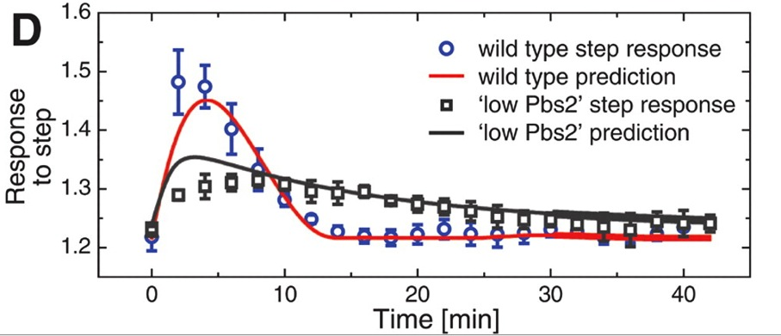
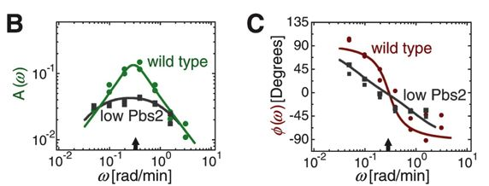
Modeling the Behavior of the Mutant Relative to Wildtype Provides Biological Information
Input:
[NaCl]
time
The mathematical model accurately predicts wild type response and mutant to osmolyte step shock.
Output:
Analysis:
Phase shift or delay in mutant means Hog pathway controls rapid response
Lower amplitude in mutant means lower maximal response

Slide 11
Assessing the Importance of Gene Expression
Osmolyte difference
Yeast regulates intracellular osmolyte concentration by expressing two proteins
Time for protein expression > =20 min
Fps-1
P-Hog
But!
Yeast recovery <= 15 minutes
Osmolyte export
2 proteins
When do the proteins Hog expresses become important?
Intracellular Glycerol

Slide 12
Strategy to Study the Long Term Importance of Gene Expression
Are the proteins expressed by Hog more important in the long term than the short term?
Implement periodic impulses on a ‘long’ time scale
Add a chemical that inhibits protein synthesis in some cells
Keep some as control
Observe any changes?
Yes
No
Proteins expressed are important
Proteins expressed are not important

Slide 13
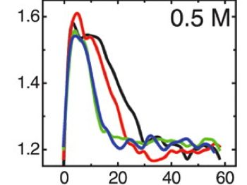
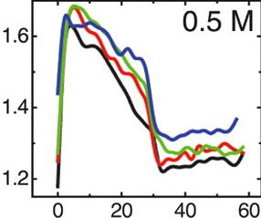
Proteins Expressed by P-Hog Control Cell Response in Long Term
[NaCl]
Input:
time
Normal Protein Synthesis
Output:
No protein Synthesis
First Pulse
Second Pulse
Third Pulse
Forth Pulse
Response
Time (minutes)
Analysis: Gene expression feedback loop is necessary for long term response/ fluctuating environment

Slide 14
Conclusion & Summary
Osmolyte difference
1. Hog feedback loop is necessary for maximal (through amplitude) and rapid (through phase shift) response
Fps-1
P-Hog
Osmolyte export
2 proteins
2. Protein expression feedback loop is necessary for long term response and for severe fluctuating environments (pulses)
Intracellular Glycerol

Slide 15
N = 1,2 ; zn = 0

Slide 17
The Essence of the Measurement Method
Notes:
Time constant for significant media replacement significantly less than 10 seconds
Pump constantly removing solution → one of the valves is always inputing solution
LOOK INTO FIGURE 2

Slide 18
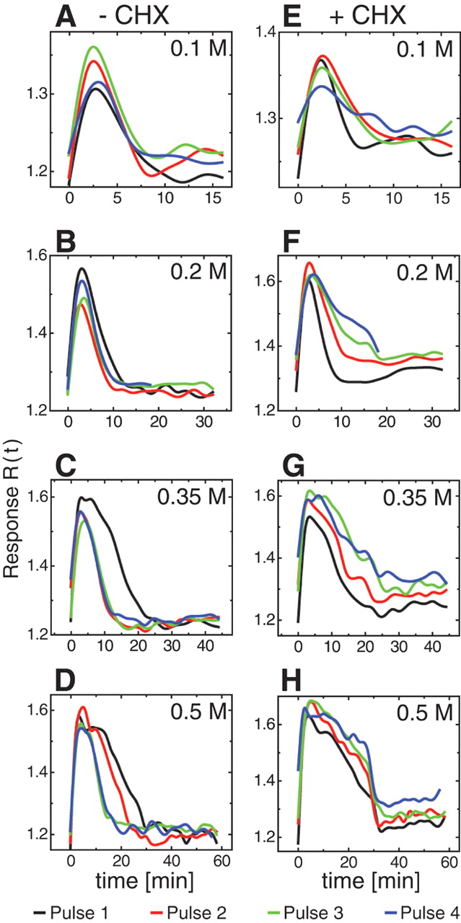
[NaCl]
time
[NaCl]
time
[NaCl]
time
[NaCl]
time

Slide 19
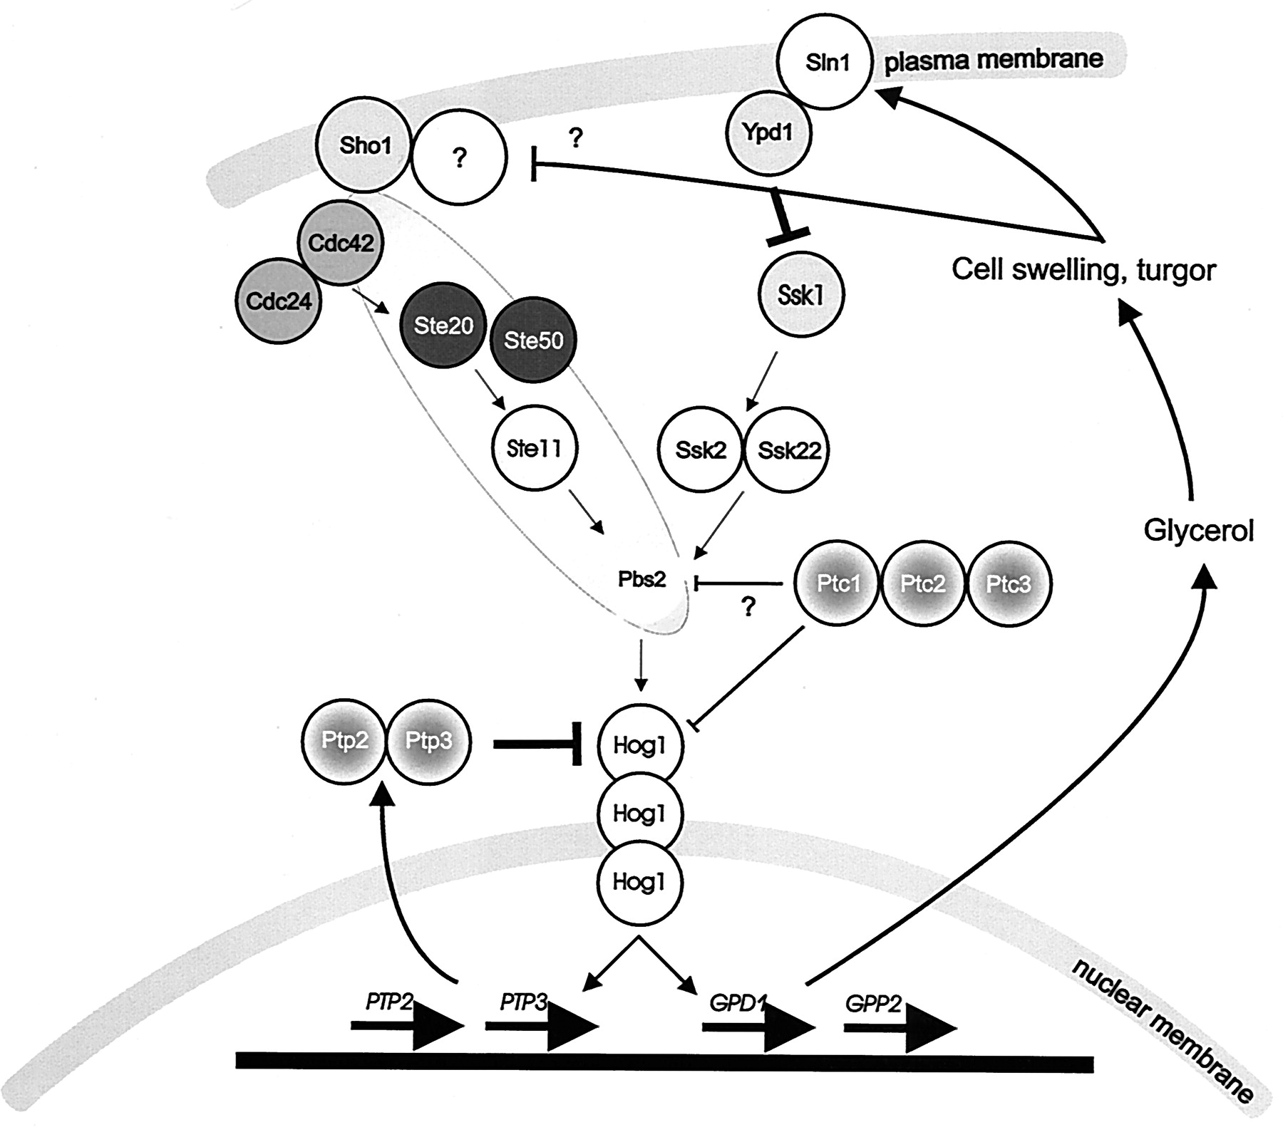
Osmolyte difference
Fps-1
P-Hog
Osmolyte export
Intracellular Glycerol

