Slide 1
Cloning the Cstps-1 gene from Citrus sinensis
Cassidy Albertson
Beth Anderson
Orijit Kar

Slide 2
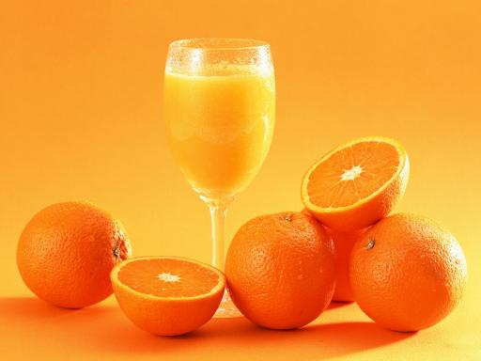
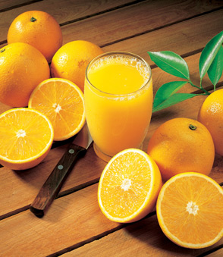
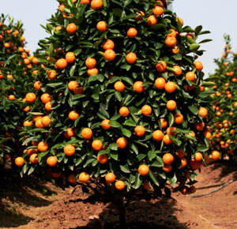
Citrus sinensis: The Valencia Orange
Oranges are the most popular tree fruit, originating in South and Southeast Asia.
Valencia oranges developed in the 19th century in California
Used largely for juice production.

Slide 3
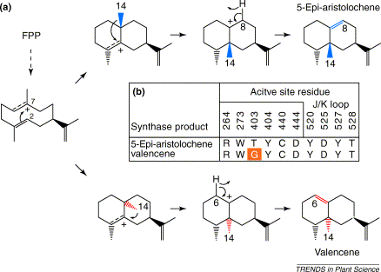
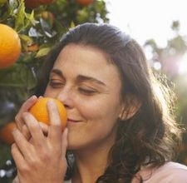
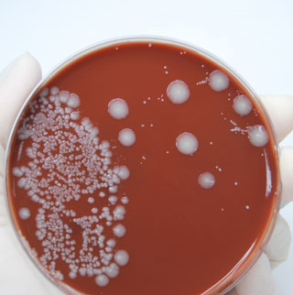
Biochemical goals
In Citrus sinensis, the Cstps-1 gene codes for the production of the enzyme Citrus Valancene Synthase (CVS).
In vivo, CVS reacts with farnesyl pyrophosphate (FPP) to produce the characteristically fragrant valencene (as well as 5-Epi-aristolochene).
Valencene is one of the compounds responsible for the characteristic “orange” smell.

Slide 4
DNA Isolation
We plan to buy a Valencia orange from a local grocer
Tissue will be taken from the peel
Using technique developed/demonstrated by Cheng et. al. in “An Efficient Protocol for Genomic DNA Extraction from Citrus Species.”
Minimizes polysaccharide contamination
Many fruits, especially citrus, have especially high polysaccharide levels
Contamination hinders DNA manipulative techniques such as PCR

Slide 5
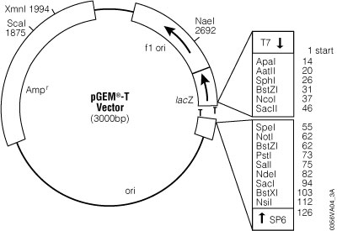
Amplification & Testing
atgtcgtctg gagaaacatt
5’ atgtcgtctg gagaaacatt tcgtcctact gcagatttcc atcctagttt atggagaaac……..1500 bp…………………………………atttacaaag aggacgacgg ctatacgcat tcttacctaa ttaaagatca aattgcttct
gtgctaggag accacgttcc attttga
c tggtgcaagg taaaact 5’
Amplify gene using PCR
Insert into pGem T-Vector
Ligate
Resequence to check for potential introns
Transform vector into E. coli to test for lethality

Slide 6
Transformation
• Cut out gene sequence from T-vector with EcoRI and SpeI restriction enzymes
• Insert into BioBrick-compatible vector with promoter
• Transform into competent E. coli
• Incubate for 24 hours at 37ºC (optimal growth conditions)
Selected Promotors:
All inducible, available, and shown to work
BBa_I13453 – Induced by arabinose
BBa_I0500 – induced by L-arabinose
BBa_I765001 – induced by UV light

Slide 7

Testing for Gene Expression
We will introduce Farnesyl pyrophosphate (FPP) into the growth media
FPP serves as the substrate for the Valencene Synthase
This enzyme-substrate complex forms Valencene.
Valencene is a major component of the familiar and sweet citrus aroma.
Detection of this odor in our culture will serve as a positive indication of gene expression.

Slide 8
References
Chappell, Joe (2004), “Valencene synthase – a biochemical magician and harbinger of transgenic aromas.” Trends in Plant Science, Vol. 9, No. 6, June 2004.
Cheng, Yun-Jiang, et. al. (2003), An efficient protocol for genomic DNA extraction from Citrus Species.” Plant Molecular Biology Reporter,
21: 177a-177g, June 2003.
Sharon-Asa, et. al. (2003), “Citrus fruit flavor and aroma biosynthesis: isolation, functional characterization, and developmental regulation ofCstps1, a key gene in the production of the sesquiterpene aroma compound valencene.” The Plant Journal, 36: 664–674.

