Slide 1
Test of SBEToolbox
Kristen Horstmann
Maggie O’Neil

Slide 2
Notes
Add installation/informational slides
Output window does not save automatically or scroll, as it does in MATLAB, so must make note of your results. Luckily, if you need to rerun something, it’s the push of a button
Bit of mystery behind some of these since just a button push with the output, no showing of the inner workings, but often will list the exact file name found in the SBEToolbox MATLAB folder
Keep track of which network you’re working with
  Ex: Extracted network around B to show how to do it, then had to manually restore the original network much later because never switched back over

Slide 3
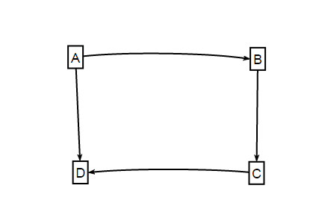
Created 4-gene Unweighted Network
Uploaded to GRNsight to export as SIF file format
GRNsight exports with a node with a blank cell next to the name if it does not regulate anything (in this case, node D). SBEToolbox will recognize this blank cell as “N/a” and count an extra node
So either delete this node in excel and resave it, OR
In SBEGUI, upload the network (Network->Open SIF File) then go to Edit->Remove Node. It will give you a list of the notes and can delete it.

Slide 4
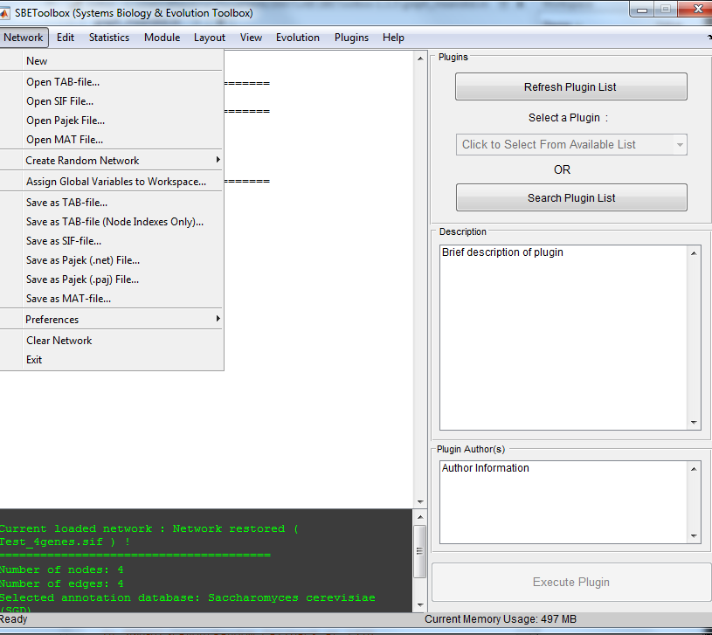
“Network” Overview
Mostly importing, saving, and exporting data sets

Slide 5
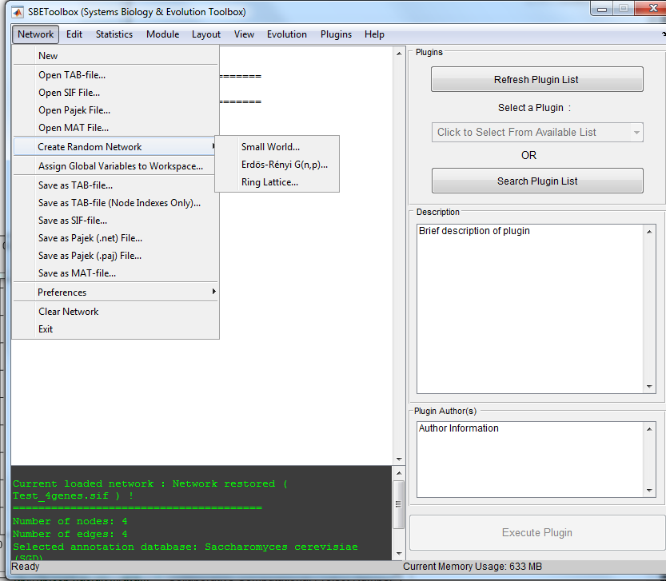
Random Networks

Slide 6
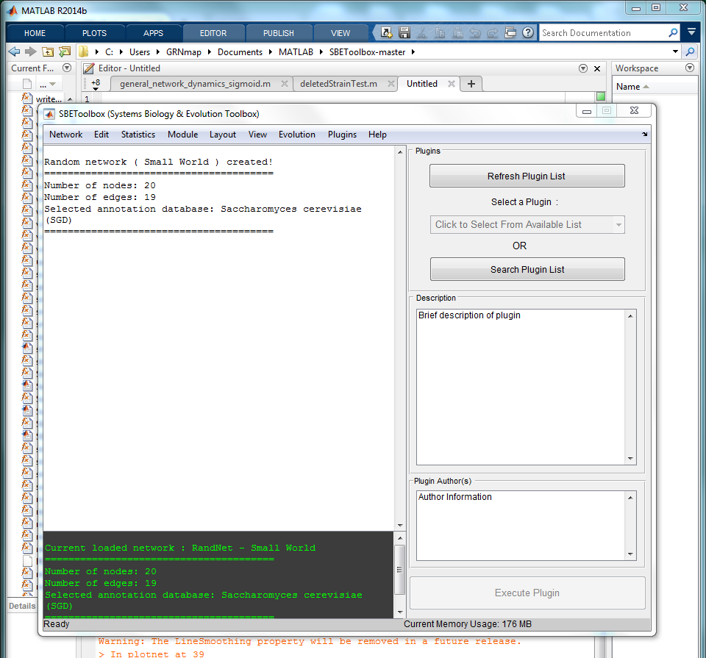
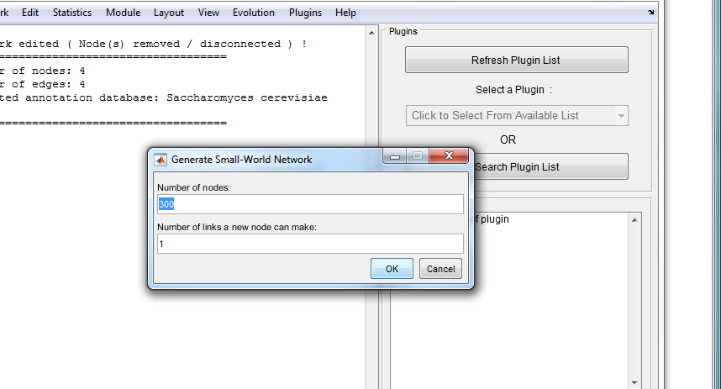
“Network” -> “Create Random Network”-> “Small World”
Creates a random network using the “small world” model, which requires two parameters to be set, number of nodes and number of connections a node can have (ex. 20 nodes, 1 edge per node). Displays the number of edges and nodes for that random network in the main toolbox window

Slide 7
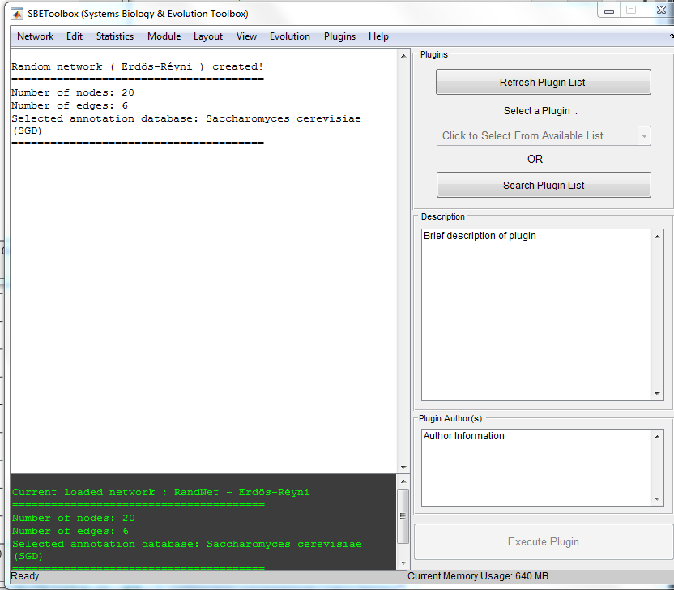
Erdos Renyi
Asks how many nodes one wants and probability of each edge (automatically put as .5) and creates random network based on Erdos-Renyi random graph model
Does not specify which model, as there are two, based on: https://en.wikipedia.org/wiki/Erd%C5%91s%E2%80%93R%C3%A9nyi_model#Definition
Can then run all programmed tests

Slide 8
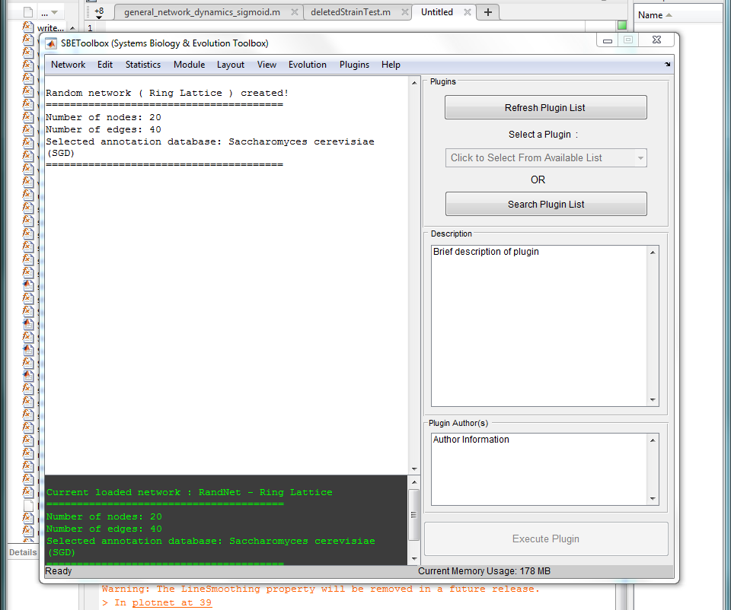
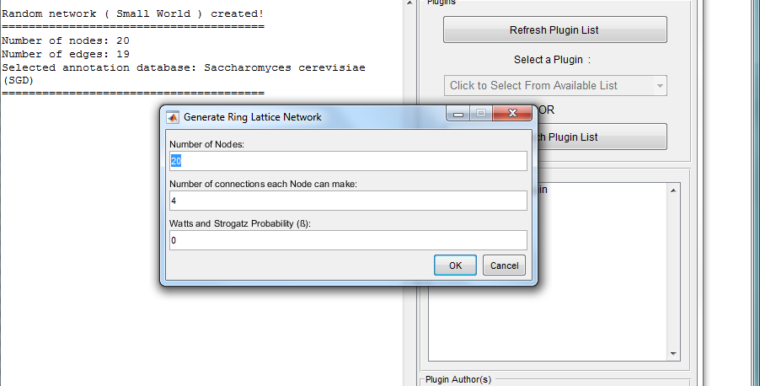
“Network” -> “Create Random Network”-> “Ring-Lattice”
Creates a random network using the “ring-lattice” model, which requires three parameters to be set, number of nodes, number of connections a node can have, and a constant beta (ex. 20 nodes, 1 edge per node, beta=0). Displays the number of edges and nodes for that random network in the main toolbox window

Slide 9
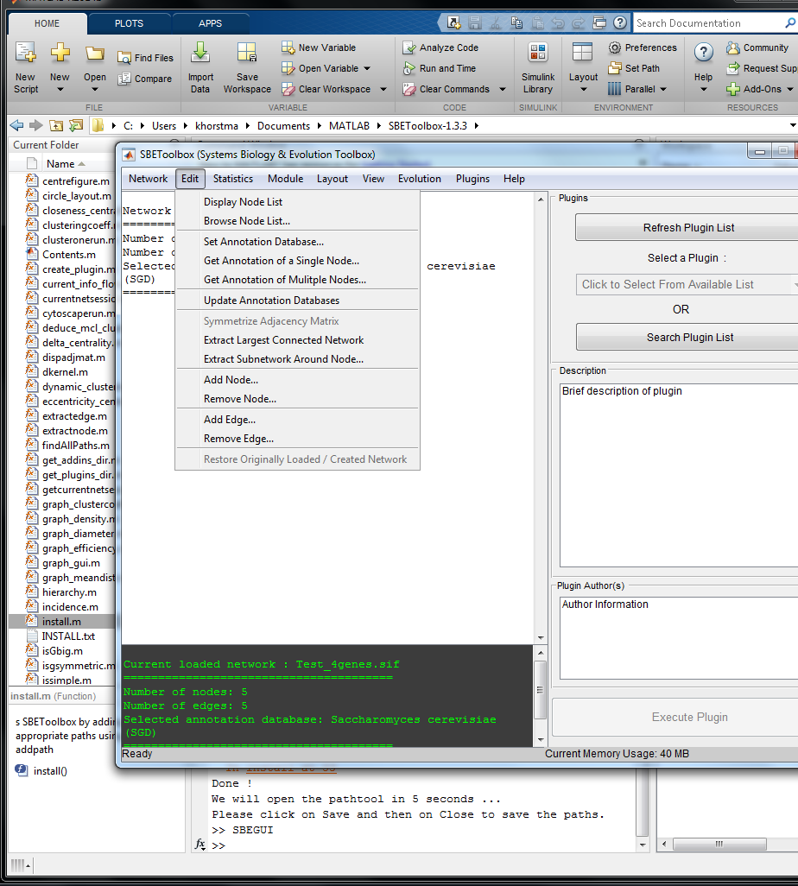
“Edit”Overview

Slide 10
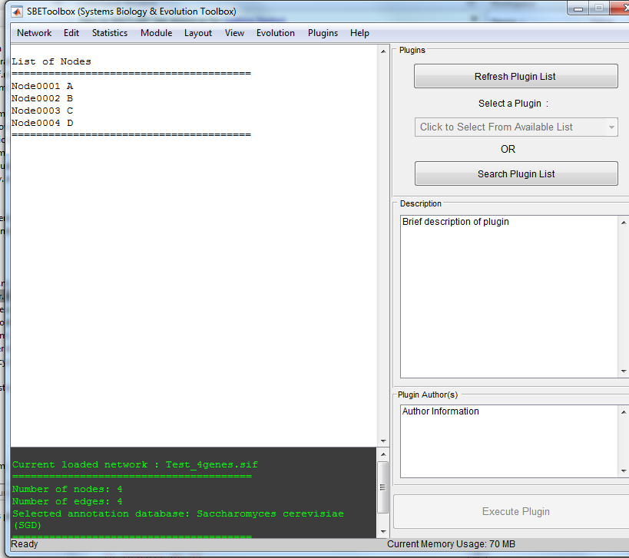
Display Node List
Simply gives a list of the node’s number and given names

Slide 11
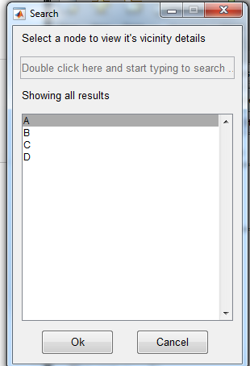
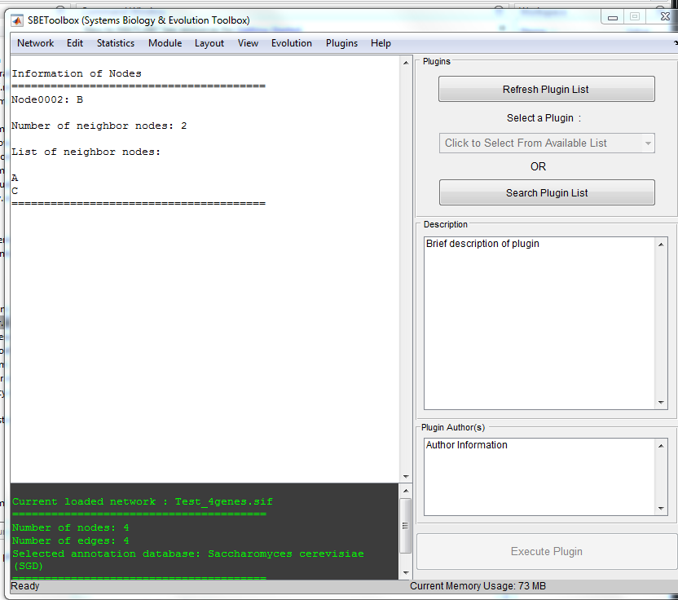
Browse Node List
First, a window with the list of all the nodes pops up. Select the node you want more network information about
In this case, node B was selected. The node number, its neighbors, and its neighbors’ nodes is all listed

Slide 12
Annotation
Set Annotation Database
  Can choose between 25+ organismal databases
  Set ours as S. cerevisiae
Get Annotation of a Single Node
  Will give the quick definition and synonym of the node
  So ZAP1= “Zinc regulatory protein” etc
Get Annotation of Multiple Nodes
  Same function but can choose multiple at once
Update Annotation Databases
  Updates Databases from whichever source SBEToolbox uses

Slide 13
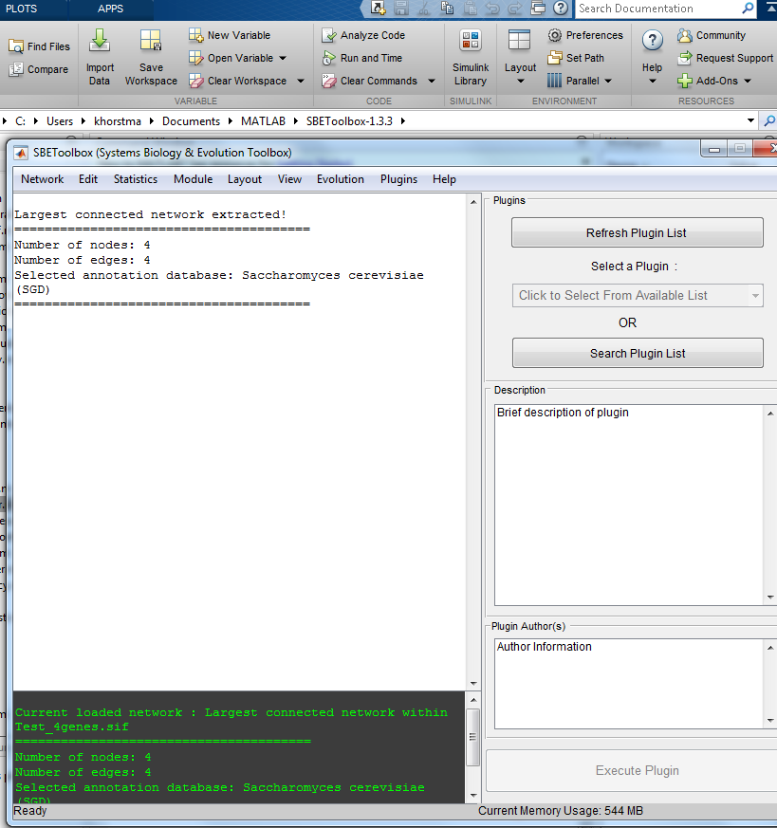
Extract Largest Connected Network
Extracts the largest inner-connected network in the larger network
Since all four of our nodes were connected in someway, 4 was our largest network
“Extract subnetwork around node.” Select a node, and gives the edges and nodes connected/around it

Slide 14
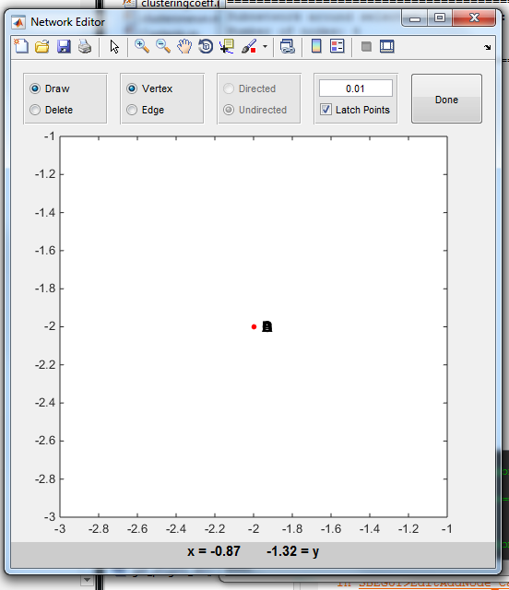
Add/Remove Node/Edge
Removing a node
  List of Nodes pops up and can select and remove
Adding Node/Edge
  Gives a graph and you just click to add a vertex or edge based on coordinates. Not sure how this one works yet

Slide 15
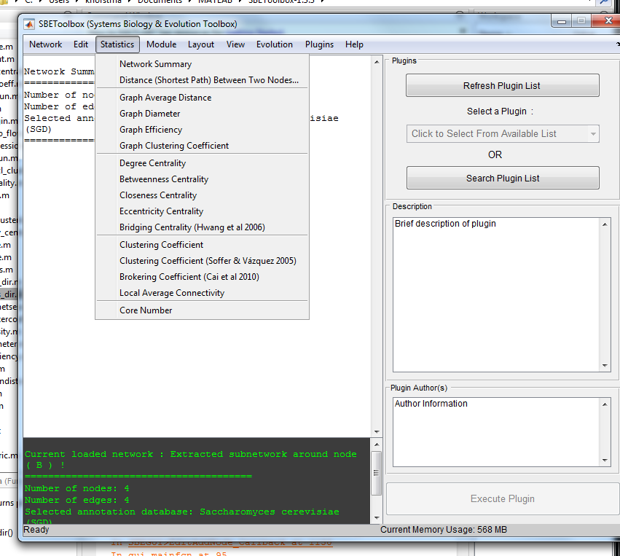
“Statistics” Overview
- “Network Summary” gives number of nodes, edges, and the selected annotation database

Slide 16
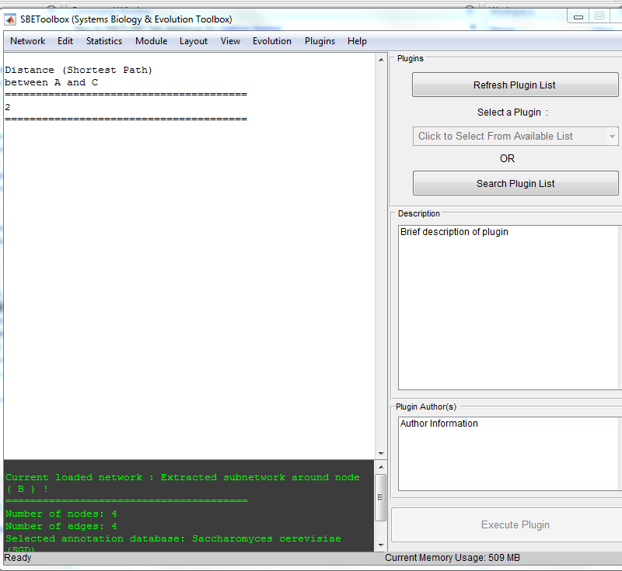
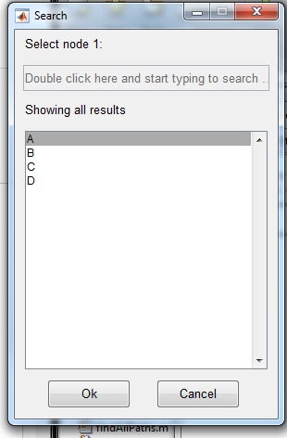
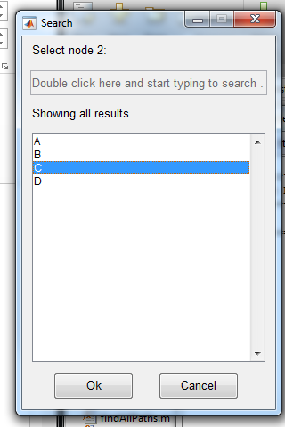
Distance (Shortest Path) Between Two Nodes
Finds the shortest path between two selected nodes
Note: Nodes must be selected as demonstrated in second image. The gray-scaled automatic bar in first image will not register

Slide 17
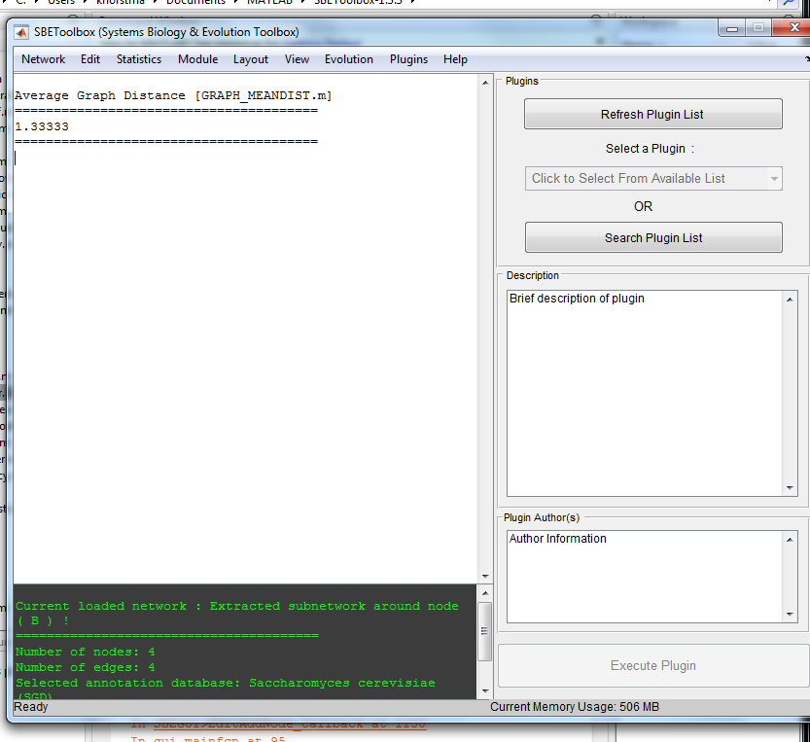
Graph Average Distance
- Finds the average distance between nodes in the network

Slide 18
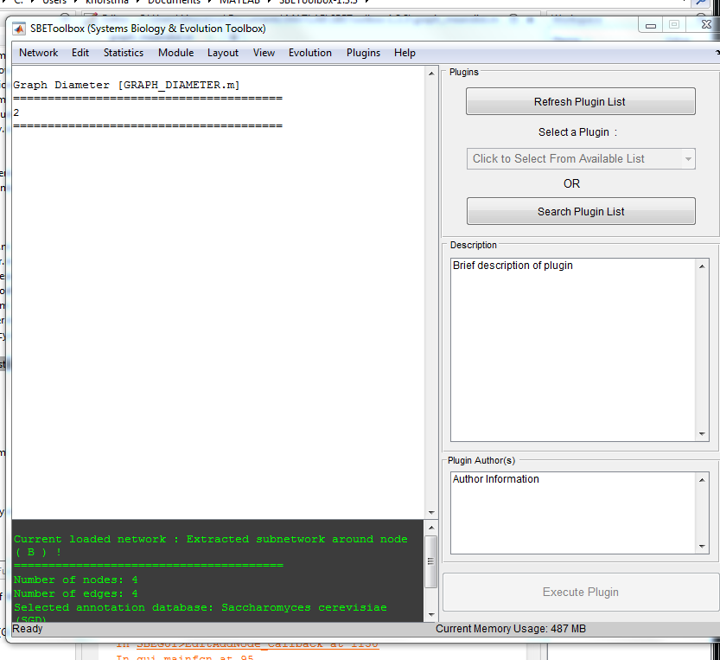
Graph Diameter
- Maximum distance between any pair of vertices

Slide 19
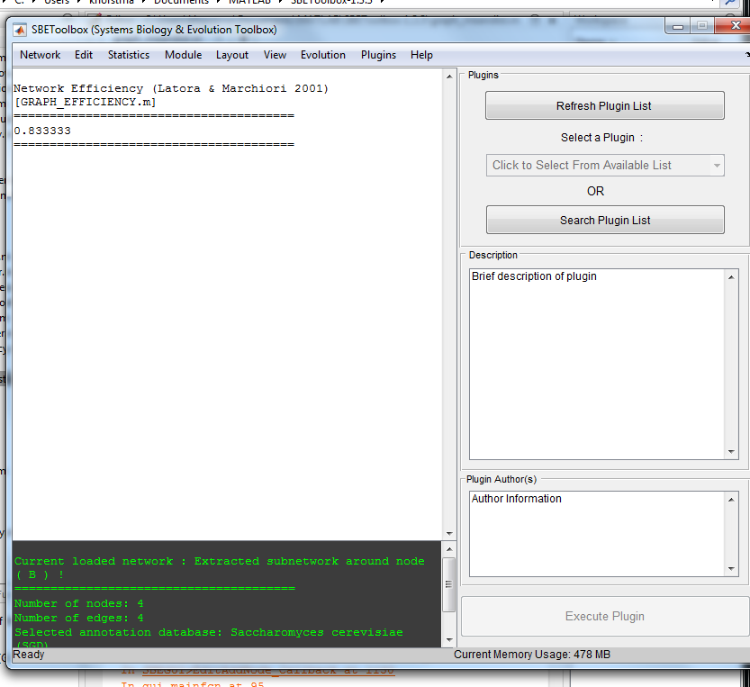
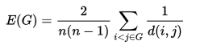
Network Efficiency
Measure of how efficiently a network exchanges information
n= total nodes in the network
D(i,j) length of the shortest path between a node i and node j

Slide 20
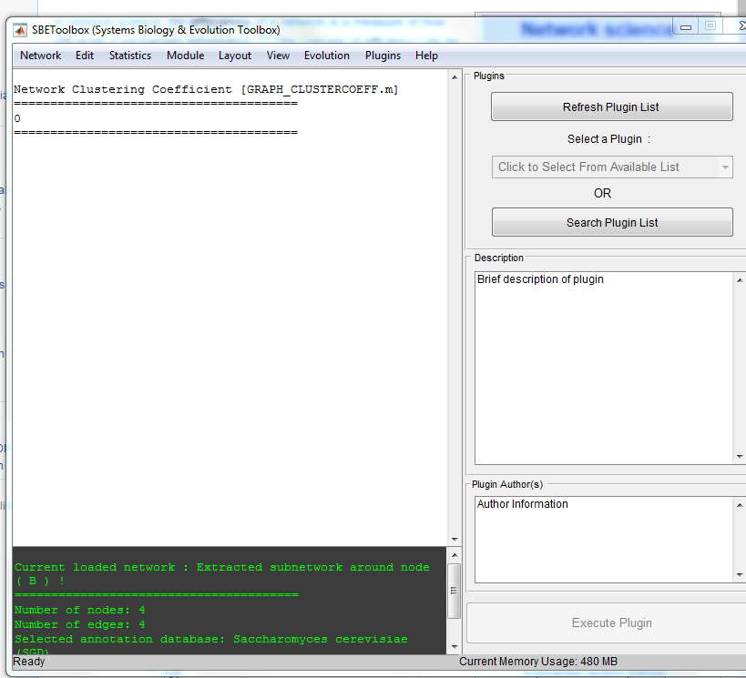
Graph Clustering Coefficient
- Measure of the degree of the nodes in a graph clustering together (global scale)

Slide 21
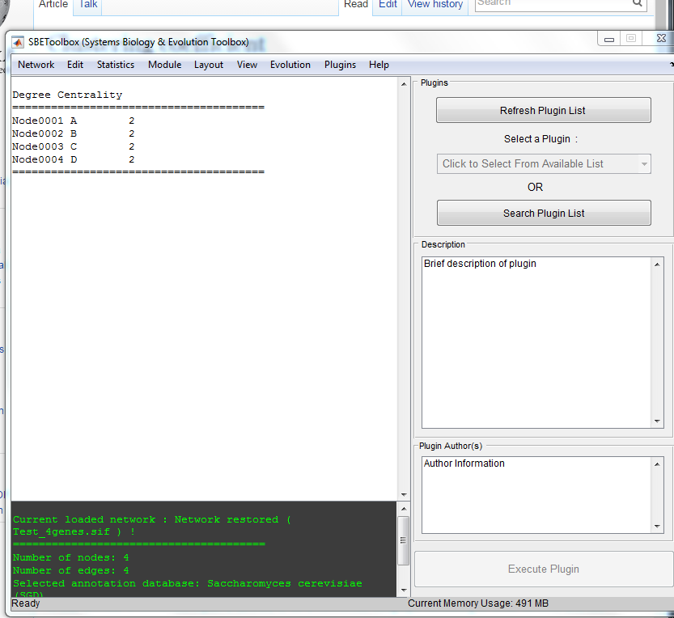
Degree Centrality
- Number of links on each node, whether indegree or outdegree

Slide 22
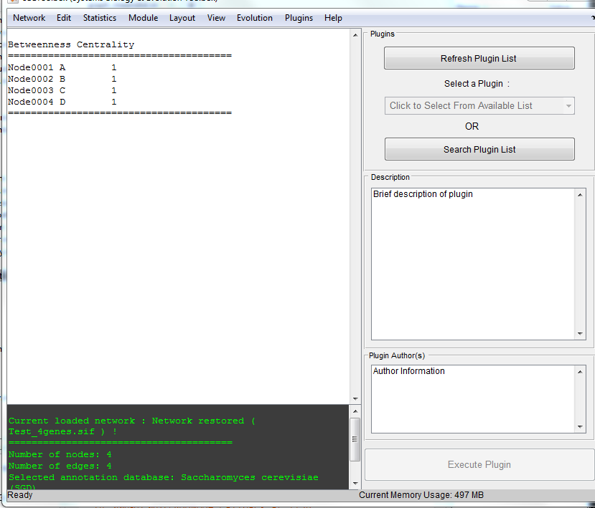
Betweenness Centrality
- Node’s centrality in a network. Measures the number of times a node acts as a bridge along the shortest path between two other nodes

Slide 23
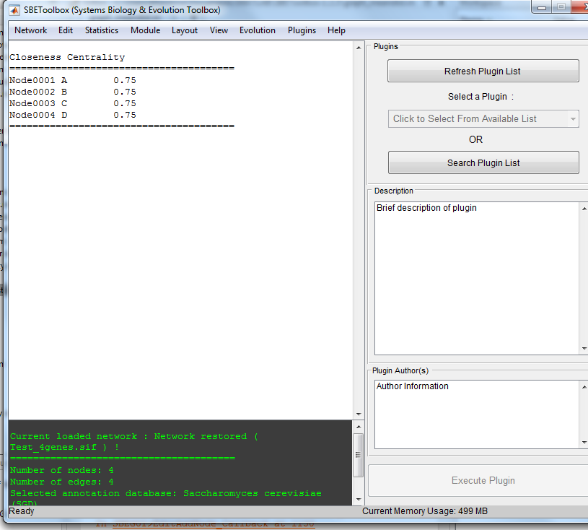
Closeness Centrality
- Average length of the shortest path between the node and all other nodes in the graph. More central a node, closer it is to all other nodes

Slide 24
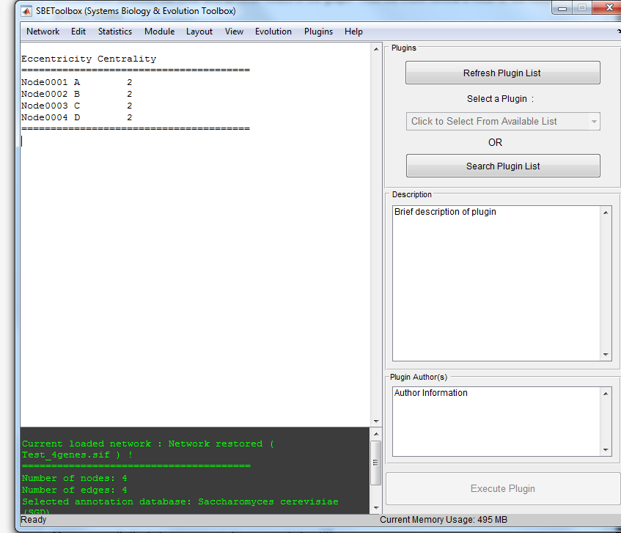
Eccentricity Centrality
- Greatest geodesic distance between v and any other vertex. How far a node is from the node most distant from it in the graph

Slide 25

Bridging Centrality (Hwang et al 2006)
Proposed in Hwang article : https://www.cse.buffalo.edu/tech-reports/2006-05.pdf
Gives value of how “bridged” the individual nodes are relative to other nodes

Slide 26
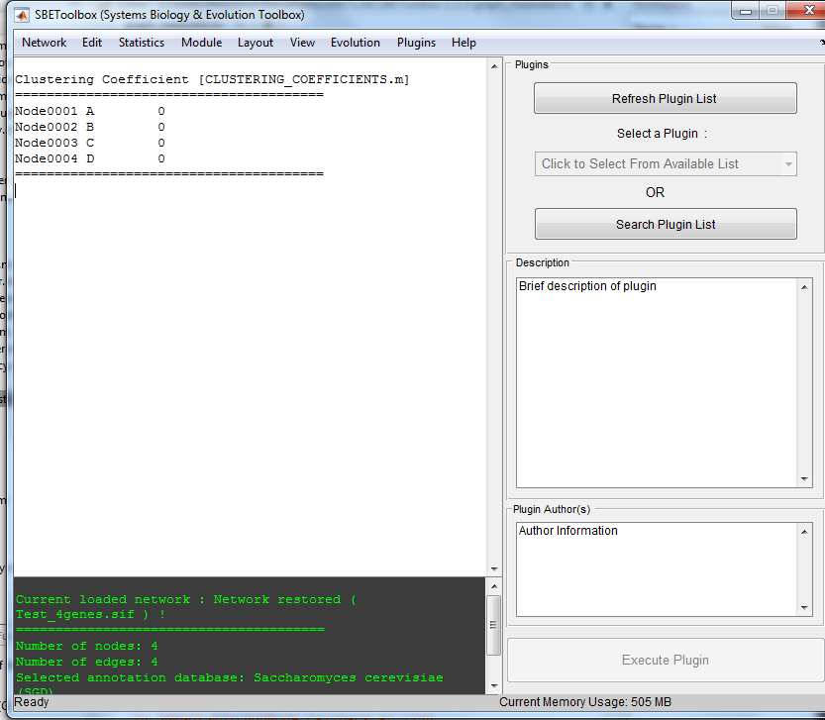
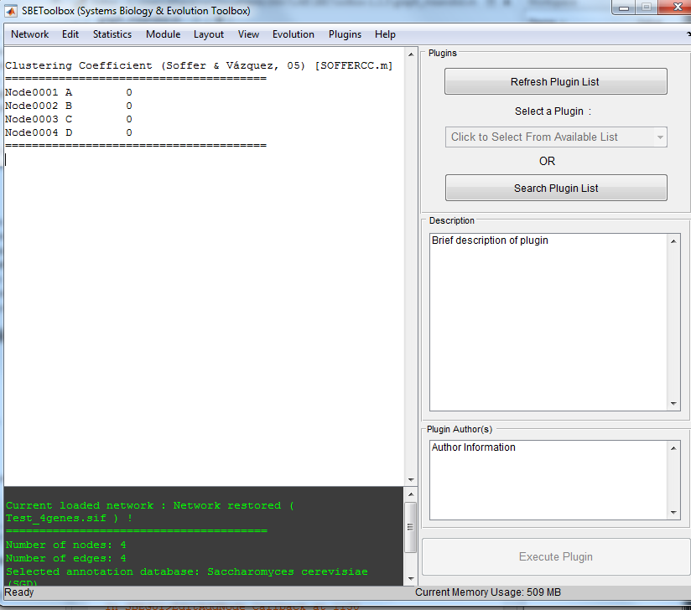
Clustering Coefficient
Has two options: clustering coefficient and clustering coefficient (Soffer & Vazquez 2005: https://www.ncbi.nlm.nih.gov/pubmed/16089694)
Quantifies how close its neighbors are to forming a subset of vertices of an undirected graph (local)

Slide 27

Brokering Coefficient (Cai et al 2010)
https://www.ncbi.nlm.nih.gov/pubmed/20937604

Slide 28
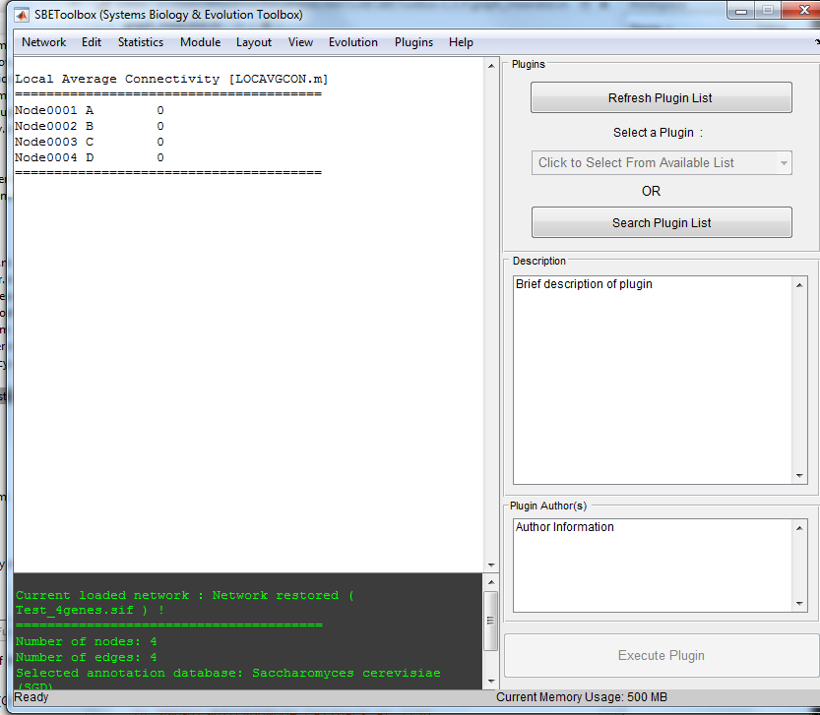
Local Average Connectivity
- Average of the size of the smallest vertex cut separating nonadjacent pairs of vertices

Slide 29
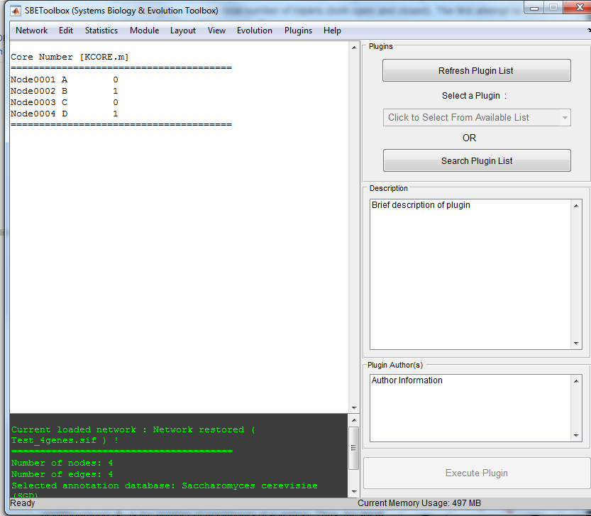
Core Number
Exhibits homomorphism in a graph

Slide 30
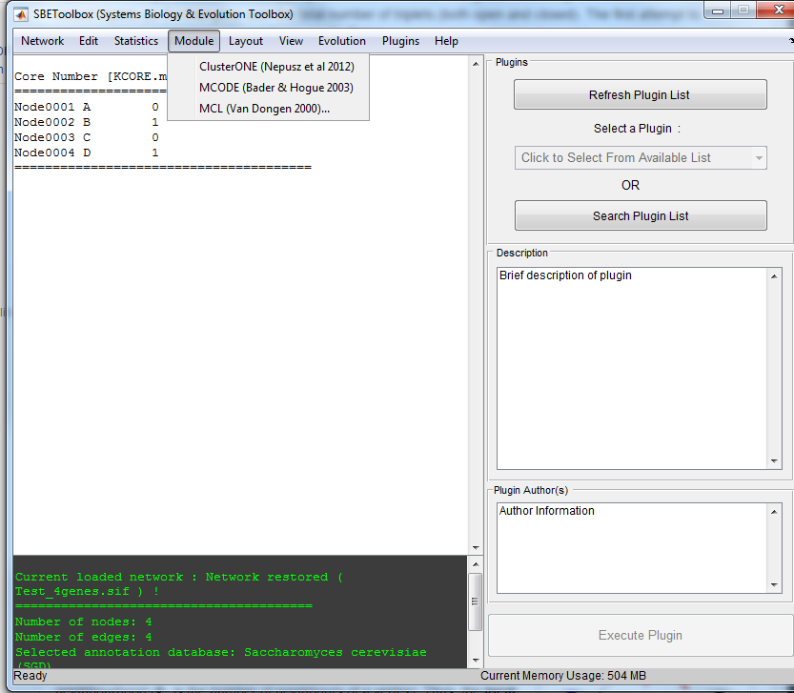
“Module” Overview
Looks like they took codes/programs written by others that they found useful/necessary and added it to the toolbox for ease of use

Slide 31
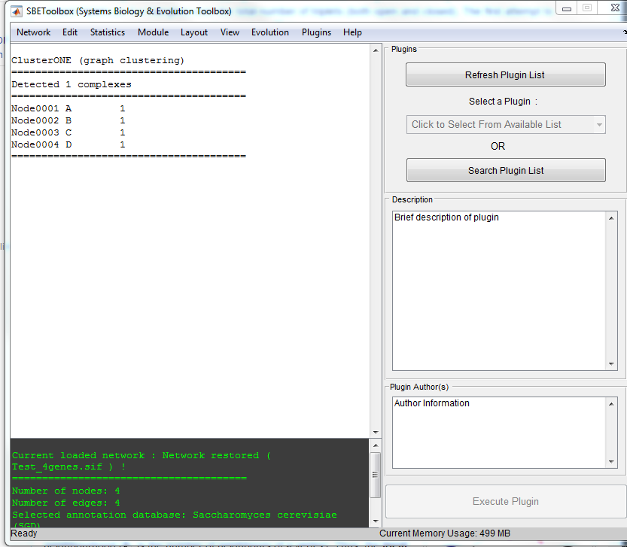
ClusterONE (Nepusz et al 2012)
- https://www.ncbi.nlm.nih.gov/pmc/articles/PMC3543700/

Slide 32
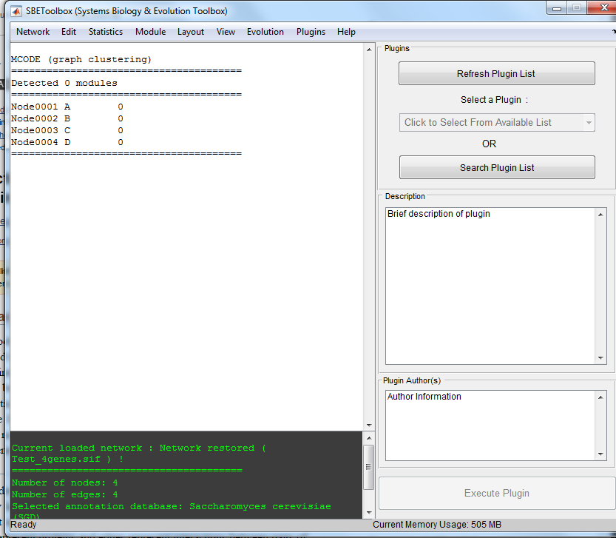
MCODE (Bader & Hogue, 2003)
-https://www.ncbi.nlm.nih.gov/pmc/articles/PMC149346/

Slide 33
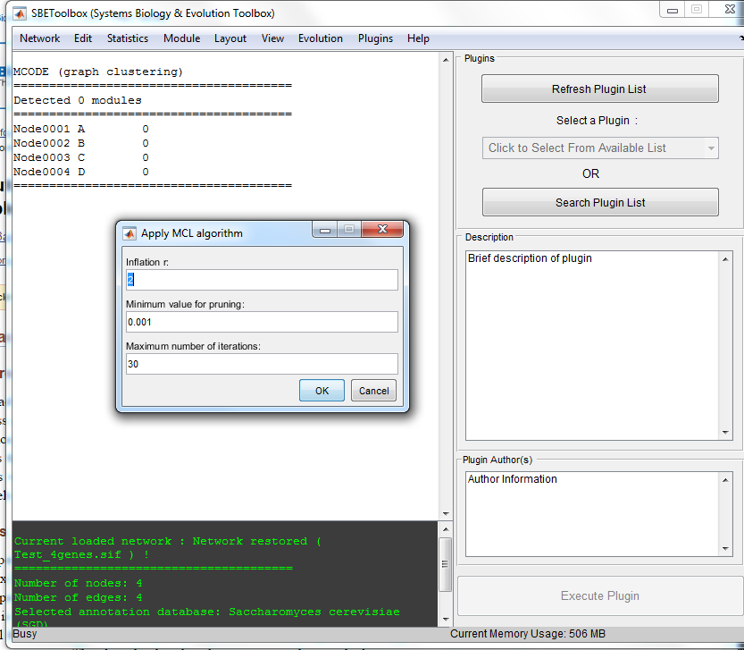
MCL (Van Dongen 2000)
Pop up of variables to enter to use algorithm
http://nar.oxfordjournals.org/content/30/7/1575.short

Slide 34
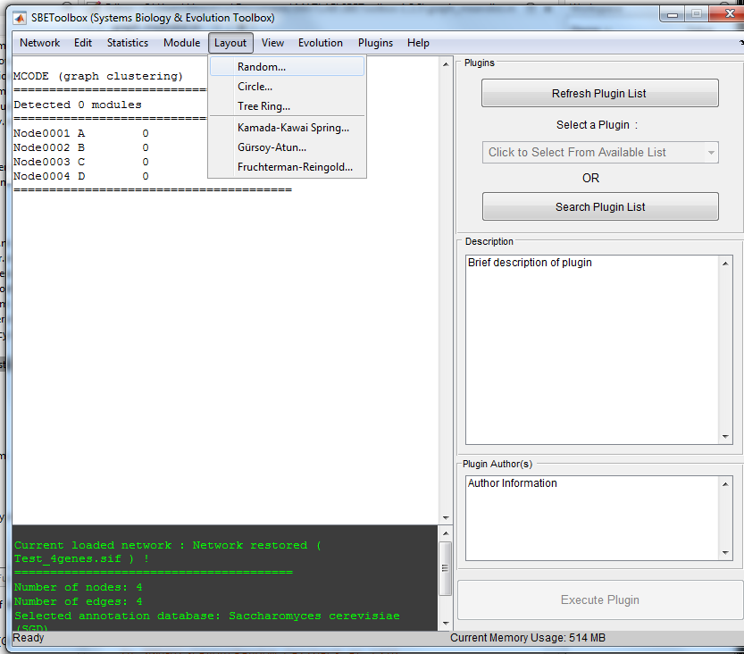
“Layout” Overview

Slide 35
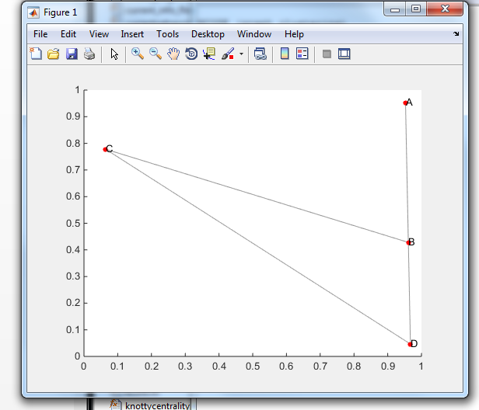
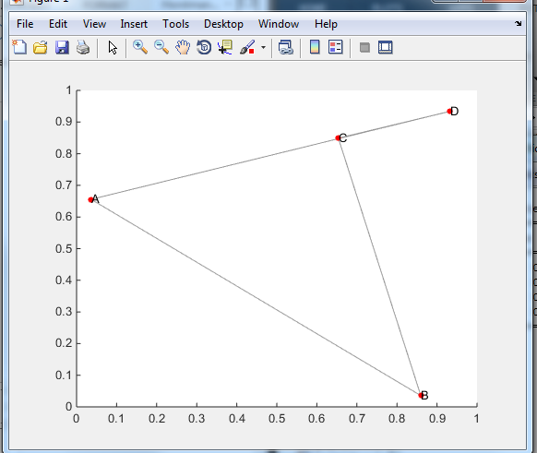
Random
Creates random network orientation of the nodes

Slide 36
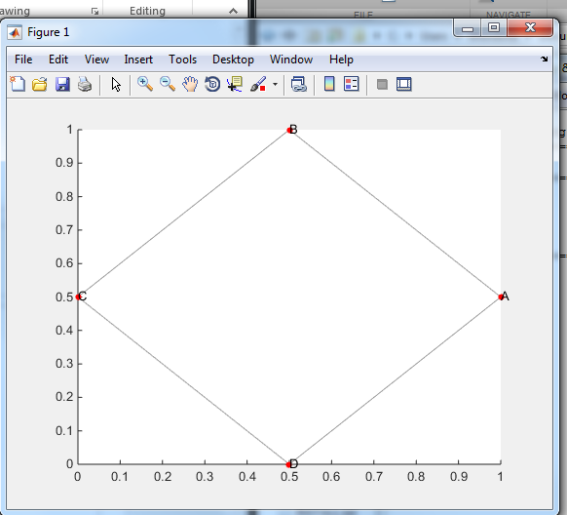
Circle
- Believe this arranges the nodes into a circle, but hard to tell for sure as this test network was square-shaped anyways

Slide 37
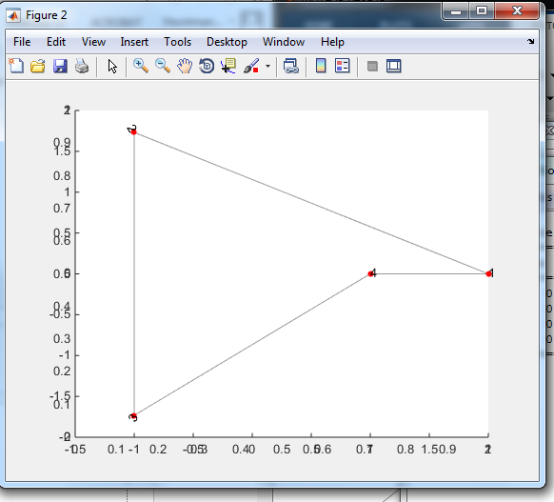
Tree Ring
Arranges nodes in a “tree ring” format
Popup asked how many nodes were in the center (1 here)
Could find information on tree graphs and ring graphs but nothing on tree ring graphs so will continue looking into this

Slide 38
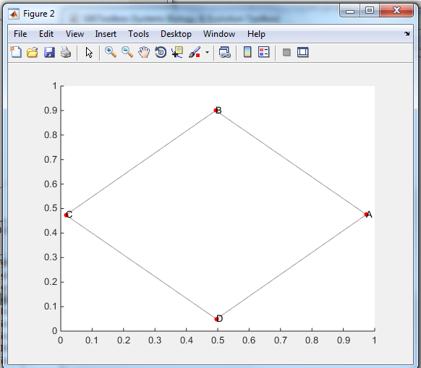
Kamada-Kawai Spring…
http://www.sciencedirect.com/science/article/pii/0020019089901026
These next three graphs are all clearly related, as most articles had them listed together, but very difficult to find information on each algorithm individually

Slide 39
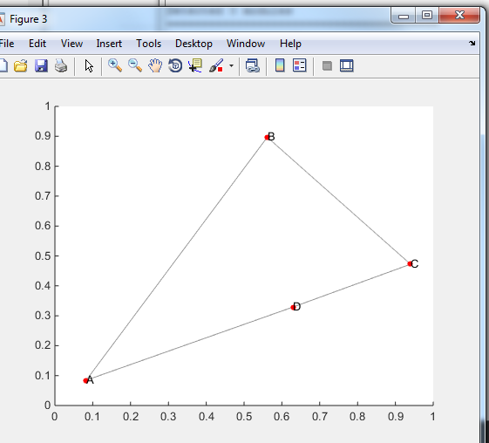
Gursoy-Atun….

Slide 40
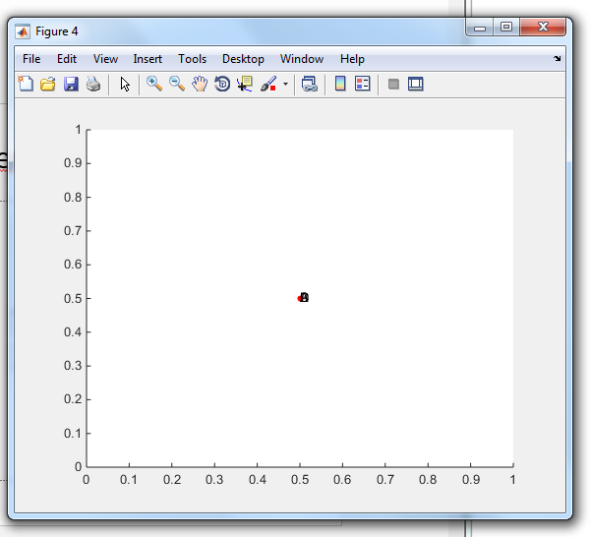
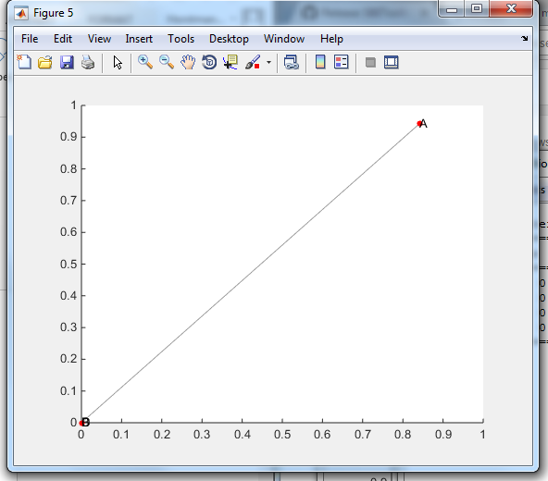
Fruchterman-Reingold
- Asked for iterations number, gave 200 as the default, and just pressed ok. Graph did not look different when run with 20, 5, or 3 iterations. However, when tested with 2 iterations, got graph on the right
- Again, need to dig deeper to find the specific applications and working of this graph

Slide 41
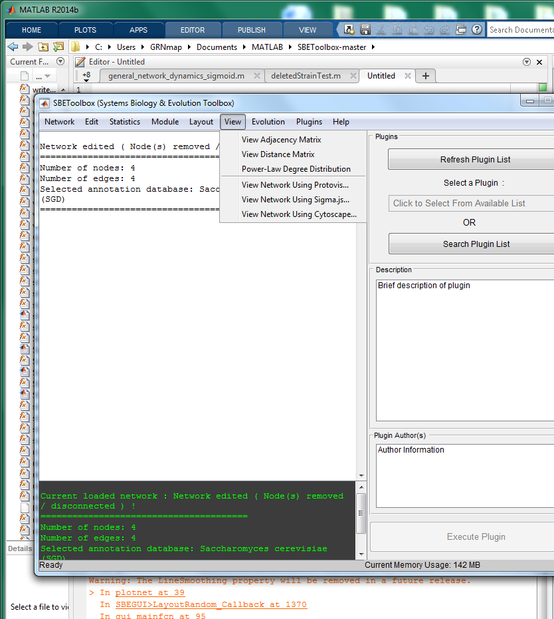
“View” Overview
When view is clicked, a number of functions pop up, which are displayed in two categories

Slide 42
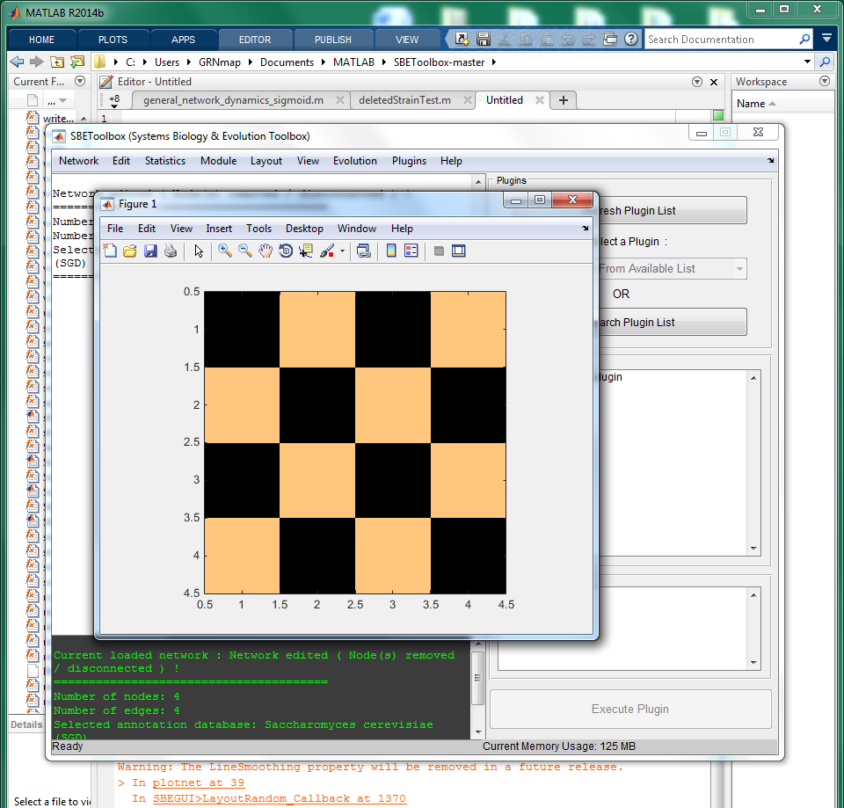
“View Adjacency Matrix”
Color-block 4x4 matrix displayed for ABCD graph shows whether the edges are connected or not using a binary scale (ie. Orange is a connection, black is no connection)

Slide 43
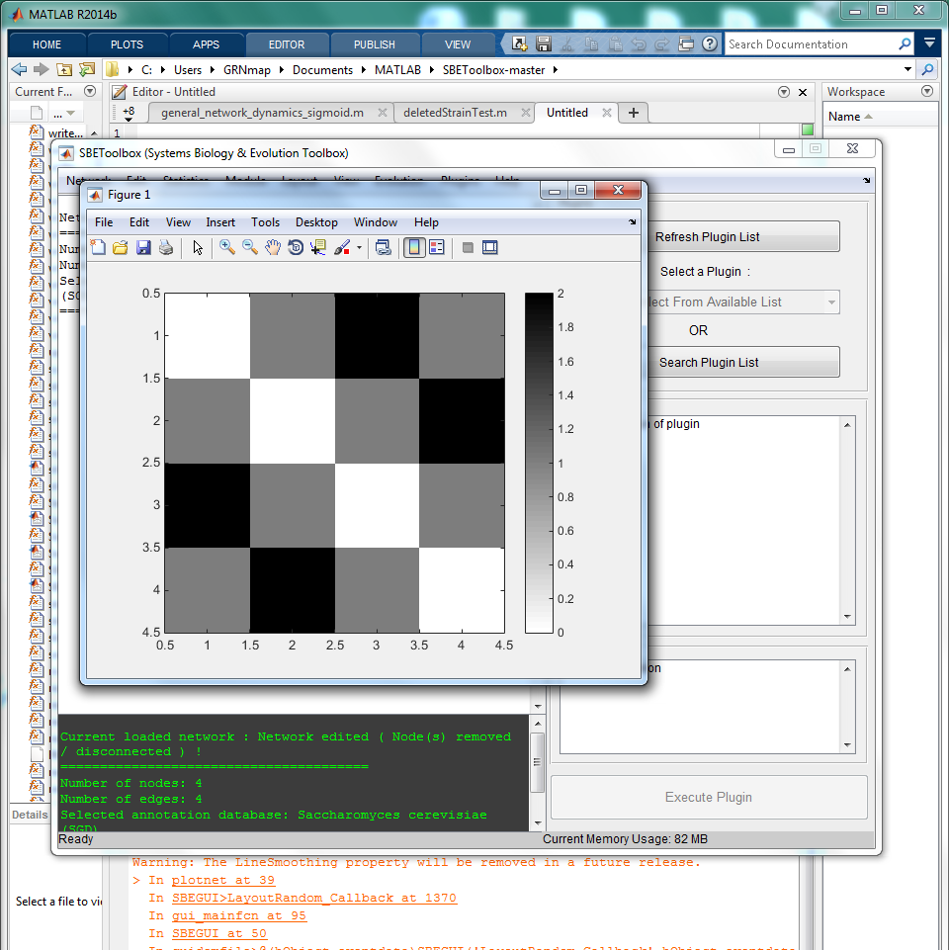
“View Distance Matrix”
Function displays 4x4 gradient matrix for ABCD graph, with different colors indicating how many edges apart the nodes are from eachother

Slide 44
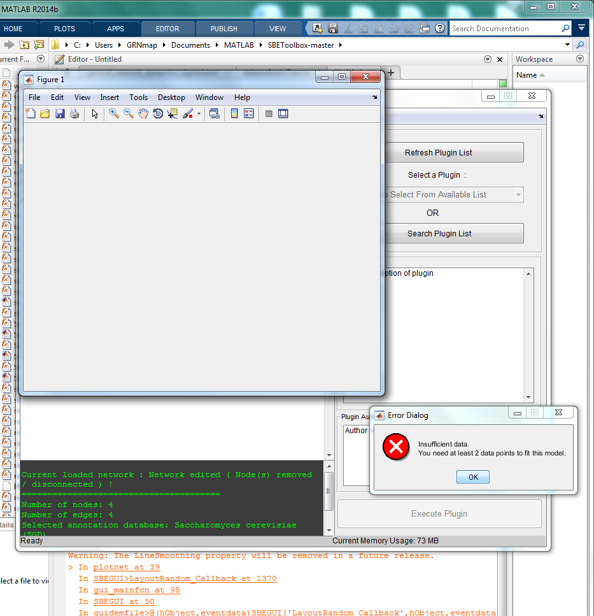
“Power-Law Degree Distribution”
Error came up when attempting to run with ABCD graph. Data deemed insufficient for this function, but might work with larger 21 gene network to show distribution

Slide 45
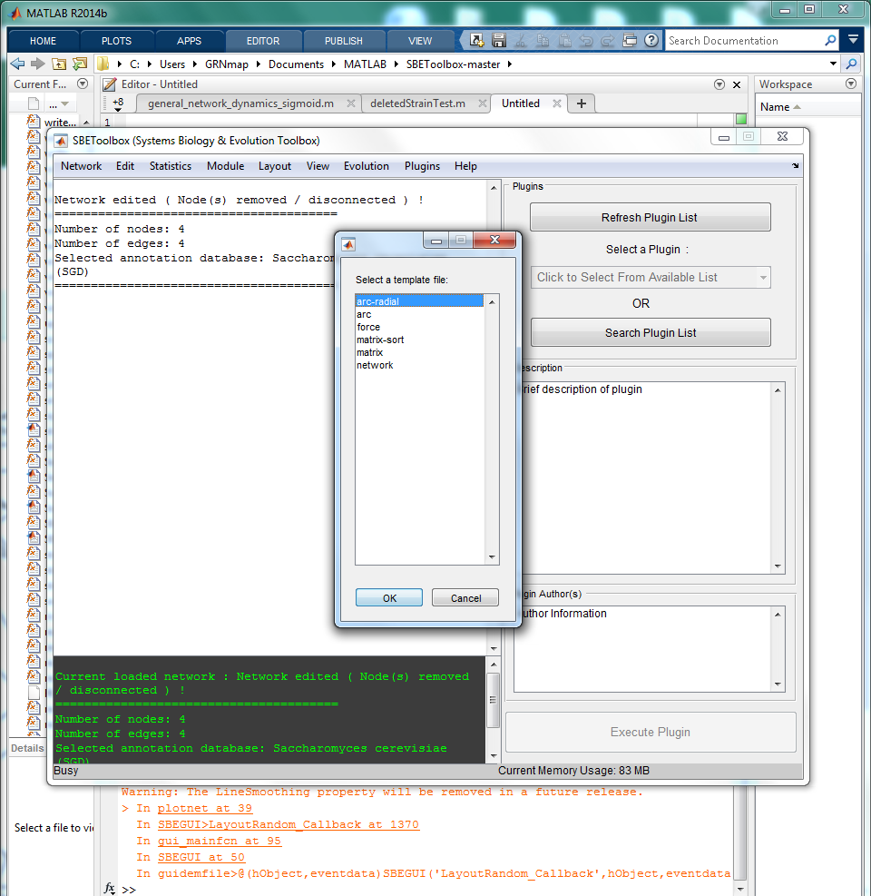
“View Network Using Protovis…”
Function results in a menu being pulled up that has a variety of options for what is assumed to be “Protovis,” what appears to be an html visualization tool.

Slide 46
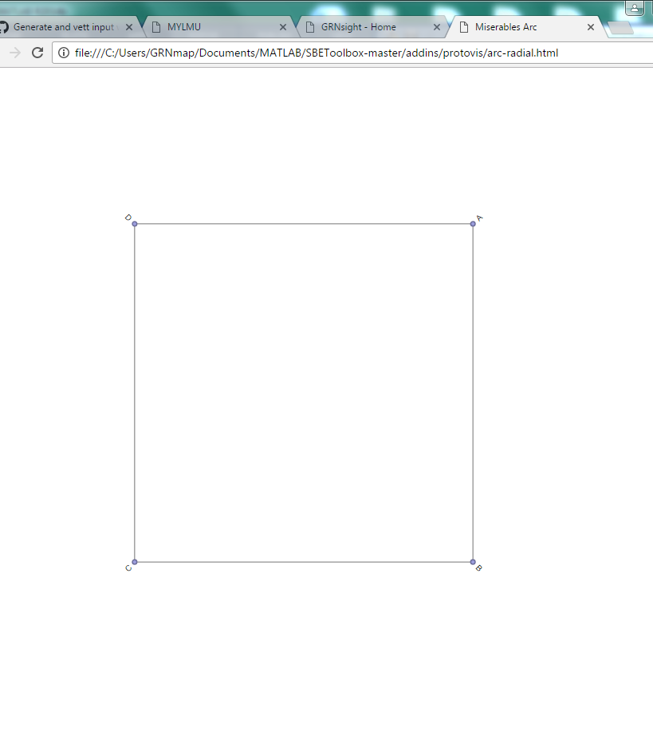
“View Network Protovis…” -> “arc-radial”
Selecting “arc-radial” from the “protovis” menu results in a network that displays the ABDC matrix in a radial format

Slide 47

“View Network Protovis…” -> “arc”
Selecting the “arc” option from the menu results in the nodes being displayed in a horizontal line, with the edges displayed as arcs between nodes

Slide 48


“View Network Protovis…” -> “force”
By selecting the “force” option, a browser pops up with an un-labeled network. Through clicking on one of the nodes, you can drag around the network and see what the force is of one node on the rest of the graph

Slide 49

“View Network Protovis…” -> “matrix-sort”
In selecting “matrix-sort” a matrix pops up in a new window displaying the nodes as edges and rows, with intersections being their connections or lack of connections, with dark grey being a connection and light grey showing no connection

Slide 50

“View Network Protovis…” -> “Network”
Selecting the network option from the menu pulls up a screen in the default browser of the computer that displays a possible graph of the network

Slide 51

“View Network Protovis…” -> “Matrix”
Similar to the “View Adjacency Matrix” option in the “View” tab, selecting the “matrix” option pulls up a browser window which displays a visual, binary matrix that represents the connections between nodes with each row and column being a node. This display has a benefit however, in that the names rather than the assigned numbers are displayed for each node.

Slide 52

“View Network Using Sigma.js…”
Similar to when selecting “view network using protovis…”when this option is selected, a menu pops up with a variety of options for the layout method.

Slide 53


“View Network Using Sigma.js…’ -> “frutcherman_reingold_force”
When the first option, “frutcherman_reingold_force” is selected, another menu appears offering more selections. No matter which is selected, each tries to pull up a Firefox browser window which requires you to copy and paste the url into Firefox to use the function

Slide 54

“View Network Using Sigma.js…’ -> “frutcherman_reingold_force”
Once any of the menu items from the last slide are selected and the corresponding url is opened in Firefox, the following is seen. For the ABCD graph, only a single point for D is shown. When you hold your cursor at any point on the dark screen or on dot “D”, using the scroller on your mouse you can zoom in or out of the image. When each option was selected after the ABCD graph was uploaded, there was no change in image due to the fact that the graph is only displaying as a single node, “D”

Slide 55


“View Network Using Sigma.js…’ -> “gursoy_atun”
When “gursoy_atun” is selected from the “Sigma.js” view option, a list of file options identical to that shown for the “frutcherman_reingold_force.” Selecting any of these options results in the browser saying you must open the link in Firefox

Slide 56

“View Network Using Sigma.js…’ -> “gursoy_atun” -> “curve_edges”
Once the link is open Firefox, you can select any of the visualization options listed at the top of the screen. The above graph is for the “curve-edges” option. When you hover the mouse over any of the nodes, you are able to see the label attached to that node (shown above for node A)

Slide 57

“View Network Using Sigma.js…’ -> “gursoy_atun” -> “fisheye”
Selecting “fisheye” shows the same curved-edge network, however depending on where you have the cursor, you are able to see a zoomed in view (with labels) of the portion of the graph you are hovering over. For above, cursor was in center between nodes B C and D

Slide 58

“View Network Using Sigma.js…’ -> “gursoy_atun” -> “force_atlas2”
When “force_atlas2” is selected, the network is displayed as static with curved edges and the nodes on the very edges of the image so that they cannot all be seen at once. When “stop layout” or “start layout” is selected, the edges appear and disappear

Slide 59


“View Network Using Sigma.js…’ -> “gursoy_atun” -> “hide_non_neighbor”
When “hide_non_neighbor” is selected, the same curved edges graph appears. However, when you hover your cursor on a specific node, only the part of the graph that is directly connected to that node will appear. (ex. Shown for node D)

Slide 60

“View Network Using Sigma.js…’ -> “gursoy_atun” -> “highlight_neighbor”
When “highligh_neighbor” is selected, similar to “hide_non_neighbor” you have to hover the cursor over a node to see the visualization, which makes any non-neighbors grey, and keeps the remaining nodes and edges green (ex. Shown for node D)

Slide 61
“View Network Using Sigma.js…’ -> “kamada_kawai”
When this option is selected, in the same case as “frutcherman_reingold_force” and “gursoy_atun,” a browser window pops up, no matter the menu selection, which tells you to use Firefox.

Slide 62

“View Network Using Sigma.js…’ -> “kamada_kawai”-> “curve_edges”
When the link is copied to Firefox and
“curve_edges” is selected, a cyan graph pops up which is static with the nodes displayed on the sides of the page, with all the edges in curved arcs.

Slide 63

“View Network Using Sigma.js…’ -> “kamada_kawai”-> “fisheye”
Similar to the “fisheye” selection for “gursoy_atun,” when the cursor is held near a node, that portion of the graph expands to show a zoomed in version of that section of the graph, with the remaining portion of the graph being unchanged.

Slide 64

“View Network Using Sigma.js…’ -> “kamada_kawai”-> “force_atlas2”
Similar to the “force_atlas2” selection for “gursoy_atun,” this option lets you hide or show the edges by clicking “start layout” or “stoplayout” and you can drag the relatively static graph around the page

Slide 65

“View Network Using Sigma.js…’ -> “kamada_kawai”-> “hide_non_neighbor”
Similar to the “hide_non_neighbor” selection for “gursoy_atun,” this option lets you hide the non-neighbors of any node by hovering your cursor over the desired node. This image shown is an example for node D

Slide 66

“View Network Using Sigma.js…’ -> “kamada_kawai”-> “highlight_neighbor”
Similar to the “highlight_neighbor” selection for “gursoy_atun,” this option lets you highlight the neighbors of the selected node by hovering your cursor over a node, and displays the rest of the graph as grey. The above example is for node D.

Slide 67
“View Network Using Sigma.js…’ -> “circle”
When this option is selected, in the same case as “frutcherman_reingold_force,” “gursoy_atun,” and “kamada_kawai,” a browser window pops up, no matter the menu selection, which tells you to use Firefox.

Slide 68

“View Network Using Sigma.js…’ -> “circle”
Once the Firefox link is open, the graph for selection “circle” has the same options and properties of the functions as all the options in “kamada_kawai” with the only difference being that the graph for “circle” is red instead of cyan

Slide 69

“View Network Using Cytoscape”
When “View Network using Cytoscape” is selected, the Cytoscape software displays the above opening screen

Slide 70

“View Network Using Cytoscape”
Once Cytoscape opens, the above window appears with a depiction of the graph in the bottom left window. Not sure how all features of program work, so leaving that analysis for a different time

Slide 71

“Evolution” Overview
Above is the menu for the “Evolution” tab. Not sure when this option would be used, so will be explored further at a later date.

Slide 72

“Plugins” Overview
Above is the menu for the “Plugins” tab. Not sure when this option would be used, so will be explored further at a later date.

