Slide 1
Week 11 Assignment Figures
Cameron Rehmani Seraji
BIOL-398-05/S17
Department of Biology
Loyola Marymount University

Slide 2
Over 50% of the Genes are Significant for the Different P-values
ANOVA | dHAP4
p < 0.05 | 5584 genes 90.22%
p < 0.01 | 5154 genes 83.28%
p < 0.001 | 4287 genes 69.27%
p < 0.0001 | 3352 genes 54.16%
B & H p < 0.05 | 5577 genes 90.11%
Bonferroni p < 0.05 | 3325 genes 53.72%

Slide 3
 | Cold Shock |  |  | Recovery
t test | t₁₅ | t₃₀ | t₆₀ | t₉₀ | t₁₂₀
Average Log Fold Change > 0.25 and p < 0.05 | 2039 genes 32.95% | 2126 genes 34.35% | 2174 genes 35.13% | 1859 genes 30.04% | 1932 genes 31.22%
Average Log Fold Change < -0.25 and p < 0.05 | 2176 genes 35.16% | 2272 genes 36.71% | 2177 genes 35.18% | 1862 genes 30.09% | 2199 genes 35.53%
Total p < 0.05 | 5584 genes 90.22% | 5584 genes 90.22% | 5584 genes 90.22% | 5584 genes 90.22% | 5584 genes 90.22%
Total B & H p < 0.05 | 5557 genes 89.80% | 5557 genes 89.80% | 5557 genes 89.80% | 5557 genes 89.80% | 5557 genes 89.80%
Total Bonferroni p < 0.05 | 3325 genes 53.72% | 3325 genes 53.72% | 3325 genes 53.72% | 3325 genes 53.72% | 3325 genes 53.72%

Slide 4
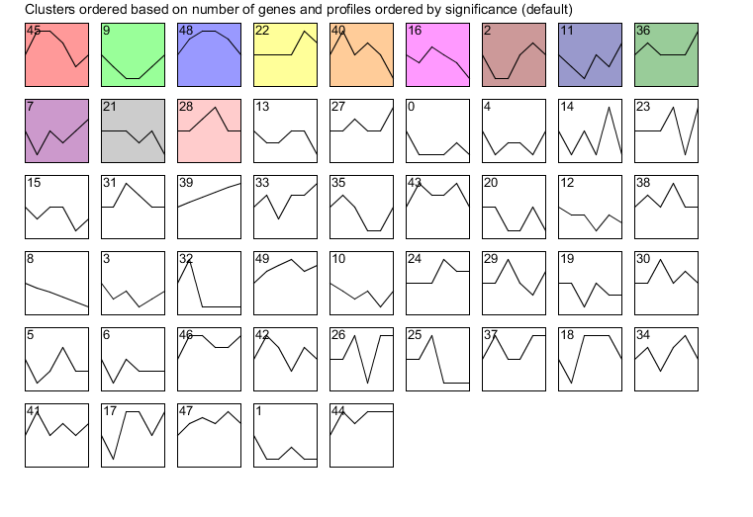
12 Profiles are Statistically Significant

Slide 5
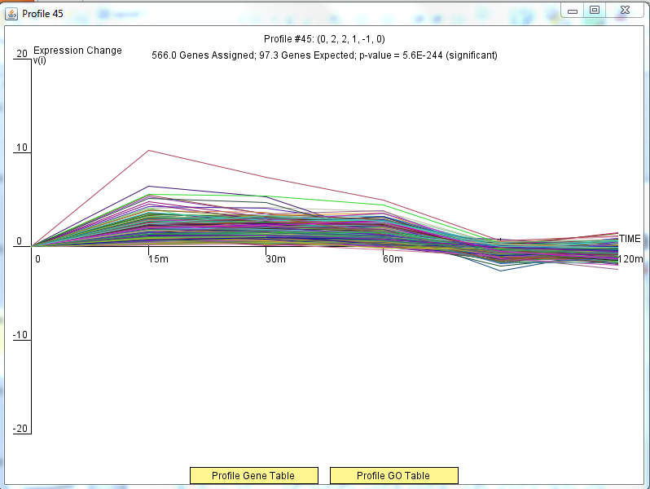
Profile 45 Included 566 Genes

Slide 6
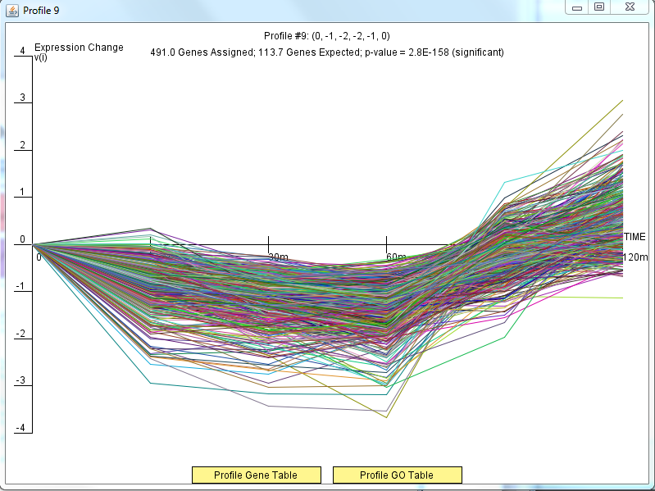
Profile 9 Included 491 Genes

Slide 7
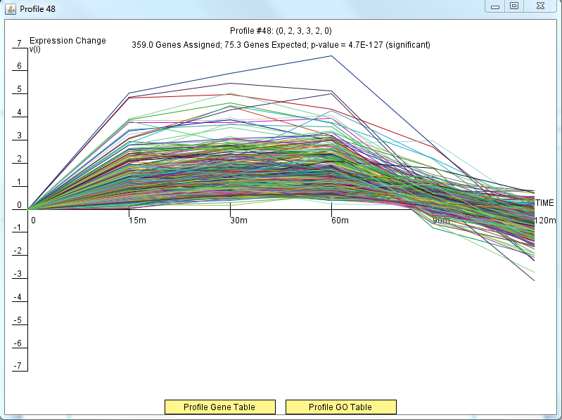
Profile 48 Included 359 Genes

Slide 8
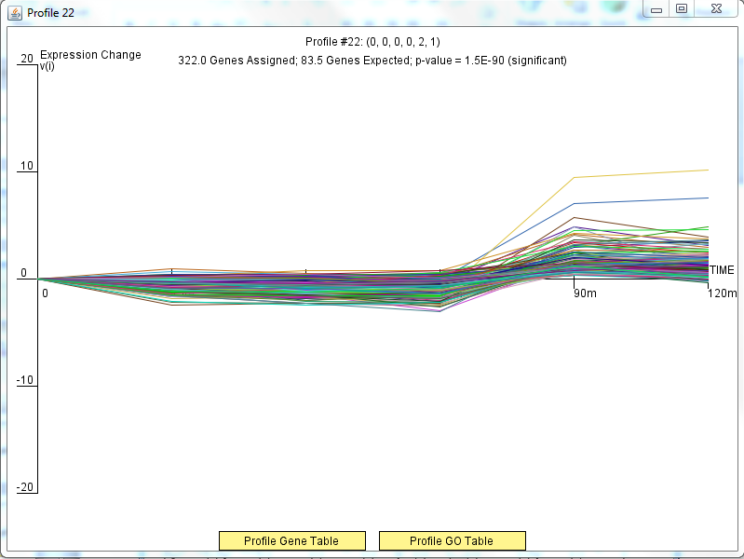
Profile 22 Included 322 Genes

Slide 9
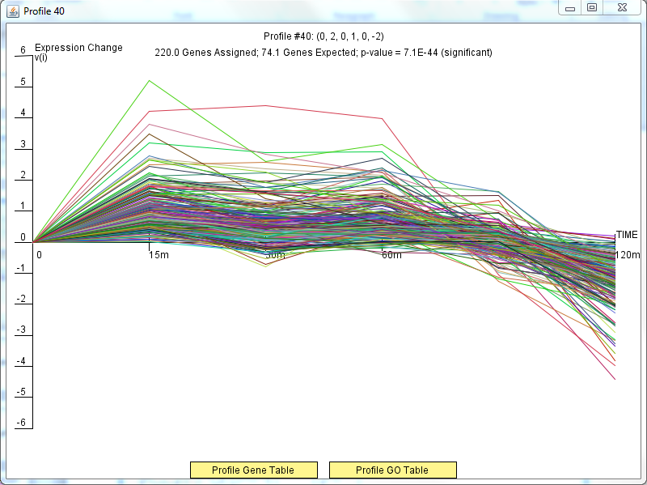
Profile 40 Included 220 Genes

Slide 10
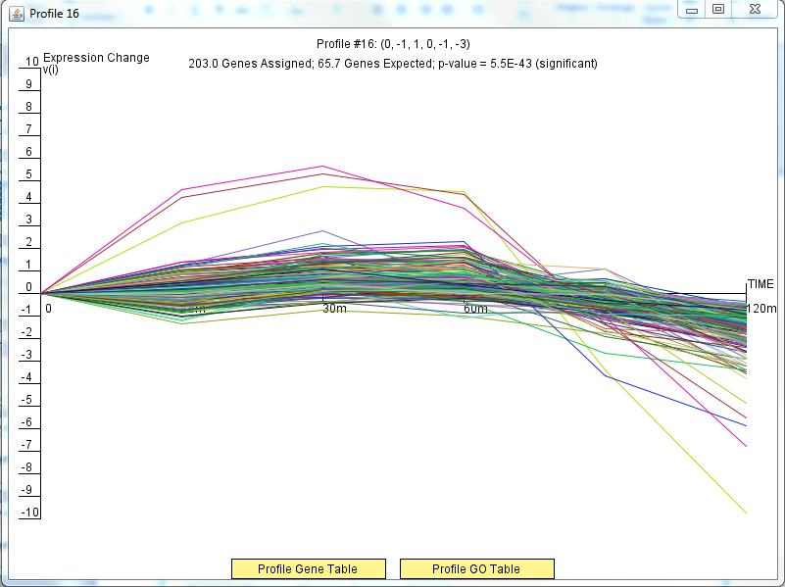
Profile 16 Included 203 Genes

Slide 11
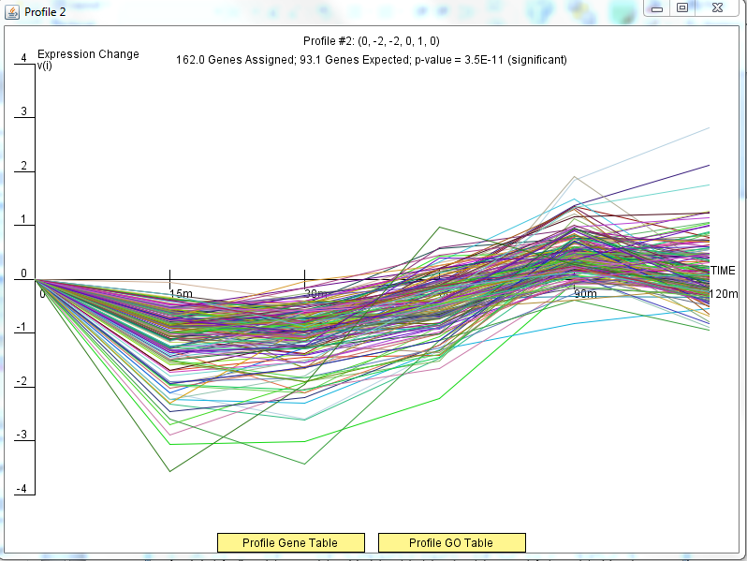
Profile 2 Included 162 Genes

Slide 12
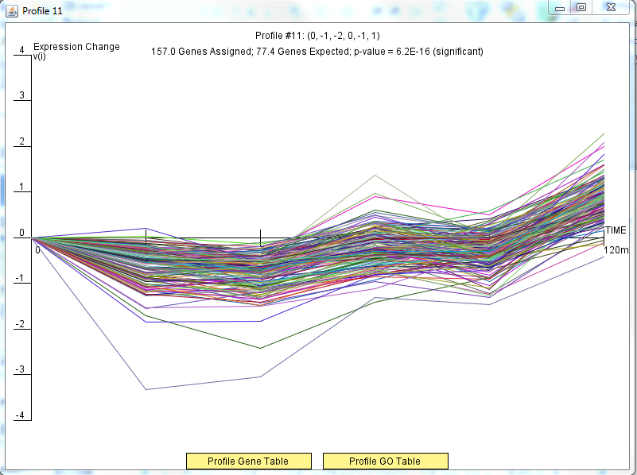
Profile 11 Included 157 Genes

Slide 13
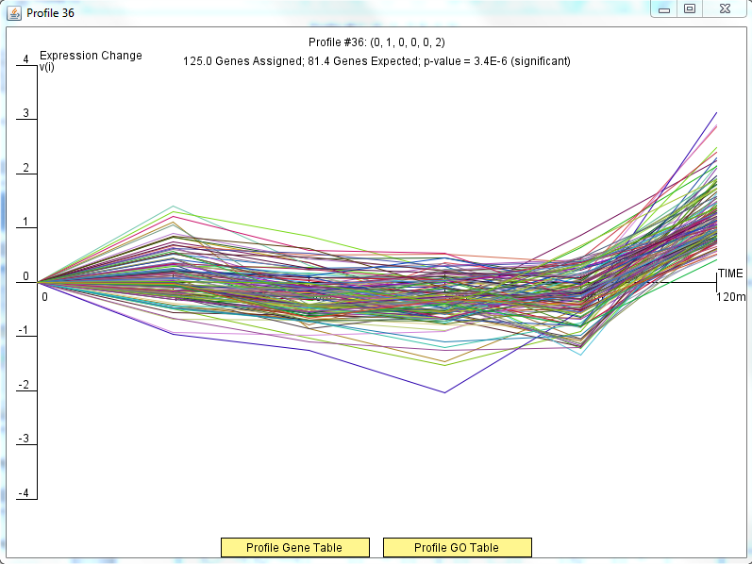
Profile 36 Included 125 Genes

Slide 14
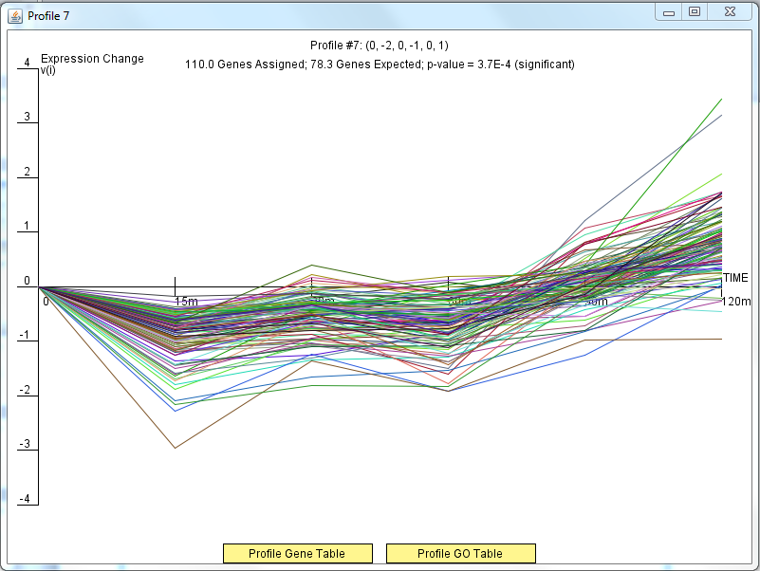
Profile 7 Included 110 Genes

Slide 15
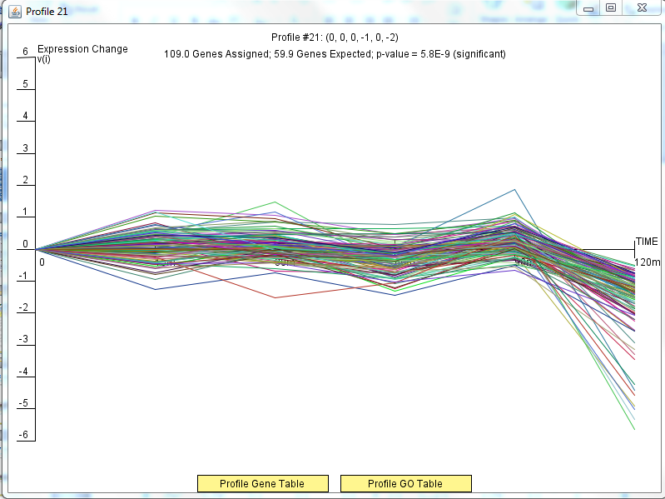
Profile 21 Included 109 Genes

Slide 16
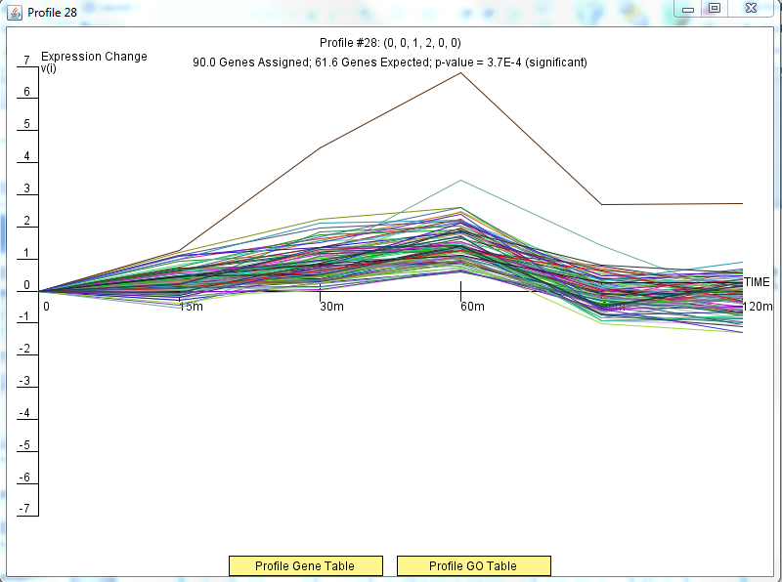
Profile 28 Included 90 Genes

Slide 17
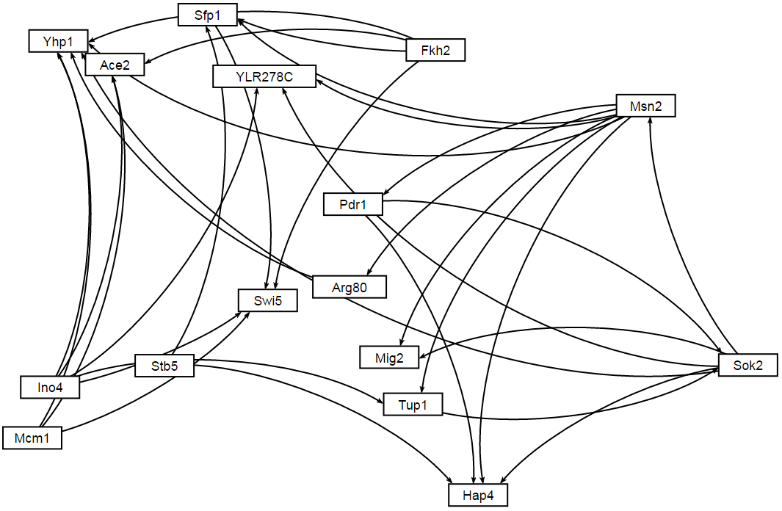
GRNsight Profile 45 Network

