Slide 1
Isolating methane monooxygenase gene from methylomonas / Methylosinus species
Austin Jones
Jace Dolphin

Slide 2
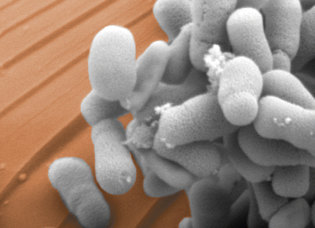
Organism
Methylosinus trichosporium

Slide 3
Source
Tentatively a source from around here
ATCC backup
Media:
ATCC plate or other media

Slide 4
Gene Information
Produces methane monooxygenase enzyme
Breaks down methane for cells’ use (source of carbon and energy)
Degrades trichloroethylene
Full degradation converts trichloroethylene to ethene and hydrogen chloride dissolved in water.
Oxidizes wide range of substrates
“Included are saturated and unsaturated, linear, branched and cyclic compounds up to about C8, as well as aromatic, heterocyclic, and chlorinated compounds” (Merkx et al. 2001)
Makes enzyme system ideal for petroleum spills, related cleanup

Slide 5
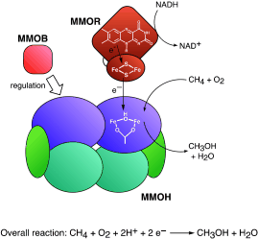
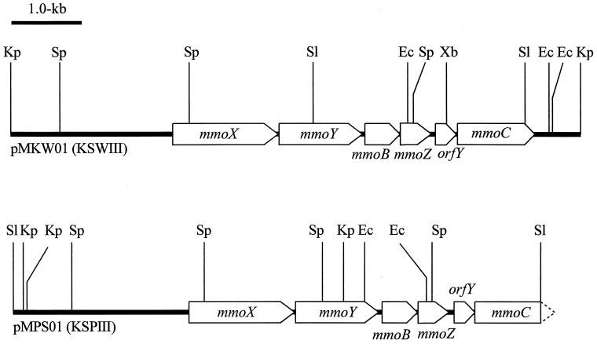
Gene Information
Accession number: X55394
Introns: None (prokaryotic)

Slide 6
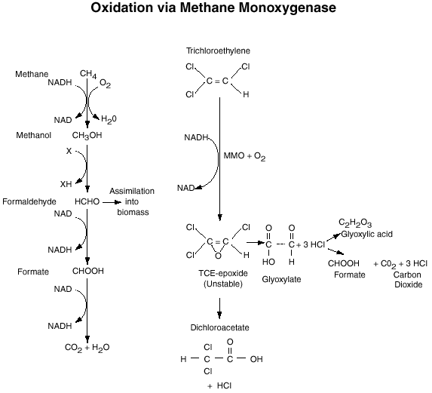
Degradation of trichloroethylene via methane monooxygenase

Slide 7
Primers
X-Y (~3kb)
F – 5’gaattcgcggccgcttctag atggcgatcagtctcgctac 3’
5’ (gaattcgcggccgcttctag)atggcgatcagtctcgctac..... ……..tcgccggctacaagaactga(tactagtagcggccgctgcag)3’
3’ agcggccgatgttcttgact atgatcatcgccggcgacgtc5’
R – 5’ ctgcagcggccgctactagtatcagttcttgtagccggcga 3’
Black – gene sequence
White – primer sequences
Blue – 5’ additions in order to add biobricks
- Forward: biobricks prefix
- Reverse: rev. complement of biobricks suffix
Yellow – biobricks prefix/suffix to be added on ends of gene sequence (3’ addition is the complement of blue addition to reverse primer: biobricks suffix)

Slide 8
Primers
B-Z-D-C (~2.5kb)
F – 5’ gaattcgcggccgcttctagatgtccagcgctcataacgc 3’
5’ (gaattcgcggccgcttctag)atgtccagcgctcataacgc…. …..aattcctggcgagcggctga(tactagtagcggccgctgcag)3’
3’ ttaaggaccgctcgccgact atgatcatcgccggcgacgtc5’
R – 5’ ctgcagcggccgctactagtatcagccgctcgccaggaatt 3’
Black – gene sequence
White – primer sequences
Blue – 5’ additions in order to add biobricks
- Forward: biobricks prefix
- Reverse: rev. complement of biobricks suffix
Yellow – biobricks prefix/suffix to be added on ends of gene sequence (3’ addition is the complement of blue addition to reverse primer: biobricks suffix)

Slide 9
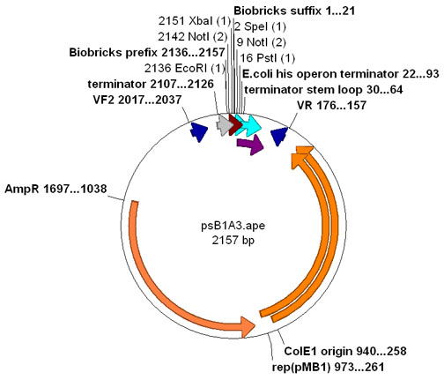
Part:pSB1A3
pSB1K3: Kanamycin Resistance

Slide 10
Steps
DNA Extraction
PCR – 2 genes amplified
Ligation
X-Y → pSB1A3 (ampicillin R.)
B-Z-D-C → pSB1K3 (kanamycin R.)
Clone each into E. coli, grow on media, add appropriate antibiotic after each round
Test ability to digest methane, TCE

Slide 11
Tests
Potassium permanganate
If methanol is present, solution will turn blue and produce odor
Tryptophan
Test for glyoxylic acid (byproduct of TCE digestion)
Tryptophan will react with glyoxylic acid and form a red/violet precipitate in solution

Slide 12
Reference Publication
Shigematsu, Toru, Satoshi Hanada, Masahiro Eguchi, and Yoichi Kamagata.
"Soluble Methane Monooxygenase Gene Clusters from Trichloroethylene-Degrading Methylomonas sp. Strains and Detection of Methanotrophs during In Situ Bioremediation." APPLIED AND ENVIRONMENTAL MICROBIOLOGY 65.12 (1999): 5198-206. NCBI. NIH, Dec. 1999. Web. 27 Aug. 2012. <http://www.ncbi.nlm.nih.gov/pmc/articles/PMC91705/pdf /am005198.pdf>.
Maarten Merkx Dr., Daniel A. Kopp, Matthew H. Sazinsky, Jessica L. Blazyk, Jens Müller Dr., Stephen J. Lippard Prof. Dr. Dioxygen Activation and Methane Hydroxylation by Soluble Methane Monooxygenase: A Tale of Two Irons and Three Proteins. Angew. Chem. Int. 2001, 40: 2782-2807

