Slide 1
GRNmap and GRNsight
June 24, 2015

Slide 2
Systems Biology Workflow
DNA microarray data:
wet lab-generated or published
New experimental questions
Statistical analysis,
clustering
Tessa Morris
Generate gene regulatory network
Visualizing the results
Modeling dynamics of the network

Slide 3
Statistical Analysis Was Used to Build A Gene Regulatory Network
Indicates which genes had significant changes in expression at any time point
Clustering Genes with Similar Expression Profiles
Selected genes with a corrected p < 0.05 from the within-strain ANOVA
Clusters of genes with similar profiles also assigned a p value for significance
YEASTRACT Database
Selected genes from significant clusters (profiles)
Identified which transcription factors regulate the genes in the clusters
Within-strain ANOVA

Slide 4
Within-strain ANOVA Indicates Which Genes Had Significant Changes in Expression at Any Timepoint
Within-strain ANOVA
Clustering
YEASTRACT
ANOVA | WT | dCIN5 | dGLN3 | dHAP4 | dSWI4
p < 0.05 | 2377 (38.4%) | 1995 (32.2%) | 1856 (30.0%) | 2387 (38.6%) | 2583 (41.7%)
p < 0.01 | 1531 (24.7%) | 1157 (18.7%) | 1007 (16.3%) | 1489 (24.1%) | 1679 (27.1%)
p < 0.001 | 850 (13.7%) | 566 (9.15%) | 398 (6.43%) | 679 (11.0%) | 869 (14.0%)
p < 0.0001 | 449 (7.25%) | 280 (4.52%) | 121 (1.96%) | 240 (3.88%) | 446 (7.21%)
B & H p < 0.05 | 1673 (27.0%) | 1117 (18.1%) | 889 (14.4%) | 1615 (26.1%) | 1855 (30.0%)
Bonferroni p < 0.05 | 226 (3.65%) | 109 (1.76%) | 20 (0.32%) | 61 (0.99%) | 179 (2.89%)

Slide 5
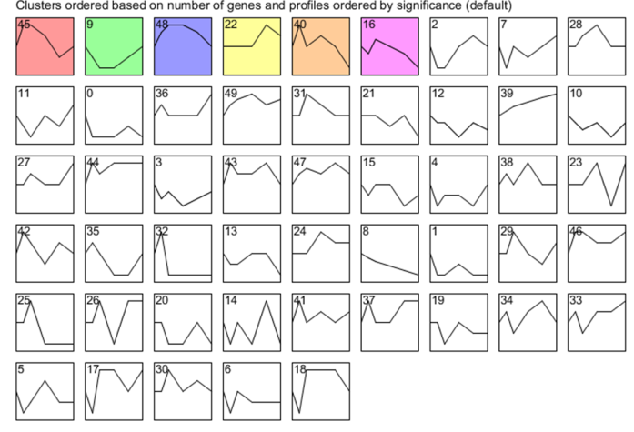
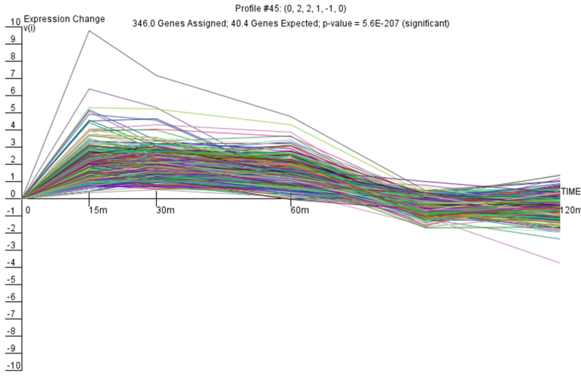
STEM Software Groups Genes with Similar Expression Profiles and Assigns P values to Clusters
Within-strain ANOVA
Clustering
YEASTRACT

Slide 6
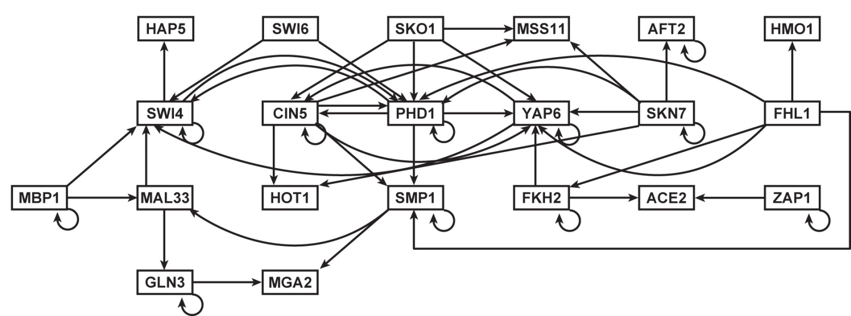
YEASTRACT Identifies Which Transcription Factors Regulate the Genes in the Clusters and Generates a Gene Regulatory Network
Within-strain ANOVA
Clustering with STEM
YEASTRACT
Each node is a transcription factor
Each edge is a regulatory relationship

Slide 7
Systems Biology Workflow
DNA microarray data:
wet lab-generated or published
New experimental questions
Statistical analysis,
clustering
K. Grace Johnson
Trixie Roque
Tessa Morris
Generate gene regulatory network
Visualizing the results
Modeling dynamics of the network

Slide 8
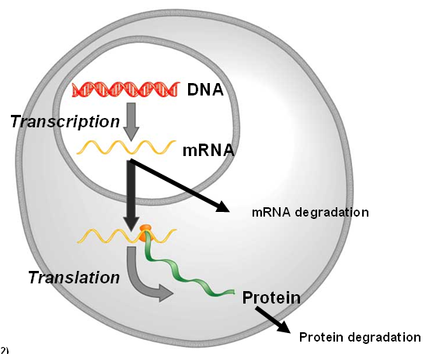
GRNmap Uses Ordinary Differential Equations to Model Dynamics of Each Gene in the Network
Parameters are estimated from DNA microarray data.
Weight parameter, w, gives the direction (activation or repression) and magnitude of regulatory relationship.

Slide 9
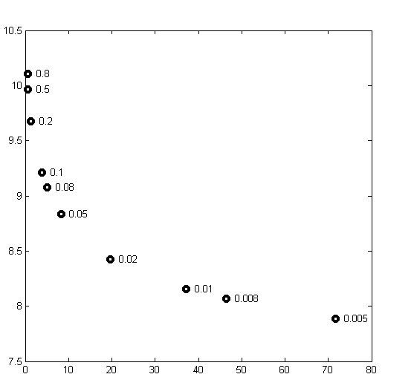
A Penalized Least Squares Approach is Used to Estimate Parameters
Least Squares Error
Plotting the least squares error function showed that not all the graphs had clear minima.
We added a penalty term so that MATLAB’s optimization algorithm would be able to minimize the function.
θ is the combined production rate, weight, and threshold parameters.
α is determined empirically from the “elbow” of the L-curve.
Parameter Penalty Magnitude

Slide 10
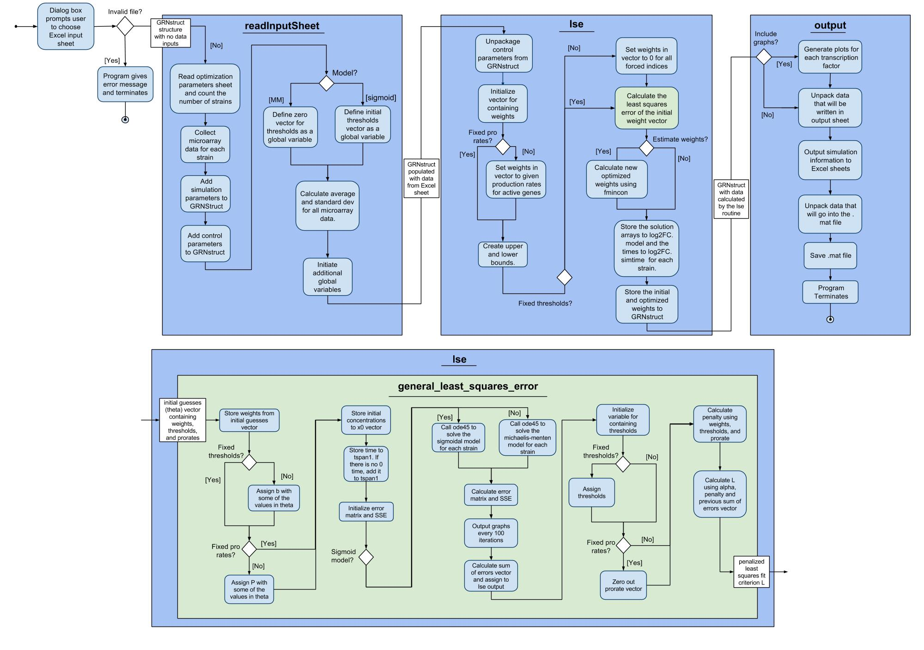
UML Activity Diagram Documents the Flow the of Program

Slide 11
UML Activity Diagram Documents the Flow the of Program

Slide 12
Input Workbooks Were Designed to Test the Sixteen Ways GRNmap Can be Run
Sigmoidal
Michaelis-Menten
Estimate + Forward
Forward Only
Fix p
Estimate p
Graph
No Graph
Graph
No Graph
Graph
No Graph
Estimate + Forward
Estimate b, Estimate p
Graph
No Graph
Estimate b, Fix p
Graph
No Graph
Fix b, Estimate p
Graph
No Graph
Fix b, Fix p
Graph
No Graph
Forward Only
Graph
No Graph

Slide 13
We Added New Features, Fixed Bugs, and Documented the Changes to GRNmap
New Features and Fix Bugs
Testing
Document
Updated activity diagram, GitHub wiki, and GRNmap website
Testing Framework
Currently working to automate testing
Manual tests were performed to verify changes and check for bugs before releasing
Including changing names of worksheets, computing standard deviations, and creating optimization diagnostics output

Slide 14

Parameters Were Estimated for a 21-gene, 50-edge Gene Regulatory Network
Do the model parameters accurately represent what is happening in the cell during cold shock?
Notes:
Working Hypothesis network

Slide 15
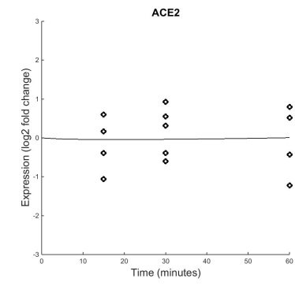
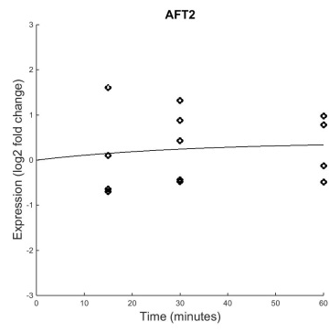
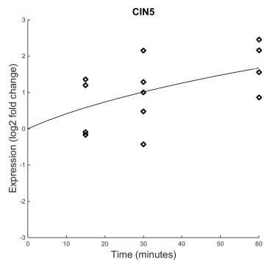
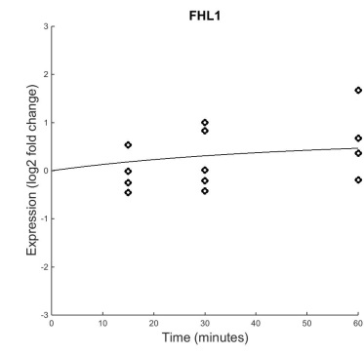
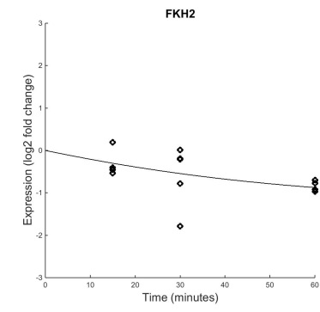
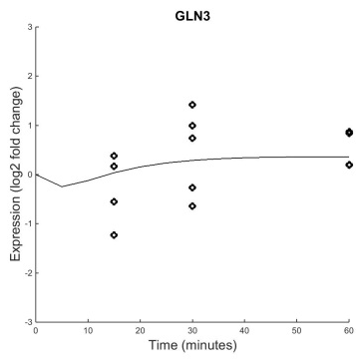
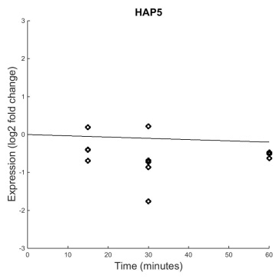
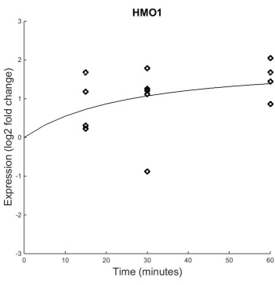
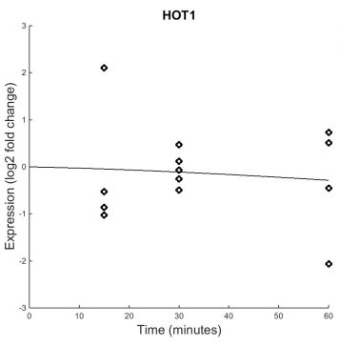
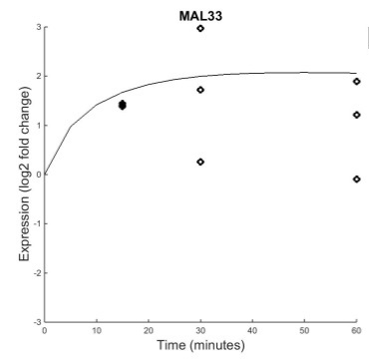
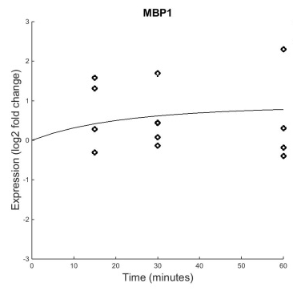
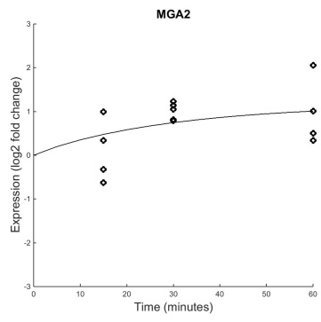
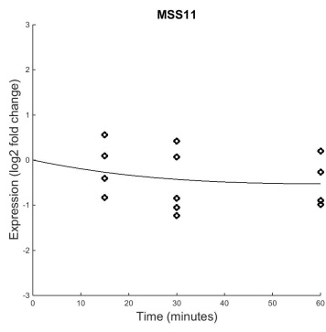
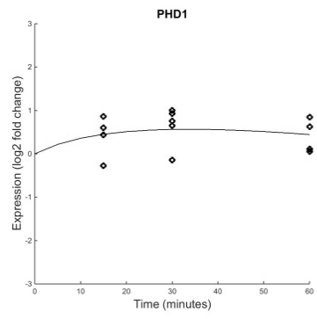
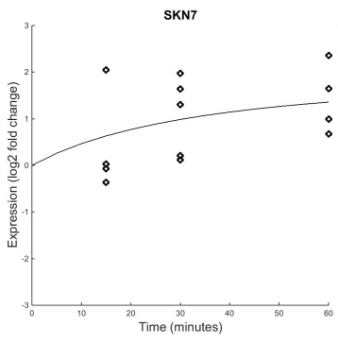
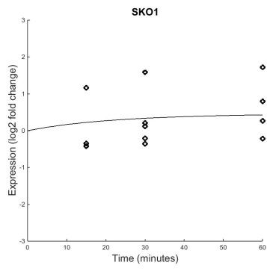
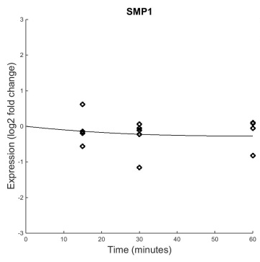
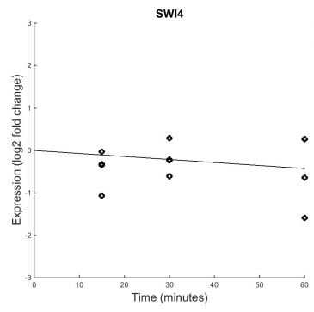
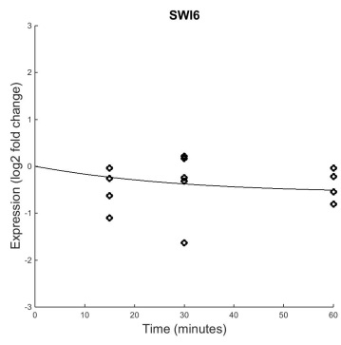
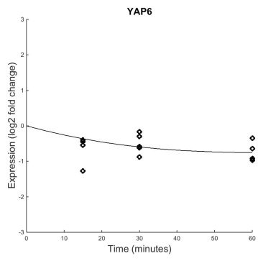
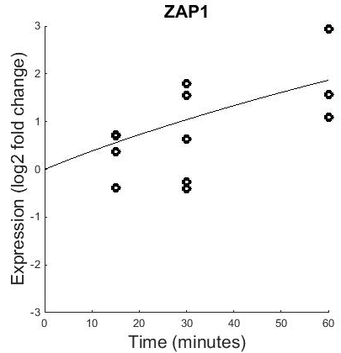
B&H p=0.8702
B&H p=0.7161
B&H p=0.0642
B&H p=0.4454
B&H p=0.1274
B&H p=0.4125
B&H p=0.1539
B&H p=0.0409
B&H p=0.6387
B&H p=0.0101
B&H p=0.5240
B&H p=0.1028
B&H p=0.4275
B&H p=0.0017
B&H p=0.0228
B&H p=0.1330
B&H p=0.6046
B&H p=0.6367
B&H p=0.1178
B&H p=0.0003
B&H p=0.0086
Generally, the model fits the experimental data well.
Notes:
dCIN5

Slide 16
B&H p=0.8702
B&H p=0.7161
B&H p=0.0642
B&H p=0.4454
B&H p=0.1274
B&H p=0.4125
B&H p=0.1539
B&H p=0.0409
B&H p=0.6387
B&H p=0.0101
B&H p=0.5240
B&H p=0.1028
B&H p=0.4275
B&H p=0.0017
B&H p=0.0228
B&H p=0.1330
B&H p=0.6046
B&H p=0.6367
B&H p=0.1178
B&H p=0.0003
B&H p=0.0086
Generally, the model fits the experimental data well.
Notes:
dCIN5

Slide 17
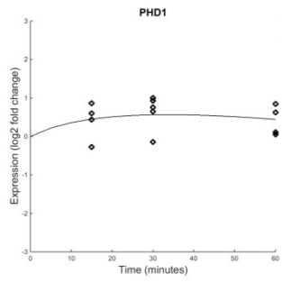
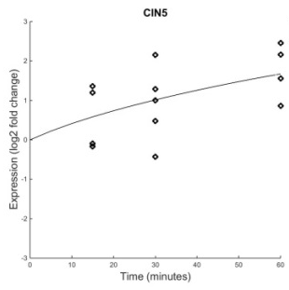





PHD1 Has a Good Fit with Significant Dynamics
B&H p=0.0017
Regulators: PHD1, CIN5, FHL1, SKN7, SKO1, SWI4, SWI6
Weight: 0.16
B&H p=0.0017
B&H p=0.0642
Weight: -0.28
B&H p=0.4454
Weight: 0.062
B&H p=0.0228
Weight: -0.10
B&H p=0.1330
Weight: 0.085
B&H p=0.6367
Weight: 0.16
Most regulators also have significant dynamics, making the weights easier to estimate
B&H p=0.1178
Weight: 0.14
Total repression: -0.38
Total activation: 0.61
Notes:
Analyze fit of gene, dynamics of gene, dynamics of regulators

Slide 18
Systems Biology Workflow
DNA microarray data:
wet lab-generated or published
New experimental questions
Statistical analysis,
clustering
Anindita Varshneya
Visualizing the results
Generate gene regulatory network
Modeling dynamics of the network

Slide 19
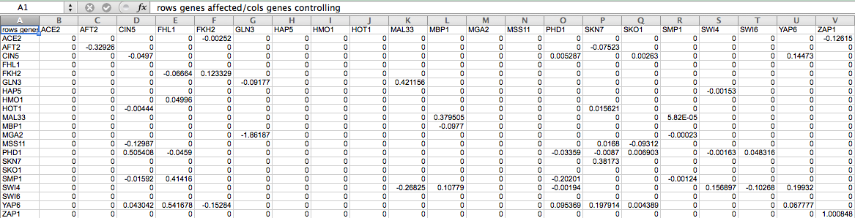
GRNmap Produces an Excel Spreadsheet with an Adjacency Matrix Representing the Network
0 represents no relationship.
A positive number shows activation.
A negative weight signifies repression.
The magnitude of the weight is the strength of the relationship.
However, GRNmap does not generate any visual representation of the Gene Regulatory Network.

Slide 20
GRNsight Has Sophisticated Architecture and Follows Open Source Development Practices
GRNsight has two parts:
  The server parses the spreadsheet using the node.js framework
  The web client receives that data and generates the graph visualization
GRNsight implementation takes advantage of other open source tools
  The Data-Driven Documents (D3) JavaScript library to generate a graph derived from input network data and uses Scalable Vector Graphics (SVG) to form the elements of the graph.
  GRNsight implements D3’s force layout algorithm which applies a physics-based simulation to the graph.
GRNsight follows an open development model using an open source github.com code repository and issue tracking.

Slide 21
Implemented Test-Driven Development Using Mocha Testing Framework
Unit testing is a software testing method by which individual units of source code are tested to determine whether they are fit for use.
Prior to implementing the unit testing framework, each test spreadsheet was manually uploaded onto the website to test for errors.
Unit testing is now executed through Mocha, a JavaScript test framework running on node.js.
All tests are written in Chai, a behavior-driven development/test-driven development assertion library for node.js.
With 140 automated unit tests in place, we are close to closing off development of version 1.

Slide 22

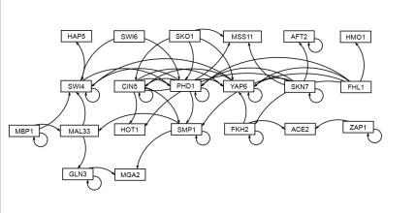
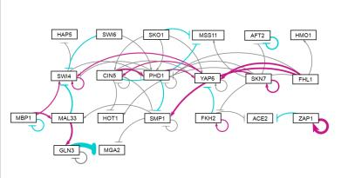
GRNsight Automatically Lays Out Unweighted and Weighted Graphs
Adobe Illustrator: several hours to create
GRNsight: 10 milliseconds to generate, 5 minutes to arrange
GRNsight: colored edges for weights reveal patterns in data

Slide 23
Systems Biology Workflow
DNA microarray data:
wet lab-generated or published
Statistical analysis,
clustering,
Gene Ontology, term enrichment
New experimental questions
Kevin McGee
Generate gene regulatory network
Visualizing the results
Modeling dynamics of the network

