Slide 1

Engineered bacteriophage targeting gene networks as adjuvants for antibiotic therapy
Yang Xin
Paper presentation
PNAS 2009, 106(12):4629-4634

Slide 2
Introduction
Antimicrobial drug development is increasingly lagging behind the evolution of antibiotic resistance
as a result, there is a pressing need for new antibacterial therapies that can be readily designed
Phage(噬菌体) can lyse bacteria or be modified to express lethal genes to cause cell death

Slide 3
How to reduce antibiotic resistance?
Object : bacteriophage
Function : overexpress proteins
Target : gene networks
Effect : enhance bacterial killing by antibiotics
Phage therapy to kill bacteria has been in use since the early 20th century . Phage can lyse bacteria or be modified to express lethal genes to cause cell death . However, phage that are directly lethal to their bacterial hosts can select for phage-resistant bacteria in a short time.

Slide 4
How to reduce antibiotic resistance?
To reduce the development of phage resistance, we sought to develop engineered phage that would exert minimal evolutionary pressures. Instead of overexpressing lethal genes, our design targets nonessential genes and the networks they regulate that are not directly attacked by antibiotics. Combination therapy with different antibiotics, different bacteriophage, or antibiotics plus phage may reduce the incidence of phage resistance and/or antibiotic resistance .

Slide 5
How to reduce antibiotic resistance?
Therefore, by using a combination of engineered antibiotic-enhancing phage and antibiotics, we hoped to reduce the incidence of antibiotic resistance and enhance bacterial killing.

Slide 6
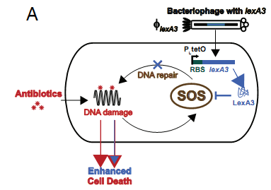
Results: Targeting the SOS DNA Repair System
lexA3:
a repressor of the SOS response
This experiment confirmed that lexA3 suppressed the SOS response induced by ofloxacin treatment.

Slide 7
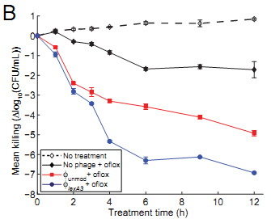
ΦlexA3’s antibiotic-enhancing effect
Both phage enhanced
ofloxacin’s bactericidal effect.
No significant bacterial regrowth was apparent with combination of phage and antibiotic treatment up to 12 h during treatment.

Slide 8
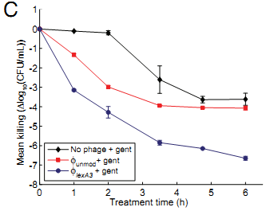
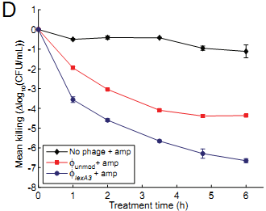
Whether our engineered phage could increase killing by various types of antibiotics other than quinolones?
gentamicin
ampicillin
It indicates that engineered phage such as ΦlexA3 can act as general adjuvants for the 3 major types of bactericidal drugs.

Slide 9
Other findings on ΦlexA3
whether ΦlexA3 can act as an antibiotic adjuvant in different situations?(with varying initial phage concentration and with varying doses of ofloxacin)
Experiment shows :Φ lexA3 is a strong adjuvant for ofloxacin at doses below as well as above the minimum inhibitory concentration (60 ng/ml).
In addition, simultaneous application of ΦlexA3 and ofloxacin improved killing of biofilm cells by about 1.5 and 2 orders of magnitude compared with Φ unmod plus ofloxacin and no phage plus ofloxacin, respectively.

Slide 10
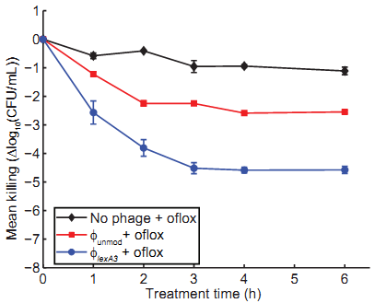
Enhancing Killing of Antibiotic-Resistant Bacteria
These results demonstrate that antibiotic-enhancing
phage
combat antibiotic-resistant bacteria
have the potential to bring defunct antibiotics back into clinical use

Slide 11
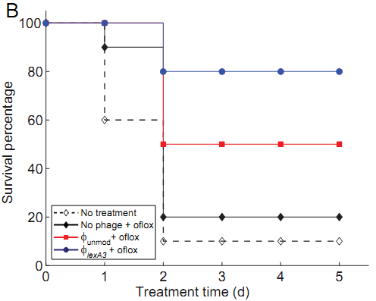
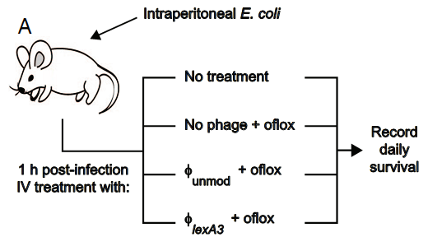

Increasing Survival of Mice Infected with Bacteria
The in vivo efficacy of our antibiotic-enhancing phage in rescuing infected mice from death demonstrates the feasibility of our designs for clinical use.

Slide 12
Reducing the Development of Antibiotic Resistance
1
1592
43.5
Number of resistant cells(median)
2.5
Unmodified phage Φunmod treatment lead to the fact that all samples contained > 1 resistant cfu, and more than half of the samples had > 20 resistant cfus.
Φ lexA3 treatment results in a majority of samples with either no resistant cfus or < 20 resistant cfus .

Slide 13
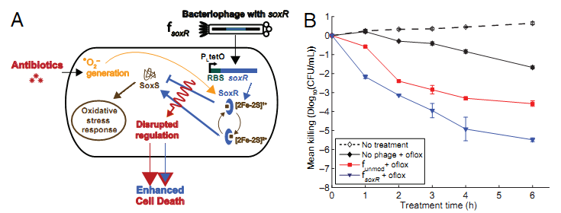
Flexible Targeting of Other Gene Networks
As shown in Fig. B, ΦsoxR enhanced killing by ofloxacin compared with unmodified phage Φunmod and no phage.

Slide 14
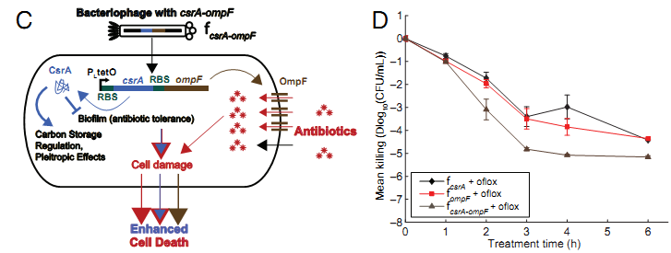
Flexible Targeting of Other Gene Networks
Together, these results demonstrate that engineering phage that target non-SOS genetic networks and/or overexpress multiple factors can produce effective anti-biotic adjuvants.

Slide 15
Discussion
A potential concern: the development of phage resistance resulting from the loss of the F-plasmid required for infection.
Engineered phage may be adopted more readily in industrial, agricultural, and food processing settings which could be economically advantageous, reduce community-acquired antibiotic resistance.
Targeting clinical bacterial strains with libraries of engineered phage will be a crucial step in applying this strategy against real-world infections.

Slide 16
Q & A

Slide 17
Thank you !

