Slide 1
Probing the Kinesin Reaction Cycle with a 2D Optical Force Clamp Block S., Asbury C., Shaevitz J,, Lang M.
Reviewed by
Sahar and Pablo
20.309
Notes:
Hi, I’m Sahar Alkhairy and I’m Pablo … And today we’ll be presenting the paper named: …

Slide 2
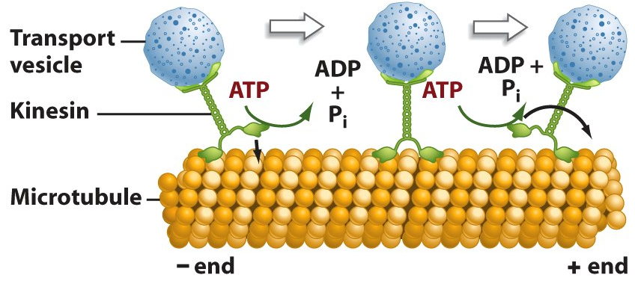
Kinesin Movement and Reaction Cycle
Microtubule attachment
ATP binding
ATP Hydrolysis
Release of ADP & phosphate
Microtubule detachment
Silica bead
Taken from
http://www.uic.edu/classes/bios/bios100/summer2006/kinesin.jpg
Notes:
ME
As you see in the video more than four biochemical events are known to occur for each 8-nm step that kinesin takes, for example, microtubule attachment, ATP binding, ATP hydrolysis release of ADP and phosphate, microtubule detachment, etc.

Slide 3
Objectives
Study dependence of kinesin motility on magnitude and orientation of load at various ATP concentrations, by using 2D optical force clamp
Calculate velocity, randomness, run length of kinesin
Compute turnover rate (k_{cat}), apparent binding constant for substrate (k_{b}), Michaelis constant (K_{m})
Determine number of transitions on kinesin biochemical cycle using fluctuation analysis
Notes:
Me:
In this presentation we will,

Slide 4
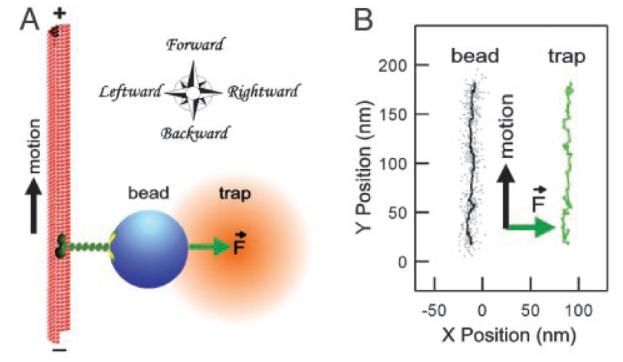
Materials and Methods
Notes:
To study load effects on kinesin displacement, a silica bead was attached to kinesin and used in conjunction with an optical trap to exert forces in the forward, backward (lingitudinal), rightward, and leftward (sideways) directions.
B shows how the optical trap was moved parallel to the bead in order to maintain applied force constant (this is an example for rightwards applied load).
They also used sub-pixel resolution video trafficking of the bead centroids to compare kinesin velocities without external loads.

Slide 5
Results – Sideways Load
Notes:
These plots are results of force applied sideways
ME
TOP LEFT
Velocity as function of ATP concentration for fixed sideways loads (0, +4.8 pN blue / right, -4.8 pN red / left)
sideways loads in either direction lowered kcat, but did not affect kb, the apparent rate constant for ATP binding
However, the effect of sideways loads on kcat was asymmetric, with leftward load causing a greater reduction is speed (26%) than rightward load (9%)
TOP RIGHT
Plot velocity versus sideways load at ATP fixed at high level of 1.6 mM
Increasing leftward forces from 0.8 to 7.8 pN caused kinesin velocity to decrease by 30% relative to its unloaded speed
However, even at the highest leftward loads (7.8 pN) the kinesin did not induce stall
Behavior under rightward forces (Blue graph) was essentially the same, except that the velocity decreased by only 15%.
BOTTOM LEFT
The bottom left graph shows the same thing as the the top right graph but clearly shows the assymetry between rightward forces and leftward forces.
BOTTOM RIGHT
The bottom right graph shows the Run length vs sideways force.
As you can see increasing sideways force in either direction resulted in shorter runs, but leftward loads (red) consistently produced a greater reduction in run length than rightward loads, regardless of microtubule orientation
CONCLUSION:
These four graphs show that the sideways Loads Have an Asymmetric Effect on kcat.

Slide 6
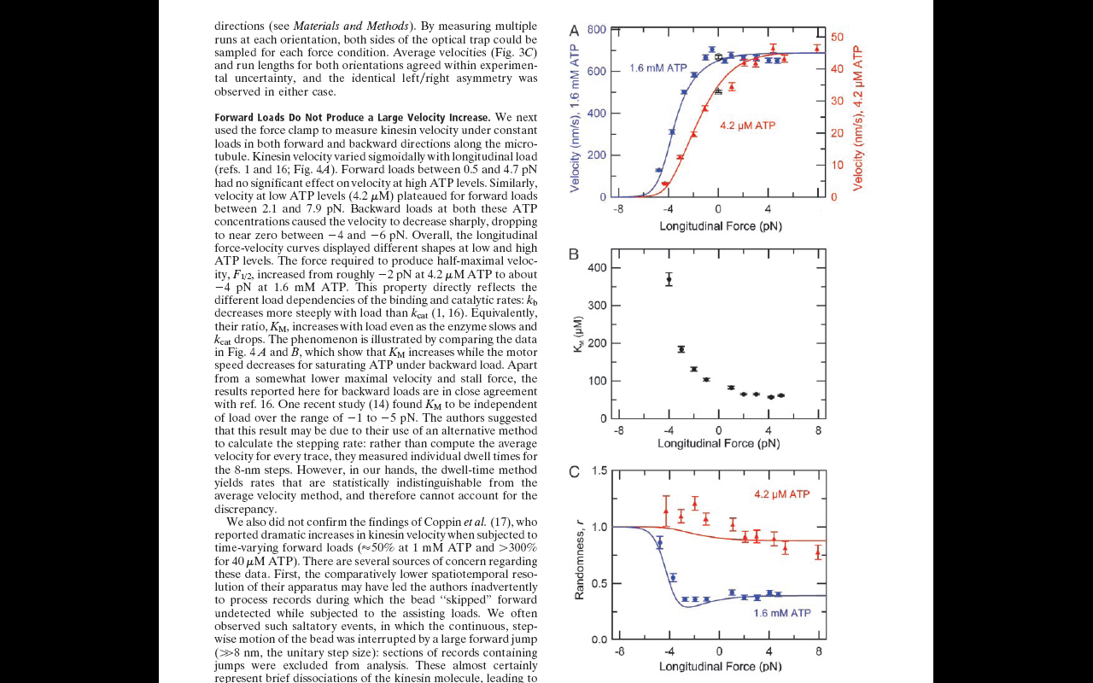
Results – Longitudinal Load
Forward loads had no major effects on kinesin velocity
No effect at high [ATP]
Sharp decrease in velocity with backward loads
[ATP]-dependent F_{1/2}
Increasing K_{m} with increasing load
Load-dependent k_{cat} , k_{b}
Notes:
Forward loads had no significant effects on velocity (max 40% at low [ATP], no effect at high [ATP]) compared with no load controls... They also reach a plateau at ~0.5pN for high [ATP], 2.1pN low [ATP]
Backward loads had sharp decrease in velocity for both [ATP]s. Near zero at -4pN for low, -6pN for high [ATP] (NEVER ZERO!). F1/2 increased from -2pN to -4pN for high [ATP] – load-dependent transitions in biochemical kinesin cycle. This is further confirmed by increasing Km with increasing backward load (kcat decreases more slowly than kb….)

Slide 7
Results – Longitudinal Load
Randomness parameter (r)
Measure for variability of kinesin motion
r ⁻¹ ~ number of rate-determining events in the system
Systems consisting of Poisson-distributed events
ATP binding limits system at low [ATP]
r~1/3 at high [ATP]
At least 4 rate-limiting steps in the system

Slide 8
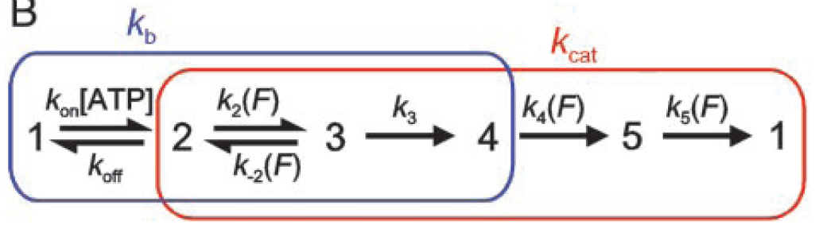
Conclusions
Sideways loads have weak, asymmetrical effects on kinesin velocity
Longitudinal loads display sigmoidal kinesin velocity variations
Forward loads do not yield major increase in kinesin velocity
Backward loads lead to [ATP]-dependent stall
Fluctuation analysis shows that the biochemical cycle contains at least four transitions
A well-aligned one-stroke mechanism to model the relatively strong effects longitudinal load and the weak effects of the sideways loads
Weaker force dependencies account for the observed effects of sideways loads

Slide 9
Thanks!

Slide 10
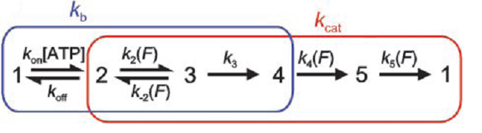
Method of Testing Hypothesis
Studied the dependence of kinesin motility on the magnitude and direction of load at various ATP concentrations, by using a recently developed 2D optical force clamp
This instrument can record long records of the motion of individual kinesin molecules under fixed forces applied in any azimuthal direction
If motion and force production occur during a single transition in the kinesin cycle, then applied load will affect the kinetics in predictable ways.
Measuring how kcat and kb vary with force therefore provides a means to test the one-stroke model and can supply information about where other force-dependent transitions may reside in the overall reaction pathway
k_{cat}: turnover rate, k_{b}: apparent binding constant for substrate, k_{i}: underlying microscopic rate constants
Notes:
Pablo
If time

Slide 11
Calculation of Velocity & Parameters
[x(t), y(t)] = measured displacement perpendicular to and along the microtubule axis
[x(t), y(t)] = [mt + b] {+ A exp(-(-t-t₀)/τ }}
v = individual run velocity: from slope of line fit of x- and y- displacement vs. time
Rate parameters (k_{cat} and k_{b}) obtained from fit of data to MM equation
v = 8.2 nm k_{cat}[ATP] / ([ATP] + k_{cat}/ k_{b})
Michaelis constant K_{M} = k_{b} / k_{cat}
Notes:
ME:
In order to compute turnover rate (kcat), apparent binding constant for substrate (kb), Michaelis constant (KM), we first measure the displacement perpendicular to and along the microtubule axis.
Fit the displacements to the following expression
Get the velocity v from the line fit of x- and y- displacement vs. time
Then we get kcat and kb from the following equation.
Then finally get km from dividing kb by kcat

Slide 12
Calculation of Randomness and K_{M}
variance vs dt = [y(t+dt) – (y(t) + <v>dt)]² ~ dt
variance is linearly dependent on dt between 3.5 ms and 20 nm /<v>
r = slope of variance / d<v> , where d = 8.2 nm step size
r is equivalent to 2 D / d<v> , where D is effective diffusion coefficient in hopping model, corresponding to Markov transitions among enzyme states
Global mean randomness and standard error obtained arithmetically from r values
Mean run length : L = L + R(1-f)/f , L is average run length, f is fraction of runs that terminated inside the limited detector region, R = 300 nm
v_{high} = velocity at high ATP, v_{low} = velocity at low ATP
Michaelis constant K_{M}
Notes:
Pablo- if you neeed

Slide 13
Five State Model
Derived from global fit of reaction scheme to data of two sets of graphs
Notes:
Pablo
Why k3 k4 k5 are irreversible ….

