Slide 1


TÜRK – ROMEN
TOHUM ENDÜSTRISI TOPLANTISI
Hoşgeldiniz!
The National Inspection of Seeds' Quality (INCS) is the official regulatory body, within the Ministry of Agriculture, Forests and Rural Development, with the responsibility for official seed and propagation material certification in Romania.
The legal framework regarding the production, processing, quality control and certification, marketing of seeds and propagating material, as well as the registration of plant varieties is harmonized after EU legislation (LAW No. 266/2002)

Slide 2
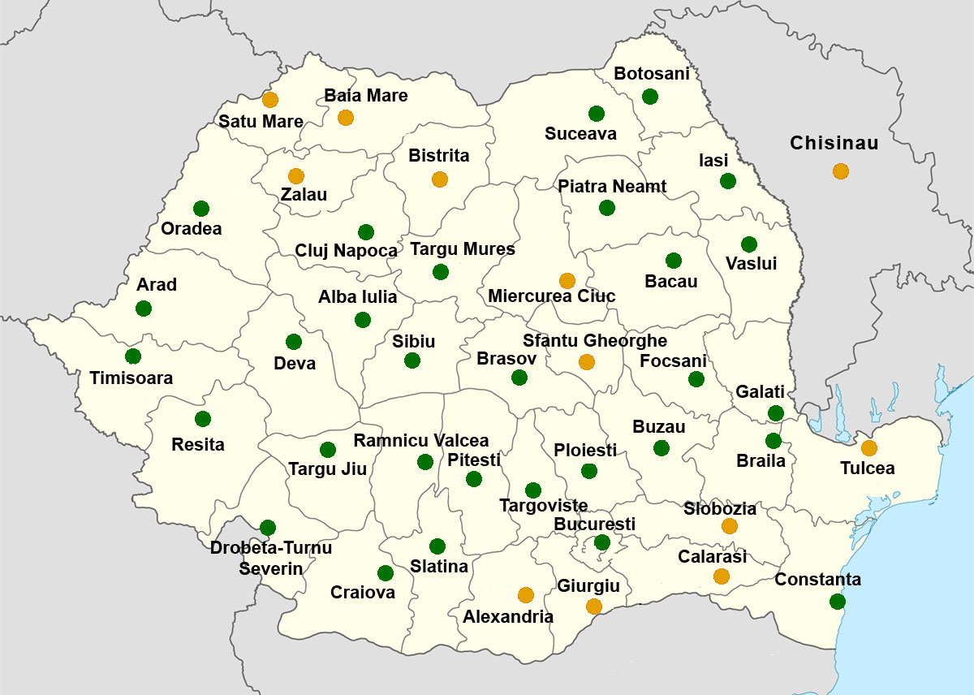
TÜRK – ROMEN
TOHUM ENDÜSTRISI TOPLANTISI
National Inspection of Seeds' Quality organizes, coordinates and controls the activity of the Territorial Inspectorates for the quality of seeds and propagating material in 30 locations and the Central Laboratory for the Quality of Seeds and Propagating Material

Slide 3
TÜRK – ROMEN
TOHUM ENDÜSTRISI TOPLANTISI
Central Laboratory for Quality of Seed and Planting Material Bucharest
Laboratory information:
an official lab, with internal governmental affiliation, according to the Government Decision 1433/ December 2009, operating as a subordinate of the Ministry of Agriculture and Rural Development
affiliated and accredited by the “International Seed Testing Association” (ISTA) – Zurich, Switzerland
ISO 17025 RENAR (national accreditation organism) accredited for GMO testing

Slide 4
TÜRK – ROMEN
TOHUM ENDÜSTRISI TOPLANTISI
Activity in 2013:
a total of 4393 samples were analysed, out of which: 1540 samples/22.467 To were taken from batches intended for international trade and 2853 samples/27.161. To taken from batches intended for internal trade
19.504 determinations were made, out of which 8.807 were for export
The type of determination | Official sample from the seed lots for international market | Official sample from the seed lots for national market | Informative sample | TOTAL
- purity and other seed determination | 1417 | 1197 | 498 | 3112
- germination | 1417 | 2305 | 498 | 4220
- moisture | 1417 | 1197 | 30 | 2644
-seed health | 1417 | 2305 | 498 | 4220
(presence of live pests)
-Weight determination | 1281 | 877 | 0 | 2158
-Other determination (Cuscuta spp., electrophoresis, viability,cold-test, etc) | 1858 | 1292 | 0 | 3150
TOTAL | 8807 | 9173 | 1524 | 19504
The main species that were analyzed were: maize, sunflower, mustard, oil rape, barley, wheat, x Triticosecale

Slide 5
TÜRK – ROMEN
TOHUM ENDÜSTRISI TOPLANTISI
THE PERSONNEL OF LCCSMS BUCHAREST
Filled-in positions:
LCCSMS Bucharest | 26
Suceava Gene Bank | 14
TOTAL | 40
Vacancies: TOTAL | 6
Out of which: Public servants | 4
Contractual staff | 2

Slide 6
TÜRK – ROMEN
TOHUM ENDÜSTRISI TOPLANTISI
LCCSMS BUCHAREST has established and implemented a quality management system that has as its main objective to ensure customer satisfaction.
This is ensured by:
►customer cooperation;
►personnel training and monitoring;
►internal audit
►establish clear rules in conducting the flow of activities, as a process based approach: output elements of a sector is the next sector inputs;
Cooperation with clients:
►Access in LCCSMS laboratories is controlled. A customer can request access during laboratory tests of his sample, thus eliminating any suspicion on the results.
► Customers can access data on the legal framework of their activity through a special department within the laboratory

Slide 7
Sampling
Reception
Purity analysis
Germination test
Determination of moisture content
CHECK RESULTS
Preparing official documents
QC and release
TÜRK – ROMEN
TOHUM ENDÜSTRISI TOPLANTISI

Slide 8
TÜRK – ROMEN
TOHUM ENDÜSTRISI TOPLANTISI
Sample reception
Recording
Weight analysis of received seeds
Grinding
Sampling reduction
Weight analysis
Obtaining laboratory sample
Storing working sample
DNA extraction
Makeray Nagel Kit
DNA storage -20°C
qPCR/PCR experiment setup
Quantification / Semi-quantitative PCR
TaqMan probe on ROCHE LightCycler 480 II
LEDOMG
ISO17025 for GMO analysis involving:
qPCR MON810
in evaluation:
t-NOS and 35S for corn and soybean
in preparation:
NK603, GA21, TC1507 identification
2013
2014
2015

