Slide 1
GRNmap Testing
Grace Johnson and Natalie Williams
June 3, 2015

Slide 2
GRNmap Testing
The comparison of estimated weights, production rates, and b values from different runs of the same network will give us insight to further test GRNmap

Slide 3
GRNmap Testing
Strain Run Comparisons
Each strain alone, two strains, three strains, four strains, all strains
Non-1 Initial Weights Comparisons
Initial weights = 0
Initial weights = 1
Initial weights = -1
Initial weights = 3
Initial weights = -3
Initial weights = 10
Three runs with weights randomly distributed between -1 and 1
One run with weights randomly distributed between -3 and 3

Slide 4
To compare estimated parameters we ran GRNmap using data from:
Wt alone
Each deletion strain alone
Wt vs each deletion strain
Wt + dCIN5 + dZAP1
Wt + dCIN5 + dZAP1 + dGLN3

Slide 5
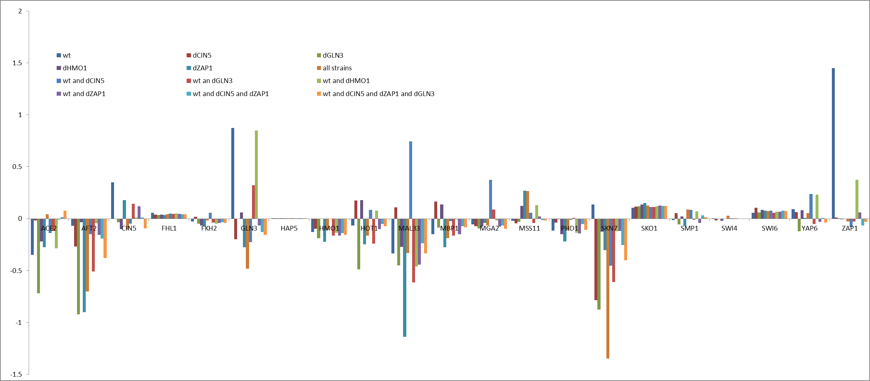
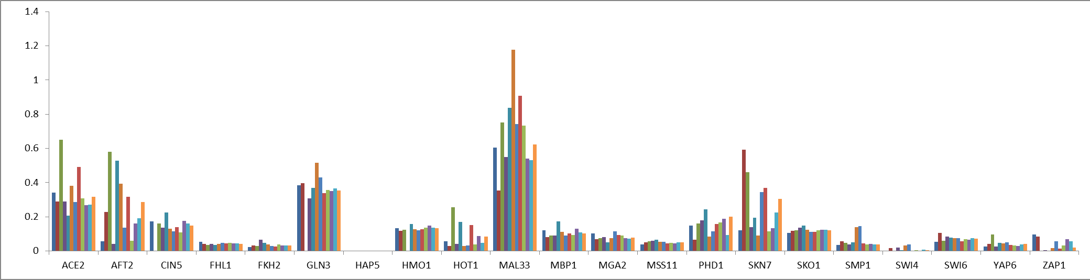
Estimated production rates and b values varied widely between strain runs
Figure 1: Estimated b values
Figure 2: Estimated production rates

Slide 6
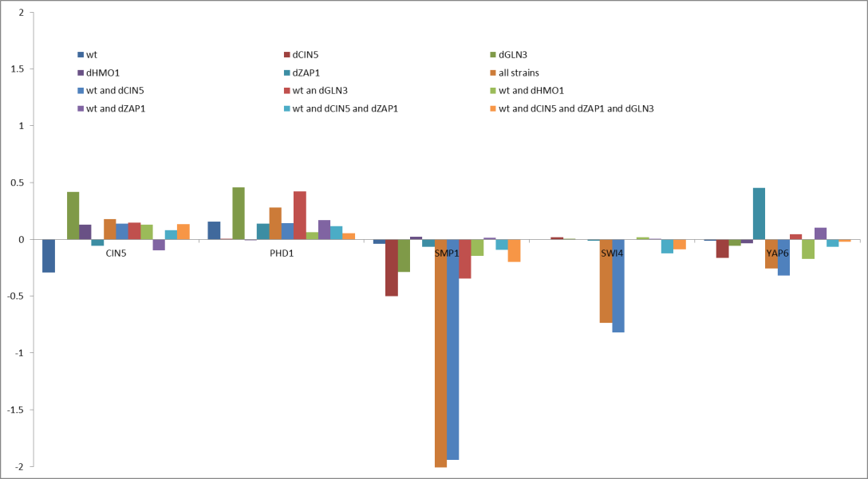
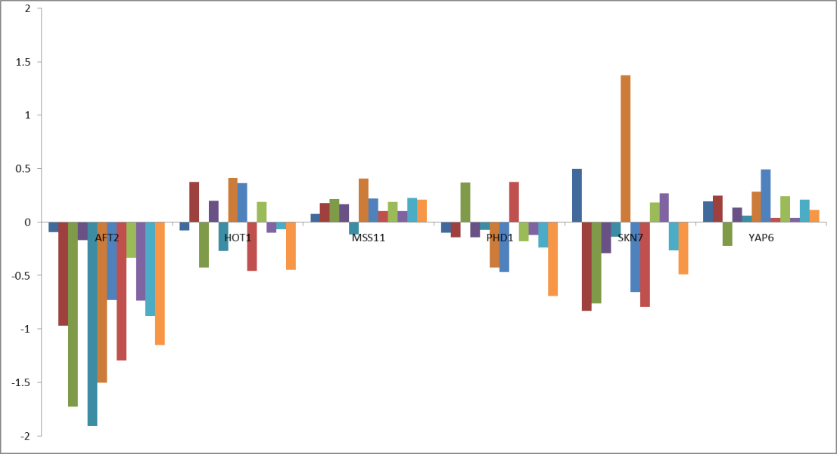
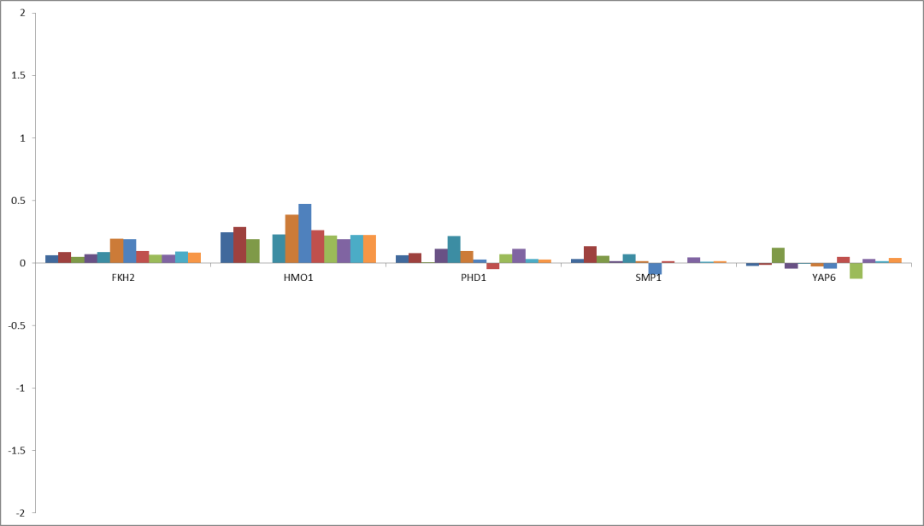
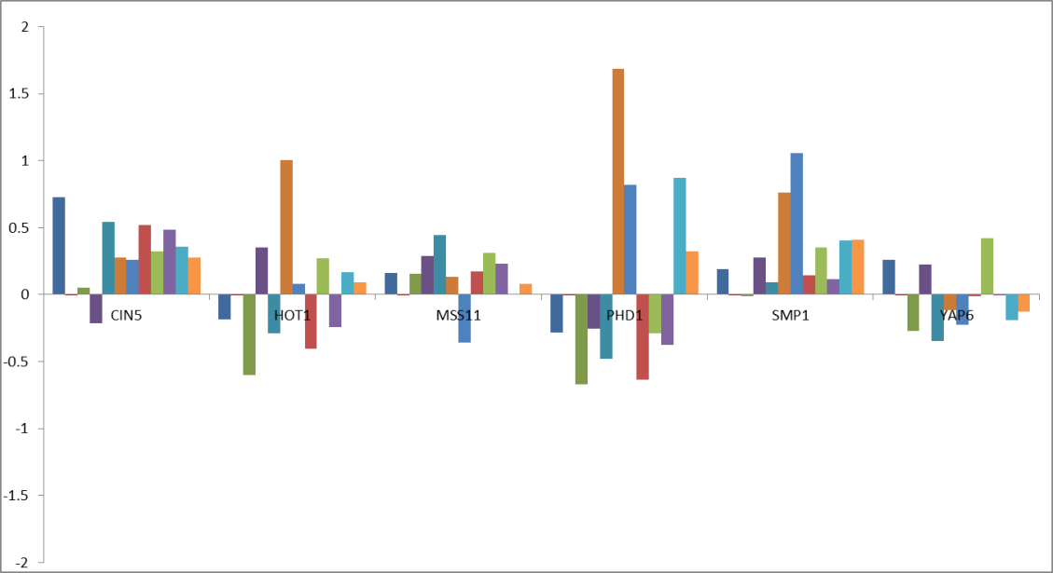
Estimated weights also varied widely between strain runs
Figure 3: regulator PHD1
Figure 4: regulator SKN7
Figure 5: regulator FHL1
Figure 6: regulator CIN5

Slide 7
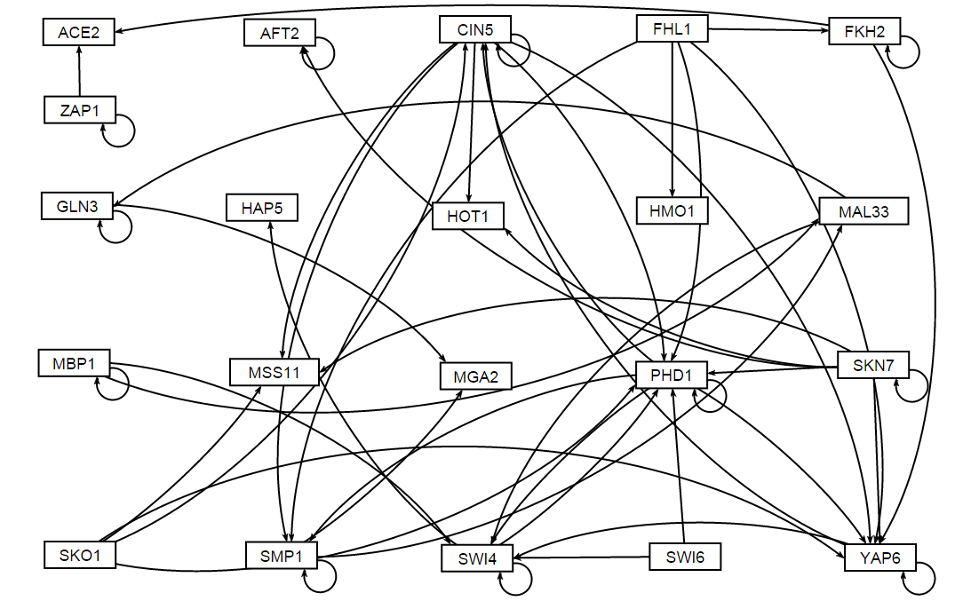
Figure 7: Unweighted network

Slide 8
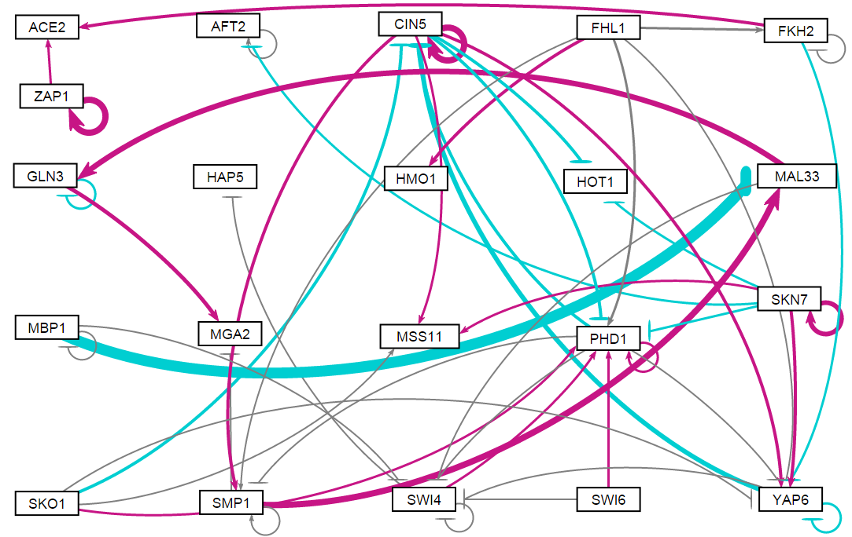
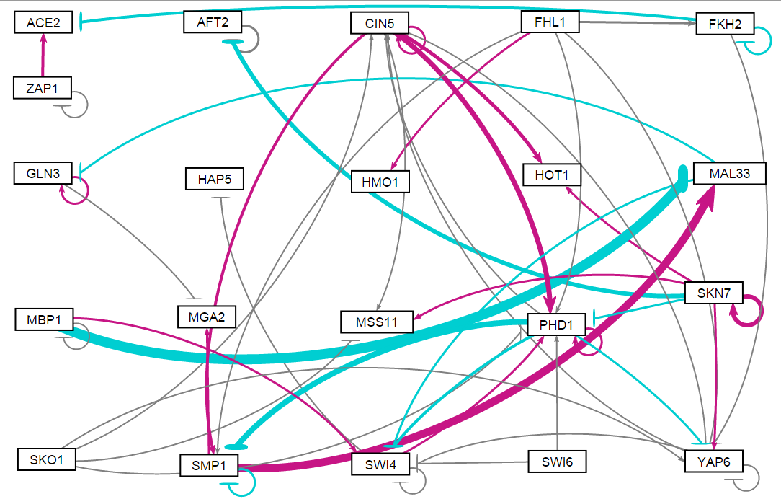
Visualized networks also display variations between runs
Figure 8: wt only, initial weights 1
Figure 9: All strains, initial weights 1

Slide 9
All-strain, varied weight comparisons
The purpose of this test is to see how model outputs for the same network are affected by different initial weight guesses (other than 1). We evaluate by looking at LSE values and estimated parameters.
We did not further analyze one-strain runs because they exhibited no difference when initial weights were varied

Slide 10
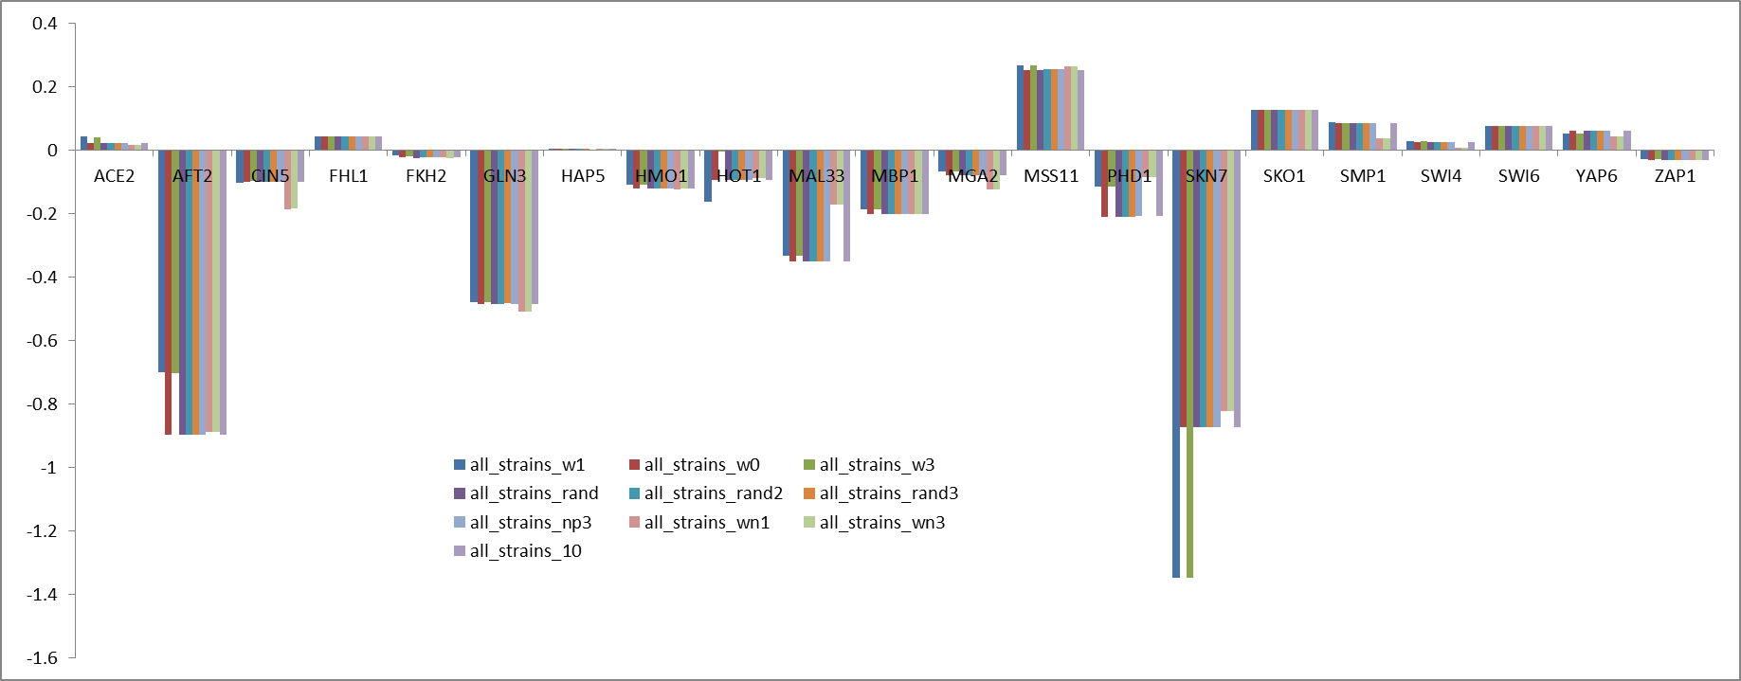
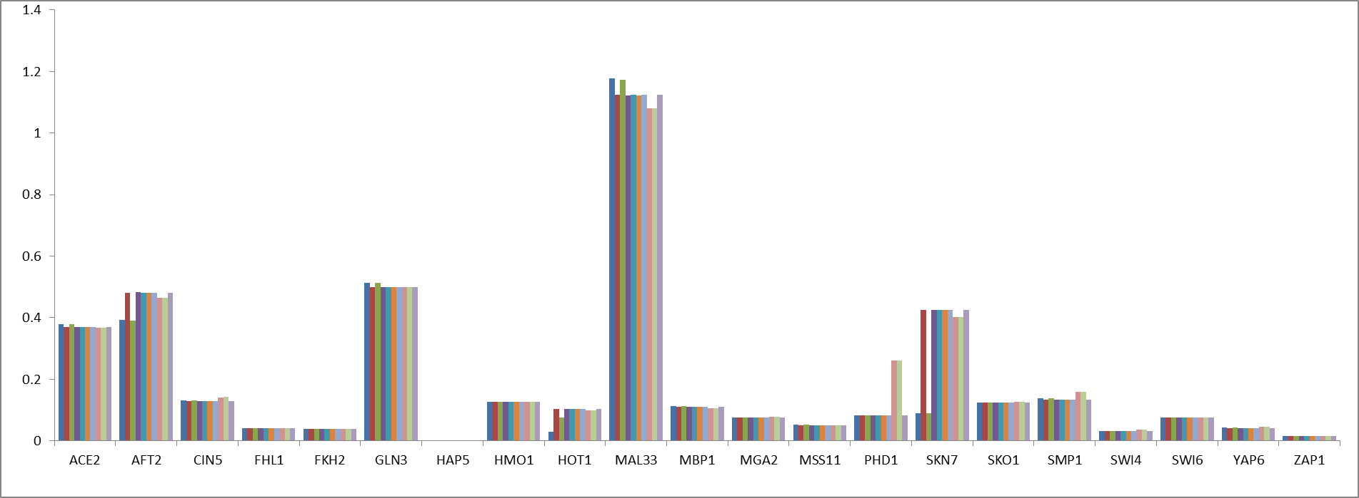
Estimated production rates and b values remained relatively consistent with different weights
Figure 10: Estimated b values
Figure 11: Estimated production rates

Slide 11
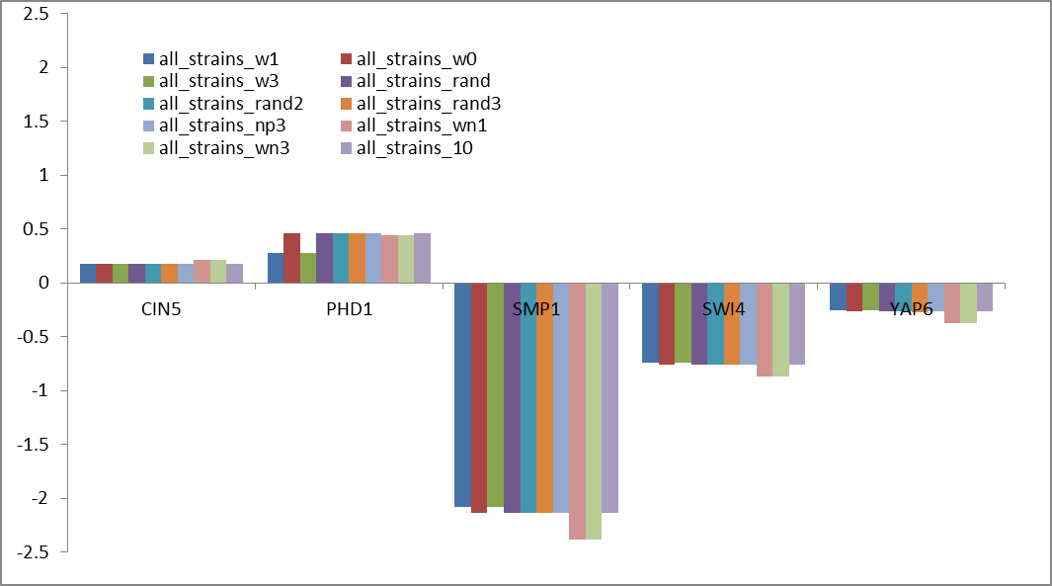
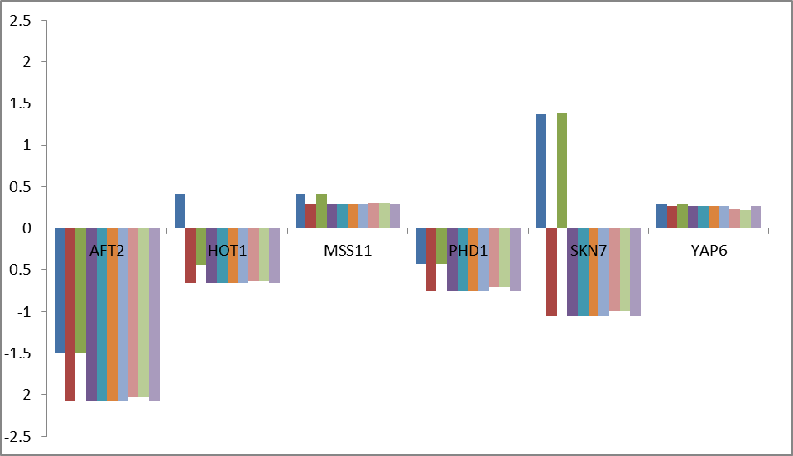
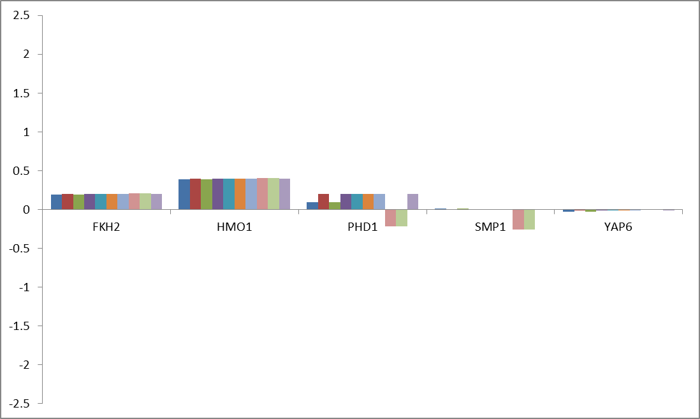
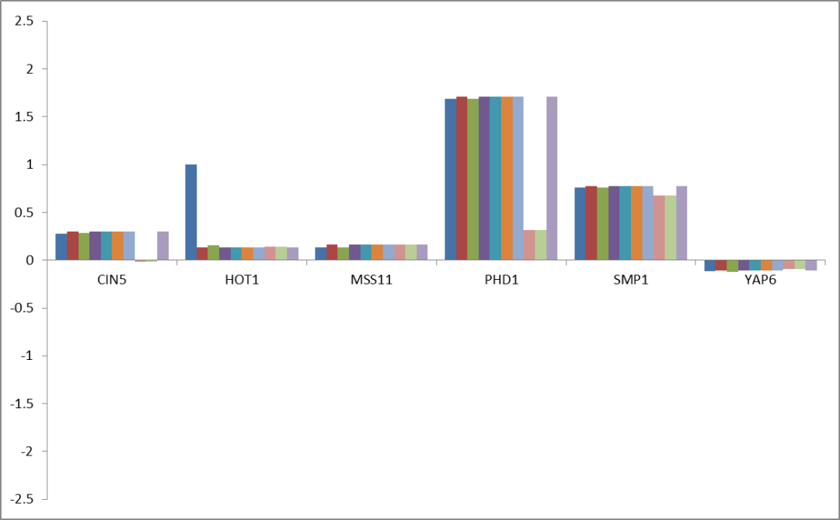
Estimated weights remained fairly consistent, with exceptions in pairs
Figure 12: regulator PHD1
Figure 13: regulator SKN7
Figure 14: regulator FHL1
Figure 15: regulator CIN5

Slide 12
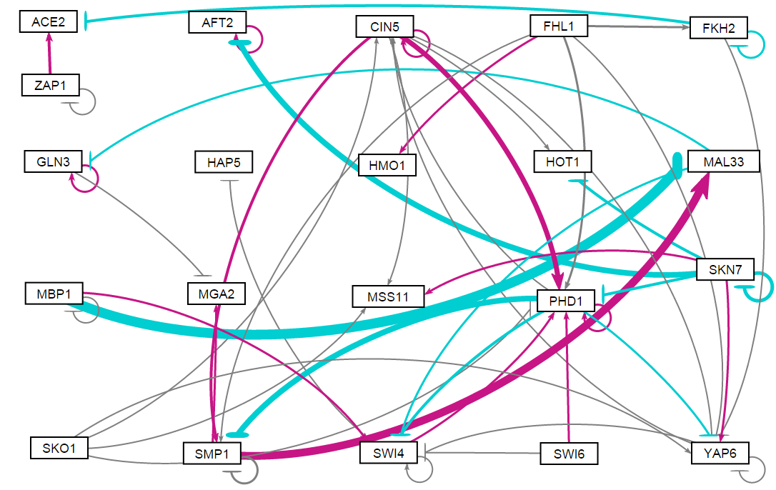
Visualized networks showed slight differences
Figure 16: All strains, initial weights 1
Figure 17: All strains, initial weights 0

Slide 13
LSE’s of outputs with different weights show the same three groupings
Run | All Strains | Wt Only
w = -1 | 45.2566 | N/A
w = -3 | 45.2565 | N/A
w =1 | 45.7010 | 6.8824
w = 3 | 45.6978 | 6.8824
w = 0 | 45.3083 | 6.8824
w = 10 | 45.3083 | N/A
w = rand (-1,1) | 45.3083 | 6.8824
w = rand (-1,1) | 45.3083 | N/A
w = rand (-1,1) | 45.3083 | N/A
w = rand (-3,3) | 45.3083 | N/A
Ideal LSE (sum of squares) | 0.5520 | 0.4875

Slide 14
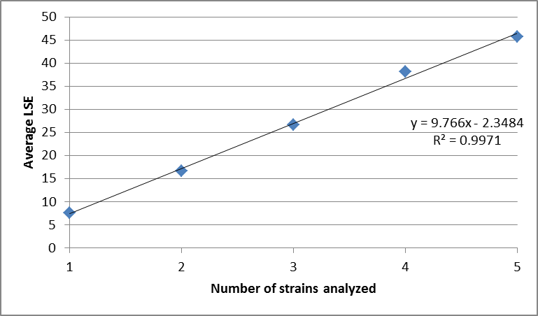
As the number of strains analyzed increases, the code output LSE displays a linear trend
Figure 18 : Output LSE values

