Slide 1
Detection of Mutations in EGFR in Circulating Lung-Cancer Cells
S. Maheswaran et al. The New England Journal of Medicine. 2007
Colin Reisterer and Nick Swenson

Slide 2
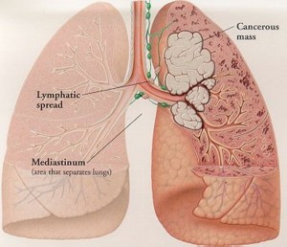
Clinical background: Non-small cell lung cancer (NSCLC)
NSCLC is the most common form of lung cancer and is primarily caused by smoking and other inhalable carcinogens. Morbidity is high and treatment is difficult.
Stages of NSCLC
Tumor is limited to the lung in normal tissue
Tumor spreads to area around lung
Tumor spreads to lymph nodes, other side of chest, and/or neck
Tumor spreads elsewhere in lungs & metastasises in other areas of the body
http://www.all-cancer-treatments.com/types-of-lung-cancer.html
Outlook
14% 5+ year survival
Stage 1 NSCLC: surgical intervention has 70% 5+ year survival
Nonoperable NSCLC: 9 month average survival after diagnosis
(2011). Non-Small-Cell Lung Cancer.
http://www.webmd.com/lung-cancer/no-small-cell-lung-cancer

Slide 3
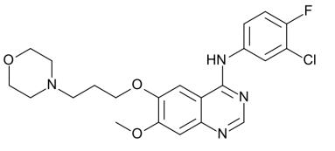
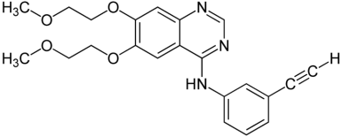
Treatment options for NSCLC
Surgery
Excision of the lung tumor mass
Most effective solution but only applicable in early stages (33% operable)
50% relapse rate
Chemotherapy
DNA damaging drugs
Cell growth inhibitors
Tyrosine Kinase Inhibitors
Radiation & Laser Therapy
Concentrated energy to destroy tumor cells
Gefitinib (Iressa)
Erlotinib (Tarceva)
Surgery is most effective treatment, but most patients will require an alternative due to late stage tumor progression!

Slide 4
Tyrosine Kinase Inhibitors (TKIs)
The Tyrosine Kinase Inhibitors used to treat NSCLC target EGFR which is mutated and oncogenic in many lung cancers. Treatments are effective but relapses are commonly experienced.
TKI Target: Epithelial Growth Factor Receptor (EGFR), a Proto-Oncogene
EGFR controls DNA synthesis and cell proliferation
Cancerous mutations in EGFR upregulate signaling and can be blocked by tyrosine kinase inhibitors
EGFR Receptors
Tyrosine kinases (drug target)
Problem: Most patients using TKIs see relapse within 1 year
DNA synthesis, cell proliferation, tumor growth

Slide 5
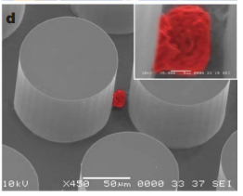
Monitoring mutations in circulating tumor cells
NSCLC tumor cells acquire additional EGFR mutations that inhibit drug action. Patients taking TKIs need to be monitored to determine if alternate therapy must be pursued.
Capture of circulating tumor cells using CTC-Chip Technology
Authors previously developed microfluidic device to isolate circulating tumor cells
Blood samples are flowed through the chip and tumor cells are captured by posts coated in antibody specific to epithelial tumor cells
Bound tumor cells can be analyzed for EGFR mutations that confer resistance to TKIs
Nagrath, S., L. V. Sequist, et al. (2007). "Isolation of rare circulating tumour cells in cancer patients by microchip technology." Nature 450(7173): 1235-1239.
CTC-Chip capture is robust, high purity, minimally invasive method for collection of circulating tumor cells in patients!

Slide 6

Analysis of DNA mutations in captured tumor cells
The CTC-Chip was used to capture tumor cells from the blood of 23 different patients. To test for EGFR mutations the SARMS assay was validated and utilized.
1. DNA extraction from captured tumor cells
2. Scorpion Amplification Refractory Mutation System (SARMS)
SARMS assay allows for detection of multiple EGFR mutations using DNA-fluorophore hybrids complementary to mutated alleles in question
Authors validated assay by re-identifying mutations in samples with previously known mutations
Found the SARMS test could identify mutants below detection limit of standard sequencing
Whitcombe, D., J. Theaker, et al. (1999). "Detection of PCR products using self-probing amplicons and fluorescence." Nat Biotechnol 17(8): 804-807.
Combination of CTC-Chip capture and SARMS genetic screening allows characterization of EGFR in NSCLC patients

Slide 7
Characterization of EGFR in Cancerous Patients
Summary: Most of the cancerous patients in their sample group had two mutations in EGFR from tumorous lung cells
Primary Mutation
The mutation suspected to be responsible for the lung cancer tumor
A deletion or single amino acid substitution in the exons of EGFR
Secondary Mutation
The mutation that is linked to EGFR resistance to tyrosine kinase inhibitors, a cancer therapy
Mutation that authors were interested in was the T790M mutation
Authors used this mutation as a biomarker for therapy resistance

Slide 8
T790M Mutation in Pretreatment Tumor Cells
Cell Isolation
Mutation Testing
Monitoring
Cells were isolated by tumor biopsy of 26 patients
Patients had not yet received therapy
All 26 patients had a primary mutation
10 of 26 (38%) of patients had a T790M mutation
Given tyrosine kinase inhibitors as treatment
Monitored over 40 months for survival
Results
Patient Type | Median Survival (Mo)
T790M Positive | 7.7
T790M Negative | 16.5
Patients that had the T790M mutation had a lower survival rate than those without the mutation
Likely patients resistant to tyrosine kinase inhibitor

Slide 9
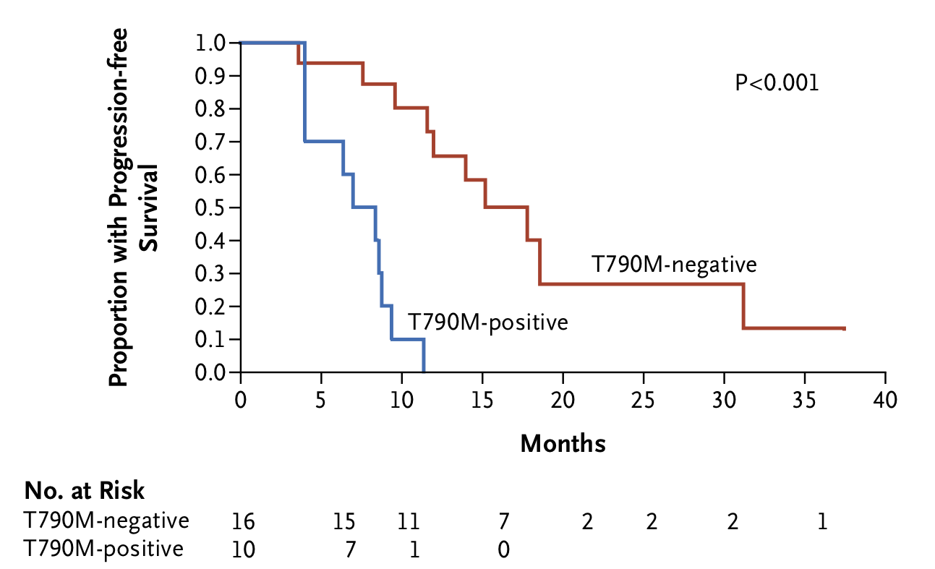
T790M Mutation as a Marker for Survival

Slide 10
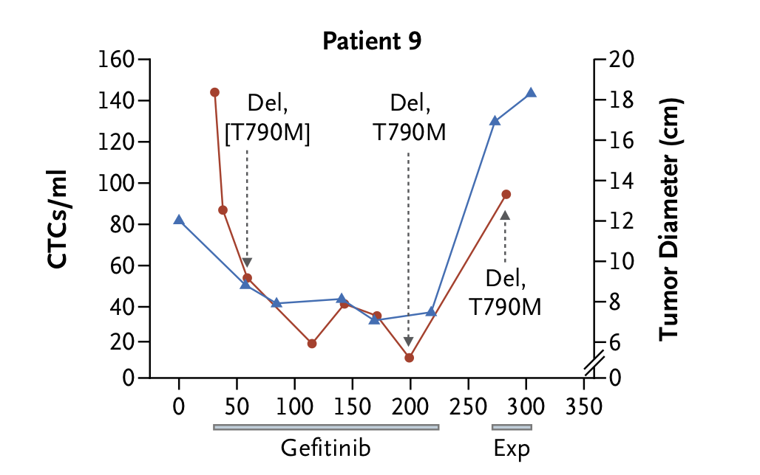

Tyrosine Kinase Inhibitors Select for T790M
Select Patients
Administered tyrosine kinase inhibitor (Gefitinib) to patients who were positive and negative for the T790M mutation in pretreatment
Monitor over Long Term
Monitor the tumor size and circulating tumor cells during course of tyrosine kinase inhibitor
Record frequency of T790M mutation
Result
After the course of gefitinib, the frequency of T790M mutation increased from 1 T790M mutation for every 10 primary mutations to 1 T790M mutation for every 1 primary mutation
Patients negative for T790M mutation developed T790M

Slide 11
Conclusions
T790M is a Marker for Survival of Patients
Patients that are positive for the T790M mutation have decreased survival times as compared to patients that are negative when treated with tyrosine kinase inhibitors
Tyrosine kinase inhibitors likely cannot bind to EGFR with T790M mutation
Tyrosine Kinase Inhibitors (Gefitinib) can Select for T790M Mutations
Treatment with tyrosine kinase inhibitors increased the incidence of T790M for patients positive for T790M and created T790M mutations in patients negative for T790M
Tyrosine kinase inhibitors select for mutation
Potentially use irreversible tyrosine kinase inhibitors that still bind to T790M

Slide 12
QUESTIONS?

