Slide 1
Invadopodia and Podosomes
Peyton Group Meeting
Journal Review
April 3, 2012
Lauren Barney

Slide 2
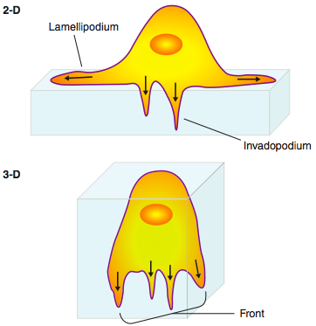
Migration
Migration is a very important process in vivo
Necessary for immune responses, wound healing, and embryonic development
Uncontrolled cell migration occurs in cardiovascular, immune, and developmental diseases as well as in tumor formation and metastasis
Barriers in the body can prevent cell migration unless the cells can get through them
Bravo-Cordero, et al. (2012)

Slide 3
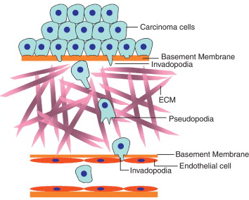
Invasion
Cells often must invade to cross membranes or barriers in the body
Boundaries: blood vessel walls, ECM, tissue boundaries
Invadosomes including invadopodia and podosomes are cell-ECM contacts that are used when cells need to cross boundaries
Examples:
Cancer metastasis
Migration of immune cells to sites of infection
Bravo-Cordero, et al. (2012)

Slide 4
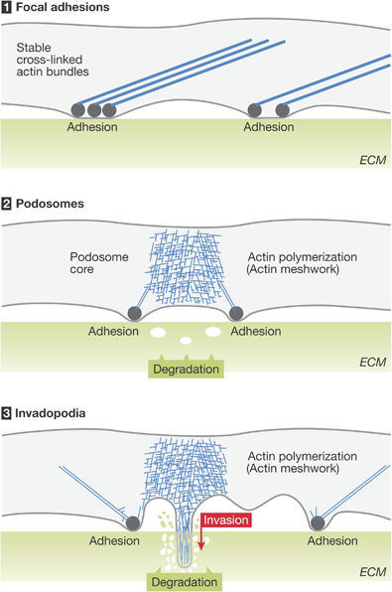
What are invadopodia and podosomes?
Actin rich protrusions used for adhesion to and degradation of the ECM
They are significantly different than focal adhesions in structure and function
Used for invasion through the matrix or for crossing barriers in the body
Some cell types have an intrinsic ability to form invadopodia or podosomes, and sometimes they can be induced with growth factors or other stimulation
Gray circles: viniculin-rich adhesion site
Gimona, Grashoff and Kopp (2005)
Notes:
http://www.nature.com/embor/journal/v6/n10/fig_tab/7400526_F2.html
Differences between adhesion structures. Focal adhesions (1) anchor bundled actin filaments at the sites of integrin clustering and extracellular matrix (ECM) contact. By contrast, podosomes (2) and invadopodia (3) are characterized by high actin polymerization activity and short, disorganized actin cores surrounded by a ring of adhesion structures. Whereas the podosome cores are dynamic and have a minute-scale turnover rate, invadopodia can remain stable for several hours and invade the ECM as a consequence of excessive matrix degradation. Green spheres. pieces of ECM removed from the substrate by MMP activity;grey circles, vinculin-rich adhesion sites; white areas, regions of complete ECM degradation.

Slide 5
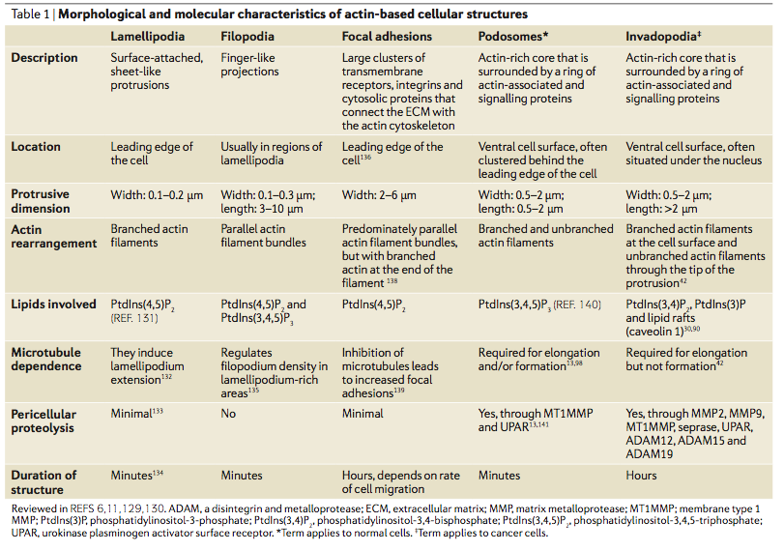
Types of Cell Adhesion Structures
Murphy and Courtneidge (2011)

Slide 6
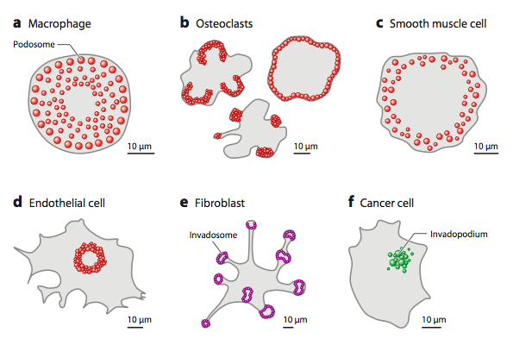
Clinical Relevance
Rous sarcoma virus –transformed
rosette
Linder, Wiesner and Himmel (2011)

Slide 7
What are the differences between invadopodia and podosomes?
Invadopodia
Podosomes
Longer lived (on the order of an hour or more)
Are typically separate from one another, but can appear in groups
No ring of proteins around the actin core
Often around the nucleus or the leading edge
Generally, cells with invadopodia have 1-10
Size: 8 μm diameter, 5 μm deep
Shorter lived (on the order of minutes)
Podosomes can form a ring structure called a rosette
There is a ring around the actin core containing adhesion proteins such as vinculin or talin
Often at the leading edge
Cells often have many podosomes (10-100)
Size: 1 μm diameter, 0.4 μm deep
Notes:
Podosomes are most prominent in cells derived from the monocytic lineage, such as macrophages, osteoclasts and dendritic cells, but they have also been described recently in epithelial, endothelial, and even smooth muscle cells. These adhesion structures seem to be required for physiological processes such as the migration of phagocytes, smooth muscle cells and dentric cells, and the adhesion, migration and invasion of endothelial cells during the formation of blood vessels. Podosomes have also been proposed to be the precursors of invasive and matrix-degrading organelles such as the osteoclast ring and the invadopodia of tumour cells. These latter structures form protrusions at the ventral surface of invasive tumour cells, and they coincide with degradation sites of the underlying ECM. Despite their different structural and functional features, focal adhesions, podosomes and invadopodia share many of the same molecular components FROM: Gimona, Grashoff and Kopp. “Oktoberfest for adhesion structures.” MBO reports (2005) 6, 922–926.

Slide 8
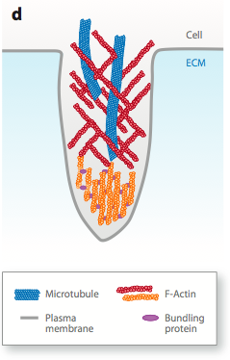
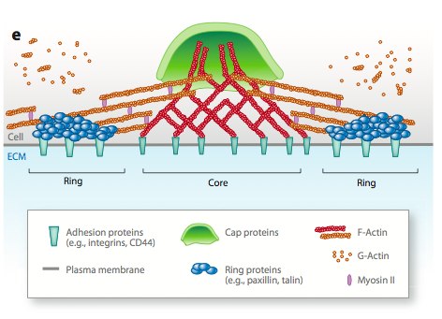
Structure of Invadopodia and Podosomes
Invadopodia
Podosomes
Linder, Wiesner and Himmel (2011)
Notes:
Both have localization of actin, and are composed of actin regulators such as: cortactin, N-WASP, Arp2/3, plaque proteins (talin, paxillin, vinicuilin), Also: phosophotyrosine (activated proteins)

Slide 9
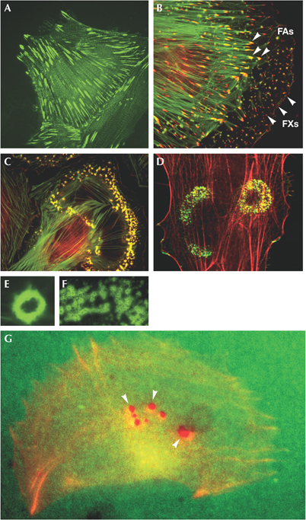
Imaging
C: Podosomes (yellow) in smooth muscle cells
D: Podosome rosettes (yellow) in epithelial cells
G: Invadopodia (red) near the center of a cell on a green fluorescent ECM substrate
Gimona, Grashoff, and Kopp (2005)
Notes:
Different types of cell–extracellular matrix contact structures. (A) Elongated focal adhesions (FAs) in a stationary adhesive cell. (B) Peripheral focal complexes (FXs) and anchoring FAs in a protruding cell. (C) Podosomes (yellow) in smooth muscle cells. (D) Podosome rosettes (yellow) in epithelial cells. (E) Podosomes can aggregate to rings. (F) Aggregates of podosome rings can form belt-like structures. (G) Invadopodia (red; arrowheads) in a cell grown on a fluorescent extracellular matrix substrate (green) form preferentially in the centre of the cell. Images were provided by M. Gimona (A, B, C, E, F), S. Linder (D), and R. Buccione and I. A. Grande (G).
From: Gimona, Grashoff and Kopp. “Oktoberfest for adhesion structures.” MBO reports (2005) 6, 922–926.

Slide 10
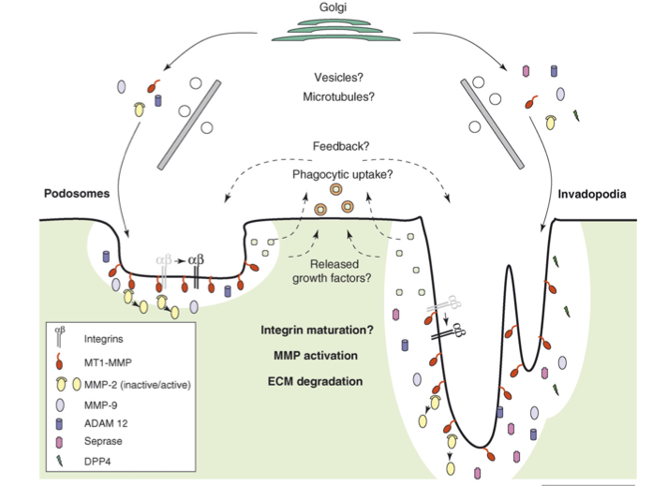
How do invadopodia and podosomes degrade the ECM?
They secrete matrix metalloproteinases (MMPs)
A family of proteins which can degrade proteins
Many are secreted, but can be membrane proteins
Can secrete other proteases to degrade the ECM proteins
Initiation of invadopodia or podosomes creates a migratory phenotype, where focal adhesions are dissolved and the cell can begin to migrate
Linder (2007)

Slide 11
What can induce the formation of invadopodia and podosomes?
Growth factors: result in phosphorylation of key proteins in the pathway
Platelet derived growth factor (PDGF)
Transforming growth factor-β (TGFβ)
Epidermal growth factor (EGF)
Integrins
αvβ3 integrin: found in podosomes of osteoclasts and invadopodia of several types of cancer
Interference with the αvβ3 integrin results in defective podosomes
The β1 integrin subunit is also found in both podosomes and invadopodia
Activation of the β1 integrin subunit induces invadopodia formation
Stiffness and other environmental cues

Slide 12
Stiffness Effects
Both invadopodia and podosomes have recently been shown to be mechanosensors, which can use stiffness cues to induce ECM degradation and migration
Stiffness has been shown to influence the lifetime and spacing of podosomes
Rigidity is important in matrix degradation with invadopodia
There is an optimal rigidity for invadpodia formation and ECM degradation (~30 kPa)
Invadopodia and podosomes can also be used for signal transduction within the cell via mechanotransduction

Slide 13
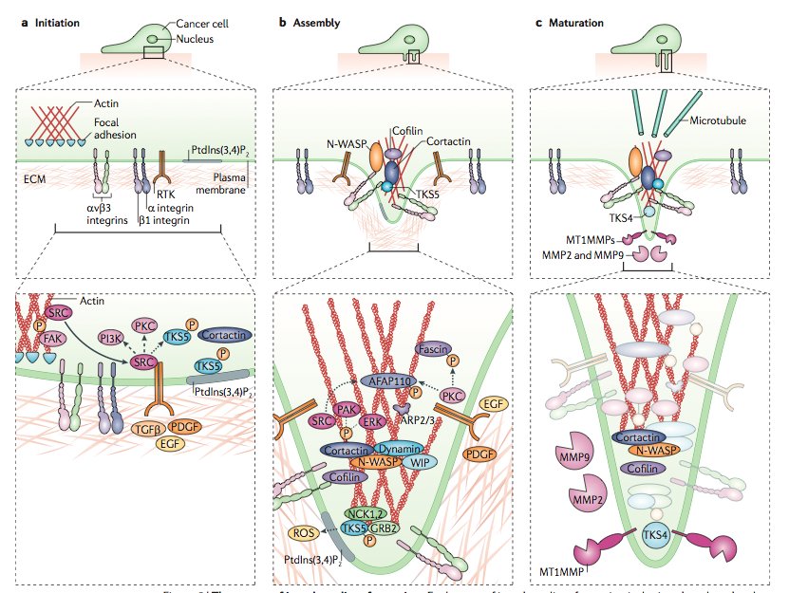
Assembly and Maturation of Invadopodia
Murphy and Courtneidge (2011)
Notes:
Figure 5 | The stages of invadopodium formation. Each stage of invadopodium formation is depicted on three levels:
the basic shape of the structure in relation to the cell (top), a simple representation of key proteins in relation to the cell
membrane (middle) and a detailed molecular overview (bottom). a | During initiation of invadopodium formation, cells establish focal adhesions with the extracellular matrix (ECM) through the interaction of integrins, SRC and Tyr397-phosphorylated focal adhesion kinase (FAK). In invading cells, a switch occurs to release SRC, enabling it to bind and phosphorylate Tyr kinase substrate with five SH3 domains (TKS5) (as well as phosphoinositide 3-kinase (PI3K) and protein kinase C (PKC). Phosphorylated TKS5 will then localize to regions containing phosphatidylinositol-3,4- bisphosphate (PtdIns(3,4)P2). The intracellular switch is initiated by growth factors such as epidermal growth factor (EGF), platelet-derived growth factor (PDGF) and transforming growth factor-β (TGFβ). As TKS5 colocalizes with cortactin in precursors of invadopodia, it might form the scaffold that recruits cortactin. b | The formation of invadopodia occurs through the recruitment and activation of the actin regulatory complex ARP2/3 and WASP-interacting protein (WIP), the phosphorylation of key invadopodium components, such as cortactin, TKS5, fascin and 110 kDa actin filament-associated protein (AFAP110), and the production of reactive oxygen species (ROS). TKS5 binds NCK1, NCK2, growth factor receptor-bound protein 2 (GRB2) and neural Wiskott–Aldrich syndrome protein (N-WASP) (the TKS5–N-WASP interaction is not shown here). Cortactin associates with N-WASP and the ARP2/3 complex (the cortactin–ARP2/3 interaction is not shown here), and will generate a complex of WIP and dynamin
during invadopodia formation. Phosphorylation of both cortactin (by SRC, p21-activated kinase (PAK) and extracellular signal-regulated kinase (ERK)) and TKS5 (by SRC) regulate invadopodium formation. In addition, phosphorylation of cortactin by EGF causes dissociation from cofilin to initiate actin polymerization and invadopodium formation. c | During maturation, invadopodia promote the degradation of the ECM by coordinating the secretion of matrix metalloprotease 2 (MMP2) and MMP9 and enabling the delivery (potentially through microtubules) and presentation of membrane type 1 MMP (MT1MMP) to the tip of the protruding structure, through the interaction of these proteases with key invadopodium components such as cortactin, Tyr kinase substrate with four SH3 domains (TKS4) and
β1 integrin. Dephosphorylation of cortactin blocks the severing ability of cofilin and enables the stabilization of invadopodia. The mechanisms by which the proteins associate, and how they are temporally regulated, are largely unknown and should be explored further. Faded-out circles represent proteins that are present during maturation, but have unknown roles in ECM degradation. Dotted arrows indicate a regulatory pathway for which the mechanism is unknown. Dashed lines represent an enzyme–substrate interaction. P, phosphate; RTK, receptor Tyr kinase.
From Murphy and Courtneidge (2011)

Slide 14
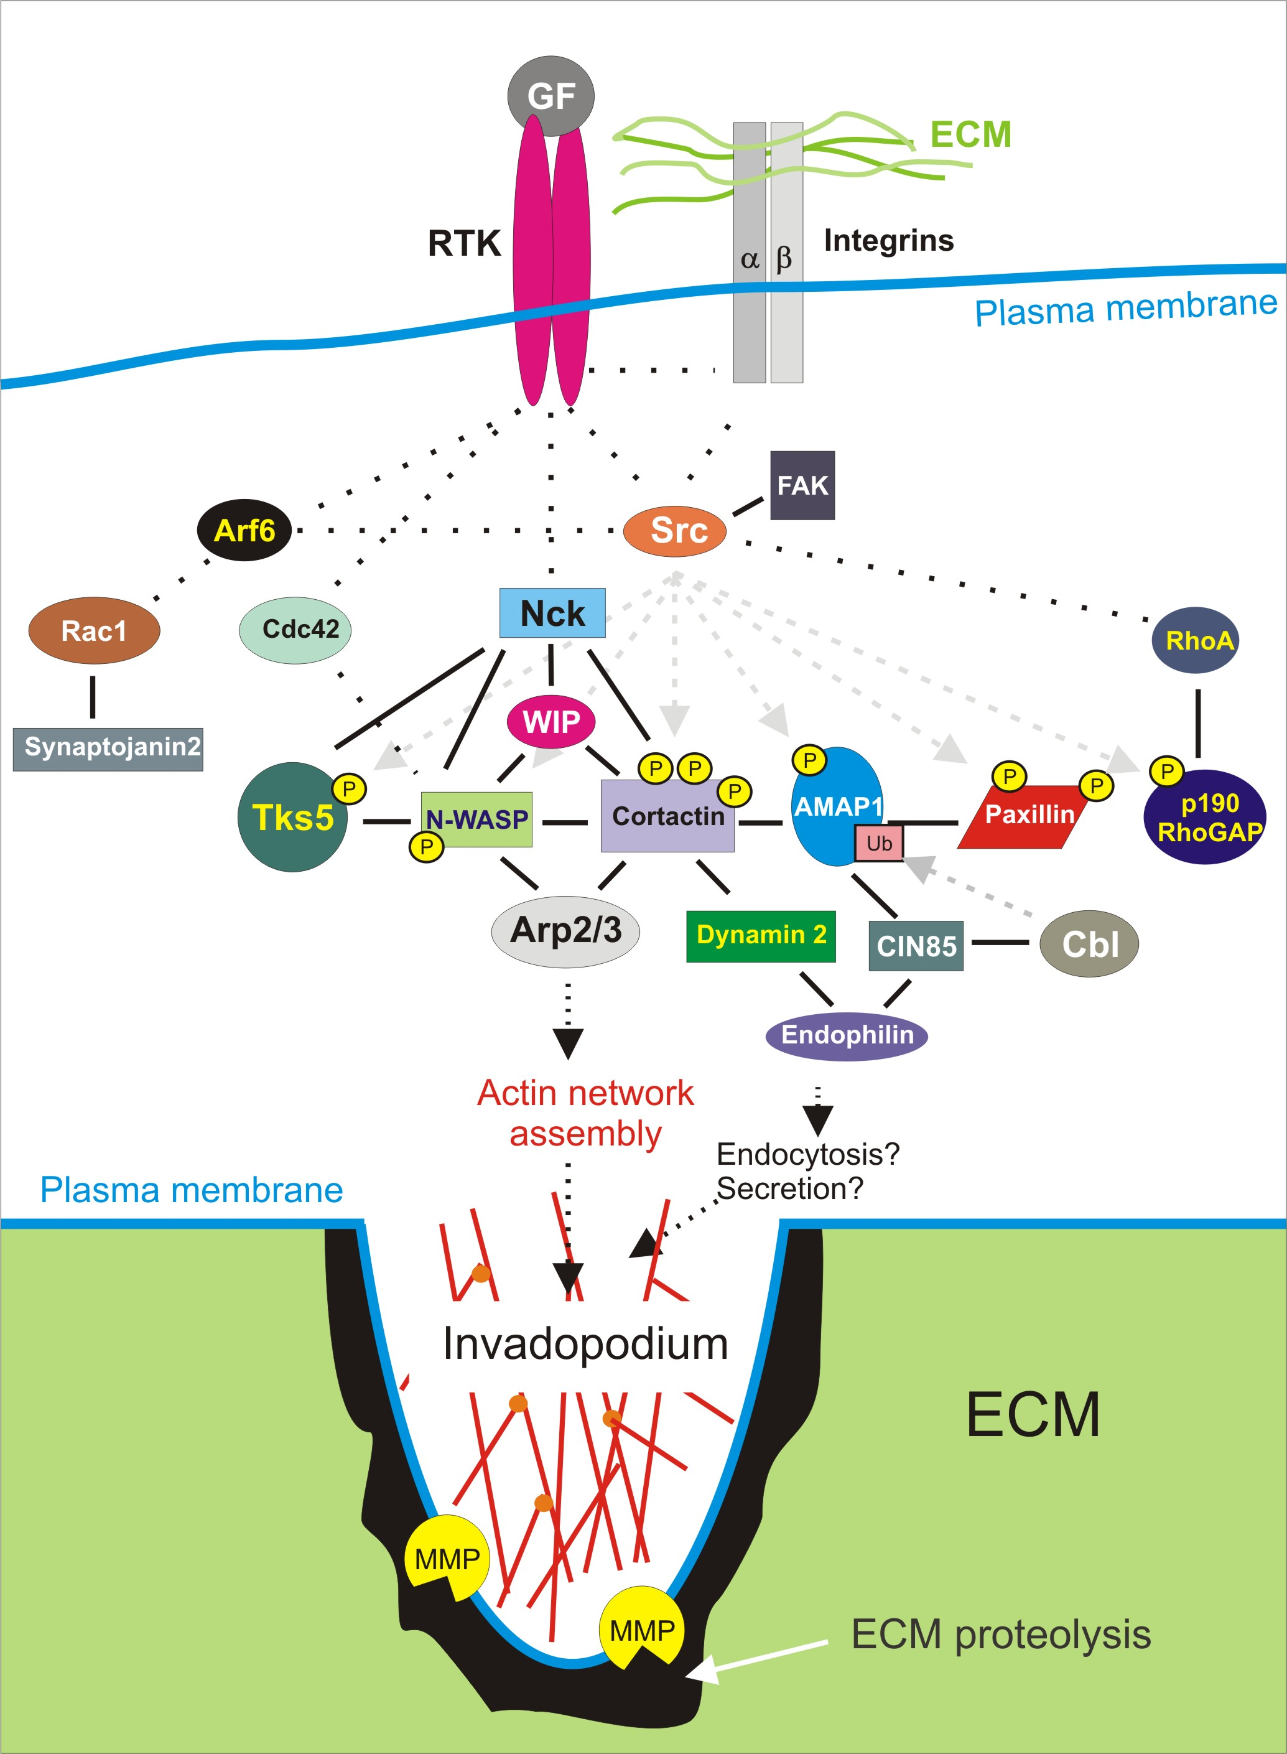
Invadopodia can be induced by growth factors or integrins
http://www.latrobe.edu.au/biochemistry/lab/lock/index.htm
Notes:
Also: references Stylli et al paper.
Invadopodia signaling: a working model (see text for details). Integrins and receptor tyrosine kinases (RTKs) on invasive tumour cells are activated by adhesion to extracellular matrix (ECM) and growth factors (GF) respectively. Activation of Src (by integrins and/or RTKs) and recruitment and activation of multiple components of the actin regulatory machinery (cortactin, N-WASP, Arp2/3, Cdc42, Nck, WIP) promotes actin network assembly essential for invadopodia protrusion and matrix degradation. Potential roles for secretion and/or internalization are inferred based on the critical involvement of several membrane regulatory proteins in invadopodia regulation (e.g. Dynamin 2, endophilins, CIN85, Cbl and cortactin). Solid lines indicate direct protein-protein interactions and dotted lines indicate where the signaling intermediates are not known. Tyrosine phosphorylation (yellow circles) and monoubiquitination (pink squares) of substrates by Src and Cbl respectively, is indicated (dashed arrows). Proteins implicated as essential for invadopodia by RNA interference or dominant negative mutant studies are indicated (􏰾). Protein interactions that when disrupted in cells inhibit invadopodia formation are indicated (red diamonds). (Stylli, et al.)

Slide 15
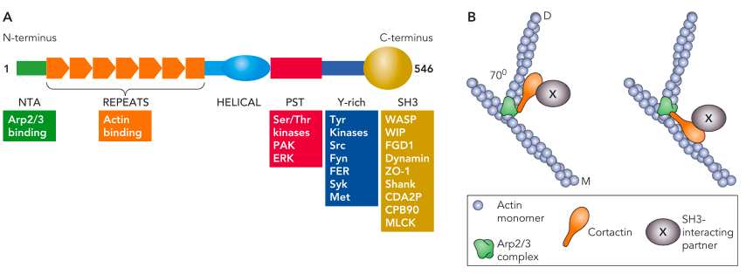
Cortactin
Protein in the cytoplasm of cells which can become activated by stimuli to promote rearrangement of the actin cytoskeleton
Involved in the formation of lamellipodia, invadopodia, as well as cell migration and endocytosis
Becomes activated in invadopodia; phosphorolated on three tyrosine residues
Has been shown to regulate the secretion of MMPs at invadopodia
Cosen-Binker and Kapus (2006)
Notes:
The activated Arp2/3 complex binds to the side of a mother filament (M) to nucleate a daughter filament (D). The schemes show two potential (nonexclusive) configurations of cortactin arrangement near the branch point. In both cases, the N terminus of cortactin binds to the Arp2/3 complex, whereas the F-actin binding repeats interact either with the daughter filament or with the mother filament as suggested in Refs. 93 and 98, respectively. During the finalization of this review, Pant et al. (76) published a study in which they used electron micro- scopy and three-dimensional reconstruction to investigate the geometry of the interaction between purified actin and the cortactin N terminus. They found that binding of cortactin to actin subdomain-1 widens the gap between the intertwining actin filaments. They propose a model in which cor- tactin binding to the mother filament might facilitate the recruitment of WASP at this locus. The COOH terminal SH3 domain can associate with a variety of partners (X).
From: Cosen-Binker and Kapus (2006)

Slide 16
Immunofluorescent Imaging
Invadopodia are usually quantified using IF imaging
Actin is localized into punctate spots at invadopodia and podosomes
Also stain for other specific invadopodia or podosome markers
Cortactin: although, it also can randomly colocailize with actin, so confocal microscopy must be used to ensure that it is the bottom of the cell
TKS5: a key adaptor protein in invadopodia and podosomes which is not present in focal adhesions
Expression of TKS5 actually induces the formation of invadopodia, even in cells which don’t normally have them
Colocalization of actin with an invadopodia marker and local ECM degradation
See a void in a fluorescent ECM matrix that is colocalized with punctate spots of actin and the invadopodia marker (cortactin, etc)

Slide 17
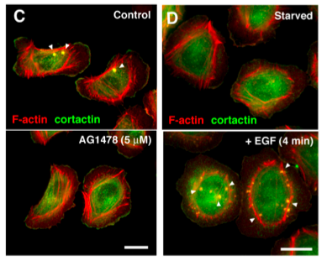
Imaging and Quantification of Invadopodia
Yamaguchi, Pixley and Condeelis (2006)
MTLn3 cells derived from the 13762NF rat mammary adenocarcinoma
C: cells have invadopodia until they are treated with an EGF receptor kinase inhibitor
D: serum starved cells don’t have invadopodia, but invadopodia form when cells are treated with EGF
Notes:
Yamaguchi et al, “Molecular mechanisms of invadopodium formation: the role of the N-WASP–Arp2/3 complex pathway and cofilin,” JCB • VOLUME 168 • NUMBER 3 • 2005
EGF and EGF receptor signaling are necessary for invadopodium formation. (A) Effect of an EGF receptor kinase inhibitor AG1478 on invadopodium formation. Cells were cultured on FN-gelatin coverslips in the presence of serum with or without AG1478 for 16 h. Cells were then stained with rhodamine phalloidin and anti-cortactin antibody to quanti- tate invadopodium formation. (B) Effect of serum starvation and subse- quent EGF stimulation on invadopodium formation. Cells cultured on FN- gelatin coverslips were serum starved for 4 h with or without 5 􏰵M AG1478 and stimulated with 12.5 nM EGF for 4 min. Error bars repre- sent the SD of three different determinations. (C) Morphology of cells treated with AG1478. After treatment with AG1478 in the presence of serum, cells were stained with rhodamine phalloidin and anti-cortactin antibody. Cells formed stress fibers and lamellipodia even after AG1478 treatment. (D) Morphology of cells serum starved and stimulated with EGF. Arrowheads denote invadopodia. Bars, 10 􏰵m.

Slide 18
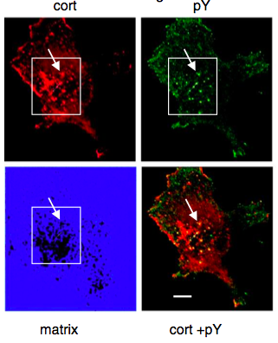
Fluorescent Matrix
Bowden, et al. (2006)

Slide 19
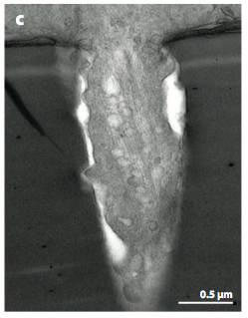
Scanning Electron Microscopy
An invadopodium on a MDA-MB-231 cell seeded on pore filters
Linder, Wiesner and Himmel (2011)

Slide 20
Conclusions
This is a still very recent field; podosomes were first seen in 1985 and invadopodia were first described in 1994
Currently, the classification of invadopodia and podosomes has not been clearly defined
It is also not clear whether invadopodia and podosomes originate from the same basic structures, even though they have similar pathways, which also haven’t been identified completely
However, an understanding of roles of invadopodia and podosomes in cell migration is crucial for making improvements in understanding and treating diseases

Slide 21
References
Albiges-Rizo, et al. “Actin machinery and mechanosensitivity in invadopodia, podosomes and focal adhesions.” Journal of Cell Science 122 (2009) 3037-3049
Bowden, et al. “Co-localization of cortactin and phosphotyrosine identifies active invadopodia in human breast cancer cells.” Experimental Cell Research 312 (2006) 1240-1253
Bravo-Cordero, et al. “Directed cell invasion and migration during metastasis,” Curr Opin Cell Biol (2012)
Cosen-Binker and Kapus. “Cortactin: The Gray Eminence of the Cytoskeleton.” Physiology 21 (2006) 352-361
Gimona, Grashoff and Kopp. “Oktoberfest for adhesion structures.” MBO reports (2005) 6, 922–926.
Linder, “The matrix corroded: podosomes and invadopodia in extracellular matrix degradation” Trends in Cell Biology 17 (2007)
Linder, Wiesner and Himmel, “Degrading Devices: Invadosomes in Proteolytic Cell Invasion.” Annu. Rev. Cell Dev. Biol. 27 (2011) 185–211.
Murphy and Courtneidge, “The ‘ins’ and ‘outs’ of podosomes and invadopodia: characteristics, formation and function.” Nature Reviews Molecular Cell Biology 12 (2011) 413-426
Stylli, Kaye and Lock. “Invadopodia: At the cutting edge of tumour invasion.” Journal of Clinical Neuroscience 15 (2008) 725–737
Yamaguchi, Pixley and Condeelis. “Invadopodia and podosomes in tumor invasion.” European Journal of Cell Biology 85 (2006) 231-218.

