Slide 1
Modeling the Glutamate Metabolic Pathway in Saccharomyces cerevisiae to Resemble Experimental Data
Anthony Wavrin & Matthew Jurek
Department of Biology
Loyola Marymount University
February 28th, 2013

Slide 2
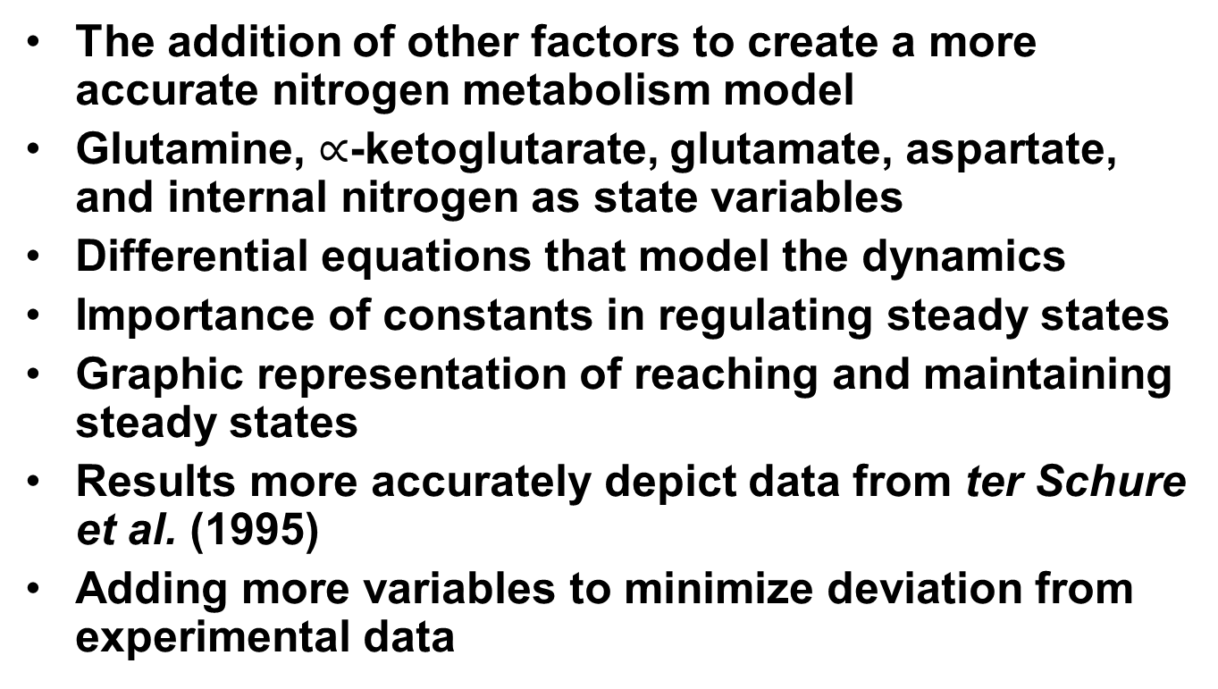
Outline
The addition of other factors to create a more accurate nitrogen metabolism model
Glutamine, $∝$-ketoglutarate, glutamate, aspartate, and internal nitrogen as state variables
Differential equations that model the dynamics
Importance of constants in regulating steady states
Graphic representation of reaching and maintaining steady states
Results more accurately depict data from ter Schure et al. (1995)
Adding more variables to minimize deviation from experimental data

Slide 3
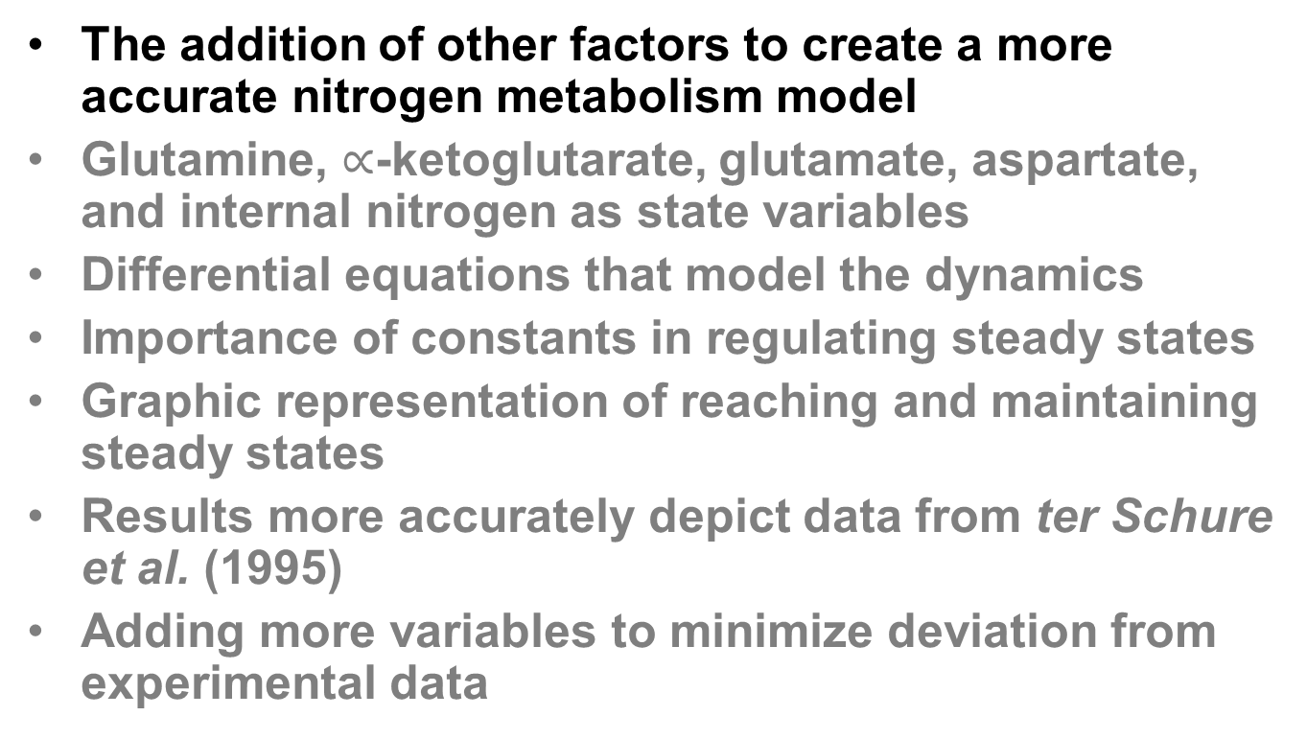
Outline
The addition of other factors to create a more accurate nitrogen metabolism model
Glutamine, $∝$-ketoglutarate, glutamate, aspartate, and internal nitrogen as state variables
Differential equations that model the dynamics
Importance of constants in regulating steady states
Graphic representation of reaching and maintaining steady states
Results more accurately depict data from ter Schure et al. (1995)
Adding more variables to minimize deviation from experimental data

Slide 4
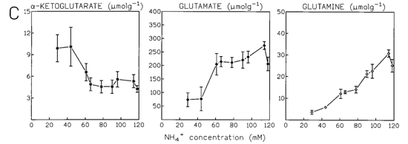

The Role of Aspartate Within the Model
The unproportional increase in glutamate, with respect to $∝$-ketoglutarate and glutamine, indicates another possible source of glutamate.
ter Schure et al. (1995) J. Bacteriol. 177(22):6672

Slide 5
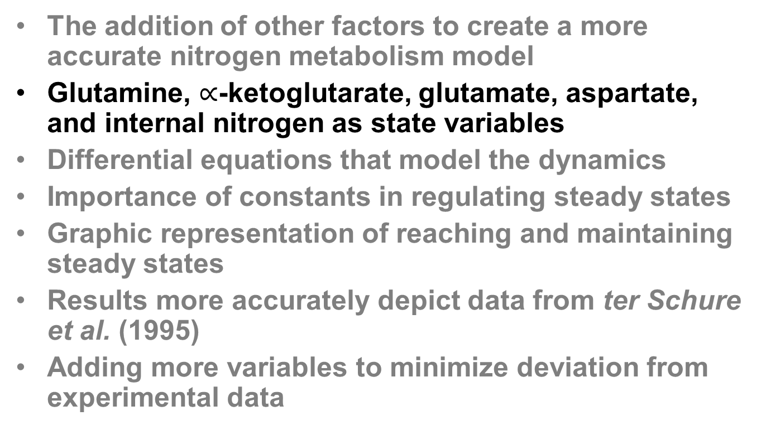
Outline
The addition of other factors to create a more accurate nitrogen metabolism model
Glutamine, $∝$-ketoglutarate, glutamate, aspartate, and internal nitrogen as state variables
Differential equations that model the dynamics
Importance of constants in regulating steady states
Graphic representation of reaching and maintaining steady states
Results more accurately depict data from ter Schure et al. (1995)
Adding more variables to minimize deviation from experimental data

Slide 6
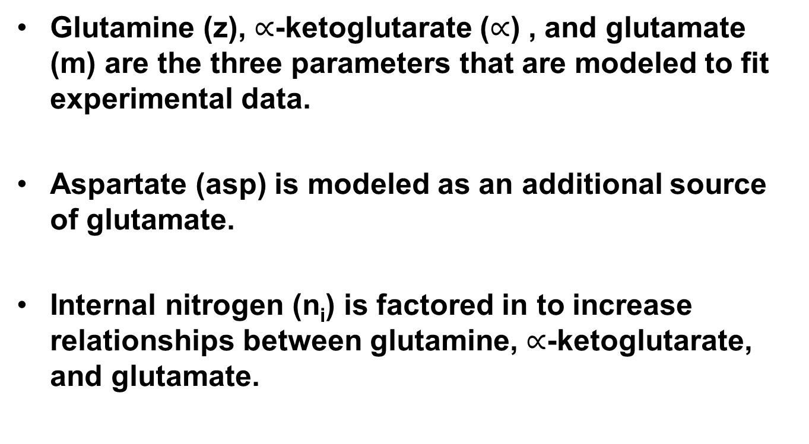
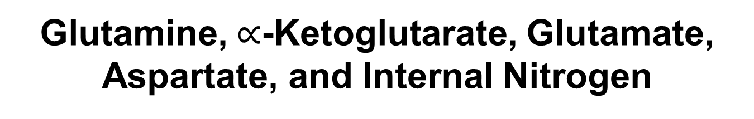
Glutamine, $∝$-Ketoglutarate, Glutamate, Aspartate, and Internal Nitrogen
Glutamine (z), $∝$-ketoglutarate ($∝$) , and glutamate (m) are the three parameters that are modeled to fit experimental data.
Aspartate (asp) is modeled as an additional source of glutamate.
Internal nitrogen (n_{i}) is factored in to increase relationships between glutamine, $∝$-ketoglutarate, and glutamate.

Slide 7
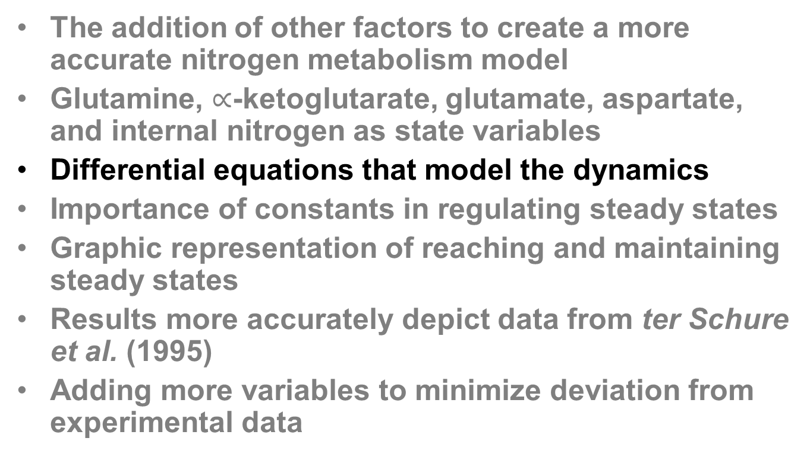
Outline
The addition of other factors to create a more accurate nitrogen metabolism model
Glutamine, $∝$-ketoglutarate, glutamate, aspartate, and internal nitrogen as state variables
Differential equations that model the dynamics
Importance of constants in regulating steady states
Graphic representation of reaching and maintaining steady states
Results more accurately depict data from ter Schure et al. (1995)
Adding more variables to minimize deviation from experimental data

Slide 8
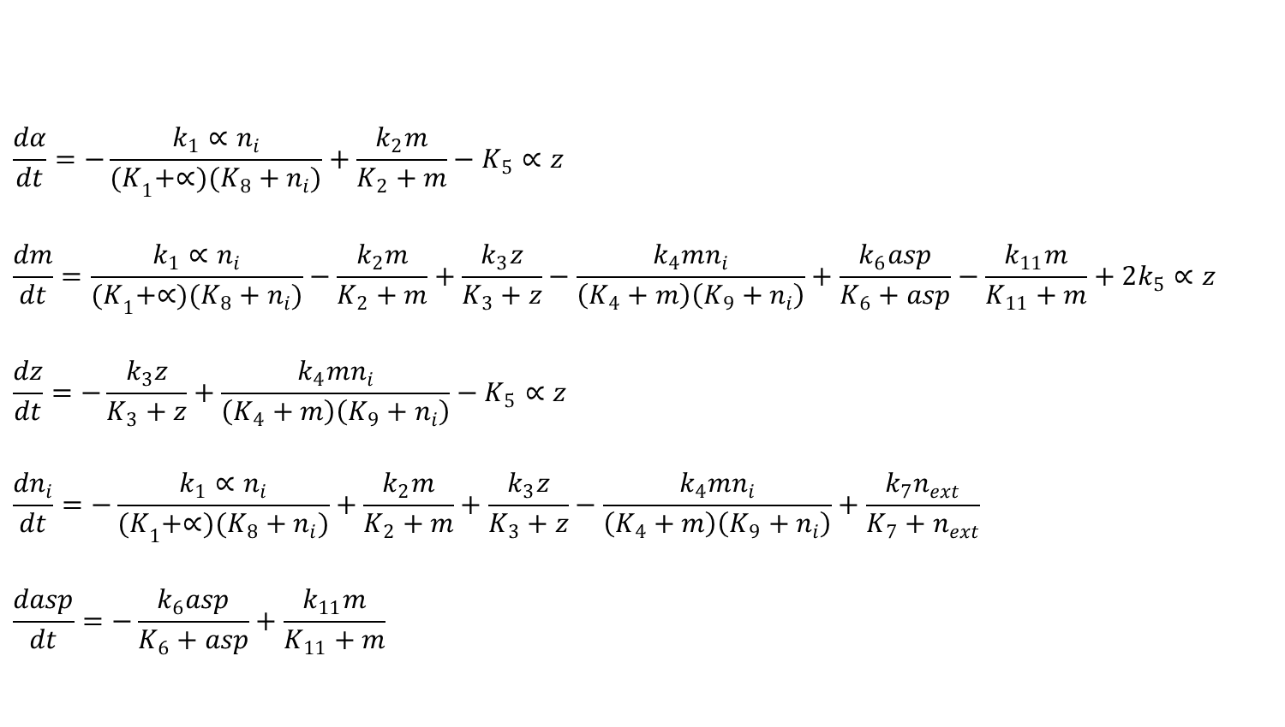
Differential Equations Defining the Model
$$\frac{dα}{dt}=−\frac{k_{1}∝n_{i}}{{(K}_{1}+∝)(K_{8}+n_{i})}+\frac{k_{2}m}{K_{2}+m}−K_{5}∝z$$
$$\frac{dm}{dt}=\frac{k_{1}∝n_{i}}{{(K}_{1}+∝)(K_{8}+n_{i})}−\frac{k_{2}m}{K_{2}+m}+\frac{k_{3}z}{K_{3}+z}−\frac{k_{4}mn_{i}}{\left(K_{4}+m\right)\left(K_{9}+n_{i}\right)}+\frac{k_{6}asp}{K_{6}+asp}−\frac{k_{11}m}{K_{11}+m}+2k_{5}∝z$$
$$\frac{dz}{dt}=−\frac{k_{3}z}{K_{3}+z}+\frac{k_{4}mn_{i}}{\left(K_{4}+m\right)\left(K_{9}+n_{i}\right)}−K_{5}∝z$$
$$\frac{dn_{i}}{dt}=−\frac{k_{1}∝n_{i}}{{(K}_{1}+∝)(K_{8}+n_{i})}+\frac{k_{2}m}{K_{2}+m}+\frac{k_{3}z}{K_{3}+z}−\frac{k_{4}mn_{i}}{\left(K_{4}+m\right)\left(K_{9}+n_{i}\right)}+\frac{k_{7}n_{ext}}{K_{7}+n_{ext}}$$
$$\frac{dasp}{dt}=−\frac{k_{6}asp}{K_{6}+asp}+\frac{k_{11}m}{K_{11}+m}$$

Slide 9
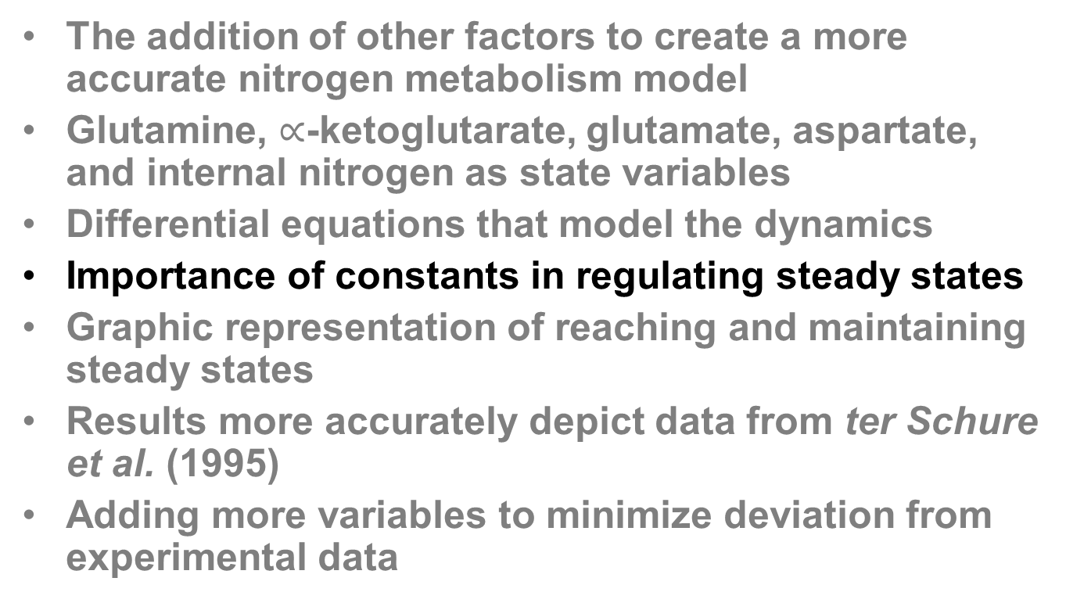
Outline
The addition of other factors to create a more accurate nitrogen metabolism model
Glutamine, $∝$-ketoglutarate, glutamate, aspartate, and internal nitrogen as state variables
Differential equations that model the dynamics
Importance of constants in regulating steady states
Graphic representation of reaching and maintaining steady states
Results more accurately depict data from ter Schure et al. (1995)
Adding more variables to minimize deviation from experimental data

Slide 10
Constants Utilized Within the Model
Constants | Role
k_{x} | Main determinant of maximum rate of reaction
K_{x} | The concentration at which k_{1/2} occurs
n_{ext} | Concentration of nitrogen in feed

Slide 11
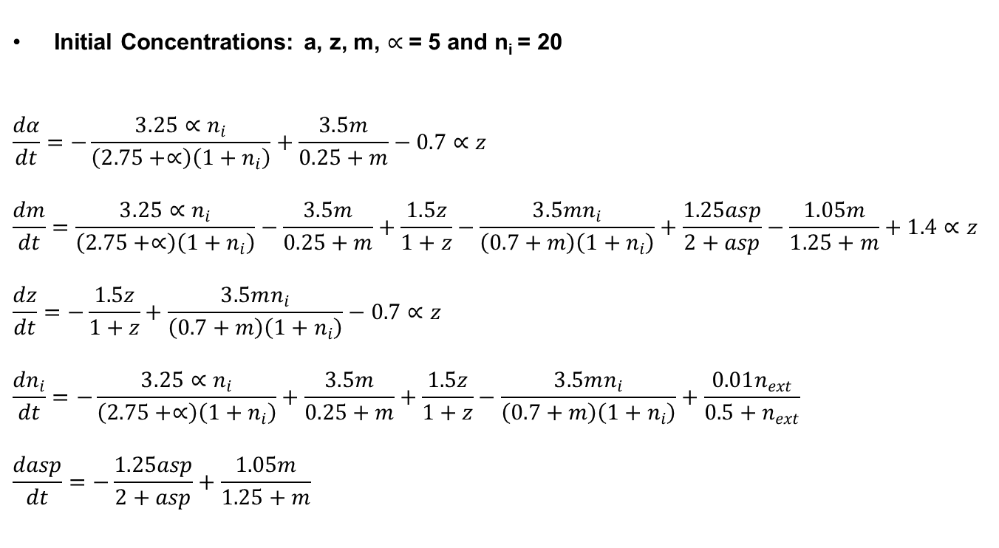
Constants in Equations at Steady State
Initial Concentrations: a, z, m, $∝$= 5 and n_{i} = 20
$$\frac{dα}{dt}=−\frac{3.25∝n_{i}}{\left(2.75+∝\right)\left(1+n_{i}\right)}+\frac{3.5m}{0.25+m}−0.7∝z$$
$$\frac{dm}{dt}=\frac{3.25∝n_{i}}{\left(2.75+∝\right)\left(1+n_{i}\right)}−\frac{3.5m}{0.25+m}+\frac{1.5z}{1+z}−\frac{3.5mn_{i}}{\left(0.7+m\right)\left(1+n_{i}\right)}+\frac{1.25asp}{2+asp}−\frac{1.05m}{1.25+m}+1.4∝z$$
$$\frac{dz}{dt}=−\frac{1.5z}{1+z}+\frac{3.5mn_{i}}{\left(0.7+m\right)\left(1+n_{i}\right)}−0.7∝z$$
$$\frac{dn_{i}}{dt}=−\frac{3.25∝n_{i}}{\left(2.75+∝\right)\left(1+n_{i}\right)}+\frac{3.5m}{0.25+m}+\frac{1.5z}{1+z}−\frac{3.5mn_{i}}{\left(0.7+m\right)\left(1+n_{i}\right)}+\frac{0.01n_{ext}}{0.5+n_{ext}}$$
$$\frac{dasp}{dt}=−\frac{1.25asp}{2+asp}+\frac{1.05m}{1.25+m}$$

Slide 12
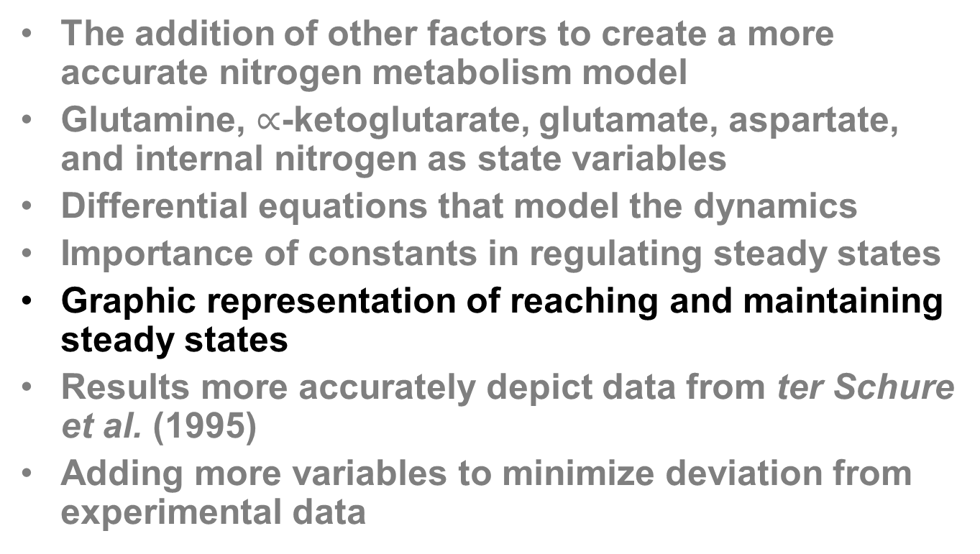
Outline
The addition of other factors to create a more accurate nitrogen metabolism model
Glutamine, $∝$-ketoglutarate, glutamate, aspartate, and internal nitrogen as state variables
Differential equations that model the dynamics
Importance of constants in regulating steady states
Graphic representation of reaching and maintaining steady states
Results more accurately depict data from ter Schure et al. (1995)
Adding more variables to minimize deviation from experimental data

Slide 13
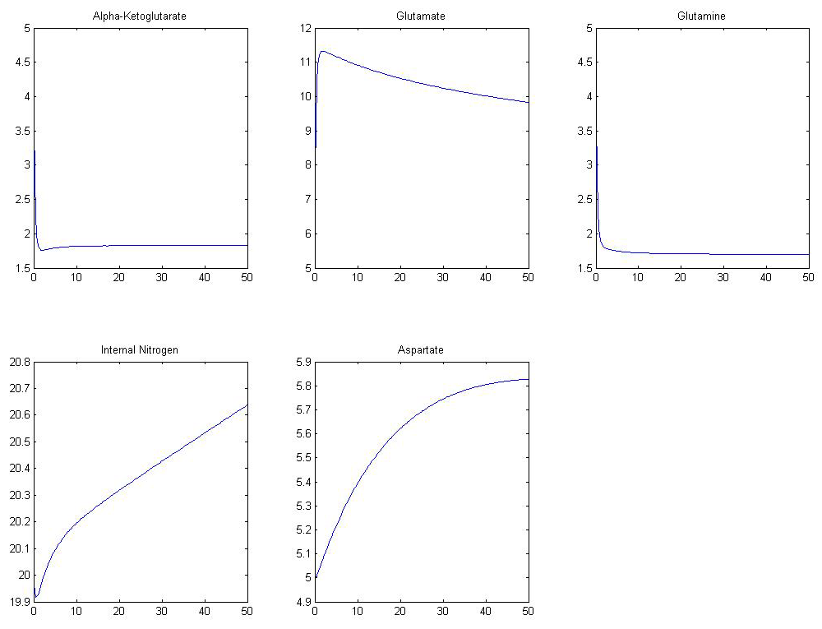
Model Reaching Steady State
Concentration
Concentration
Concentration
Time
Time
Time
Concentration
Concentration
Time
Time

Slide 14
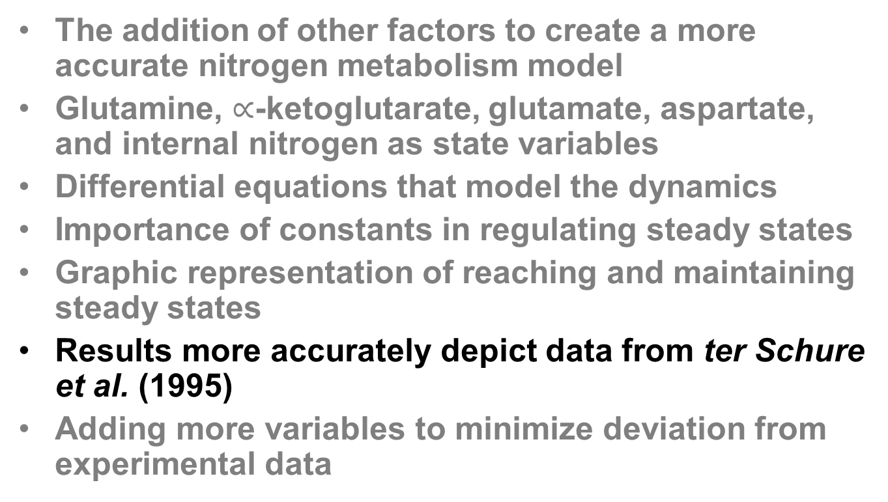
Outline
The addition of other factors to create a more accurate nitrogen metabolism model
Glutamine, $∝$-ketoglutarate, glutamate, aspartate, and internal nitrogen as state variables
Differential equations that model the dynamics
Importance of constants in regulating steady states
Graphic representation of reaching and maintaining steady states
Results more accurately depict data from ter Schure et al. (1995)
Adding more variables to minimize deviation from experimental data

Slide 15
Model vs. ter Schure et al.
Concentration
Concentration
Concentration
Time
Time
Time
ter Schure et al. (1995) J. Bacteriol. 177(22):6672

Slide 16
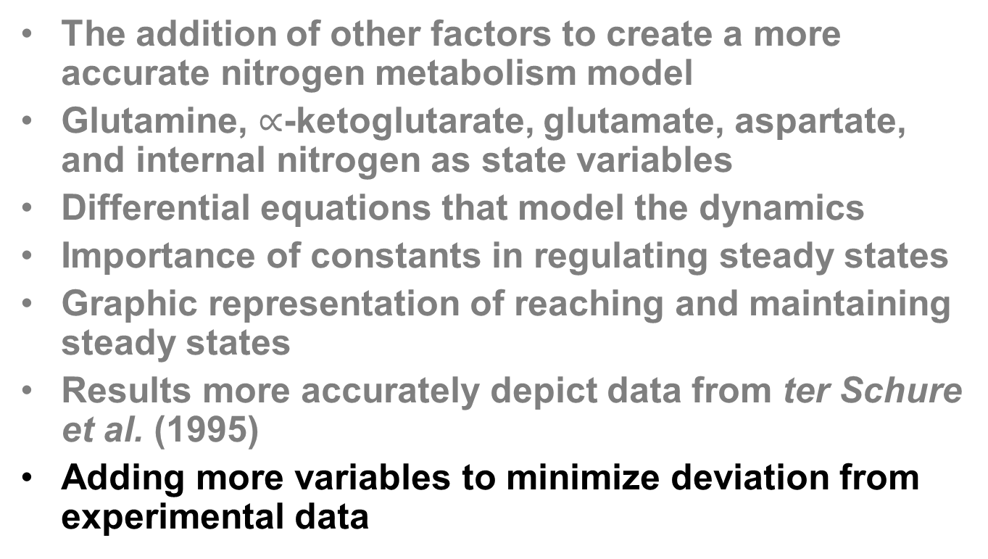
Outline
The addition of other factors to create a more accurate nitrogen metabolism model
Glutamine, $∝$-ketoglutarate, glutamate, aspartate, and internal nitrogen as state variables
Differential equations that model the dynamics
Importance of constants in regulating steady states
Graphic representation of reaching and maintaining steady states
Results more accurately depict data from ter Schure et al. (1995)
Adding more variables to minimize deviation from experimental data

Slide 17
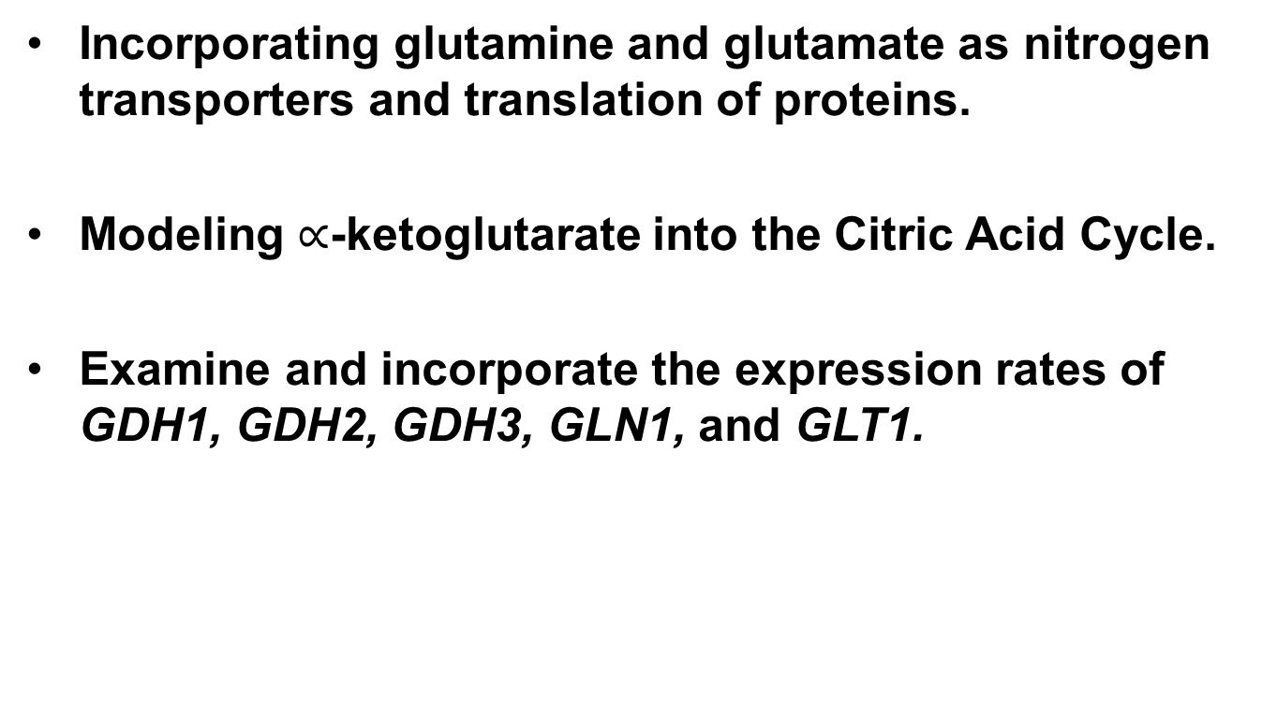
Further Experimentation
Incorporating glutamine and glutamate as nitrogen transporters and translation of proteins.
Modeling $∝$-ketoglutarate into the Citric Acid Cycle.
Examine and incorporate the expression rates of GDH1, GDH2, GDH3, GLN1, and GLT1.

Slide 18
Acknowledgements
A special thanks to Dr. Dahlquist for the biological background necessary to model this system and Dr. Fitzpatrick for his assistance in the logistics of modeling.

Slide 19
References
John, E. H. and Flynn, K. J. (2000) Modelling phosphate transport and assimilation in microalgae; how much complexity is warranted?. Ecol. Modelling, 125, 145–157.
Schilling, C. H., Schuster, S., Palsson, B. O. & Heinrich, R. Metabolic pathway analysis: basic concepts and scientific applications in the post-genomic era. Biotechnol. Prog. 15, 296–303 (199).
ter Schure, E.G., Sillje, H.H.W., Verkleij, A.J., Boonstra, J., and Verrips, C.T. (1995) Journal of Bacteriology 177: 6672-6675.

