Slide 1
Establishing Baseline Performance Scores for the CAGEN Robust Gene Response Challenge
Shaunak Sen
Caltech CDS
Dec 14, 2011

Slide 2
CAGEN - Critical Assessment of
Genetically Engineered Networks
Systematize the design of genetic networks
(address issues of robustness, connectability)
- Facilitate applications, for ex. in agriculture, medicine

Slide 3
CAGEN Challenge #1 : Robust Gene Response
Induce OUTPUT (YFP) in response to INPUT (IPTG), so that,
Detectable: >10 fold induction
Robust: Low variability across cells & temperatures
Fast: Quick response
Speed
>10 X₀
Low Variability
OUTPUT
YFP induction
1 X₀
Time
IPTG Addition
INPUT

Slide 4
Purpose
Establish Baseline Performance
Challenge Specifications
Purpose: Establish Baseline Performance Score
for Self Assessment
And Critical Assessment
ANNOUNCEMENT
Self Assessment by Participants
SELECTION
Critical Assessment of Selected Designs

Slide 5
Performance metric to score robustness and speed of designs
Time integral of square error
Worst Case
Small
Output
Normalizing factor
(equilibrium amplitude of reference trace)
Time
Input
j = 1, 2, 3, … 15
(at least 5 traces for 3 temperatures)
r(t) is a trace chosen as reference,
M is equilibrium amplitude of r(t),
T₁ is time when r(t) is 10% of M, and
T₂ is time after which r(t) stays within 10% of M.
X
P_{x}
x

Slide 6
Single cell dynamics are measured for a simple reference design, for different temperatures
P_{inducible}
YFP
E. coli
 | 30 °C | 32 °C | 34 °C
#1 | ? | ? | ?
#2 | ? | ? | ?
#1
P_{lac}
yfp
IPTG
#2
P_{lac}
cI-yfp
IPTG

Slide 7
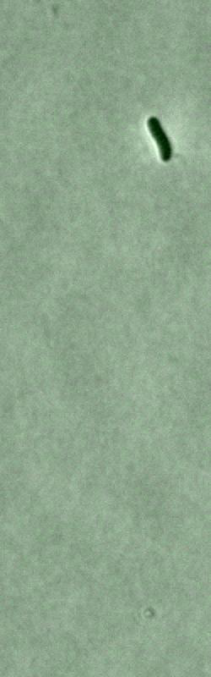
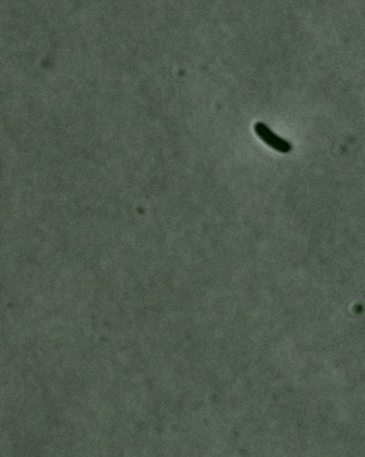
Movies
P_{inducible}
YFP

Slide 8
Reference trace exhibits > 10x induction
Cell division
Mean Fluorescence (a.u.)
10x induction
No induction
Camera Bgd.
Time (minutes)

Slide 9
Baseline Performance Score for Self Assessment
Performance scores for inducible protein expression circuits
S = 1.45
S = 1.22
#1
P_{lac}
Reference trace (32 °C)
Traces at 32 °C
Traces at 34 °C
Traces at 30 °C
#2
P_{lac}
Reference trace (34 °C)
Traces at 34 °C
Traces at 30 °C
yfp
cI-yfp
IPTG
IPTG
Mean Fluorescence (a.u.)
Mean Fluorescence (a.u.)
Time (minutes)
Time (minutes)

Slide 10
Critical assessment will be on a μfluidic platform allowing for controlled induction time
Simulation/
Eric Klavins
P_{inducible}
GFP
E. coli
 | 30 °C | 32 °C | 34 °C
 | ? | ? | ?
Benefit #1.
Exact induction time
measurement.
Benefit #2:
Similar decay time
measurement.
P_{lac}
gfp
IPTG

Slide 11
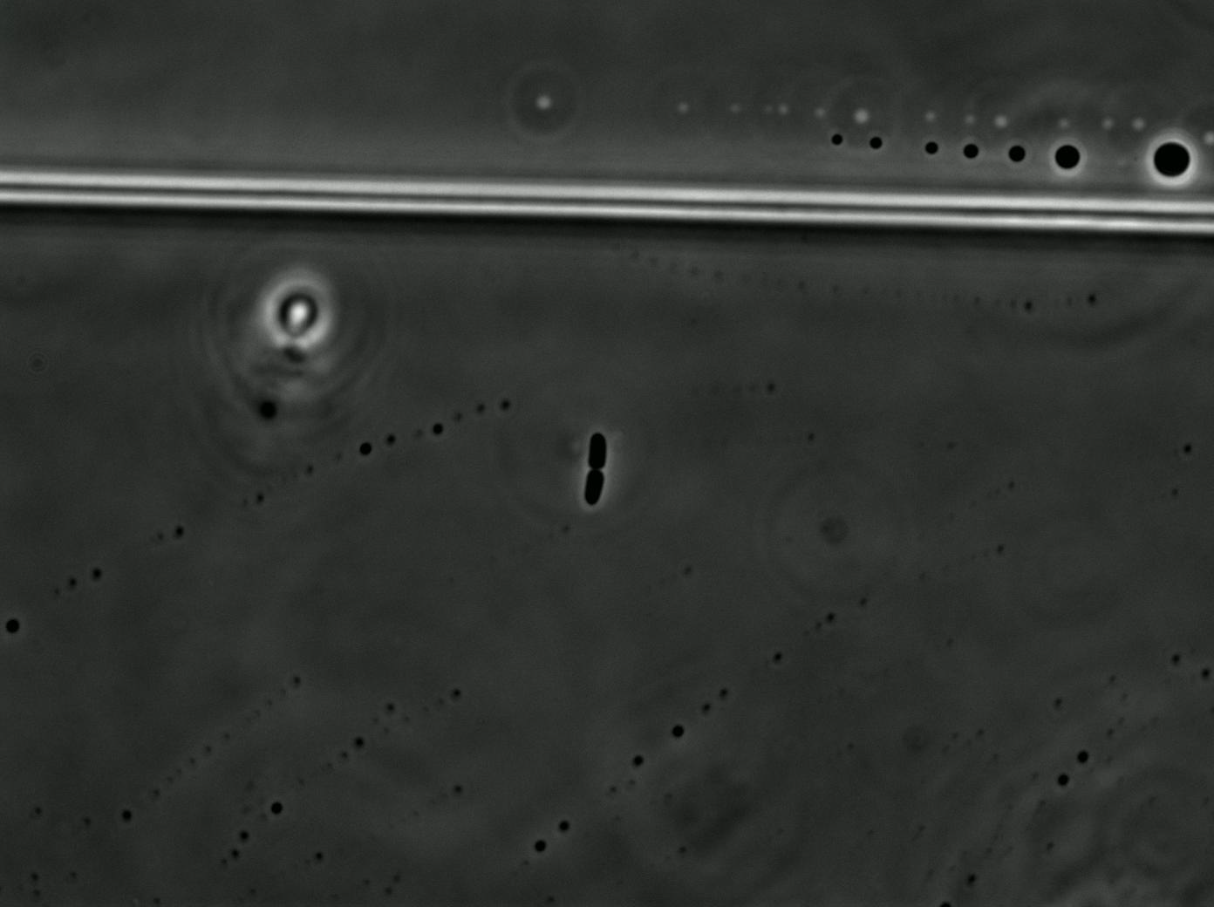
Movie
P_{lac}
GFP

Slide 12
Single-Cell Dynamics with Controlled Induction Time
S = 2.29

Slide 13
Population level metric to estimate performance score
Single-Cell Dynamics/ Microscopy
Population Dynamics/
Flow Cytometry
X
P_{x}
x

Slide 14
Future Work
Fast Linear Amplifier in 3 Steps
1. Fast Increase
2. Fast Decay
3. Linear Response
(this CAGEN Challenge)
Small
Small
Output
Output
Output
Time
Time
Input
Input
Input

