Slide 1
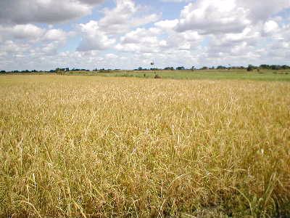
Past, Present and Future
of Agriculture
David LeBauer
COSMOS
6 July 2009
Notes:
1
After WW2, green revolution grew out of technological and industrial advances and has enabled the exponentially growing human population and economy. Paradox: lots of advance in the last 40 years allowed population to increase but where will it level off?

Slide 2
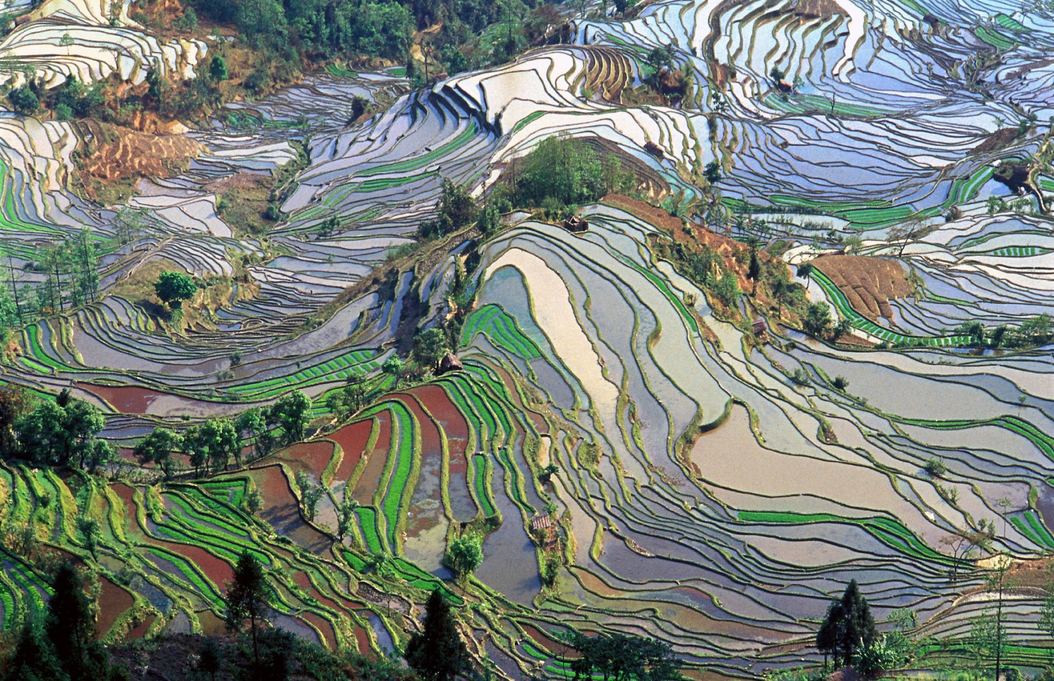
Part One: The Past
Notes:
This is an image of rice, one of the first crops cultivated in SE asia
Same today as in ancient times, except for the crop itself
2

Slide 3
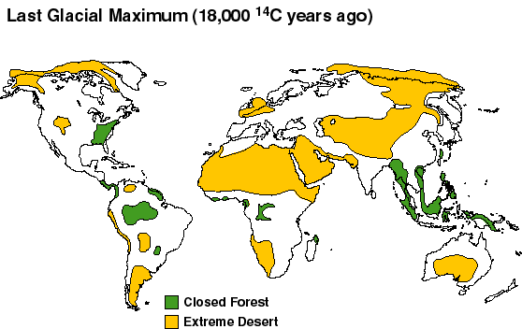

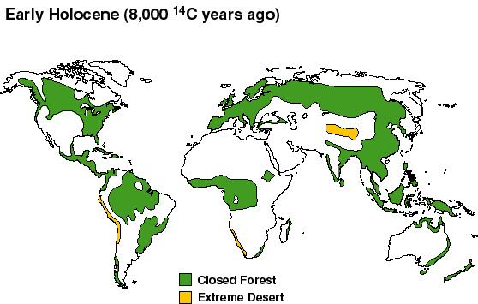

Climate change and
Origins of agriculture
18,000 y.a.
cold, dry ice age
8,000 y.a.
warm, wet interglacial
Closed Forest
Desert
Prehistoric Megafauna
Adams J.M. (1997). Global land environments since the last interglacial. Oak Ridge National Laboratory, TN, USA.
Notes:
Transition from hunter-gatherer to more sedentary
Associated with climate change hunter-gatherers had colonized the world by the end of the last ice age
killed off many large mammals
As the climate warmed, the populations that had spread out began to increase in size
Possibly younger-dryas (~13-11.5kya)

Slide 4
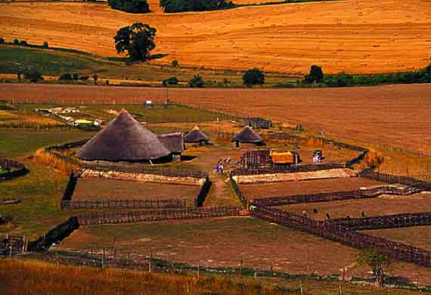
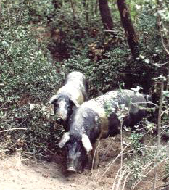
Early Farming Methods
Notes:
First was the Domestication of grains and some animals
Began independently in mesopotamia, china, america, subtropical africa, papua new guinea
europe and asia: domesticated wheat, barley, rice, in europe and asia
americas: only corn in
papua new guinea: only taro
When farming began,
human height avg. reduced from 5’10 avg to 5’1 avg, took 10ky to return to 5’10
more babies b/c people can only carry a single infant as a nomad, as nomad, need to wait 4 years
4

Slide 5
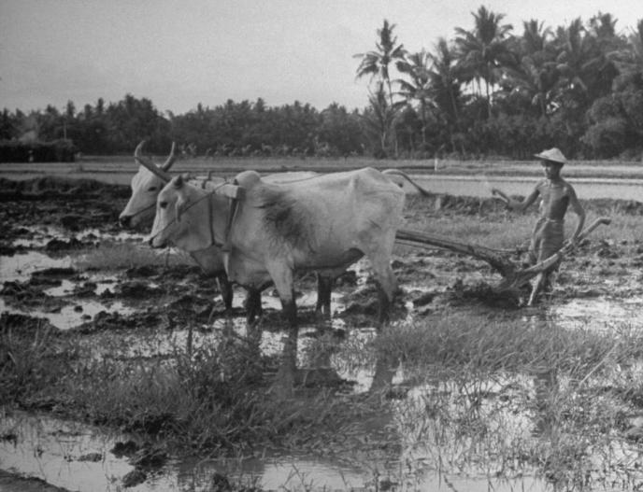
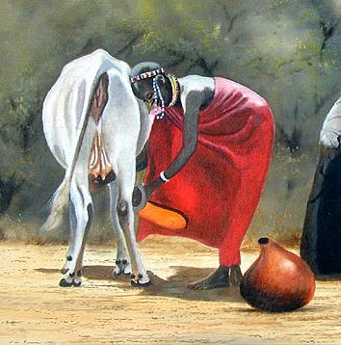
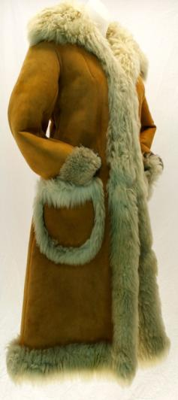
Animal
products
Milk
Labor
Wycliffe Ndwiga
Leather
Notes:
Later, secondary products from animals
12 of 14 domesticatable animals are from eurasia
leather(from no domesticated animals)
wool (from sheep, llamas, alpacas, and Angora goats)
manure for soil conditioning (from all domesticated animals)
milk (from goats, cattle, yaks, sheep, horses and camels)
labor (from oxen, onagers, donkeys, horses and camels)
Glue (from hooves and bones)
Plough: one of the major advances in ag
turn over the upper layer of the soil,
bring fresh nutrients to the surface bury weeds
aerates the soil
better soil moisiure retention

Slide 6
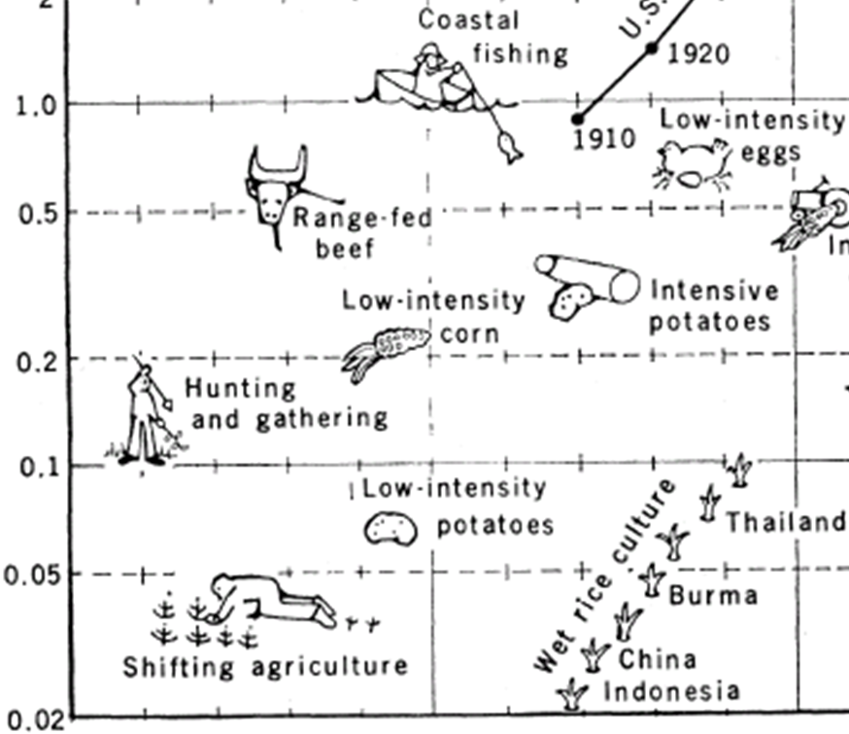
Economics of Early Agriculture
Calorie input / Calorie output
Animal Calories Required
Human Calories
Required
Notes:
I use the term economics in reference to the cost-benefit basis using calories as a unit of exchange
Early agriculture was limited to crops that required less caloric input than was received, to get a net benefit
6

Slide 7
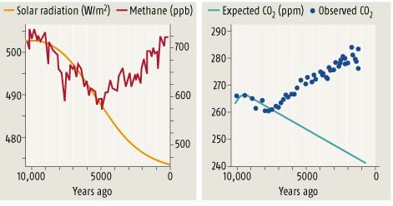

Global Effects of Early Agriculture
Rice Farming & Irrigation
Deforestation & Biomass Burning
Ruddiman, 2005
Notes:
Notably, agriculture employing irrigation, particularly wet-rice farming, started boosting methane levels around 5000 years ago. Deforestation and biomass burning started boosting CO₂ levels around 8000 year ago. Higher levels of these GHGs kept the Earth warm and prevented temperatures from falling to a threshold that would have triggered glaciation.
7

Slide 8
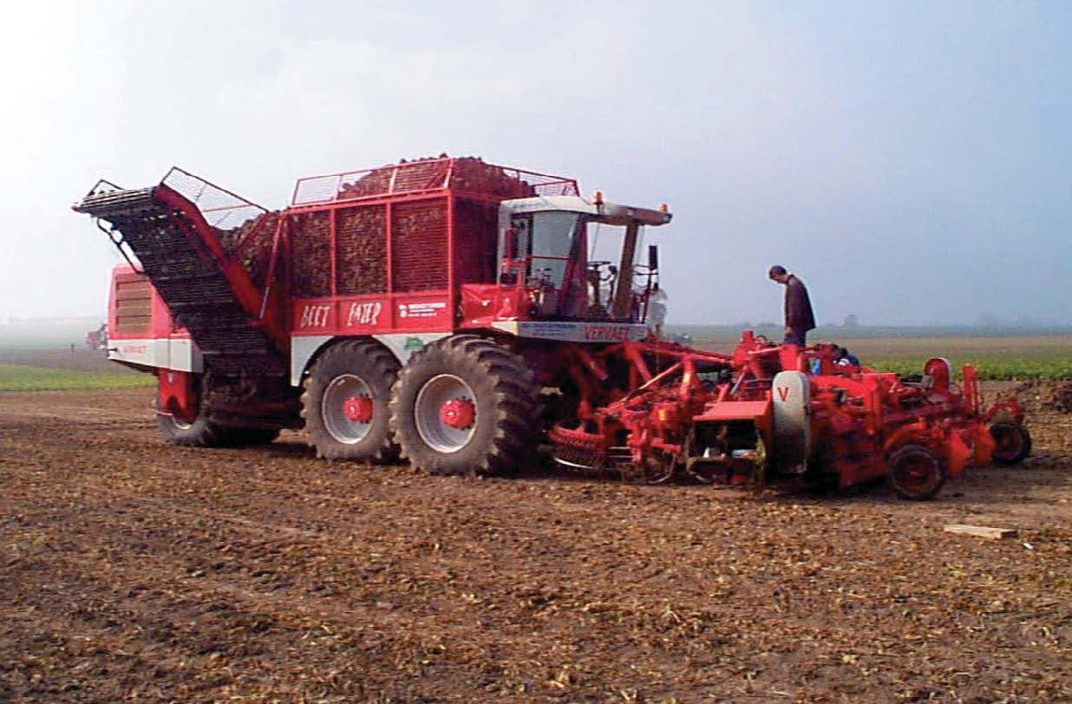
Part Two: The Present
Notes:
We now jump from prehistory to modern history
over the past century, farming has been scaled up following an industrial model intended to maximize financial profit
lots of new methods were developed, but WW2 provided the capacity to scale up agriculture as an industrial enterprise
8

Slide 9
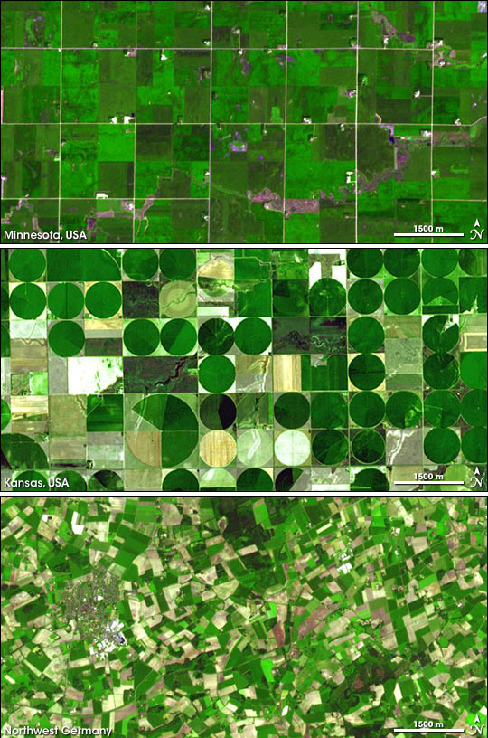
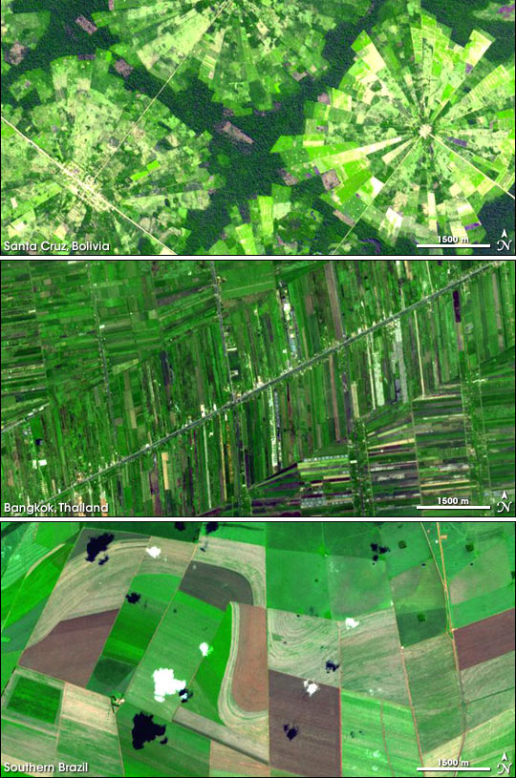
The Green
Revolution
(1945-?)
Part Three: The Future
Notes:
The green revolution
irrigation
fertilizer
improved crop varieties
pesticides / herbicides
9

Slide 10
Fossil Fuels support
Food Chain
Calorie input / Calorie output
-Tillage
-Pesticides
-Herbicides
-Fertilizers
-Harvest
-Distribution
Notes:
10

Slide 11
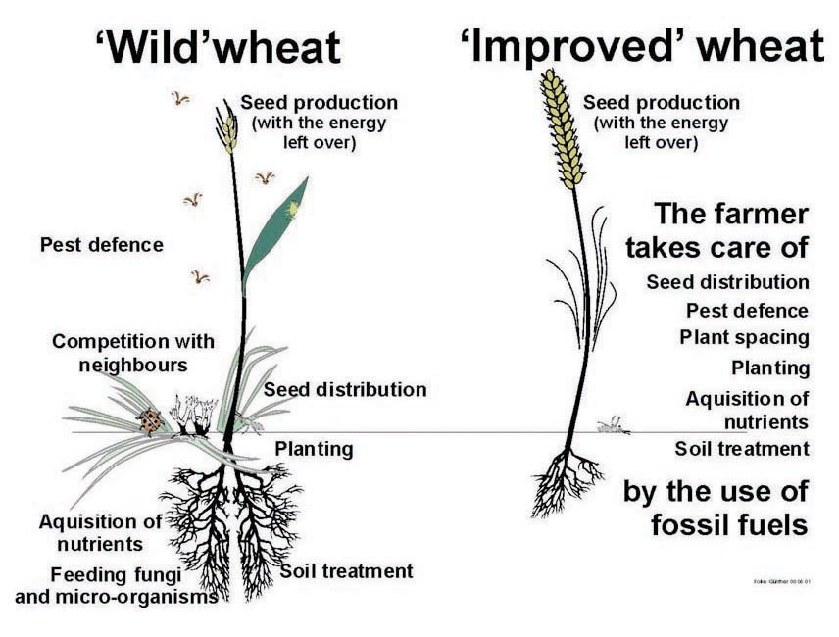
Crop “Adaptaptations”
Notes:
Plant breeding has been a major component of
11

Slide 12
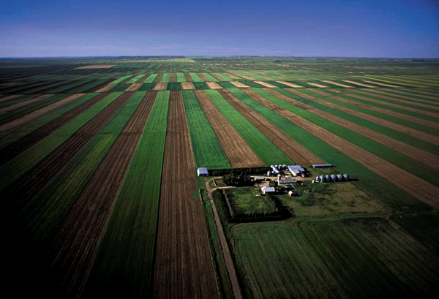
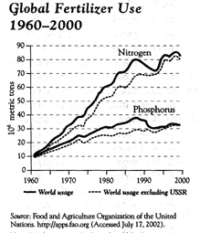
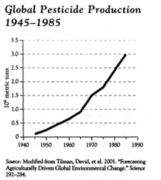
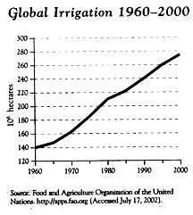
Notes:
12

Slide 13
Negative Aspects of
Modern Agriculture
- Energy intensive
- Degradation and loss of soils
- Environmental pollution
- Poison in the food chain
- Vertically integrated business
- Monocultures susceptible to disease
Notes:
13

Slide 14
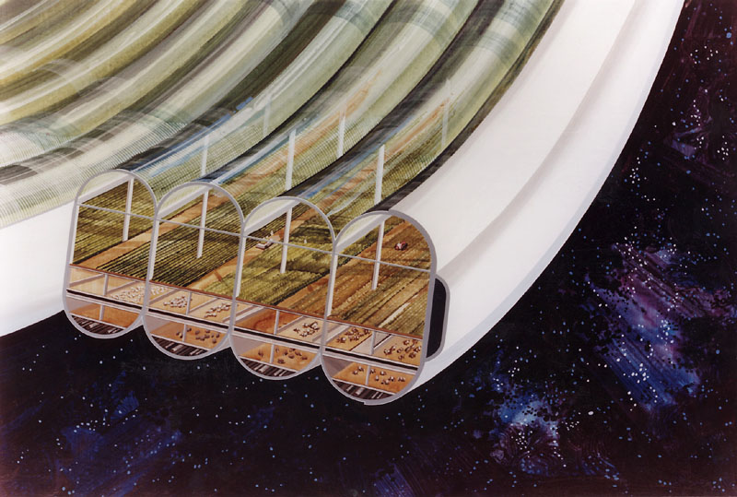
Part Three: The Future
Notes:
The reason that I take a particular interest in agriculture is all of the potential to use science to improve these systems
As we will see, the possibilities are endless
14

Slide 15
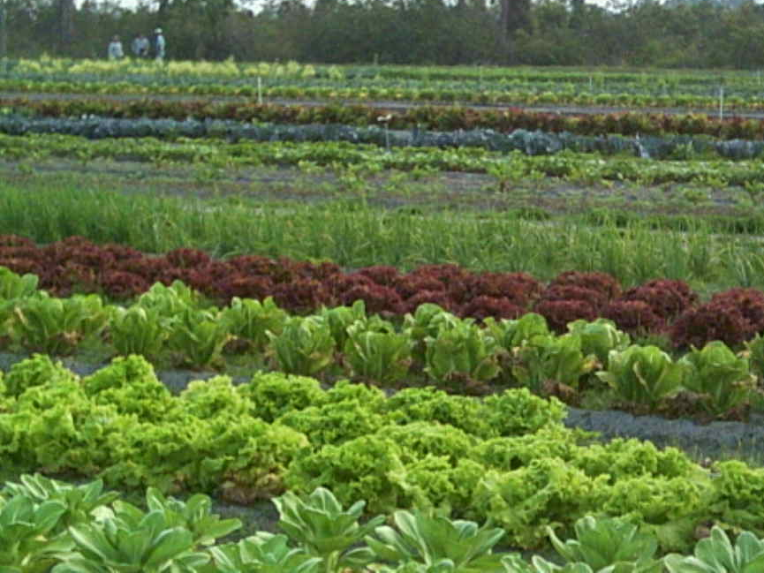
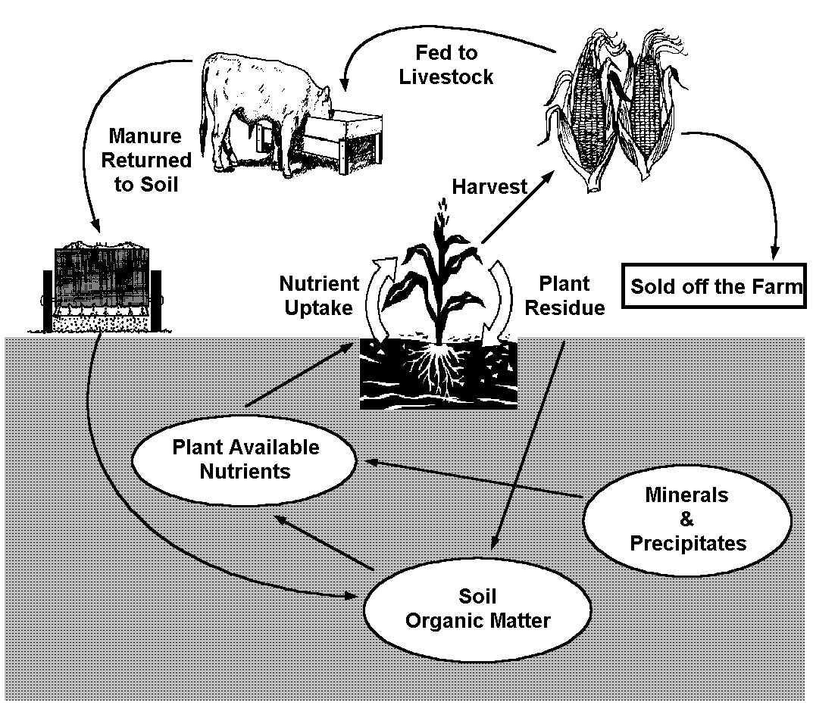
Sustainable Agriculture
Biodiversity
Preservation of natural resources
Integration of biological cycles
Notes:
15

Slide 16
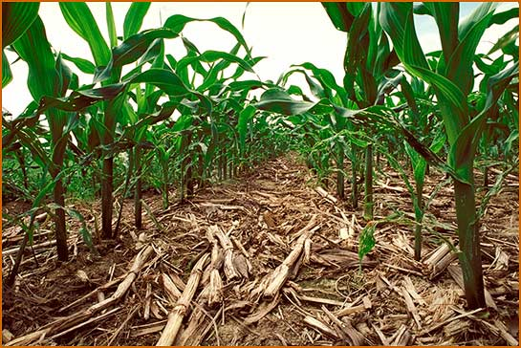
No-till Farming
Notes:
Retains carbon for soil, promotes soil microflora/fauna
But, requires special equipment, can allow pathogens to persist.
16

Slide 17
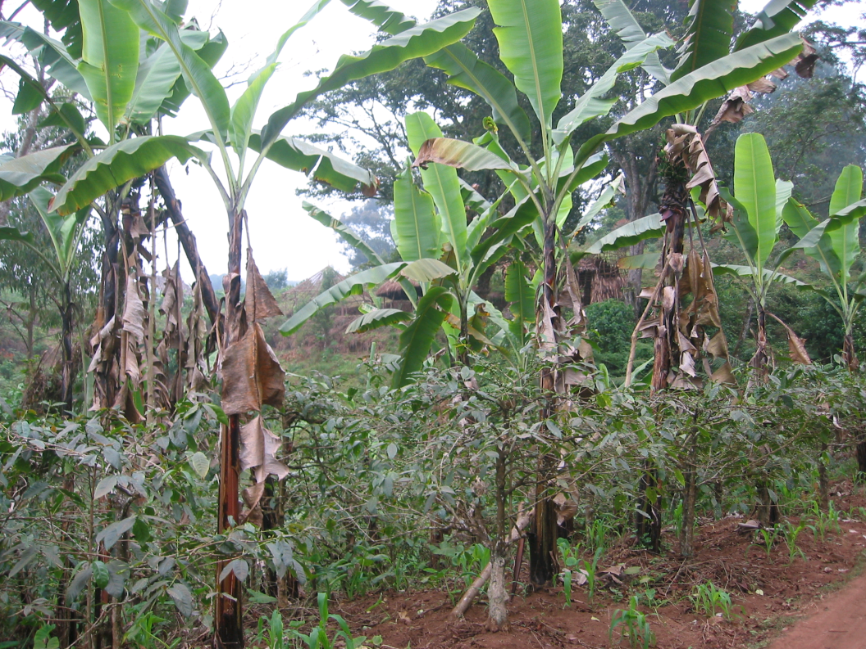

Intercropping
Banana and shade grown Coffee
Notes:
17
Emphasizes biodiversity

Slide 18
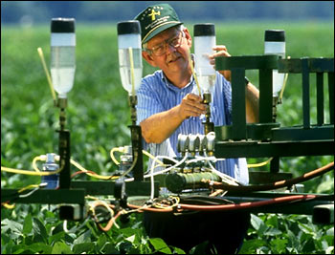
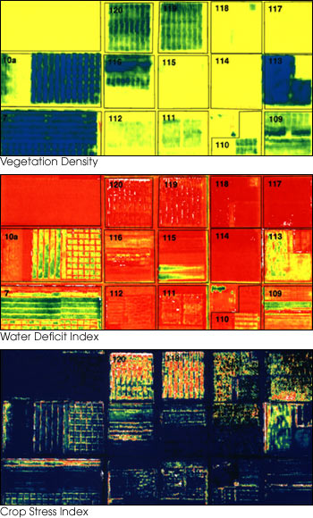
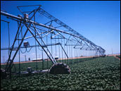
Precision Farming
GPS equipped tractors combined with satellite and direct real time imagery
  Apply pesticides, fertilizers, irrigation where needed
  Use same ruts each year
Photos from NASA earth observatory
Notes:
18

Slide 19
Genetically Modified Organisms
thus far used to induce insect resistance
Also some nutritional enhancement
Pharming
Could be used to improve crop sustainability.
Notes:
Mostly for insect resistance
Can also improve nutrition
Terminator seeds
Genes move into non-GMO crops, into wild relatives

Slide 20
Biofuels
Current
  Ethanol
  Biodiesel
2nd gen:
  Non-food crop celulosic EtOH
3rd gen:
  Algae

Slide 21
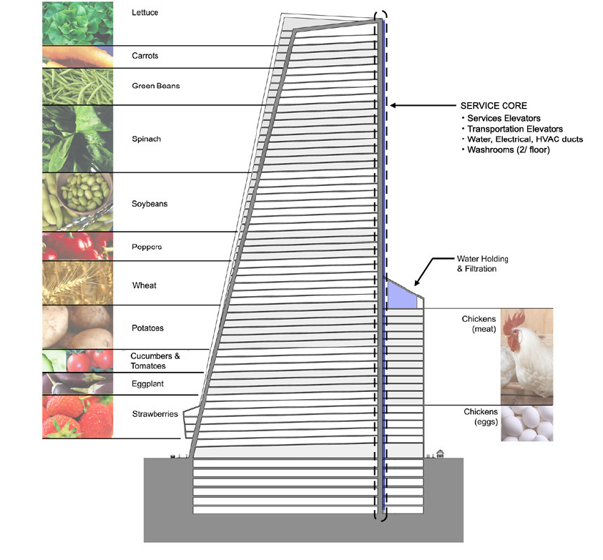
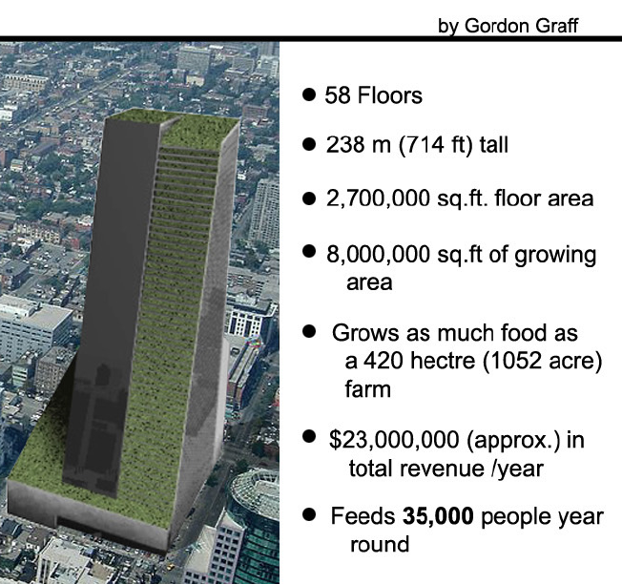
Vertical Farming
Notes:
Year round
Urban source and sink
Fewer crop failures (weather, pests)
1acre >4-6 outdoor acres
No runoff
Restore rural farmland
21

Slide 22
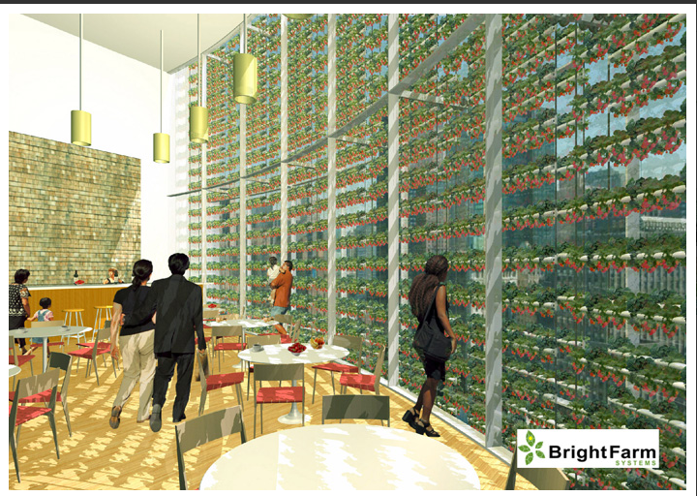
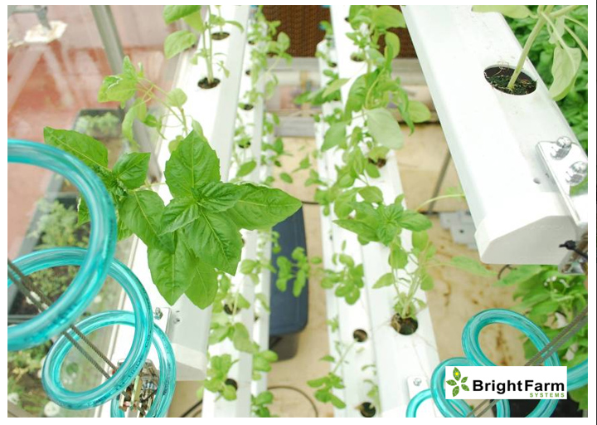
Notes:
This is what a vertical farm integrated into an office / living space could look like

Slide 23
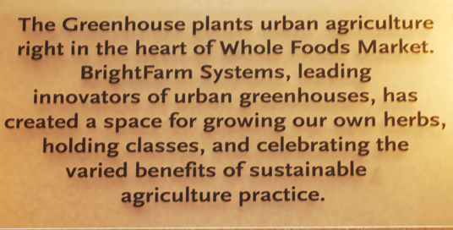
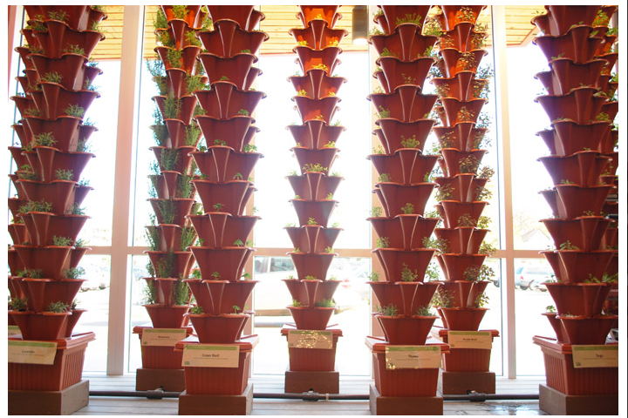
Notes:
Not that far off – this is a picture of a Whole Foods market in New Jersey

Slide 24
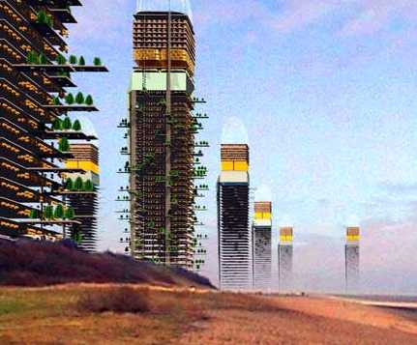
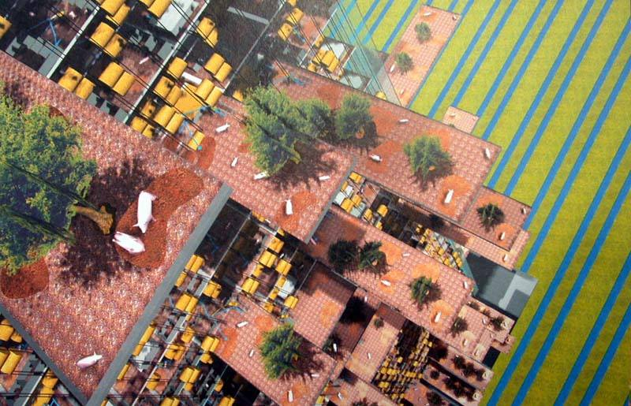
Pig City
-Fish, acorn feed grown on roof
-Methane generator
-Wastewater recycling
Notes:
24

Slide 25
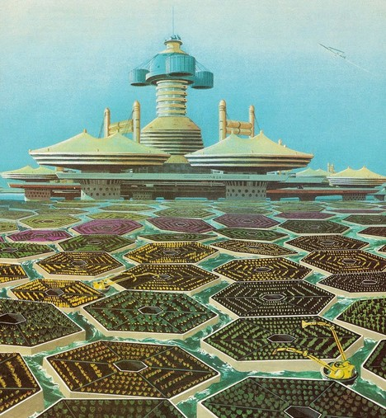
Notes:
1960’s vision by Walt Disney: Ocean farming.
Water evaporates under rafts and irrigates the crops. Walt disney

Slide 26
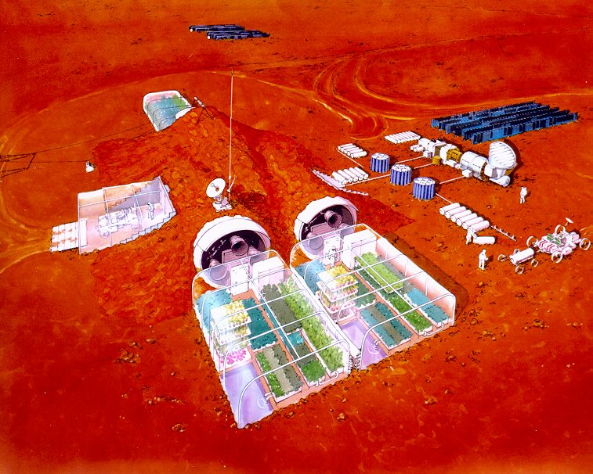
Mastering a closed system:
Mars colonies and beyond
Notes:
26

Slide 27
The End
Notes:
27

