Slide 1
Final Biology Group Presentation
December 9-11, 2009
Biophysics 101
Anugraha Raman, Jacqueline Nkuebe and Ridhi Tariyal

Slide 2
LIT
MODEL
Trait-o-matic
Phenotype

Slide 3
GWAS Data Proposal to the Rotterdam Management Team
MODEL
Correspondence with various scientists to begin to create a sane model for gene-gene interactions
Creation of Test Data with the Modeling Team
Hypothesis-building tool
Phenotype
SNP query tool

Slide 4
Overview
Recap from Eye Color Presentation of 11/24
Thinking of How Everything Fits Together:
  Thought-projects realized by the Infrastructure Team
  Working with the Modeling Group
  Dataset Creation
Future Directions

Slide 5
Just a recap from last time….

Slide 6
WHO?
Target Consumer:
  High school student with mathematical skills, discretionary time and a keen sense of curiosity
  OR
  Biologists with very specific, high end needs
  OR
  Experimental geneticists
  OR
  Clinical geneticists

Slide 7
Let’s think about how everything fits together…

Slide 8
Goal 1
To make edit/add features to Trait-o-Matic based on our bio-stream research
  Research Friendly
  Increased Utility

Slide 9
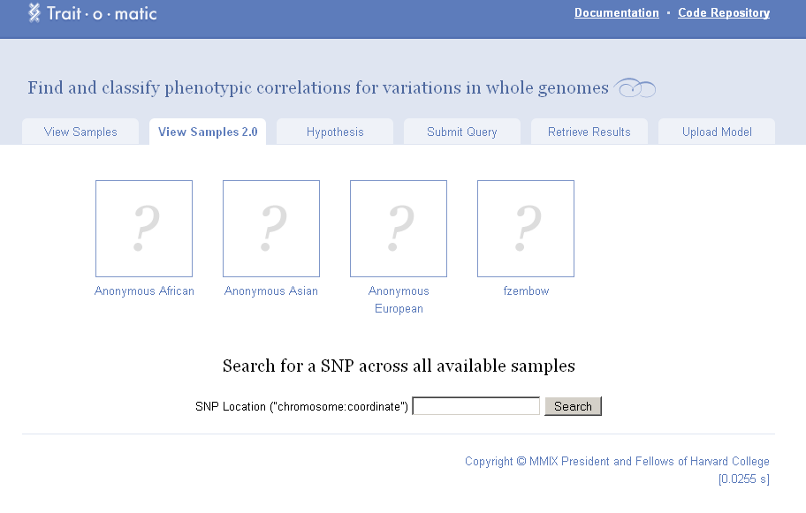
Querying for SNPs by Chromosomal Location
“We realized that it would be helpful to be able to type in a particular SNP location and get a listing of all of the genotypes for that location for everyone in the Trait-o-matic database…”

Slide 10
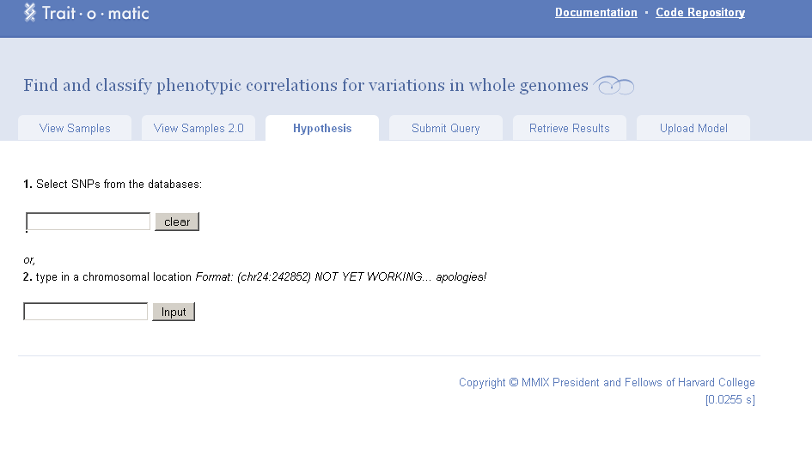
SNP specific Data by Allele/Trait

Slide 11
Goal 2
Provide test case details: We decided that thinking about LD (linkage-disequilibrium) in a math model was ultimately unnecessary…
  Complicate problem too much
  This can be a future direction once basic models are in place

Slide 12
Where do we find this new dataset?

Slide 13
The Process
Rotterdam Study Correspondence (and others) (Dr. Liu)—Wrote a proposal to the Management Team
Dataset Creation (“Toy” Story)
Discussion with the Math Modeling Group about an ideal dataset
HapMap data? (HaploView)

Slide 14
Literature Search Yielded…
~34 Eye-Color SNPs

Slide 15
Combining Biological and Modeling Group Requirements
1. Read a CSV(i.e. spreadsheet on excel) file of SNP/phenotype data and process it into python (it is general enough to deal with arbitrarily many SNPs and multiple phenotypes so long as they are ordinal (ie. as long as there are phenotypes we can call 0, 1, ...)).
2. Process these arrays into conditional probabilities.
3. Take logits of probabilities, make an array of these logits where each genotype maps to its corresponding probabilities.
4. Link into a scipy ols package, and perform a regression
5. Take in a new genotype and provide the predicted phenotype (probably using PGP 10 genotype inputs)

Slide 16
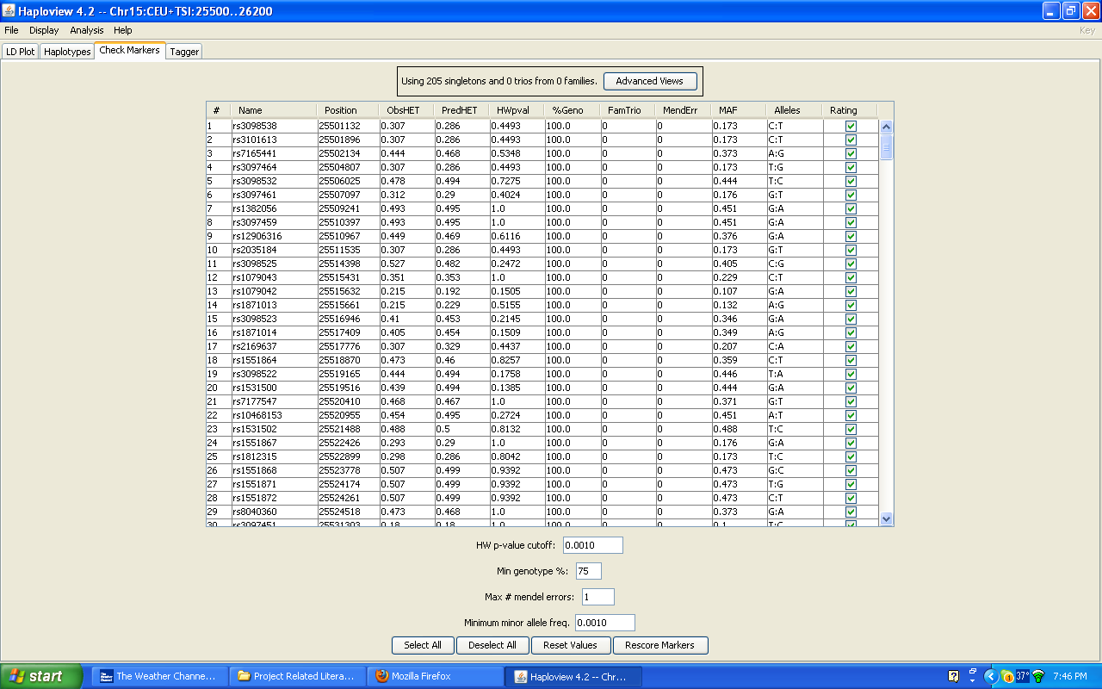
Enter HapMap

Slide 17
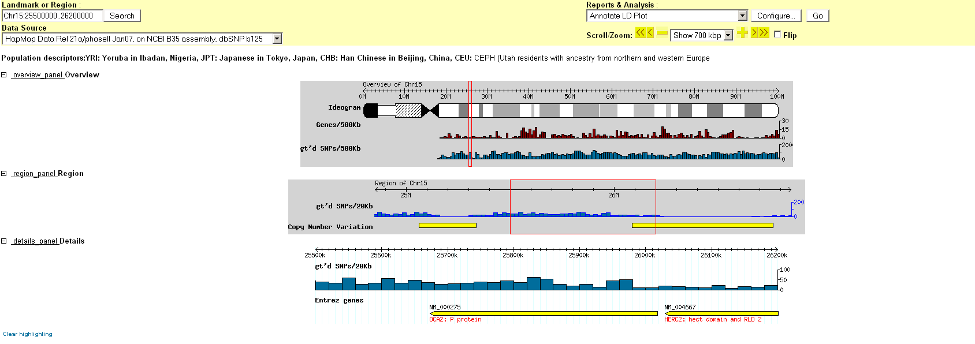
Chromosome 15 (Eye Color Specific Region)

Slide 18
What’s missing?
Corresponding phenotypic data…

Slide 19
Data-Set Creation

Slide 20
 | 1 |  | 2 |  | 3 |  | 4 |  | 5 |  | 6 |  | 7 |  | 8 |  | 9 |  | 10 |  | 11 |  | 12 |  | Rule 1 | Phenotype 1 | Rule 2 | Phenotype 2
 | AT | TT | CG | GG | CG | GG | CG | GG | AT | TT | AT | TT | AT | TT | CG | GG | CG | GG | CG | GG | AT | TT | AT | TT
1 | 0 | 1 | 1 | 0 | 1 | 1 | 1 | 1 | 0 | 0 | 1 | 1 | 1 | 0 | 1 | 1 | 0 | 1 | 0 | 1 | 1 | 0 | 0 | 1 | 6 | intermediate | 2.17 | blue
2 | 1 | 1 | 0 | 1 | 0 | 1 | 0 | 1 | 1 | 0 | 0 | 1 | 0 | 0 | 0 | 0 | 0 | 1 | 1 | 1 | 1 | 0 | 1 | 0 | 15 | brown | 1.5 | blue
3 | 0 | 1 | 0 | 1 | 0 | 1 | 1 | 0 | 1 | 0 | 0 | 0 | 1 | 1 | 1 | 0 | 1 | 0 | 1 | 0 | 1 | 1 | 1 | 1 | 15 | brown | 9.4 | intermediate
4 | 0 | 1 | 0 | 0 | 0 | 1 | 1 | 1 | 1 | 0 | 0 | 1 | 1 | 0 | 0 | 1 | 1 | 1 | 1 | 0 | 0 | 0 | 1 | 0 | 15 | brown | 5.5 | intermediate
5 | 1 | 0 | 1 | 0 | 1 | 0 | 1 | 1 | 1 | 0 | 1 | 1 | 0 | 0 | 1 | 1 | 1 | 0 | 1 | 0 | 1 | 1 | 0 | 0 | 15 | brown | 6.57 | intermediate
6 | 0 | 0 | 1 | 1 | 1 | 0 | 0 | 1 | 1 | 1 | 1 | 1 | 0 | 0 | 1 | 0 | 0 | 0 | 0 | 0 | 0 | 1 | 1 | 1 | 3 | blue | 2.57 | blue
7 | 0 | 0 | 0 | 1 | 1 | 1 | 1 | 0 | 1 | 1 | 1 | 1 | 1 | 1 | 1 | 0 | 0 | 0 | 1 | 0 | 1 | 1 | 1 | 1 | 17 | brown | 5.4 | intermediate
8 | 1 | 0 | 0 | 1 | 0 | 1 | 1 | 1 | 1 | 0 | 1 | 0 | 0 | 1 | 1 | 0 | 0 | 1 | 1 | 0 | 0 | 0 | 0 | 0 | 17 | brown | 6.5 | intermediate
9 | 1 | 1 | 0 | 0 | 1 | 0 | 0 | 1 | 0 | 1 | 0 | 0 | 1 | 0 | 1 | 1 | 1 | 0 | 1 | 1 | 1 | 0 | 1 | 0 | 13 | brown | 5.5 | intermediate
10 | 0 | 0 | 1 | 0 | 1 | 0 | 1 | 0 | 0 | 1 | 1 | 1 | 1 | 1 | 1 | 1 | 1 | 0 | 0 | 1 | 1 | 0 | 0 | 0 | 3 | blue | 9.67 | intermediate
11 | 0 | 1 | 1 | 0 | 0 | 1 | 1 | 0 | 0 | 0 | 1 | 0 | 1 | 0 | 1 | 0 | 1 | 0 | 1 | 0 | 0 | 0 | 0 | 0 | 18 | brown | 4.67 | blue
12 | 1 | 0 | 1 | 1 | 0 | 0 | 0 | 0 | 1 | 1 | 1 | 0 | 0 | 0 | 1 | 0 | 0 | 0 | 0 | 1 | 0 | 0 | 1 | 0 | 3 | blue | 0.67 | blue
13 | 0 | 1 | 1 | 0 | 0 | 0 | 0 | 1 | 1 | 1 | 0 | 1 | 1 | 0 | 1 | 1 | 0 | 1 | 0 | 0 | 0 | 1 | 0 | 1 | 1 | blue | 2.57 | blue
14 | 1 | 1 | 1 | 0 | 0 | 1 | 0 | 0 | 1 | 1 | 1 | 0 | 1 | 0 | 1 | 0 | 1 | 0 | 0 | 0 | 1 | 1 | 0 | 0 | 6 | intermediate | 5.07 | intermediate
15 | 0 | 1 | 1 | 1 | 1 | 1 | 0 | 1 | 1 | 1 | 1 | 0 | 0 | 1 | 1 | 1 | 0 | 1 | 1 | 1 | 1 | 0 | 1 | 1 | 18 | brown | 7.17 | intermediate
16 | 0 | 1 | 0 | 0 | 0 | 1 | 1 | 0 | 1 | 0 | 1 | 0 | 0 | 1 | 0 | 0 | 0 | 1 | 0 | 0 | 1 | 1 | 0 | 0 | 6 | intermediate | 5.4 | intermediate
17 | 1 | 0 | 1 | 1 | 0 | 0 | 0 | 1 | 0 | 1 | 0 | 0 | 0 | 0 | 0 | 0 | 1 | 0 | 0 | 0 | 1 | 1 | 1 | 1 | 0 | blue | 6.57 | intermediate
18 | 1 | 0 | 0 | 0 | 1 | 1 | 0 | 1 | 0 | 1 | 1 | 0 | 0 | 0 | 1 | 1 | 0 | 0 | 0 | 1 | 0 | 1 | 1 | 0 | 5 | intermediate | 1.9 | blue
19 | 1 | 1 | 1 | 0 | 1 | 1 | 0 | 1 | 1 | 0 | 1 | 0 | 1 | 0 | 1 | 0 | 1 | 1 | 1 | 1 | 1 | 1 | 0 | 1 | 18 | brown | 6.57 | intermediate
20 | 0 | 1 | 0 | 0 | 0 | 1 | 0 | 0 | 0 | 1 | 0 | 0 | 1 | 0 | 0 | 1 | 1 | 1 | 0 | 1 | 0 | 0 | 0 | 0 | 3 | blue | 4 | blue
21 | 0 | 1 | 1 | 0 | 1 | 0 | 1 | 0 | 0 | 0 | 1 | 1 | 0 | 1 | 1 | 0 | 0 | 0 | 1 | 0 | 0 | 0 | 0 | 0 | 16 | brown | 5.67 | intermediate
22 | 1 | 0 | 0 | 0 | 1 | 0 | 1 | 0 | 0 | 1 | 1 | 1 | 1 | 1 | 1 | 0 | 0 | 1 | 1 | 0 | 1 | 1 | 0 | 1 | 15 | brown | 5.4 | intermediate
23 | 0 | 0 | 1 | 1 | 0 | 0 | 0 | 1 | 1 | 1 | 1 | 1 | 0 | 0 | 1 | 0 | 0 | 1 | 0 | 1 | 0 | 0 | 0 | 0 | 3 | blue | 2.17 | blue
24 | 1 | 0 | 0 | 0 | 1 | 1 | 0 | 0 | 0 | 0 | 1 | 0 | 1 | 0 | 0 | 0 | 1 | 1 | 0 | 0 | 1 | 1 | 0 | 0 | 5 | intermediate | 4.4 | blue
25 | 0 | 1 | 1 | 1 | 0 | 0 | 1 | 1 | 0 | 0 | 1 | 1 | 1 | 1 | 1 | 0 | 0 | 1 | 0 | 1 | 1 | 0 | 1 | 0 | 4 | blue | 7.17 | intermediate
Phenotypic Ranges:
(0-4)= Blue
(5-12)= Intermediate
(13-19)= Brown
 | 1 |  | 2 |  | 3 |  | 4 |  | 5 |  | 6 |  | 7 |  | 8 |  | 9 |  | 10 |  | 11 |  | 12 |  | Rule 1 | Phenotype 1 | Rule 2 | Phenotype 2
 | AT | TT | CG | GG | CG | GG | CG | GG | AT | TT | AT | TT | AT | TT | CG | GG | CG | GG | CG | GG | AT | TT | AT | TT
1 | 1 | 1 | 0 | 0 | 0 | 0 | 1 | 0 | 1 | 0 | 1 | 0 | 1 | 0 | 1 | 0 | 1 | 1 | 0 | 0 | 1 | 1 | 1 | 0 | 4 | blue | 4.4 | blue
2 | 1 | 0 | 0 | 1 | 1 | 0 | 0 | 0 | 1 | 1 | 1 | 1 | 0 | 0 | 1 | 0 | 0 | 1 | 0 | 1 | 1 | 0 | 1 | 0 | 3 | blue | 0 | blue
3 | 1 | 0 | 0 | 0 | 0 | 1 | 1 | 0 | 1 | 0 | 1 | 0 | 0 | 1 | 0 | 1 | 1 | 1 | 0 | 1 | 1 | 0 | 1 | 1 | 5 | intermediate | 9 | intermediate
4 | 1 | 1 | 1 | 1 | 0 | 1 | 0 | 0 | 1 | 1 | 1 | 0 | 1 | 1 | 1 | 1 | 1 | 0 | 0 | 0 | 1 | 0 | 1 | 0 | 6 | intermediate | 9.67 | intermediate
5 | 0 | 1 | 0 | 0 | 0 | 0 | 1 | 1 | 1 | 1 | 1 | 0 | 1 | 1 | 0 | 0 | 0 | 1 | 0 | 0 | 0 | 0 | 1 | 1 | 4 | blue | 6.5 | intermediate
6 | 1 | 1 | 0 | 0 | 0 | 0 | 1 | 1 | 0 | 0 | 0 | 1 | 0 | 0 | 1 | 0 | 1 | 0 | 0 | 0 | 0 | 1 | 0 | 1 | 1 | blue | 5.9 | intermediate
7 | 0 | 0 | 1 | 0 | 0 | 1 | 0 | 1 | 1 | 1 | 1 | 0 | 0 | 0 | 1 | 0 | 0 | 0 | 0 | 1 | 1 | 0 | 0 | 1 | 5 | intermediate | 2.17 | blue
8 | 0 | 1 | 1 | 0 | 0 | 1 | 0 | 1 | 1 | 1 | 0 | 0 | 1 | 0 | 0 | 0 | 1 | 1 | 1 | 0 | 0 | 0 | 0 | 1 | 15 | brown | 6.17 | intermediate
9 | 1 | 1 | 0 | 1 | 1 | 1 | 0 | 1 | 0 | 1 | 0 | 1 | 0 | 0 | 0 | 1 | 1 | 0 | 0 | 0 | 0 | 1 | 1 | 0 | 3 | blue | 5.9 | intermediate
10 | 1 | 0 | 0 | 0 | 0 | 1 | 0 | 1 | 0 | 0 | 1 | 0 | 0 | 0 | 0 | 1 | 1 | 0 | 1 | 0 | 0 | 0 | 1 | 1 | 17 | brown | 5.5 | intermediate
11 | 0 | 0 | 0 | 1 | 1 | 1 | 0 | 1 | 1 | 0 | 1 | 1 | 1 | 1 | 1 | 0 | 0 | 1 | 1 | 1 | 0 | 1 | 0 | 0 | 17 | brown | 6.9 | intermediate
12 | 0 | 1 | 1 | 0 | 0 | 0 | 1 | 1 | 0 | 1 | 1 | 0 | 1 | 0 | 1 | 1 | 1 | 1 | 0 | 1 | 0 | 0 | 1 | 1 | 4 | blue | 6.17 | intermediate
13 | 0 | 0 | 1 | 1 | 1 | 1 | 1 | 1 | 1 | 1 | 1 | 0 | 1 | 0 | 0 | 0 | 0 | 1 | 1 | 1 | 1 | 1 | 0 | 0 | 17 | brown | 2.57 | blue
14 | 1 | 0 | 1 | 0 | 1 | 1 | 1 | 0 | 0 | 0 | 1 | 1 | 1 | 1 | 1 | 0 | 1 | 0 | 0 | 1 | 1 | 1 | 0 | 0 | 5 | intermediate | 10.07 | intermediate
15 | 1 | 1 | 0 | 1 | 0 | 1 | 1 | 1 | 0 | 0 | 1 | 0 | 1 | 1 | 0 | 1 | 0 | 1 | 0 | 1 | 1 | 0 | 1 | 0 | 6 | intermediate | 6.5 | intermediate
16 | 0 | 1 | 1 | 1 | 1 | 1 | 1 | 1 | 1 | 0 | 1 | 1 | 0 | 1 | 0 | 1 | 0 | 1 | 0 | 1 | 0 | 1 | 1 | 1 | 6 | intermediate | 7.57 | intermediate
17 | 1 | 1 | 0 | 0 | 1 | 1 | 1 | 0 | 1 | 1 | 1 | 0 | 1 | 0 | 0 | 0 | 0 | 0 | 0 | 0 | 0 | 0 | 0 | 0 | 6 | intermediate | 0 | blue
18 | 1 | 0 | 0 | 1 | 1 | 0 | 0 | 1 | 0 | 1 | 0 | 0 | 1 | 1 | 1 | 0 | 1 | 0 | 0 | 1 | 0 | 1 | 0 | 0 | 0 | blue | 10.9 | intermediate
19 | 1 | 0 | 0 | 0 | 0 | 0 | 1 | 0 | 0 | 0 | 1 | 0 | 1 | 1 | 1 | 1 | 0 | 0 | 0 | 0 | 1 | 1 | 1 | 0 | 3 | blue | 5.4 | intermediate
20 | 0 | 1 | 1 | 1 | 1 | 0 | 1 | 1 | 0 | 1 | 1 | 1 | 0 | 1 | 0 | 1 | 0 | 1 | 1 | 0 | 1 | 1 | 1 | 0 | 16 | brown | 7.57 | intermediate
21 | 0 | 0 | 0 | 1 | 0 | 0 | 0 | 0 | 0 | 0 | 1 | 1 | 0 | 1 | 1 | 0 | 0 | 0 | 1 | 1 | 0 | 1 | 0 | 1 | 15 | brown | 5.4 | intermediate
22 | 1 | 0 | 0 | 1 | 1 | 1 | 0 | 0 | 0 | 0 | 1 | 1 | 1 | 1 | 0 | 1 | 0 | 1 | 1 | 1 | 0 | 0 | 0 | 0 | 17 | brown | 5 | intermediate
23 | 1 | 0 | 1 | 0 | 1 | 1 | 0 | 0 | 0 | 1 | 1 | 1 | 1 | 1 | 1 | 0 | 0 | 1 | 0 | 1 | 0 | 0 | 1 | 1 | 5 | intermediate | 5.67 | intermediate
24 | 1 | 1 | 1 | 0 | 1 | 1 | 0 | 0 | 1 | 1 | 1 | 0 | 0 | 0 | 0 | 1 | 1 | 1 | 0 | 0 | 1 | 1 | 0 | 1 | 6 | intermediate | 5.07 | intermediate
25 | 1 | 0 | 1 | 0 | 0 | 1 | 0 | 1 | 1 | 1 | 1 | 0 | 1 | 1 | 1 | 0 | 0 | 1 | 0 | 1 | 0 | 0 | 1 | 1 | 5 | intermediate | 7.17 | intermediate
Rules:
(.5*homozygous recessive SNP1 + 2*homozygous recessive SNP3+ 3*heterozygous SNP6+ 12*heterozygous SNP10)
(.67*heterozygous SNP2+ 1.5*homozygous recessive SNP4+ 5*homozygous recessive SNP7+ 4*heterozygous SNP9+ .4*homozygous recessive SNP11)

Slide 21
 | 1 |  | 2 |  | 3 |  | 4 |  | 5 |  | 6 |  | 7 |  | 8 |  | 9 |  | 10 |  | 11 |  | 12 |  | Rule 1 | Phenotype 1 | Rule 2 | Phenotype 2
 | AT | TT | CG | GG | CG | GG | CG | GG | AT | TT | AT | TT | AT | TT | CG | GG | CG | GG | CG | GG | AT | TT | AT | TT
1 | 1 | 1 | 0 | 1 | 1 | 1 | 1 | 1 | 1 | 0 | 0 | 0 | 0 | 1 | 1 | 0 | 1 | 0 | 1 | 1 | 0 | 1 | 1 | 1 | 15 | brown | 10.9 | intermediate
2 | 1 | 1 | 0 | 0 | 1 | 0 | 0 | 1 | 0 | 1 | 0 | 1 | 0 | 0 | 1 | 0 | 1 | 1 | 0 | 1 | 0 | 1 | 1 | 1 | 1 | blue | 5.9 | intermediate
3 | 1 | 0 | 0 | 1 | 0 | 1 | 0 | 1 | 1 | 1 | 0 | 0 | 1 | 0 | 1 | 1 | 1 | 1 | 0 | 1 | 1 | 1 | 1 | 1 | 2 | blue | 5.9 | intermediate
4 | 1 | 1 | 0 | 1 | 1 | 1 | 1 | 1 | 0 | 1 | 0 | 0 | 1 | 1 | 1 | 0 | 1 | 1 | 0 | 0 | 1 | 1 | 1 | 1 | 3 | blue | 10.9 | intermediate
5 | 0 | 0 | 1 | 0 | 0 | 1 | 1 | 1 | 1 | 1 | 1 | 0 | 1 | 1 | 1 | 1 | 0 | 1 | 0 | 1 | 1 | 0 | 1 | 1 | 5 | intermediate | 7.17 | intermediate
6 | 1 | 0 | 1 | 0 | 1 | 0 | 1 | 0 | 1 | 1 | 1 | 0 | 1 | 1 | 0 | 1 | 0 | 0 | 1 | 0 | 0 | 1 | 0 | 1 | 15 | brown | 6.07 | intermediate
7 | 0 | 0 | 0 | 0 | 1 | 0 | 1 | 0 | 0 | 1 | 0 | 0 | 0 | 0 | 0 | 0 | 1 | 0 | 1 | 0 | 1 | 1 | 0 | 1 | 12 | brown | 4.4 | blue
8 | 0 | 0 | 1 | 1 | 1 | 0 | 0 | 1 | 1 | 0 | 1 | 0 | 1 | 0 | 1 | 0 | 0 | 1 | 1 | 1 | 1 | 0 | 0 | 1 | 15 | brown | 2.17 | blue
9 | 0 | 0 | 1 | 1 | 0 | 0 | 1 | 0 | 1 | 0 | 0 | 0 | 1 | 0 | 0 | 1 | 0 | 0 | 0 | 1 | 1 | 1 | 1 | 1 | 0 | blue | 1.07 | blue
10 | 0 | 0 | 0 | 1 | 1 | 0 | 0 | 0 | 1 | 0 | 1 | 1 | 1 | 1 | 1 | 0 | 0 | 0 | 0 | 1 | 0 | 1 | 0 | 0 | 3 | blue | 5.4 | intermediate
11 | 1 | 1 | 0 | 0 | 1 | 1 | 0 | 1 | 1 | 0 | 0 | 0 | 1 | 1 | 0 | 1 | 1 | 1 | 1 | 1 | 1 | 1 | 0 | 1 | 15 | brown | 10.9 | intermediate
12 | 0 | 0 | 0 | 0 | 0 | 1 | 0 | 0 | 1 | 0 | 1 | 0 | 0 | 1 | 1 | 0 | 1 | 0 | 0 | 0 | 0 | 0 | 1 | 0 | 5 | intermediate | 9 | intermediate
13 | 1 | 0 | 0 | 0 | 1 | 1 | 1 | 1 | 1 | 1 | 1 | 0 | 1 | 0 | 1 | 1 | 0 | 0 | 0 | 1 | 0 | 0 | 1 | 1 | 5 | intermediate | 1.5 | blue
14 | 1 | 0 | 1 | 0 | 0 | 0 | 0 | 1 | 0 | 1 | 1 | 0 | 1 | 0 | 1 | 1 | 0 | 1 | 1 | 0 | 0 | 1 | 0 | 0 | 15 | brown | 2.57 | blue
15 | 1 | 1 | 0 | 1 | 0 | 0 | 0 | 1 | 1 | 1 | 1 | 1 | 1 | 1 | 0 | 0 | 1 | 1 | 1 | 0 | 1 | 0 | 1 | 0 | 16 | brown | 10.5 | intermediate
16 | 0 | 1 | 0 | 1 | 0 | 1 | 1 | 0 | 1 | 0 | 1 | 0 | 1 | 1 | 1 | 0 | 0 | 0 | 0 | 0 | 1 | 0 | 1 | 0 | 6 | intermediate | 5 | intermediate
17 | 1 | 1 | 1 | 1 | 0 | 1 | 1 | 0 | 0 | 0 | 1 | 1 | 0 | 1 | 1 | 0 | 1 | 0 | 0 | 1 | 0 | 0 | 0 | 1 | 6 | intermediate | 9.67 | intermediate
18 | 1 | 0 | 1 | 0 | 1 | 1 | 0 | 0 | 1 | 1 | 0 | 0 | 0 | 1 | 1 | 1 | 1 | 0 | 0 | 1 | 1 | 0 | 0 | 1 | 2 | blue | 9.67 | intermediate
19 | 1 | 1 | 1 | 0 | 1 | 1 | 1 | 1 | 1 | 0 | 0 | 0 | 0 | 1 | 0 | 0 | 1 | 1 | 0 | 1 | 0 | 0 | 1 | 0 | 3 | blue | 11.17 | intermediate
20 | 0 | 0 | 1 | 0 | 0 | 0 | 0 | 1 | 1 | 0 | 1 | 1 | 1 | 1 | 1 | 1 | 1 | 0 | 1 | 0 | 1 | 1 | 1 | 1 | 15 | brown | 11.57 | intermediate
21 | 1 | 0 | 0 | 0 | 0 | 0 | 0 | 0 | 1 | 0 | 1 | 0 | 0 | 1 | 0 | 0 | 0 | 1 | 1 | 0 | 0 | 1 | 0 | 1 | 15 | brown | 5.4 | intermediate
22 | 0 | 0 | 1 | 1 | 1 | 0 | 0 | 1 | 0 | 0 | 1 | 0 | 0 | 0 | 0 | 1 | 1 | 0 | 0 | 0 | 1 | 0 | 1 | 1 | 3 | blue | 6.17 | intermediate
23 | 1 | 1 | 0 | 1 | 1 | 0 | 0 | 0 | 0 | 1 | 0 | 0 | 1 | 1 | 0 | 1 | 0 | 0 | 1 | 1 | 0 | 0 | 1 | 0 | 13 | brown | 5 | intermediate
24 | 0 | 0 | 0 | 1 | 1 | 0 | 1 | 0 | 1 | 0 | 0 | 1 | 1 | 0 | 0 | 0 | 0 | 0 | 0 | 0 | 1 | 1 | 0 | 0 | 0 | blue | 0.4 | blue
25 | 1 | 0 | 0 | 0 | 1 | 0 | 1 | 0 | 1 | 0 | 1 | 0 | 0 | 1 | 1 | 0 | 1 | 1 | 1 | 1 | 0 | 0 | 1 | 1 | 15 | brown | 9 | intermediate

Slide 22
Future Directions

Slide 23
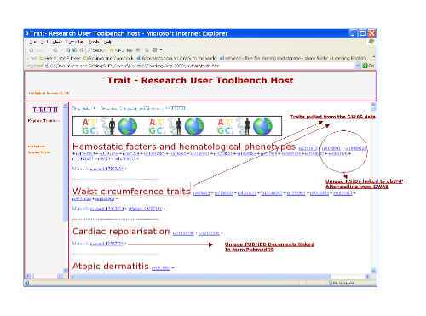
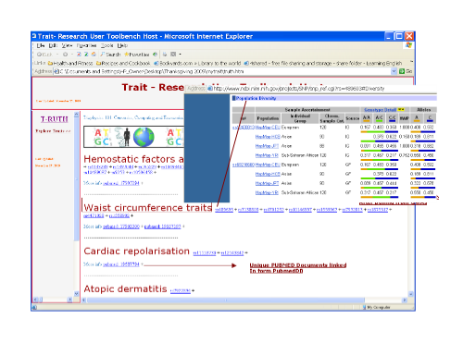
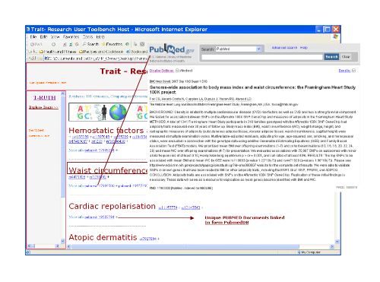
Finding info for Future Trait Investigations
Now, since we can download HapMap based data from dbSNP, this population diversity info can be thoroughly evaluated in future tools

Slide 24
Factoring in Environmental Factors
Way to combine human phenome project, environmental knowledge, genotype and Trait-o-Matic in a consistent, usable way

Slide 25
Protein-Protein Interactions
If goal is to truly model epistasis, you need to understand all protein-protein interactions
 | Gene, Chromosome | Function of Protein Product | Involved in the the Following Metabolic Pathways | Predicted Interacting Partners (Protein ID)
SNP_1
SNP_2
SNP_3
SNP_4
Above we see a matrix for protein products of these genes. Sometimes we have to look at surrounding protein interactions as well (ABO Blood Typing)
  Bombay Phenotype makes phenotypic determination of offspring difficult
  If the recessive form of H antigen (found on surface of rbcs) is inherited from two parents a child can have blood type O even if both parents do not have O.
  H antigen is precursor to A and B antigens in blood

Slide 26
Future Directions
Tutorial on how to use Trait-o-Matic add-ons
  SNP location based query tool
3-D visualization (student appeal)
  click on a different portions a human body to look at traits associated with that particular area
Potential Forensics Application (expanding target audience)
  Choose list of traits known in suspect → creation of potential DNA sequence/ Image

Slide 27
And More…
Exploring the question of chromosomal location standardization (Bruce Birren)
  in progress
Improving collection of phenotype data from PGP participants
  what does the current questionnaire look like?
Organization of phenotype-outputs in T-O-M
Pharmaco-genetics Direction

Slide 28
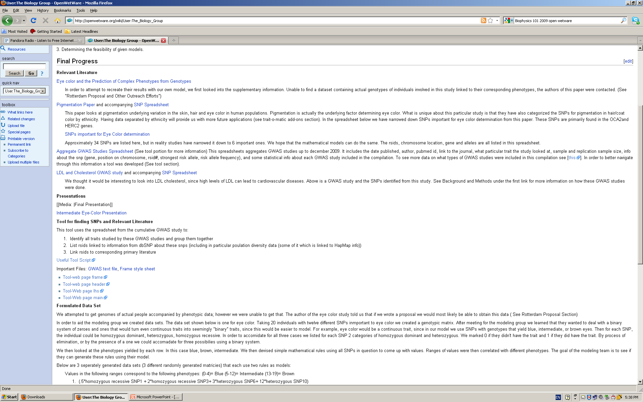
Final Progress and Contributions

Slide 29
THANKS!
Professor Church and Harris
Sasha
Dr. Fan Liu and Manfred Kayser (Rotterdam)
Dr. Bruce Birren, Amy Carmargo (Broad)
Biophysics 101 (’09)

