Slide 1
synthetic gene networks that count
Lv ChenChen

Slide 2
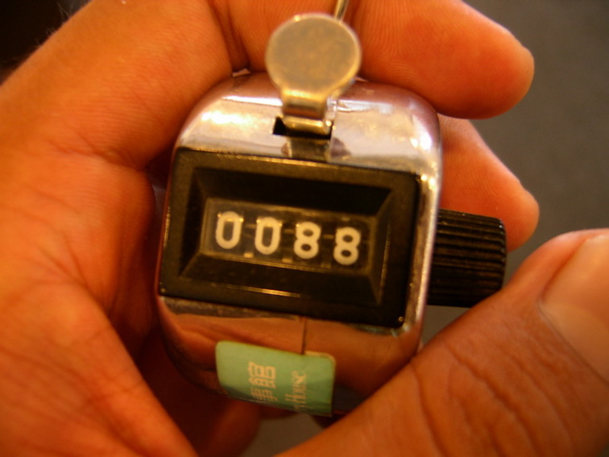
A counter!!
A counter is a key component in digital circuits and computing that retains memory of events or objects, representing each number of such as a distinct state.

Slide 3
Counter in cells
processes or biomolecules to maintain
metabolism and growth.
telomere length regulation
cell aggregation
threshold effect:(门槛效应；识阈效应)
system behaviors
Critical
Observed phenotypic change.

Slide 4
Friedland et al. take important steps to
build biological counters by integrating these
functional operations.
Two different circuit architectures for encoding counters that trigger the expression of a desired protein following the processing of two or three input signal pulses.

Slide 5
riboregulated transcriptional cascade
(RTC) counter
Riboregulators (cis and trans)
a stem-loop structure
count brief arabinose pulses
RTC two-counter
promoter PLtet0-1
T7 RNA polymerase
downstream gene (GFP)

Slide 6
expected expression profiles
Arabinose
树胶醛醣

Slide 7
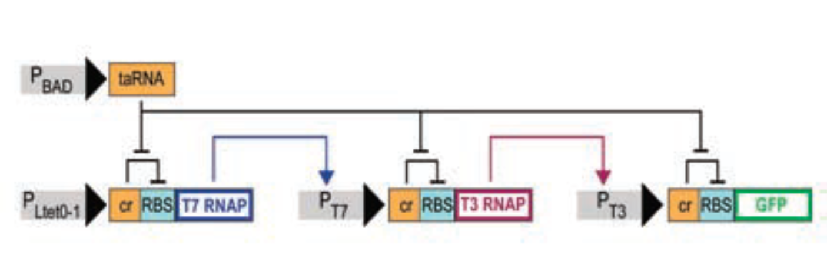
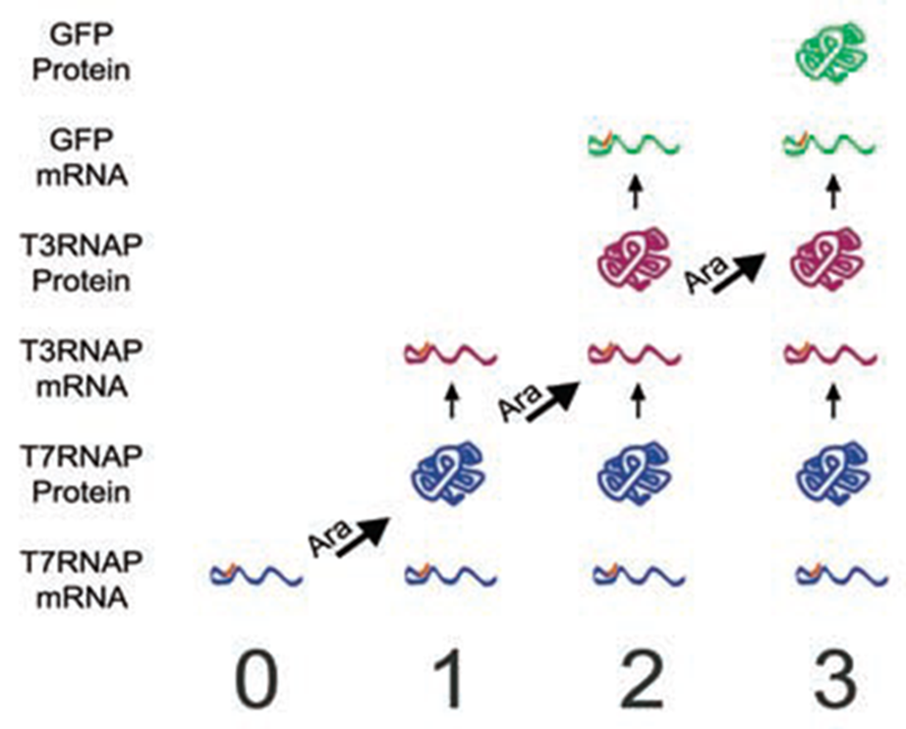
RTC three-counter
expected
expression profiles after zero, one,
two, and three arabinose pulses

Slide 8
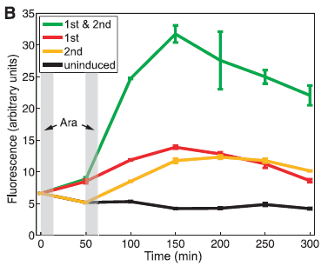
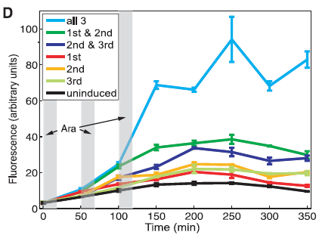
Mean fluorescence of
three replicates of RTC two/three-counter
cell populations over time, measured by a flow cytometer.
considerable slope
slight leakage
temporal progression

Slide 10
The DIC counter
Recombinase
Cre and flpe
loxP and flperecombination
target (FRT) sites

Slide 11
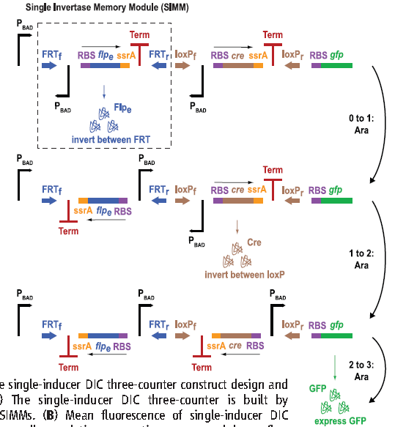
The DIC three-counter

Slide 12
Mean fluorescence of single-inducer DIC three-counter cell populations over time

Slide 13
GFP fluorescence ratios between the single-inducer DIC three-counter exposed to three pulses of arabinose (N)
versus two pulses of arabinose (N – 1) with varying arabinose pulse lengths and intervals;
experimental results are represented by black dots.

Slide 14
The multiple-inducer DIC three-counter

Slide 16
synthetic counters complementary designs be used across a range of time scales
RTC: as a safety mechanism (in biosensing,
bioremediation, or medical purposes)
Mul-indu-DIC : sequential events (in settings:
developmental biology and gene cascades
sin-indu- DIC : events encountered in its environment
(e.g., for biosensing);
SIMM design :in synthetic circuits to maintain genetic
memory of low-frequency events

Slide 17
Q&A
Thank you!!
Figures all come from
A. E. Friedland et al., Science 324, 1199 (2009)

