Slide 1
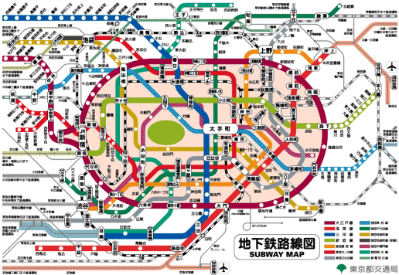
Intracellular Signaling
Fall Semester, Lab Meeting 3
9/30/09
Notes:
Compared it to the tokyo subway system

Slide 2
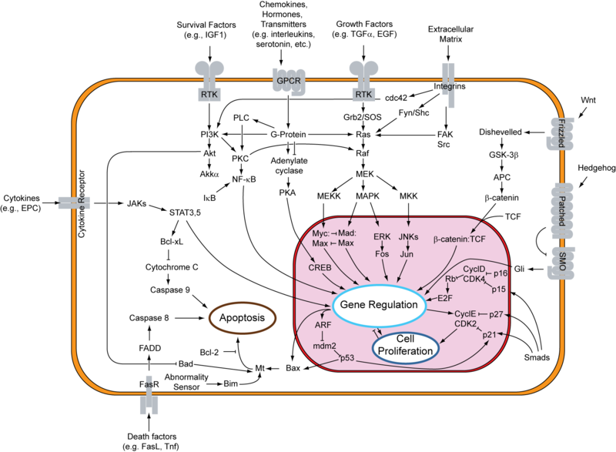
Cell Signaling Basics
Intercellular:
Endocrine
Paracrine
Autocrine
Juxtacrine
Intracellular
Hydrophobic
Hydrophilic
Gasses
Fall Semester, Lab Meeting 3
9/30/09
Notes:
Endocrine: Travel through blood (hormones)
Paracrine: Target cells in vicinity emitted by cell (neurotransmitters)
Autocrine: affect cells of the same type, (immune cells)
Juxtacrine: transmitted along membranes via protien or lipid components (immediate cells around)
____________
Hydrophobic: Water-insoluble Diacylglycerol (DAG), lipid soluable diffuse in plane of plasma membrane and is an activator for PKC (Protein kinase C, which is a family of enzymes that control the function of other protiens through phosphorylation of hydroxyl groups f serine and theorine amino acids.
phosphatidylinositols (diffuse from plasma membrane into intermembrane to regulate membrane associated “effector protiens”
Hydrophilic: Water-soluble, cyclic AMP and Ca, cyclic GMP IP3 CAMP, transferring the effects of hormones and is involved in the activation of protien kinases and regulates the effects of adrenalin and glucagon. Also regulates the passage of Ca2+ through ion channels (derived from ATP
cGMP: activates protein kinases in response to peptide hormones, common regulator of ion channel conductance, glycogenolysis and cellular apoptosis. Also is a phototrandsuction in the eye (degradation of sodium channels to close leading to hyperpolarization in the photoreceptor’s plamsa membrane for information to be sent to the brain. (also have the Unami Taste)
Apoptosis( programmed cell suicide)
proien kinase: enzyme that modifies other protiens and are turned on or off by (phosphorylation), resulting binding of activator proteins or inhibitor protiens or controlling their location in cell relative to substrates.
IT3 Inositol trisphosphate: lipid signaling in biological cells used to mobilze Ca from storage organelles and to regulate cell proliferation
Cytosol: cytoplasmic matrix
Ca2+ = neurotransmitter to release neurons, contraction of muscles and fertilization. Many enzymes require calcium ions as a cofactor. Typical cell has a ionized calcium concentration of 100nM (outside environment is in mM)
Gasses: That third phase
PICTURE: Various protien kinase, transcription factors and

Slide 3
Intracellular Signaling Basics
Generated en mass in response to receptor activation .
Diffuse away from source to other specific parts in cell
Pass signal on by binding to and altering behavior of selected signaling proteins or target proteins.
Fall Semester, Lab Meeting 3
9/30/09
Notes:
Can be rapid, miliseconds long (ion flux) or days (gene expression)

Slide 4
Intracellular Signaling
Main types of signaling molecules:
Relay proteins
Messenger proteins
Adaptor proteins
Amplifier proteins
Transducer proteins
Birurcation proteins
Integrator proteins
Latent gene regulatory proteins
Fall Semester, Lab Meeting 3
9/30/09
Notes:
Relay: Pass message to next
Messenger: one part of cell to another, (cytosol to nucleus)
Amplifer: enzymes or ion channels greatly increase signals they receive, either large amounts of small intracellular mediators or by activating large numbers of downstream intracellular signaling proteins. (Multiple steps that are amplifier are called Signaling Cascade
Transducer: convert signal to another form. (Enzyme that makes cyclic AMP, converts signal and amplifies it)
Bifurcation: spread signal from one pathway to another
Integrator: receive two or more signaling pathways and integrate before relaying a signal onward.
Latent: activated at surface by activated receptors and then migrate to nucleus to stimulate gene transcrption

Slide 5
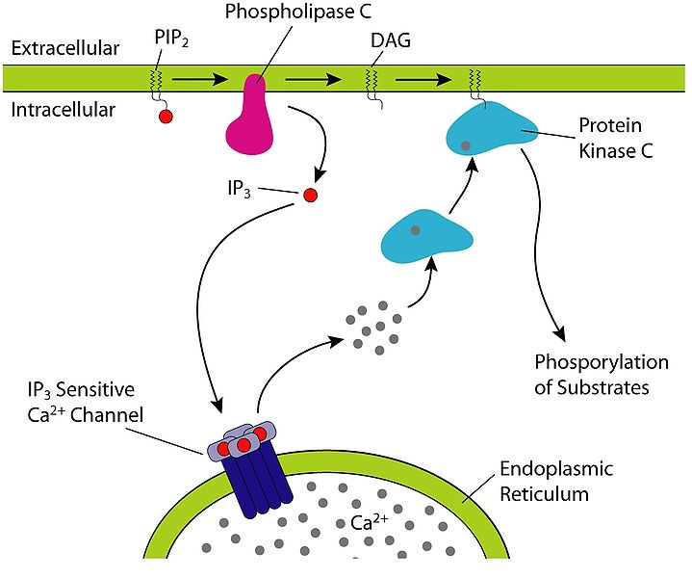
Intracellular Signaling Systems
cAMP
Phosphoinositol
Arachidonic acid
cGMP
Tyosine kinase
Fall Semester, Lab Meeting 3
9/30/09
Notes:
cAMP: activation of cyclic nucleotide gated ion chanels, exchange protiens and enzymes
Phosphoinstiol: inositol triphosphate: acts on the “ “ receptor to release calcium, other forms of the molecule in the tetra, penta and hexa form have been seen in gene expression
AA: regulation of signaling enzymes such as PLC-y PLC-delta and PKC-alpha, beta and gamma isoforms.
(PLC): phospholipase, cleave phospholipids just before the phosphate group, : cleaves PIP2 to form DAG and IP3.
PIP2: Phosphatidylinositol 4,5 bisphosphate: substrate needed for signaling protiens (SHOWN IN PICTURE)
Tyrosine kinase: Enzyme that can transfer a phosphate group from ATP to tyrosine residue in a protien
Tyrosine: amino acid

Slide 6
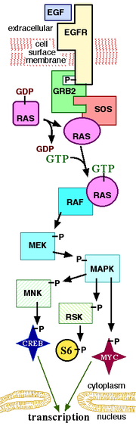
Intracellular Signaling Pathways
MAPK/ERK
Hedgehog
TGP beta
JAK-STAT
Fall Semester, Lab Meeting 3
9/30/09
Notes:
MAPK/ERK: binding of growth factors to cell surface receptors, promotes cell division. Activated Ras activates protein kineas of RAF kinase, then phosphorylates and activates MEK, then phosphorylates and activates MAPK.
RAF: protien kinease
MEK:Kinase enzme
Hedgehog: gives information for cell embro to form properly, different subpathways have different concentrations depending on the area of the cell
TPG: Transforming growth factor beta: cell growth, differentiation, apoptosis, cellular homeostais. Ligand that binds to a type II receptor which phosphorylates to a type I receptor, then phosphoralyes recptor regulated SMAD, which minds with co SMAD SMAD4, and accumulates in the nucleus where they act as transcription factors( protien cross over into nucleus) regulating gene expression
SMAD: protien
JAK-STAT: regulation of response to cytokines and groth factors, transduces the signal carried from polypepties to the cell nucleus where STAT protiens modify gene expression
JAK Janus kinases: tyrosine kinases that transduce cytokine mediated signals(Originally called “Just another kinase” but name was taken from the two faced roman god of dorways as they posess two near idential phosphate transfering domains.
STAT: Signal transducers and activators of transcription regulate cell growh and differentiation, leads to aniogenesis. Also function with the immune system.
Growth of new blood vessles.

Slide 7
Intracellular Signaling: Molecular Switches
On receipt of a signal they switch from inactive to active
Largest class activates or deactivates proteins by phosphorylation
GTP binding is the next largest class
Active when GTP is bound and inactive when GDP is bound
Fall Semester, Lab Meeting 3
9/30/09
Notes:
Causes protien kinase: two types, serine/threonine kinases, phosphorylate protiens on serines and theonines, and also tyosine kinases
Phosphorylation: addition of a phosphate group onto a protien, of EXNa/K-atpase regulates homeostasis of the water content (many receptors are turned on or off by this)
Mediates enzyme inhibiton.
GDP: guanosine diphosphate: nucleotide, used to help pyruvate kinase and phosphonelphyurvate

Slide 8
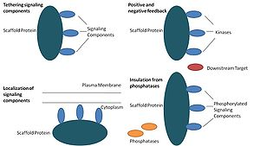
Intracellular Signaling: Processing
Many complex signals come in with multiple interactions
Scaffold proteins
Fall Semester, Lab Meeting 3
9/30/09
Notes:
Scaffold: orginize groups of interacting protiens into signaling complexes. , activates a sequence which is preassembled into a signaling complex by a large scaffold , or is assembled after the signal is activated (works as docking sites)

Slide 9
Intracellular Signaling: Cell Response
Response varies from linear gradient to abrupt changes
If receptors act independently, then a linear gradient normally occurs
If quick change occurs normally more than one effector molecule is required.
Activation of one enzyme and inhibition of the reverse reaction also causes quick change
Fall Semester, Lab Meeting 3
9/30/09
Notes:
Steroid hormones are linear as the nuclear hormone receptor protien binds a single molecule and each DNA recognition sequence acts independently thus as concentration of acivated receptor hormone complex increases, the complexes imcreases proportionatly.
Speed increases as the number of cooperating molecules increases
Reversal: Glycogen breakdown in skeletal muscle cells induced by adrenaline. : adrenaline binding to G proein leads to increase in cAMP which activates an enzyme that promotes glycogen breakdown and inhibits an enzyme that promotes glycogen synthesis.
ALL OR NOTHING: caused by signals reaching a critical threshold. Causing an action potential (ex: ion channel flux in a certain area allows more ions in causing all the ion channels to open

