Slide 1
Physiological and Transcriptional Responses of Anaerobic Chemostat Cultures of Saccharomyces cerevisiae
Subjected to Diurnal Temperature Cycles
Hebly, M., de Ridder, D., de Hulster, E. A. F., de la Torre Cortes, P., Pronk, J. T., & Daran-Lapujade, P. (2014). Applied and Environmental Microbiology, 80(14), 4433-4449.
doi: 10.1128/AEM.00785-14
Student Names
Department of Biology
Loyola Marymount University
April 8, 2015

Slide 2
Outline
Background Information
How does the specimen respond physiologically?
How is gene expression affected?
What causes this response?

Slide 3
Introduction
Temperature is an abiotic factor that is well-studied in most microorganisms
Drastic change in temperature induces a “shock”
Circadian rhythms allow for acclimation to temporal changes in temperature

Slide 4
Study of S. cerevisiae
Generation time and temperature change vary by same magnitude
Adaptation rate to changing temperatures is temperature-dependent
Transcription and translation rate directly related
Is S. cerevisiae able to acclimate to temperature changes?
Or does it experience “continuous temperature shock”?

Slide 5
Experimental Design
2 flask cultures of yeast grown to prep for manipulation
Plated on chemostat; steady-state (control) and diurnal temperature cycle (12-30°C sin fxn)
Samples taken during 5th and/or 6th cycle at 3 hr intervals
Analyses of interest
Physiology response (biomass, residual glucose, etc)
Budding Index (BI)
Microarray & Transcriptome analysis

Slide 6
Outline
Background Information
How does the specimen respond physiologically?
How is gene expression affected?
What causes this response?

Slide 7
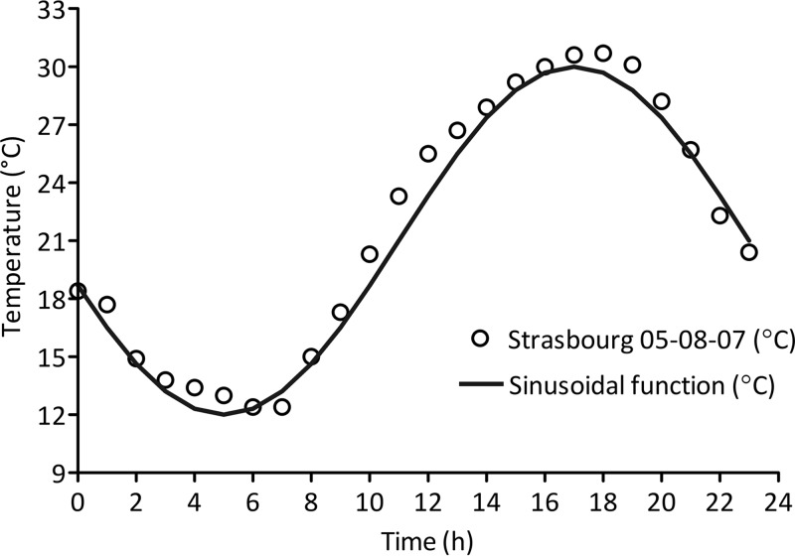
Fig. 1: Temperature Profile
Diurnal Time Cycle (DTC)
Represents 24-hour temperature cycles
Open circles represent actual temp data of Strasbourg, France

Slide 8
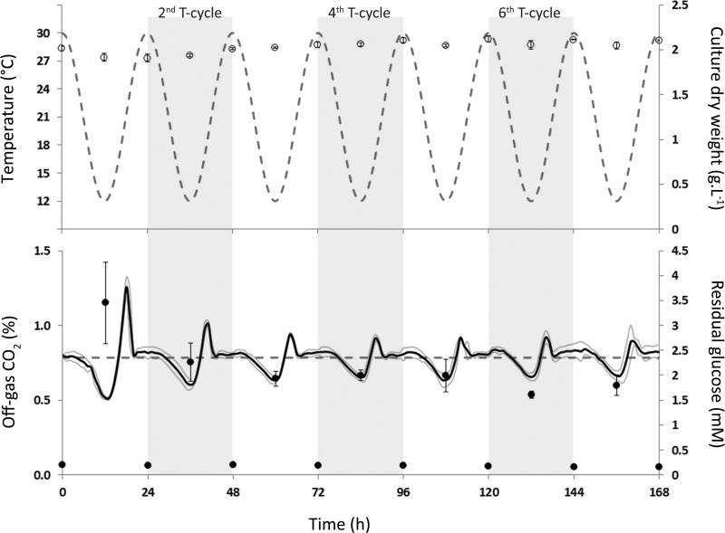
Fig. 2: Adaptation to DTC
Biomass concentration remained the same throughout cycles
Decline in fluctuation of residual glucose and CO₂ levels suggests acclimation

Slide 9
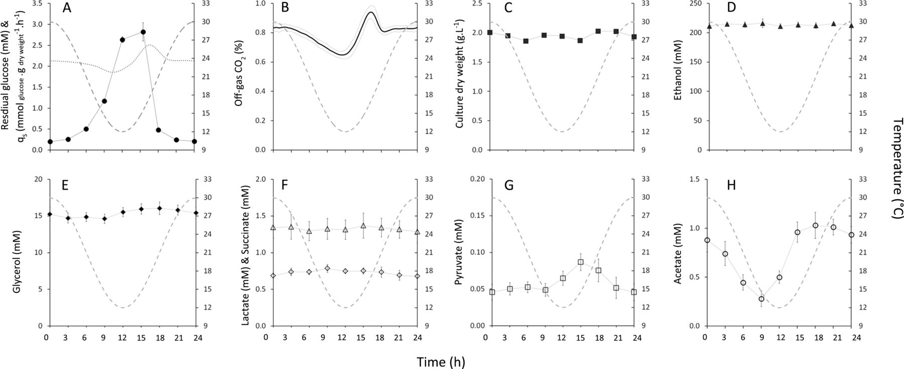
Fig. 3: Physiology with Temperature
Residual glucose concentration inversely correlated with temperature
Glucose concentration profile not symmetrical as imposed temperature profile
Off-gas CO₂ profile revealed
Slow deceleration of CO₂ production during temperature increase
Sharp acceleration when temperature increased

Slide 10
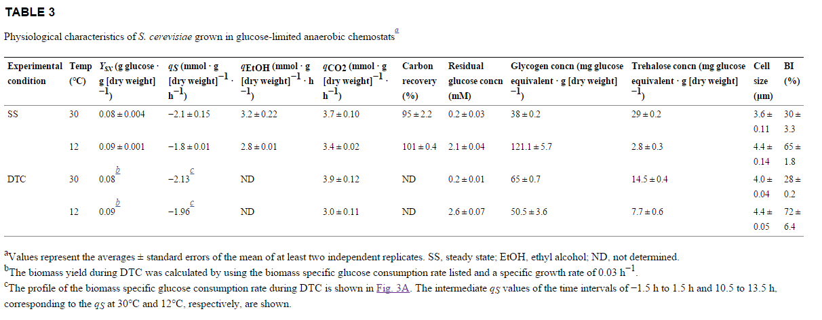
Table 3: Physiology at Constant Temp
Important for comparison to determine extent of acclimatization

Slide 11
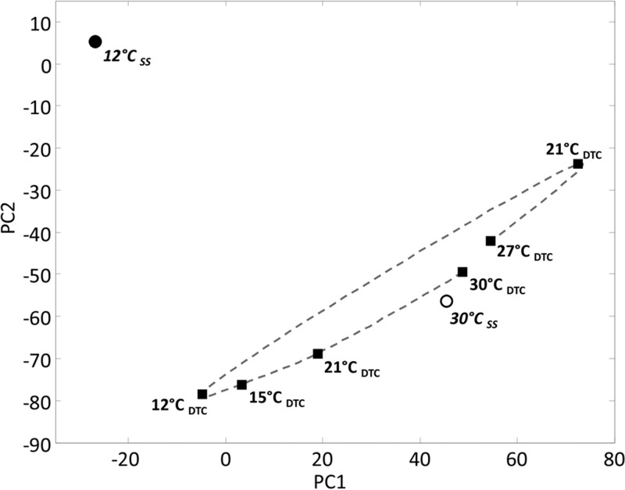
Fig. 8: Average Expression Levels
Principal Component Analysis: distance between points = more different
Expression levels were significantly different at 12°C
Suggests that acclimation occurred according to temperature profile rather than temperature itself

Slide 12
Physiological Response
DTC cultures at 12-30° extremities closely resembled steady-state acclimatized to same temperature
This suggests a full acclimation to changing temps rather than a “continuous shock”

Slide 13
Outline
Background Information
How does the specimen respond physiologically?
How is gene expression affected?
What causes this response?

Slide 14
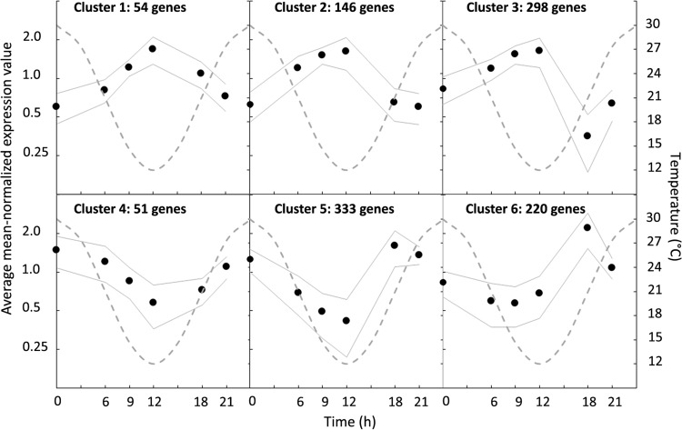
Fig. 4: Transcriptome Reprogramming
Genes clustered by transcript profile (k-means clustering)
Shows positive or negative correlation (p<0.002) to DTC
Suggests major reprogramming of transcriptome

Slide 15
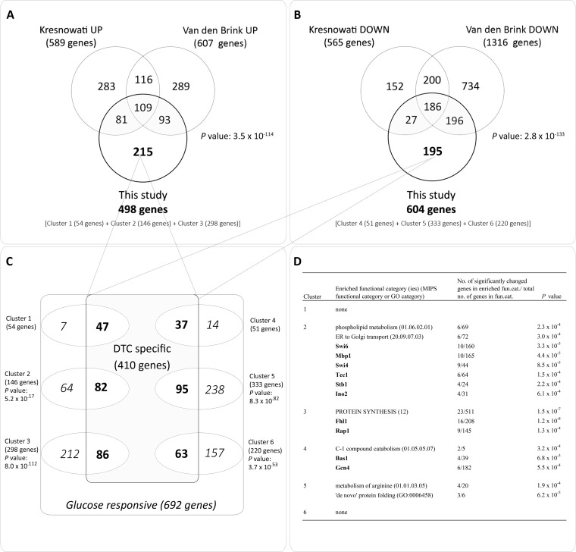
Fig. 5: Gene Comparisons
Compared with the data from Kresnowati et al. (2006) and Van den Brink et al. (2008), there was an overlap in glucose-responsive genes
410 genes showed no overlap with the 2 studies, but possible glucose-response
Out of the 410 genes that showed to be glucose-responsive 253 were DTC-specific

Slide 16
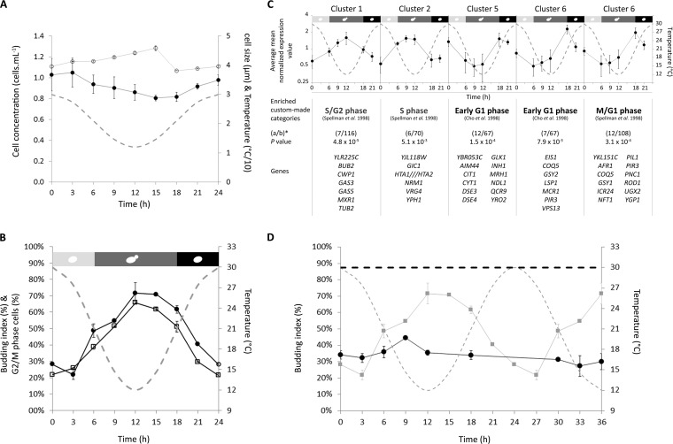
Fig. 6: Cell & Gene Distribution
Decrease in temperature impeded cell division, hence low cell concentration
Cell division resumed with increase in temperature
Cell size (growth) unaffected by initial decrease in temperature
Accumulation of budded cells in G₂/M phase of cell cycle for 12°C temperature change
The budding index is inversely proportional in DTC, and constant at 30°C reintroduction
∆T=~12°C

Slide 17
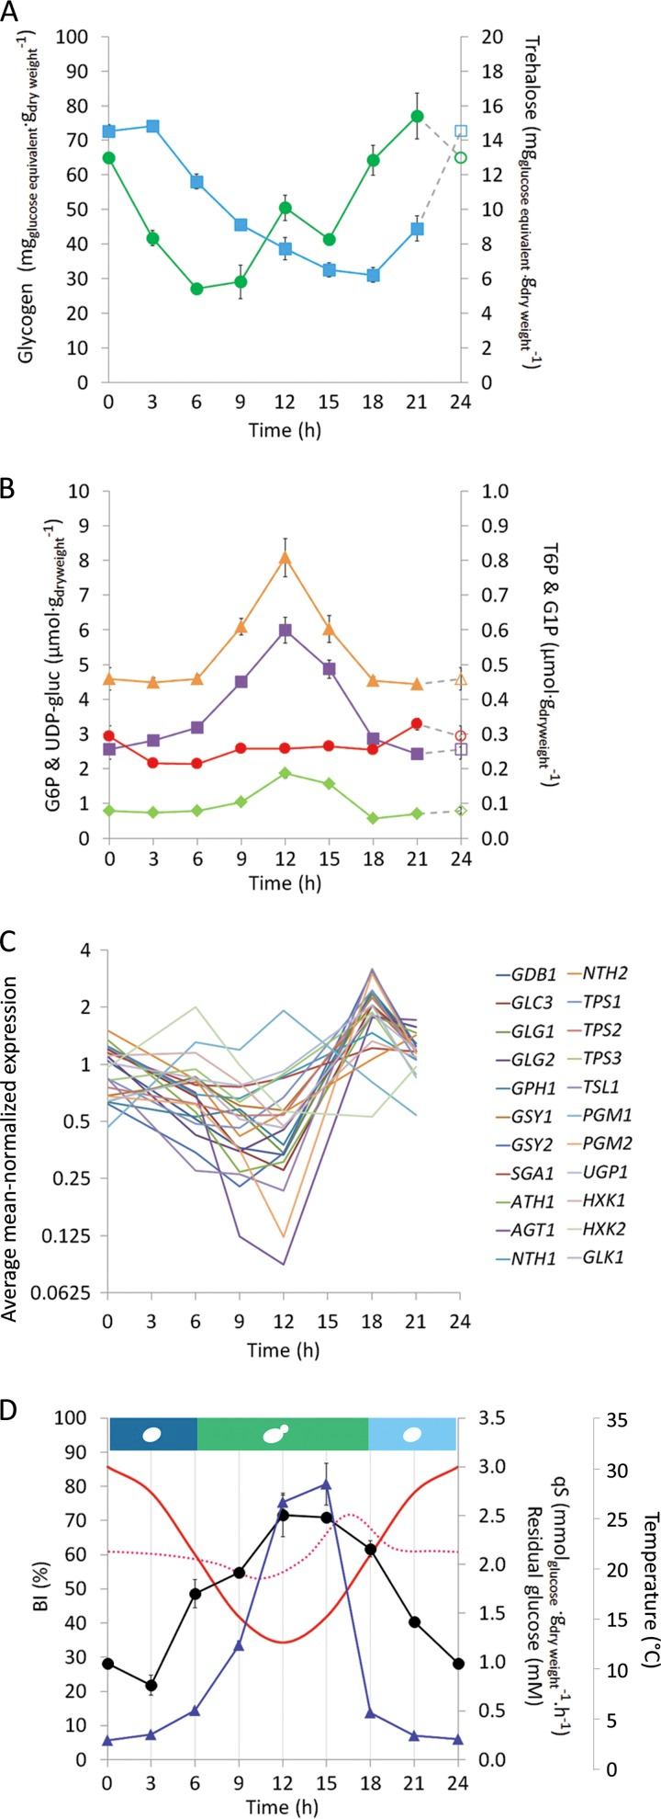
Fig. 7: Carbohydrate Storage
Intracellular concentrations of both glycogen and trehalose affected by temperature
Minimal changes in expression of UDP-glucose (red circle) and trehalose-6-phosphate (green diamond) during DTC
Sharp increase in expression when glucose concentration fell below <80%

Slide 18
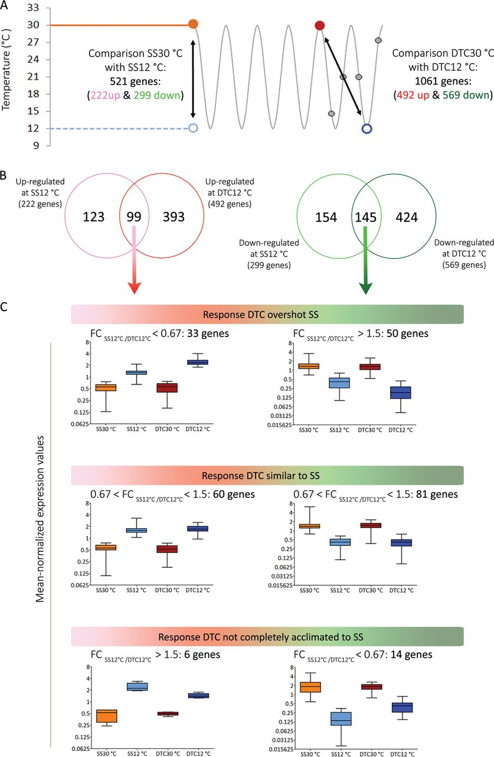
Fig. 9: Comparison of Transcript Levels
Response during DTC required twice as many genes when compared to steady-state cultures
Upregulation and downregulation of genes in low temperature steady-state similar to responses during DTC

Slide 19
Gene Expression
Gene expressions were shown to be different for shock and acclimation scenarios
Cell cycles partially synced with DTC
Residual glucose levels had a strong impact on yeast transcriptome
Confirmed to be explained by Monod kinetics

Slide 20
Outline
Background Information
How does the specimen respond physiologically?
How is gene expression affected?
What causes this response?

Slide 21
Acclimation vs. Cold Shock
Very few genes were similarly regulated in response to respective conditions
Interestingly, IZH1 & IZH4 were upregulated in both conditions (zinc ion transport)
This suggests a relationship between zinc homeostasis and temperature
Supported by documented involvement in membrane fluidity

Slide 22
Future Studies
Previous studies exposed S. cerevisiae to constant temperature
This study suggests a more realistic model concerning temperature cycles to capture these growth dynamics

Slide 23
Acknowledgements
Ross Carson
Mike Leon Guerrero
Sheila Melone

Slide 24
References
Hebly, M., de Ridder, D., de Hulster, E. A. F., de la Torre Cortes, P., Pronk, J. T., & Daran-Lapujade, P. (2014). Physiological and transcriptional responses of anaerobic chemostat cultures of Saccharomyces cerevisiae subjected to diurnal temperature cycles. Applied and Environmental Microbiology, 80(14), 4433-4449. doi: 10.1128/AEM.00785-14

