Slide 1
Modeling Regulation of Nitrogen Metabolism in Saccharomyces cerevisiae
Kara Dismuke | Kristen Horstmann
Department of Biology
Loyola Marymount University
BIOL 398-04 | Dahlquist, Fitzpatrick
Thursday March 5, 2015
Notes:
KRISTEN
Saccharomycs cerevisiae= type of yeast (makes beer….cerevisea….cerveza)
ideal model for systems biology
small genome- 6,000 genes
extensive data available
molecular genetic tools available
Nitrogen metabolism- go over definition

Slide 2
Outline
Central Nitrogen Metabolism in S. cerevisiae
Establish theoretical approach for modeling concentrations of:
  Alpha-ketoglutarate
  Glutamate
  Glutamine
Steady-state shown in graphical results
  Compare & observe trends for 3 amino acids
Notes:
KRISTEN

Slide 3
Purpose
The purpose of this Journal Club is to develop a theoretical model to represent nitrogen metabolism and the effects of changing various parameters and to compare our results to the experimental results found in ter Schure’s paper, The Concentration of Ammonia Regulates Nitrogen Metabolism in Saccharomyces cerevisiae.
Notes:
KRISTEN

Slide 4
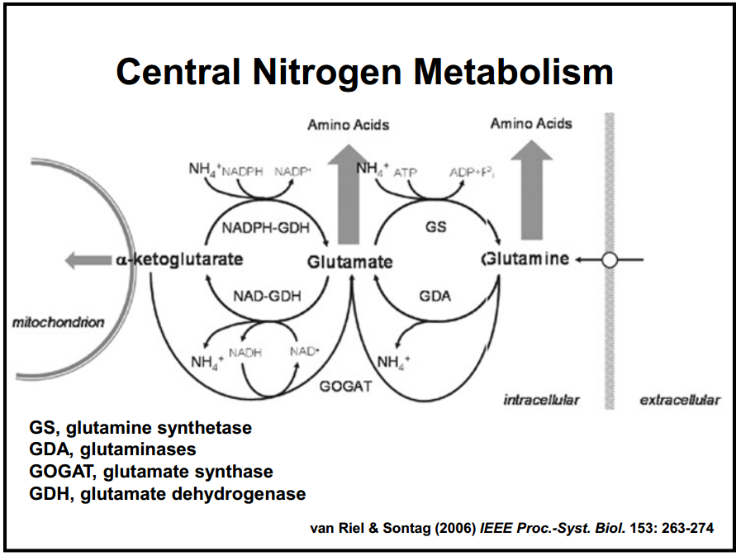
Background
Nitrogen is essential for all organisms
  Ammonia incorporation
Conversions catalyzed by enzymes
Assimilation of nitrogen
  Enzyme reactions
Glutamate: central role
Notes:
KRISTEN
Nitrogen is essential:
Nitrogen enters through plants, fungi but mainly bacteria & archaea and reduces it to ammonia
Ammonia incorporation: Ammonium is incorporated into organic molecules by glutamate dehydrogenase and glutamine synthase
Conversions catalyzed by enzymes: Most conversions between organic & inorganic nitrogen= catalyzed by bacterial and archaeal enzymes
Assimilation of nitrogen: achieved through metabolic conversions between 3 amino acids
Enzyme reactions: Involve substrate and product
Glutamate: central role in mammalian nitrogen flow
Nitrogen donor
Nitrogen acceptor
Metabolic pathway: when the product of 1 reaction becomes the substrate for the next reaction

Slide 5
Variables & Equations
State Variables Parameters
-a: alpha-ketoglutarate -r₁= NADPH-GDH -r₋₁= NAD-GADH
-b: glutamate -r₂= GS -r₋₂= GDA
-c: glutamine -r₃= GOGAT
Systems of Differential Equations
Notes:
KARA
Amino acids
Explain significance of model
Michaelis-Menten
assumes equations are at equilibrium
assumes total amount of enzymes are conserved
da/dt…change in concentration of AK over time…dependent on concentrations of itself, gutatmine, glutatmate as well as the parameters of the equations AK is involved in
Same idea
Print & have

Slide 6
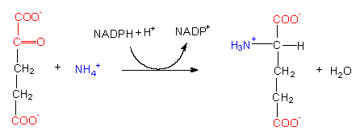
Parameters
Glutamate Dehydrogenase:
Reverse:
r₁
alpha-ketoglutarate (a) glutamate (b)
r₋₁
glutamate (b) alpha-ketoglutarate (a)
https://s10.lite.msu.edu/res/msu/botonl/b_online/e19/19e.htm
Notes:
KARA
Enzymes: NADPH, etc.

Slide 7
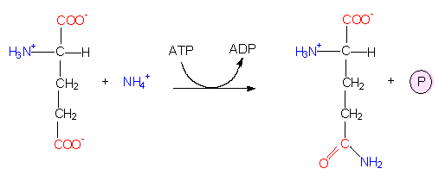
Parameters
Glutamate Synthetase:
Reverse:
r₂
glutamate (b) glutamine (c)
r₋₂
glutamine (c) glutamate (b)
https://s10.lite.msu.edu/res/msu/botonl/b_online/e19/19e.htm
Notes:
KARA

Slide 8
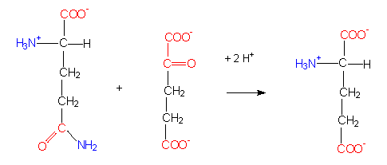
Parameters
Glutamate Synthase:
r₃
alpha-ketoglutarate (a) + glutamine (c) 2 glutamate (2b)
2
2
https://s10.lite.msu.edu/res/msu/botonl/b_online/e19/19e.htm
Notes:
KARA

Slide 9
Analysis of Steady-State
Partial derivatives= 0
  Steady state/dynamic equilibrium
Our Simulation Results
  Run 1: steady at approx. 4.5
  Run 2: steady at approx. 3.75
  Note: Carried out to 5 time units (.1 intervals)
Notes:
KRISTEN
Partial deriv= 0 (dynamic equilibrium…remains constant over time, but work is still being carried out)
were the process maintaining the system to cease, the conditions would not remain
no more nitrogen
enzymes stop working to convert substrates to products

Slide 10
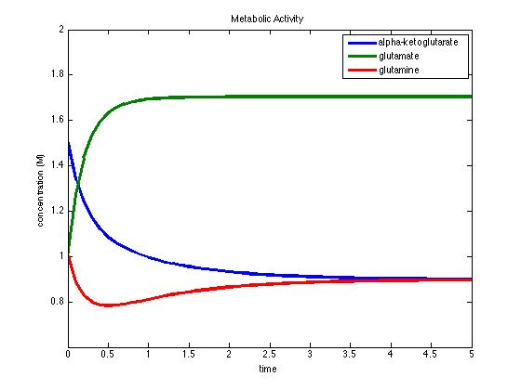
Simulation: Run 1
Note: For Run 1, all parameters were set to 1 and a₀=1.5, b₀=1, c₀=1.
Notes:
Enzymes
Equilibrium= states that the system wants to stay in
R1= function of r1(enzyme)…more enzyme, speed up reaction
KARA

Slide 11
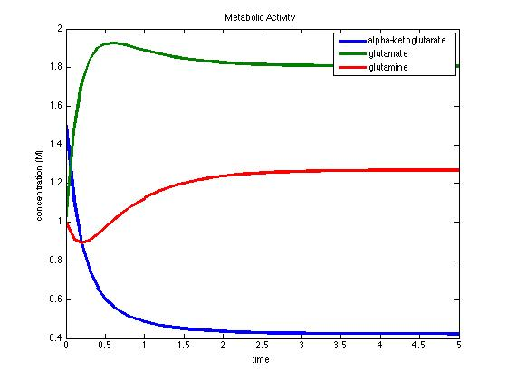
Simulation: Run 2
Note: For Run 2, all parameters were set to 1 except for r₁= 5.
Notes:
Initial values- look at graph
KARA

Slide 12
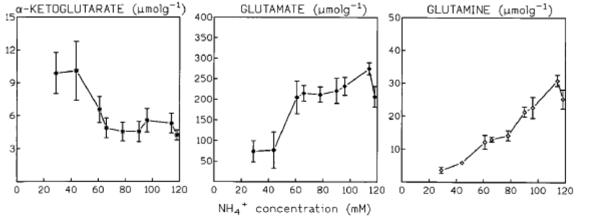
Results & Discussion
Trends amongst 3 amino acids
Note different axes
Theoretical vs. experimental
Notes:
Notice trends
Note different x axes, but also note we know, as time increases, ammonia concentration increase
KARA

Slide 13
Conclusion
Central Nitrogen Metabolism in S. cerevisiae depends on the 3 amino acids discussed
Using theoretical approach, our models reached equilibrium for the following:
  Alpha-ketoglutarate
  Glutamate
  Glutamine
Noting as time increases ammonia concentration increases, we observed trends when we compared our results to those found in the ter Schure paper
Notes:
KRISTEN

Slide 14
Final Question
"If the ammonia concentration is the regulator, this may imply that S. cerevisiae has an ammonia sensor which could be a two-component sensing system for nitrogen…"
What do you make of this sentence? What could these two components be?
Notes:
Glucose (fixed concentration)
Ammonia concentration (changes levels of intercellular metabolites like AK, glutamine, glutamate)
2 component reg. system serves as a basic stimulus-response coupling mechanism to allow organisms to sense & respond to changes in many different environmental conditions
-since glucose is also a regulator (ter Schure Microbiology), either the sensor is the same or it has a different sensor
BOTH

Slide 15
References
Van Riel & Sontag (2006) IEEE Proc.-Syst. Biol. 153: 263-274
https://s10.lite.msu.edu/res/msu/botonl/b_online/e19/19e.htm
http://www-plb.ucdavis.edu/courses/bis/105/RecordedLectures/NMetabMP3.ppt
ter Schure, E.G., Sillje, H.H.W., Verkleij, A.J., Boonstra, J., and Verrips, C.T. (1995) Journal of Bacteriology 177: 6672-6675.
Notes:
Any questions?

