Slide 2
Goal
To engineer a plant that emits light to act as natural street lamps in rural parts of the developing world.

Slide 3
Background
Lack of lighting in rural parts of developing countries
Two-component signaling systems shown to output a desired molecule based on a stimulus. Importantly, using light stimulus (as we’ve seen in bacterial photography system)
2CS also shown to work in plants

Slide 4
Construct
Make chimeric Cph1 (light-sensing) and cytokinin (equivalent to EnvZ, the histidine kinase) transmembrane receptor
Couple this to PhoB (response regulator)
Put luciferase expression under 4 PhoB promoter boxes + relevant plant promoter (already have a synthetic promoter)
Transform all of this with the Agrobacterium thing into tobacco
Notes:
Rationale for using Cph1: already a two-component signaling system. Phytochromes lack the 5 domains critical for histidine kinase activity. Need histidine kinase activity.

Slide 5
Plant species
Test in arabidopsis first
Heterlogous histidine kinase and response receptor:
OmpR and other response regulators didn’t work
Only PhoB worked
Can’t make the assumption that PhoB will work in tobacco plans if other canonical response regulators didn’t work in
i.e. we cannot extrapolate that all plants display AHK.
Notes:
Appendix Notes:
-We chose to built a proof-of-concept construct in Arabidopsis thaliana because…

Slide 6
Plant Construct
Diagram of plant cell transformation method
Notes:
-First, test that plasmid is stable by transforming into protoplasts (plant cells with cell wall removed for easier plasmid transformation). [We do this so that the time and effort put into putting the whole construct in a full plant does not go to waste if it doesn’t work]
-Transform plasmids into plants with the A. tumefaciens Ti plasmid and transfer by conjugation into the A. tumefaciens strain GV3111 with the helper plasmid pTiB6S3SE. Inoculate Nicotiana tabacum (tobacco) with the bacterial vector by the leaf disk inoculation method*. Select for kanamycin-resistant transformants. Screen primary transformants with a luciferase assay (with cell extracts).
-Luciferase activity ranged from 500 to 2500 LU per microgram of protein, depending on the plant organ.
*The plant organ was a factor in their experiment because they administered luciferin by plant uptake of the solution such that the vasculature of the plant was reflected.
-To image, expose by contact to Kodak Ektachrome 200 film.
From Gallois P and Marinho P. Leaf Disk Transformation Using Agrobacterium tumefaciens-Expression of Heterologous Genes in Tobacco. Springer 1995; 49:39-48.
“Basically, it consists of immersing the leaf disks in a liquid culture of Agrobacterium carrying the chosen transformation vector. The plant tissue and Agrobacterium are then cocultivated on regeneration medium for a period of 2 d at the end of which the leaf disks are transferred to regeneration medium supplemented with an antibiotic to kill the bacteria (cefotaxime), and a selective agent against untransformed plant cells. It takes about 2 mo to obtain rooted plantlets that can be transferred to soil. The protocol presented here works well in our hands with Nicotiana tabacum cultivar “petit havana” mutant SR1 (2) andAgrobacterium tumefaciens strain LBA4404 (3) harboring binary vectors conferring kanamycin resistance (100 mg/L).”

Slide 7
Luciferase: Ow 9186
Two substrates: ATP and luciferin (Ow 1986)
Advantage: only one protein needed for light production
How many copies of luciferase do fireflies produce to emit visibly bright light?

Slide 8
Luciferin
In 1985 paper, they soaked plant leaves in luciferin. Expression lasted 45 to 60 min.
DMSO aided in uptake of luciferin substrate by the plant.
Regenerate using Luciferin Regenerating Enzyme (LRE): to improve intensity and duration of output.
Still need to administer luciferin in water (water plants every day)

Slide 9
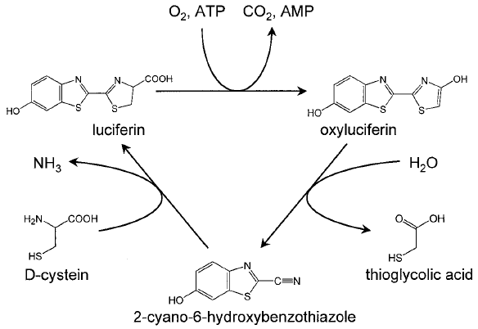
Luciferin-Luciferase Recycling in Firefly

Slide 10
Measuring Otuput

Slide 11
Potential problem
Genomic similarity between Arabidopsis thaliana and Nicotiana tabacum?
Both are vascular plants at least…

Slide 12
Effects on plant metabolism
Power-output: effect on metabolism?
Make it conditional: constitutively generating luciferin is not economical for plant’s energy
Luciferase uses luciferin and ATP to emit light (and ATP = power)

Slide 13
Experiments
Measuring light output of plants (lambda = 510- 670 nm) (luminometer)
Time of light emitting (duration)
Optimal ATP concentration – how vary that???
Temperature variation
Increase promoter strength? (of PhoB binding to the gene’s promoter)

Slide 14
Future steps
Enhance kinasing activity to saturation
Find luciferin coding gene (E.g. isolate mRNA in luminous organs… etc.)

Slide 15
Appendix

Slide 16
Potential problems
In 1986, luciferase expression was greatest at the rooms and stem, and not much in the leaves. For our application, we want greater leaf emittance (^ surface area).
This could be caused by luciferin diffusion through the vasculature of the plants. They administered luciferin by solution to the roots and the uptake of luciferin through the cell wall depends on the organ. So we hope that by synthesizing luciferin within the plants, we will see more luciferase expression in leaves.

Slide 17
Potential problems
High luciferin concentrations (400 uM and above) were toxic to cultured suspension cells and blocked further growth.

