Slide 1
BioBricks:
Registry and Assembly Standarts
Piotr Faba & Florian Sessler

Slide 2
The Aim of Synthetic Biology
To enable the systematic engineering of biology
To promote the open and transparent development of tools for engineering biology
And to help construct an interdisciplinary community that can productively apply biological technology

Slide 3





Engineering Approach
Abstraction
Standardisation
Quality Control
Industrial Revolutions
Mechanical
Transport
Chemical
Digital
Machine Tool
Trains
Large scale
production
Hardware
Car / Road
Communication
protocols
Nuts & Bolts
File Format

Slide 4
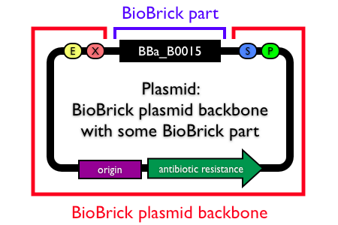
What is a BioBrick?
Defined structure and function
Designed to be composed and incorporated into living cells
Restriction sites, (start codon,) sequence
"parts", "devices" and "systems"

Slide 5
How is engineering biology different from electronic engineering
Reproduction – cell growth & division
Evolution – survival pressures
Mutation – evolutionary pressures can force new mutations
Diffusion – can lead to cross-talk of systems (no PCB)
Decoupling – existing biological chassis are complicated, device may interact with endogenous pathways
BioBricks - behave differently in various environments
Performance varies with labs due to variety of practices used to handle parts
-> Need for well characterised behaviour of parts:
in isolation
assembled‏

Slide 6
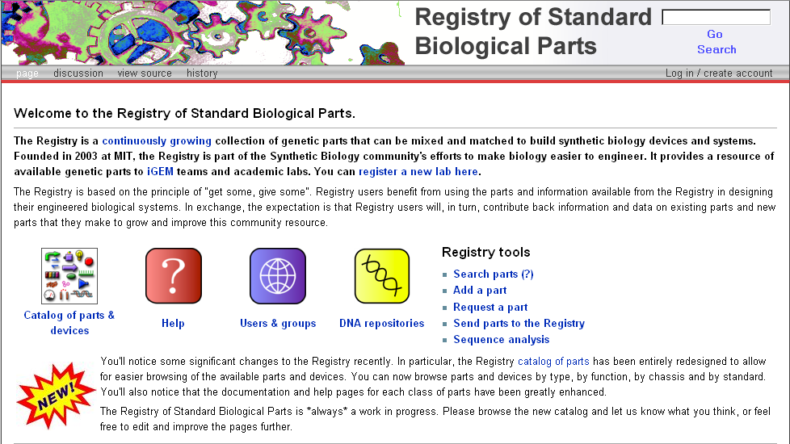
The Registry

Slide 7
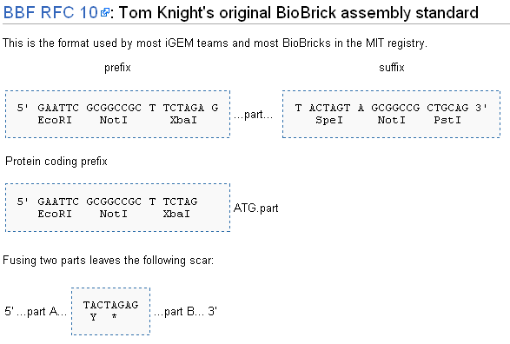
Standards

Slide 8

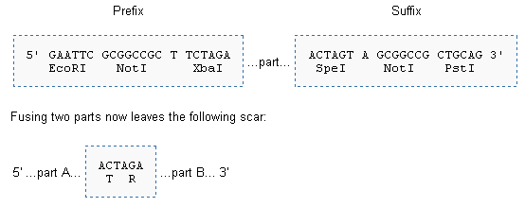
Other Standards
BBF RFC 20
BBF RFC 23

Slide 9
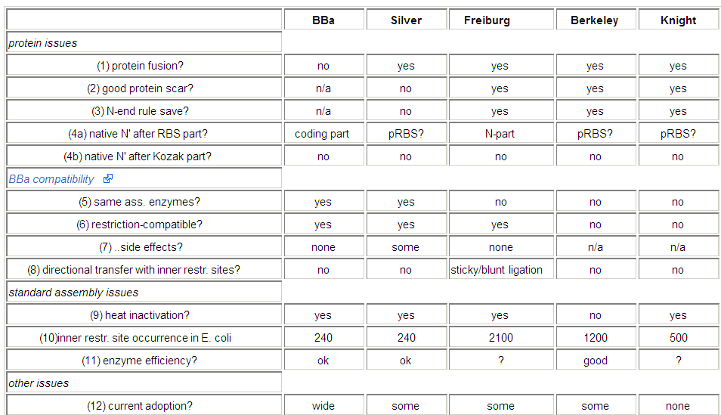
Assembly standards

Slide 10
Standardization

