Slide 1

CRISPR bacon: a sizzling technique to generate genetically engineered pigs
DeMayo FJ, Spencer TE
Jennifer Thornton
April 1, 2015
Notes:
Hee hee hee

Slide 2
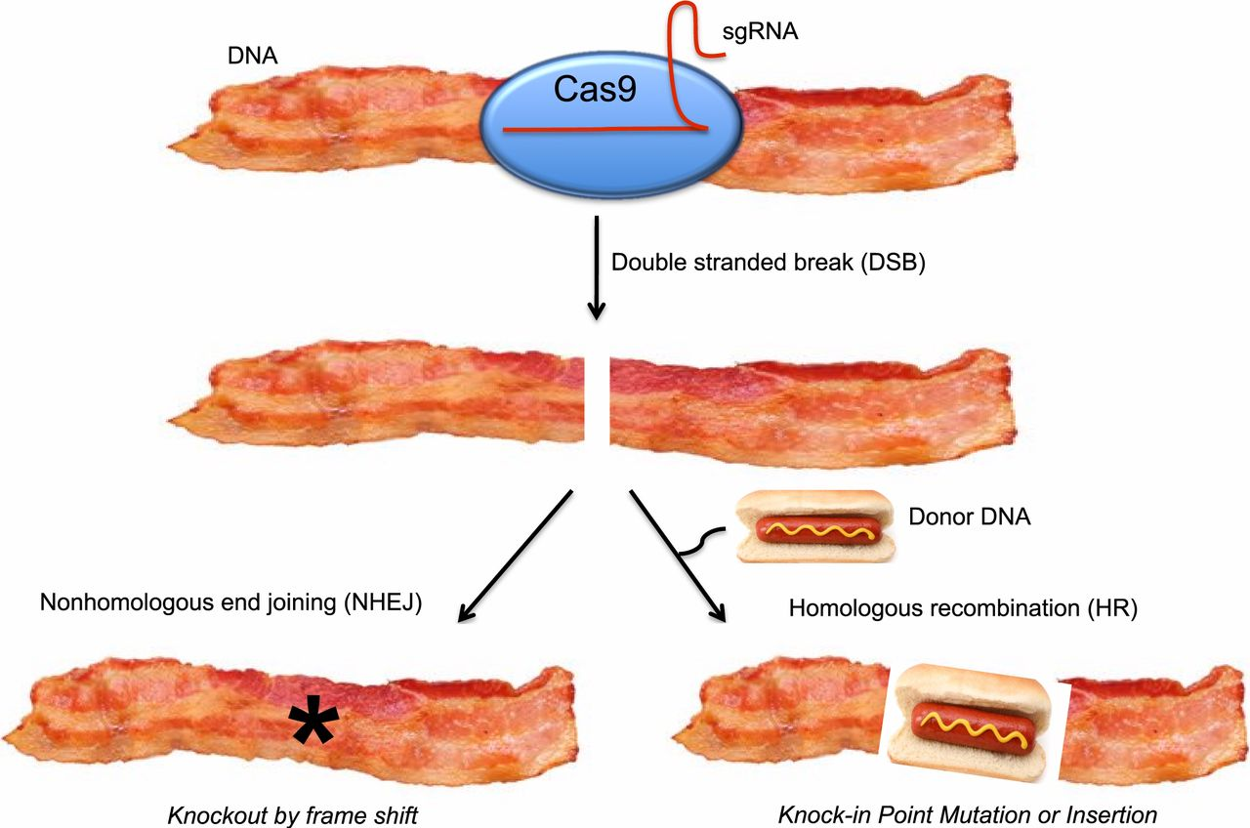
Happy April Fools’ Day!
*I won’t actually cover this paper, but it’s real and you should check it out at
http://www.ncbi.nlm.nih.gov/pubmed/25100711

Slide 3
Multiplex Genome Engineering Using CRISPR/Cas Systems
Le Cong, F. Ann Ran, David Cox, Shuailiang Lin, Robert Barretto, Naomi Habib, Patrick D. Hsu, Xuebing Wu, Wenyan Jiang, Luciano A. Marraffini, and Feng Zhang
Jennifer Thornton
April 1, 2015

Slide 4
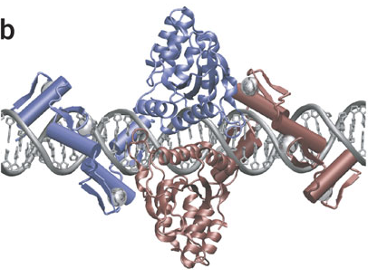
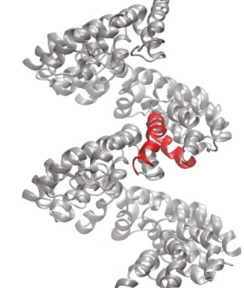
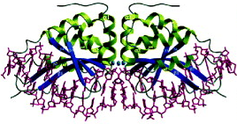
Precise genome editing tools are essential for the advancement of synthetic biology
Targeted mammalian genome editing is valuable for scientific discovery and genetic engineering
Pre-existing genome-editing technologies were laborious to customize, expensive
Transcription activator-like effectors (TALEs)
Homing meganucleases
Zinc fingers
The need remained for scalable, affordable
genome editing technologies
Miller et al., Flechsig H, Stoddard BL

Slide 5
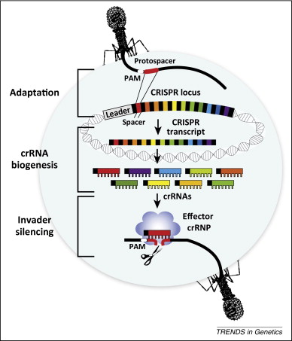
Cong et al. demonstrated CRISPR/Cas systems can precisely edit the mammalian genome
In nature, CRISPR/Cas serves as a bacterial immune system by selectively cleaving non-native DNA
Scientists hijacked this system to serve as a precise genome engineering tool
Cong et al. used CRISPR/Cas to edit the mammalian genome
They expect this tool to be scalable and affordable

Slide 6
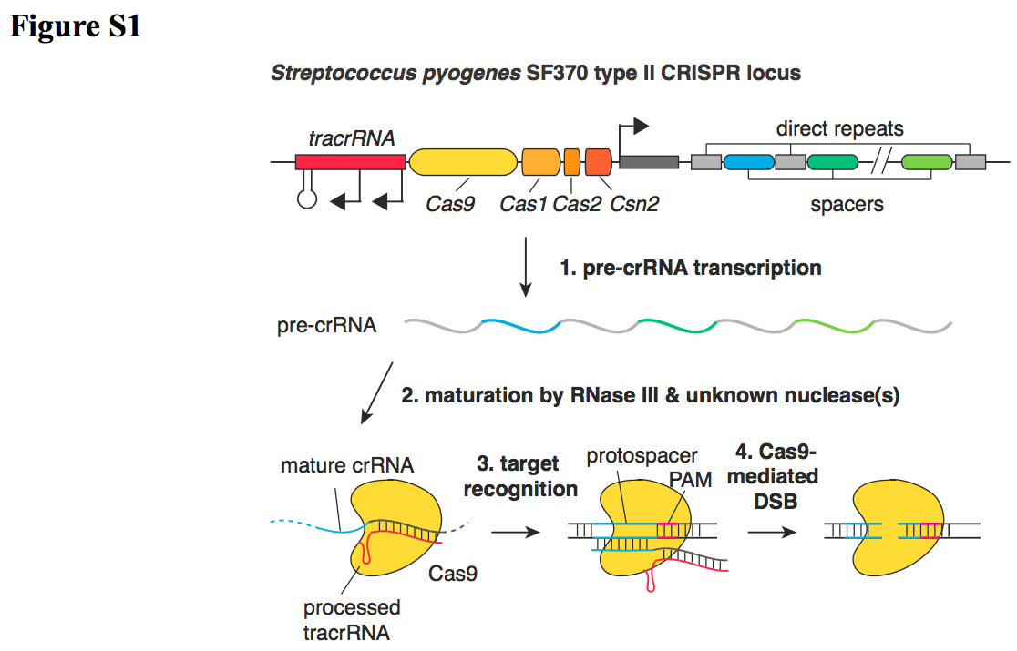
Overview: The steps of RNA-guided site-specific DNA cleavage by S. pyogenes CRISPR/Cas system
1. Pre-crRNA and tracrRNA are transcribed
2. RNAs hybridize to each other and pre-crRNA is processed by RNases
3. The mature crRNA:tracrRNA duplex directs the Cas9 protein to the DNA complementary to the mature crRNA sequence
4. Cas9 mediates cleavage of the target DNA

Slide 7
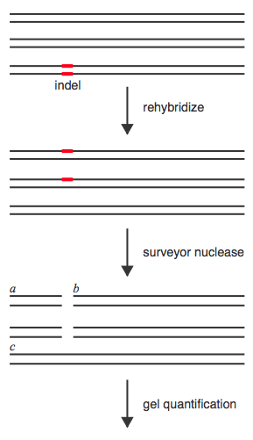
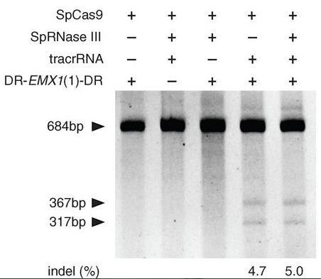
Genome cleavage efficiency was determined with the SURVEYOR assay
CRISPR/Cas9 cleavage results in indel formation
Mixture of experimental and unmodified DNA amplified by gPCR
Strands slowly reannealed to form heteroduplexes
SURVEYOR nuclease cleaves DNA with mismatches only
Cleaved products can be visualized on a gel and quantified
c
c
b
a

Slide 8
The CRISPR/Cas system can be implemented in mammalian cells with only three components
Mammalian modifications
Attached nuclear localization signals to SpCas9 to ensure it localizes to the nucleus
Designed a pre-crRNA sequence to target a 30 bp site in the human EMX1 locus
System implementation
Transfected human 293FT cells with different combinations of CRISPR/Cas components
Found SpRNase III unnecessary for efficient EMX1 cleavage
Endogenous mammalian RNases may assist in CRISPR/Cas-mediated DNA cleavage

Slide 9
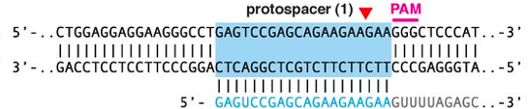
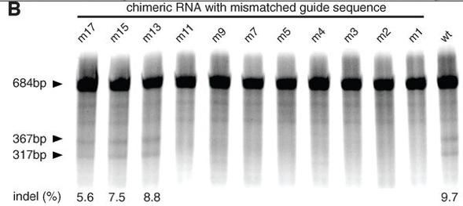
Single nucleotide mismatches between the crRNA and target sequence abolishes DNA cleavage
Cleavage efficiency was tested with an array of crRNAs with a single base mismatch from the target
Mismatches up to 11 bp 5’ of the PAM site abolished cleavage
Mismatches farther upstream retained efficient cleavage activity
Target EMX1 locus
crRNA (wt)
chimeric RNA with mismatched guide sequence
CRISPR/Cas is highly specific in human cells, consistent with previous bacterial and in vitro studies

Slide 10
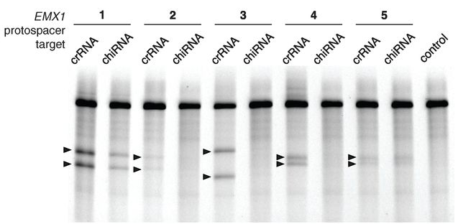
Three component CRISPR/Cas system can successfully cleave the genome at multiple sites
Five sequences within the EMX1 locus were separately targeted, and all were efficiently cleaved by CRISPR/Cas
Chimeric crRNA-tracrRNA hybrids were also tested, and not all achieved cleavage – RNA components are best not combined
Two sequences were targeted at once with a single CRISPR array encoding a pair of spacers, and both were efficiently cleaved
CRISPR/Cas system can mediate diverse and multiplexed editing within a single genome

Slide 11
Assumptions and concerns
Assumptions
That cleavage incidence is high enough for practical purposes
  Efficient cleavage from 1.5-27% indel – is the lower end efficient enough?
That cleavage could be achieved at any gene of interest
  Certain genes may be difficult to access due to chromatin, etc.
  PAM sites may not exist near genes of interest
That CRISPR/Cas technology is safe to use
  It is advertised as easy to use and efficient – is this bad news for safety?
Concerns
Efficiency, generalizability, and safety concerns can be addressed in future work. This work was excellent and fit for publishing.

Slide 12


Impact and future work
Showed that S. pyogenes CRISPR system can be reconstituted in mammalian cells to facilitate efficient genome editing
Opened the doors to powerful applications across basic science, biotechnology, and medicine
Multiple startups are hoping to capitalize on CRISPR/Cas success
Major pharma may soon use CRISPR/Cas for target screening, target validation, and therapeutic gene-editing
  Founded by 5 leading CRISPR scientists
  Secured an initial $43 million VC investment
  Aims to develop therapies to directly modify disease genes
  Announced in January collaborations with two CRISPR/Cas startups (Intellia and Caribou)
  Plan to use tool in drug discovery and new medicines
Expect to see a lot of exciting activity continue with CRISPR/Cas in scientific and therapeutic spaces
Notes:
See:
http://www.nature.com/news/crispr-technology-leaps-from-lab-to-industry-1.14299
http://www.novartis.com/newsroom/media-releases/en/2015/1884844.shtml

Slide 13


Leading scientists called for a worldwide moratorium on CRISPR/Cas germline gene modification (3/19/15)
Worldwide moratorium would give scientists, ethicists and the public time to fully discuss and understand issues surrounding the breakthrough
Authors of the Science article include:
  Inventer of CRISPR/Cas technology (Jennifer A. Doudna)
  Former CalTech president, member of 1975 Asilomar group (David Baltimore)
  Bioethicist (R. Alta Charo)
  George Church
CRISPR-Cas9 technology has powerful applications that should be discussed before moving forward
Notes:
New York Times article:
http://www.nytimes.com/2015/03/20/science/biologists-call-for-halt-to-gene-editing-technique-in-humans.html?_r=1
Science article:
A prudent path forward for genomic engineering and germline gene modification (19 March 2015)
Nature article (on similar topic from a week prior):
Don’t edit the human germ line (12 March 2015)

