Slide 1
Sunitha Nagrath, Lecia V. Sequist, Shyamala Maheswaran, Daphne W. Bell, Daniel Irimia, Lindsey Ulkus, Matthew R. Smith, Eunice L. Kwak, Subba Digumarthy, Alona Muzikansky, Paula Ryan, Ulysses J. Balis, Ronald G. Tompkins, Daniel A. Haber & Mehmet Toner
Nature December 2007
Isolation of rare circulating tumor cells in cancer patients by microchip technology
Presented by:
Katherine Choi and Linda Fong

Slide 2
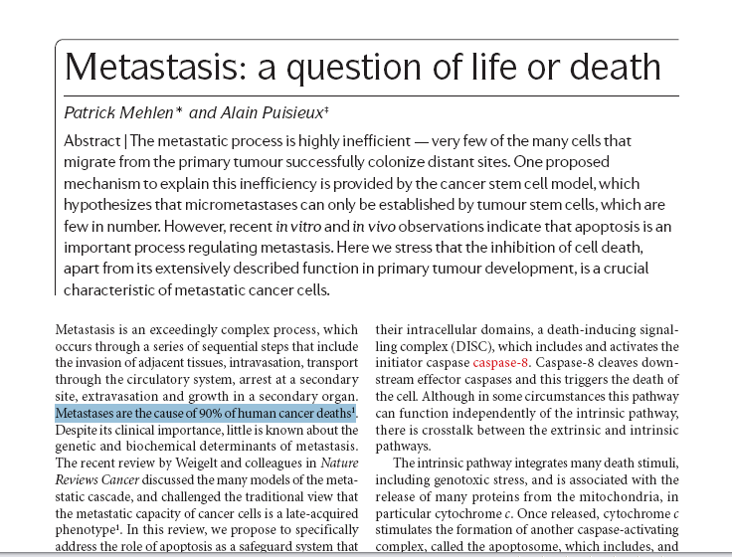
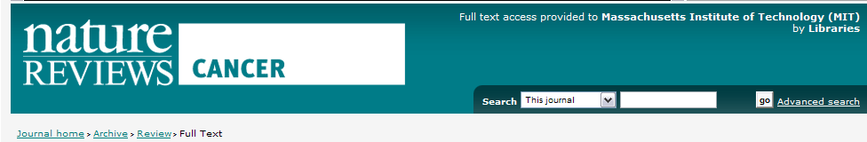
90% of Cancer Patient Deaths Result from Metastasis
Previous studies have suggested
that the presence of circulating tumor cells in patients with metastatic carcinoma is associated with short survival.
Circulating tumor cells have emerged as a potential “surrogate biopsy” for metastatic disease.
There is a growing need for noninvasive methods, such as capturing these cells, to diagnose and monitor cancer.
Notes:
L: In medicine today, Cancer is a very relevant problem that doctors and scientists are focusing on. 90% of cancer patient Deaths result from metastasis
As one nature article puts it, Metastasis is a question of life or death. When considering metastatic carcinomas, previous studies have indicated that the presence of circulating tumor cells is associated with shorter survival times.
Capturing these circulating tumor cells can pose as an alternative to invasive biopsies, which are often used to characterize tumor phenotype.
Additionally, the non-invasive methods developed in this paper may work to diagnose and monitor cancer.

Slide 3
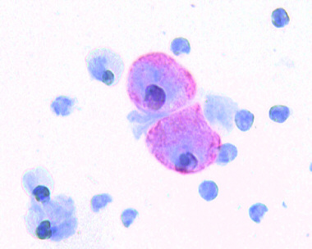
Focusing on CTCs: a Diagnostic Cancer Target
Circulating Tumor Cells
Viable tumor-derived epithelial cells
Metastatic precursor cells or
cancer stem cells
Rare : one per billion haematologic cells
Presence of CTC is a strong prognostic factor for overall survival.
Further discovery of cancer stem cell biomarkers and expand understanding of metastasis.
Notes:
L: So CTCs are Circulating Tumor Cells derived from an epithelial origin. They exist in peripheral whole blood and because they circulate throughout the body, they are considered to be a possible origin of metastatic disease. CTCs are rare, comprising as few as one per billion haematologic cells in blood, and their presence serves as a strong prognostic factor in regards to survival rates. In a larger biological context, capturing these CTCs will allow for further study of these cells, so that we can gain a better understanding of cancer stem cell biomarkers and metastasis in general.

Slide 4
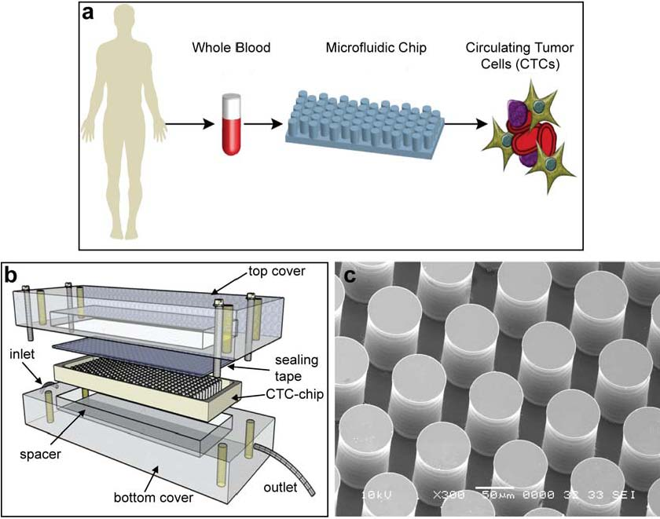
The “CTC-chip”
Efficient and selective separation of viable CTCs from peripheral whole blood samples.
No pre-labelling or processing of blood.
Target CTCs interact with anti-EpCAM-coated microposts. (epithelial cell adhesion molecule)
Notes:
L: This paper focused on the design and implementation of a new technology, which they called the “CTC-chip”. This microfluidic chip precisely controls laminar flow to allow for efficient and selective separation of CTCs from whole blood. In fact one of the characteristics that is so novel about this chip is that, no prelabeling or pre-processing of the blood is required. Essentially scientists are able to take the whole blood sample directly from the patient, flow it through this microfluidic chip, and capture CTCs. More specifically the microposts of this chip are coated with anti-epcam to enable CTC interaction and binding.
Microfluidics.
Precisely controlled laminar flow conditions, WITHOUT requisite pre-labelling or processing.
Epcam is frequently overexpressed by carcinomas of lunch, colorectal, breast, prostate, head and neck, and hepatic origina, and is absent from haematologic cells – perfect for coating micrposts.

Slide 5
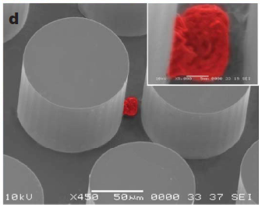
Designing Chip Structure
Micropost array of equilateral triangle geometry made chemically functional with anti- Ep-CAM
Provides the specificity for CTC capture from unfractionated blood.
Notes:
L: In regards to designing the structure of the chip, theoretical simulations characterizing cell interaction with microposts revealed equilateral triangle configuration with a 50 um distance between posts and a 50 um shift after every 3 rows was the most efficient geometric arrangement. This array of microposts that are made chemically functional with anti Ep-CAM (epithelial cell adhesion molecule) which provides the specificity for CTC capture from unfractionated blood due to the fact that EpCAM is frequently overexpressed lung, colorectal, breast, prostate, head and neck, and hepatic carcinomas while remaining absent in haematologic cells.

Slide 6
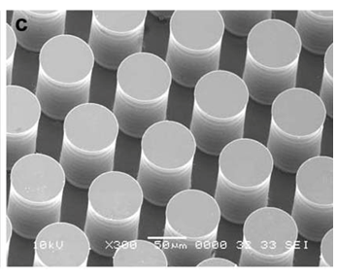
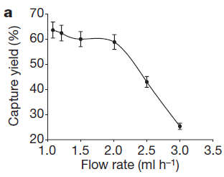
Optimizing CTC capture: Experimental Setup
Offset: increases probability of collision of cells with microposts by forcing cells to change their trajectory
Shear force: must be sufficiently low to favor cell-micropost attachment
Flow velocity: maximize frequency of cell-micropost contact.
Conclusion: Choose flow rate of 1-2 ml/h
Notes:
L: After they established this initial design, they further optimized the chip for CTC capture by adding a vertical shift of 50µm periodically throughout the chip (was incorporated after every 3 rows of microposts), This shift forces cells in the flow path to change their trajectory and therefore enhances their probability of colliding with microposts.
Additionally for the chip to work, there were 2 key parameters they need to optimize, and those were shear force and flow velocity. The shear force needed to be sufficiently low that the cells would be able to bind and remain stuck to the microposts, and flow velocity needed to be slow enough so that they could maximize the frequency and duration of cell micropost contact. They experimentally determined that a flow rate of 1-2 ml/h was optimal by running samples at different flow rates across the chip and maximizing the capture yield.
Maximum shear stress experienced by a cell near a micropost was 0.4 dyn/cm² at θ=68°
CTC-chip containing an array of 78,000 microposts within a 970mm² surface
Expected maximum velocity was 460 um/s from flow profile

Slide 7
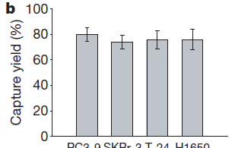
CTC-Chip Capture Efficiency is Independent of Ep-CAM Expression Levels
Compared capture rates across:
  Concentrations of 2,000 Ag/cell to greater than 500,000 Ag/cell
  Results: Mean capture yield > 65% in all cases
Prostate breast bladder NSCLC
Chip captures CTCs with equal efficiency across a wide range of Ep-CAM
Notes:
K
NSLCL (NCI-HI650), breast (SkBr-3), prostate (PC3-9) 50K ag/cell
for bladder (T-24) only 2K ag/cell
We want comfort ourselves that variations don’t matter—doesn’t hinder measurements
Epcam
Blood conc
Whole blood vs. lysed blood
Spiked blood.

Slide 8
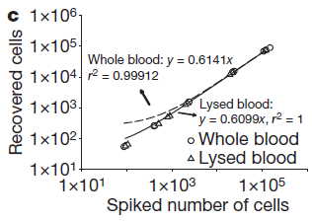
CTCs Isolated Directly From Whole Blood Without Need For Pre-Processing
Compare capture rates across:
  50 to greater than 50,000 tumor cells per ml of whole blood
  Results: Recovery rates > 60% in all cases
Lysed blood exhibits similar capture rates to whole blood
Chip captures with equal efficiency across varying concentrations
No blood sample pre-processing required.
Notes:
K
To assess the potential steric hindrance of red blood cells in flow path, compared to lysed blood.

Slide 9
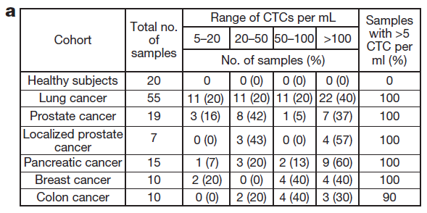
CTC-chip Performance Across Clinical Cancer Samples
Epithelial cancers:
  NSCLC
  Prostate
    Metastatic
    Localized
  Breast
  Pancreatic
  Colon
Notes:
K
Whole from cancer patients avg vol of blood analyzed 2.7 mls/ sample

Slide 10
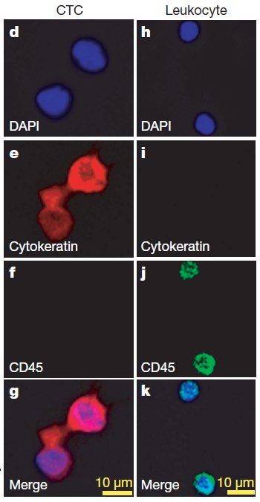
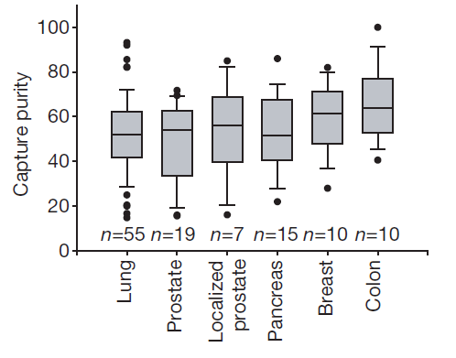
Significant Gains in Purity and Sensitivity
CTCs only captured in patient samples with cancer
Sensitivity: CTCs detected in 99.1% of cancer samples
Purity: CTCs constitute ~50% of captured cells
Notes:
K
Using a control of healthy patients, only detected ctcs where they were present. No false positives
Out of the 116 samples (from 68 patients), we found ctcs in 115 of them….resulting a sensitivity of 99.1%.
---
In order to gauge purity of what is captured,
Here (left) stained with cytokeratin (plus morphological characteristics) to identify CTC cells, and CD45 for hemaetalogic cells (not expressed in ctcs). The average purity of capture was defined as the ratio of cyto+ to cd45+.
Cytokeratin = marker for epithelial cells.

Slide 11
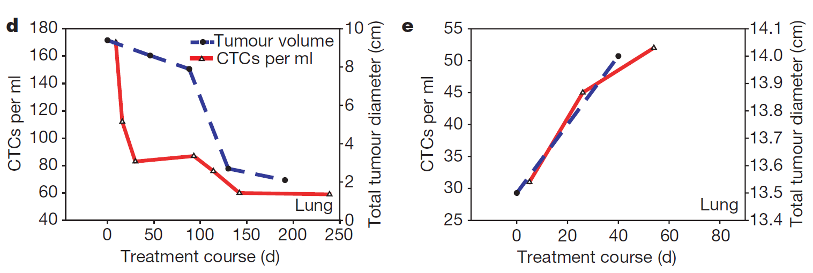
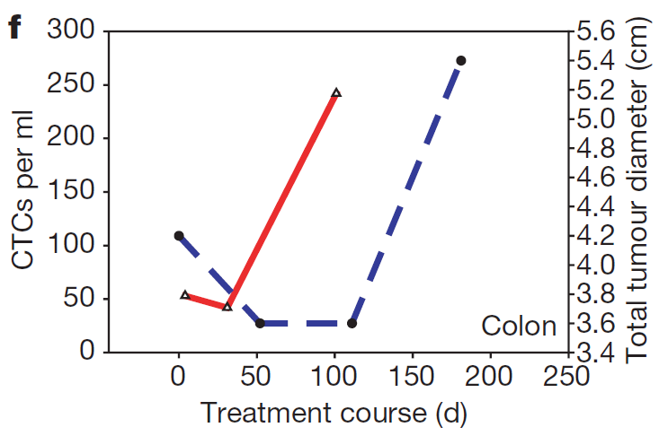
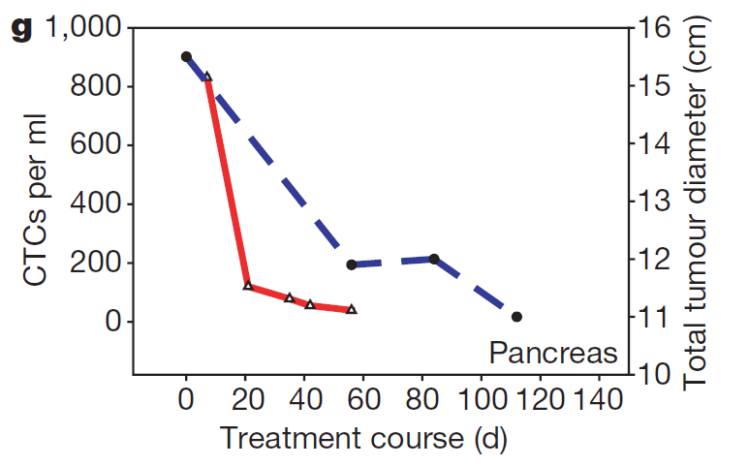
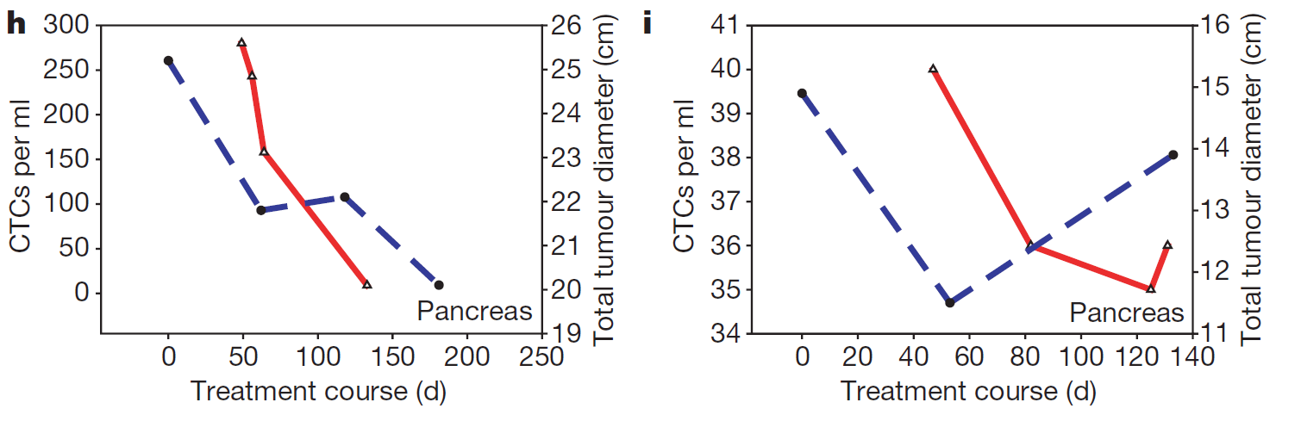
CTC correlation with clinical response to treatment
Direct correlation between percent change in CTC quantity and percent change in tumor size
Notes:
K
Ct scans were performed at baseline and at regular intervals according to std clinical practice. Sum of unidimensional size in cm of all significant and measurable tumor sites.
Absolute number not nce corr. With size, but percent change in ctc quantity and percent change in tumour size.
Trend follows that of tumor response to treatment. These are 6 patients.

Slide 12
CTC-chip vs. Existing technology
Cancer | Immunomagnetic Bead Purification | CTC Chip
Prostate | 4±24 (average # of CTCs ± s.d.) | 86±78 (metastatic), 94±63 (localized)
Lung | 11±118 | 155±236
Breast | 10±33 | 79±52
Colorectal | 1±2 | 121±127
Pancreatic | 1±2 | 196±228
Purity | 0.01-0.1% | 49%-67%
Yield | ~20-60% | 99.1%
CTC-Chip outperforms the current leading technology for identifying CTCs
Notes:
L: To really gain a sense of how significant this CTC-chip technology is, we can compare its CTC capture rates to those of the currently leading technology, immunomagnetic bead purification. And we can see that the CTC chip outperforms immunomagnetic bead purification across a variety of cancer as well has exhibits increased purity and yield.
Immunomagnetic bead purification is currently the lead technology in the clinical setting with reported success in identifying CTCs

Slide 13
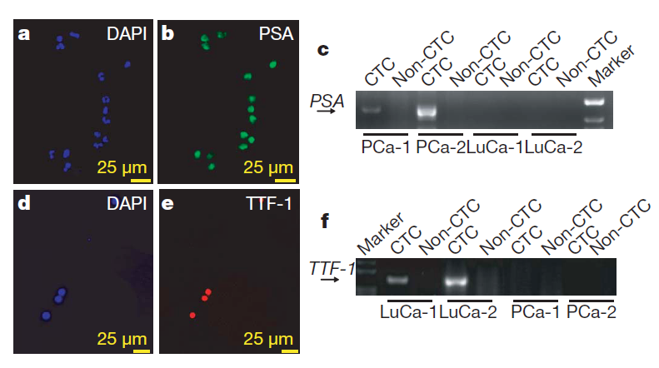
Subsequent Molecular Analysis
Cells are viable after capture
Potential for immunostaining
Tested the expression of 2 tumor specific markers PSA and TTF-1
Notes:
L: Following cell capture on the chip, these researchers showed that cells were still viable through live/dead assays, and that they could be immunostained. They tested for 2 tumor specific markers. PSA which is prostate specific antigen and TTF-1 which is specific for lung adenocarcinoma. They also used RT-PCR amplification to show that PSA transcripts appeared in the cells of patients with prostate cancer but were absent from the lung cancer cells and non-CTC cells (hematologic cells).

Slide 14
Advantages of CTC-Chip Technology
Blood does not need preprocessing
Unprecedented purity of CTC capture
Sensitivity of chip detects CTC in cancer patients.
Detects CTCs across a wide range of cancers
Applicable for capture of other rare circulating cells via alternate Abs on microposts
Future Directions:
  CTCs found in localized prostate cancer and metastatic prostate cancer are similar—novel finding with this technique and warrants further study
Cancer | Immunomagnetic Bead Purification | CTC Chip
Prostate | 4±24 (average # of CTCs ± s.d.) | 86±78 (metastatic), 94±63 (localized)
Notes:
L: Therefore in conclusion, the main advances of this CTC chip technology include the fact that whole blood samples can be used without preprocessing. The chip allows for both increased purity and sensitivity. It can detect CTCs across a wide range of cancers from prostate to pancreas to lung. And the microchip design can be applied to capturing other rare cells as well, by using antibodies other than Epcam.
Lastly one interesting note to point out, if we refer back to this table that we saw a few slides ago, was that this chip was able to isolate approximately the same number of CTCs in both metastatic prostate cancer as well as localized (or not metastatic) prostate cancer. This novel finding enabled by the chip warrants further study as it may reveal deeper insights about metastasis and the biology of CTCs.

Slide 15
Questions?

Slide 16
Patient Population
Type of Cancer | Number of Samples
NSCLC | 55
Prostate | 26
Pancreatic | 15
Breast | 10
Colon | 10
Total | 116
68 Patients with epithelial cancers.
7 of 26 subjects with prostate cancer had untreated clinically localized disease. Specimens collected before prostatectomy with curative intent.
Volume of blood: 2.7 mls/sample (range, 0.9 - 5.1 mls )
20 healthy individuals as controls (3.0 ± 0.4 mls).
Notes:
Patient population
Diff drugs given to patients.
Supplement figures
Big setup

Slide 17



Cancer Drug Treatment
Cancer | Drug Treatment
d. NSCLC | 1st-line carboplatin, paclitaxel
e. NSCLC | 2nd-line pemetrexed
Colorectal | 1st -line 5FU, irinotecan
Pancreatic | 1st-line gemcitabine, bevacizumab
h. Pancreatic | 1st-line gemcitabine
Pancreatic | 1st-line gemcitabine, erlotinib

Slide 18
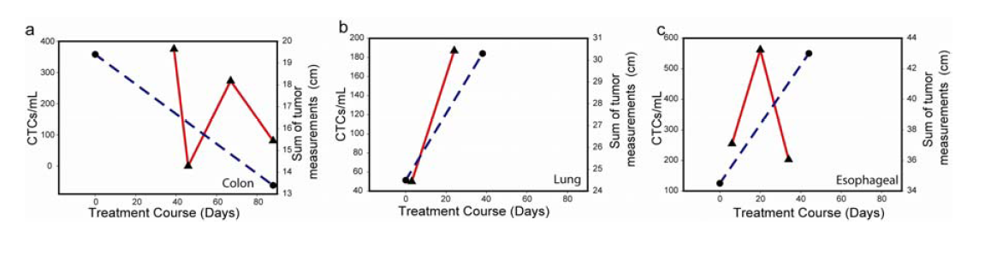
Cancer | Drug Treatment
a. Colorectal Cancer | 1st-line infusional 5FU, oxaliplatin, and bevacizumab.
b. NSCLC | 1st-line carboplatin, paclitaxel, and an experimental agent.
c. Esophageal cancer | 1st-line cisplatin and irinotecan.

Slide 19
Purity of Capture – CTC chip
 | Average purity of capture (ratio of cytokeratin+ to CD45+ cells)
NSCLC | 52%
Metastatic prostate | 49%
Localized prostate | 53%
Pancreatic | 53%
Breast | 60%
Colon | 67%

Slide 20
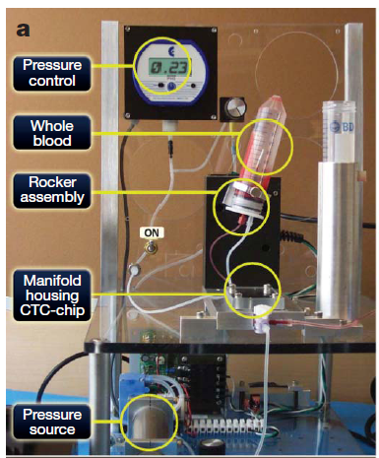
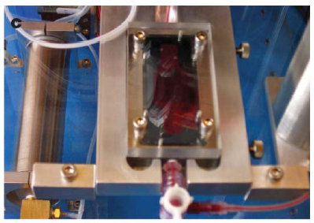
Experimental Setup

Slide 21
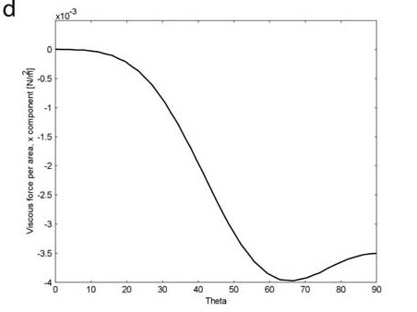
Micropost Structure
Array of 78,000 microposts within a 970 mm² surface.
Equilateral triangle configuration

Slide 22
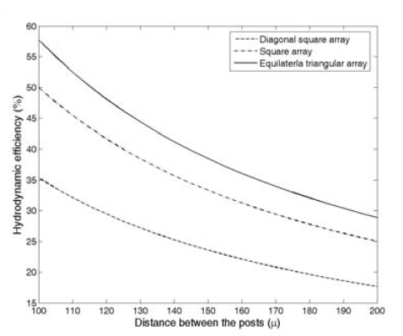
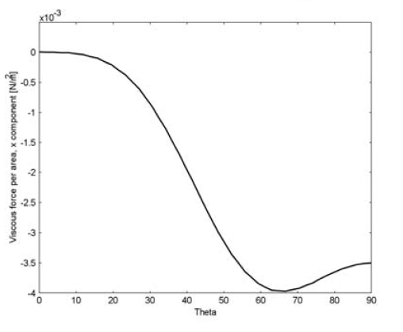
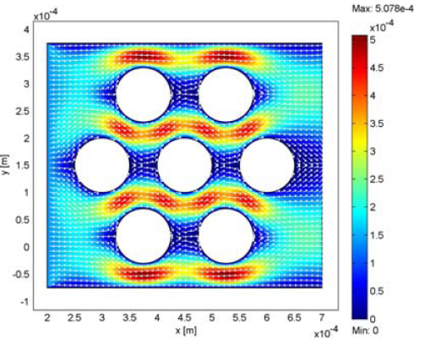
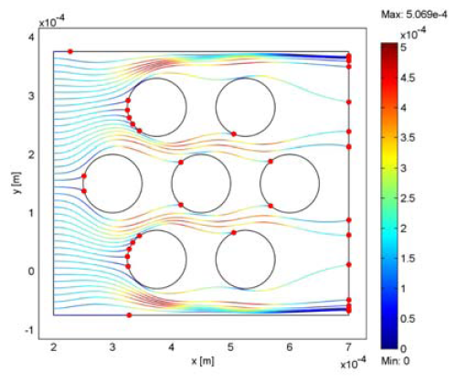
Notes:
Figure S2. Design criteria and computational analysis of hydrodynamics in the microfluidic chip. (a) Comparison of the hydrodynamic efficiency of different post array arrangements by distance between the posts using square, diagonal square, and equilateral triangular arrays. (b) Computational analysis of the micropost array. Cell trajectories (solid lines) are based on particle tracings and the end positions of the cells are indicated by red dots. Cells starting from positions between the microposts followed the streamline and never came into contact with the microposts, an observation predicting detrimental impact on target cell capture. To address this concern, a vertical periodic shift of 50μm was incorporated after every 3 rows of microposts, forcing cells to change their trajectory and hence enhancing the probability of collision with microposts. (c) Flow
Profile for an equilateral triangular array: Velocity vectors and surface contours colored by magnitude of velocity. (d) Shear stress, x-component along the surface of the post.

Slide 23
PBS + varied EpCAM expression
NSCLC NCI-H1650 and breast cancer SKBr-3 cells >500,000
Prostate cancer PC3-9 cells ~50,000
Bladder cancer T-24 cells ~2,000
Spiked into PBS at concentration of 100 cells/ml
> 65% mean capture yield
T-24 cells were captured as efficiently as high-level antigen-expressing cells, they believe due to augmented cell-substrate interations inherent within the CTC-chip.

Slide 24
Varied Blood Concentrations
NCI-H1650 cells spiked into whole blood from healthy donors
Concentrations from 50-50,000 tumor cells/ml
>60% recovery rate

Slide 25
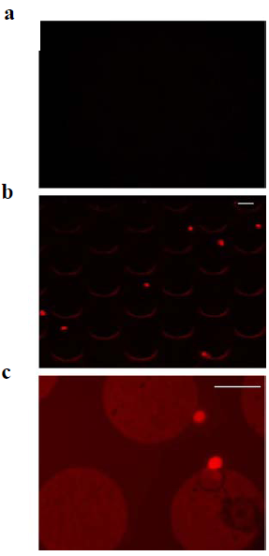
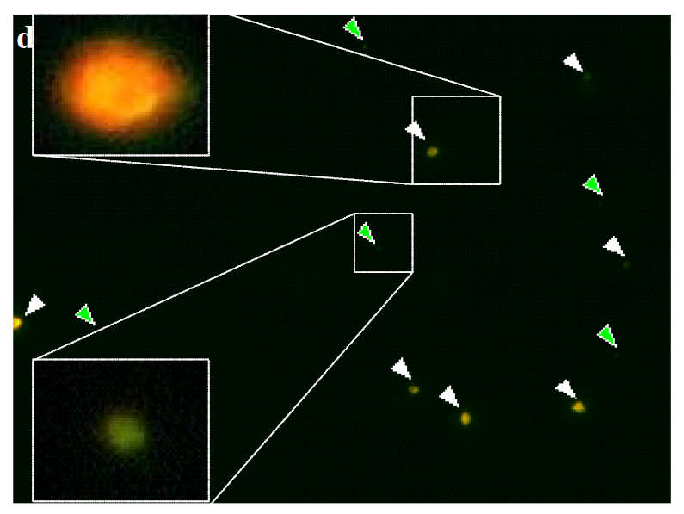
White = CTCs, green = leukocytes.
a. Non functionalized control
device
b. Cell capture func with antiEpCAM
c. Higher magnification of b.

