Slide 1
Population dynamics of toxic algal blooms in Lake Champlain
Edmund M. Hart, Nicholas J. Gotelli, Rebecca Gorney, Mary Watzin

Slide 2

If you bang your head against a wall long enough…

Slide 3

…sometimes you break through.

Slide 4
The problem…
Toxic algal blooms in Missisquoi Bay
2003 - 2006

Slide 5
The problem…
Growth rates of toxic algal blooms in Missisquoi Bay
2003 - 2006

Slide 6
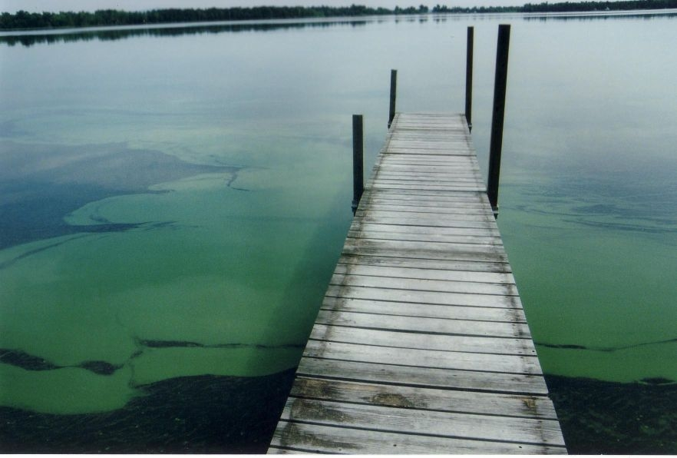
The Question…
What controls toxic algal bloom population dynamics in Missisquoi Bay?

Slide 7
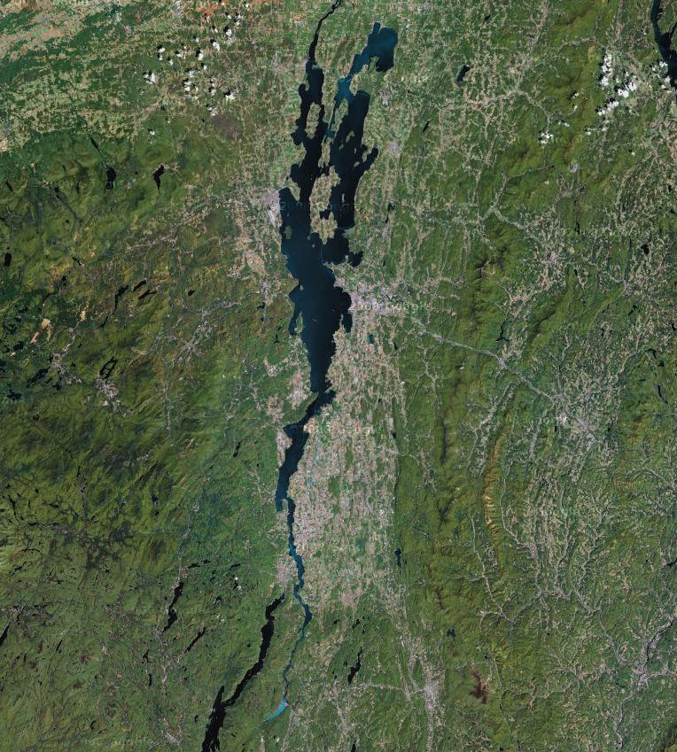
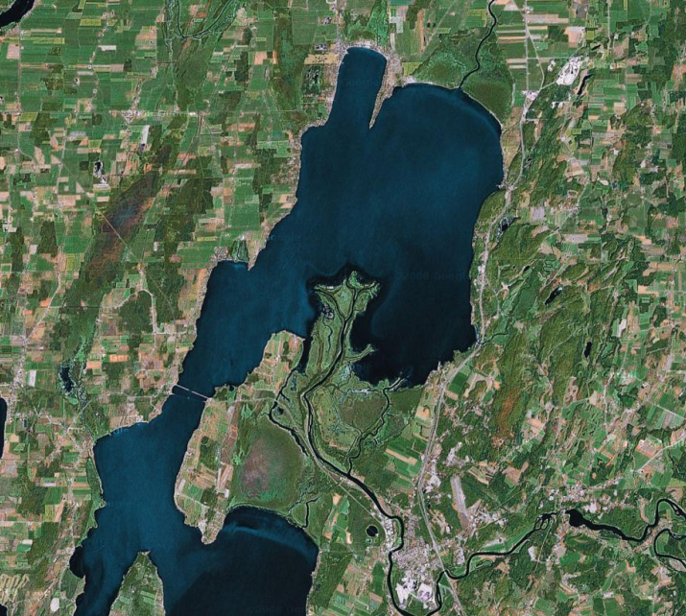
The Lake

Slide 8
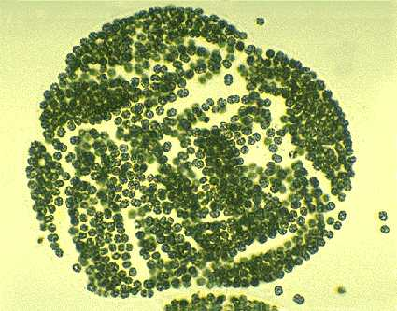
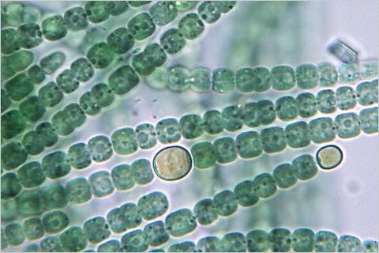
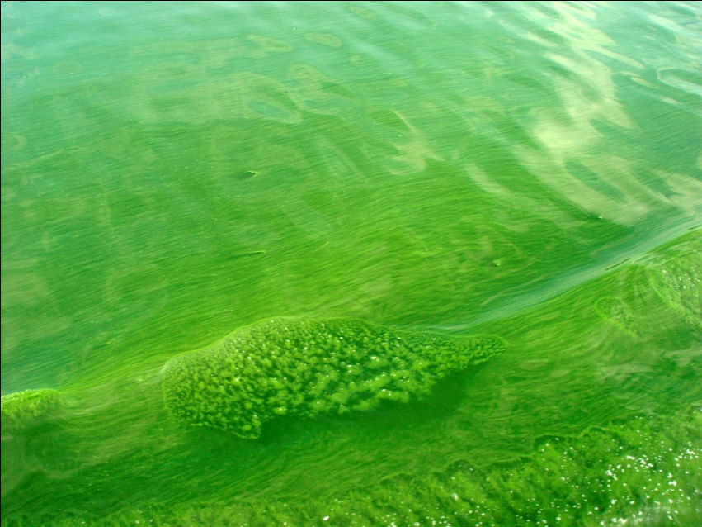
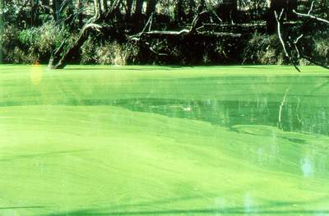
The Algae
Microcystis
Anabaena

Slide 9
The data
Microcystis 2003
Julian Day | Microcystis (cells/ml)
182 | 3667.883
188 | 46381.514
195 | 89095.144
203 | 111960.543
210 | 31070.727
217 | 19824.800
224 | 16395.252
231 | 27626.305
238 | 26363.801
247 | 44301.534
252 | 27541.291
259 | 43930.596
267 | 16324.465
273 | 16104.062
280 | 6366.310
287 | 9052.005
Julian Day | Highgate Cliffs | Chapman Bay | Route 78 Access | Highgate Springs | Alburg | Tyler Place Boatdock
182 | 747.8851 | 1509.895 | 10350.7 | 2063.053 | NA | NA
188 | NA | NA | NA | NA | NA | NA
195 | 128876.4 | 195970 | 11626.42 | 19907.8 | NA | NA
203 | NA | NA | 111960.5 | NA | NA | NA
210 | 26196.89 | 60016.66 | 30515.1 | 7554.263 | NA | NA
217 | 26749.99 | 10106.43 | 5350.629 | 37092.14 | NA | NA
224 | 20330.28 | 18108.55 | 17739.17 | 9403.008 | NA | NA
231 | 29417.31 | 14473.77 | 24029.86 | 42584.29 | NA | NA
238 | 29852.44 | 32075.16 | 32581.51 | 10946.1 | NA | NA
247 | 38663.23 | 31373.18 | 40378.36 | 66791.37 | NA | NA
252 | 24605.86 | 8037.793 | 16097.45 | 16343.4 | 72621.95 | NA
259 | 28372.98 | 141275 | 13656.03 | 23240.47 | 13108.5 | NA
267 | 13770.97 | 17851.11 | 25768.67 | 5911.274 | 18320.3 | NA
273 | 19411.78 | 14821.51 | 8386.386 | 25066.42 | 12834.23 | NA
280 | 3067.318 | 11353.27 | 6735.426 | 9277.938 | 1397.603 | NA
287 | NA | NA | 3493.938 | NA | NA | 14610.07
Data is from the Rubenstein Ecosystems Science Laboratory’s toxic algal bloom monitoring program
Data from dominant taxa (Microcystis 2003-2005, Anabaena 2006)
Averaged across all sites within Missisquoi bay for each year
Included only sites that had ancillary nutrient data

Slide 10
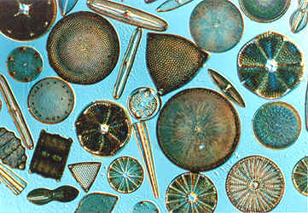
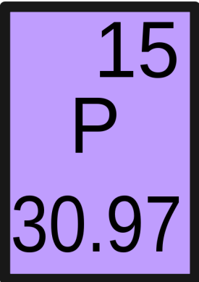

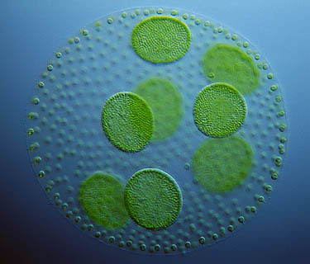
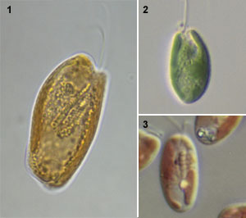
Ancillary data
The nutrients
The competitors
Chlorophyceae (green algae)
Bacillariophyceae (diatoms)
TP
SRP
TN
TN
TP
Cryptophyceae

Slide 11
Mathematical Framework
Population models take on a general form of
Basic types include:
Random Walk
Exponential Growth
Logistic Growth (Ricker form shown)

Slide 12
Mathematical Framework
Density dependent
Random walk
Exponential

Slide 13
Mathematical Framework
Typically we analyze growth rates

Slide 14
Mathematical Framework
Density dependent
Random walk
Exponential

Slide 15
Mathematical Framework
Exogenous drivers

Slide 16
Mathematical Framework
Exogenous drivers
Ricker logistic growth
Linear
Linear

Slide 17
Mathematical Framework
Exogenous drivers

Slide 18
A naïve analysis
For each year fit the following models
Assessed model fit with AICc (AIC + 2K(K+1)/n-K-1)
Random walk /
exponential growth
Density dependent
(endogenous factors)
Environmental factors
Competitors

Slide 19
A naïve analysis
Microcystis 2004

Slide 20
A naïve analysis
Microcystis 2004
Model | AICc | ∆AICc | AIC weight | R²
 | 29.7 | 0 | 0.33 | 0.45
 | 30.5 | 0.81 | 0.22 | 0.41
 | 32.2 | 2.45 | 0.10 | 0.49
 | 32.3 | 2.57 | 0.09 | 0.48
 | 33.3 | 3.58 | 0.05 | 0.44

Slide 21
A Problem
Autocorrelation plot for Microcystis 2004
Not Stationary!

Slide 22
A solution?
Detrending!
Microcystis 2004

Slide 23
A solution?
Probably not…
Need to have evidence to assume an environmental change results in shifting carrying capacity.
Can introduce spurious corellations
Microcystis 2004

Slide 24
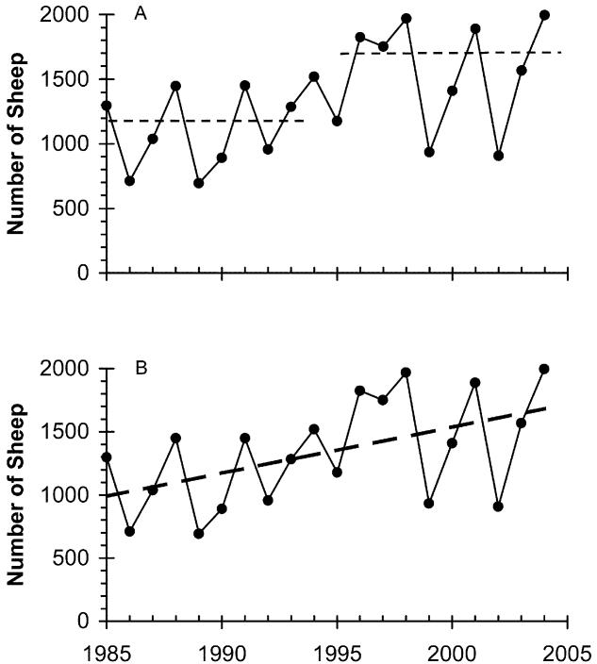
Another solution?
Step detrending!
Figure 1: Total counts of Soay sheep on the island of Hirta, showing two hypotheses for the apparent trend in the average number of sheep (dotted lines). A, Step trend. B, Linear trend. From Am Nat 168(6):784-795.

Slide 25
Another solution?
Step detrending!
Microcystis 2004
Too short, only 5 points!

Slide 26
Another solution!
Time series “stitching”
Julian Day | Microcystis (cells/ml)
182 | 3667.883
188 | 46381.514
195 | 89095.144
203 | 111960.543
210 | 31070.727
217 | 19824.800
224 | 16395.252
231 | 27626.305
238 | 26363.801
247 | 44301.534
252 | 27541.291
259 | 43930.596
267 | 16324.465
273 | 16104.062
280 | 6366.310
287 | 9052.005
Julian Day | Growth Rate | Microcystis (cells/ml)
182 | 2.54 | 3667.88
188 | 0.65 | 46381.51
195 | 0.23 | 89095.14
203 | -1.28 | 111960.54
210 | -0.45 | 31070.73
217 | -0.19 | 19824.80
224 | 0.52 | 16395.25
231 | -0.05 | 27626.31
238 | 0.52 | 26363.80
247 | -0.48 | 44301.53
252 | 0.47 | 27541.29
259 | -0.99 | 43930.60
267 | -0.01 | 16324.47
273 | -0.93 | 16104.06
280 | 0.35 | 6366.31
Julian Day | Growth Rate | Microcystis (cells/ml)
182 | 2.54 | 3667.88
188 | 0.65 | 46381.51
195 | 0.23 | 89095.14
203 | -1.28 | 111960.54
210 | -0.45 | 31070.73
217 | -0.19 | 19824.80
224 | 0.52 | 16395.25
231 | -0.05 | 27626.31
238 | 0.52 | 26363.80
247 | -0.48 | 44301.53
252 | 0.47 | 27541.29
259 | -0.99 | 43930.60
267 | -0.01 | 16324.47
273 | -0.93 | 16104.06
280 | 0.35 | 6366.31

Slide 27

Squint real hard
I can see it because I’m always squinting to keep an eye out for ninjas!
Toxic algal blooms in Missisquoi Bay
2003 - 2006

Slide 28
Phase portraits
2004 Microcystis

Slide 29
Phase portraits
2003 Microcystis
2005 Microcystis
2004 Microcystis
2006 Anabaena

Slide 30
A naïve analysis revisited
For each year fit the following models
Assessed model fit with AICc (AIC + 2K(K+1)/n-K-1)
Random walk /
exponential growth
Density dependent
(endogenous factors)
Environmental factors
Competitors
Do all this again but with our two new series!

Slide 31
Bloom phase dynamics
Model | AICc | ∆AICc | AIC weight | R²
 | 33.1 | 0 | 0.63 | 0.8
 | 38.3 | 5.2 | 0.04 | 0.71
 | 38.4 | 5.3 | 0.04 | 0.64
 | 38.9 | 5.8 | 0.03 | 0.7
 | 38.9 | 5.8 | 0.03 | 0.7

Slide 32
Decline phase dynamics
Model | AICc | ∆AICc | AIC weight | R²
 | 78.8 | 0 | 0.21 | 0.18
 | 81.2 | 2.4 | 0.06 | -
 | 81.4 | 2.6 | 0.06 | 0.13
 | 81.6 | 2.8 | 0.05 | 0.12
 | 81.7 | 2.9 | 0.05 | 0.04
*
* Cr = Cryptophyceae

Slide 33
The problem revisited…
Growth rates of toxic algal blooms in Missisquoi Bay
2003 - 2006

Slide 34
Is it N:P then?

Slide 35
No, but what can we say then?
Toxic algal blooms have two distinct dynamic phases, a pattern observed across years and genera.
N:P important in the bloom phase, but not the decline, i.e. nutrients don’t always matter.
Once a bloom starts, you can’t really do anything about it.
And one more thing about N:P

Slide 36
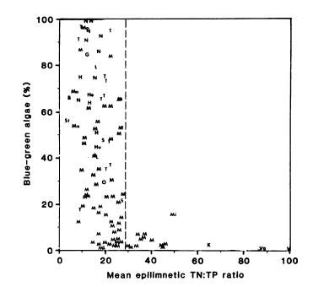
A final thought on N:P
Population size and N:P
on bloom phase data
Partial residual plot of bloom
phase growth rate model
Smith 1983

Slide 37
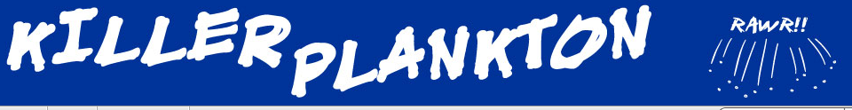

Thanks!
VT EPSCoR
My collaborators
Nicholas Gotelli
Rebecca Gorney
Mary Watzin
The EPSCoR
complex systems group
perfunctory comic to keep you entertained during questions

Slide 38
Mathematical Framework
Environmental Factors
Effect on growth rate
Effect on density dependence

Slide 39
Plankton Time Series Analysis
A naïve approach
Complex population dynamic approach
Using a complex population dynamics modeling approach we parse four years of plankton time series into two distinct phases, bloom phase and decline
phase, each with distinct dynamics. This method provides a far superior fit to
traditional statistical correlative methods.

